Slide 1
FAMO.US
By
Uma Krishnan

Slide 2

Infinite Scroll is Awesome for Toilet Paper

Slide 3
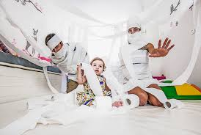
Infinite Scroll is Awesome for Toilet Paper – Sometimes Not

Slide 4
Infinite Scroll is DEFINTELY NOT So Awesome for DOM
That’s Why I am excited to have found out about FAMO.US

Slide 5
Infinite Scroll is NOT So Awesome for DOM
Besides Performance Issues, it also violates the principle of WYSIWIG

Slide 6
Traditional WebCart
http://www.amazon.com/gp/cart/view.html/ref=gno_cart
Details takes you to a different page from the cart

Slide 7
Traditional WebCart
Details takes you to a different page from the cart

Slide 8
Tradtional Lighbox
http://www.amazon.com/gp/cart/view.html/ref=gno_cart
Garys out the grid/summary

Slide 9
ISOTOPE
http://www.newschool.edu/parsons/academics.aspx
Very Nice but has infinite Scroll..

