Slide 1
Lecture 2: Miscellaneous UNIX/C concepts
  Key based authentication and remote shell
  Portable C programs and C standards
  Debugger
  Make
  Some commonly used C/C++ programming tricks and conventions.
  The system command

Slide 2
ssh with Key based authentication
    Password based authentication is inconvenient at times
      Remote system management
      Starting a remote program
      ……
    Key based authentication allows login without typing the password.
  Key based authentication with ssh in UNIX
    Remote ssh from machine A to machine B
      Step 1: at machine A: ssh-keygen –t rsa
      (do not enter any pass phrase, just keep typing “enter”)
      Step 2: append A:.ssh/id_rsa.pub to B:.ssh/authorized_keys
More information, SSH with Keys HOWTO at http://sshkeychain.sourceforge.net/mirrors/SSH-with-Keys-HOWTO/SSH-with-Keys-HOWTO.html

Slide 3
Portable C programs and C standards
  Portable programs are supposed to run on different platforms.
    Most C compilers by default support ANSI C plus extensions.
      The extensions kill the portability.
      Example non-standard constructs: typeof(var), ({a=1; b=2;}), see example0.c.
    Keys for writing portable programs
      Following language standard (e.g using ANSI C).
      Knowing which language extensions are used.
  C standards:
    Original ANSI C of 1989: ANSI/ISO/IEC 9899:1990
    ANSI/ISO/IEC 9899:1995
    ISO/IEC 9899:1999

Slide 4
How to make sure that only standard C constructs are used in a program?
  Using the right C compiler flags:
    gcc, cc
      ‘-ansi’: ISO C90 programs.
      ‘-ansi’ + ‘-pedantic’: reject non-ISO programs
      ‘-std=c99’: ISO C99 programs
      ‘man gcc’ for more information.
    Using ANSI C, the code must pass ‘–Wall –ansi –pedantic’ with no warning messages
      All programs in this course must be compiled with ‘-Wall –ansi –pedentic’ or ‘-Wall –std=xxx –pedentic’ unless you know a specific reason to not use such flags.

Slide 5
C compilers:
  See the example code (example1.c), how to fix the errors/warnings?
  Some examples:
    gcc –g –c –Wall –ansi –pedentic example.c
    gcc –Wall –ansi –pedantic example1.c example2.c
    gcc –g example.o
    gcc –g example.o -lm

Slide 6
Debugger:
  The code must be compiled with –g option.
  ddd, xxgdb, gdb
  The power of a debugger:
    Finding the line that causes coredump.
    See example (cannot do in this classroom, please try after class):
      Break point/show value/change value/step/next/continue/print
    Very efficient in debugging sequential code
    Not very effective in debugging concurrent code (multiple threads, multiple processes)

Slide 7
Core dump file
  The memory image file of a process when it terminates (crashes).
  A common reason of core dump file not created is resource limit on core file
  Controlling core file size is shell specific
    csh: limit [resource] [limit], or simply unlimit to remove all limits
    sh: ulimit -c [limit]
  Load core dump file into debugger
    gdb: gdb executable_file coredump_file
    ddd: ddd executable_file coredump_file
  To locate the line that causes core dump
    backtrace (or bt)

Slide 8
Make
    make [-f makefile][option] target
    A tool to update files that are derived from other files. Great for software development.
    The default files are ./makefile, ./Makefile, and some others in order.
      This is for POSIX make.
      Other make utility such as GNU make may do this slightly differently.
    The default files can be overwrite with the –f option
      make –f myprog.mk

Slide 9
Make
  The makefile has five components:
    Macros: define constants
    Target rules (explicit rules): tell when and how to make targets
    Inference rules (implicit rules): also tell how to make targets, make will first check if a target rule can apply before it checks the inference rules.
    Directives: do something special when reading a make file
    Comments: anything after a # sign.

Slide 10
Macros:
  String1 = string2
  E.g. CC=gcc
  CFLAG=-Wall –ansi –pedantic
  Some common variables:
    CC: default C compiler
    CXX: default C++ compiler
    CFLAGS: flags for C compiler
    CXXFLAGS:
    ……

Slide 11
Target rules:
      Target [target…] : [prerequisite…]
      <tab> command
      <tab> command
      …
      Example:
      a.out : myprog1.c myprog2.c myprog3.c
      $(CC) myprog1.c myprog2.c myprog3.c
      Another example
      clean:
      rm –f a.out
      rm –f *.o
      rm –f *~
      rm –f *.pdf
    ‘make [-f makefile][option] target’

Slide 12
Inference rules:
      Target:
      <tab> command
      <tab> command
      …
    Target must be of the form .s1 or .s1.s2 where .s1 and .s2 must be prerequisites of the .SUFFIXES special target.
      .s1.s2 ➔ make *.s2 from *.s1
      .s1 ➔ make * from *.s1
    Example:
        .c:
        $(CC) –o $@ $<
        .c.o
        $(CC) –c $<
$@: target file
$<: first prerequisite
$?: All newer prerequisites
$^: all prerequisites

Slide 13
See the example makefile2
  How to modify the makefile if I want only recompile one file instead of the whole system?
    makefile3
A file (makefile4) with inference rules.
  What happens when we do ‘make a.o’? What about ‘make b.o’?
  What happens when myprog2.o also depends on myprog.h?

Slide 14
UNIX convention:
  Normal execution: exit code 0
    This is the default exit code.
  Abnormal execution: exit with a non-zero code
  Try to follow this convention in this course, or some utility may break.
    See example x.mk

Slide 15
Some C programming tricks:
  Header files: contain common declarations.
    Source files use the #include directive to include the header files.
    Sometimes using header files can cause problems, see example2.c.
      Including a header file multiple times may cause “duplicate declaration” errors.
      Why including stdio.h two times does not have any problem?
        Look at /usr/include/stdio.h, this file is protected.

Slide 16
Header files:
  The following mechanism prevents the body of a header file from being included multiple times.
      #ifndef MYHEADER
      #define MYHEADER
      ….
      /* the body of the header file */
      #endif

Slide 17
How/when is a macro processed?
  Try ‘gcc –E example1a.c’ and ‘cpp example1a.c’
    #define MAX_LENGTH 256
    For (I=0; I<MAX_LENGTH; I++) ….

Slide 18
Macros with parameters:
  Macros with parameters look/work like functions:
    #define max(a, b) (a>b)?a:b
  Macros with parameters need to be defined carefully, otherwise weird things can happen.
    What is wrong with the following macro?
      #define sum(a, b) a+b

Slide 19
What is wrong with the following macro?
  #define sum(a, b) a +b
  Checkout example3.c
How to fix the problem?

Slide 20
C programs with command line arguments.
  int main(int argc, char* argv[]) {}
    argc is the count of command line arguments. argc >=1. Command line arguments are separated by spaces.
    argv is an array of pointers to character strings that contain the actual command-line arguments.
    See example4.c (link) for the use of command line arguments.
      You will need to use command line arguments in most of the programming assignments.

Slide 21
The environment List (try ‘env’ )
  Environment variables can be defined in shell
    setenv DISPLAY L103:0.0
    DISPLAY=L103:0.0
  These variables can be accessed in the program
  Historically,
    int main(int argc, char *argv[], char *envp[]);
    Not ANSI C.
  New methods for accessing environmental variables:
    extern char **environ;

Slide 22
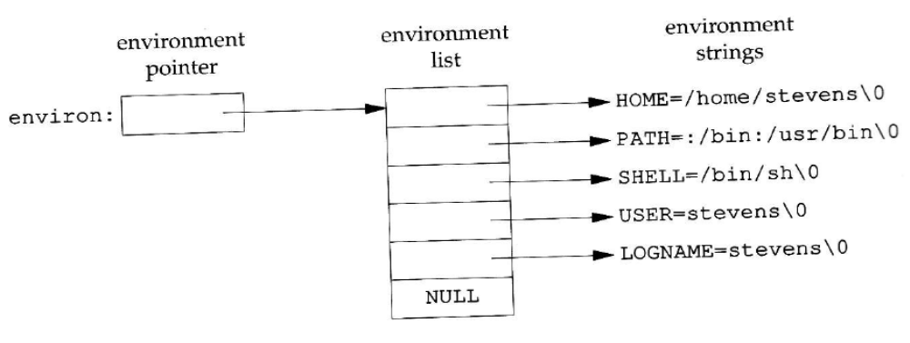
This figure shows an example how the environment list is organized.
See example6.c for how to use environ.

Slide 23
ANSI C also specifies a routine for accessing environment variables:
  char *getenv(char *name)
  See example7.c.
Other routines (not in ANSI, now in some POSIX):
  int putenv(const char *str);
  int setenv (const char *name, const char *value, int rewrite);
  void unsetenv (const char *name);
  See example8.c

Slide 24
Some routines to parse/format strings in C:
  sprintf/sscanf
  sprintf(str, format, arg1, arg2….)
    Similar to printf except that the result is stored in str.
  sscanf(str, format, arg1, arg2,…)
    Similar to scanf except that the values are read from str.
    Example: How to get all the fields from the output of ‘ps’ on diablo?
      See example5.c for the use of sprintf/sscanf

Slide 25
The system system calls:
  Allows commands to be executed in a program
  int system(const char *string)
    Works as if string is typed in a terminal.
    Returns the exit status (format specified by waitpid()) if successful.
    Returns –1 or 127 if error.
  See example5a.c.

