Slide 1
The influence of music during the civil rights movement
Rahmenthema des Wissenschaftspropädeutischen Seminars: African American history, literature and culture Leitfach: Englisch
Kursleiter: StR S. Köse
Verfasser: Oliver Ilczuk

Slide 2
Structure
Main goal and other goals
Revisit the role music had during the civil rights movement
Music as a means of demonstration
Media coverage of the civil rights movement
Most well-known liberation song
People performing the liberation songs
Results of the research
Conclusion

Slide 3
Music as a means of demonstration
Slaves used voice to communicate and address issues during the 18th and 19th century
Early stages of protest songs often had religious connotations and dealt with various topics
“Soul” gained traction as a genre representing pride, hope and love
Music was commonplace during protest and gave the members pride in their actions and a voice
Support from the church by providing vocal leadership during protests

Slide 4
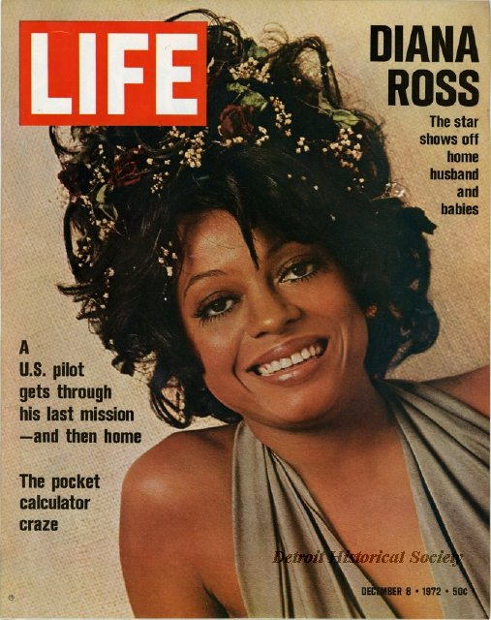
Media coverage of the civil rights movement
Famous musicians engaged in the civil rights movement because of its media coverage
Ed Sullivan Show allowed black people to perform in front of a bigger audience
Helped spread the civil rights movement
Diana Ross only gained popularity because of the Ed Sullivan Show
The show exposed America to the civil rights movement and its cause

Slide 5
Most well-known liberation song
Great example of the dynamic principles of the movement is the song “We Shall Overcome”
Started as “I’ll Overcome Someday” in the 18th century
Got rewritten by African American tobacco laborers during the interwar period
Song was changed many times to fit various situations

Slide 6
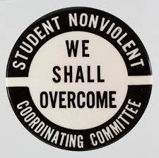
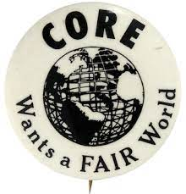
People performing the liberation songs
Student Nonviolent Coordinating Committee (SNCC)
Congress of Racial Equality (CORE)
SNCC called “the public face” of the movement
Went out of their way to cross racial and geographical barriers
Activists performing at the front lines of the movement were crucial
Bob Dylan’s “Oxford Town” started a riot ending in casualties

Slide 7
Results of the research
Influence of music on its audience is not to be underestimated
Revealed the long process it took for African Americans to be able to stand up for themselves
Would not be able to happen without performers and modern broadcasting devices

Slide 8
Conclusion
Liberation songs are an important and powerful part of the movement
Established new courage and a sense of community
Maintained hope and faith in the future
Motivated downtrodden to work toward a better future
Use of music has not changed much
Still widely used to address social problems

Slide 9
Works cited
Eyerman, Ron. "Music in movement: Cultural politics and old and new social movements." Qualitative Sociology 25.3 (2002)
Gridley, Mark. "Misconceptions in linking free jazz with the civil rights movement." College Music Symposium. Vol. 47. College Music Society (2007)
King, LaGarrett J. "Black history is not American history: Toward a framework of Black historical consciousness." Social Education 84.6 (2020)
Morant, Kesha M. "Language in action: funk music as the critical voice of a post–civil rights movement counterculture." Journal of Black Studies 42.1 (2011)
Rodriguez, Noreen Naseem, and Amanda Vickery. "Much bigger than a hamburger: Disrupting problematic picturebook depictions of the Civil Rights Movement." International Journal of Multicultural Education 22.2 (2020)
Rose, Leslie Paige. "The freedom singers of the civil rights movement: Music functioning for freedom." Update: Applications of Research in Music Education 25.2 (2007)

Slide 10
sources
Diana Ross:
https://detroithistorical.org/sites/default/files/images/2012005038.JPG
Accessed 17.11.2022
SNCC:
https://generocity.org/philly/2020/04/14/birthed-by-hbcu-students-sncc-offers-important-lessons-for-todays- student-activists/
Accessed 17.11.2022
CORE:
https://aaregistry.org/story/c-o-r-e-effective-against-racism/
Accessed 17.11.2022

