Slide 1
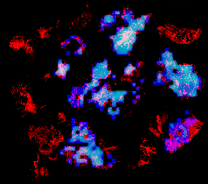
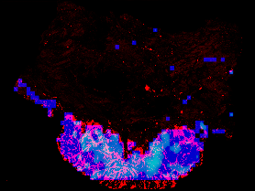
Red color: TILs regions
Blue color: Tumor regions
Cyan color: TMB High regions

