Slide 1
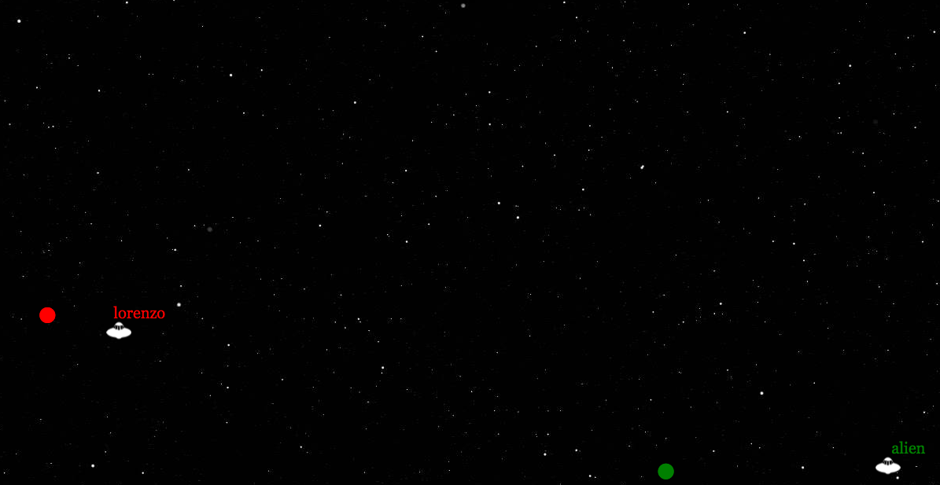
Net robots
https://github.com/netgroup/netrobots

Slide 2
Rules
There is a game grid (e.g. 300 x 300) where multiple space craft moves and fire rockets each other
You must write a C program that
Decide where to move your space craft
Decide where to fire rockets to hit other space crafts
The last survivor wins the game

Slide 3
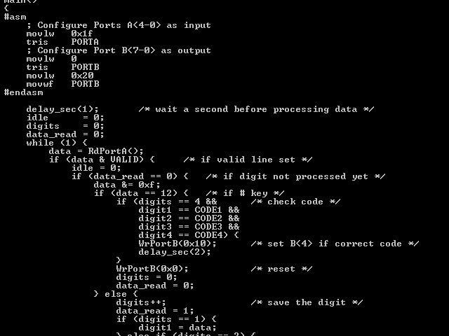
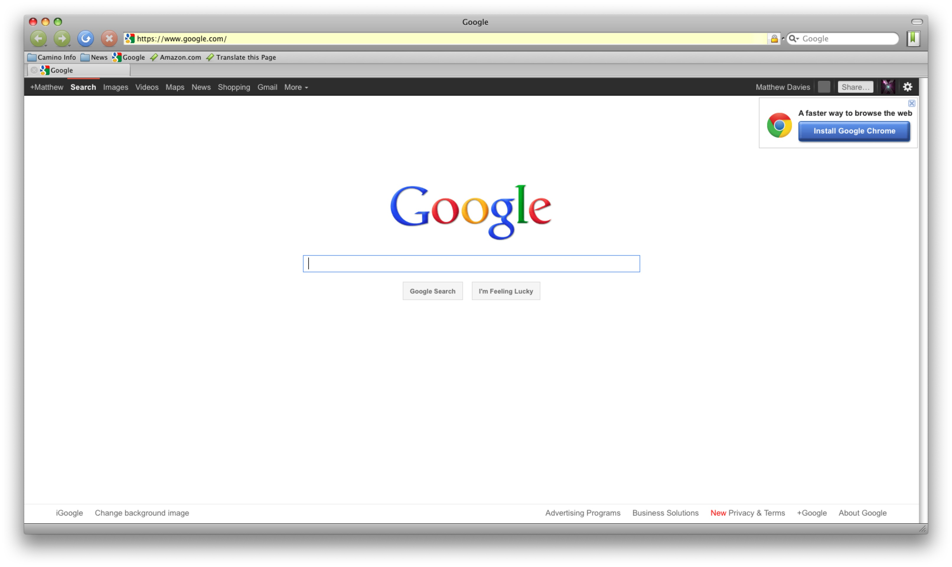
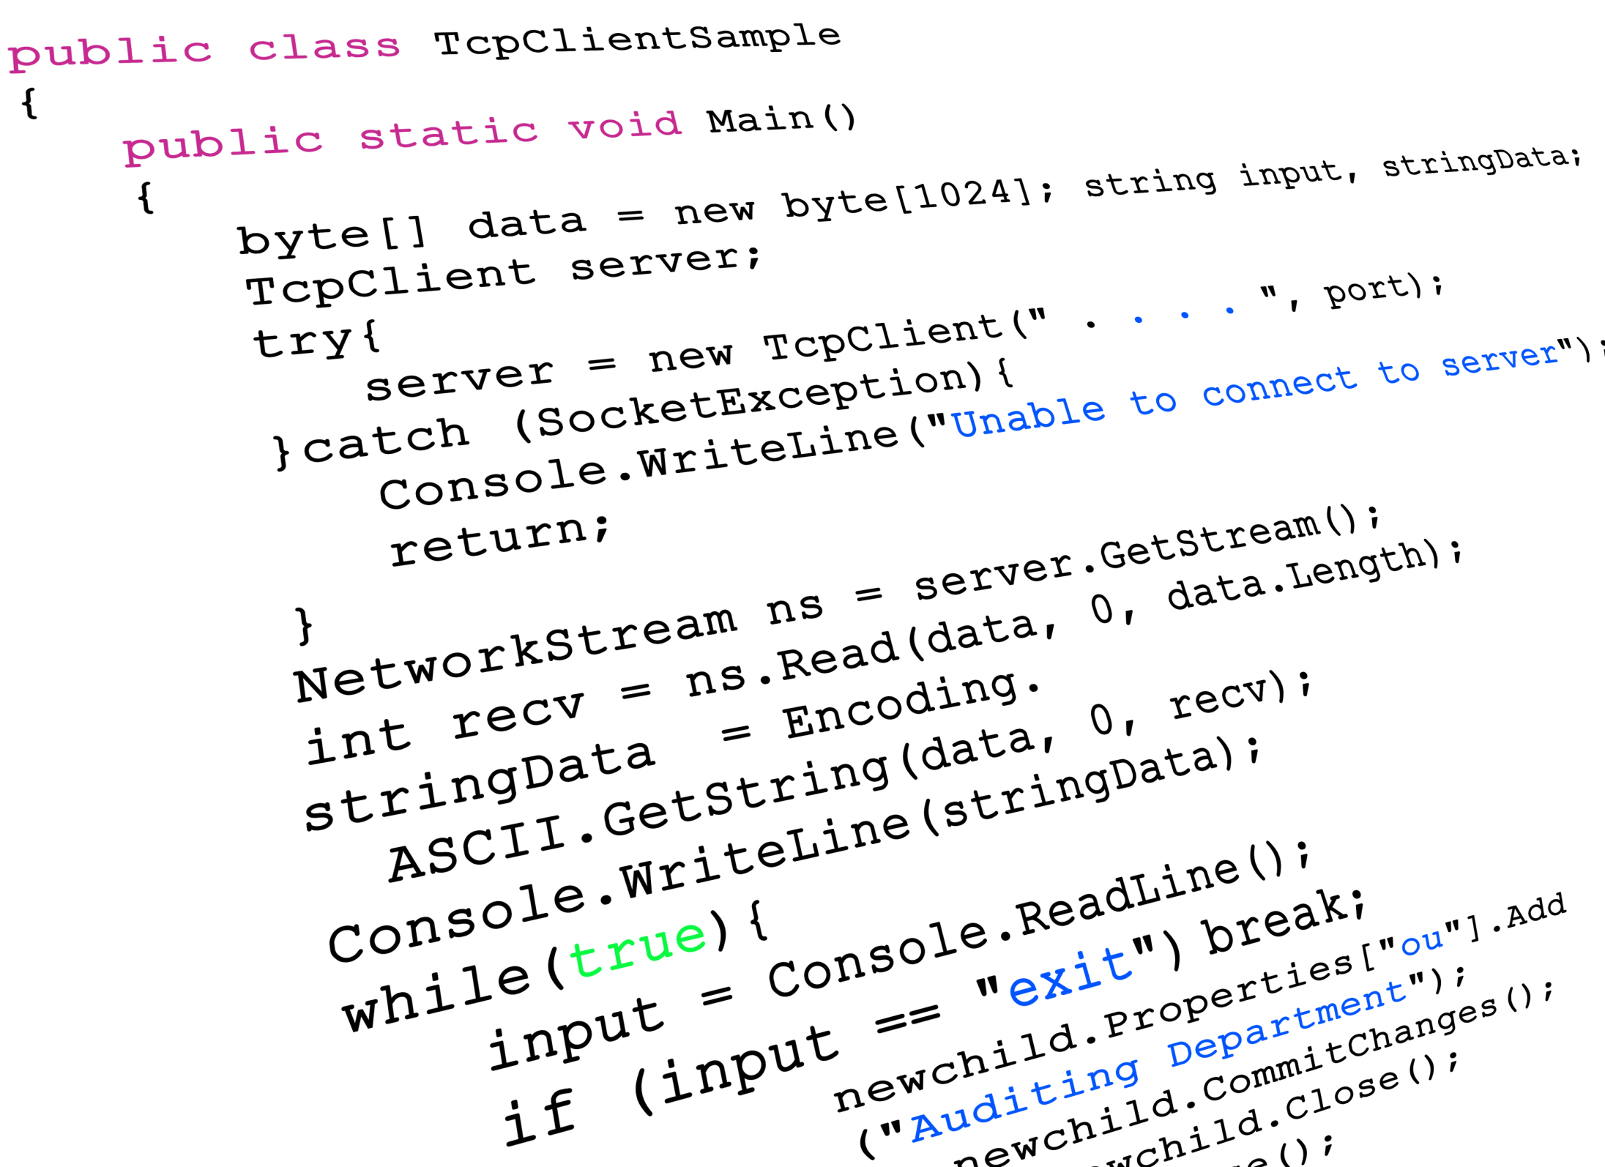
How it works
Web page (JS)
Client program (C)
Your PC
web socket
Server engine
(python)
Client program (C)
My PC
Your PC

Slide 4
How it works
Server asks periodically to every connected client the action to do (request/response)
What should I do?
Move space craft to the right
Server
Your client

Slide 5
How it works
Server also provides information about the game
There are 2 spacecrafts at position X1, Y1, X2, Y2
There is rocket at position X1, Y1
What should I do?
Move space craft to the right
Server
Your client

Slide 6
Messages
All these message are coded in ASCII strings
You must parse the string, decide the tactic and then write back a string with your instructions
There are only three request messages:
give me your name
tell me what action to do (move, fire)
quit

Slide 7
Message 1: quit request
if you receive a “quit request” you program must exit
example of message received
q
no answer needed

Slide 8
Message 2: name request
if you receive a “name request” you program must provide your name
This message carries also the information about the game grid size
n 300
Tell me your name. The game grid is 300 X 300
n lorenzo
My name is lorenzo

Slide 9
Message 3: action request
if you receive a “action request” you program must decide either:
to move up (u), or down (d), or left (l) or right (r)
to fire a rocket, specifying an angle
a GAME_STATUS
Tell me what to do
f 122
Fire with angle 122°
OR
m u
Move up

Slide 10
Message 3: action request
for your convenience the serve tell you:
if you can fire or not
the coordinates of your space craft position followed by the other space craft positions
the coordinates of any rockets and their angle
a CAN_FIRE NUMBER_OF_SHUTTLES X1 Y1 X2 Y2 ... NUMBER_OF_ROCKETS X1 Y1 A1 X2 Y2 A2 ...
a 0 3 120 234 45 87 98 67 1 10 100 282.23
You can NOT fire
There are 3 space crafts: your coords are (120,234) the others are at (45,87) and (98,67)
There is one rocket at coords (10,100) with angle 282.23°

Slide 11
Messages (SUMMARY)
Action requests | Message
Quit | q
Ask for your name and give to you arena size | n GRID_SIZE
Ask for an action and give to you the game status | a CAN_FIRE NUMBER_OF_SHUTTLES X1 Y1 X2 Y2 ... NUMBER_OF_ROCKETS X1 Y1 A1 X2 Y2 A2 ...
Action response | Message
Tell your name | n YOUR_NAME_HERE
Move or fire | m u f 125.23

Slide 12
Install
apt-get install git
git clone https://github.com/netgroup/netrobots.git
Edit
edit client/empty.c
Run
./your_program SERVER_IP

