Slide 1
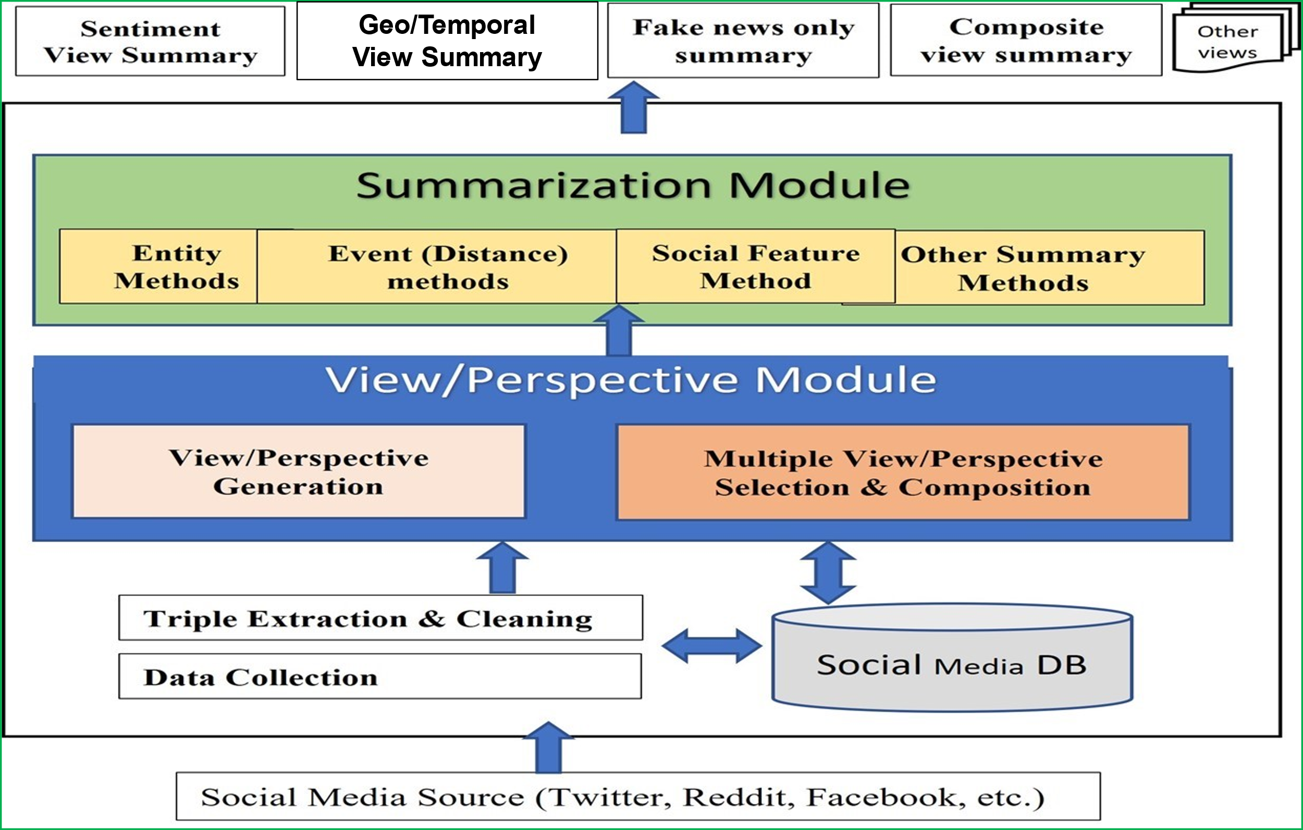
Notes:
To address the social media’s overwhelmingly large volume of posts, and to summarize them by different perspectives,
we developed a multiple view-based summarization framework
to summarize the same social media contents in different perspectives.

Slide 2
For the summarization, we developed three different summarization methods:
Entity-centered summarization (E),
Social feature-oriented summarization (SF),
Distance-based summarization (D).
These can be applied alone, or combined with different perspectives:
Sentiment (S),
Geo-location (G),
Timeline (T)
etc.
The power of our framework lies in the composition where different views can be combined to provide fine-grained summaries.
For instance, the summarization can be made from the perspectives of combined negative views about certain people, or fake news view with positive sentiments only during December 2020, etc.

Slide 3
We focus on post sentences that have <subject, verb, object> triples describing events or activities.
Social media users are often more interested in tweets that describe events or activities (Liu et al. 2012).
We used the Stanford Open IE model to extract triples from sentences.
A post with two sentences
A shipment of Sputnik V vaccine arrived in Vietnam. The handover ceremony took place at Noi Bai airport.
subject | verb | object
shipment | arrived in | vietnam
handover ceremony | took place at | noi bai aiport
Notes:
The classifier recursively splits a sentence into a set of logically entailed shorter clauses,
and predicts at each step whether an edge should yield a new independent clause.

Slide 4
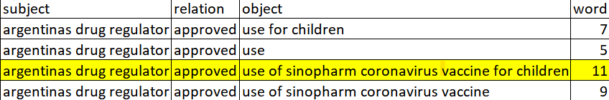
Cleaning Process
We first removed triples where “be,” or “have” and their tense forms are the verbs, as these are auxiliary verbs that carry little meaning.
We removed duplicate triples derived from the same sentence.
Notes:
We then applied each summarization method to the cleansed triple set.

Slide 5
Triple Distance-based Summarization
In this summarization view, we produced a summary based on important contextual information conveyed by the whole triples.
To create triple sentence representations, we created embeddings by using BERT and an autoencoder (Bank et al. 2020) to learn a vector representation of each triple.

Slide 6
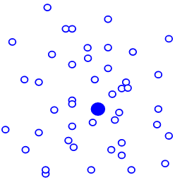
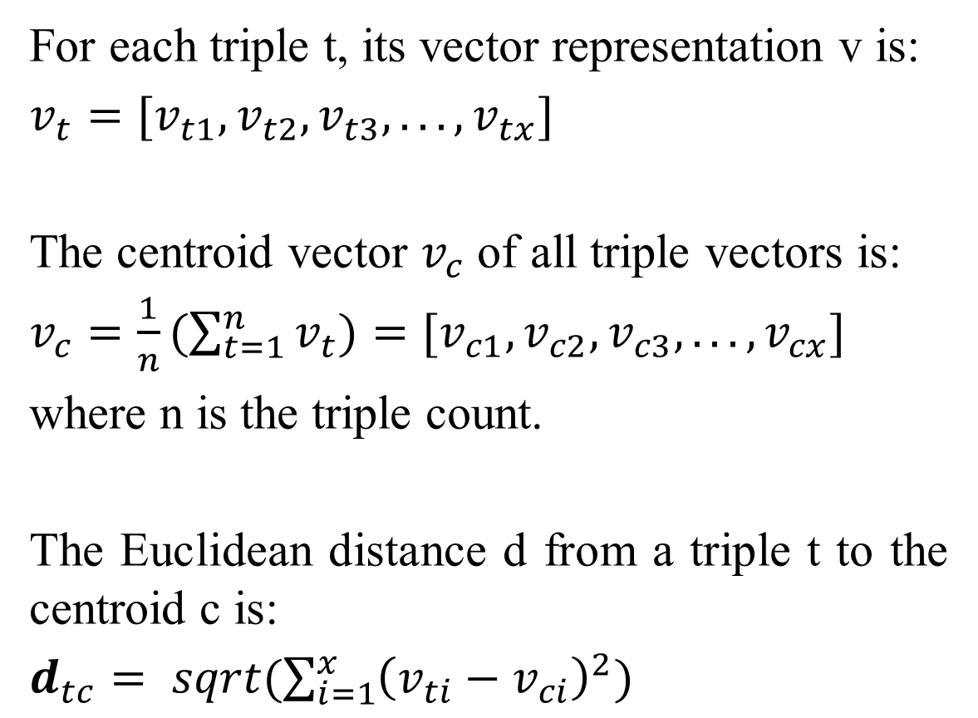
Triple Distance-based Summarization
For each triple t, its vector representation v is:
$v_{t}=[v_{t1},v_{t2},v_{t3},... ,v_{tx}]$
The centroid vector $v_{c}$ of all triple vectors is:
$v_{c}=\frac{1}{n}(\sum_{t=1}^{n}{v_{t}})=[v_{c1},v_{c2},v_{c3},... ,v_{cx}]$
where n is the triple count.
The Euclidean distance d from a triple t to the centroid c is:
$d_{tc}= sqrt(\sum_{i=1}^{x}{{\left(v_{ti}−v_{ci}\right)}^{2}})$
Notes:
Each hollow dot is a triple vector representation
Solid dot is the centroid of all triple vector representations

Slide 7
Triples with the shorter distances to the centroid have higher rankings, which are selected as summary triples.
The original sentences corresponding to the selected triples are used to make the summary.
subject | verb | object
shipment | arrived in | vietnam
handover ceremony | took place at | noi bai aiport
Post
A shipment of Sputnik V vaccine arrived in Vietnam. The handover ceremony took place at Noi Bai airport.

Slide 8
Post
A shipment of Sputnik V vaccine arrived in Vietnam. The handover ceremony took place at Noi Bai airport.
Summary Text
A shipment of Sputnik V vaccine arrived in Vietnam.
...

Slide 9
Social Feature-based Summarization
In this view, we obtain a summary based on social prominence.
We exploit the social network signals (i.e., user’s followers, retweet count) to identify the saliences of tweets.
(Liu et al. 2012) stated that a tweet is more important if
(1) It has been retweeted many times, and
(2) it is posted by a user with many followers.
They defined the salience score of a tweet as the multiplication of retweet count, user follower count and readability.

Slide 10
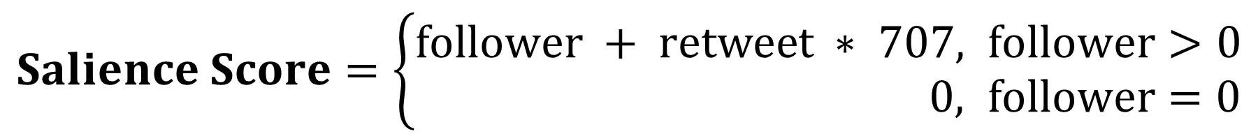
Social Feature-based Summarization
Our goal is to identify summaries with social prominence on social media. Thus, we modified the formula and defined the salience score of a tweet:
$Salience Score=\left\{\begin{aligned}follower + retweet ∗ 707, &follower>0 \\ 0, &follower=0\end{aligned}\right.$
where 707 is the average number of followers of a user on Twitter (Petrov 2023). When a post is retweeted, there will be on average 707 people who will see it.
We rank triples by scores of their original tweets, and select the top-scoring triples. The corresponding original sentences of the triples are selected to form the summary.

Slide 11
Entity-based Summarization: Subjects and Objects in <S, V, O>
In this summarization, we obtain summary based on prominent entities, to discover the most interesting or prominent entities mentioned in the posts.
Besides, important entities can appear in different actions.
Preprocessing: We first identify triple verbs expressing similar meanings using different words, such as “offer,” “give,” and “provide,” all of which express a similar meaning of “giving something to someone.”

Slide 12
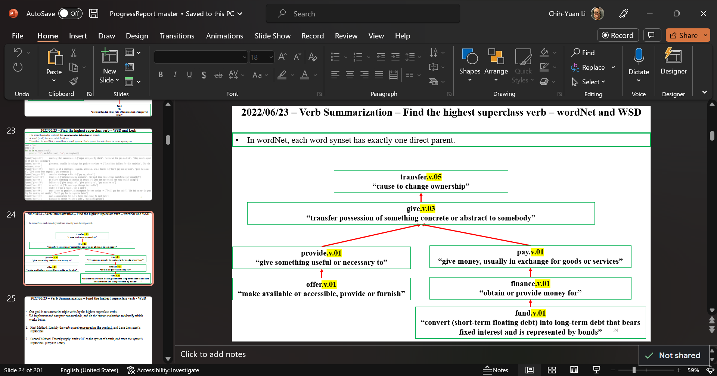
highestSuperclass = [ ] // a list of root verbs of triple verbs
for v in tripleVerb: // a list of triple verbs in the triple set
currentV = v + ‘.v.01’
while ( len(wordNet.synset(currentV).hypernyms()) ==1 ):
currentV = wordNet.synset(currentV).hypernyms()
highestSuperclass.append(currentV)
Notes:
WordNet is a large lexical database with synonym sets collection

Slide 13
Entity-based Summarization: Subjects and Objects in <S, V, O>
We identified the frequent activities by selecting triples whose root verbs occur more often than a threshold.
Therefore, we select triples that have frequent root verbs.
Then, we identify important entities to focus on.

Slide 14
Entity-based Summarization
We identify important entities (Subjects and Objects) based on the frequencies, by labelling frequencies on words in entities.
To achieve better experiment on labelling and obtain frequent and important entities, we first perform text preprocessing on the entities.
def preprocess (entity): if (length of entity) < three characters: return EMPTY string entity = remove stop words and numbers from entity return lemmatization (entity)

Slide 15
def preprocess (entity): if (length of entity) < three characters: return EMPTY string entity = remove stop words and numbers from entity return lemmatization (entity) - - - - - - - - - - - - - - - - - - - - - - - - - - - - - - - - - - - - - - - - - - - - - - - - - - - - - - - - - - - - - - - - - - - - - - - def main () preprocessedSubject = [ ] // a list collecting preprocessed subjects proprocessedObject = [ ] // a list collecting preprocessed objects subjectWord = [ ] // a list that collects all words in triple subjects objectWord = [ ] // a list that collects all words in triple objects for each (subject s, object o) of triple t in triple set ST: // s is the subject, o is the object of triple t in ST s = preprocess (s) o = preprocess (o) if s == empty string or o == empty string: remove t from ST s = s.split(“ ”)[:-2] // if s have more than two words, remove all except for the last two words preprocessedSubject.append(s) preprocessedObject.append(o) subjectWord.extend (s.split(“ ”)) objectWord.extend (o.split(“ ”))
Entity-based
Summarization
subject
“1,000 useful covid vaccines”
“useful covid vaccine”
preprocessed subject
“covid vaccine”
// preprocessedSubject = [ ‘covid vaccine’ ]
// subjectWord = [ ‘covid’ , ‘vaccine’ ]

Slide 16
Entity-based Summarization: Subjects and Objects in <S, V, O>
for each (word x) in (subjectWord): //subjectWord = [ ‘covid’ , ‘vaccine’ ] label x with an integer score of its frequency in subjectWord for each (subject s) in (processedSubject): //processedSubject = [‘covid vaccine’] Subject Score of s = higher score of the word in s
In processedSubject, IF the frequency of word “covid” is 87, “vaccine” is 80,
then the Subject Score of subject “covid” is 87, “vaccine” is 80,
and “covid vaccine” is 87.
Same scoring labeling method applies to Object Score for objects.

Slide 17
Entity-based Summarization
Triple Score = α*(Subject Score) + (1-α)*Object Score
and α ∈ [0.0, 0.1, 0.2, 0.3, 0.4, 0.5, 0.6, 0.7, 0.8, 0.9, 1.0]
To identify the best summary, we experimented with assigning different weights (α) to the subject and object entities.
We select the corresponding original sentences of top-scoring triples to form the summary.

Slide 18
Evaluation
For evaluation, we compared our view summaries with the summaries generated by extractive and abstractive summarization models from the literature.
Extractive models are BertSum and SBert, which are variants of BERT that we used in Distance view.
The summary consists of words in the original text.
Abstractive summarization models are Bart and T5 .
The summary captures the ideas in newly constructed sentences.
Notes:
Bart and T5 are better than Gensim and GPT-2
Based on our human evaluation.

Slide 19
Evaluation
To our knowledge, there is no social media dataset with gold standard summaries for performance evaluation.
Instead, we used a dataset of BBC news items (Greene and Cunningham, 2006).
There are 2,225 news items, each of which has an extractive summary.
We randomly selected 20 documents to work on.
This dataset doesn’t have social signals, geolocations, or timelines.
Notes:
Why 20?
Length Constraint for GPU and model

Slide 20
Evaluation by Rouge Scores (Lin 2004)
Rouge Score (F-1) | 1-gram | 2-gram | LCS
View (E), α = 0.7 | 0.465 | 0.310 | 0.444
View (D) | 0.557 | 0.427 | 0.551
View ( S(Negative)+D ) | 0.58 | 0.416 | 0.572
View ( S(Negative)+E ), α = 0.7 | 0.459 | 0.299 | 0.433
BertSum | 0.406 | 0.174 | 0.394
SBert | 0.444 | 0.152 | 0.428
bart-large-cnn | 0.402 | 0.150 | 0.394
T5 | 0.304 | 0.104 | 0.304
Notes:
F-1=2*R*P/(R+P)
R = common gram count of reference and candidate divided by reference gram count
P = common gram count of reference and candidate divided by candidate gram count
All the models we selected to compare with are variations of the transformer architecture.
One disadvantage of transformers is that when the input sequence is long, the performance of the attention mechanism is undermined.
We had to break long text items into chunks, and combine summarized chunks as output.
This loses contextual information,

Slide 21
Application of Multiple View Summarization Framework towards COVID-19 Vaccine Tweet Summarization
A dataset (Preda, 2021) of 18,024 tweets about the COVID vaccines, Pfizer/BioNTech, Moderna, Oxford/AstraZeneca (AZ), Sinopharm, Sinovac, Covaxin, and Sputnik V.
This dataset contains social features, geographical and temporal information.
Therefore, Geographical-view (G) and Temporal-view (T) can also be used with view Entity (E), view Social Feature (SF), view Distance (D).
We present the experiments with combined View (G+SF), View (G+E), and View (G+D).
Notes:
Out of 18,024, for view (G)
We got rid of 1,936 posts without location info

Slide 22
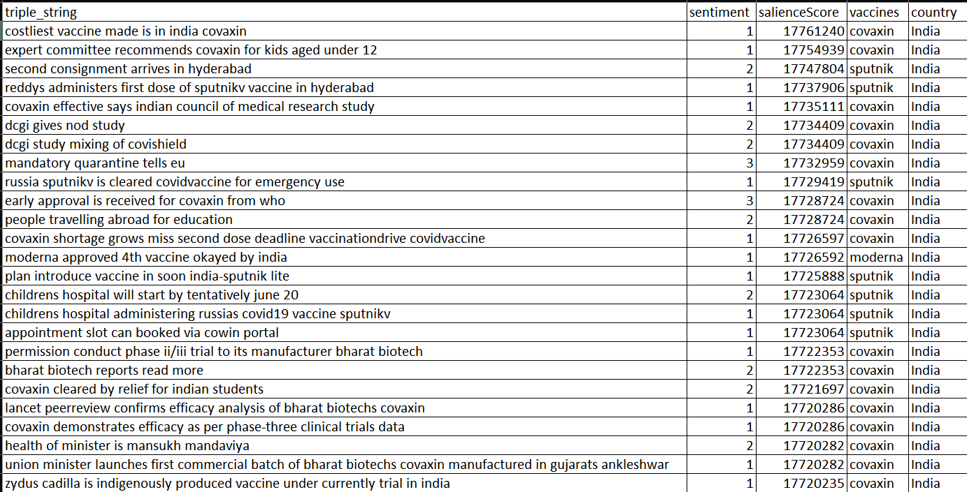
Result - Summary Triples – View Social Feature + View Geographical
Notes:
Out of 18,024, for view (G)
We got rid of 1,936 posts without location info

Slide 23
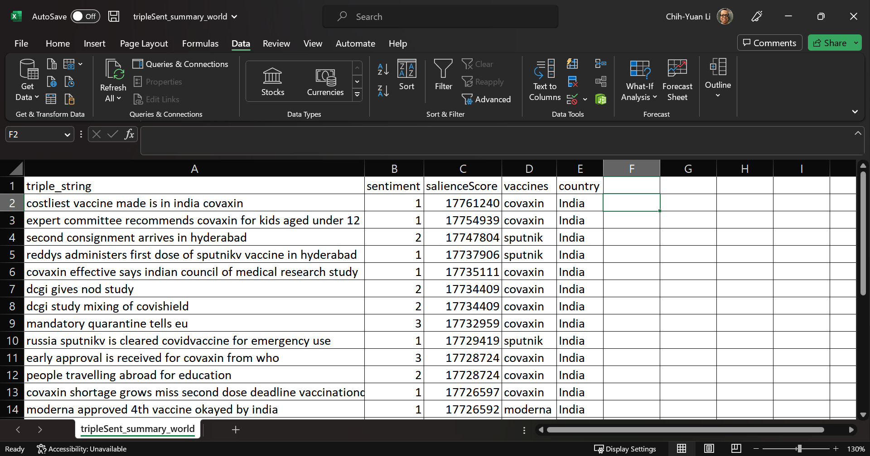
Result - Summary Triples – View Social Feature + View Geographical

Slide 24
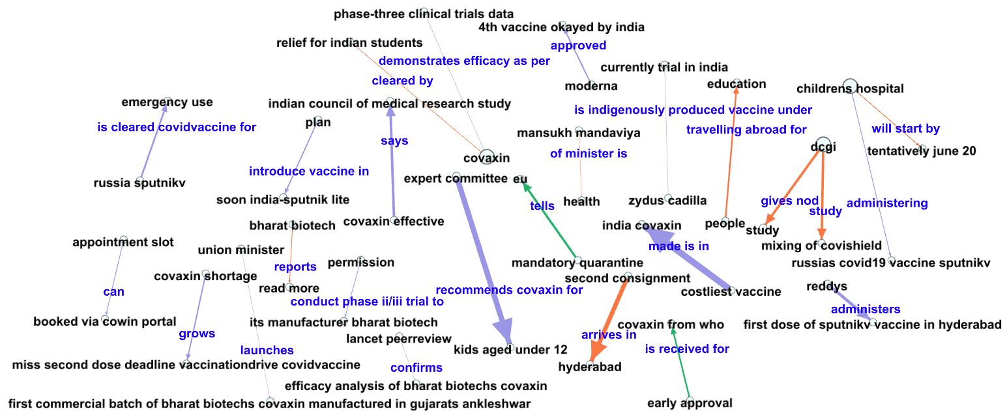
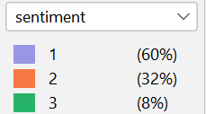
Result - Knowledge Triple Visualization – View Social Feature + View Geographical

Slide 25
Summary Text – Corresponding original sentences of summary triples, sorted by timeline
India gets third coronavirus vaccine as Russias SputnikV is cleared for emergency use CovidVaccine. Dr Reddys administers first dose of the SputnikV vaccine in Hyderabad. The second consignment of SputnikV arrives in Hyderabad, Telangana. There are plans to introduce single-dose vaccine soon in India-Sputnik Lite. JustIn. A PIL has been moved in Delhi High Court challenging Centres notification which has accorded permission to conduct the Phase II/III clinical trial of Covaxin in the age group 2 to 18 years to its manufacturer Bharat Biotech. Bharat Biotech Amid Travel Fears NDTVs Shonakshi Chakravarty reports Read more. Assam Covaxin Shortage Grows Into Crisis, Some Miss Second Dose Deadline VaccinationDrive CovidVaccine. Made in India Covaxin is the third costliest vaccine globally. Delhis Madhukar Rainbow Childrens Hospital will start administering Russias COVID19 vaccine SputnikV, tentatively by June 20. The appointment slots can be booked via CoWIN portal, according to the hospital administration. After Covaxin, Zydus Cadilla is the second indigenously produced vaccine for children currently under trial in India. I request for your kind intervention so that an early approval is received for Covaxin from WHO. This will also benefit people travelling abroad for education, jobs or business. Moderna approved for emergency use, 4th vaccine okayed by India COVID19Vaccine. Accept Covishield, Covaxin Or Face Mandatory Quarantine, India Tells EU. COVAXIN effective against DeltaPlus variant of COVID19, says Indian Council of Medical Research study. DCGI gives nod to study mixing of Covishield and Covaxin. Union Minister of Health and Family Welfare, Mansukh Mandaviya launches the first commercial batch of Bharat Biotechs Covaxin manufactured in Gujarats Ankleshwar. Subject Expert Committee recommends Covaxin for kids aged between 2 and 18 NDTVs Meher Pandey reports. The Lancet peer-review confirms the efficacy analysis of Bharat Biotechs Covaxin. As per phase-three clinical trials data, Covaxin demonstrates 77.8% efficacy against symptomatic COVID19. Covaxin Cleared By UK, Relief For Indian Students And Tourists.
Notes:
From 18,024 posts to a 300-word READABLE summary.
Sentences are listed as their original (timeline) order in the dataset

Slide 26
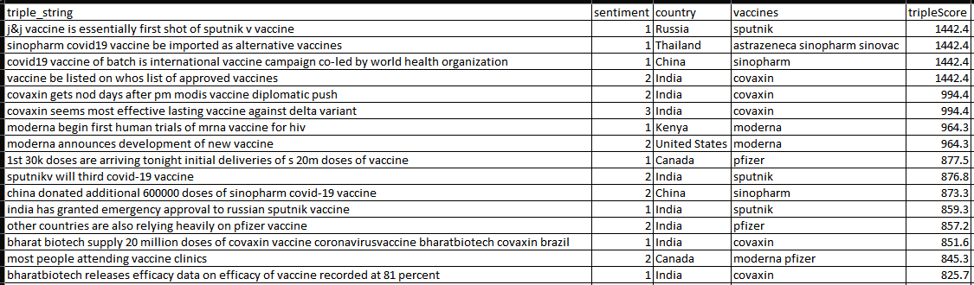
Result – View Entity + View Geographical
Notes:
Vaccines are top entities.

Slide 27
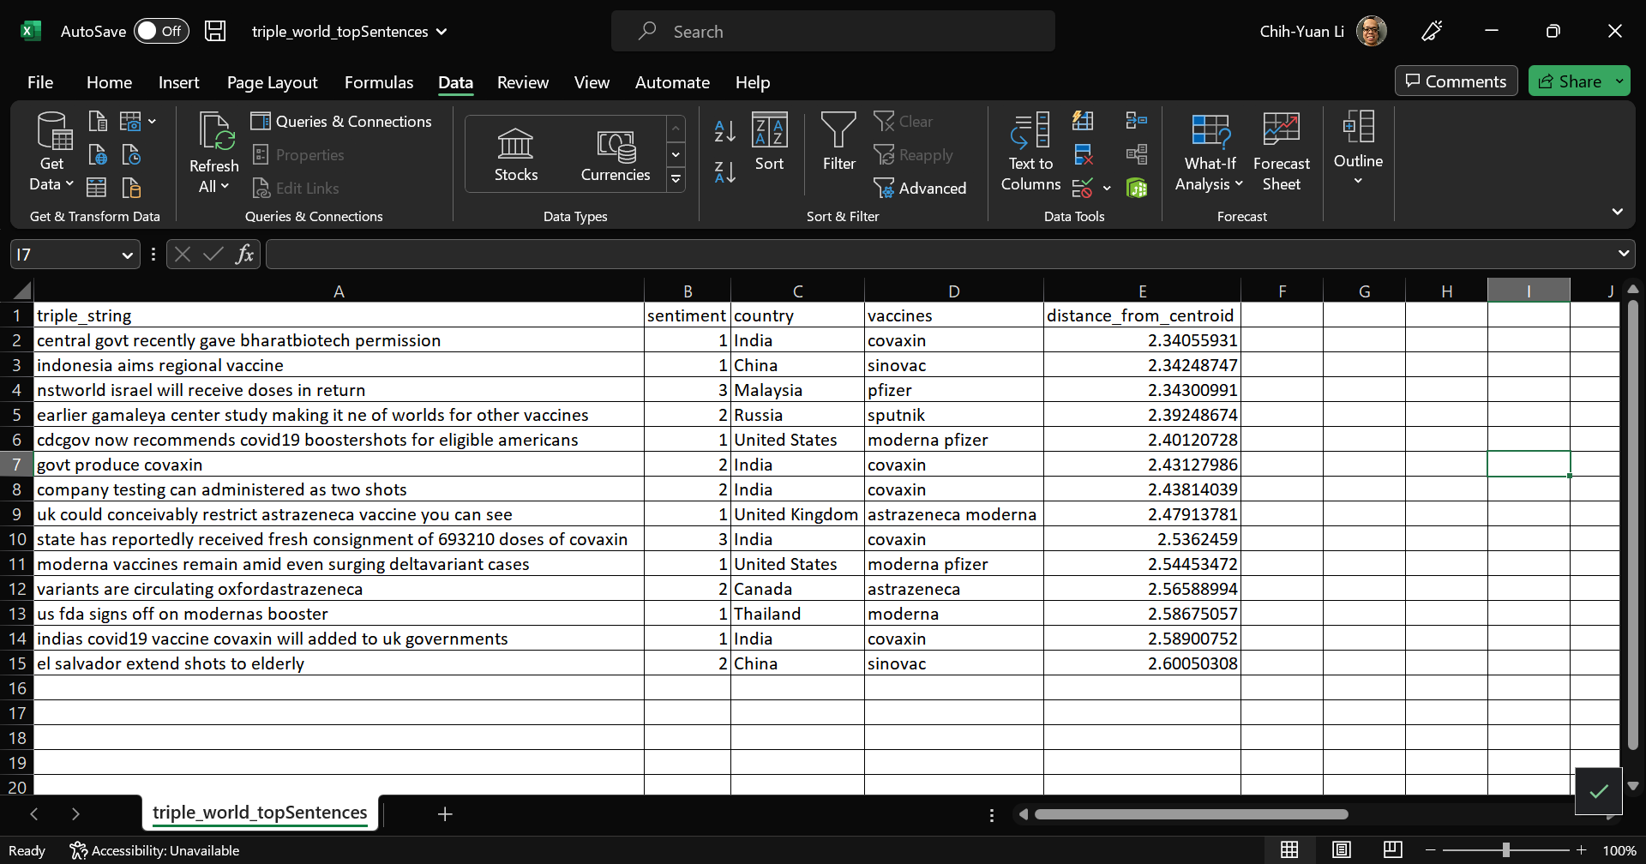
Result – View Distance + View Geographical
Notes:
Contextual topic info
Government or Institutes performed actions about vaccines

Slide 28
Result – Findings
The summary triples are mainly based in India, and discussed India’ state vaccine, Covaxin. The summaries are negative sentiment based.
Three views build summaries in different perspectives, and all three views have no common selection of triples and sentences in the summaries.
The average sentence length in view (G+D) is the longest among three views, while that of view (G+SF) is the shortest
 | Summary Triple # | Summary Sentence # | Word # in Summary Sentences | Avg word # per sentence
G+SF | 25 | 22 | 304 | 13.81
G+E | 16 | 16 | 305 | 19.06
G+D | 14 | 14 | 309 | 22.07
Notes:
Mention again
our work can be extended to different combined perspectives

Slide 29
The above work is accepted and currently pending publication
Li, C., Chun, S. A., & Geller, J. (2023). Multiple View Summarization Framework for Social Media. The International FLAIRS Conference Proceedings, 36(1). https://doi.org/10.32473/flairs.36.133169

