Slide 1
Canola TILLING population update
Chris Helliwell
Bjorg Sherman
Jasmine Rajamony
Csiro Agriculture and food

Slide 2
Canola functional genomics project
Understanding genes and genetic variation underlying traits in commercial cultivars
Forward genetics – novel traits by mutagenesis and identification of causal genes
Mutant population in Australian background
Reverse genetics – new alleles of genes regulating important traits (using the knowledge from model plant systems)
TILLING population (based on the mutant collection)
Genome editing

Slide 3
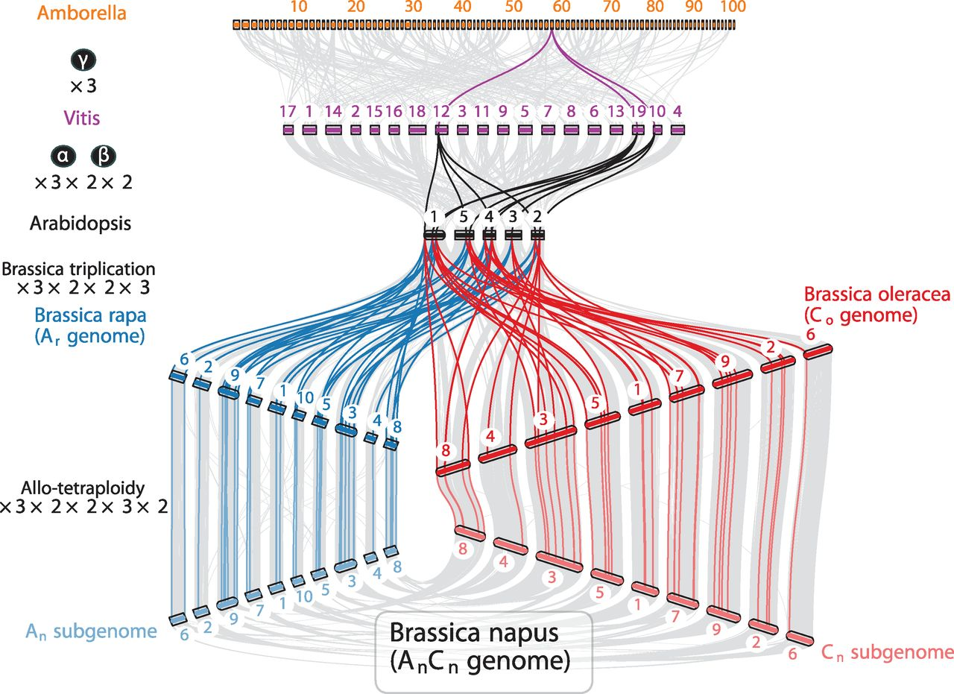
Canola (B. napus) is an allopolyploid related to the major model species Arabidopsis thaliana
150 Mb 30,000 genes
540 Mb 42,000 genes
630 Mb 48,000 genes
1130 Mb 101,000 gene models

Slide 4
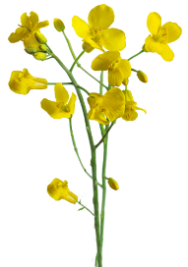
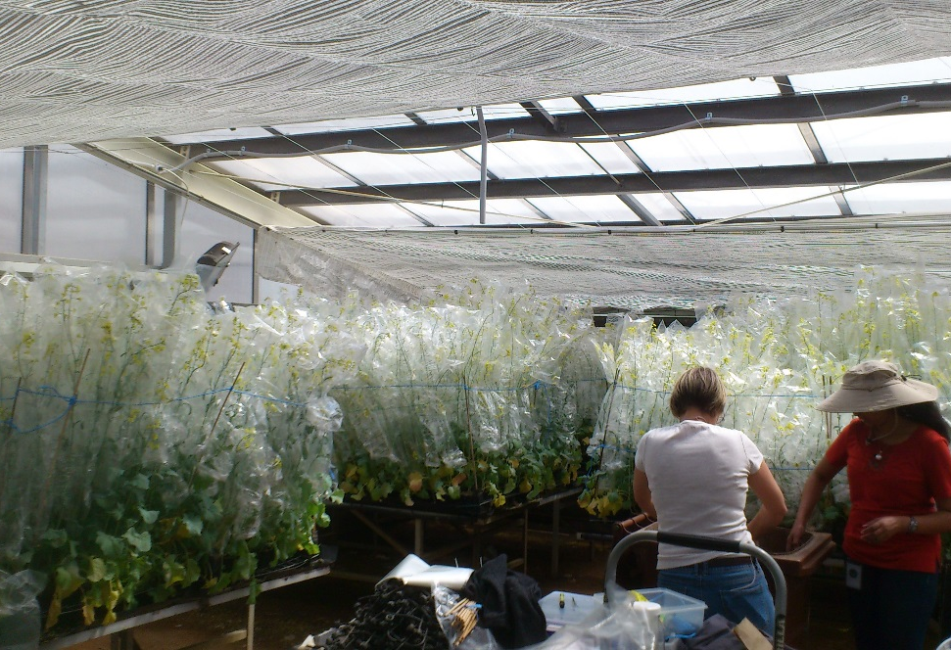
Canola mutant population
Australian cultivar
“Zircon” (NuSeed)
Mutagenesis
M1
M2 seed
screens for novel traits
Single M2 seed
TILLING population
DNA + Seed library
High density planting: ~300 plants per bench

Slide 5
Canola genome sequence
1130 Mb genome
79% genome coverage, 96% of ESTs
101,040 gene models, 91,167 match to B. Oleracea or B. rapa models
Relatively few genes lost from A and C genomes (112 and 91)
Frequent homeologous exchanges between genomes – one section replaced with corresponding region from homeologous sub genome (chromosome, gene or nucleotide level)
96% of genes expressed in leaf or root, similar contributions from A and C genomes
Expansion of lipid synthesis genes

Slide 6
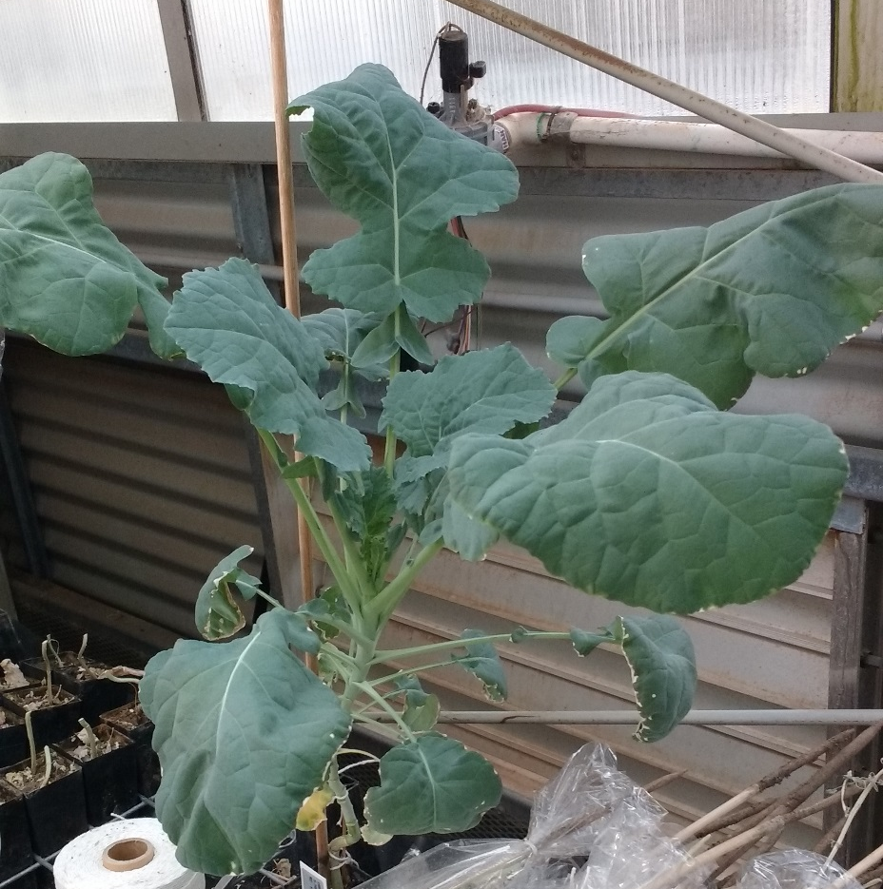
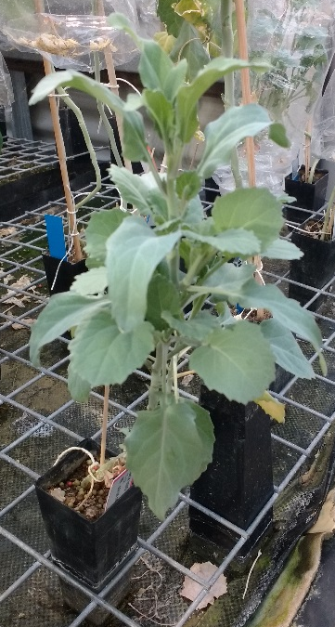
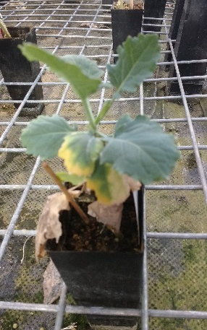
Mutant population
M1 – 6000 plants
M2 seed harvested – 2000+ lines
M2 plants – 1200 grown, sampled for DNA
Phenotypes:
Early flowering (M1)
Late flowering
Spiky leaves (holly-like)
Leaves from axillary meristems
Larger leaves
Dwarf

Slide 7
Target traits in canola
Seed properties
Oil content (seed and leaf)
Oil properties
Glucosinolates
Tocopherols
Fibre
Storage proteins
Architecture
Pod shatter
Branching and determinancy
Apetalous
Synchronous flowering
Phenology
Flowering time – photoperiod/vernalization/temperature
Establishment
Vigour
Disease
Blackleg
Sclerotinia

Slide 8
Screening the TILLING population
Assemble list of genes for target traits – Oils, Flowering, Disease, Hormones –> 930 B napus genes
Screening Gene-by-gene?
– inefficient
very similar homeologs – specific PCR difficult -> CelI digests problematic
Amplicon sequencing?
- Lots of primers needed
Sequence capture?
More cost-effective and efficient for large numbers
More likely to show specific genes containing mutations
=> Capture design made for 925 genes = 1.5 Mb target sequences

Slide 9
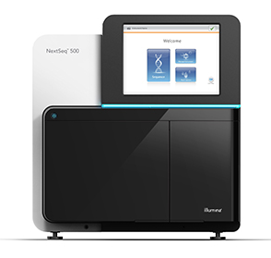
Pilot sequence capture screen
Capture oligos
gDNA from individual M2s
Pools of 12 DNAs
24 barcoded libraries
Pooled library
Captured library
Sequence
Analysis to identify new mutations

Slide 10
TILLING screen – analysis
Sequence reads mapped to canola genome with high stringency
Duplicate reads removed
Variant bases called
Variants unique to 1 pool of plants identified
Identify amino acid variants
Data filtered – at least 4 unique sequences showing variant sequence

Slide 11
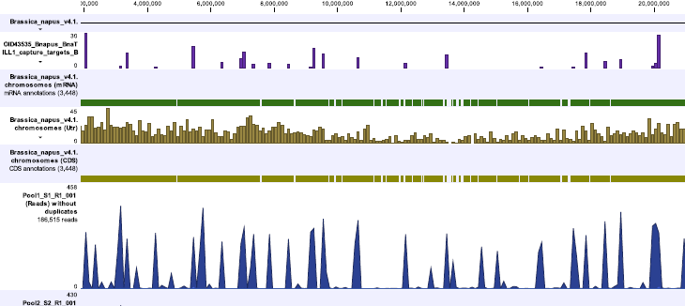
High level view of aligned reads

Slide 12

Mutation detection
Sequence variant unique to pool
Verification and identification of individual mutant line

Slide 13
Summary of data so far
Sequence capture successful – coverage of 85% of targeted sequence
From 288 lines: 8000 amino acid variants in 925 target genes
524 premature stop codons = 0.5 per gene
Mainly G->A or C->T changes as expected for EMS
*subject to verification*
Mutation rate 1 per 70,000 bp
Suggests final population of 1500-2000 lines; 3-4 premature stops per gene

Slide 14
Next
Verification of mutants/refine analysis pipeline
Extract DNA for next ~1500 lines
Screen with current capture set
Design more capture targets?
Phenotype mutant lines, cross mutants to knock out multi-gene families

Slide 15
Functional Genomics for Canola Traits
Bjorg Sherman
Jasmine Rajamony
Julianne Lilley
John Kirkegaard
Shannon Dillon
Surinder Singh
James Petrie

Slide 16
Conservation of gene function between canola and Arabidopsis
Arabidopsis FLC in canola
Canola FLC in Arabidopsis
Tadege et al 2001

Slide 17
TILLING screen - pilot
gDNA isolation
Qiagen Mag Bead kit 96 well
Quantify gDNA
Qubit and qPCR
Pool DNA
12 lines per pool, 24 pools = 288 lines
Fragment gDNA
Covaris sonicator
Barcoded libraries
KAPA library kit/Roche adapters 24 libraries
Pool libraries
Exome capture
Nimblegen design – 5400 exons, 12 Mb
Sequence
Identify mutations

Slide 18
Canola and Arabidopsis genes are closely related e.g. FLC
Tadege et al 2001

Slide 19
Mutagenesis
Aim for high rate of mutagenesis (should be tolerated due to gene redundancy)
-> small population size (1000s)
Sodium azide slows germination
Used 2mM for bulk treatments
2000+ M1
EMS % based on published data
Bulk treatment with 0.4% - 2000+ M1
Increased to 0.6% - 2000+ M1 (0.8% lethal)

