Slide 1


CMPT 276 - Group 13
Ahmed
Rain
Kaleb
Joseph

Slide 2

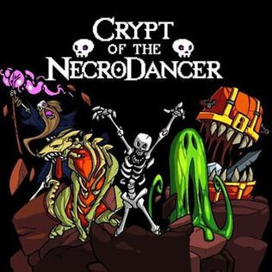
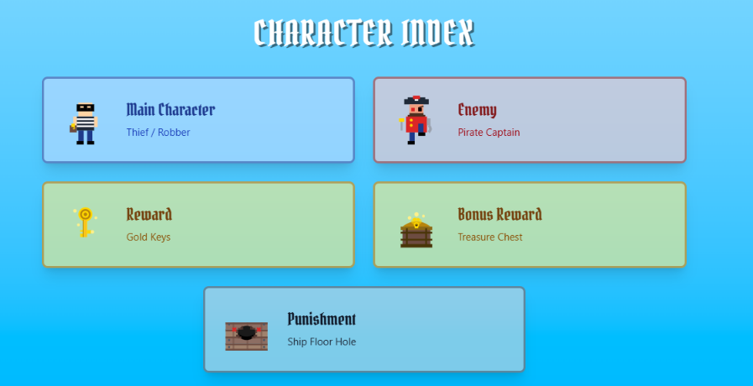
Game Design
Pirate-themed escape game
Rhythm-based game (Inspired by Crypt of the Necrodancer)
1 tile/tick = 1 tile/beat
Music is core functionality of the game
Notes:
Game is based on a pirate ship
Escape off with treasure
Main character is a robber

Slide 3

Demo
Notes:
Moving on the beat
Red border indicates trip
Enemy red eyes indicate chasing the player
Using trap to sacrifice score to escape from enemy
Collect keys/bonus chest
Escape

Slide 4
Software Design and Architecture
Entity code architecture inspired by Godot
Uses LibGDX on game core
Uses Singleton design pattern and strategy design pattern for level instance
Use factory design pattern in levels for tiles and entity instances
Uses BFS for enemy

Slide 5
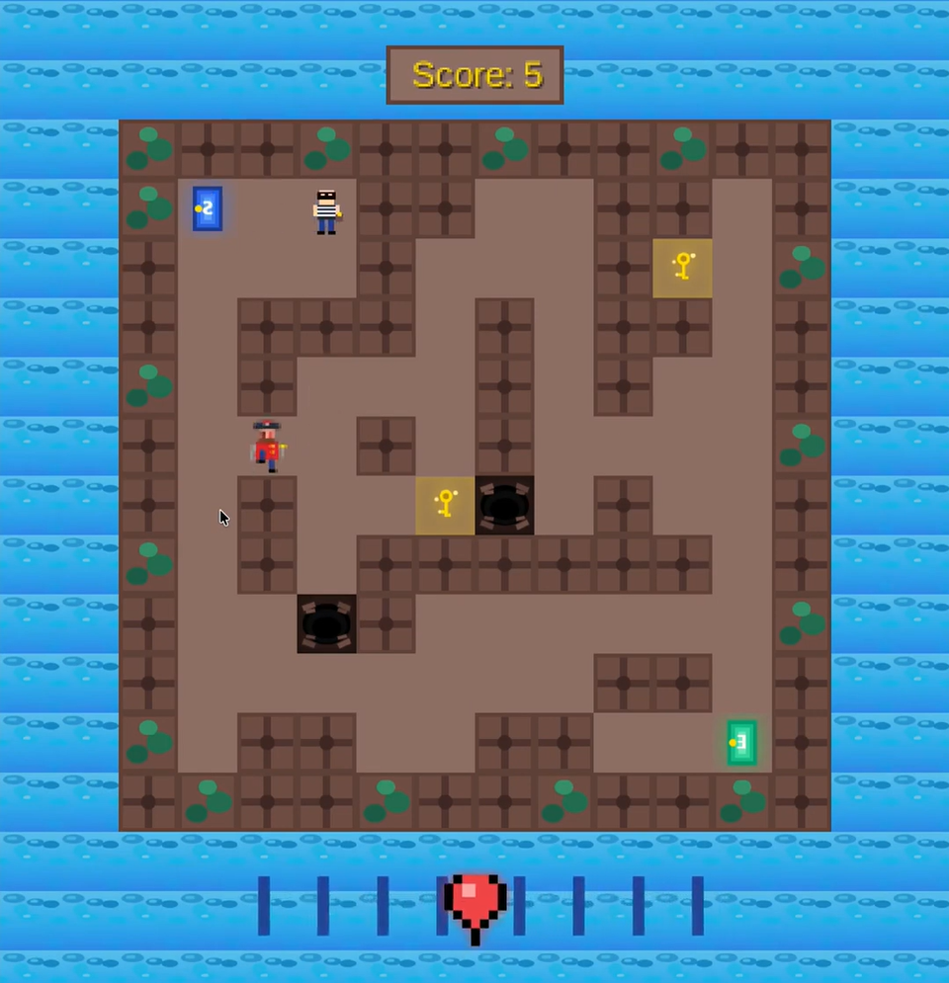
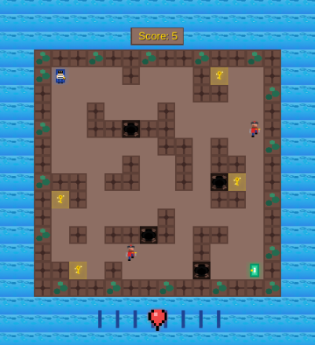
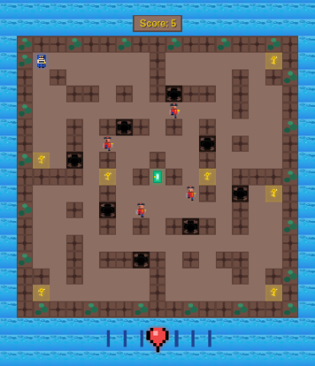
Implementation and Testing
Levels:
Level is a shared base class handling the grid and game logic, with Level1, Level2, and Level3
Implementation: Level initializes the tile grid, spawns all entities, and tracks win/lose state, with each subclass implemented as a singleton defining its own layout.
Testing: Tests covered grid setup, player spawning, score, and distance calculations.
Level 1
Level 2
Level 3

Slide 6
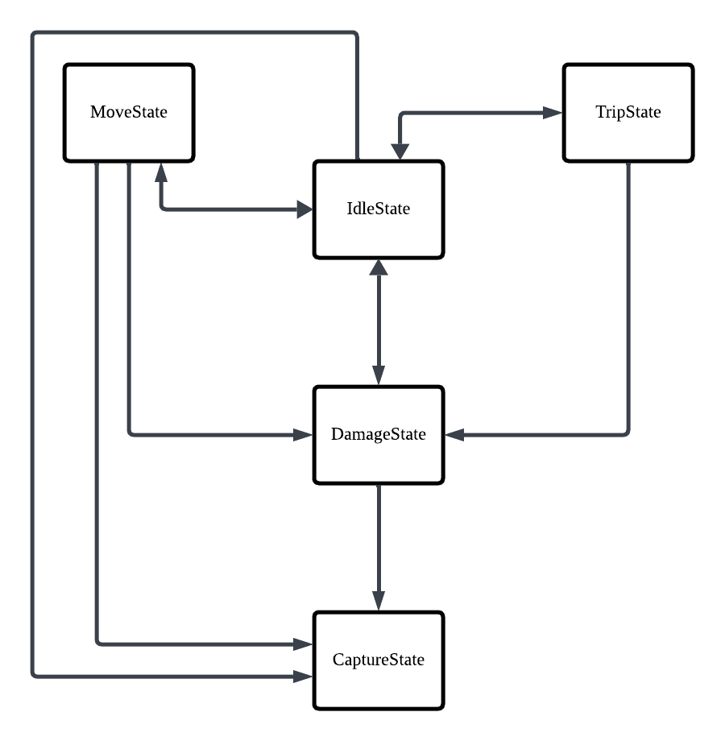
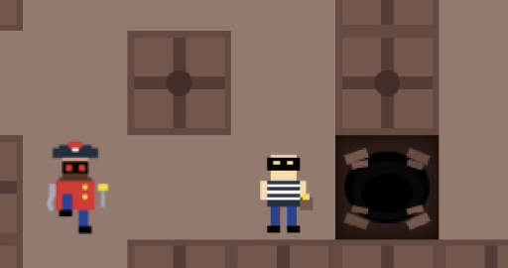
Implementation and Testing
Player:
Most player logic is implemented with a state machine.
The player starts in the idle state, where they can attempt to move, be captured by an enemy, or take damage transitioning to the corresponding state as necessary.
Testing: Tests verify that state transitions take place under the correct conditions.
Notes:
State example: moving onto a trap (IdleState -> MoveState -> DamageState -> IdleState or CaptureState)

Slide 7
Implementation and Testing
Save Manager:
Handles saving player high score and level unlock status
Implementation: uses a csv file to hold player information.
Testing: ensures proper read and write actions
Enemy:
Enemy is an instance with the automated tracing and path-finding logic inside the interaction with player.
Implementation: Using BFS with Level-order Traversal to find the actual distance between the enemy and player and where is the next tile to move to when it’s tracing state or outside of the range. Using random logic otherwise.
Testing: Test the reaction of enemy in different situations (Map).
Notes:
Save Manager handles save files, allows for reading and writing to a csv style file
Save files contain high score, level 2 and 3 unlock status
BFS for tracing, random, range, back, automatically

Slide 8
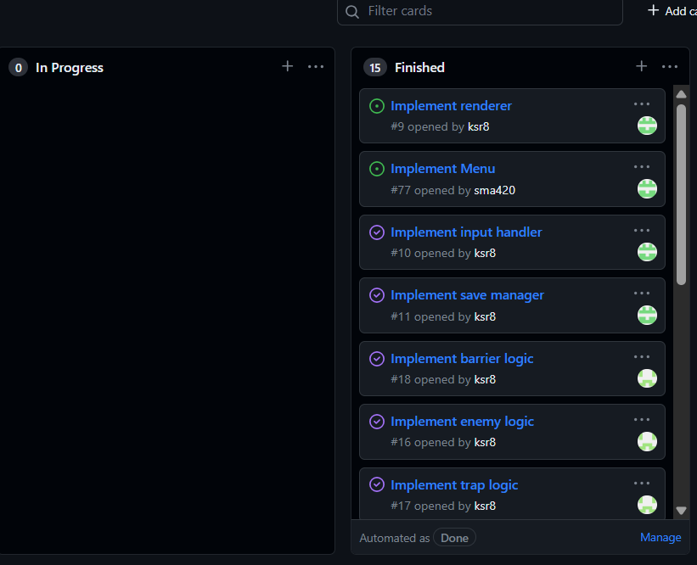
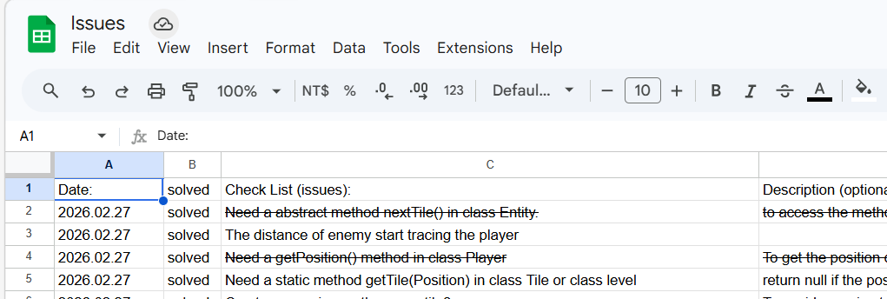
Project and Team Management
Weekly wednesdays meeting
Discord for communication
Issues table for problems handling
Utilized github “Project” feature to organize task management

Slide 9
Challenges and Lessons Learned
Challenges:
Difficulties in debugging
Class implementation relying on other incomplete classes
Time management, as we were unable to fully implement the complete game within the given phase deadline.
Lessons Learned:
Allocate more time for debugging
Set up testing at an early stage
Make a timeline to be organized for deadlines

Slide 10
Thank You

