Slide 1
Introduction (MCU)
HAL (Hardware Abstract Layer)
Off-chip Peripheral
(eg, sensors, radio, screen)
App
RTOS,
Protocol Stack,
Off-chip Peripheral Lib
Pin
On-chip Peripheral
(eg, GPIO, SPI, UART, ETH, SD)
MMIO & Interrupt
Vendor HAL, Platform HAL
MCU
Peripheral MMIO
MCU
MCU Structure
Programming Model

Slide 2
Introduction (Programming)
App
App
App
RTOS
Protocol Stack
Off-chip Peripheral Lib
RTOS,
Protocol Stack
Off-chip Peripheral Lib
Lib
Vendor HAL
Platform HAL
Vendor HAL, Platform HAL
Peripheral MMIO
Peripheral MMIO
Peripheral MMIO
MCU
MCU
MCU
Standard
Bare metal
Hybrid
High development efficiency
Fine-grained control
Less power, Faster speed
Balance
Standard Firmware
Non-Standard Firmware
Non-Standard Firmware

Slide 3


Introduction (Emulator)
How did I develop Qiling before?
Reversing peripheral interface logic and translate them into Python code.
App
App
What needs to do for reversing peripheral interface logic？
Qiling
Read the official doc day by day.
Develop the firmware of target peripheral.
Observe the register access sequence.
Understand the official HAL Lib logic.
Unicorn
Shortage
Peripheral MMIO
stm32 is famous for its rich doc, but not all company’s peripherals have detailed doc.
Not all peripherals require high-precision simulation, firmware just do simple check.’
The logic of different peripherals has a lot in common, catch them !!
MCU

Slide 4
Auto/Semi-auto Reversing
- HAL Library represents the peripheral interface, finding a way to pass these functions but not need to read a lot of doc.
- Find the same pattern cross different peripheral.
Is symbolic execution the best method?
Do it on source code or binary?

Slide 5
Auto/Semi-auto Reversing
Input: Standard Firmware (need source code)
Output: Peripheral Logic (Python code in Qiling) / New Qiling.
Workflow:
Find all HAL function (entry/exit point) through elf.
Do symbolic execution when enter entry point.
Trying to match the preset pattern, find the most simple pattern to pass the code.
After exiting the HAL function, add new logic into qiling.
Restart from 1, but ignore the reversed HAL function,
Training the Qiling through auto-reversing the standard firmware, and the new engine can emulate all firmware.

Slide 6
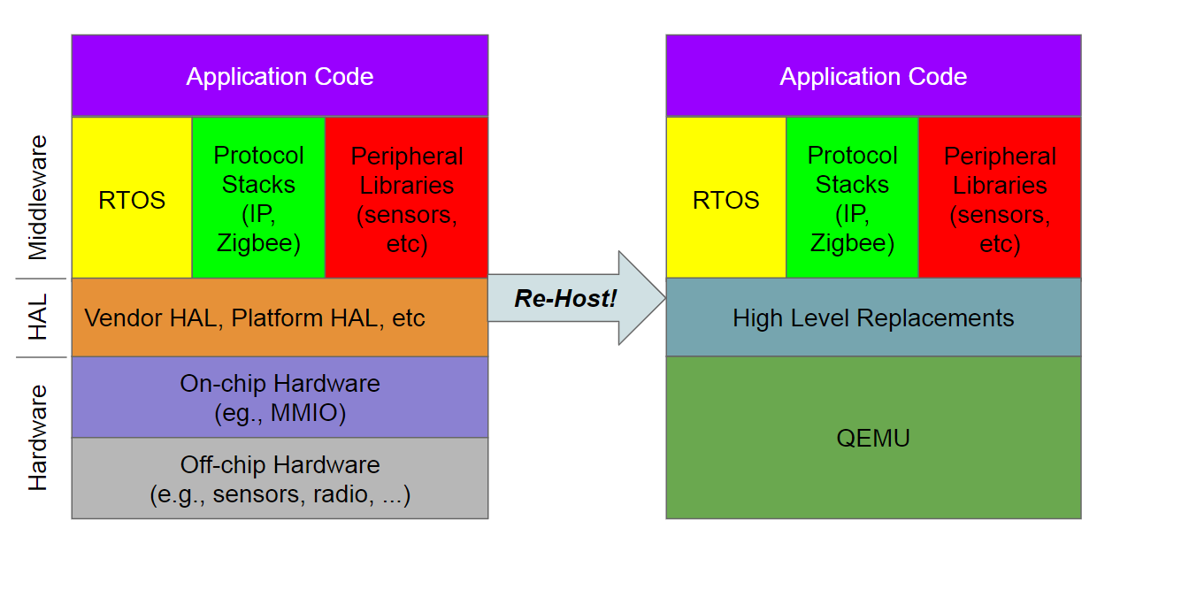
Related work
HALucinator: Firmware Re-hosting Through Abstraction Layer Emulation
Requires the firmware use a HAL, and the HAL must be available to the analyst (e.g., either open source, or part of the microcontroller’s SDK)
The effectiveness of LibMatch, especially when the compiler or library versions used is unknown, is limited.
Just run the firmware, do not know the peripheral interface logic.

Slide 7
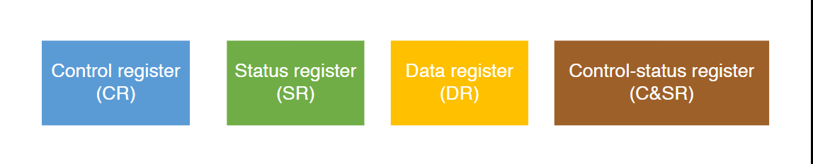
Related work
- P2IM: Scalable and Hardware-independent Firmware Testing via Automatic Peripheral Interface Modeling
Did not consider the mutual influence of registers, and the register model is not flexible enough.
Registers are identified and categorized by monitoring access to the memory-mapped peripheral region.
The model generalizes peripheral registers into four types and provides the access patterns and handling strategy for each type.

Slide 8
Related work
- Jetset: Targeted Firmware Rehosting for Embedded Systems
Key Insight: It is designed to ignore most paths through the firmware to focus on a particular target piece of code.
Approach: Jetset use heuristic search and symbolic execution to find the path to target code.
Difference: Neither P2IM nor Jetset really care peripheral logic, they just want to skip the code related to peripheral access, and then fuzzing at the target point. It is hard to find the peripheral-related bug. (Concurrency bug)

Slide 9
Experiment
Platform
Parameter
STM32F407, STM32F411, STM32F103
SAM3X8E
GD32VF103 – RISCV, Rust (more arch)
BES2300 (real world example)
MK64FN1M0VLL12 (optimal)
Completeness
Correct rate
Pattern coverage / number
Fuzzing result (optimal)
Software
Peripheral
Ethernet (TCP, UDP, HTTP)
Filesystem (SD card, Fatfs)
Drone (Emuflight, betaflight)
RTOS (FreeRTOS, RT-thread)
PLC (optimal)
GPIO
UART, SPI, I2C
TIM, RTC
SDIO, SD Card
ETH
CRC, RNG
ADC, DAC

