Slide 1
Trivial RISC-V CPU
于峥 518030910437

Slide 2
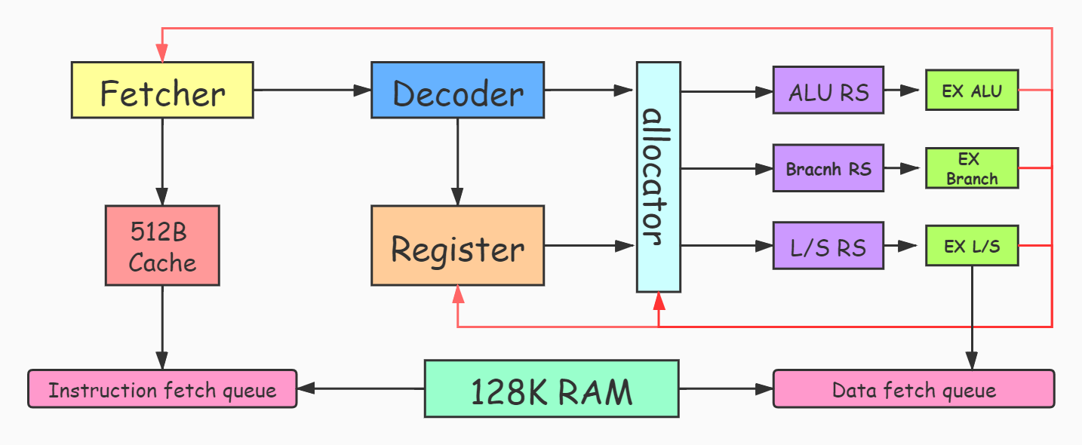
Design

Slide 3
Design
Fetch
Dispatch
Execute

Slide 4
Fetch Instruction
4/6/7/8 periods
Send 2 pc and pc+4 every period
Signal
Signal
Signal
Signal
Signal
Signal
Signal
Signal
Data
Data
Data
Data
Data
Data
Data
Data

Slide 5
Memory Port
IF Pre-fetch
Write Buffer

Slide 6
ROB or virtual register ?
Virtual Register
Can‘t predict multiple times.
Register X
current
Register Y

Slide 7
Decrease wns
LUT (Look up Table)
if
switch
negedge
Complex Logic
Less Bit
????????
more stage

Slide 8
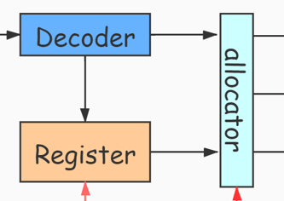
Negedge or Combinatorial logic ?
Decoder | posedge clk
Register | always (*)
allocator | negedge clk
100MHz：WNS：-1.8ns

Slide 9
Negedge or Combinatorial logic ?
Decoder | posedge clk
Register | always (*)
allocator | always (*)
100MHz：WNS：-0.9ns

Slide 10
Small cache
Cache : 4K
LUT : 89%
WNS : -0.9ns
Cache : 512B
LUT : 34%
WNS : -0.2ns

Slide 11
More stage
allocator

Slide 12
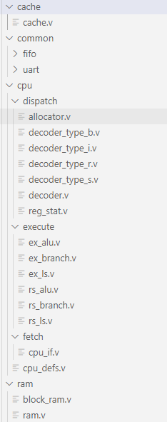
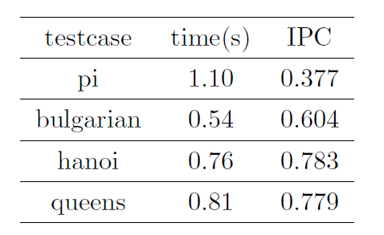
Performance
100MHz : 0.042ns
200MHz : -2.497ns

Slide 13
More complex program
float operate
multithreading
os ????

Slide 14
Develop
Switches
LEDs
VGA
UART

Slide 15
Meaning

Slide 16
Thanks

