Slide 1
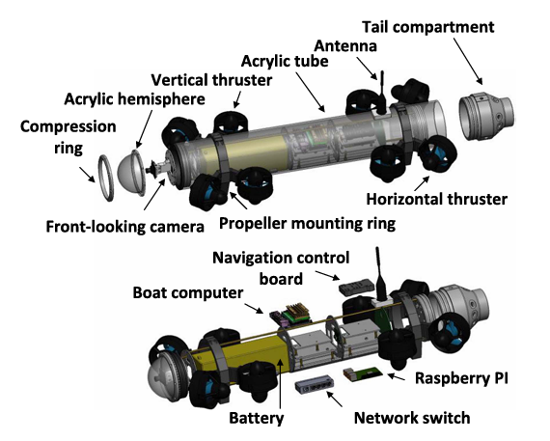
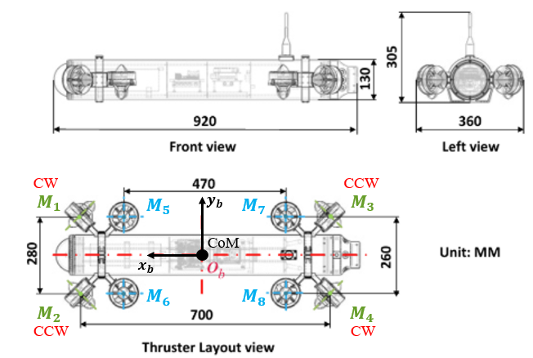
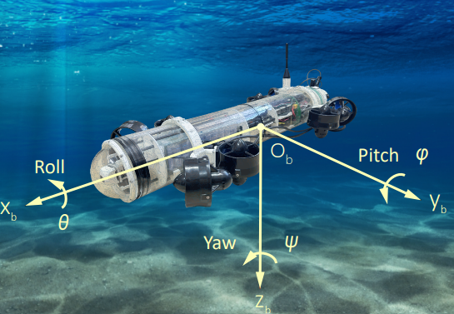
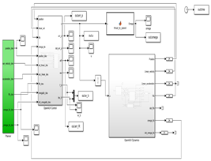
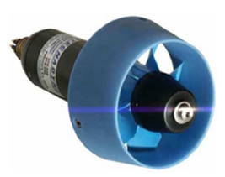
DIPARTIMENTO DI INGEGNERIA ELETTRICA E TECNOLOGIE DELL’INFORMAZIONE
SCUOLA POLITECNICA E DELLE SCIENZE DI BASE
LAUREA MAGISTRALE IN INGEGNERIA DELL’AUTOMAZIONE E ROBOTICA
Field & Service Robotics – Final Technical Project
OpenAUV: Design and Robust Control
Studenti: Claudia Adamo, Mat. P38000357
Emanuele Fusco, Mat. P38000338

Slide 2
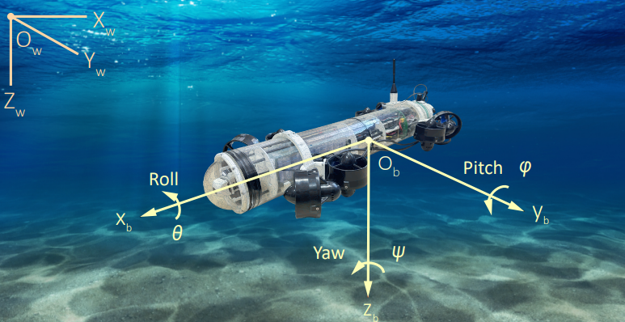

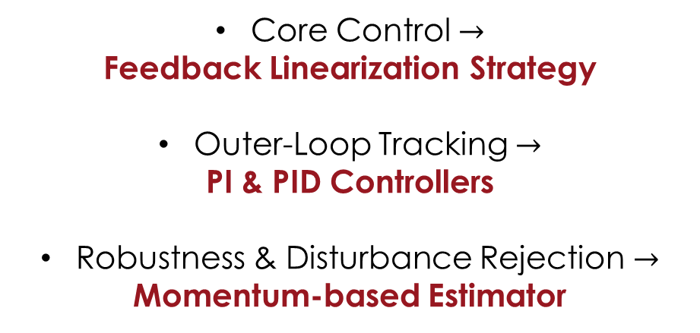


Introduction: Project Organization and Milestones
Platform Selection for the Project
$$O_{b}≡CoM$$
The OpenAUV is a fully-actuated underwater robot.
Proposed Control Architecture Roadmap
NED convention adopted
Core Control $→$
Feedback Linearization Strategy
Outer-Loop Tracking $→$
PI & PID Controllers
Robustness & Disturbance Rejection $→$
Momentum-based Estimator
Illustration of the OpenAUV prototype. Source: Sha et al., IEEE RA-L, 2025.
A
Note: The $y_{b}$axis orientation reflects a graphical error in the original paper.
B
Simulink Models:
(A) OpenAUV_v1dist.slx
(B) OpenAUV_v2OBS.slx
Field & Service Robotics – OpenAUV: Design and Robust Control – Introduction 2/33

Slide 3
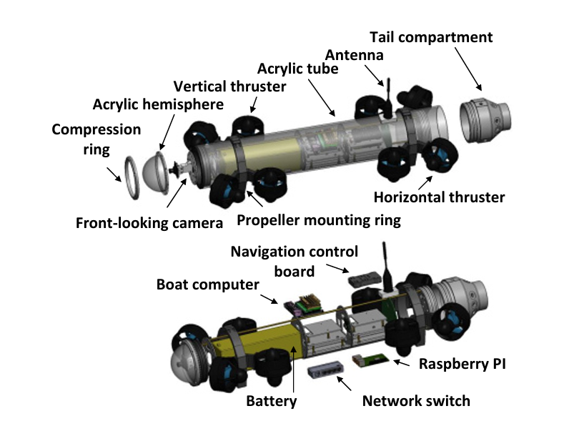
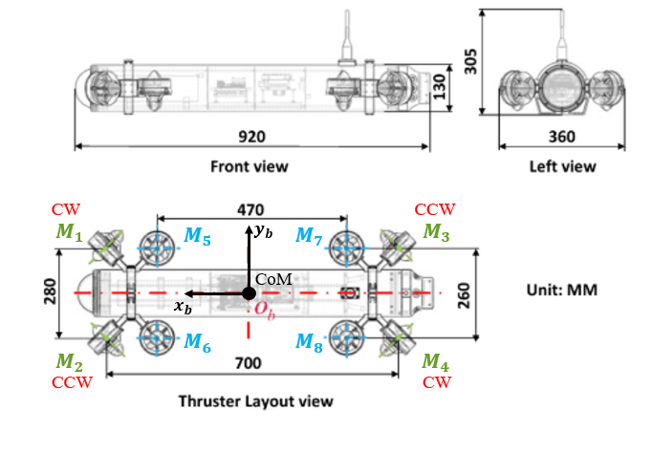
Design of the OpenAUV
https://github.com/schahzy/OpenAUV
Field & Service Robotics – OpenAUV: Design and Robust Control – Design of the OpenAUV 3/33

Slide 4


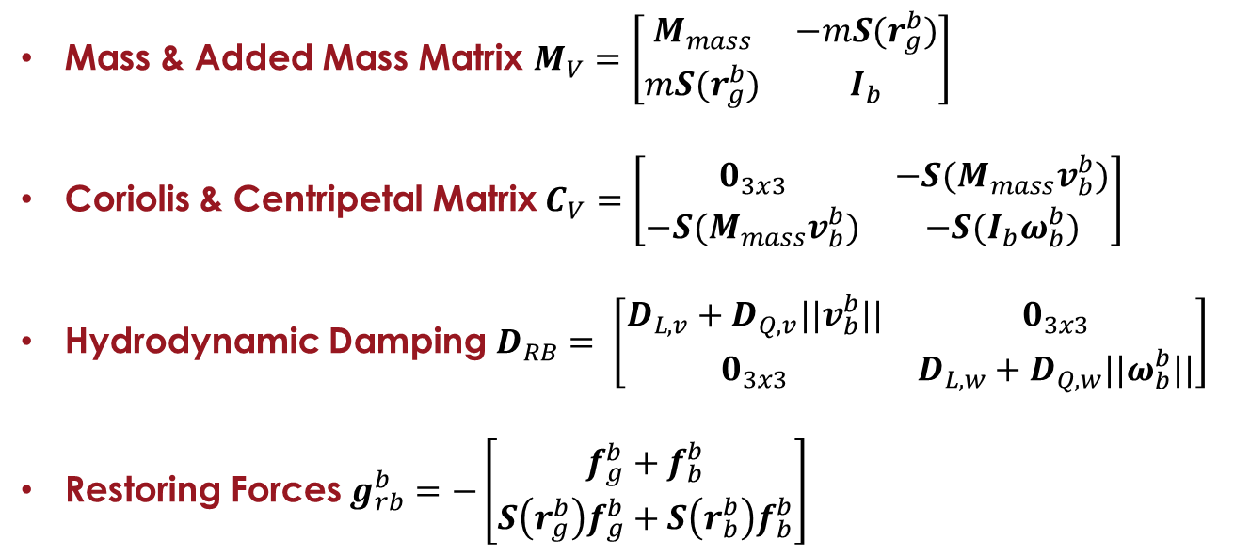

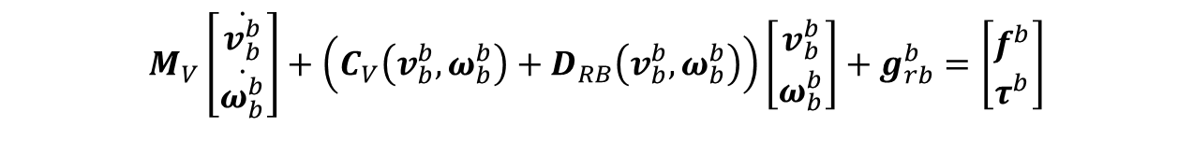




Dynamics of the OpenAUV in the Body Frame
OpenAUV Body Frame
$$y_{b}$$
$$M_{V}\left[\begin{aligned}\dot{v_{b}^{b}} \\ \dot{ω_{b}^{b}}\end{aligned}\right]+\left(C_{V}\left(v_{b}^{b}, ω_{b}^{b}\right)+D_{RB}\left(v_{b}^{b}, ω_{b}^{b}\right)\right)\left[\begin{aligned}v_{b}^{b} \\ ω_{b}^{b}\end{aligned}\right]+g_{rb}^{b}=\left[\begin{aligned}f^{b} \\ τ^{b}\end{aligned}\right]$$
$$O_{b}$$
$$r_{g}^{b}$$
Mass & Added Mass Matrix $M_{V}=\left[\begin{matrix}M_{mass} & −mS(r_{g}^{b}) \\ mS(r_{g}^{b}) & I_{b}\end{matrix}\right]$
Coriolis & Centripetal Matrix$C_{V}=\left[\begin{matrix}0_{3x3} & −S(M_{mass}v_{b}^{b}) \\ −S(M_{mass}v_{b}^{b}) & −S(I_{b}ω_{b}^{b})\end{matrix}\right]$
Hydrodynamic Damping $D_{RB}= \left[\begin{matrix}D_{L,v}+D_{Q,v}||v_{b}^{b}|| & 0_{3x3} \\ 0_{3x3} & D_{L,w}+D_{Q,w}||ω_{b}^{b}||\end{matrix}\right]$
Restoring Forces$g_{rb}^{b}=−\left[\begin{aligned}f_{g}^{b}+f_{b}^{b} \\ S\left(r_{g}^{b}\right)f_{g}^{b}+S\left(r_{b}^{b}\right)f_{b}^{b}\end{aligned}\right]$
$$x_{b}$$
$$r_{b}^{b}$$
$$z_{b}$$
$$z_{b}^{b}>z_{g}^{b}$$
The AUV features a top-heavy and unstable configuration.
Field & Service Robotics – OpenAUV: Design and Robust Control – Dynamics in the Body Frame 4/33

Slide 5














Thruster Configuration Matrix
$$d_{i}$$
$$y_{b}$$
$$r_{i}$$
$$O_{b}$$
$$x_{b}$$
$$r_{i}$$
$$z_{b}$$
$$y$$
$$O$$
$$x$$
$$z$$
Field & Service Robotics – OpenAUV: Design and Robust Control – Thruster Configuration Matrix 5/33

Slide 6



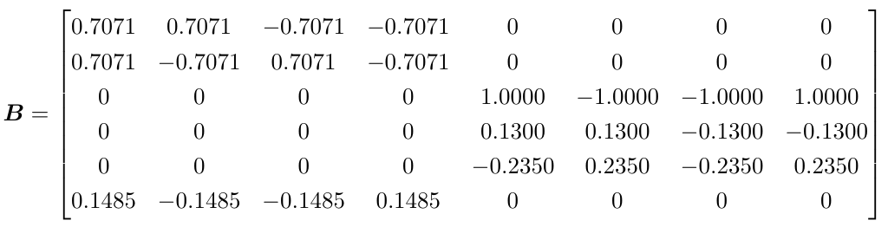

Thruster Configuration Matrix
$$d_{i}$$
$$y_{b}$$
$$r_{i}$$
$$O_{b}$$
$$x_{b}$$
$$z_{b}$$
$$y$$
$$O$$
$$x$$
$$z$$
Field & Service Robotics – OpenAUV: Design and Robust Control – Thruster Configuration Matrix 6/33

Slide 7


Thruster Configuration Matrix
$$d_{i}$$
$$y_{b}$$
$$r_{i}$$
$$O_{b}$$
$$x_{b}$$
$$z_{b}$$
$$y$$
$$O$$
$$x$$
$$z$$
Field & Service Robotics – OpenAUV: Design and Robust Control – Thruster Configuration Matrix 7/33

Slide 8
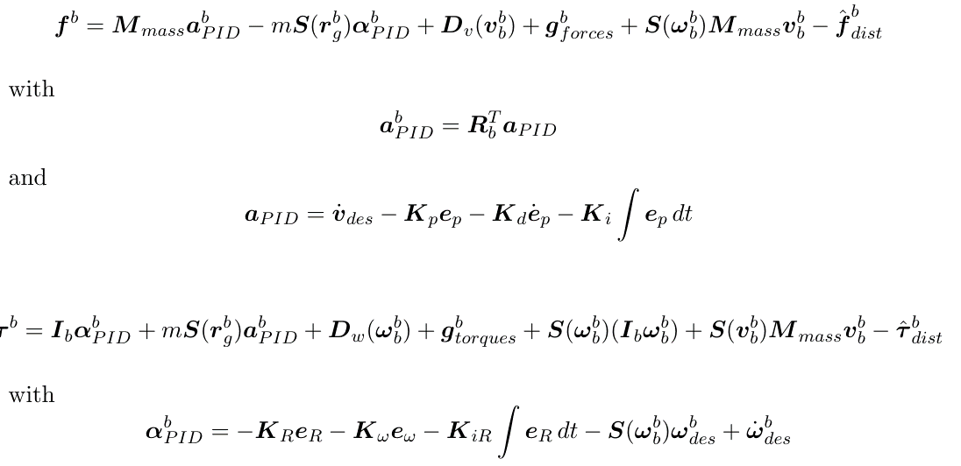

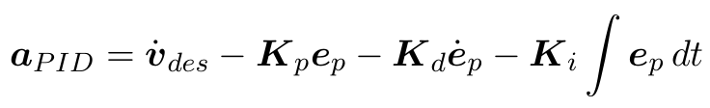
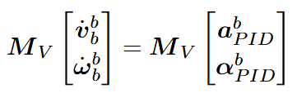
Feedback Linearization + PID
FB Linearization
Field & Service Robotics – OpenAUV: Design and Robust Control – Feedback Linearization + PID 8/33

Slide 9
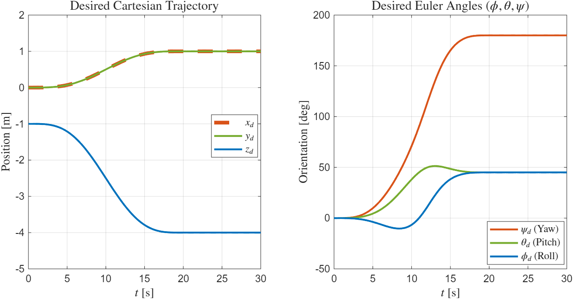
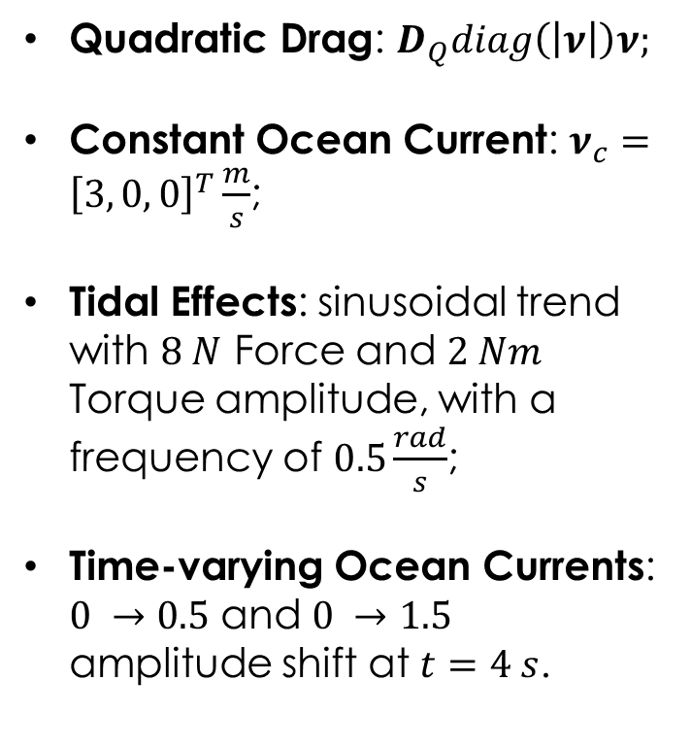
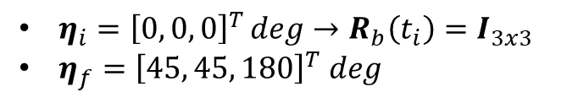
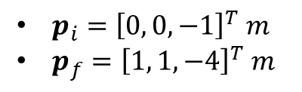
Simulation Setup & Disturbance Modeling
Non-linear disturbances:
Quadratic Drag: $D_{Q}diag\left(\left|ν\right|\right)ν;$
Constant Ocean Current: $ν_{c}={\left[3, 0, 0\right]}^{T}\frac{m}{s}$;
Tidal Effects: sinusoidal trend with $8 N$ Force and $2 Nm$ Torque amplitude, with a frequency of $0.5\frac{rad}{s}$;
Time-varying Ocean Currents: $0 →0.5$ and $0 →1.5$ amplitude shift at $t=4 s$.
Time history of the Desired Position and Orientation of the OpenAUV.
$p_{i}={\left[0, 0, −1\right]}^{T} m$
$p_{f}={\left[1, 1, −4\right]}^{T} m$
$η_{i}={\left[0, 0, 0\right]}^{T}\deg{→R_{b}\left(t_{i}\right)=I_{3x3}}$
$η_{f}={\left[45, 45, 180\right]}^{T} deg$
Field & Service Robotics – OpenAUV: Design and Robust Control - Simulation Setup & Disturbance Modeling 9/33

Slide 10
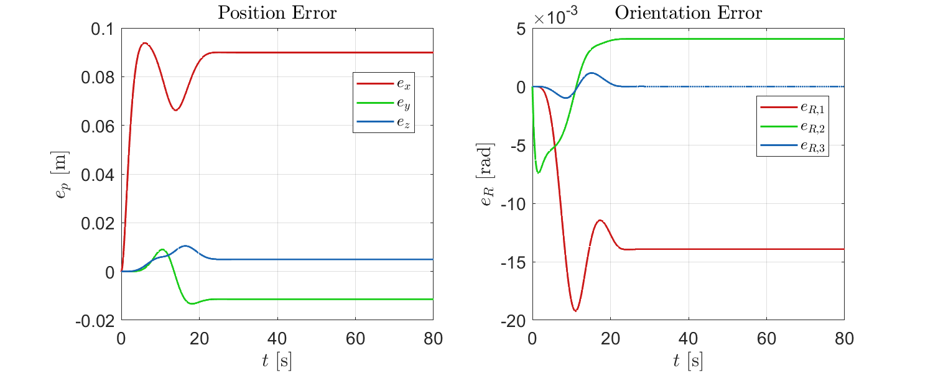
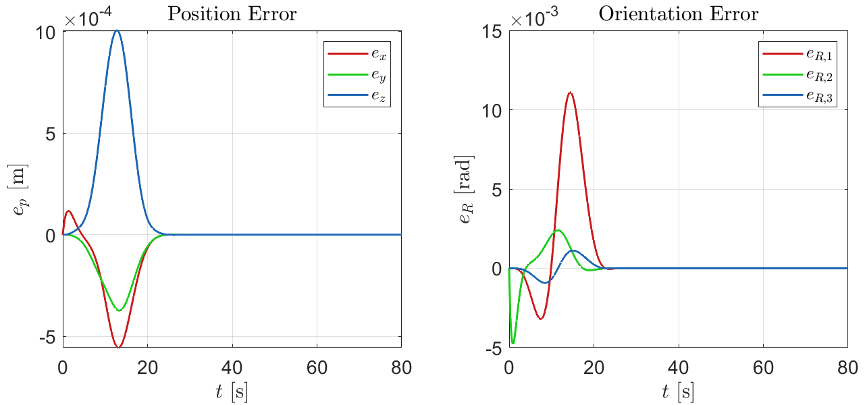
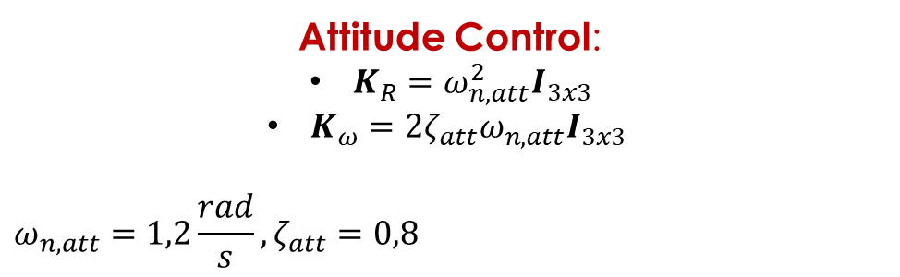
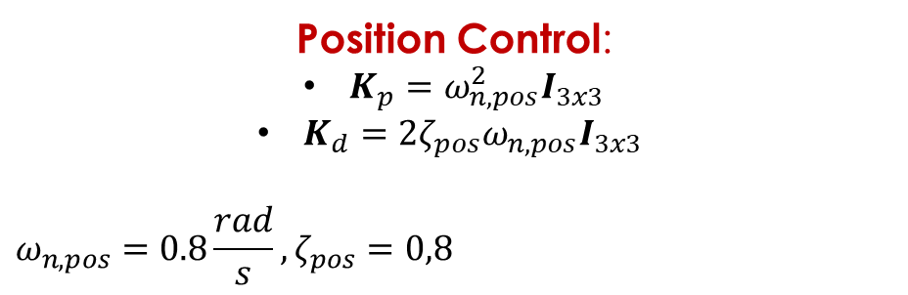
Behavior Analysis without the Momentum-based Estimator
FBL + PD Control
Position Control:
$K_{p}=ω_{n,pos}^{2}I_{3x3}$
$K_{d}=2ζ_{pos}ω_{n,pos}I_{3x3}$
$$ω_{n,pos}=0.8\frac{rad}{s},ζ_{pos}=0,8$$
Attitude Control:
$K_{R}=ω_{n,att}^{2}I_{3x3}$
$K_{ω}=2ζ_{att}ω_{n,att}I_{3x3}$
$$ω_{n,att}=1,2\frac{rad}{s},ζ_{att}=0,8$$
Behavior of the OpenAUV with the constant current.
Behavior of the OpenAUV without the constant current.
Field & Service Robotics – OpenAUV: Design and Robust Control – PD Control without the Momentum-based Estimator 10/33

Slide 11
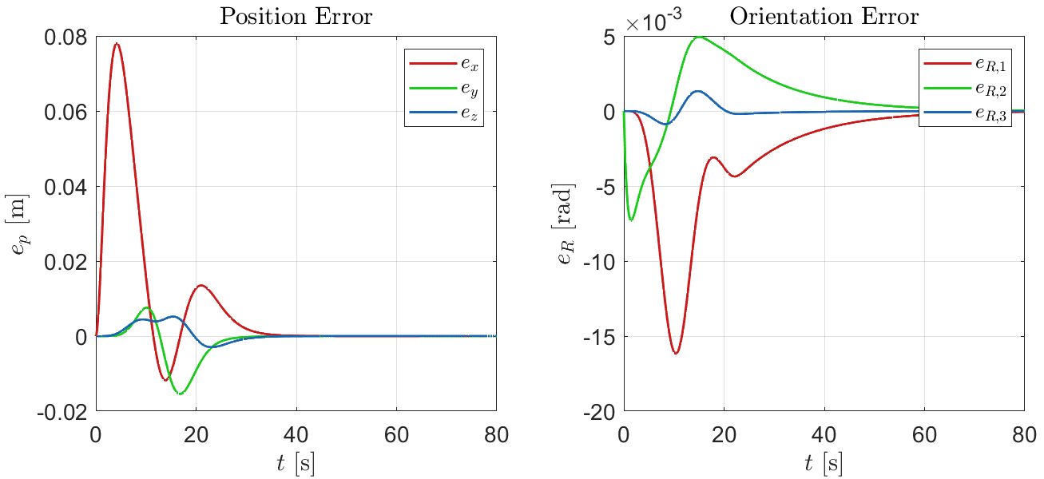
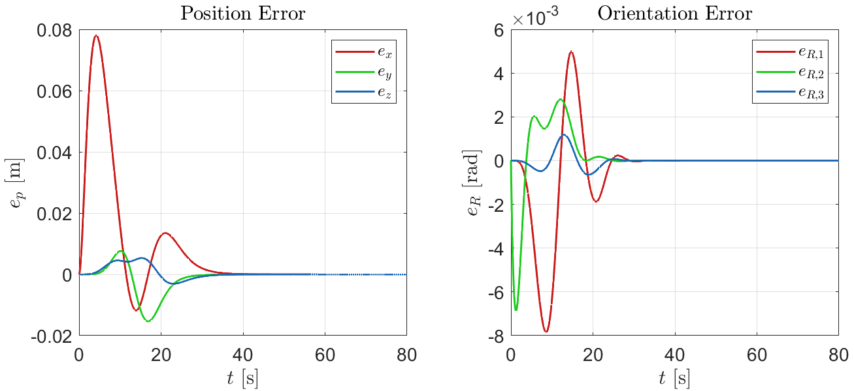
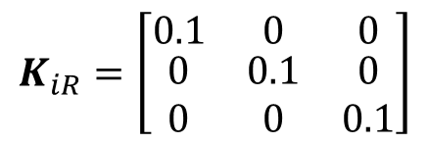
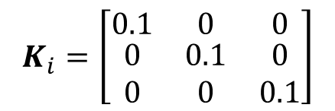
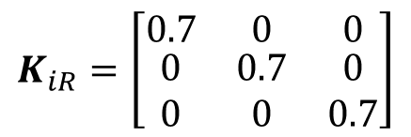
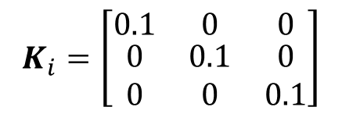
Behavior Analysis without the Momentum-based Estimator
FBL + PID Control
$$K_{i}=\left[\begin{matrix}0.1 & 0 & 0 \\ \begin{aligned}0 \\ 0\end{aligned} & \begin{aligned}0.1 \\ 0\end{aligned} & \begin{aligned}0 \\ 0.1\end{aligned}\end{matrix}\right]$$
$$K_{iR}=\left[\begin{matrix}0.1 & 0 & 0 \\ \begin{aligned}0 \\ 0\end{aligned} & \begin{aligned}0.1 \\ 0\end{aligned} & \begin{aligned}0 \\ 0.1\end{aligned}\end{matrix}\right]$$
$$K_{i}=\left[\begin{matrix}0.1 & 0 & 0 \\ \begin{aligned}0 \\ 0\end{aligned} & \begin{aligned}0.1 \\ 0\end{aligned} & \begin{aligned}0 \\ 0.1\end{aligned}\end{matrix}\right]$$
$$K_{iR}=\left[\begin{matrix}0.7 & 0 & 0 \\ \begin{aligned}0 \\ 0\end{aligned} & \begin{aligned}0.7 \\ 0\end{aligned} & \begin{aligned}0 \\ 0.7\end{aligned}\end{matrix}\right]$$
Behavior of the OpenAUV with the constant current.
Field & Service Robotics – OpenAUV: Design and Robust Control – FBL + PID Control without the Estimator 11/33

Slide 12
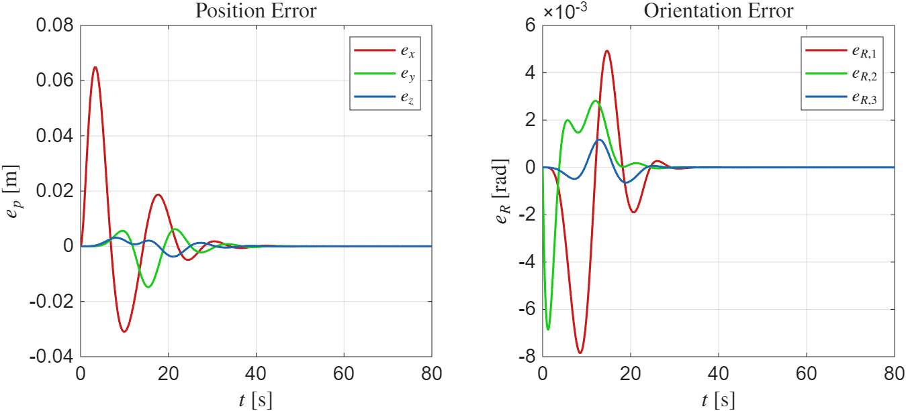
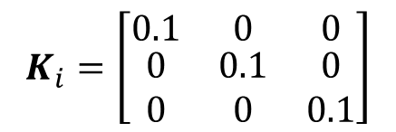
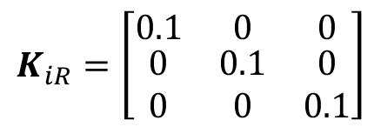
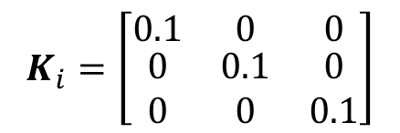

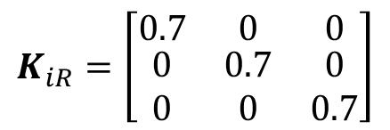
Behavior Analysis without the Momentum-based Estimator
FBL + PID Control
$$0.3$$
$$K_{i}=\left[\begin{matrix}0.1 & 0 & 0 \\ \begin{aligned}0 \\ 0\end{aligned} & \begin{aligned}0.1 \\ 0\end{aligned} & \begin{aligned}0 \\ 0.1\end{aligned}\end{matrix}\right]$$
$$K_{iR}=\left[\begin{matrix}0.1 & 0 & 0 \\ \begin{aligned}0 \\ 0\end{aligned} & \begin{aligned}0.1 \\ 0\end{aligned} & \begin{aligned}0 \\ 0.1\end{aligned}\end{matrix}\right]$$
$$K_{i}=\left[\begin{matrix}0.1 & 0 & 0 \\ \begin{aligned}0 \\ 0\end{aligned} & \begin{aligned}0.1 \\ 0\end{aligned} & \begin{aligned}0 \\ 0.1\end{aligned}\end{matrix}\right]$$
$$K_{iR}=\left[\begin{matrix}0.7 & 0 & 0 \\ \begin{aligned}0 \\ 0\end{aligned} & \begin{aligned}0.7 \\ 0\end{aligned} & \begin{aligned}0 \\ 0.7\end{aligned}\end{matrix}\right]$$
Behavior of the OpenAUV with the constant current.
Field & Service Robotics – OpenAUV: Design and Robust Control – FBL + PID Control without the Estimator 12/33

Slide 13
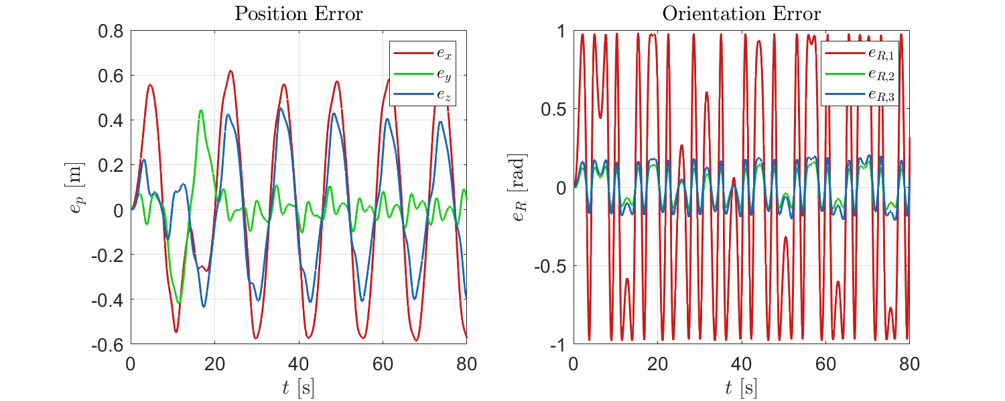
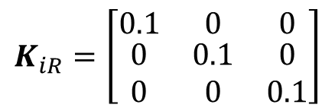
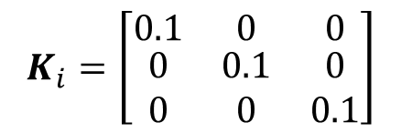
Behavior Analysis without the Momentum-based Estimator
FBL + PID Control
$$K_{i}=\left[\begin{matrix}0.1 & 0 & 0 \\ \begin{aligned}0 \\ 0\end{aligned} & \begin{aligned}0.1 \\ 0\end{aligned} & \begin{aligned}0 \\ 0.1\end{aligned}\end{matrix}\right]$$
$$K_{iR}=\left[\begin{matrix}0.1 & 0 & 0 \\ \begin{aligned}0 \\ 0\end{aligned} & \begin{aligned}0.1 \\ 0\end{aligned} & \begin{aligned}0 \\ 0.1\end{aligned}\end{matrix}\right]$$
Behavior of the OpenAUV with the constant current and sinusoidal wrench.
Field & Service Robotics – OpenAUV: Design and Robust Control – FBL + PID Control without the Estimator 13/33

Slide 14
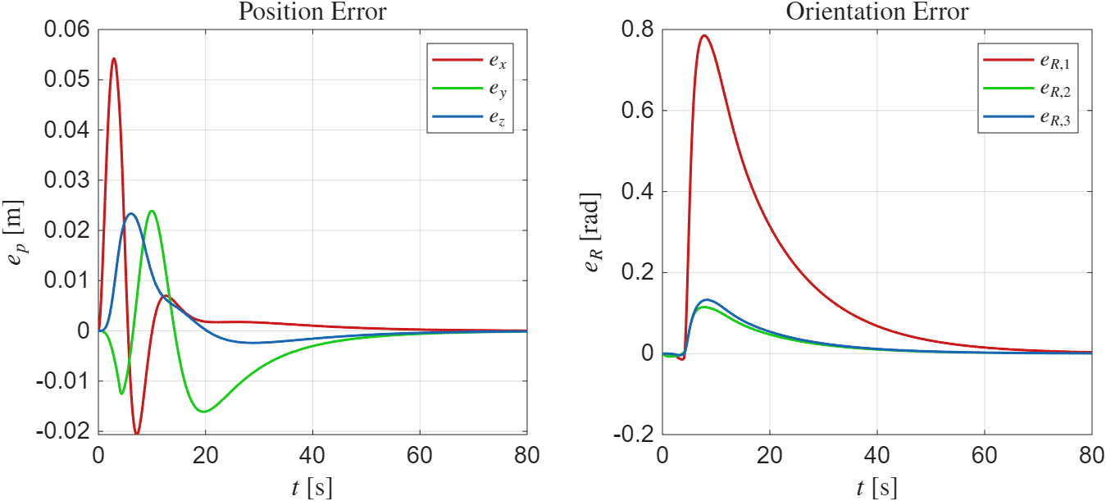
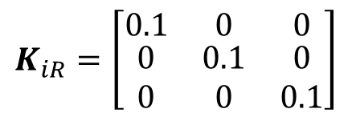
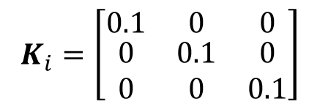
Behavior Analysis without the Momentum-based Estimator
FBL + PID Control
$$K_{i}=\left[\begin{matrix}0.1 & 0 & 0 \\ \begin{aligned}0 \\ 0\end{aligned} & \begin{aligned}0.1 \\ 0\end{aligned} & \begin{aligned}0 \\ 0.1\end{aligned}\end{matrix}\right]$$
$$K_{iR}=\left[\begin{matrix}0.1 & 0 & 0 \\ \begin{aligned}0 \\ 0\end{aligned} & \begin{aligned}0.1 \\ 0\end{aligned} & \begin{aligned}0 \\ 0.1\end{aligned}\end{matrix}\right]$$
Behavior of the OpenAUV with the constant current and 0.5 step variation.
Field & Service Robotics – OpenAUV: Design and Robust Control – FBL + PID Control without the Estimator 14/33

Slide 15
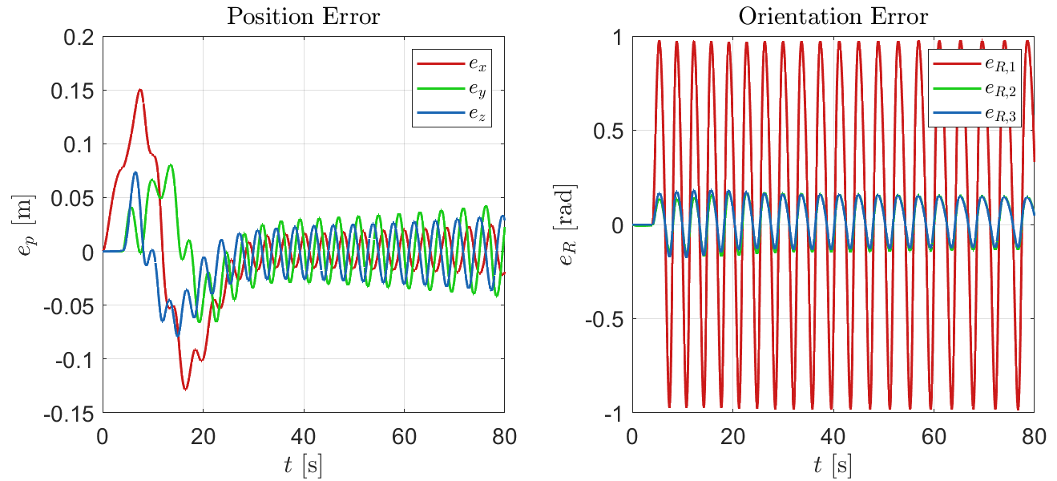
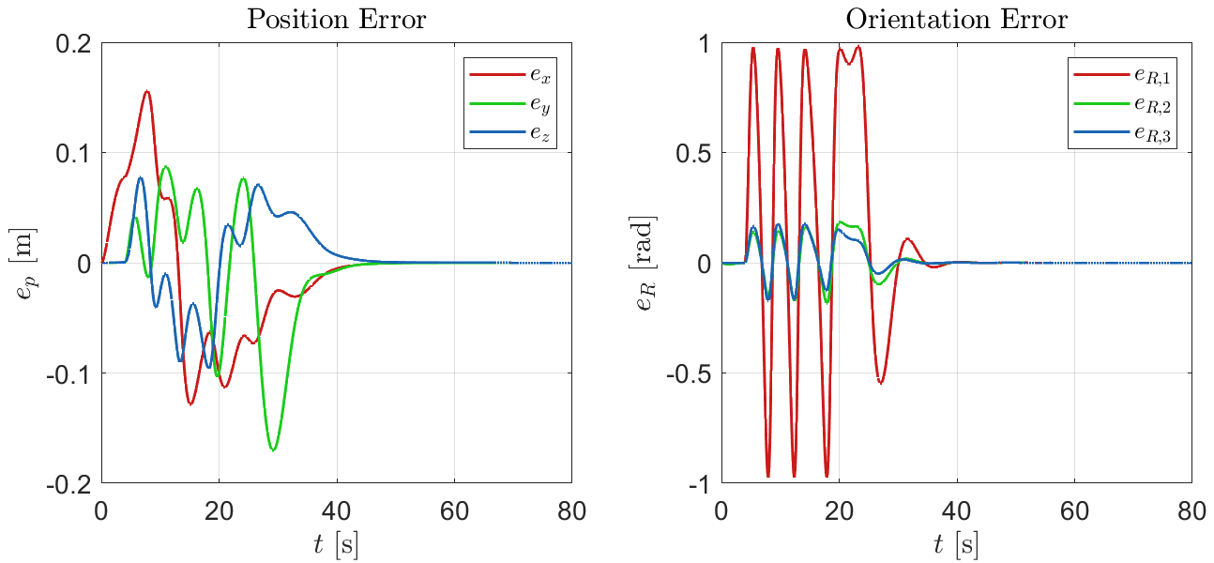
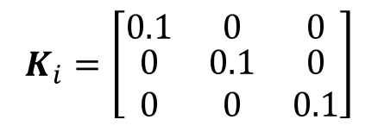
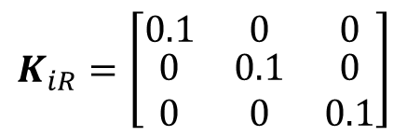
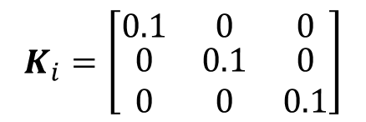
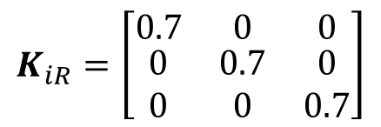
Behavior Analysis without the Momentum-based Estimator
FBL + PD Control
$$K_{i}=\left[\begin{matrix}0.1 & 0 & 0 \\ \begin{aligned}0 \\ 0\end{aligned} & \begin{aligned}0.1 \\ 0\end{aligned} & \begin{aligned}0 \\ 0.1\end{aligned}\end{matrix}\right]$$
$$K_{iR}=\left[\begin{matrix}0.1 & 0 & 0 \\ \begin{aligned}0 \\ 0\end{aligned} & \begin{aligned}0.1 \\ 0\end{aligned} & \begin{aligned}0 \\ 0.1\end{aligned}\end{matrix}\right]$$
$$K_{i}=\left[\begin{matrix}0.1 & 0 & 0 \\ \begin{aligned}0 \\ 0\end{aligned} & \begin{aligned}0.1 \\ 0\end{aligned} & \begin{aligned}0 \\ 0.1\end{aligned}\end{matrix}\right]$$
$$K_{iR}=\left[\begin{matrix}0.7 & 0 & 0 \\ \begin{aligned}0 \\ 0\end{aligned} & \begin{aligned}0.7 \\ 0\end{aligned} & \begin{aligned}0 \\ 0.7\end{aligned}\end{matrix}\right]$$
Behavior of the OpenAUV with the constant current and 1.5 step variation.
Field & Service Robotics – OpenAUV: Design and Robust Control – PD Control without the Momentum-based Estimator 15/33

Slide 16
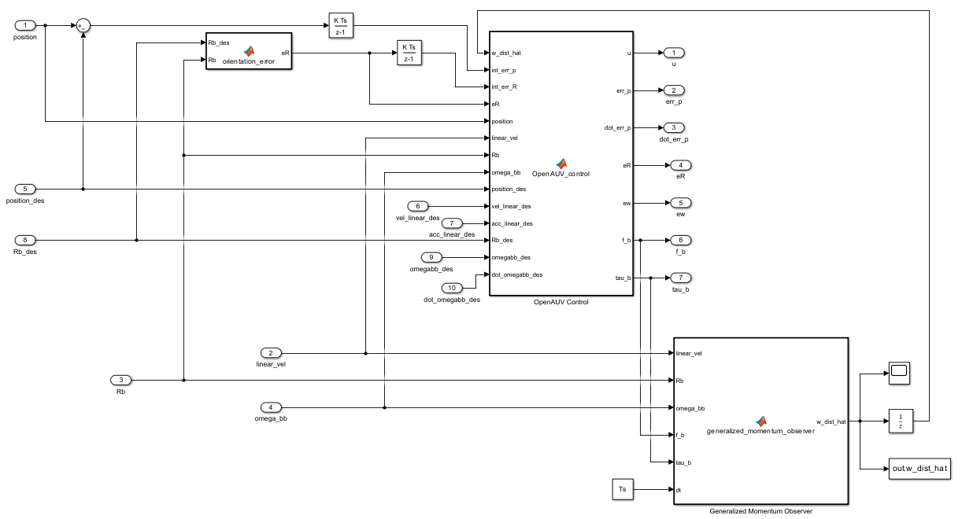
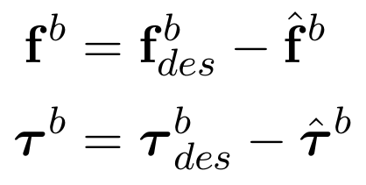


Behavior Analysis with the Momentum-based Estimator
Field & Service Robotics – OpenAUV: Design and Robust Control – Behavior Analysis with the Momentum-based Estimator 16/33

Slide 17
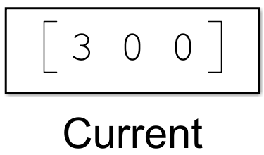



Constant Disturbance (PID)
Field & Service Robotics – OpenAUV: Design and Robust Control – Constant Disturbance (PID) 17/33

Slide 18
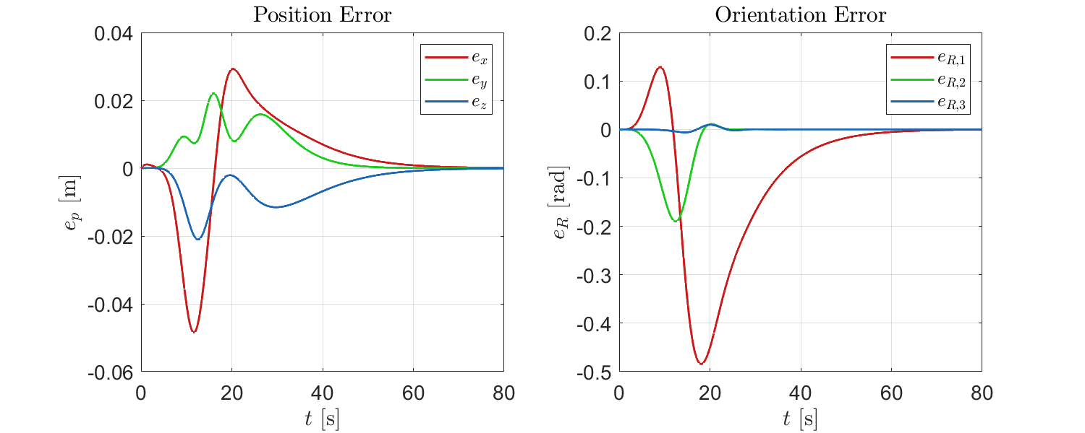
Constant Disturbance (PID + MBE)
Field & Service Robotics – OpenAUV: Design and Robust Control – Constant Disturbance (PID + MBE) 18/33

Slide 19


Constant Disturbance (PID + MBE)
Field & Service Robotics – OpenAUV: Design and Robust Control – Constant Disturbance (PID + MBE) 19/33

Slide 20


Constant and Sinusoidal Disturbance (PID)
+
Field & Service Robotics – OpenAUV: Design and Robust Control – Constant and Sinusoidal Disturbance (PID) 20/33

Slide 21

Constant and Sinusoidal Disturbance (PID + MBE)
+
Field & Service Robotics – OpenAUV: Design and Robust Control – Constant and Sinusoidal Disturbance (PID + MBE) 21/33

Slide 22

Constant and Sinusoidal Disturbance (PID + MBE)
+
Field & Service Robotics – OpenAUV: Design and Robust Control – Constant and Sinusoidal Disturbance (PID + MBE) 22/33

Slide 23




Step disturbance (PID)
+
Field & Service Robotics – OpenAUV: Design and Robust Control – Step disturbance (PID) 23/33

Slide 24

Step disturbance (PID+MBE)
+
Field & Service Robotics – OpenAUV: Design and Robust Control) – Step disturbance (PID+MBE) 24/33

Slide 25

Estimated Forces and Moments
+
Field & Service Robotics – OpenAUV: Design and Robust Control) – Estimated Forces and Moments 25/33

Slide 26


Step disturbance (PID+MBE)
+
Field & Service Robotics – OpenAUV: Design and Robust Control) – Step disturbance (PID+MBE) 26/33

Slide 27

Step disturbance (PID+MBE)
+
Field & Service Robotics – OpenAUV: Design and Robust Control) – Step disturbance (PID+MBE) 27/33

Slide 28

Step disturbance (PID+MBE)
+
Field & Service Robotics – OpenAUV: Design and Robust Control) – Step disturbance (PID+MBE) 28/33

Slide 29


Nonlinear Thruster Hydrodynamic Modeling
The T200 Actuator
The BlueRobotics T200 is the primary propulsion unit for the OpenAUV.
While standard models assume a fixed thrust/rotational speed relationship:
$$T_{i}=\left\{\begin{aligned}c_{f,forward}Ω_{des,i}\left|Ω_{des,i}\right|, if Ω_{des,i}≥0 \\ c_{f,backward}Ω_{des,i}\left|Ω_{des,i}\right|, if Ω_{des,i}<0\end{aligned}\right. for i=1,…, 8$$
T200 Thruster for marine robotics propulsion.
Advanced control requires accounting for axial inflow velocity.
Field & Service Robotics – OpenAUV: Design and Robust Control – Nonlinear Thruster Hydrodynamic Modeling 29/33

Slide 30



Hydrodynamic concepts
Advance Ratio $J$
The ratio between inflow velocity and propeller tip speed. It quantifies how "fast" the propeller travels through the fluid.
$$J=\frac{v_{a}}{nD}$$
Asymmetric Nominal Thrust $K_{T0}$
Accounting for propeller asymmetry by switching nominal coefficients based on the desired rotation direction.
$$K_{T0 }=\left\{\begin{aligned}\frac{4π^{2}c_{f,forward}}{ρD^{4}}, if{ Ω}_{des,i}≥0 \\ \frac{4π^{2}c_{f,backward}}{ρD^{4}}, if{ Ω}_{des,i}<0\end{aligned}\right.$$
Thrust Coefficient $K_{T}(J)$
A non-dimensional parameter describing thrust performance, subject to degradation as velocity increases.
$$K_{T,i}= K_{T0,i}− a_{1}J_{i} − a_{2}J_{i}|J_{i}|$$
Source: Kim, J. & Chung, W. K. (2006). "Accurate and practical thruster modeling for underwater vehicles". Ocean Engineering, 33(1)
Field & Service Robotics – OpenAUV: Design and Robust Control – Hydrodynamic concepts 30/33

Slide 31













Wake Fraction and Inflow Velocity
Advance Velocity
wake fraction
$$v_{b}^{b}$$
$$v_{a,5}$$
$$v_{b}^{b}$$
$$y_{b}$$
$$v_{a,1}$$
$$O_{b}$$
$$x_{b}$$
$$z_{b}$$
Field & Service Robotics – OpenAUV: Design and Robust Control – Wake Fraction and Inflow Velocity 31/33

Slide 32




Slow Trajectory
$22$ s
Field & Service Robotics – OpenAUV: Design and Robust Control – Slow Trajectory 32/33

Slide 33




Fast Trajectory
$8$ s
Field & Service Robotics – OpenAUV: Design and Robust Control – Fast Trajectory 33/33

Slide 34

THANKS FOR THE ATTENTION!

