Slide 1
TGS Salt Identification Challenge
Christopher Lach
MSDS 696 (Practicum II): Review Presentation

Slide 2
Project Overview: Project Description
Project:
This project’s goal was to binary classify pixels.
Salt (1) White or Sediment Black (0).
The Data was downloaded and imported from Kaggle.
This Project was a Kaggle Competition that ended in late October right before Week 1 of class.
Predictions can be evaluated using Kaggle’s Late Submission web application.

Slide 3
Project Overview: Data Description
Training Data:
4000 Gray Scaled Images equating to the project’s features.
4000 Masks that consists of black (0) and white (1) pixels.
Testing Data:
18,000 Gray Scaled Images
All Data:
Depths CSV for all images (Train and Test)
All images have an associated ID that is unique for each Image.
The Image and Mask have the same ID so you ensure you have the correct target label.
Submission File:
Classify Images and Create Masks

Slide 4
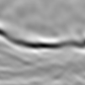

Project Overview: Data Description
Seismic Image
Mask

Slide 5
Problems Associated With Drilling in Heavy Salt Formations Basins
Bit-balling and packoff because of reactive shales within the salt
Wellbore erosion when drilling through the salt formation and/or through shales above or below the salt formation
Excessive torque and packoffs caused by salt creep
Well-control issues
Excessive mud losses

Slide 6
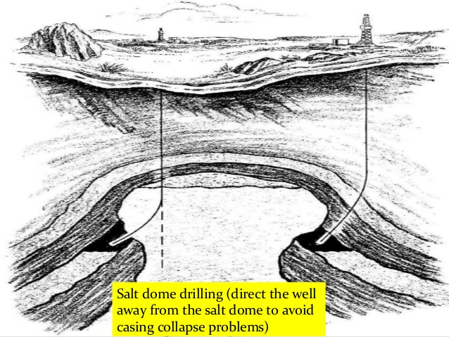
Project Overview: Purpose

Slide 7
Steps of the Project
Step
Description of Step
Download Data From Kaggle
-Navigate to Kaggle Competitions
-Select TGS Salt Classification
-Download all the Data as Compressed Zip
Unzip Downloaded Files
-Used 7-zip File Manager for Unzipping.
-Created Data folder containing Train and Test Directories.
-Train Directory had masks as well
Convert the Images into 128 x 128
-Conversion helps CNN perform by having even pixel size.
-Used skimage resize for conversion.
Convert the Images into Numpy Arrays
-Used Keras’s image library for conversion.
-Function used was img_to_array

Slide 8
Steps of the Project
Step
Description of Step
Augmentation of Images and Masks
-Used the Augmentor Library
-Used various types of augmentations with various amounts of Augmented Data.
-Moved Output Directory from train -> images to data folder
-Renamed folders Aug_images / Aug_masks
-Used Python to move files without click and dragging.
Directory Manipulation
Import Augmented Images and Masks
-Rerun the same python code that occurred for the original images and masks.
Concatenate Augmented Data with Original Data
-Used Numpy Concate to combine the arrays.
-Shape of Array: (# of images, width, height, channel depth)

Slide 9
Steps of the Project
Step
Description of Step
Define Mean IOU Metric
-Used Tensorflow.mean_iou
-Used Keras backend so that I was able to see the metric during model fitting.
-Constructed with Keras Modeling
-Conv2D, relu, strides, same padding, and concatenations
Build U-Net
Compile and Fit with Early Stopping
-Train Model on compiled Data.
-Test Model on first 350 non-augmented images.
-Save the best weights in model to be used for prediction.
Import Test Images
-Rerun Import and Conversion Code, the same as before.

Slide 10
Steps of the Project
Step
Description of Step
Load Model and Predict
-Load_Model and import custom mean_iou object
-If confidence is above 0.5 threshold, have it become salt (1)
Resize Prediction back to 101x101
-Resize and Numpy Squeeze
Convert Predictions to Kaggle Competition Format
-Used build function to convert predictions.
-Called function on predictions list

Slide 11
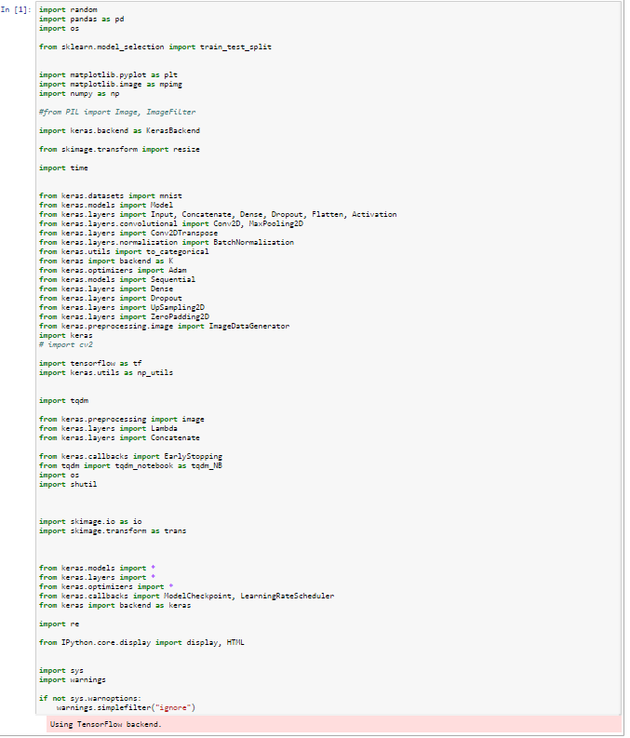
Steps of the Project: Original Design

Slide 12
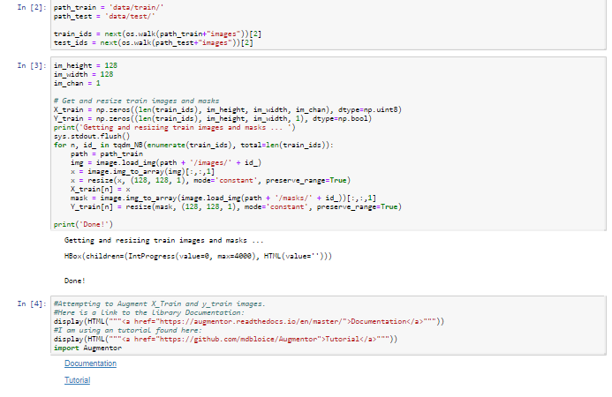
Steps of the Project: Original Design

Slide 13
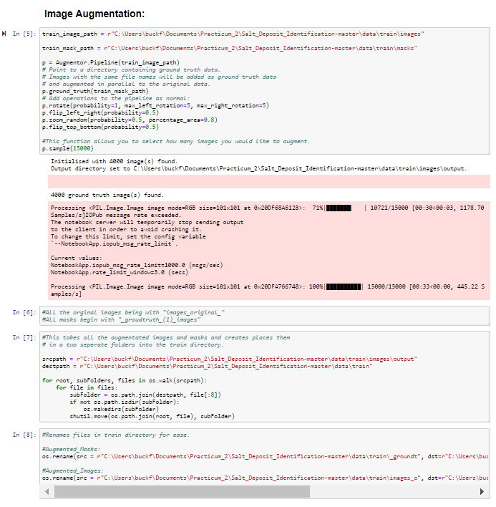
Steps of the Project: Original Design

Slide 14
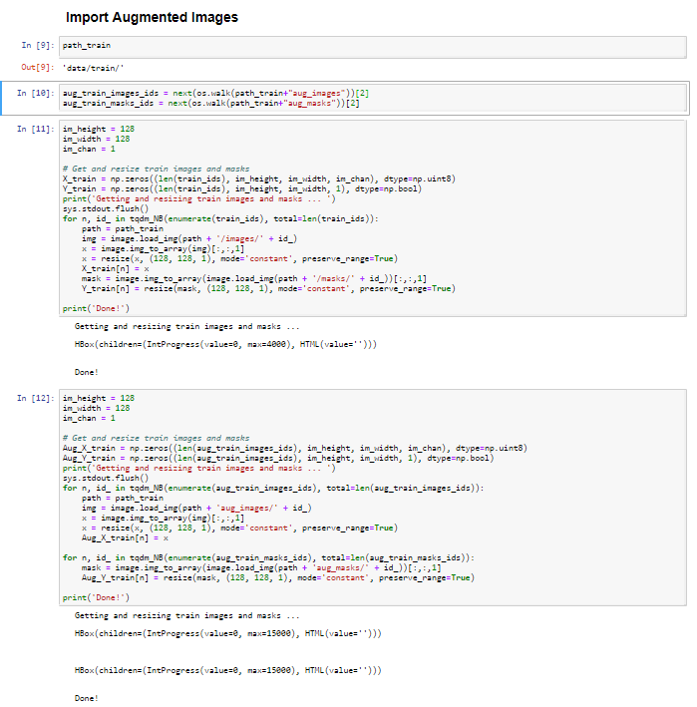
Steps of the Project: Original Design

Slide 15
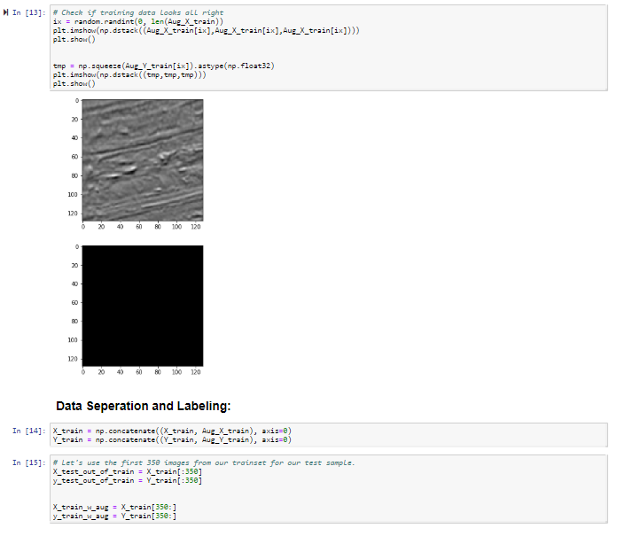
Steps of the Project: Original Design

Slide 16
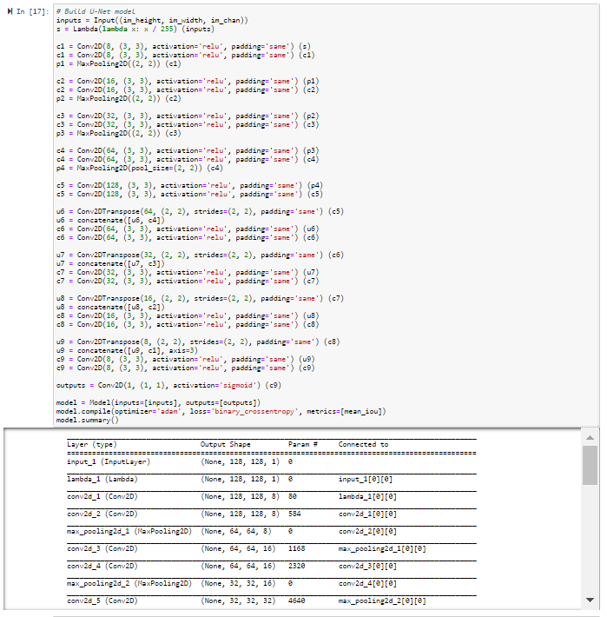
Steps of the Project: Original Design

Slide 17
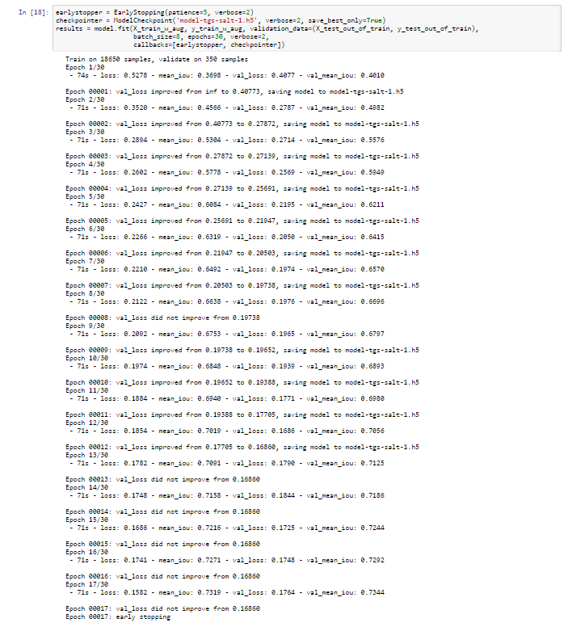
Steps of the Project: Original Design

Slide 18
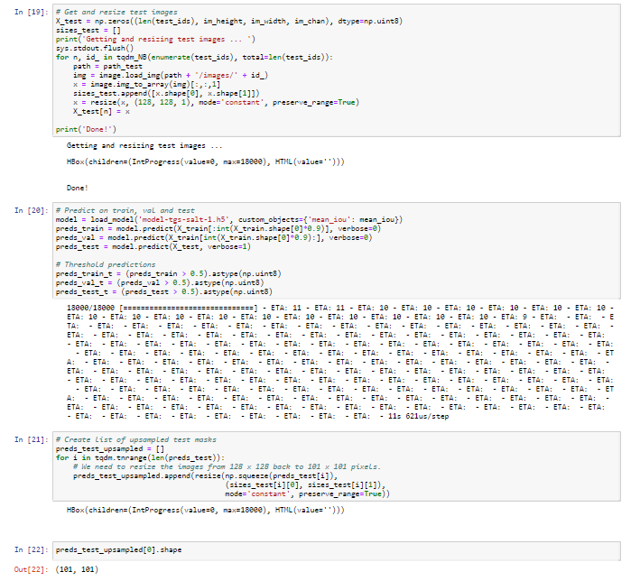
Steps of the Project: Original Design

Slide 19
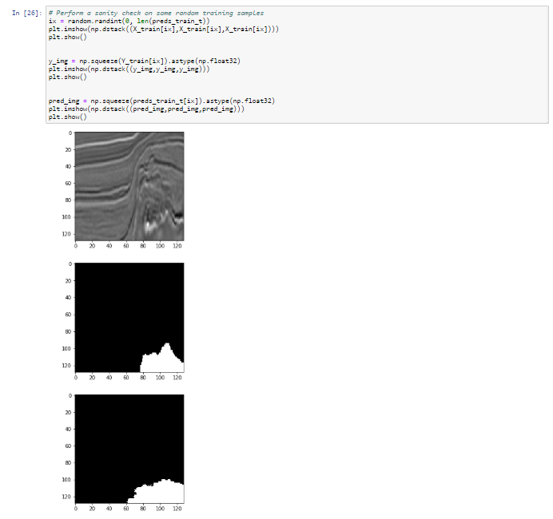
Steps of the Project: Original Design

Slide 20
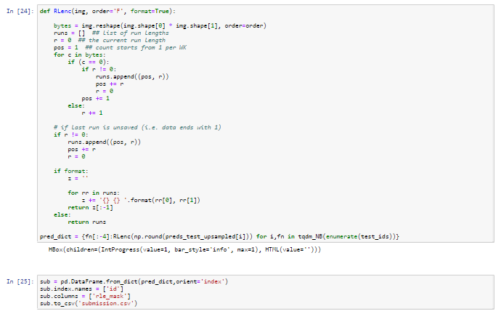
Steps of the Project: Original Design

Slide 21
Steps of the Project: Original Design
As evident, there is a lot of code from start to finish.
In order for testing purposes and efficiency, I created python files to eliminate some of the code on the screen for the user.
Same Results but easier to read and use.

Slide 22
Improving User Experience:
In order to prevent the user from feeling overwhelmed in code, I created individual python scripts to make the process more user friendly.
I placed the following python scripts in the python_scripts directory:
dataloader.py
Imports the data into training and test data
Converts data into 128 x 128 numpy arrays
image_augmentor.py
Used the Augmentor Library to augment the images
The user can select how many images they would like to augment.
mean_iou.py
Used Tensorflow’s Mean IOU function and keras backend to produced the metric used by Kaggle for submission evaluation.
Modeling.py
Contains a U-Net CNN structure for classifying images.
submission.py
Formats the predictions according to Kaggle Submission Rules.

Slide 23
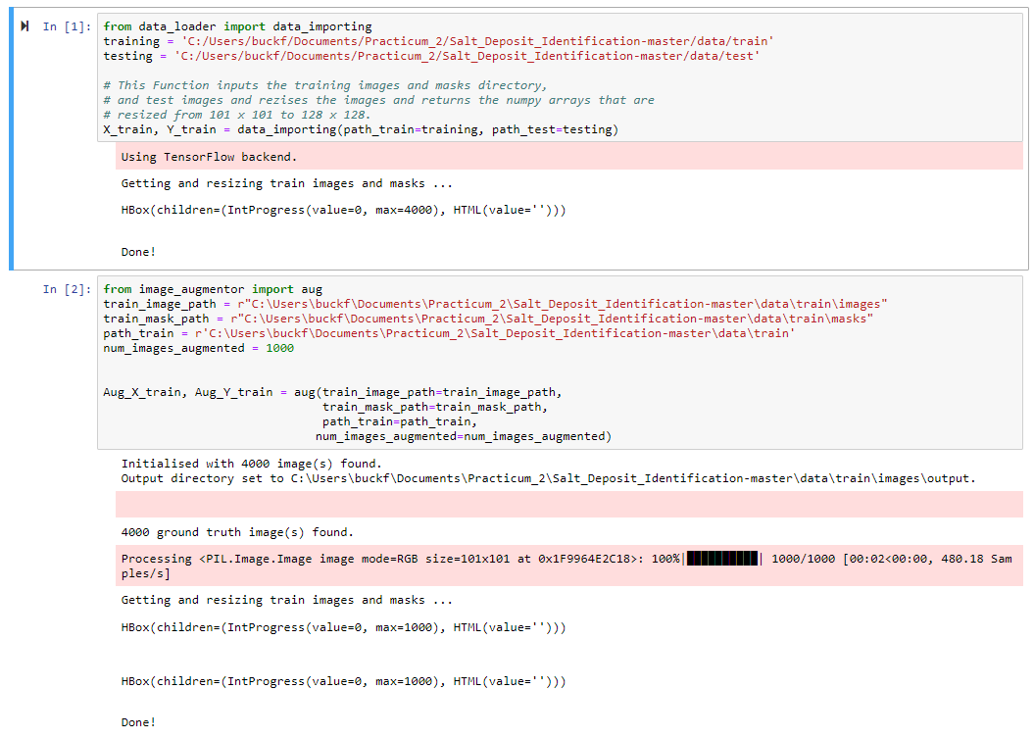
Steps of the Project: Final Design

Slide 24
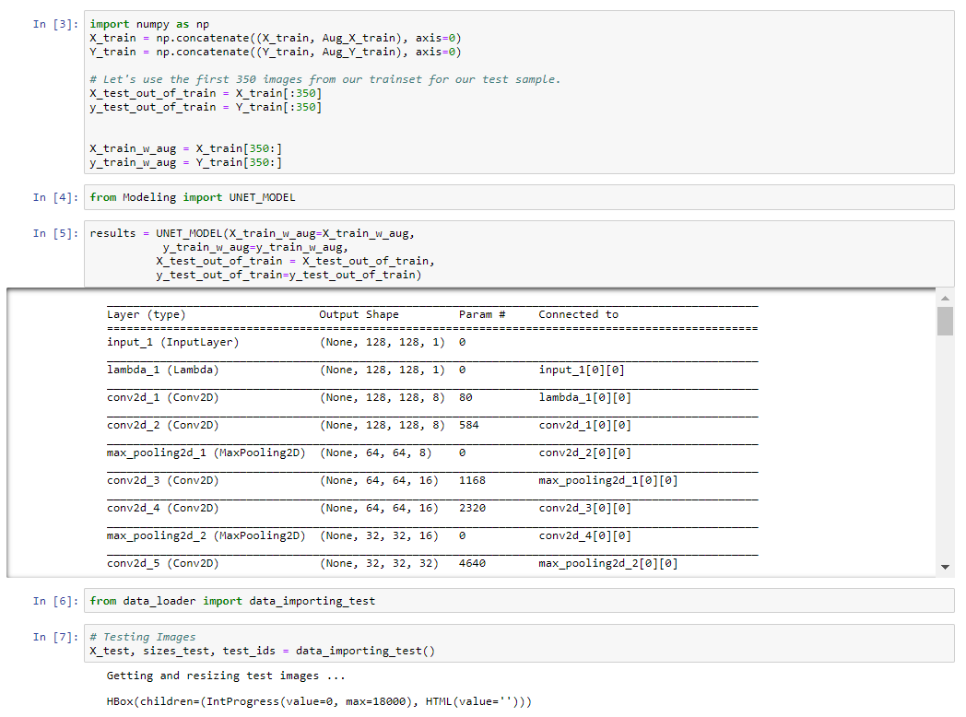
Steps of the Project: Final Design

Slide 25
Steps of the Project: Final Design

Slide 26
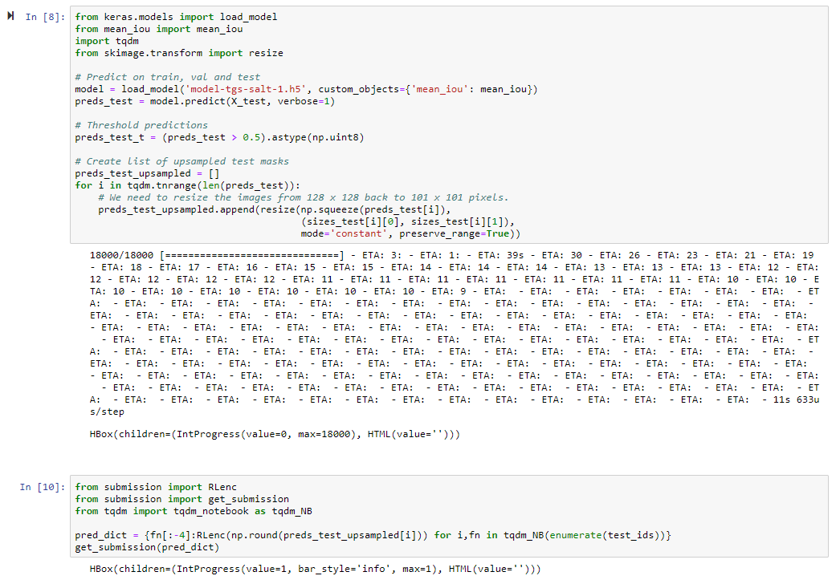
Steps of the Project: Final Design

Slide 27
Trial | Augmentation | Probability | Model Structure | Train IOU | Validation Mean IOU | Kaggle Mean IOU
1 | Right Rotation | 1 | U-Net-1 | 0.7391 | 0.7414 | 0.656666
 | Left Rotation | 1
 | Flip over X-axis | 0.5
 | Flip over Y-axis | 0.5
 | Number of Augmented Images | 1000
2 | Right Rotation | 1 | U-Net-1 | 0.7462 | 0.7485 | 0.6648899
 | Left Rotation | 1
 | Flip over X-axis | 0.5
 | Flip over Y-axis | 0.5
 | Number of Augmented Images | 9000
3 | Rotate 90 | 1 | U-Net-1 | 0.7616 | 0.7638 | 0.691783
 | Rotate 270 | 1
 | Flip over X-axis | 0.3
 | Flip over Y-axis | 0.8
 | Number of Augmented Images | 9000
3 | Rotate 90 | 1 | U-Net-2
 | Rotate 270 | 1
 | Flip over X-axis | 0.3
 | Flip over Y-axis | 0.8
 | Number of Augmented Images | 9000

Slide 28
References Cited
Challenges in drilling salt formations and rubble zones. (n.d.). Retrieved December 9, 2018,
from https://petrowiki.org/Challenges_in_drilling_salt_formations_and_rubble_zones
TGS Salt Identification Challenge (n.d.). Retrieved December 9, 2018, from https://www.kaggle.com/c/tgs-salt-identification-challenge

