Slide 1
TGS Salt Identification Challenge
Christopher Lach
MSDS 696 (Practicum II): Review Presentation

Slide 2
Project Overview: Project Description
Project:
This project’s goal was to binary classify pixels.
Salt (1) White or Sediment Black (0).
The Data was downloaded and imported from Kaggle.
This Project was a Kaggle Competition that ended in late October right before Week 1 of class.
Predictions can be evaluated using Kaggle’s Late Submission web application.

Slide 3
Project Overview: Data Description
Training Data:
4000 Gray Scaled Images equating to the project’s features.
4000 Masks that consists of black (0) and white (1) pixels.
Testing Data:
18,000 Gray Scaled Images
All Data:
Depths CSV for all images (Train and Test)
All images have an associated ID that is unique for each Image.
The Image and Mask have the same ID so you ensure you have the correct target label.
Submission File:
Classify Images and Create Masks

Slide 4
Project Overview: Data Description
Seismic Image
Mask

Slide 5
Problems Associated With Drilling in Heavy Salt Formations Basins
Bit-balling and packoff because of reactive shales within the salt
Wellbore erosion when drilling through the salt formation and/or through shales above or below the salt formation
Excessive torque and packoffs caused by salt creep
Well-control issues
Excessive mud losses

Slide 6
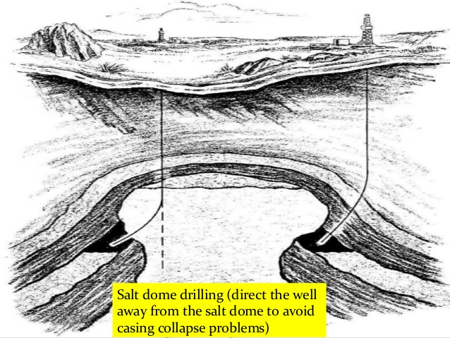
Project Overview: Purpose

Slide 7
Steps of the Project
Step
Description of Step
Download Data From Kaggle
-Navigate to Kaggle Competitions
-Select TGS Salt Classification
-Download all the Data as Compressed Zip
Unzip Downloaded Files
-Used 7-zip File Manager for Unzipping.
-Created Data folder containing Train and Test Directories.
-Train Directory had masks as well
Convert the Images into 128 x 128
-Conversion helps CNN perform by having even pixel size.
-Used skimage resize for conversion.

Slide 8
Steps of the Project: Original Design

Slide 9
Improving User Experience:
In order to prevent the user from feeling overwhelmed in code, I created individual python scripts to make the process more user friendly.
I placed the following python scripts in the python_scripts directory:
dataloader.py
Imports the data into training and test data
Converts data into 128 x 128 numpy arrays
image_augmentor.py
Used the Augmentor Library to augment the images
The user can select how many images they would like to augment.
mean_iou.py
Used Tensorflow’s Mean IOU function and keras backend to produced the metric used by Kaggle for submission evaluation.
Modeling.py
Contains a U-Net CNN structure for classifying images.
submission.py
Formats the predictions according to Kaggle Submission Rules.

Slide 10
Results

Slide 11
References Cited
Challenges in drilling salt formations and rubble zones. (n.d.). Retrieved December 9, 2018,
from https://petrowiki.org/Challenges_in_drilling_salt_formations_and_rubble_zones
TGS Salt Identification Challenge (n.d.). Retrieved December 9, 2018, from https://www.kaggle.com/c/tgs-salt-identification-challenge

