Slide 1
Topic Review: Thymomas and Thymic Carcinomas
Jason Liu
PGY-3, Radiation Oncology
City of Hope

Slide 2
Outline
Epidemiology
Clinical presentation
Initial evaluation and diagnosis
Staging
Treatment
Practice questions

Slide 3
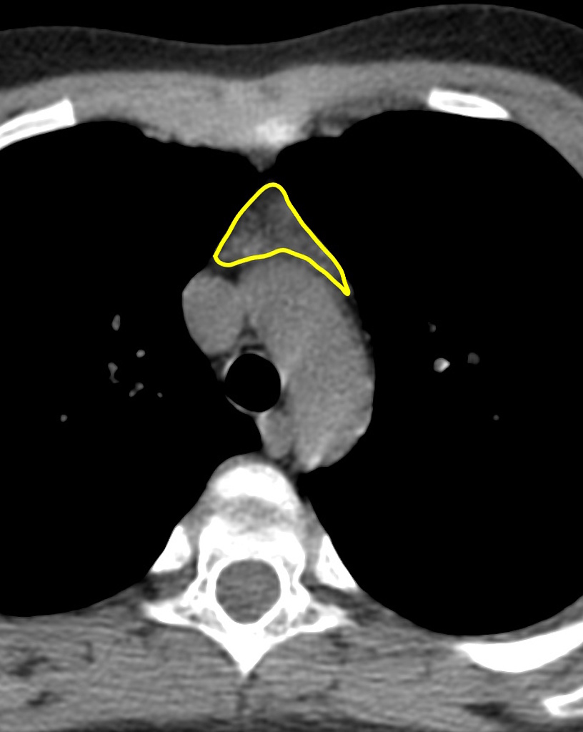
What is thymoma and thymic carcinoma?
Both are neoplasms arising in the thymus
Thymus – primary lymphoid organ in the anterior mediastinum behind the sternum in front of the heart
Responsible for T cell maturation in childhood and early adolescence, afterwards it shrinks and is replaced by fatty tissue
Thymomas are more common, slow growing, and do not often spread beyond the thymus gland
Thymic carcinomas are less common, more aggressive, and more likely to spread beyond the thymus gland

Slide 4
Epidemiology
Thymus cancers are rare, only 500 cases per year in the United States
Most common in patients aged 40-60, equal prevalence in men and women
No known risk factors
DDX for anterior mediastinal mass:
Thymoma (50%)
Lymphoma (25%)
Thyroid cancer (15%)
Teratoma, germ cell tumors, and thymic carcinoma (remaining 10%)

Slide 5
Clinical presentation of thymus cancers
Incidental finding on imaging in asymptomatic patient
Local thoracic symptoms
Chest pain, SOB, cough, SVC syndrome
Paraneoplastic syndrome (thymomas)
Myasthenia gravis – autoimmune disorder attacking acetylcholine receptors at the neuromuscular junction
Presents as progressive weakness, diplopia, ptosis, and fatigue
Present in 50% of patients with thymoma
Pure red cell aplasia – autoimmune disorder attacking erythrocyte precursors in the bone marrow
Presents as anemia, fatigue, headaches, dizziness, pale skin
Present in 10% of patients with thymoma
Paraneoplastic syndromes are not readily reversed with thymectomy!

Slide 6
Initial evaluation and diagnosis
After identifying an anterior mediastinal mass on imaging, H&P and labs can help narrow down the DDX
H&P: ask about progressive weakness (myasthenia gravis), B symptoms (lymphoma)
Labs: CBC (pure red cell aplasia), CMP, acetylcholine receptor Ab (myasthenia gravis), beta-hCG/AFP/LDH (germ cell tumor)
Myasthenia gravis needs to be screened for and optimally managed prior to surgery due to the risk of post-op myasthenic crisis

Slide 7
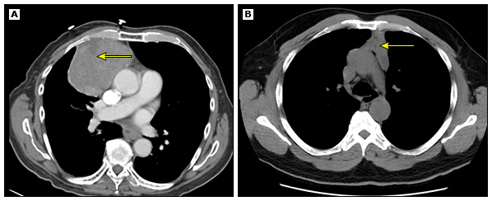
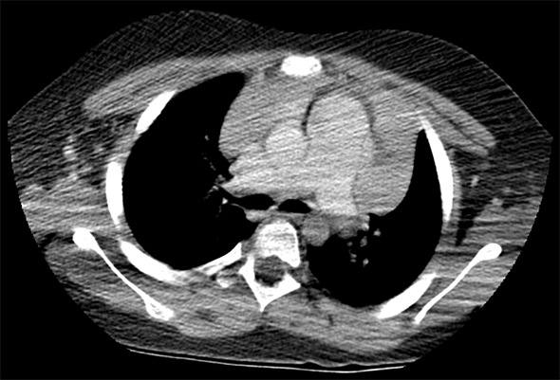
Initial evaluation and diagnosis
CT scan to evaluate whether mass is well circumscribed (top) or if it infiltrates surrounding soft tissue (bottom)
Determines resectability
If well circumscribed, initial step is complete resection which can establish diagnosis
If infiltrating surrounding soft tissue, initial step is biopsy instead

Slide 8
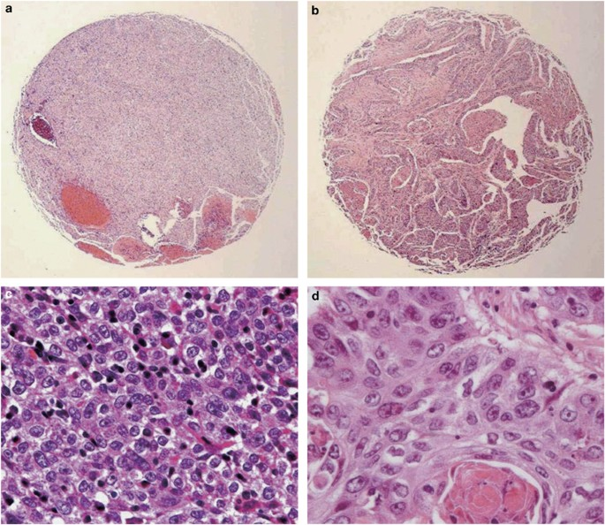
Pathology and IHC
Thymoma
Thymic carcinoma
Thymomas – epithelial or spindle shaped cells mixed with immature T cells
5 types: A, AB, B1, B2, and B3
Ascending order of atypia
Thymic carcinoma – atypical cells mixed with mature T cells
Positive for CD5 and c-kit, helpful in distinguishing it from B3 thymoma

Slide 9
Staging
Masaoka staging has been used in many studies and continues to be widely used
Stage I – encapsulated
Stage II – invasion into fatty tissue or mediastinal pleura
Stage III – invasion into pericardium, lung, or great vessels
Stage IVA – pleural or pericardial dissemination
Stage IVB – lymph node or distant mets
AJCC includes thymus cancers in its most recent 8th edition
Stage I – encapsulated or invasion into fatty tissue or mediastinal pleura (Masaoka I-II)
Stage II – invasion into pericardium (Masaoka III)
Stage III – invasion into lung or great vessels (Masaoka III)
Stage IV – lymph node or distant mets (Masaoka IV)

Slide 10
Treatment
Overall similar between thymomas and thymic carcinomas
Discussed in the following categories
Resectable
Unresectable

Slide 11
Resectable
Considered resectable if mass is completely encapsulated or invades readily resectable structures such as mediastinal pleura, pericardium, or adjacent lung
Initial step involves surgical resection (total thymectomy and lymph node dissection)
Indications for adjuvant radiation
R1-2 – always indicated
R0 – strongly consider for Masaoka II-III (pericardium, lung)
Not recommended for Masaoka I (encapsulated)
Indications for adjuvant chemo
R1-2

Slide 12
Benefits of adjuvant radiation
Curran et al. (JCO 1988) examined 5-year local failure rates with vs. without adjuvant radiation
For R0 resection: beneficial for higher Masaoka stages
Masaoka I without radiation 0%
Masaoka II-III without radiation 50% vs. 0% with radiation
For R1-2 resection: beneficial for all
Masaoka I without radiation 25% vs. 5% with radiation
Masaoka II-III without radiation 80% vs. 20% with radiation
The International Thymic Malignancies Interest Group (ITMIG) also showed an OS benefit with adjuvant RT for Masaoka II-III (JTO 2016)
5- and 10-year OS rate was 95% and 86% with radiation vs. 90% and 79% without radiation (p=0.002)

Slide 13
Adjuvant radiation doses
R0 Masaoka II-III – 50.4 Gy
R1 – 54 Gy
R2 – 60 Gy

Slide 14
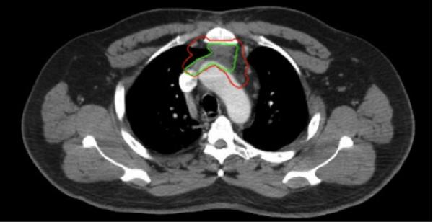
Radiation volume
CTV should encompass the entire thymus, surgical clips, and any potential sites with residual disease
Elective nodal irradiation not recommended as thymus cancers do not commonly metastasize to regional lymph nodes

Slide 15
Unresectable
Considered unresectable if evidence of metastases, extensive infiltration of great vessels, heart, or trachea, or medically unfit to undergo surgery
Initial step involves biopsy to establish diagnosis
For metastatic disease, treatment is primarily with chemo
For localized unresectable disease, treatment is definitive chemoradiation
70 Gy with cisplatin/etoposide
For potentially resectable disease, treatment is induction CAP (cyclophosphamide, adriamycin, cisplatin) followed by re-evaluation for resectability
If resectable, proceed with surgical resection
Otherwise treat with 70 Gy ± cisplatin/etoposide

Slide 16
Summary
Thymomas and thymic carcinomas are rare cancers arising from the thymus gland in the anterior mediastinum
Thymomas often present with paraneoplastic syndromes such as myasthenia gravis and pure red cell aplasia
Tissue diagnosis involves complete resection if resectable or biopsy if unresectable
Radiation is indicated in the adjuvant setting for R1-2 or R0 Masaoka II-III
R1 – 54 Gy
R2 – 60 Gy
R0 Masaoka II-III – 50.4 Gy
For unresectable cases, the definitive chemoradiation dose is 70 Gy

Slide 17
Practice questions from in-service
For completely resected (R0) Masaoka stage I-III thymoma, which stage(s) may have the LEAST likelihood of a local control benefit from post-operative radiation? (A) Stage I (B) Stage II (C) Stage III (D) No benefit for any stage
Notes:
A

Slide 18
Practice questions from in-service
For completely resected (R0) Masaoka stage I-III thymoma, which stage(s) may have the LEAST likelihood of a local control benefit from post-operative radiation? (A) Stage I (B) Stage II (C) Stage III (D) No benefit for any stage
Slide 12 – Curran et al. showed that 5-year local failure rate for R0 Masaoka I was already 0%
Notes:
A

Slide 19
Practice questions from in-service
In patients with thymoma, the preferred choice of chemotherapy regimen for patients with unresectable disease is: (A) carboplatin and paclitaxel (B) cisplatin, doxorubicin and cyclophosphamide (C) carboplatin and gemcitabine (D) Bevacizumab, carboplatin and paclitaxel
Notes:
B

Slide 20
Practice questions from in-service
In patients with thymoma, the preferred choice of chemotherapy regimen for patients with unresectable disease is: (A) carboplatin and paclitaxel (B) cisplatin, doxorubicin and cyclophosphamide (C) carboplatin and gemcitabine (D) Bevacizumab, carboplatin and paclitaxel
Slide 15 – induction CAP is used for potentially resectable thymoma followed by re-evaluation for resectability
Notes:
B

Slide 21
Practice questions from in-service
Regarding surgical planning for patients with thymoma: (A) pericardial involvement is a contraindication for surgery. (B) maximal debulking should be aimed in unresectable patients. (C) CT-guided trans-pleural biopsy is recommended prior to surgery. (D) serum anti-acetylcholine receptor antibody levels should be obtained pre-surgery.
Notes:
D

Slide 22
Practice questions from in-service
Regarding surgical planning for patients with thymoma: (A) pericardial involvement is a contraindication for surgery. (B) maximal debulking should be aimed in unresectable patients. (C) CT-guided trans-pleural biopsy is recommended prior to surgery. (D) serum anti-acetylcholine receptor antibody levels should be obtained pre-surgery.
Slide 6 – myasthenia gravis needs to be screened for and optimally managed before surgery due to the risk of post-op myasthenic crisis
Notes:
D

Slide 23
Practice questions from in-service
Regarding thymomas/thymic carcinomas: (A) pericardial invasion is considered unresectable disease. (B) there is no role for chemotherapy in the management of thymomas. (C) involvement of mediastinal lymph nodes is considered Masaoka stage IVB disease. (D) thymoma-associated myasthenia gravis is readily reversed with surgical resection.
Notes:
C

Slide 24
Practice questions from in-service
Regarding thymomas/thymic carcinomas: (A) pericardial invasion is considered unresectable disease. (B) there is no role for chemotherapy in the management of thymomas. (C) involvement of mediastinal lymph nodes is considered Masaoka stage IVB disease. (D) thymoma-associated myasthenia gravis is readily reversed with surgical resection.
Slide 9 – Masaoka stage IVB involves lymph node and distant mets
Notes:
C

Slide 25
Practice questions from in-service
Regarding thymomas: (A) 80% of patients have myasthenia gravis. (B) they are not sensitive to platinum-based chemotherapy. (C) maximum surgical resection should be performed in tumors with pericardial invasion. (D) surgical resection often reverses the symptoms of thymoma-related myasthenia gravis.
Notes:
C

Slide 26
Practice questions from in-service
Regarding thymomas: (A) 80% of patients have myasthenia gravis. (B) they are not sensitive to platinum-based chemotherapy. (C) maximum surgical resection should be performed in tumors with pericardial invasion. (D) surgical resection often reverses the symptoms of thymoma-related myasthenia gravis.
Slide 11 – thymoma is resectable even if it involves pericardium, mediastinal pleura, or adjacent lung
Notes:
C

Slide 27
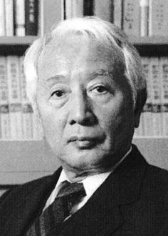
Questions?
Guess who this is?

