Slide 1
Topic Review: Medulloblastoma
Jason Liu
PGY-2, Radiation Oncology
City of Hope

Slide 2
Outline
Epidemiology
Signs and symptoms
Imaging
Diagnosis
Staging
Risk stratification
Molecular groups
Treatment

Slide 3
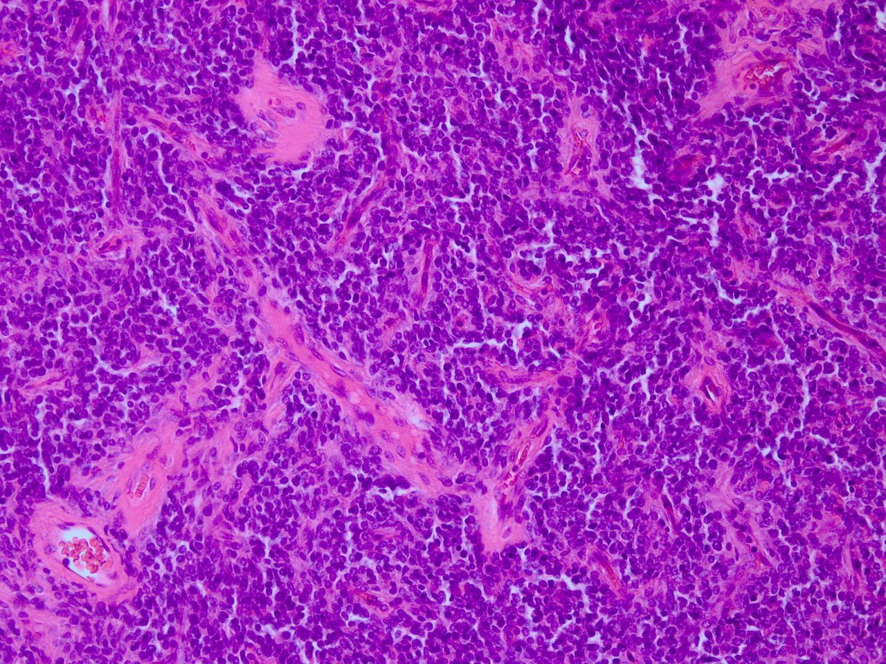
What is medulloblastoma?
Primitive neuroectodermal tumor (PNET) arising in the posterior fossa
Small round blue cell tumor
Typically found near the 4th ventricle between the brainstem cerebellum
High propensity for CSF spread
IHC markers: synaptophysin, NSE, MAP-2, vimentin

Slide 4
Epidemiology
Most common brain tumor of childhood, approximately 10% of all primary CNS tumors among children and teenagers
Peak incidence is between 5-9 years
Incidence is ~350 in the United States per year or 2 per 100,000
Risk factors include genetic syndromes
Li-Fraumeni, APC, PTCH1, BRCA2

Slide 5
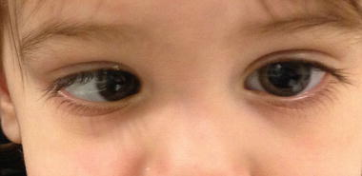
Signs and symptoms
Increased intracranial pressure
Headaches, nausea, vomiting, papilledema, altered mental status
CN VI palsy – double vision with lateral gaze
Cerebellar dysfunction
Midline – gait ataxia, truncal instability
Lateral – limb clumsiness or incoordination

Slide 6
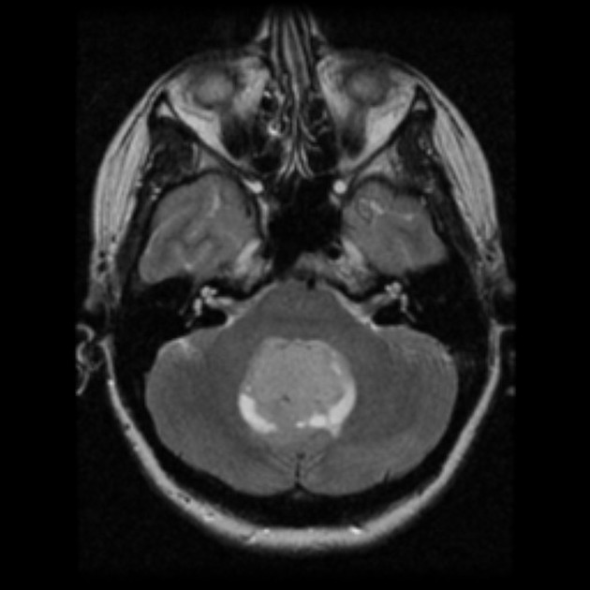
Imaging
MRI scan – heterogeneous appearance on T1 post-contrast and T2 due to regions of necrosis, hemorrhage, or cystic change
Hydrocephalus may be present due to obstruction of the 4th ventricle – treatment involves stabilization with VP shunt and steroids

Slide 7
Diagnosis
Tissue diagnosis – maximal safe resection
Cerebrospinal fluid – approximately 1/3 of medulloblastoma involves the CSF
Lumbar puncture must be delayed until after surgery in most patients due to presence of increased intracranial pressure!! – risk of herniation

Slide 8
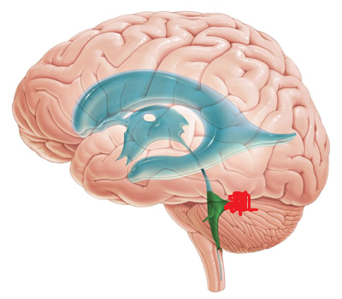
Chang’s modified staging
Extent of tumor
T1 – <3 cm
T2 – >3 cm
T3a – >3 cm with extension into aqueduct of Sylvius
T3b – >3 cm with extension into brainstem
T4 – >3 cm with extension past aqueduct of Sylvius or down foramen magnum
Degree of metastasis
M0 – no mets
M1 – microscopic in CSF
M2 – macroscopic in brain subarachnoid space
M3 – macroscopic in the spinal subarachnoid space
M4 – mets outside cerebrospinal axis

Slide 9
Risk stratification
Important in guiding the treatment of patients after surgery
Average risk
Residual tumor <1.5 cc
Localized (M0) disease
Classic or desmoplastic histology
High risk
Residual tumor >1.5 cc
M1 or higher disease
Anaplastic histology

Slide 10
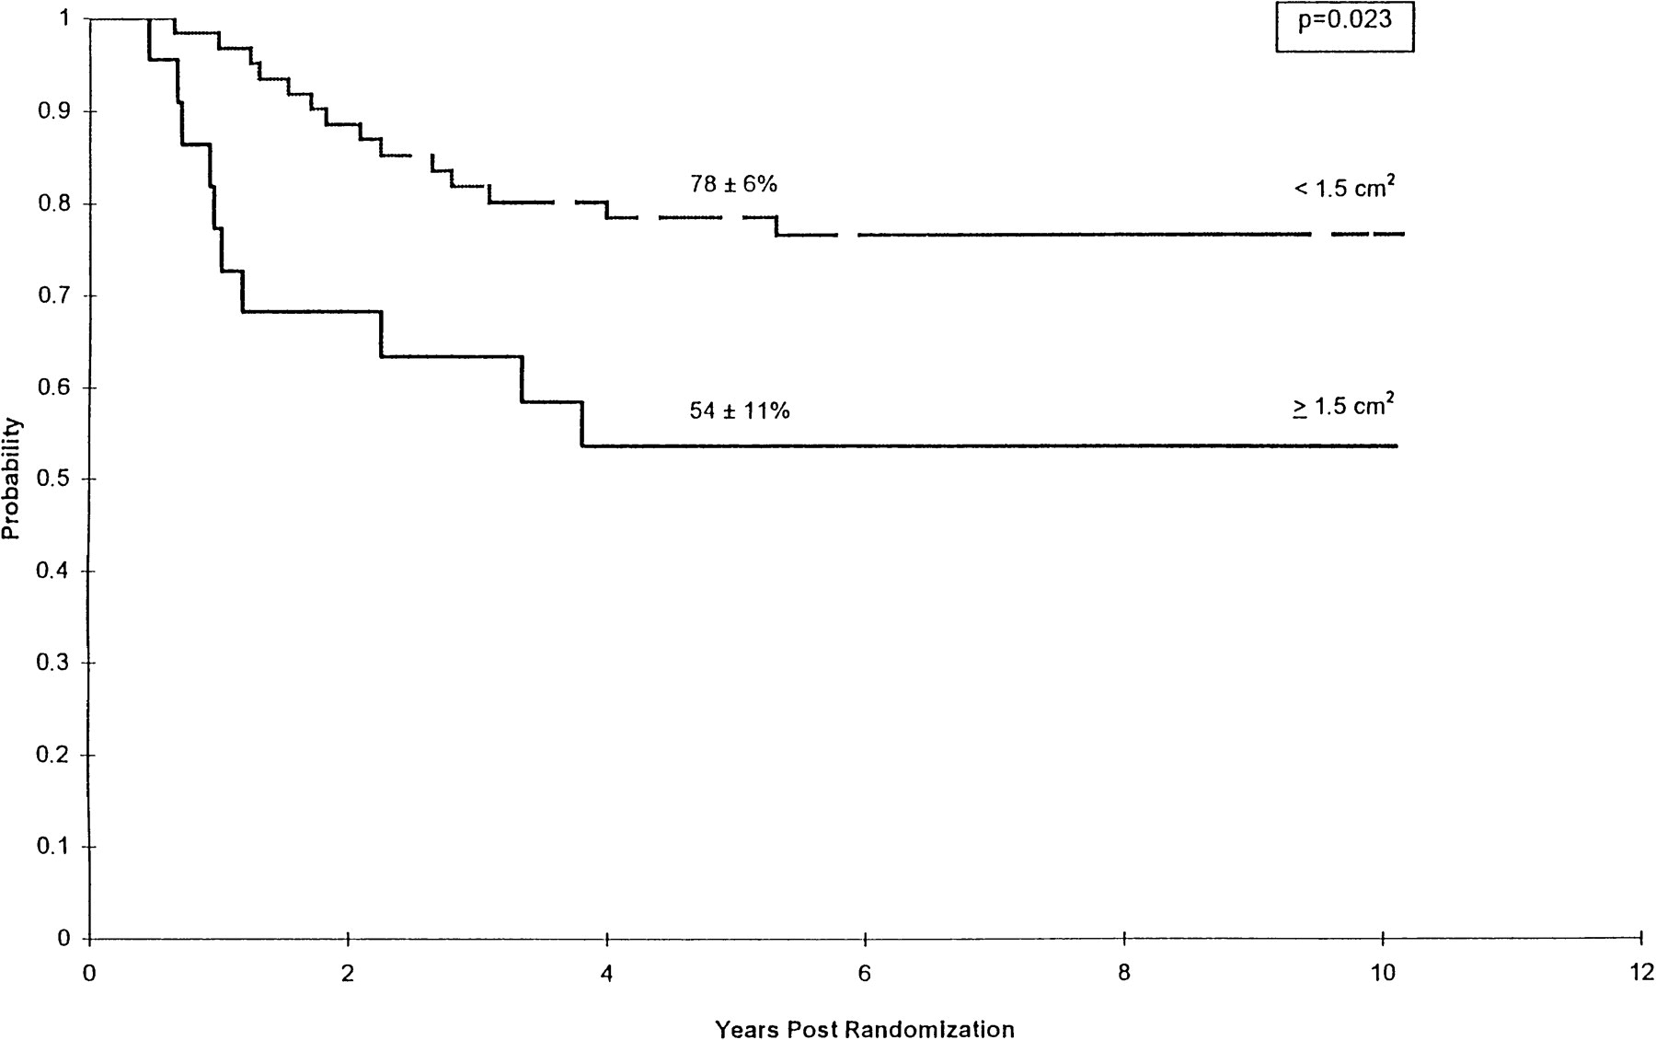
Residual tumor
Residual tumor >1.5 cc has worse prognosis
>1.5 cc – 50% 5-year PFS
<1.5 cc – 80% 5-year PFS
J Clin Oncol. 1999;17(3):832

Slide 11
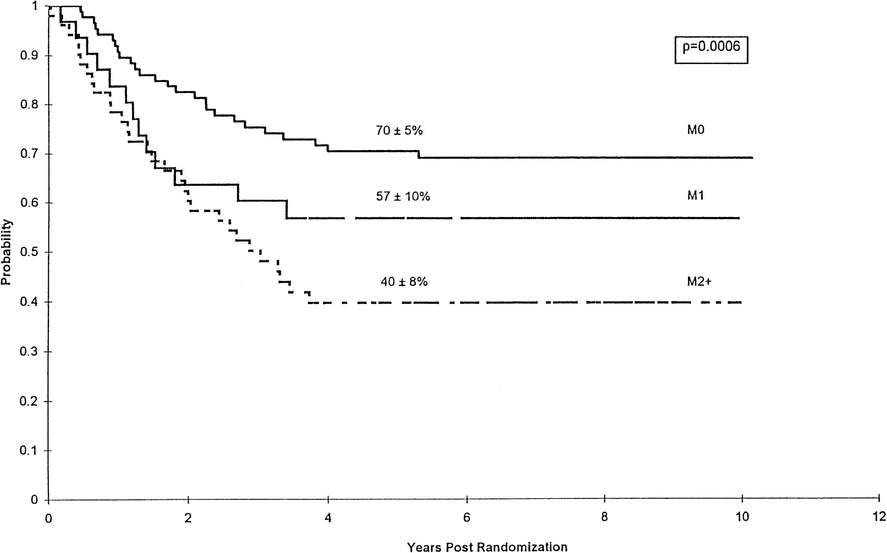
Extent of disease
Higher M stage has worse OS and PFS
M0-1 – 80% 5-year OS
M2+ – 20% 5-year OS
M0 – 70% 5-year PFS
M1 – 60% 5-year PFS
M2+ – 40% 5-year PFS
J Clin Oncol. 1999;17(3):832

Slide 12
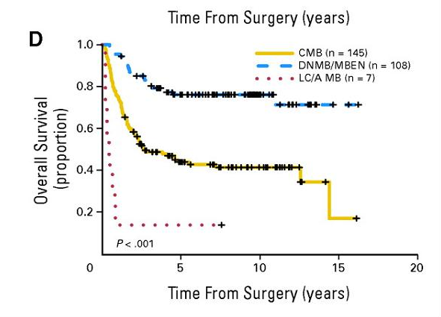
Histopathology
Classic (75%) – sheets
Intermediate prognosis
Desmoplastic (20%) – nodular
Best prognosis
Anaplastic (5%) – large cells with necrosis
Worst prognosis
J Clin Oncol. 2010;28(33):4961

Slide 13
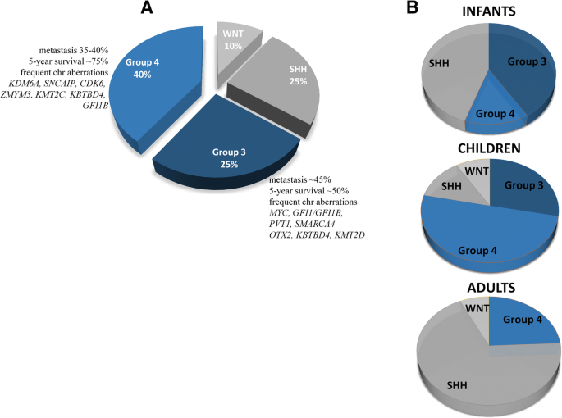
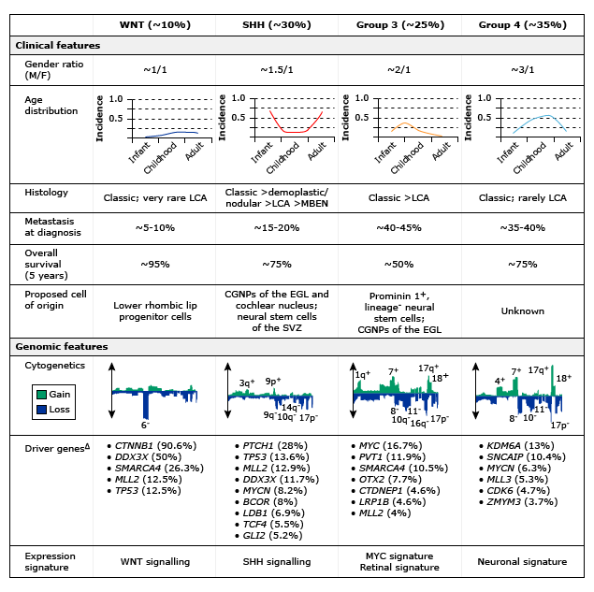
Molecular groups
Playing an increasingly important
role in the design of clinical trials
and development of new therapies
Nat Rev Cancer 2012; 12:818.

Slide 14
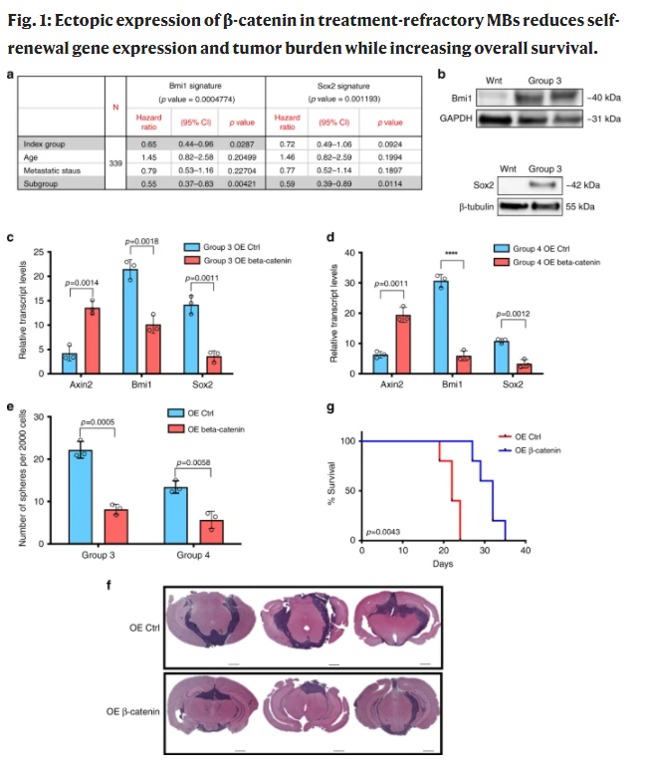
Wnt-activated
Wnt signaling is one of the key cascades regulating embryonic development
Overactivation of Wnt leads to tumor proliferation
90% of tumors have mutation in CTNNB1, which encodes beta-catenin
Unclear mechanism, but beta-catenin expression believed to improve outcomes by inhibiting self-renewal pathways
Nature. 2020; 11, 4323.

Slide 15
SHH-activated
SHH signaling is one of the key cascades regulating embryonic development
Overactivation of SHH leads to tumor proliferation
4 subtypes – large variation in prognoses
SHHα: in children, associated TP53 mutations, poor prognosis
SHHβ: in infants, poor prognosis
SHHγ: in infants, associated with desmoplastic histology, good prognosis
SHH∆: in adults with TERT promoter gene mutations, good prognosis

Slide 16
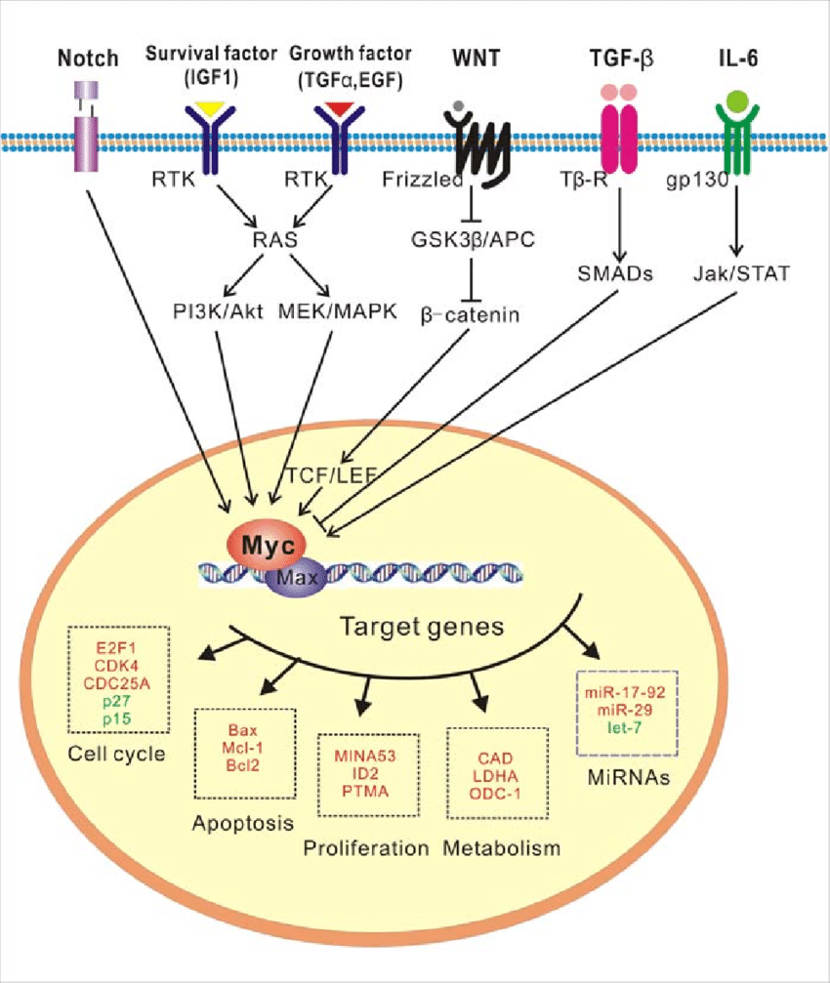
Group 3 and 4
Not driven by Wnt or SHH, no clear common driver pathway
Group 3 and 4 are more similar than they are different, but main difference is that group 3 has worse prognosis and is more commonly associated with MYC amplification (17%) than group 4 (6%)
MYC is a proto-oncogene that is associated with VEGF expression and angiogenesis
Hypothesized that angiogenesis plays a key role in the poor prognosis associated with group 3

Slide 17
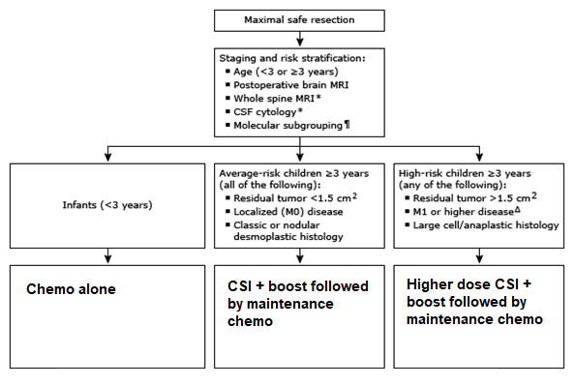
Treatment
Most often treated as part of multicenter clinical trial or institution-specific protocol
Maximal safe resection followed by risk stratification
Infants
Average risk children
High risk children

Slide 18
Treatment in infants after surgery
Chemo alone (many different regimens)
Goal is to delay or obviate the need for radiation
Use of CSI in infants has unacceptably high rates of severe neurological impairment
Endocrine dysfunction, small stature, behavioral abnormalities, secondary malignancy, decreased IQ

Slide 19
Treatment in average-risk children after surgery
CSI with boost followed by maintenance chemo
Dose and volumes for radiation?
ACNS 0331

Slide 20
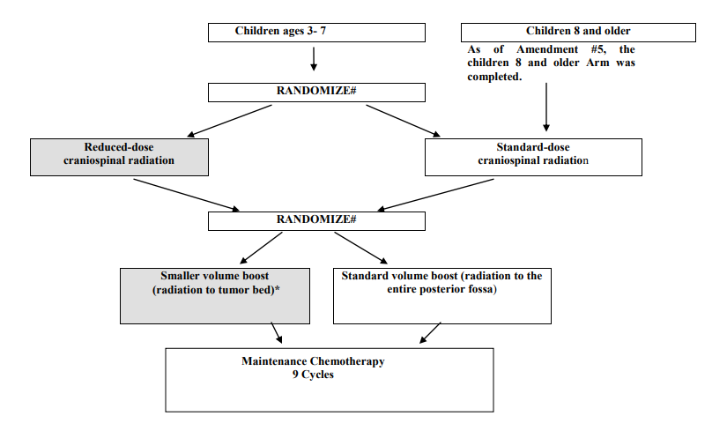
ACNS 0331
N=549 patients with average risk medulloblastoma
Two randomizations
18 Gy CSI vs. 23.4 Gy CSI
IFRT (reduced volume) vs. PFRT boost to 54 Gy
Maintenance chemo
Alternating PCV with vincristine, cyclophosphamide, mesna x9 cycles

Slide 21
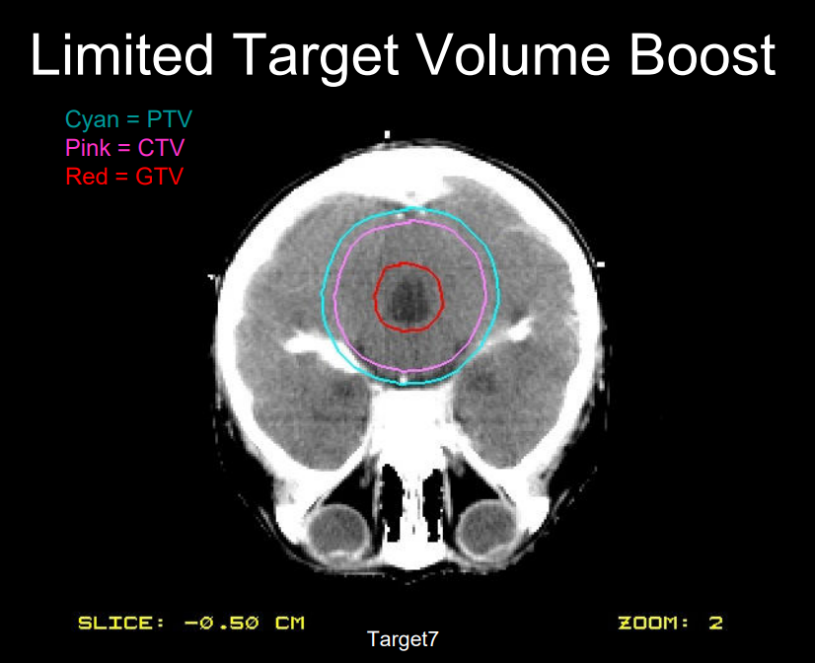
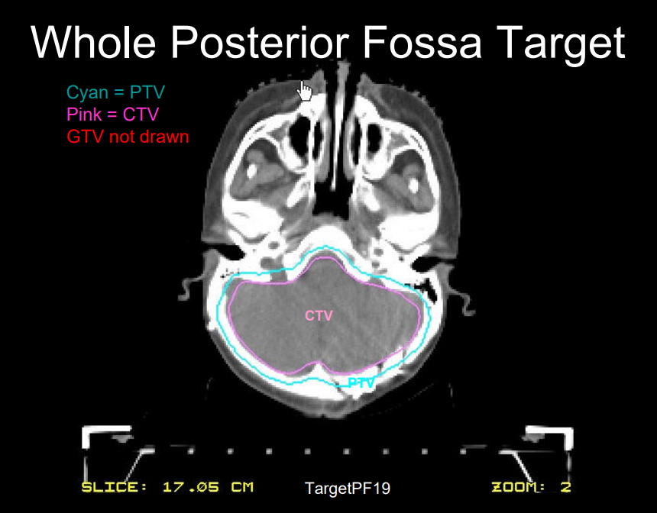
ACNS 0331 – IFRT vs. PFRT
CTV = GTV + 1.5 cm within posterior fossa
PTV = CTV + 3-5 mm

Slide 22
ACNS 0331
18 Gy CSI vs. 23.4 Gy CSI
Worsened OS with low dose CSI
5-year OS 78% vs. 86%
IFRT vs. PFRT boost to 54 Gy
No difference in OS
5-year OS 85% for both

Slide 23
Treatment in average-risk children after surgery
23.4 Gy CSI followed by 54 Gy IFRT boost in 1.8 Gy/fx with concurrent vincristine
Maintenance chemo
Alternating PCV with vincristine, cyclophosphamide, mesna x9 cycles

Slide 24
Treatment in high-risk children after surgery
36 Gy CSI followed by 55.8 Gy PFRT boost in 1.8 Gy/fx with concurrent vincristine
Maintenance chemo
Cisplatin/vincristine/cyclophosphamide x6 cycles
Ongoing investigation: ACNS 0332
Arm A: standard treatment (above)
Arm B: standard treatment + concurrent carboplatin (30 doses) during radiation
Arm C&D: closed due to lack of benefit for isotretinoin

Slide 25
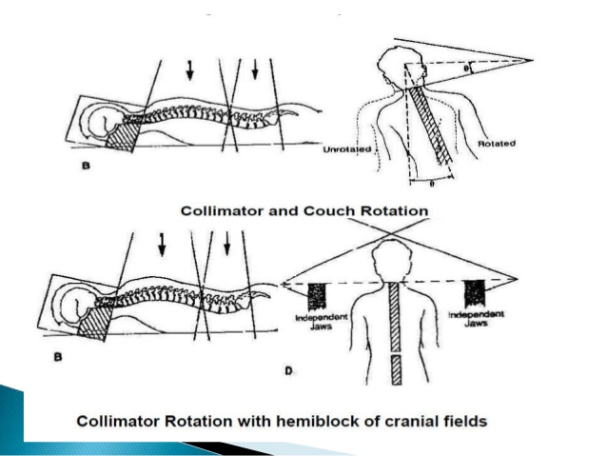
Craniospinal irradiation – 3D
Notes:
Simulate in prone/supine position
Superior border somewhere between C2-5, highest level that avoids divergence through oral cavity
Inferior border of spine field at the bottom of thecal sac (S2-3)
If the patient has two spine fields, match the two fields at the posterior vertebral body below L1 and add appropriate skin gap
To match cranial fields to the spine fields, angle the collimator of the cranial fields and kick the couch towards beam

Slide 26
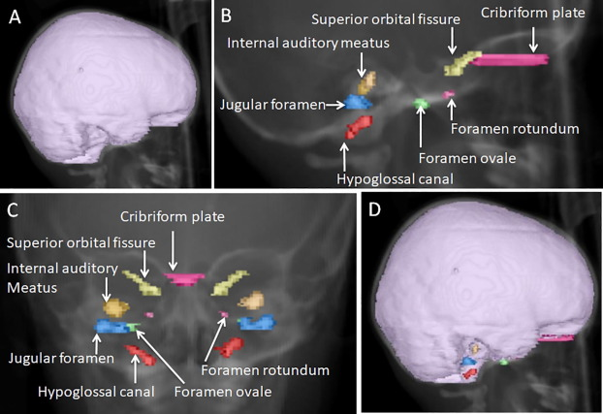
Craniospinal irradiation – IMRT
Contouring based on SIOPE guidelines
Cranial CTV – whole brain, cribiform plate (extend at least 0.5 cm inferiorly), skull base (extend at least 1 cm inferiorly), cranial nerves
Spinal CTV – cord, nerve roots in the C/T/L spine, down to thecal sac in sacral spine as determined by MRI

Slide 27
Summary
Medulloblastoma is a PNET of the posterior fossa
Most common brain tumor of childhood, peak incidence 5-9 y/o
Commonly presents with signs of increased intracranial pressure and cerebellar dysfunction
Management involves maximal safe resection followed by risk stratification
Average risk – residual tumor <1.5 cc, no metastases, classic or desmoplastic
High risk – residual tumor >1.5 cc, metastases, anaplastic
Post-surgical treatment
Infants – chemo alone
Average risk children – 23.4 Gy CSI with 54 Gy IFRT boost then maintenance chemo
High risk children – 36 Gy CSI with 55.8 Gy PFRT boost then maintenance chemo

Slide 28
Questions and discussion

