Slide 1
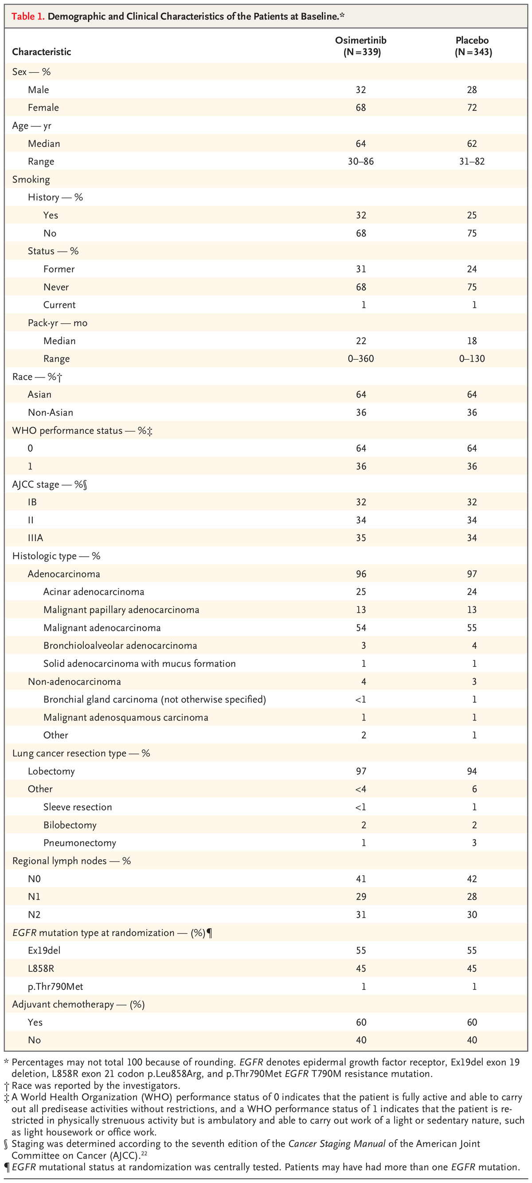

Y Wu et al. N Engl J Med 2020;383:1711-1723.
Demographic and Clinical Characteristics of the Patients at Baseline.*
Notes:
Table 1. Demographic and Clinical Characteristics of the Patients at Baseline. *

