Slide 1
Topic Review: Pediatric Rhabdomyosarcoma
Jennifer Novak MD, MS
02/22/21

Slide 2
Rhabdomyosarcoma
malignant soft tissue sarcoma of skeletal muscle phenotype originating from mesenchymal stem cell
embryology: derived from mesoderm/middle layer
3.5% of pediatric malignancies (age 0-14), #1 soft tissue sarcoma in peds
2% of malignancies in teens (age 15-19)
350 cases per year in US

Slide 3
Pathophysiology
Vast majority are sporadic
risk factors: age, gender (M>F embryonal), in utero radiation??
Genetic Risk Factors
Li-fraumini
germline TP53 mutation
NF1
chromosome 17
associated with benign subcutaneous tumors, MPNSTs, gliomas
Beckwith-Wiedemann syndrome
chromosome 11
LOH 11p15.5 (embyronal) is associated with IGF2 gene deletion
Wilms and hepatoblastoma more commonly associated
Costello syndrome
germline HRAS mutations
Noonan syndrome

Slide 4
Prognosis
for all comers: >70% of those treated with combined-modality approach survive 5 years after diagnosis
depends on histologic subtype, site of origin, resectability, age, LNI, response to therapy
younger age (1-9) better prognosis: 5 yr failure free survival 81% vs. 68% age >10 and 57% age <1
infants cannot receive as high of chemo dose and less likely to receive XRT
teens more commonly with alveolar histology

Slide 5
Presentation
Typical presentation: painless mass
site of origin determines symptoms
orbit: diplopia
bladder: urinary dysfxn
34% present with localized disease (5 year survival >80%)
15-30% present with DM (5 year survival 33%)
prostate, trunk, and extremity prone to hematogenous mets

Slide 6
Differential Diagnosis: Small Round Blue Cell Tumors
“LEARN NMR”
Lymphoma
Ewing Sarcoma
ALL
Rhabdomyosarcoma
Neuroblastoma
Nephroblastoma (Wilms)
Medulloblastoma, Melanoma
Retinoblastoma
“MRS LEEP”
SNUC (sinonasal undiff’d carcinoma)
Ethesioneuroblastoma
Pituitary Adenoma

Slide 7
IHC Tumor Markers
Rhabdomyosarcoma: MyoD1, Desmin, Myogenin
Myogenin and MyoD1+ 97% sensitivity
other myogenic proteins: actin, myosin
Ewing Sarcoma: CD99, NKX2-2
Lymphoma: CD45
Neuroendocrine: synaptophysin, chromogranin
Melanoma: S100, Sox10, HMB-45, Melan A

Slide 8
Histologic Subtypes
Histology | Frequency | Genetics | Location(s) | Age | OS
Fusion-Negative (formerly Embryonal) | 60% M:F 1.5 | LOH 11p15 | orbit, H&N, GU | 2-6 | 66%
Fusion-Positive (formerly Alveolar) | 25% | FOX01+ t(2;13) PAX3/FKHR t(1;13) PAX7/FKHR | trunk, extremities | 15-19 | 54%
Botryoid | 10% |  | GU (vagina, bladder), NPX, biliary | infant | 95%
Pleomorphic | 10% |  | extremities | adults
Spindle Cell | 5% |  | paratesticular |  | 88%
Alveolar FOX01- |  | FOX01- |  |  | 90%
Mixed type | <5%

Slide 9
Most common RMS histology by age group
Infants: Botryoid
Young children: embryonal
Teens: alveolar
Adults: pleomorphic

Slide 10
Prognosis by histology
5 yr OS:
Botryoid: 95%
Spindle cell: 88%
Embryonal: 66%
Alveolar: 54%
undifferentiated: 40%

Slide 11
Site of Origin
Favorable (3 yr OS 94%)
orbit
biliary
vaginal
paratesticular
non-parameningeal H&N
scalp
cheek
parotid
oral cavity
oropharynx
larynx
Unfavorable (3 yr OS 70%)
all other sites
parameningeal sites
infratemporal fossa
middle ear
mastoid region
nasal cavity
nasopharynx
pterygopalatine fossa
paranasal sinus
parapharyngeal space

Slide 12
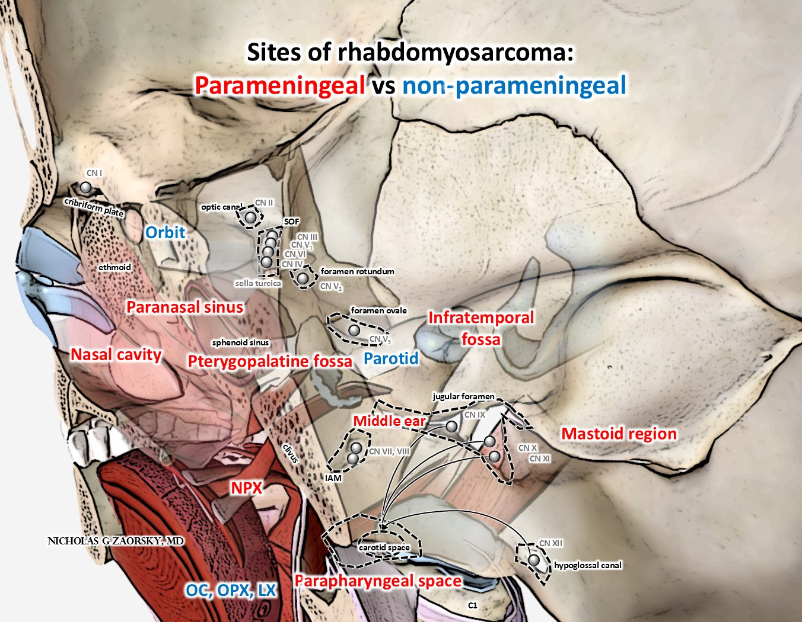

Slide 13
Most common sites of origin
H&N 40%
parameningeal 25%
orbit 9%
non-parameningeal 6%
GU 30%
Extremity 15%
Trunk 15%

Slide 14
Most common RMS histology by site:
H&N: embryonal
GU: botryoid
Extremities or trunk: Alveolar

Slide 15
Risk of Lymph Node Involvement
Varies widely by site of origin
orbit: <1%
extremity: 15%
paratesticular: 30%
Sites with >15-20% LN met rate require some form of LN evaluation at time of surgery (Paratesticular, Bladder, H&N (exception NPX), and extremity)

Slide 16
Pathologic TNM Staging Intergroup Rhabdomyosarcoma Study Group
T stage
 | T1 | confined to site of origin
 | T1a | <5 cm
 | T1b | ≥5 cm
 | T2 | extension beyond site of origin
 | T2a | <5 cm
 | T2b | ≥5 cm
N stage
 | N0 | no clinically involved nodes
 | N1 | clinically involved nodes
 | NX | LN status unknown
M stage
 | M0 | no distant metastasis
 | M1 | distant metastasis

Slide 17
Clinical Staging Based on pre-op studies (Intergroup Rhabdomyosarcoma Study Group)
Stage | Site | T stage | Size | N stage | M stage
Stage 1 | favorable | T1 or T2 | any | any | M0
Stage 2 | unfavorable | T1 or T2 | < 5cm | N0 (or NX) | M0
Stage 3 | unfavorable | T1 or T2 | < 5cm | N1 | M0
 |  |  | OR > 5cm | any | M0
Stage 4 | any | T1 or T2 | any | N0-N1 | M1
Notes:
To Summarize:
if you have a favorable site of origin (and no mets), then you’re Clinical stage I
If unfavorable site but node negative and small size (< 5 cm), then you’re stage II
If unfavorable and either node positive or size > 5cm, then you’re stage III.
and M1 makes you stage IV.

Slide 18
Clinical Group Based on surgical findings and extent of resection *IMPT bc this guides RT dose*
Group I Localized disease, R0 resection | Group II: total gross resection, R1 resection | Group III: gross residual disease, R2 resection | Group IV: distant metastasis
Ia: confined to site of origin | IIa: localized tumor, microscopic residual disease | IIIa: biopsy only (either localized or regional disease)
Ib: Infiltrative beyond site of origin, node-negative | IIb: node-positive, no microscopic residual disease | IIIb: debulking of >50% tumor
 | IIc: node-positive, microscopic residual disease | **Note: roughly 50% have group III disease

Slide 19
Clinical Risk Groups Based on Children’s Oncology Group Stratification for Rhabdomyosarcoma
Low, Intermediate, High Risk groups
Determined by:
histologic subtype
Clinical group
Clinical stage

Slide 20
Risk stratification (helps guide chemo)
Risk Group | Histology | Clinical Group (extent of disease, resection) | Clinical Stage (favorable, size, and N stage) | 5 yr OS (Pappo 2017)
LOW RISK | embryonal | I, II, or III | 1 | 90%
 |  | I, II | 2-3
INTERMEDIATE RISK | embryonal | III | 2-3 | 65%
 | alveolar | I, II, III | 1, 2, 3
HIGH RISK | embryonal | IV (DM) | 4 (M1) | 15%
 | alveolar | IV (DM) | 4 (M1)
Notes:
To be low risk, you must have embryonal histology & you have to have had a gross total resection (clinical group II) or if you have subtotal resection or biopsy then you have to be small size and node negative (clinical stage I)
If you have embryonal histology and a subtotal resection/biopsy with unfavorable disease site then you are intermediate risk.
If you have alveolar histology, you’re automatically considered intermediate risk regardless of size, regional disease, resection, etc.
High risk is characterized by distant metastasis regardless of histology.

Slide 21
Workup
H&P
Labs: CBC, CMP, LDH, and LFTs
Imaging: CT/MRI of primary, CT C/A/P, PET, bone scan
Bone marrow biopsy
Primary site core or incisional biopsy
if parameningeal: LP with cytology, if positive then do MRI brain/spine
if bladder involvement: EUA & cystoscopy

Slide 22
Treatment Paradigm
Max safe resection +/- LN evaluation or dissection
In some cases, just biopsy alone
Paratesticular: Retroperitoneal LND if >10 yo, or in N+ pts <10 yo
Extremity: need at least SLN evaluation (axillary or inguinal)
GU: pelvic LN sampling followed by LND for node+
NPX: no LND unless cN+
Adjuvant VA or VAC chemotherapy +/- RT
VAC: vincristine, actinomycin D, cyclophosphamide
addition of RT depends on risk group, timing & dose depend on extent of resection and site of origin (favorable vs unfavorable)

Slide 23
Treatment Paradigm: Low Risk
Risk Group | Histology | Clinical Group (extent of disease, resection) | Clinical Stage (favorable, size, and N stage)
LOW RISK | embryonal | I, II, or III | 1
 |  | I, II | 2-3
Low Risk | Stage 1-3, Group I: surgery → VAC (no RT)
 | Stage 1, Group II: surgery → VA + RT at week 13 (36 Gy for N0, 41.4 Gy for N1)
 | Stage 1, Group III: surgery → VA + RT (50.4 Gy)
 | Stage 2, Group II: surgery → VAC →RT (36 Gy) at week 13
 | Stage 3, Group II: surgery → VAC → RT (36 Gy for N0, 41.4 Gy for N1) at week 13

Slide 24
Treatment Paradigm: Intermediate Risk
Risk Group | Histology | Clinical Group (extent of disease, resection) | Clinical Stage (favorable, size, and N stage)
INTERMEDIATE RISK | embryonal | III | 2-3
 | alveolar | I, II, III | 1, 2, 3
Intermediate Risk | surgery → chemo → repeat surgery if possible → RT 50.4 Gy at week 13 if favorable and week 4 if unfavorable

Slide 25
Treatment Paradigm: High Risk (M+)
High Risk | Vincristine/Irinotecan → VAC chemo → RT to primary and metastatic sites (50.4 Gy) *can start RT at week 0 if symptomatic CNS disease, otherwise start at week 20 or end of chemo *45Gy if orbit
 | PAX/FOX01 negative: usually no RT to mets
 | PAX/FOX01 positive: RT to mets
 | Non pulmonary mets s/p resection: No RT for R0, 36 Gy for R1, and 50.4 Gy for R
 | Lung mets: whole lung irradiation 15 Gy/1.5 (12 Gy/1.5 if < 6 years old); even if CR *boost to gross lung disease 50.4-54 Gy

Slide 26
Exceptions to surgery
orbit
parameningeal
Gyn (cervix, vagina, uterine)
GU (bladder, prostate)
following biopsy and confirmation of diagnosis, will go straight to VAC chemotherapy

Slide 27
Adjuvant Radiation by Extent of Resection
Group 1 (R0 resection) | Group 2 (R1 resection) | Group 3 (R2 resection)
embryonal: usually no RT alveolar (& all others): 36 Gy at week 13 | embryonal: 36 Gy at week 13 alveolar: 36 Gy at week 4 If Node+ then 41.4 Gy | embryonal: 50.4 Gy at week 13 unfavorable: 50.4 Gy at week 4 >5cm: 59.5 Gy exceptions: -orbit: 45Gy week 13 -Gyn with CR to VAC, then no RT

Slide 28
Individuals NOT typically treated with adjuvant radiation
Group I favorable embryonal
Gyn w CR to chemo
group I extremity s/p amputation
group I paratesticular s/p orchiectomy
metastatic site R0

Slide 29
RT Treatment Planning
CTV= pre-operative, pre-chemo GTV + 1-1.5cm
PTV = CTV + 0.5cm
If N+ then include entire LN chain
VC given concurrently with XRT – no actinomycin due to risk of radiation recall
Dose:
36 Gy: Group I alveolar, and node-negative group II
41.4 Gy: node-positive group II (if nodes have been resected)
45 Gy: Orbit dose
50.4 Gy: definitive dose for gross residual disease (aka group III) < 5cm
59.4 Gy: group III > 5cm

Slide 30
Dose constraints (COG D9602)
bladder | <45 Gy
heart | <30.0 Gy
Liver | <23.4 Gy
rectum | <45 Gy
chiasm | <46.8
optic n | <45 Gy
lens | <14 Gy
small bowel | <45 Gy
50% of kidneys | <24 Gy, or max <19.8
lung V20 | <20Gy
lacrimal gland/cornea | <41.4 Gy

Slide 31
Site-specific RT recommendations
Orbit: CTV is only the orbit (as long as disease confined to orbit)
Only radiate regionally involved LN basins
No ENI for orbit, HN, and female GU
No RT if CR to chemo in bladder or gyn

Slide 32
Significant Clinical Trials

Slide 33
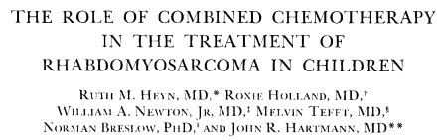
Why do we give chemo for RMS?
-Published in Cancer (1974)
-RMS s/p surgical resection randomized to VA vs. observation after surgery
-VA chemo improved OS

Slide 34
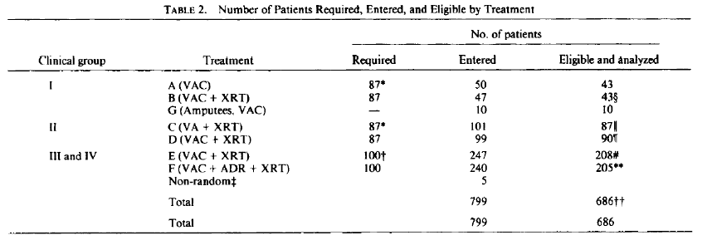
Intergroup Rhabdomyosarcoma (IRS) I-III
All IRS trials stratify/randomize by Group (resection)
IRS I (1972-1978)
conclusions: for group I, no benefit to post-op RT in addition to adjuvant VAC chemotherapy; for group II no need for cytoxan, and for groups III-IV no need for adriamycin
IRS I

Slide 35
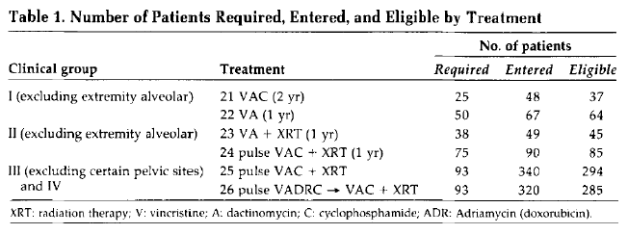
IRS II (1978-1984)
conclusions:
group I: VA x 1 yr = VAX x 2 years
group II: RT+ VA x 1 yr = RT + VAC x 1 yr (exceptions: unfavorable histologies which need VAC+RT)
group III-IV: adriamycin offers no advantage over actinomycin and was associated with worse toxicities
Chemo alone for certain pelvic sites not adequate (poor response rates)
IRS II

Slide 36
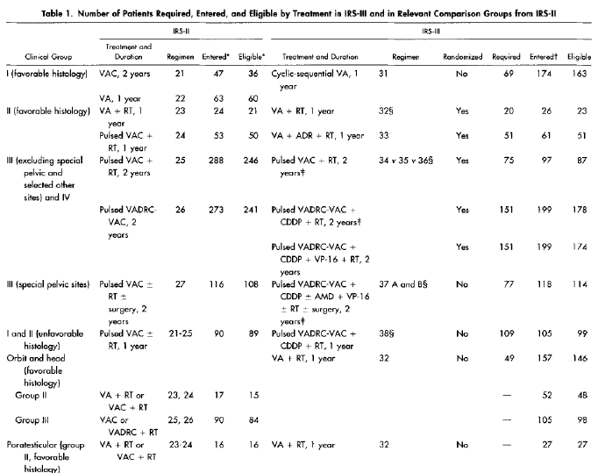
IRS II vs. III

Slide 37
IRS III (1984-1991)
conclusions: therapy should be based on risk group, tumor site, and extent of disease; 5 yr survival improved significantly from IRS I&II
-Groups I-II unfavorable histology: vincristine/adria/cpm alternating with VAC+RT did better than RT+VA or VAC
-Groups II-III favorable site: VA+RT adequate
-Groups II-III unfavorable site and group IV: No benefit to adding adriamycin, also whole brain prophylaxis did not reduce CNS relapse
-certain pelvic sites did better with multimodality Tx; bladder preservation rate and OS improved

Slide 38
IRS-IV
Accrued from 1991-1997
focused on imrpoving outcomes for group III
non-metastatic RMS s/p surgery randomized to:
VAC (vincristine, actinomycin, cyclophosphamide)
VAI (VA+ifosfamide)
VIE (V+ifosfamide+etoposide)
Group III only: randomized to conventional (50.4 Gy in 1.8 Gy fractions vs. hyperfractionated RT (59.4 Gy in 1.1Gy BID fractions)
Results:
No diff FFS between VAC, VAI, VIE (all ~75% at 3 yrs), but compared to IRS III better than 2 drug chemo regimens (VAC remains standard)
No diff hyperfrac vs conventional (conventional RT remains standard)
Embryonal tumors benefit from 3 drug chemo (3 yr FFS 83%)
For group IV: VAC + IE is standard (IE vs. vincristine/melphalan)
Paratesticular >10 yrs have worse outcomes than <10 yrs old (3 yr FFS 63 vs 90%)
Infants and adolescents have worse outcomes than children

Slide 39
IRS-IV cont.
5 yr local control by site of origin
Extremity: 96%
Orbit: 95%
GU (bladder, prostate): 90%
H&N: 88%
parameningeal: 85%

Slide 40
D-9803
Initially published JCO 2009, most recent update Red Journal 2015
“Intermediate risk”: Group I-II alveolar or Group III embryonal or alveolar
randomized to VAC x39 wks vs. VAC/VTC alternating
RT @ week 13: planned 50.4 Gy +/- delayed primary excision (“2nd look surgery”) at 36 Gy; if completely resection then stop RT if microscopic residual disease then 41.4 Gy.

Slide 41
D-9803
Conclusions:
VAC/VTC is not better than VAC alone
No LC benefit to 2nd look surgery although does allow RT dose to be reduced
84% had complete resection during 2nd look surgery, however 5 yr local failure not improved from IRS IV

Slide 42
D9602 aka IRS V
published in JCO 2011
Tried to reduce chemo and lower RT dose for low risk patients
Subgroup A (very low risk): stage 1, group I/IIA, stage 2, group I
VAx 45 weks w RT for stage 1 group IIA
Subgroup B (low risk): stage 1, grou pIIB/C, stage 1 group III, stage 2 group II, and stage 3 group I-II
VAC x45 weeks + RT (RT dose reduced from IRS IV from 41.4 Gy for microscopic residual dz to 36 Gy)

Slide 43
D9602
Results:
FFS and OS similar to IRS III, but lower than IRS IV
Comparing IRS III and IV, no evidence that reduced RT dose contributed to worse outcomes
5 yr FFS rates are similar for subsets A and B (5 yr FFS 85-89%)
45 Gy to orbit gives 5 yr FFS 86% - this is standard dose for orbit

Slide 44
ARST 0331 “IRS-VI”
published in JCO in 2014, update in Cancer 2017
Goal: try to reduce chemo for low risk patients
subset 1: stage 1 or 2, group I-II (“very low risk”): VA x 45 wks + RT for stage 1, group II
VAC x4 → VA x22 wks
this is reduced dose cpm and shorted duration compared to D9602 trial
subset 2: stage 1, group III or stage 3, group I-II
VAC x4→ VA x46 wks
reduced dose cpm
RT indications:
Group I: no RT
Group IIA: 36 Gy
Group IIB/C: 41.4 Gy
Group III orbit: 45 Gy
Group III vaginal tumors: RT was eliminated in those who achieved CR to chemo

Slide 45
ARST 0331 “IRS-VI” cont.
Results:
subset 1: shorter duration chemo & lower dose cpm maintained FFS; 3 yr FFS =89%, 3 yr OS 98%
subset 2: reduced dose cpm led to worse FFS (3 yr FFS 70%, 3 yr OS 92%); omitting RT in group III vaginal tumors seemed to worsen survival (3yr FFS 77% compared to 85% previous trial that included RT)
ARST 1431: ongoing trial of only subset 2 (“intermediate risk”), single arm study using week 9 PET to determine RT dose & benefit of RT replanning

Slide 46
High-Yield Summary
Surgery is the mainstay of treatment (except for orbit, parameningeal, Gyn (cervix, vagina, uterine), GU (bladder, prostate)
adjuvant RT: depends on risk stratification, timing & dose depend on extent of resection (“group”) and site of origin (favorable vs unfavorable)
No RT for all embyronal group I patients; if unfavorable histology group I then 36 Gy
Special pelvic sites (embryonal tumors of the vagina, cervix, and uterus who have achieved CR after chemo) NO RT
Actinomycin D is not given with RT – radiation recall
Metastatic patients: if feasible, RT all sites of disease

Slide 47
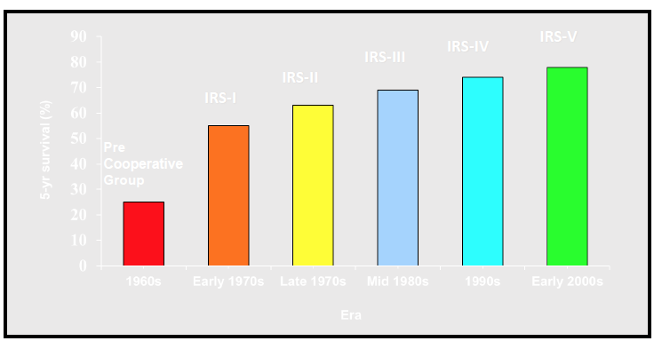
Improvement in Survival Outcomes over past 50 years
Children’s Oncology Group

Slide 48
RT doses
59.4 Gy gross disease > 5 cm
50.4 Gross disease
41.4 N+ resected
36 Gy R1 resections
36 Gy R0 alveolar
45 Gy orbit
whole lung dose 15 Gy in 10 fractions + boost to 50.4 Gy for gross disease
12 Gy for under 7 years old

Slide 49
Thank You

