Slide 1
BCOR-CCNB3 Sarcoma

Slide 2
Overview
Also called Ewing-like sarcoma and abbreviated BCS
Results from fusion transcript of BCOR-CCNB3 due to X-chromosomal paracentric inversion, leading overexpression
BCOR ubiquitously expressed protein with activity in mesenchymal stem cells
CCNBS encodes meiotic cyclin only expressed in testis during spermatogenesis
Strong male predominance (80-90% of cases)
Bone>soft tissue>visceral
Small blue cell histology>spindle cell histology

Slide 3
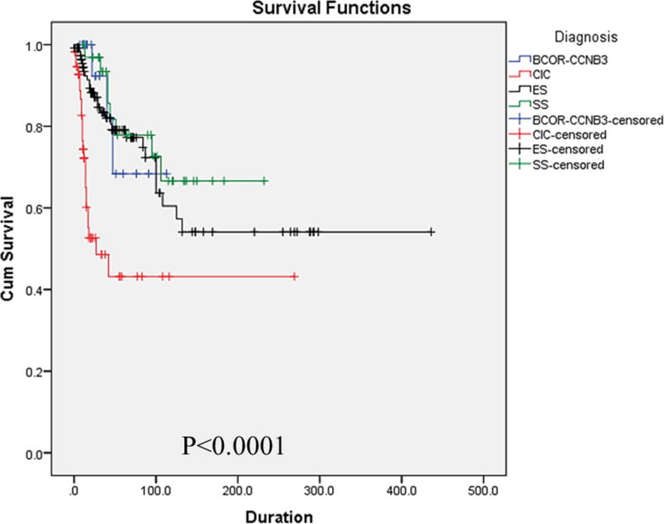
Treatment and Prognosis
Location in axial skeleton and soft tissue significantly worse survival
OS similar to ES (5 yr survival of 75%, 10 yr OS of 56%)
Improved survival on ES protocols

