Slide 1
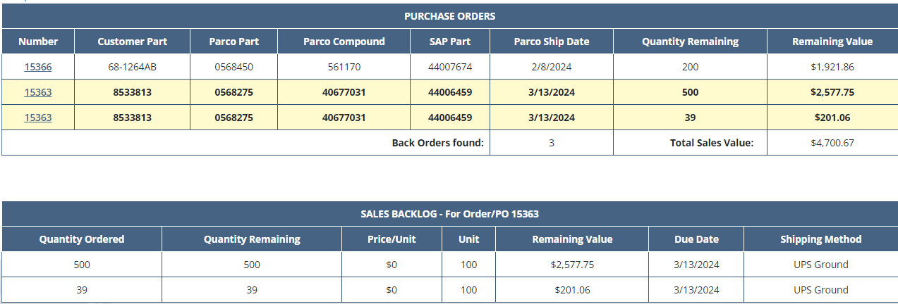
The require fields for Sales Backlog are:
For Sales Backlog is possible to search by:
Account No. + SAP Part
or
Account No. + Customer Part
or
Account No. + Purchase Order

Slide 2
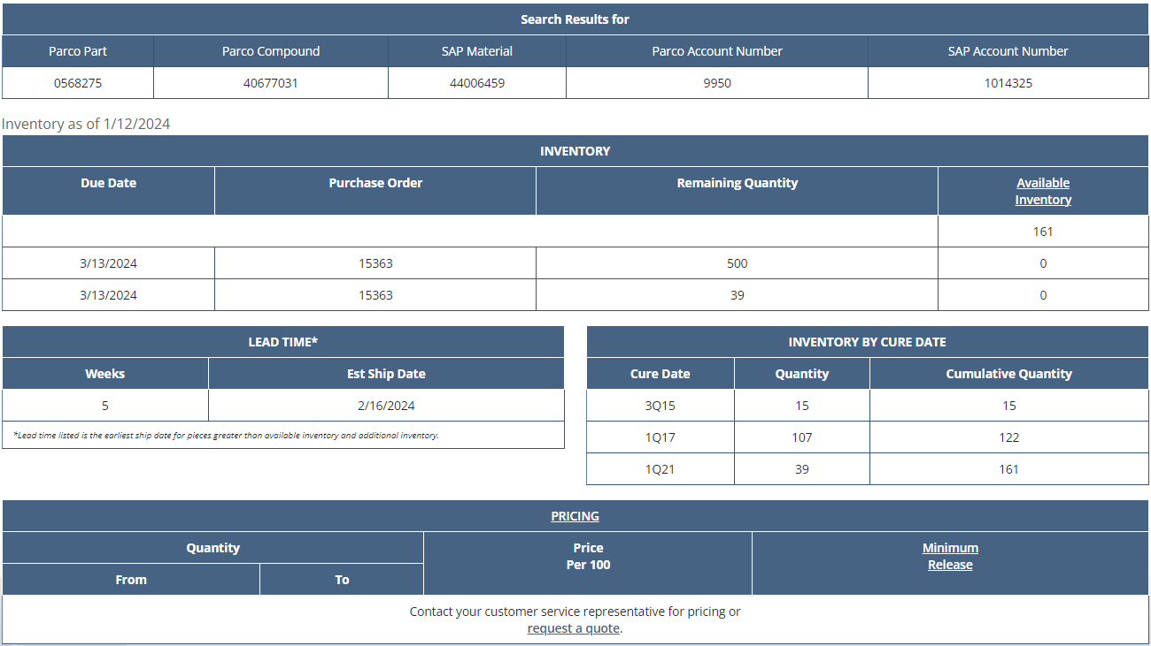
The require fields for Inventory, Lead Time, And Pricing are:
For Inventory, Lead Time, And Pricing is possible to search by:
Account No. + SAP Part
or
Account No. + Popular Compound

Slide 3
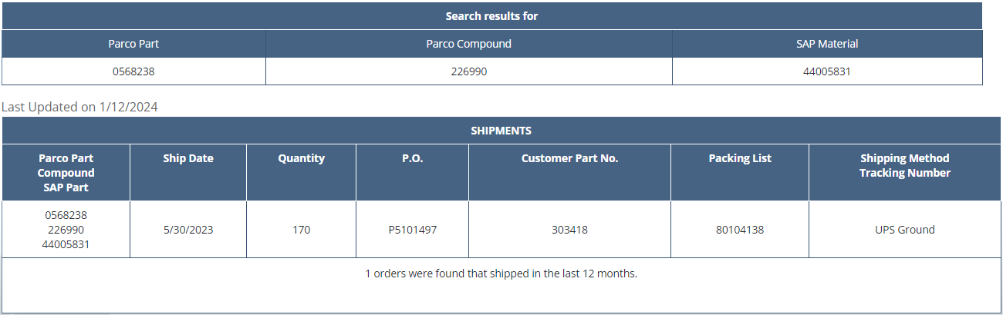
The require fields for Shipments Last 12 Months are:
For Shipments Last 12 Months is possible to search by:
Account No. + SAP Part
or
Account No. + Customer Part
or
Account No. + Ship Date

Slide 4
Information given about each order:
order number
all products purchased and their details
total price
order status
order origin
other date
support documents (if exist)

