Slide 1


Keith
In partnership with
AWS Cost Management Adoption
Presented by Andrea, Han, Hannah, Keith, Mark, and Ying on behalf of Seattle University

Slide 2
Keith
Recommendations
High-level insights & marketing opportunities:
New functionality to existing customers
High-spend small & low-spend medium/large customers
Chinese market
High-volume users
Clustering:
K-Means
By product categories used
Model
Random Forest models performed best
Recall = ~0.6 for each Visualize, Report, and Alert
F1 = 0.5-0.6 for each Visualize, Report, and Alert
Notes:
We explored several types of interactions, used a combined approach of first, last, linear
Overview of recommendations
Overview of next steps

Slide 3
Keith
AWS’ Long Product Tail
The 5 Highest-Revenue AWS Products Represent >60% of Total Revenue
- April through June 2019 -
Other Products
The top 5 (of 2,566) products represent the lion’s share of AWS revenue
Other Products
Top 5 Products
Top 5 Products
Number of products
Revenue
Notes:
We explored several types of interactions, used a combined approach of first, last, linear
Overview of recommendations
Overview of next steps

Slide 4
Ying
Small Customers Drive Revenue
Number of Users Each Month
– April through June 2019 –
Total AWS Spend per Month
– April through June 2019 –
Monthly Spend per Customer
– April through June 2019 –
Small customers drive >80% of AWS revenue
Notes:
We explored several types of interactions, used a combined approach of first, last, linear
Overview of recommendations
Overview of next steps

Slide 5
Ying
Customer Churn
However, this apparent consistency hides the story of each customer’s journey
53K unique Customers
Each month 3K dropped and 4K added
2K customers dropped in May and returned on June
Number of Customers Growth by Month
Grows by 2% on Average
May
April
All 3 Months
41K customers, or 78% of total
2K drop in May &
return in June
June
Notes:
We explored several types of interactions, used a combined approach of first, last, linear
Overview of recommendations
Overview of next steps

Slide 6
Annie
Market New Solutions to Existing Customers
Customers Expand AWS Use over Time
– April through June 2019 –
Customers appear to adopt more products over time:
Young customers use 11 products on average
Older customers use 13 products on average
Average Monthly Spend
Customer Age
Notes:
We explored several types of interactions, used a combined approach of first, last, linear
Overview of recommendations
Overview of next steps

Slide 7
Annie
Grow the Chinese Market
Customer Age
– April through June 2019 –
Number of Products Used
– April through June 2019 –
years
Notes:
We explored several types of interactions, used a combined approach of first, last, linear
Overview of recommendations
Overview of next steps

Slide 8
Annie
Market to High-Spending Small Customers
Customers who use cost management spend more on average
– Per Month, April through June 2019 –
However, this varies by customer size:
Small customers who use AWS cost services spend 9% more on average vs. those who do not
Large and Mid-sized customers who use AWS cost services spend 15% less on average vs. those who do not
Notes:
We explored several types of interactions, used a combined approach of first, last, linear
Overview of recommendations
Overview of next steps

Slide 9
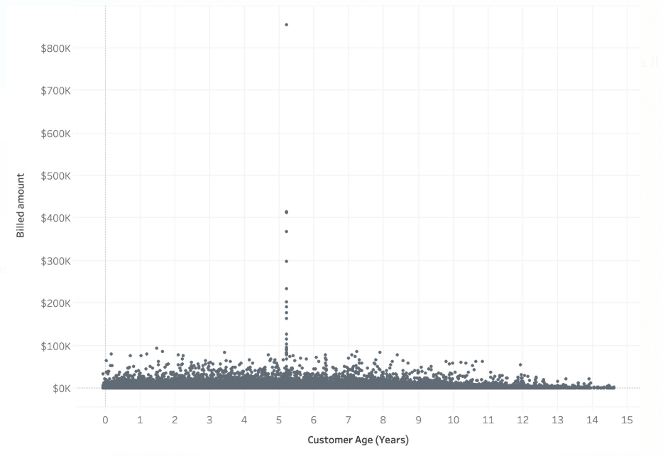
Hannah
Data Anomalies
Outliers Among Customers Who Joined January 17, 2014
– April 2019 –
$800K
$600K
$400K
$200K
$0
Additional anomalies:
Bill size (negative, large)
Product id
Geographic data
Monthly Spend
0 2 4 6 8 10 12 14
Customer Age (Years)
Notes:
We explored several types of interactions, used a combined approach of first, last, linear
Overview of recommendations
Overview of next steps

Slide 10
Mark/Han
Clustering
Clustering Method: K-Means
Clusters (by product mix):
Majority of spend on product 938
90% of spend on product 10
Relatively evenly distributed spend across product categories
Splits spend between 10 and 938 and a grouping of other products
Majority of spend on product 8
1
2
3
Customers in cluster 4 use Visualize at a higher rate than other segmented clusters:
Cluster 4 = 18909 (no visualize) 7647 (visualize) 40.4% percentage
Others = 44158 (no visualize) 13718 (visualize) 23.7% percentage
4
Cluster Name | Use Visualize
Cluster 4 | 40%
Others | 24%
5
Notes:
We explored several types of interactions, used a combined approach of first, last, linear
Overview of recommendations
Overview of next steps

Slide 11
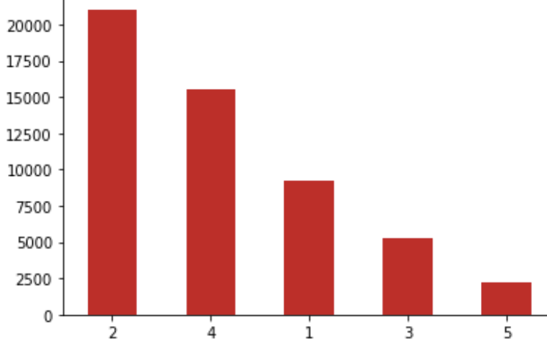
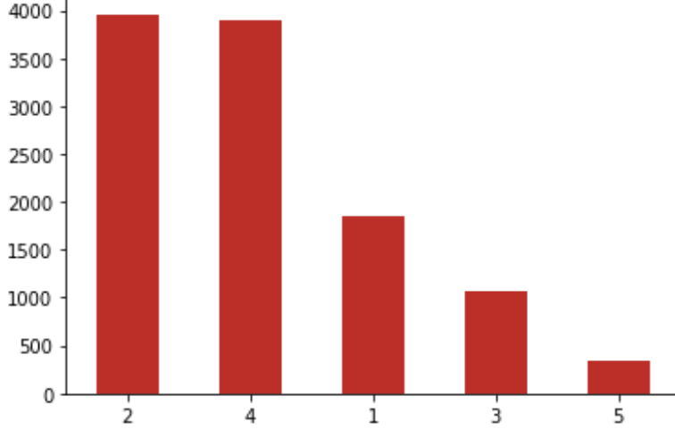
Mark/Han
Segmentation & Visualize Use
The customers in the cluster 4 market segment spread their expenditures across many products resulting in a higher use rate of Visualize. Would recommend marketing to the more diversified spend segments of clusters 3 & 4
Clusters
– Distribution–
Clusters
–Visualize Users–
Notes:
We explored several types of interactions, used a combined approach of first, last, linear
Overview of recommendations
Overview of next steps

Slide 12
Mark/Han
Building a Predictive Model
Data
K-Means Cluster for Products
Visualize
Report
Alert
Three different Random Forest Classification Models were applied in order to predict whether customers will use any of the three AWS Cost Management Tools.
Notes:
We explored several types of interactions, used a combined approach of first, last, linear
Overview of recommendations
Overview of next steps

Slide 13
Mark/Han
Model Output & Performance Metrics
Targeting predicted users of AWS Cost Management
Visualize predictions are of the most interest due to high accuracy, recall, average and positive F1 scores.
Due to highly imbalanced data Report and Alert are more difficult to accurately predict, even though they do have good average statistics.
The majority of the marketing focus for AWS Cost Reporting should be toward the Visualize user predicted classes.
 | Accuracy | Recall | F1 Score
Visualize | 65% | 56% | 43%
Report | 78% | 43% | 18%
Alert | 76% | 41% | 17%
Accuracy confidence interval: (+/-) .004
Notes:
We explored several types of interactions, used a combined approach of first, last, linear
Overview of recommendations
Overview of next steps

Slide 14
Mark/Han
Model Recommendations
AWS visualization users among high-volume AWS Users (18+ products)
Decision Tree Analysis of Visualize
Product amount is by far the most important variable.
Marketing should focus on customers using 18 or more products who are not currently using Visualize.
44% use AWS visualization
56% do not use AWS visualization
3,647 high-volume customers represent a marketing opportunity for AWS Cost Management
Notes:
We explored several types of interactions, used a combined approach of first, last, linear
Overview of recommendations
Overview of next steps

Slide 15
Mark/Han
Questions
Thank you
We would like to take this opportunity to answer any audience questions
Notes:
We explored several types of interactions, used a combined approach of first, last, linear
Overview of recommendations
Overview of next steps

