Slide 1


Bookstore Database Management
Qianhui Guo, Ying Xue, Han Li
ITeam

Slide 2

Background
01
Purpose
INTRODUCTION

Slide 3
Background of Milestone2
01 Milestone1
02 Milestone2
MySQL platform to store and retrieve information about books, authors, categories, publishers, customers, orders and purchases , order records, purchase records in 9 tables for Amazon bookstore
Randomly select the order records (300 observations) and purchase records (200 observations) within one week 2018-1-1 to 2018 1-7 from the original database

Slide 4
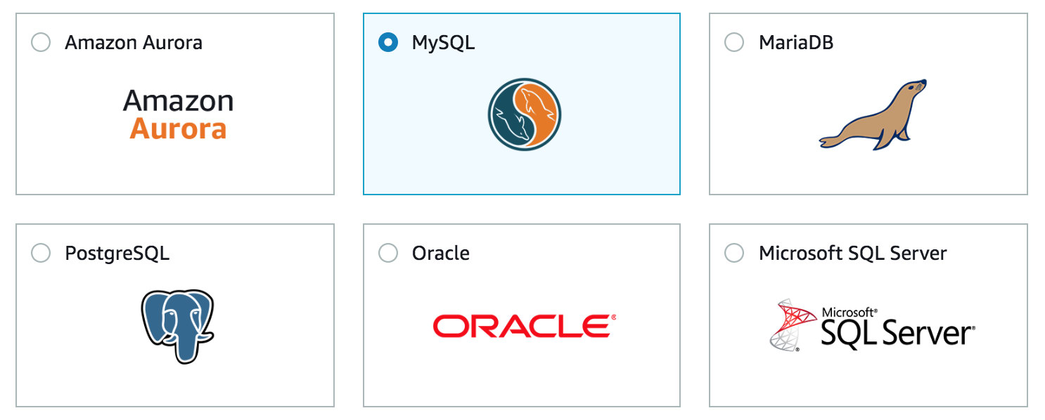
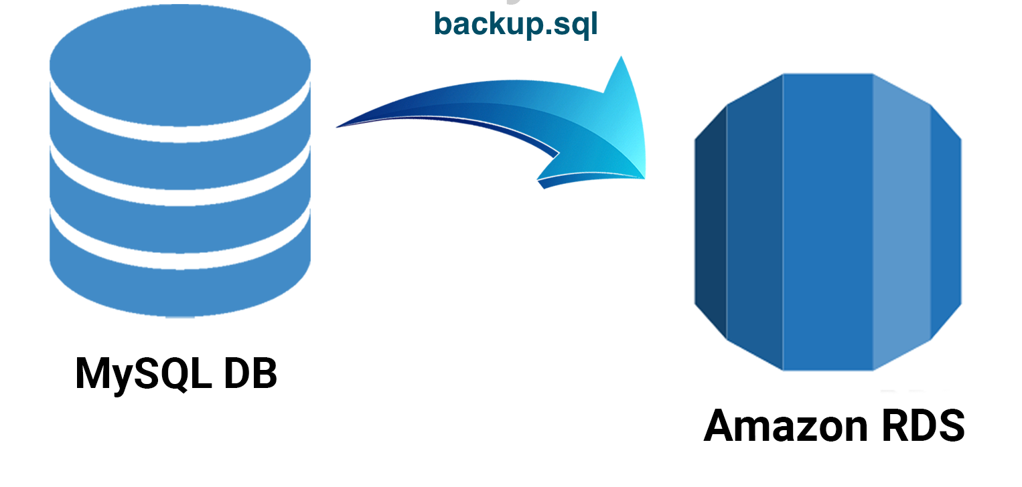
Back up to the Cloud
01 Create a MySQL Database in AWS RDS
02 Migrate existing MySQL database using backup.sql

Slide 5
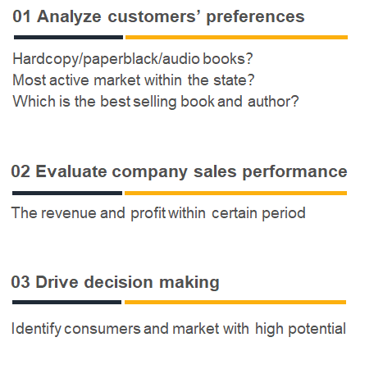
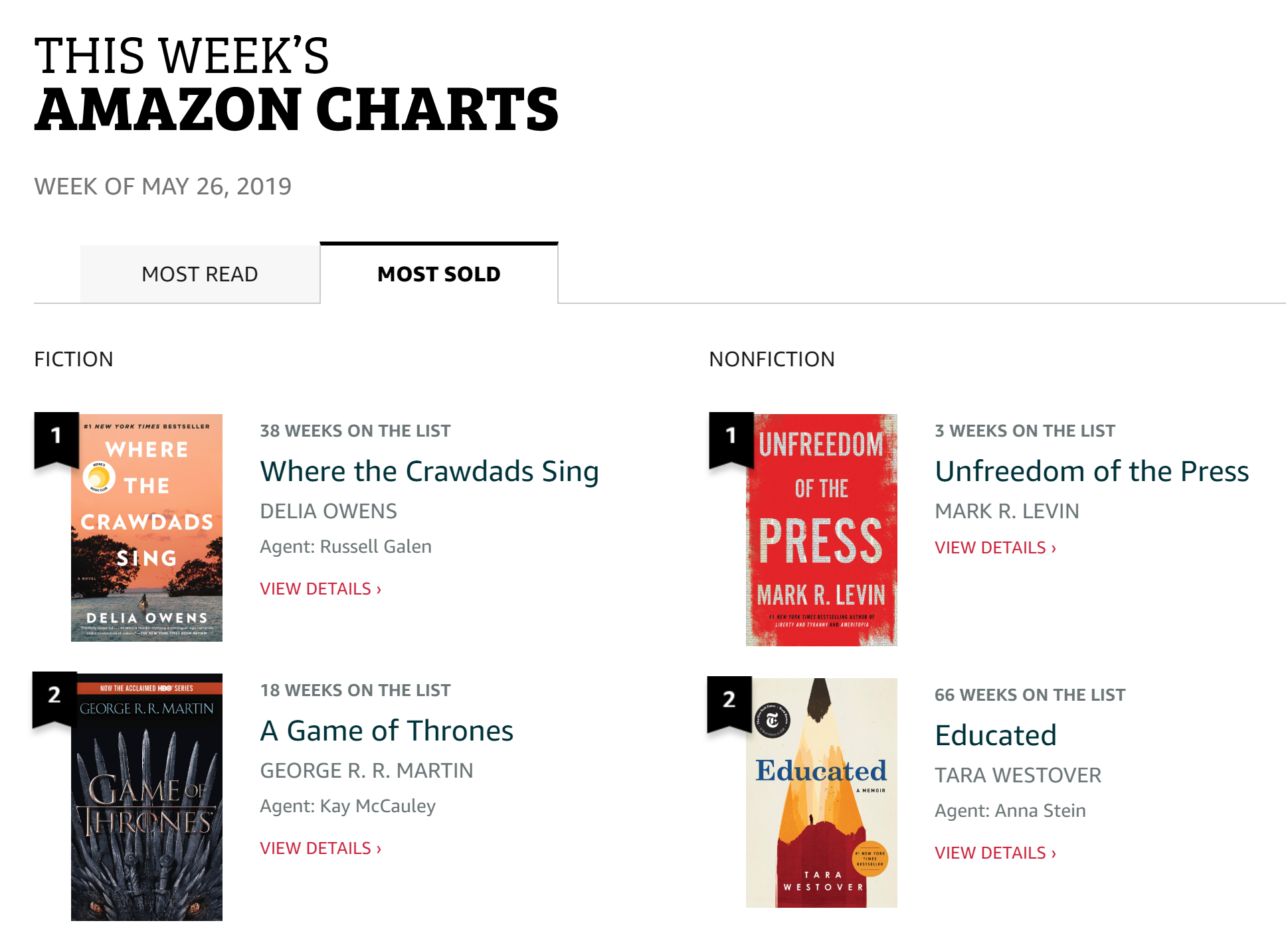
Data Analysis and Problem solved

Slide 6
Book Search Engine
02
Add New Users
Stored
Procedures

Slide 7
Book Search Engine
ISBN | Title | Author Name | Publisher | Format
1408855658 | Harry Potter and the Philosopher's Stone | Rowling JK | Fonthill Media (February 18, 2014) | Hardcopy
1408855666 | Harry Potter and the Chamber of Secrets (Harry Potter 2) | Rowling JK | Knopf | Hardcopy
1408855674 | Harry Potter and the Prisoner of Azkaban (Harry Potter 3) | Rowling JK | Scholastic Press | Paperback
1408855712 | Harry Potter and the Deathly Hallows (Harry Potter 7) | Rowling JK | Liveright | Hardcopy

Slide 8
Book Search Engine
DELIMITER $$
CREATE PROCEDURE `search_book`(IN keyword VARCHAR(50))
BEGIN
SELECT
b.ISBN, b.Title,
CONCAT(a.Aulastname,' ', a.Aufirstname) AS 'Author Name’,
p.Publisher_name AS 'Publisher',
(SELECT f.format from book_format f where f.formatID = b.FormatID)
AS "Format"
FROM
(book b INNER JOIN author a ON a.AuthorID = b.AuthorID)
INNER JOIN publisher p ON p.PublisherID = b.PublisherID
WHERE
b.Title like CONCAT('%',keyword,'%');
END$$
DELIMITER ;
Initialize input
Initialize input
Subquery
Subquery
Join
Join
Criteria
Criteria
Call Procedure
CALL search_book ('Harry Potter');
Notes:
Future improvement: allow using soundex ,

Slide 9
Add a new users
DELIMITER $$
CREATE PROCEDURE `add_customer`(
IN customer_id VARCHAR(50),
IN firstname VARCHAR(50),
IN lastname VARCHAR(50),
IN city VARCHAR(50),
IN state VARCHAR(50),
IN zipcode VARCHAR(50))
BEGIN
INSERT INTO customer
(CustomerID,CustFirstName, CustLastName,
CustCity, CustState, CustZipCode)
VALUES (customer_id, firstname,lastname, city,state,zipcode);
SELECT * FROM customer
WHERE CustomerID = customer_id;
END$$
DELIMITER ;
Initialize input
Insert
Return
Call Procedure
call add_customer ('0036b4a3d09ad551a5188c2e374dc812’,
'Gareth', 'Green', 'Seattle', 'WA','98123');
CustomerID | CustFirstName | CustLastName | CustCIty | CustState | CustZipCode
0036b4a3d09ad551a5188c2e374dc812 | Gareth | Green | Seattle | WA | 98123

Slide 10

Best Sellers
Profitable Formats
03
Recent Activities
Views

Slide 11
Best Sellers
ISBN | Title | Sales
9350330954 | Think and Grow Rich | 22
8186685693 | Alchemist | 21
9386036754 | Everyone Has A Story | 20
9562913244 | Think and Grow Rich: Original Version | 20
8183224008 | The Power of Your Subconscious Mind | 19
9385152149 | Ram - Scion of Ikshvaku (Book 1 - Ram Chandra Series): 2015 Edition with Updated... | 18
8129124025 | Half Girlfriend (Movie Tie-in Edition) | 17
8179924947 | Sanyasi Jisne Apni Sampati Bech Di: The Monk Who Sold His Ferrari (Hindi) | 16
9382618341 | The Oath of the Vayuputras (Shiva Trilogy) | 16
9386224585 | Sita: Warrior of Mithila (Ram Chandra) | 16
CREATE view best_sellers
as
SELECT ISBN,
(SELECT title FROM book
WHERE book.ISBN = order_item.ISBN)
AS 'Title’,
SUM(quantity) as 'Sales’
FROM order_item
GROUP BY ISBN
ORDER BY sum(quantity) desc
LIMIT 10;
SELECT * FROM best_sellers

Slide 12
Profitable Formats
CREATE VIEW profitable_format
AS
SELECT f.format AS 'Format’,
SUM(i.Totalprice) AS 'Total Revenue’
FROM (order_item i
INNER JOIN book b
ON i.ISBN = b.ISBN)
INNER JOIN book_format f
ON f.formatID = b.FormatID
GROUP BY f.formatID
ORDER BY sum(i.Totalprice) DESC;
Format | Total Revenue
Hardcopy | 96077
Paperback | 11559
AudioBook | 245
SELECT * FROM profitable_format;

Slide 13
Recent Activities
CREATE VIEW Purchase_Sell_record
AS
SELECT
b.ISBN, b.Title, r.Orderdatetime
AS Datetime,
o.Quantity, o.Totalprice, 'Sell’
AS Type
FROM
(book b INNER JOIN order_item o
ON b.ISBN = o.ISBN)
INNER JOIN order_record r
ON r.OrderID = o.OrderID
UNION
SELECT
b.ISBN, b.Title,r.Purchasedatetime
AS Datetime,
o.Quantity, o.Totalprice, 'Purchase’
AS Type
FROM
(book b INNER JOIN purchase_item o
ON b.ISBN = o.ISBN)
INNER JOIN purchase_record r
ON r.PurchaseID = o.PurchaseID
GROUP BY b.ISBN
ORDER BY Datetime desc
Limit 15;
ISBN | Title | Datetime | Quantity | Totalprice | Type
9385152149 | Ram - Scion of Ikshvaku (Book 1 - Ram Chandra Series): 2015 Edition with Updated... | 1/7/2018 23:55 | 2 | 480 | Sell
9386224399 | This Is Not Your Story | 1/7/2018 22:52 | 1 | 100 | Sell
8185986010 | The Bachelor of Arts | 1/7/2018 22:17 | 1 | 90 | Sell
8179924947 | Sanyasi Jisne Apni Sampati Bech Di: The MonkWho Sold His Ferrari (Hindi) | 1/7/2018 21:56 | 1 | 142 | Sell
8129137704 | My Gita | 1/7/2018 21:18 | 1 | 153 | Sell
9386850648 | Keepers of the Kalachakra: Book 5 in the Bharat Series of Historical and Mythological... | 1/7/2018 20:49 | 1 | 100 | Sell
9381626685 | The Krishna Key: Book 3 in the Bharat Series of Historical and Mythological Thrillers | 1/7/2018 20:15 | 400 | 78200 | Purchase
8129135728 | Half Girlfriend | 1/7/2018 19:43 | 1 | 106 | Sell
9386224399 | This Is Not Your Story | 1/7/2018 19:36 | 1 | 100 | Sell
9386036754 | Everyone Has A Story | 1/7/2018 19:18 | 1 | 100 | Sell
8183224008 | The Power of Your Subconscious Mind | 1/7/2018 18:48 | 1 | 159 | Sell
9351160092 | Unbreakable | 1/7/2018 18:23 | 1 | 145 | Sell
1408855674 | Harry Potter and the Prisoner of Azkaban (Harry Potter 3) | 1/7/2018 18:13 | 1 | 374 | Sell
8183224008 | The Power of Your Subconscious Mind | 1/7/2018 17:55 | 3 | 477 | Sell
8183220940 | Rahasya | 1/7/2018 17:31 | 3 | 699 | Sell
SELECT * FROM Purchase_Sell_record;

Slide 14

Proportion of
Different Formats
Popular States
04
Sales and Profits
Best Sellers
Visualization
Most Popular Author

Slide 15
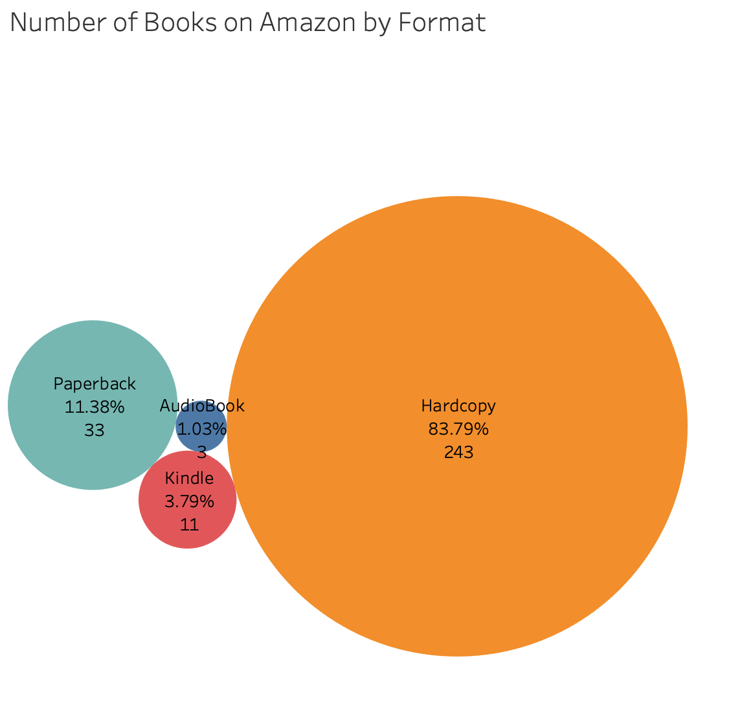
Is Amazon providing ECO friendly books?
SELECT bf.format, b.number_of_format
FROM milestone2.book_format as bf
JOIN
(SELECT formatID, count(*) as number_of_format
FROM milestone2.book
GROUP BY formatID) as b
ON bf.formatID = b.formatID
ORDER BY b.number_of_format DESC

Slide 16
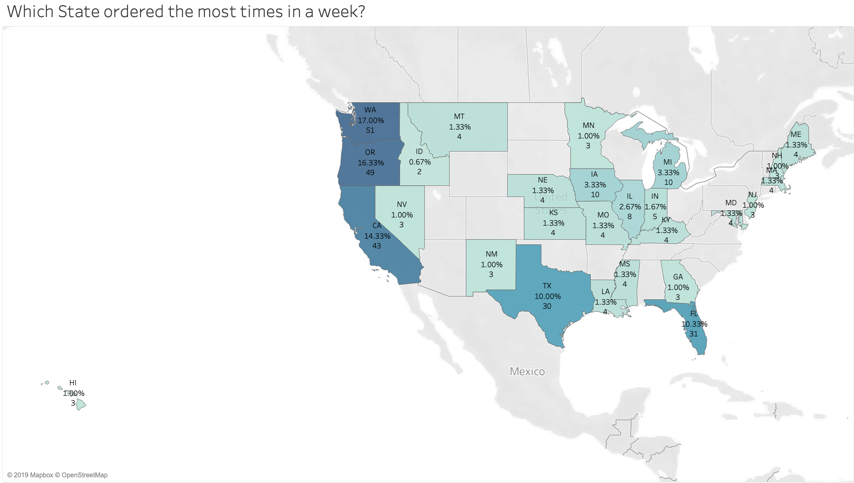
User Study: Which State is the most active?
SELECT
c.CustState,
SUM(pc.purchased_times) as TotalPurchase
FROM milestone2.customer as c
JOIN
(SELECT CustomerID, count(*) as purchased_times
FROM milestone2.order_record
Group by CustomerID
Order by purchased_times desc) as pc
ON c.CustomerID = pc.CustomerID
GROUP BY CustState
ORDER BY TotalPurchase DESC

Slide 17
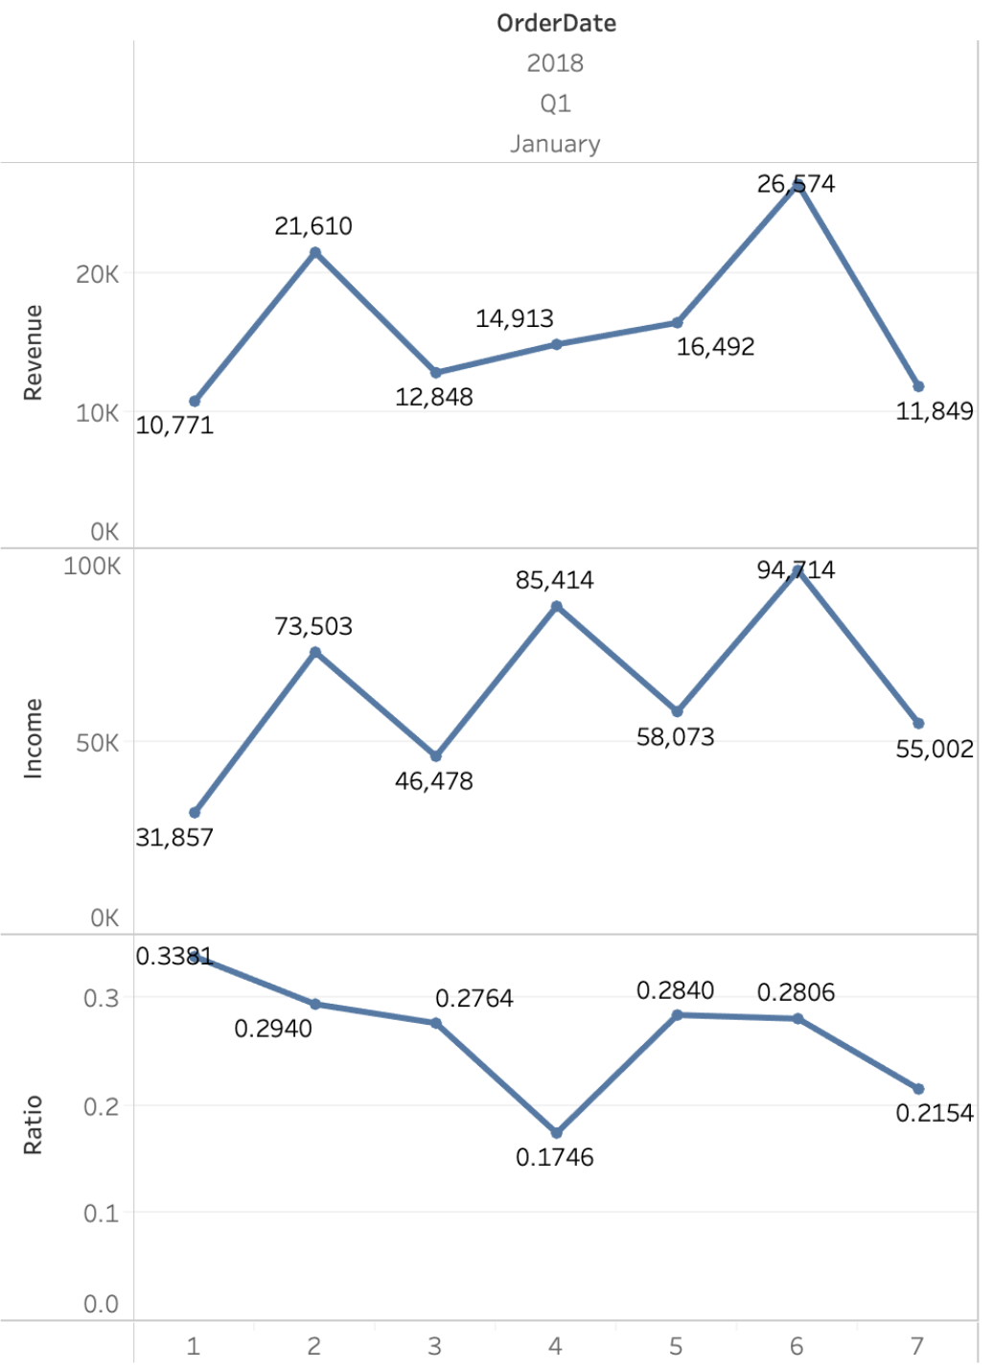
Business Analysis: Sales and Profit
SELECT
OrderDate,
SUM(TotalPrice) as Income,
SUM(Revenue) as Revenue, (sum(Revenue)/sum(TotalPrice)) as Ratio
FROM
(((SELECT oi.OrderID, oi.TotalPrice, oi.Quantity, DATE(od.Orderdatetime) as OrderDate, (oi.TotalPrice / oi.Quantity - pt.TotalPrice / pt.Quantity) as Revenue
FROM milestone2.order_item) as oi
JOIN milestone2.order_record as od
ON oi.OrderID = od.OrderID)
JOIN milestone2.purchase_item as pt
ON oi.ISBN = pt.ISBN) as odr
GROUP BY OrderDate
ORDER BY OrderDate ASC

Slide 18
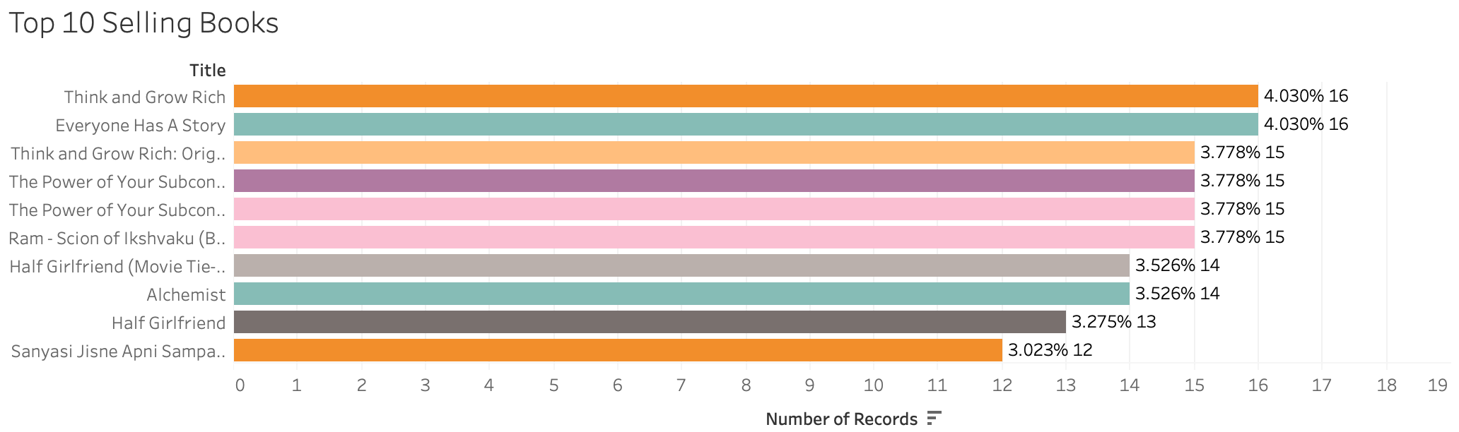

Business Analysis: Best Selling Books
SELECT b.Title, oi.number
FROM milestone2.book as b
JOIN
(Select ISBN, sum(quantity) as number
From milestone2.order_item
group by ISBN) as oi
ON b.ISBN = oi.ISBN
ORDER BY number DESC
LIMIT 10

Slide 19
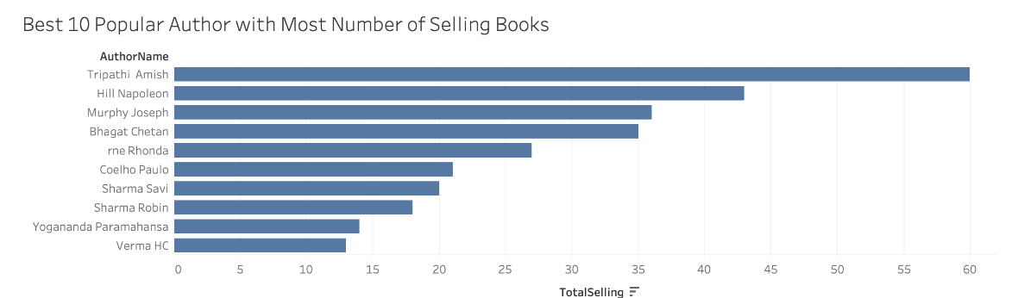

Business Analysis: Most Popular Author
SELECT
concat(a.Aulastname, ' ', a.Aufirstname)
as AuthorName, s.TotalSelling
FROM milestone2.author as a
JOIN
(Select ab.AuthorID, sum(number) as TotalSelling
From
(Select b.AuthorID, oi.number
From milestone2.book as b
Join
(Select ISBN, sum(quantity) as number
From milestone2.order_item
group by ISBN) as oi
on b.ISBN = oi.ISBN) as ab
Group by AuthorID) as s
ON a.AuthorID = s.AuthorID
ORDER BY TotalSelling DESC
LIMIT 10

Slide 20
Hands On Experience
Database Backup
05
Use SQL to Solve
Business Problem
LESSON LEARNED
AWS to Tableau

Slide 21
Hands on Experience
Valuable hands on practice:
Ex. Create schema and build a relational model, search the open data and insert it into tables
2. Enhancing the understanding of database and SQL:
More details are learned, such as the same datatype of PK and FK

Slide 22
Database Backup
Understanding the necessity of database backup:
Database backup is to maintain and restore critical/essential business data to prevent a disaster or technical outage.
2. How to perform db backup as migrating into the cloud:
In this project, we use AWS cloud and create a Mysql database. The file backup.sql is able to perform database replication. Later, we may apply different backup methods in the projects.

Slide 23
Use SQL to Solve Business Problems
Think in the way to solve business problems:
Need to think about the business requirements and outcomes before analyzing data by SQL for valuable insight of data.
Ex. We created a view showing the 10 best-selling books, which enable Amazon to recommend them to most readers.
2. Use the proper method to get the result:
Ex. We can create an advanced SQL query by using aggregate, subquery, and union function together to satisfy a customer’s request.

Slide 24
AWS to Tableau
Connect AWS to Tableau:
Ex. We had a valuable experience to touch AWS and connect the database on AWS to Tableau for further data visualization.
2. Execute SQL query in Tableau
3. Generate output of data visualization with Tableau

Slide 25
Thank you!

