Slide 1


Annie
In partnership with:
Smarketing Attribution
Presented by Andrea, Han, Hannah, Keith, Mark, and Ying on behalf of Seattle University

Slide 2
Annie
Agenda
Overview
Data & Assumptions
Simple attribution models & findings
Markov attribution model & findings
Insights & next steps
Notes:
We explored several types of interactions, used a combined approach of first, last, linear
Overview of recommendations
Overview of next steps

Slide 3



Keith
Project Overview
Goal: Use smarketing analysis to improve Zillow’s ability to recruit real estate agents
Interactions: How much credit should be assigned to each type of interaction? What is the associated ROI of spend on marketing & sales?
Methods: first touch, last touch, linear, Markov
Metrics: conversion, revenue, ROI
Conversions & revenue: calls, organic
ROI: Email consistently outperforms others
Resource allocation: How should Zillow apply these findings? How should they change the allocation of advertising and sales dollars?
Integrate email with sales team to enable cost savings
Optimize sales call time
Next steps: With more time and resources, how would you improve this analysis?
Data granularity (if available)
Expand scope: customer retention
3 month pilot program and analysis
Notes:
We explored several types of interactions, used a combined approach of first, last, linear
Overview of recommendations
Overview of next steps

Slide 4
Hannah
Data
Example Customer Journey (85 days)
1
Clicked Bing search ad
Call sales representative
Sales rep calls them
Meeting with sales rep
Convert
2
3
Key Variables for Analysis:
Interaction channel
Interaction date
Avg cost for the interaction
Acquisition date
NPV of the agent
4
5

Slide 5
Hannah
Assumptions
Organic leads are considered as organic regardless of possible prior ad exposure​
We do not have impression data to attribute how much of organic data is from ad exposure vs. truly organic. ​
Time Zone Consistency​
Assume all dates and times are recorded in the same time zone. ​
Calls​
Eliminated calls under 30 seconds; cost for each call assumed to be $10.
NPV per agent
Used last-touch attribution measure for NPV calculation.
Used averages; more granular NPV data for call and meeting channels were unavailable.

Slide 6
Keith
Attribution Methods: Simple Assumption Models
Last Touch First Touch Linear
Customer journey
Customer journey
Customer journey
These attribution methods are simple but rely on assumptions – often ignoring the impact of smarketing touchpoints that have a greater impact
Notes:
Explored multiple attribution methods--- no one ‘true’ best method
Plusses and minuses of each
They WERE using last touch

Slide 7
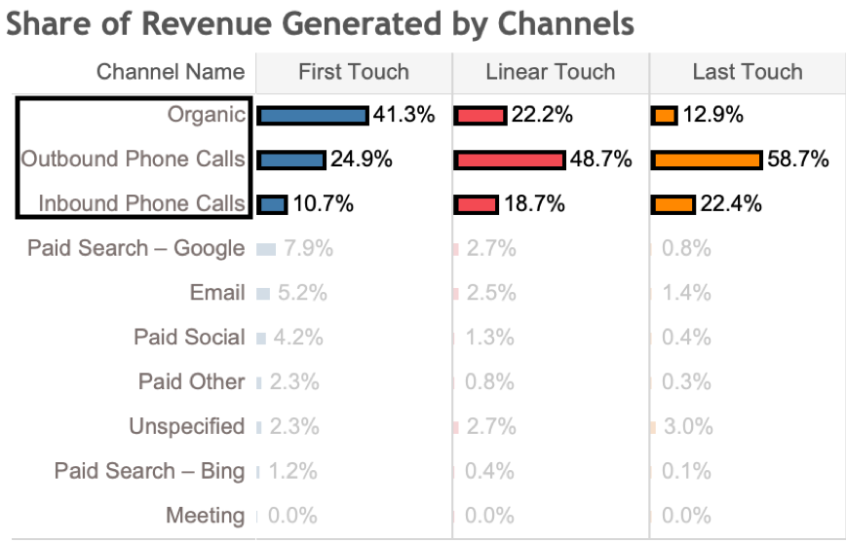
Ying
Findings: Simple Assumption Models’ Revenue Attribution
Top 3: Organic, outbound phone, inbound phone
Ranking and share varies
Most conversions are from Organic Leads initially, then closed by outbound calls
Notes:
Explored multiple attribution methods--- no one ‘true’ best method
Plusses and minuses of each
They WERE using last touch

Slide 8
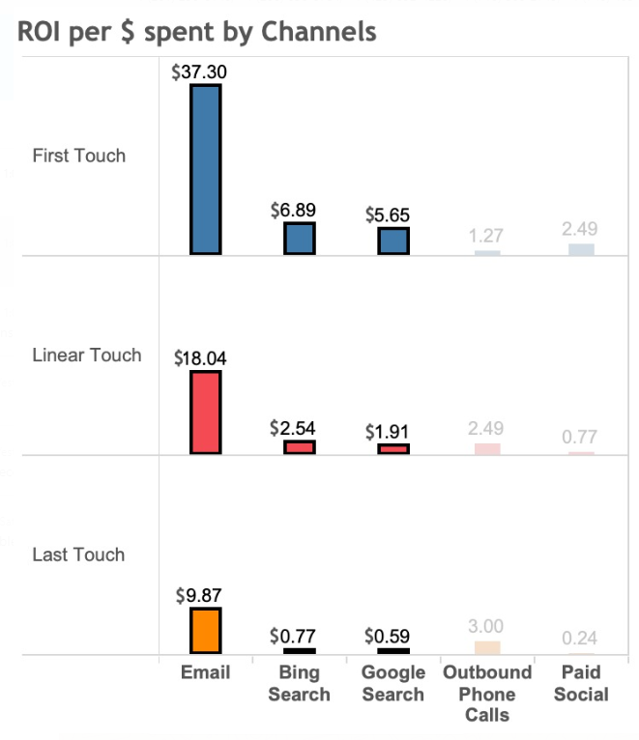
Ying
Findings: Simple Assumption Models’ ROI
Email always ranks 1st
High variance across models
High ROI due to high conversion rate and low cost
Limitation of simple models:
Underestimate or overestimate certain touch points
Do not explore correlation between the channels and the conversion
Notes:
Explored multiple attribution methods--- no one ‘true’ best method
Plusses and minuses of each
They WERE using last touch

Slide 9

Mark
A Better Way: Attribution
The Markov Attribution Model
Data-driven
Probabilistic
Considers each marketing or sales channel as a state in a Markov Chain
Start
50%
50%
Channel 1
Channel 2
Example: A visitor comes to the site via Email; they become part of the “Email state,” which has an increased probability of conversion compared to someone who has not come into any marketing channel at all.
Increases (or decreases) in conversion probability from this approach are then used as attribution weights to distribute conversions equitably.
50%
100%
50%
Channel 3
40%
60%
No Conversion
Convert

Slide 10
Mark
Why Markov Attribution
Key advantages over heuristic rule-based models
Journey Based- Channel sequence as a fundamental part of the algorithm, which makes it the model best aligned with a customers journey.
Objectivity – Data-driven. There is no need to guess weights or determine touch priority.
Robustness – Valid and reliable results. Results are a holistic view of the customer journey and therefore can reliably capture the effects of changes in marketing/sales strategy on the likelihood to convert.
Versatility – Not dataset dependent. Able to adapt to new data and is not limited by explicit assumptions about the customer decision process.

Slide 11
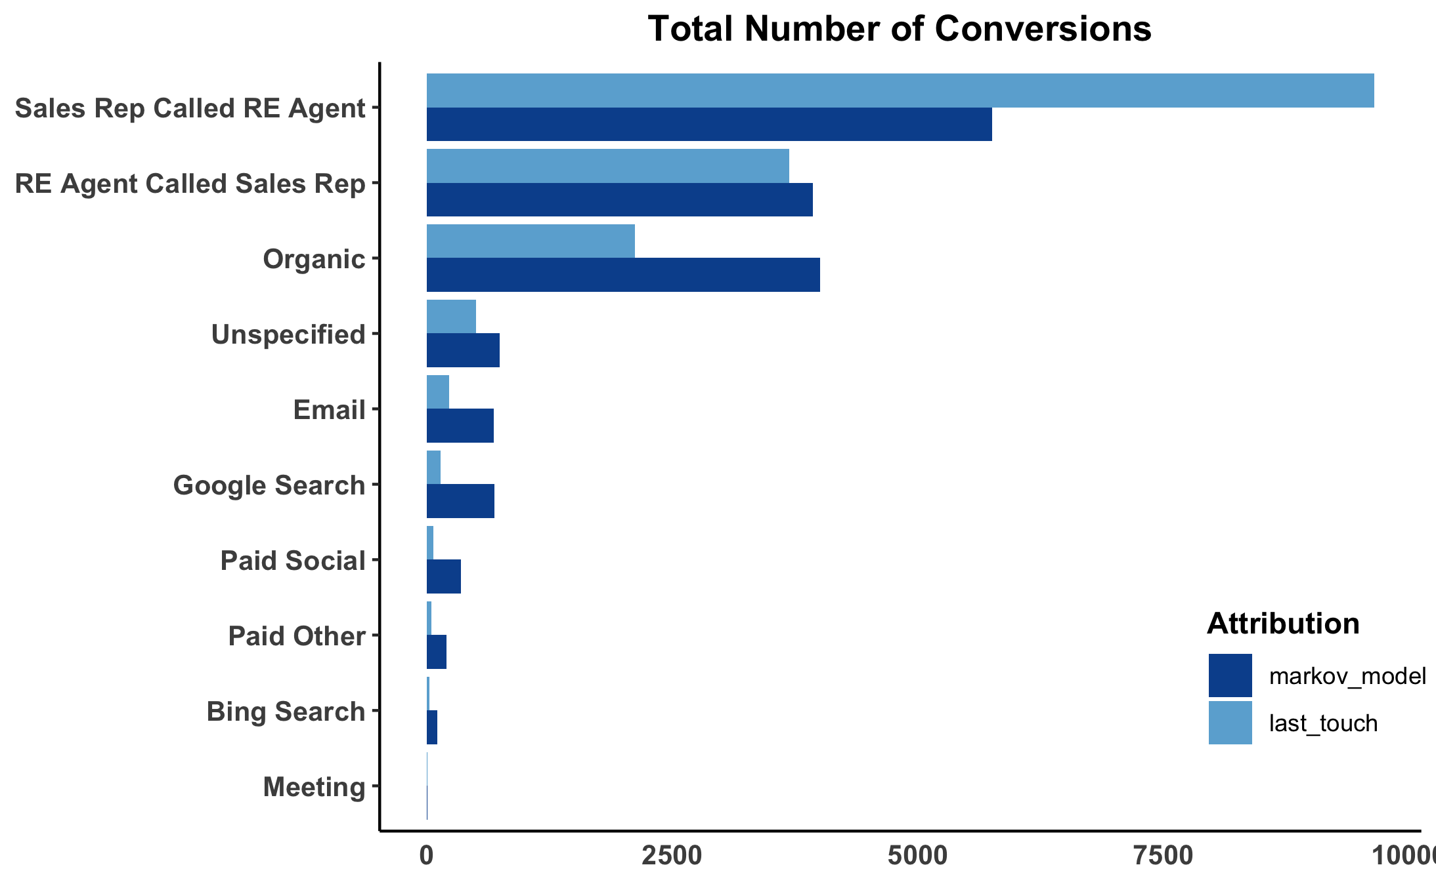
Mark
Observations: Markov vs. Last Touch
Last touch was overestimating the number of conversions for outgoing Sales Calls.
All of the marketing channels were being under-attributed by the last touch method.
Meetings result in almost no conversions, this is like due to the fact that many of them were after the acquisition date.

Slide 12
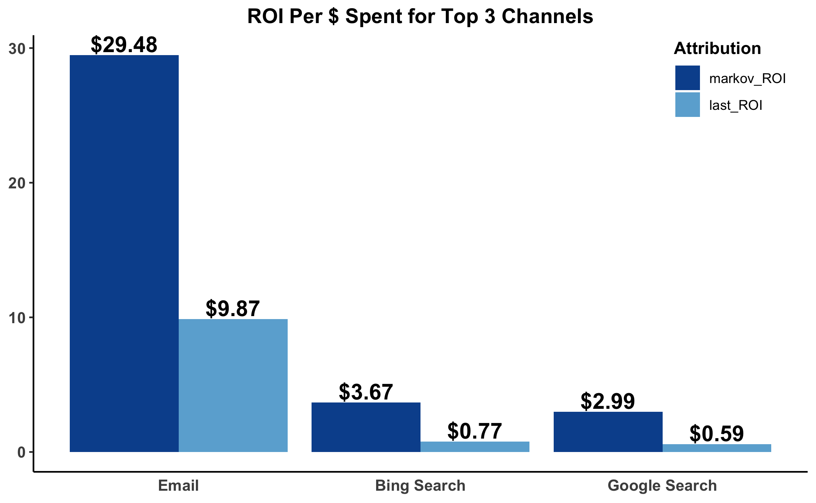
Mark
New Insights into Marketing Channel ROI
Last touch attribution was drastically underestimating ROI.
Email ROI was underestimated by 67%
Bing Search ROI was underestimated by 79%
Google Search ROI was underestimated by 80%

Slide 13
Mark
Marketing and Sales: Strategic Integration
Real Estate Agents are busy and may be difficult to reach by phone.
The conversion rate for Sales Rep Called RE Agent is only 0.24% resulting in a cost per acquisition of $4,192. It is common to see customer journeys with multiple phone calls under 5 minutes, likely due to the Agent not answering and the Sales Rep leaving a voicemail.
As evidenced by the high ROI and 3.7% conversion rate for email marketing; Agents are at least somewhat receptive to email communication.
Leverage this observation and implement a sales introduction email strategy.
Introduce sales email
Decrease the number of sales calls
Reduces costs and boosts conversion rate
Increases sales call ROI

Slide 14
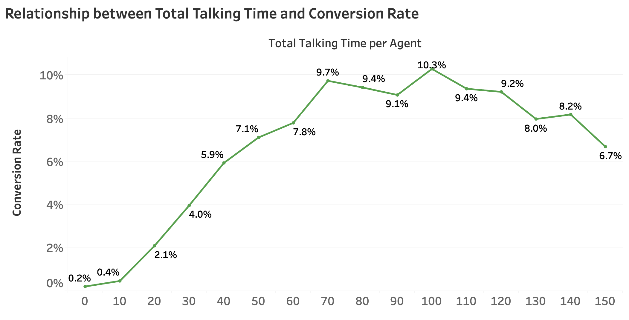
Han
Next Steps: Increasing ROI
Marketing: Multiplicative Effect
Sales: Optimize Call Time
Further understand if overlap in marketing leads are additive or redundant
Determine impact of specific sales actions: total talk time, number of calls, date/time of calls, etc.
Organic Only
72%
Paid + Organic
5%
Paid Only
26%
Initial takeaways:
Put more resources to the agents who have total talking time ~10-70 minutes
Keep total talking time per agent ~70-120 minutes
Email + Organic
2%
Email + Paid
0.5%
Email Only 9%
Agent from different Lead Type
Total talking time (minutes)

Slide 15
Annie
Next Steps: Timeline
Research
Testing
Timeline: 1 month
Model both customer acquisition and retention
Integrate additional data for analysis
Impressions
NPV of each individual agent
Cost/minute for calls
Timeline: 3 months
Pilot program:
Integrate email strategy for sales department; follow-up and appointment scheduling (save money on repeated calls)
Employ meetings as a retention strategy; reduce spend on meetings for acquisition
Focus on optimizing call times: 70-120 minutes to avoid diminishing returns
Additional analysis based off of data collected during the pilot program
1
2

Slide 16


Annie
Conclusion
Interactions:
Markov attribution: improved on existing last touch model
Conversions & revenue: closely tied to phone calls and organic lead generation
ROI: Email consistently outperforms other channels
Resource allocation:
Integrate email with sales team to enable cost savings
Optimize sales call time
Next steps:
Expand scope: include customer acquisition and retention together
Data: include impressions, NPV for each agent acquired, cost per call
Further analysis for pilot program
Notes:
We explored several types of interactions, used a combined approach of first, last, linear
Overview of recommendations
Overview of next steps

Slide 17
Annie
Questions
Thank you
We would like to take this opportunity to answer questions from the board on our research
Contact information:
Email: aghellebust@gmail.com
Notes:
We explored several types of interactions, used a combined approach of first, last, linear
Overview of recommendations
Overview of next steps

