Slide 1


Cathy
Hotel Demand Forecasting
Presented by Ying and Qiuye

Slide 2
Cathy
Agenda
1
Introduction and Project Objective
Data & EDA
Models Descriptions and Key Findings
Comparison of different models
Conclusions and Recommendations
2
3
4
5

Slide 3
Cathy
Introduction & Objective
Demand forecasting predicts how many rooms would be booked on a give day if there were no constraints.
Demand forecasting is a critical component of hotel revenue management
•10% increase in forecasting accuracy may result in 3% increase in revenue.
Apply different approaches to demand forecasting
Evaluate and find the best forecasting model for three hotels

Slide 4
Cathy
Data and Variables:
3 hotels: GLWST, MLKEP and WARUK
Two years of historical data (193,624 rows) with detailed booking information
Room type, product type, length of stay, booking date, net bookings, net revenue etc.
Dependent (y) variable is daily hotel room demand.
Most important dimensions: confirmation date and stay date
Training data: (2008-5-1 to 2009-10-31)
Test data: (2009-11-1 to 2010-4-30)
Forecast horizon: 11 horizons
1m_Nov
1m_Dec
1m_Jan
1m_Feb
1m_Mar
1m_Apr
3m_Nov-Jan
3m_Dec-Feb
3m_Jan-Mar
3m_Feb-Apr
6m_Nov-Apr

Slide 5
Cathy
Time Series Forecasting Approaches & Error Measurements
Advanced Booking
Historical
Exponential smoothing
ARIMA and seasonal ARIMA
Machine Learning
neural network
Combined models
Error Measurements: MAE, MAPE and MASE

Slide 6
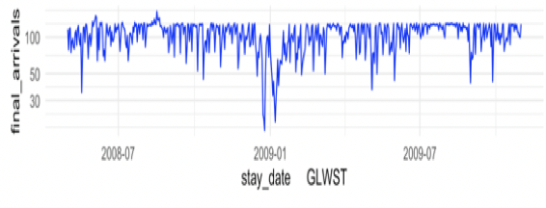
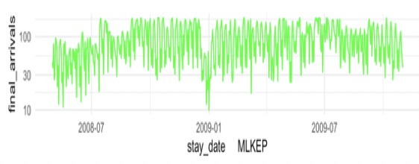
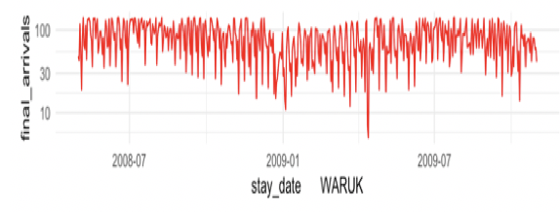
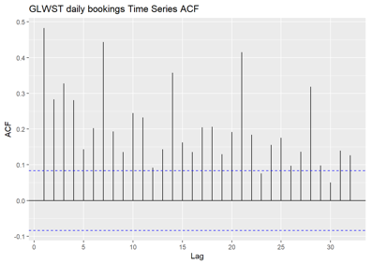
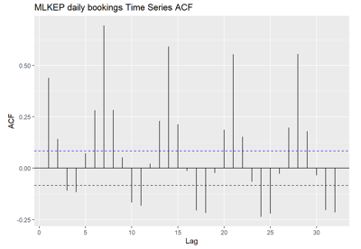
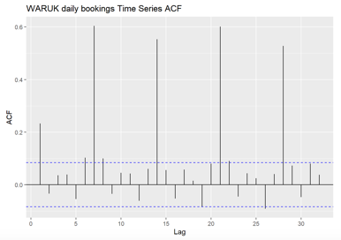
Ying
Time series and auto correlation plot:
high correlation with a week
pattern every 7, 14, 21 days
Correlation decay overtime
pattern every 7,14,21 days
cyclic pattern
pattern every 7,14,21 days
cyclic pattern

Slide 7
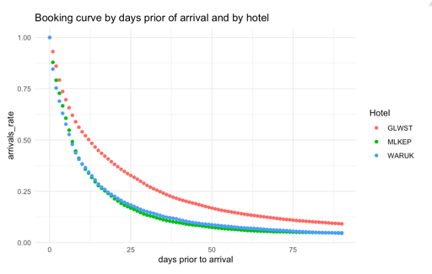
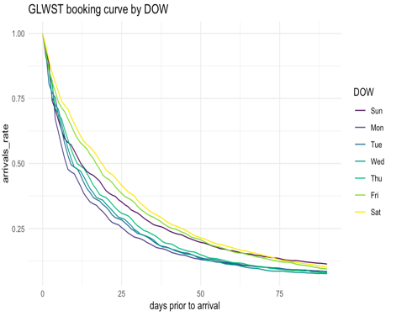
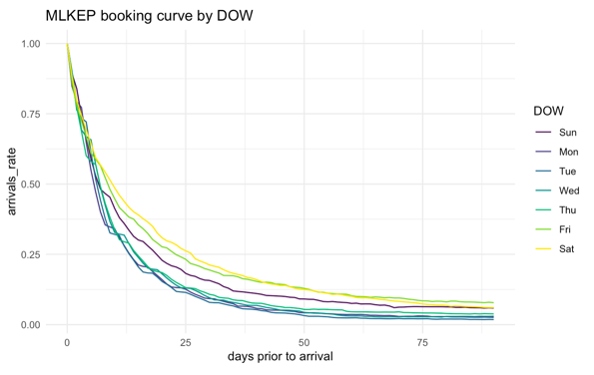
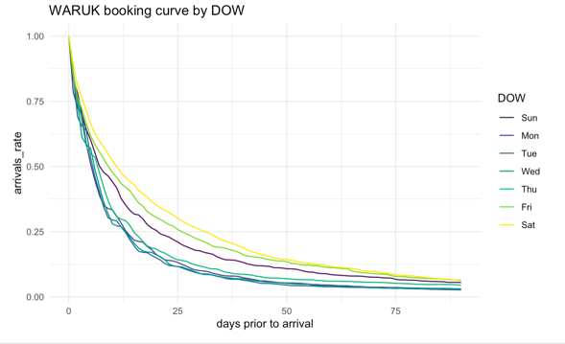
Ying
Booking Curve
Cumulative bookings increase at an increasing rate as the day 0 approaches
Most guest begin to book within 50 days especially with 30 days
all three hotels, the booking window within 30 days accounts for more than 75% of the bookings
For three hotel, customers with finals stay date on Sat, Fri and Sun appear to booking more ahead of time than those on other days of week.
Except for Sat, Fri and Sun , almost 95% of the bookings appear in 50 days before Day 0.
Notes:
which means more customers book their hotels at dates closer to the final stay date.

Slide 8
Advance Booking Model
Additive Model
Multiplicative Model
Booking Date Day n | Final Stay Date Day 0 | Days Prior K | Avg Remaining Booking
2019-03-31 | 2019-04-01 | 1 | 40
2019-04-30 | 2019-05-01 | 1 | 40
2019-03-30 | 2019-04-01 | 2 | 50
2019-04-29 | 2019-05-01 | 2 | 50
Booking Date Day n | Final Stay Date Day 0 | Days Prior k | Avg Booking Rate
2019-03-31 | 2019-04-01 | 1 | 95%
2019-04-30 | 2019-05-01 | 1 | 95%
2019-03-30 | 2019-04-01 | 2 | 90%
2019-04-29 | 2019-05-01 | 2 | 90%
Forecast = bookings at Day n + avg RB for K days prior
Forecast = bookings at Day n * avg BR for k days prior
Notes:
which means more customers book their hotels at dates closer to the final stay date.

Slide 9


Ying
Exponential Smoothing
 | Past Obs. α | Trend β | Seasonal γ
Simple Exponential Smoothing (SES)
Double Exponential Smoothing (Holt)
Triple Exponential Smoothing (Holt-Winter)
Notes:
All of the three methods forecast using the weighted averages of past observations, they attach higher weight to the recent data and less to the older data , and the weight dcreases exponentially
the additive method is preferred when the seasonal variations are roughly constant through the series, while the multiplicative method is preferred when the seasonal variations are changing proportional to the level of the series

Slide 10
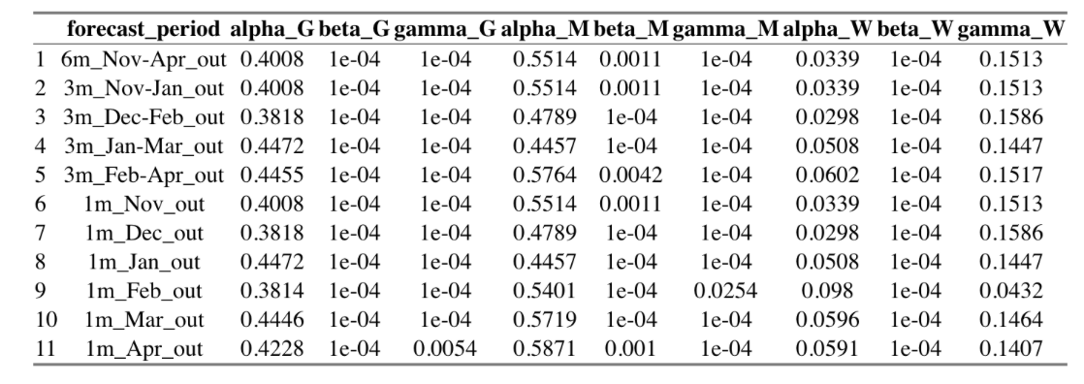
Ying
Exponential Smoothing
Assign no weight to
trend and seasonality
Assign no weight to
trend and seasonality
Assign no weight to
past observations and trend
Notes:
the additive method is preferred when the seasonal variations are roughly constant through the series, while the multiplicative method is preferred when the seasonal variations are changing proportional to the level of the series

Slide 11
Ying
Exponential Smoothing
Y | Alpha | Alpha for T
Yt | 0.5 | 0.5
Yt-1 | 0.5 | 0.25
Yt-2 | 0.5 | 0.125
Yt-3 | 0.5 | 0.0625
Yt-4 | 0.5 | 0.03125
Yt-5 | 0.5 | 0.015625
Yt-6 | 0.5 | 0.0078125
Limitation:
Give more significance to recent observations
Short term memory can’t handle the seasonal or cyclic variations well
Only consider the pattern final arrivals and neglect the cumulative bookings of each day
Notes:
as stated in our case, with the parameter decay exponentially, only the closet several observations would be considered

Slide 12
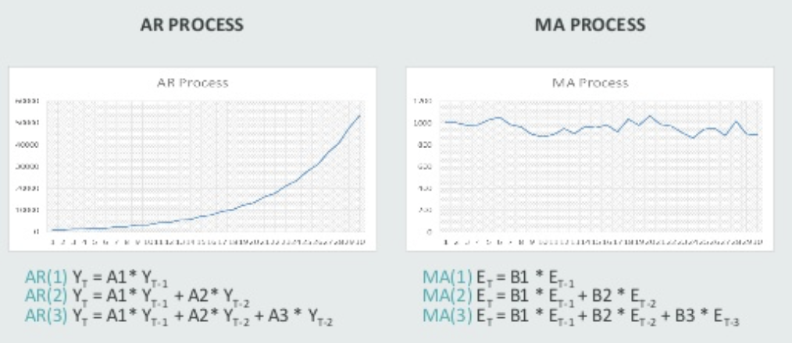
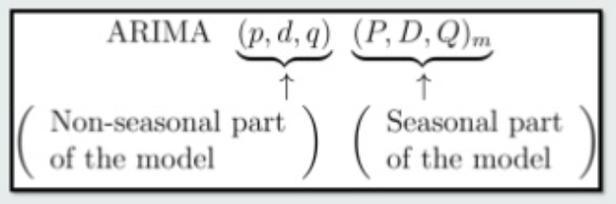

Ying
Arima and Seasonal Arima
Name
Process
Parameters
Auto Regression Integrated Moving Average
Notes:
using a linear combination of past values of final arrivals
using a linear combinations of past forecast errors

Slide 13
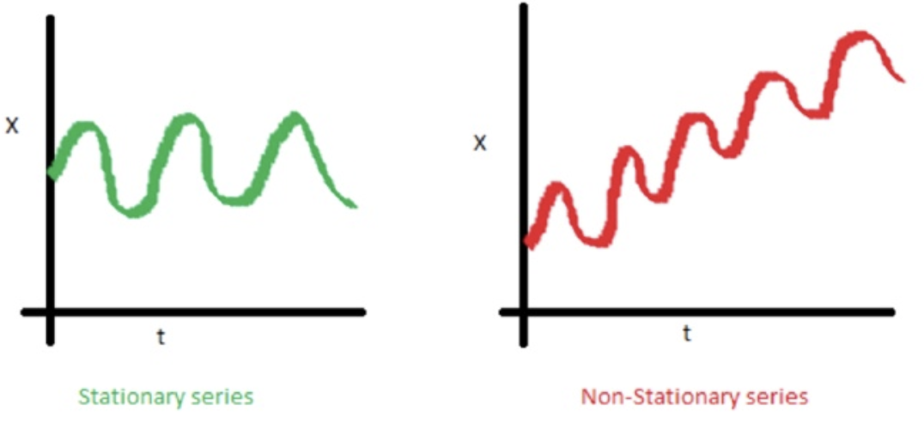
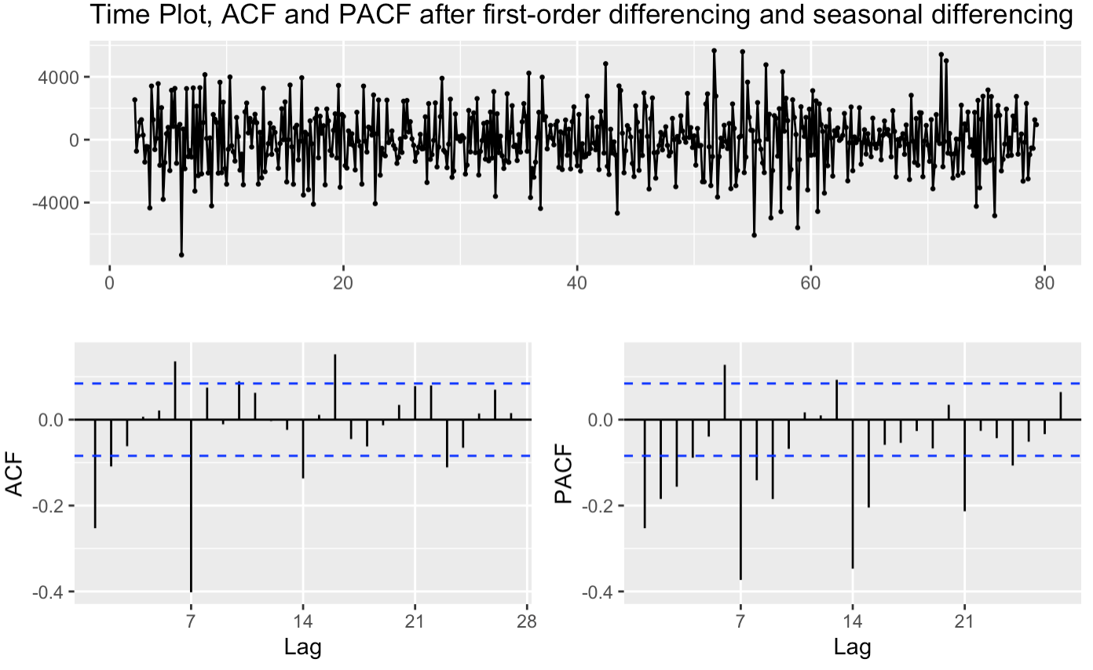
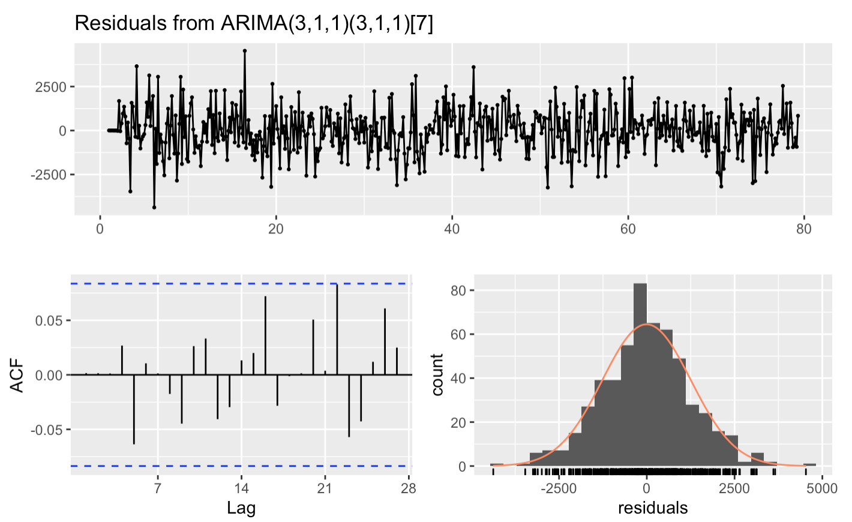
Ying
Procedure : Seasonal Arima - Arima(3,1,1,3,1,1)[7]
Differencing the series
Choose parameters with minimum AICs
Plot ACF/PACF to find candidate parameters
Plot ACF of the residuals and adjust the parameters until residuals have white noise
Make predictions
Notes:
Limitaton : The ARIMA method is appropriate only for a time series that is stationary (i.e., its mean, variance, and autocorrelation should be approximately constant through time) and it is recommended that there are at least 50 observations in the input data. It is also assumed that the values of the estimated parameters are constant throughout the series.

Slide 14
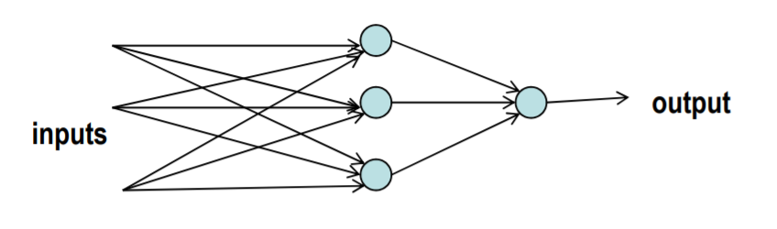
Cathy
Neural Network
Neural network (NN) algorithms have been found to be useful techniques for demand forecasting due to their ability to accommodate non- linear data, to capture subtle functional relationships among empirical data, even where the underlying relationships are unknown or hard to describe
Dependent variable: hotel room demand for each night
Independent variables: cumulative bookings, days prior, lag 1, lag 2, lag 3, lag 4, lag 5, lag 6, lag 7, lag 14, lag 21, lag 364

Slide 15
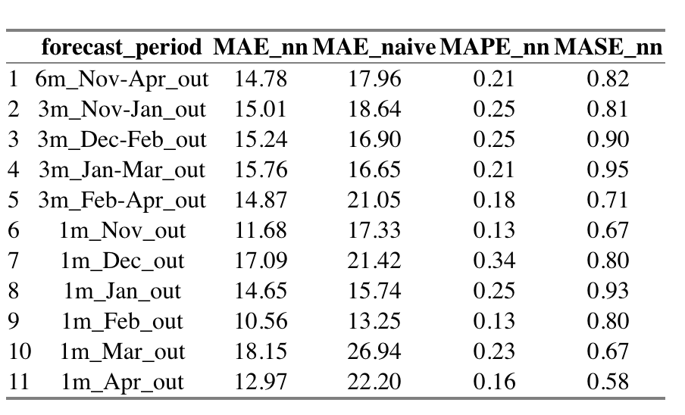
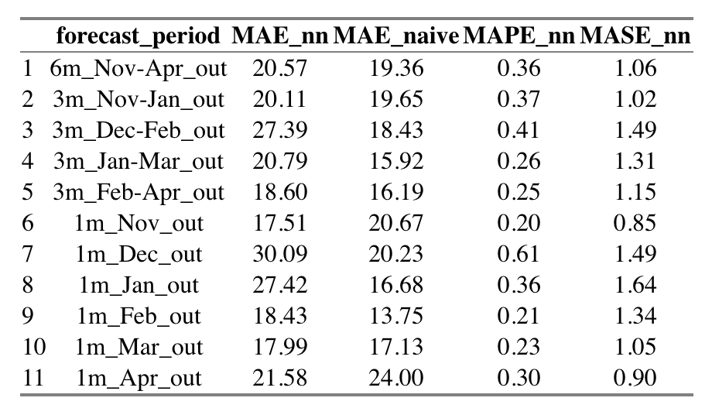
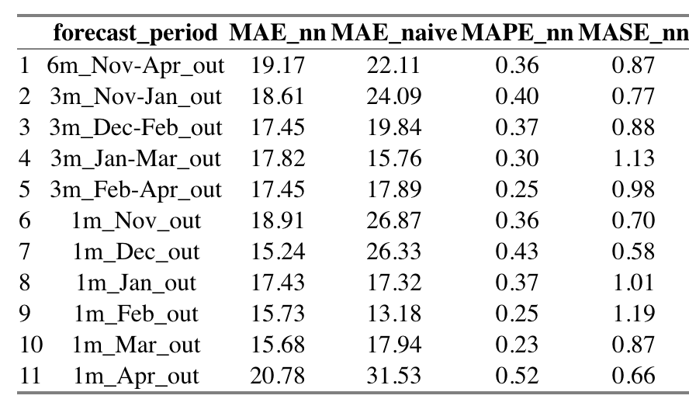
Cathy
Key Findings:
GLWST MLKEP
WARUK

Slide 16
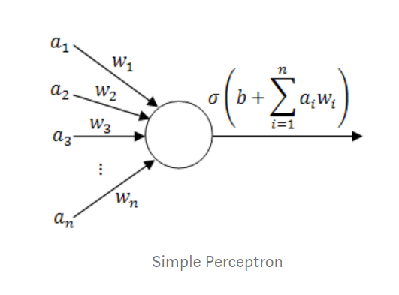
Cathy
Discussion:
Zero hidden layer performs better
Neural Network degrade performance due to their insufficient capability of modeling long-term dependencies

Slide 17
Ying
A Better Way: Ensemble Model
Final Arrival
GLM-Generized linear model
mul
add_mDOW
add
add_mDOW.hw_a[dpr]
add_mDOW.hw_m[dpr]
add.hw_a[DOW]
hw_a
add_mDOW.hw_a[DOW]
add_mDOW.hw_m[DOW]
add.hw_a[dpr]
nn
Notes:
We explored several types of interactions, used a combined approach of first, last, linear
Overview of recommendations
Overview of next steps

Slide 18
Ying
Ensemble Model -
Pros:
Flexibility - use either traditional ensemble method : mode, average, weighted average, regression and other machine learning models like SVM and Neural Network.
Robustness - aggregate result of multiple models is always less noisy than the individual models. This leads to model stability and robustness.
1
2
Cons:
1
Computation demanding
2
Hard to interpret
3
Art of choosing candidate model

Slide 19
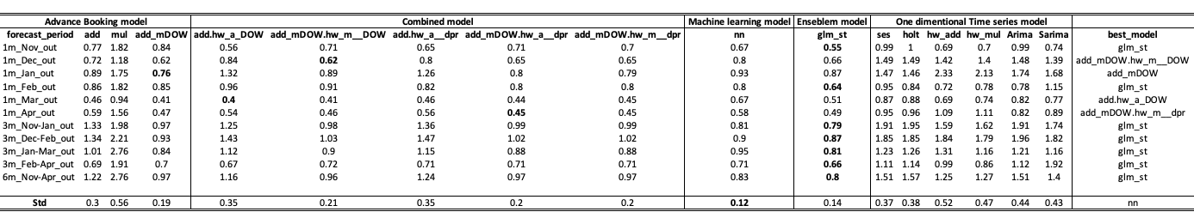
Cathy
Model Comparison - GLWST
Long term: ensemble model
Medium time horizon: ensemble model
Short term: mixed - ensemble model, combined model and advanced booking model
Most robust model: neural network

Slide 20
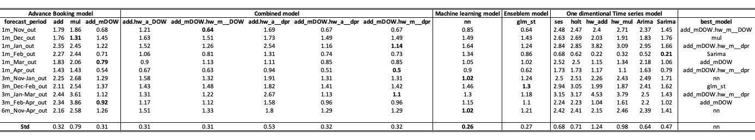
Cathy
Model Comparison - MLKEP
Long term: neural network
Medium time horizon: mixed - neural network, advanced booking model, combined model,
Short term: mixed - neural network, combined model and advanced booking model
Most robust model: neural network

Slide 21
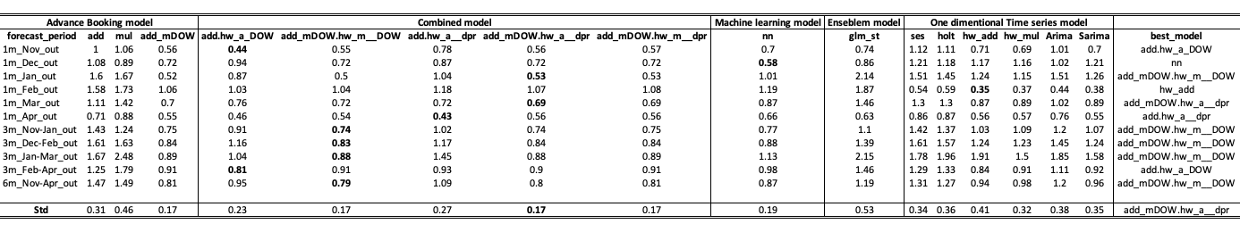
Cathy
Model Comparison - WARUK
Long term: combined model
Medium time horizon: mixed - advanced booking model and combined model
Short term: mixed - neural network, holt winters’ method, combined model and advanced booking model
Most robust model: combined model
Notes:
We explored several types of interactions, used a combined approach of first, last, linear
Overview of recommendations
Overview of next steps

Slide 22
Cathy
Conclusion:
In this study, we have presented 16 different forecasting methods. Experiments were conducted on datasets from 3 hotels. Each method was evaluated with 3 different error measures
No single best model outperform other models in all conditions
Neural Network and ensemble model are the most robust models for hotel GLWST and hotel MLKEP.
The advanced booking models combined with holt winters’ method yield the most robust results for hotel WARUK
Combined models are able to reduce error and improve accuracy
Notes:
We explored several types of interactions, used a combined approach of first, last, linear
Overview of recommendations
Overview of next steps

Slide 23
Cathy
Recommendations:
Other combinations or the same combination with different weights can be implemented in the future
More independent variables or factors should be considered such as socio-economic factor (i.e. income, taste and preference) or events (concert, sport event and conference) that may influence hotel room demand at an aggregate level.
Notes:
We explored several types of interactions, used a combined approach of first, last, linear
Overview of recommendations
Overview of next steps

Slide 24
Questions
Thank you
We would like to take this opportunity to answer any audience questions
Notes:
We explored several types of interactions, used a combined approach of first, last, linear
Overview of recommendations
Overview of next steps

