Slide 1
Explaining the Positive Manifold:
A critical comparison of intelligence models
By Claire Kelly, Tess Gilmartin, and Daan Vosters

Slide 2
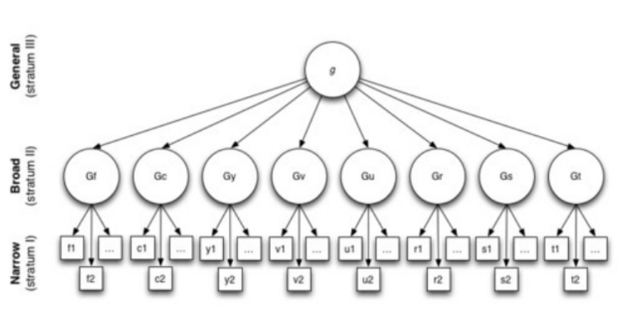
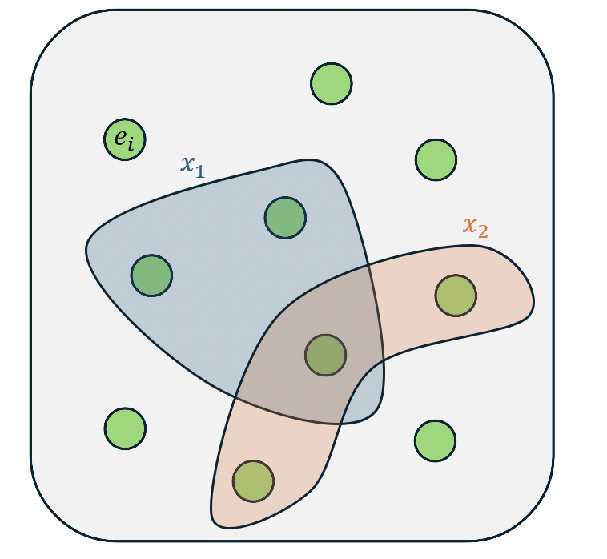

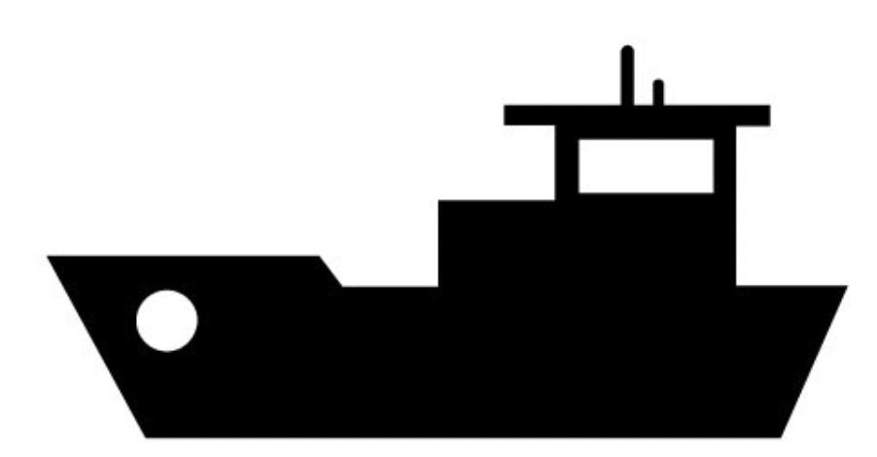


Three Models of Intelligence
Spearman's Two-Factor (1904)
Van der Maas et al. (2006) Mutualism
Thomson's Bonds (1916)
"g," a genuine psychological property, underlies the positive manifold
Mutualistic development between cognitive processes produces positive manifold
Measurement problem: overlap in sampled 'bonds' produces positive manifold
Original goal of models: provide explanation for the positive manifold.
Our goal: Parse the utility and implications of models (and their variants) which are shown to be –to some degree—satisfactory.

Slide 3
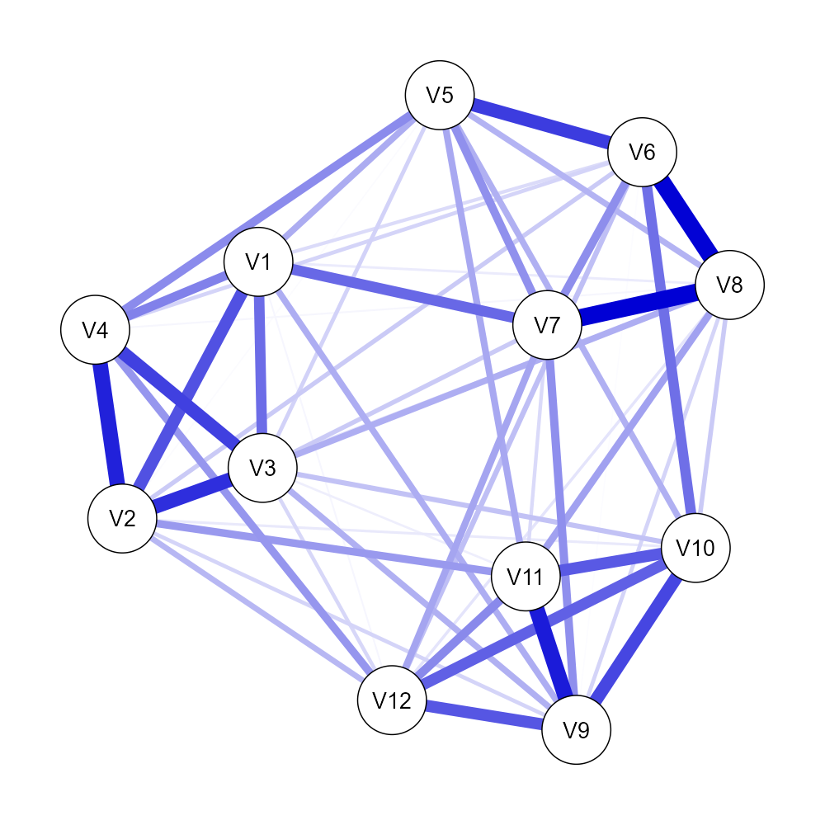
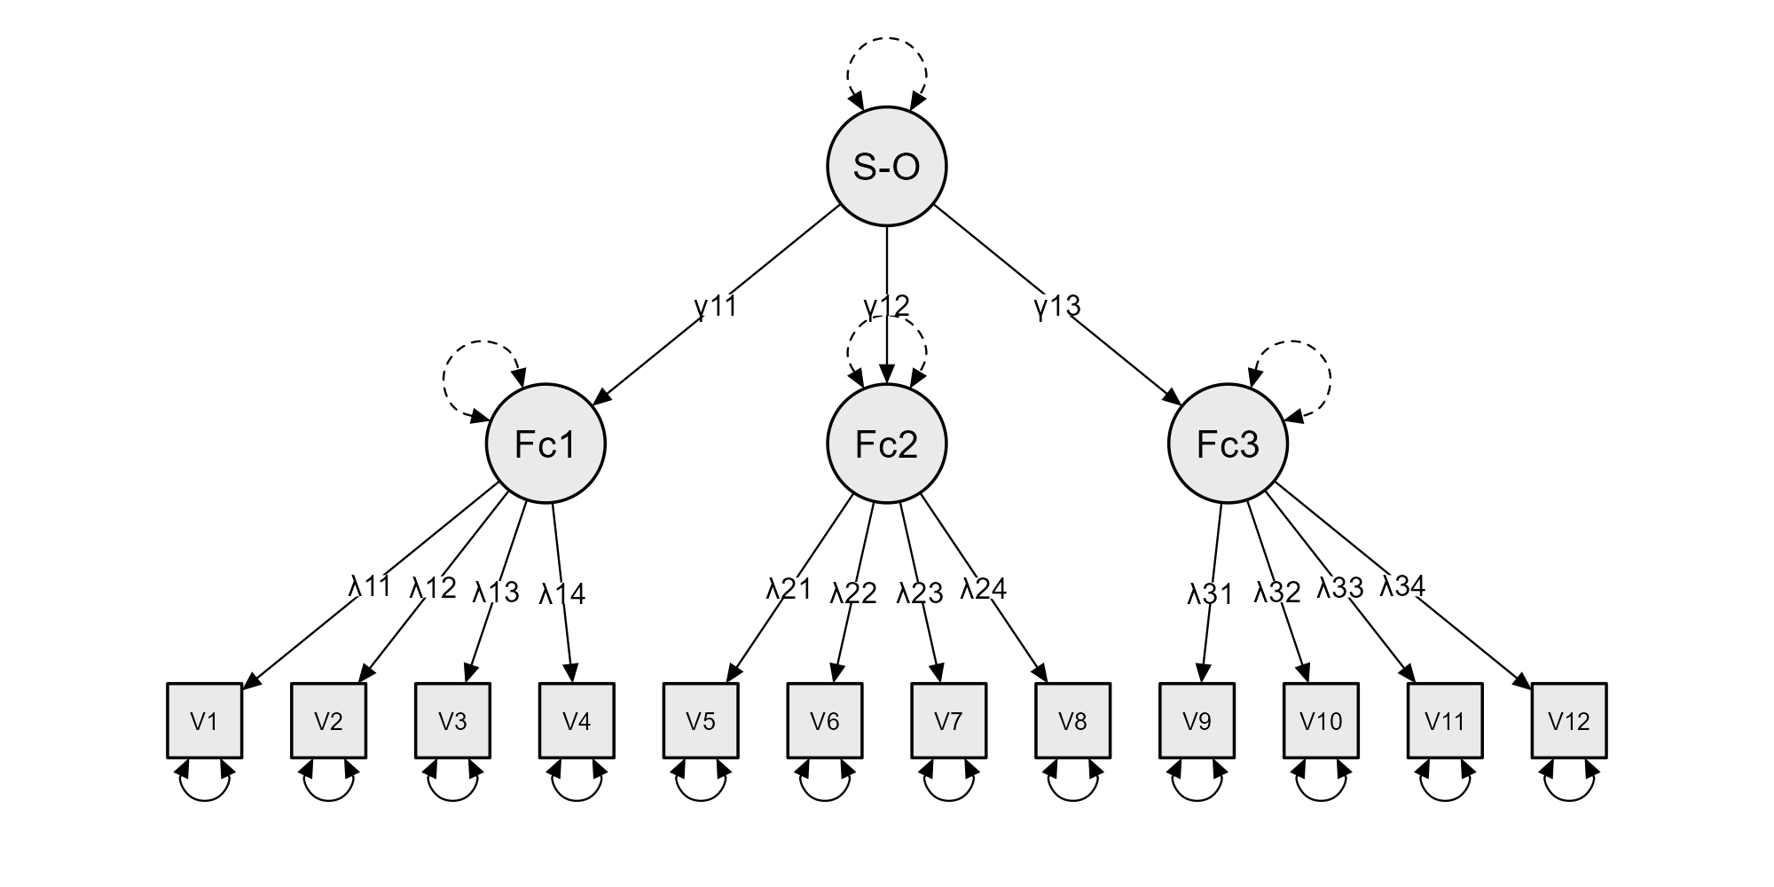
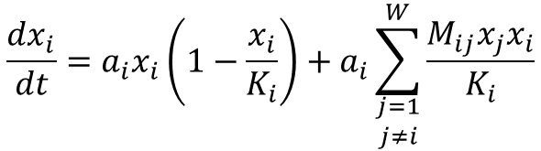
Mutualism
$$\frac{dx_{i}}{dt}=a_{i}x_{i}\left(1−\frac{x_{i}}{K_{i}}\right)+a_{i}\sum_{\begin{aligned}j=1 \\ j≠i\end{aligned}}^{W}{\frac{M_{ij}x_{j}x_{i}}{K_{i}}}$$
0.00 | 0.10 | 0.10 | 0.10 | 0.03 | 0.03 | 0.03 | 0.03 | 0.03 | 0.03 | 0.03 | 0.03
0.10 | 0.00 | 0.10 | 0.10 | 0.03 | 0.03 | 0.03 | 0.03 | 0.03 | 0.03 | 0.03 | 0.03
0.10 | 0.10 | 0.00 | 0.10 | 0.03 | 0.03 | 0.03 | 0.03 | 0.03 | 0.03 | 0.03 | 0.03
0.10 | 0.10 | 0.10 | 0.00 | 0.03 | 0.03 | 0.03 | 0.03 | 0.03 | 0.03 | 0.03 | 0.03
0.03 | 0.03 | 0.03 | 0.03 | 0.00 | 0.10 | 0.10 | 0.10 | 0.03 | 0.03 | 0.03 | 0.03
0.03 | 0.03 | 0.03 | 0.03 | 0.10 | 0.00 | 0.10 | 0.10 | 0.03 | 0.03 | 0.03 | 0.03
0.03 | 0.03 | 0.03 | 0.03 | 0.10 | 0.10 | 0.00 | 0.10 | 0.03 | 0.03 | 0.03 | 0.03
0.03 | 0.03 | 0.03 | 0.03 | 0.10 | 0.10 | 0.10 | 0.00 | 0.03 | 0.03 | 0.03 | 0.03
0.03 | 0.03 | 0.03 | 0.03 | 0.03 | 0.03 | 0.03 | 0.03 | 0.00 | 0.10 | 0.10 | 0.10
0.03 | 0.03 | 0.03 | 0.03 | 0.03 | 0.03 | 0.03 | 0.03 | 0.10 | 0.00 | 0.10 | 0.10
0.03 | 0.03 | 0.03 | 0.03 | 0.03 | 0.03 | 0.03 | 0.03 | 0.10 | 0.10 | 0.00 | 0.10
0.03 | 0.03 | 0.03 | 0.03 | 0.03 | 0.03 | 0.03 | 0.03 | 0.10 | 0.10 | 0.10 | 0.00

Slide 4
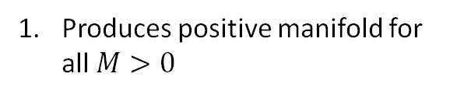
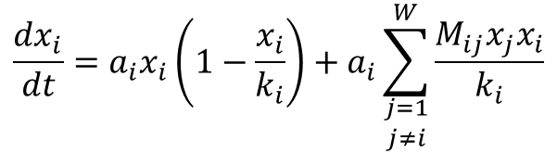


van der Maas et al. (2006)
$$\frac{dx_{i}}{dt}=a_{i}x_{i}\left(1−\frac{x_{i}}{k_{i}}\right)+a_{i}\sum_{\begin{aligned}j=1 \\ j≠i\end{aligned}}^{W}{\frac{M_{ij}x_{j}x_{i}}{k_{i}}}$$
$M$:
$k, a, x0$:
Produces positive manifold for all $M>0$
Left uncorrelated
Correlated = “g like scenario”:
- all high
- all low

Slide 5


Overlap?
Verbal intelligence +1
Startle response
Verbal intelligence
Verbal intelligence
Memory
Creativity
$$θ_{i}$$
$$θ_{j}$$
$$θ_{i}$$
$$θ_{j}$$
$$θ_{i}$$
$$θ_{j}$$
$$θ_{j}$$

Slide 6
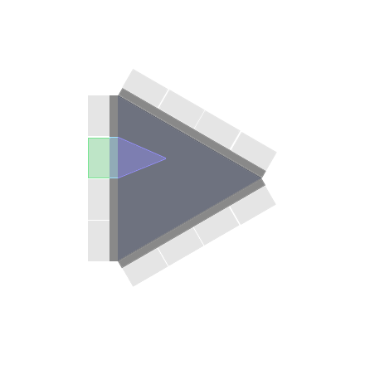
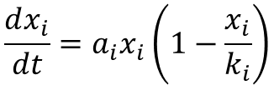

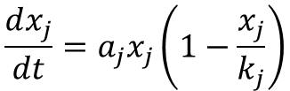


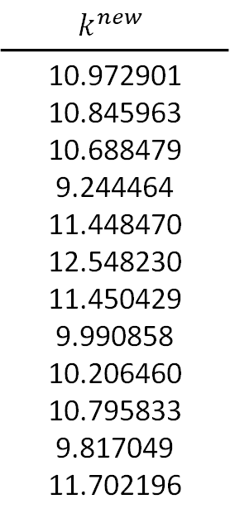
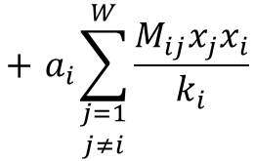
$$\frac{dx_{i}}{dt}=a_{i}x_{i}\left(1−\frac{x_{i}}{k_{i}}\right)$$
$$+{ a}_{i}\sum_{\begin{aligned}j=1 \\ j≠i\end{aligned}}^{W}{\frac{M_{ij}x_{j}x_{i}}{k_{i}}}$$
$$p_{i}^{new}=I_{i}p_{i}+(1−I_{i})(A_{i1}\frac{p_{i}+p_{j}+p_{k}+p_{l}}{4}+A_{i2}\frac{\sum_{i}^{N}{p_{i}}}{12})$$
$$\frac{dx_{j}}{dt}=a_{j}x_{j}\left(1−\frac{x_{j}}{k_{j}}\right)$$
$$For I_{i}=\frac{2}{5}, A_{i1}=\frac{1}{4}, A_{i2}=\frac{3}{4}$$
$$k^{new}$$
10.972901 10.845963 10.688479 9.244464 11.448470 12.548230 11.450429 9.990858 10.206460 10.795833 9.817049 11.702196
rnorm(N, 10, 2)
11.471514 11.154167 10.760457 7.150420 12.032110 14.781509 12.037006 8.388079 9.424207 10.897638 8.450678 13.163547
$$x_{i}$$

Slide 7
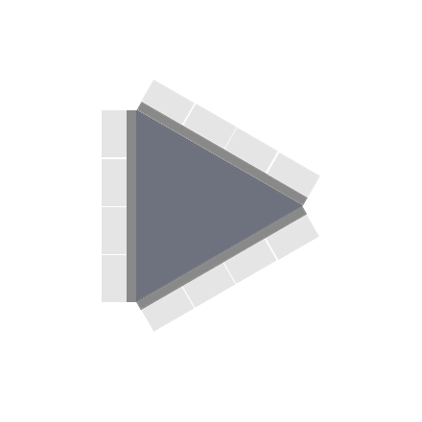
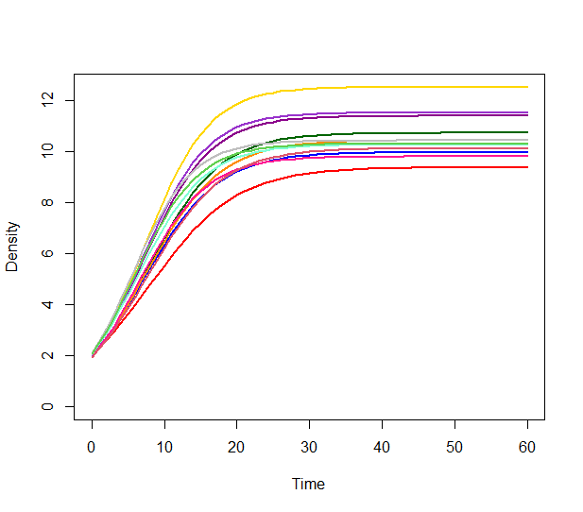
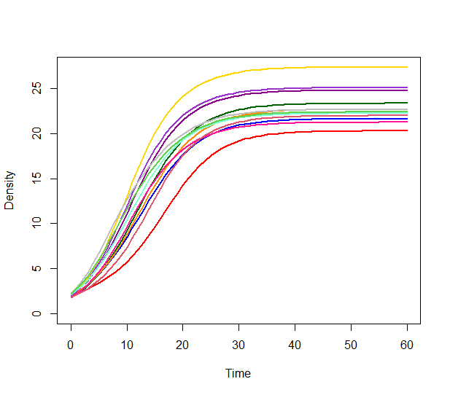
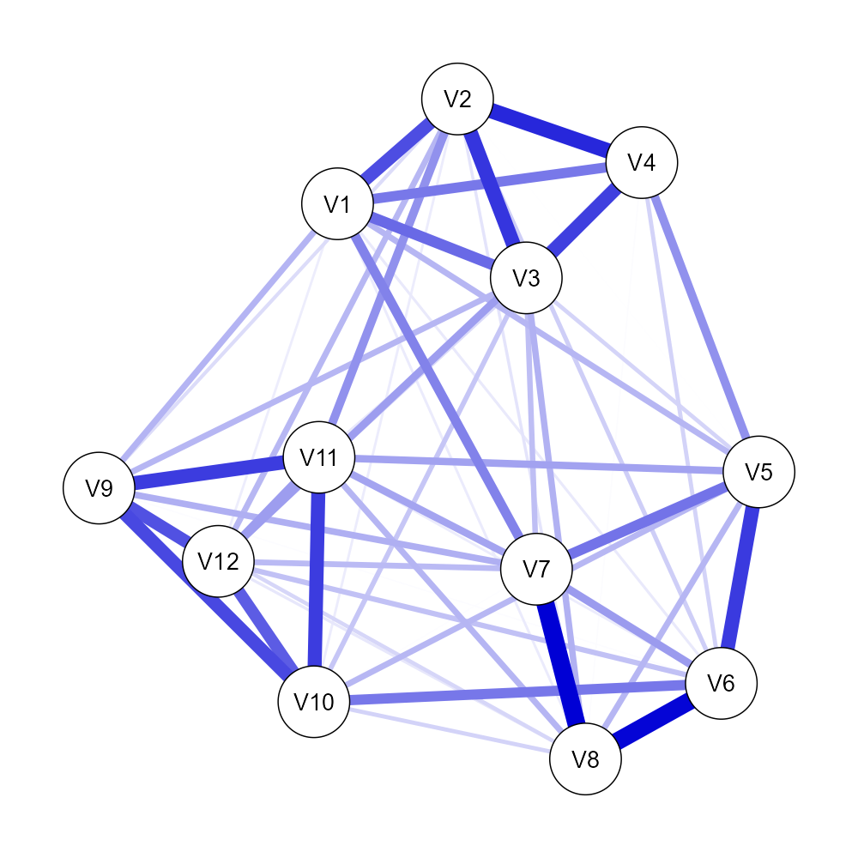
Theoretical/Practical
considerations

Slide 8
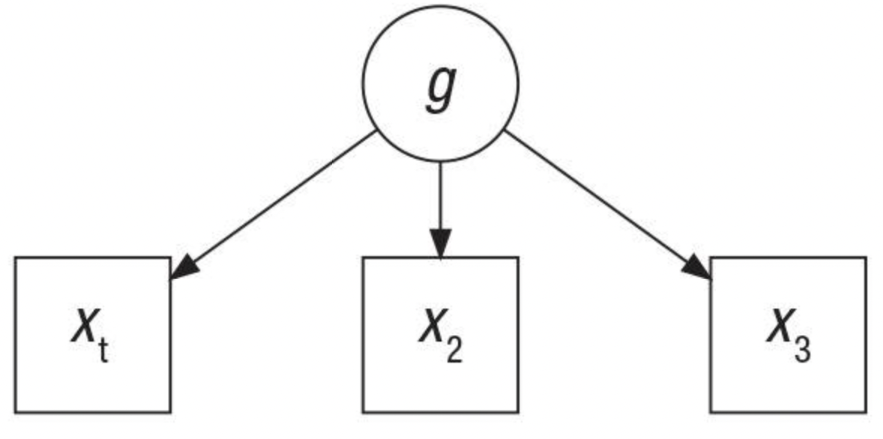
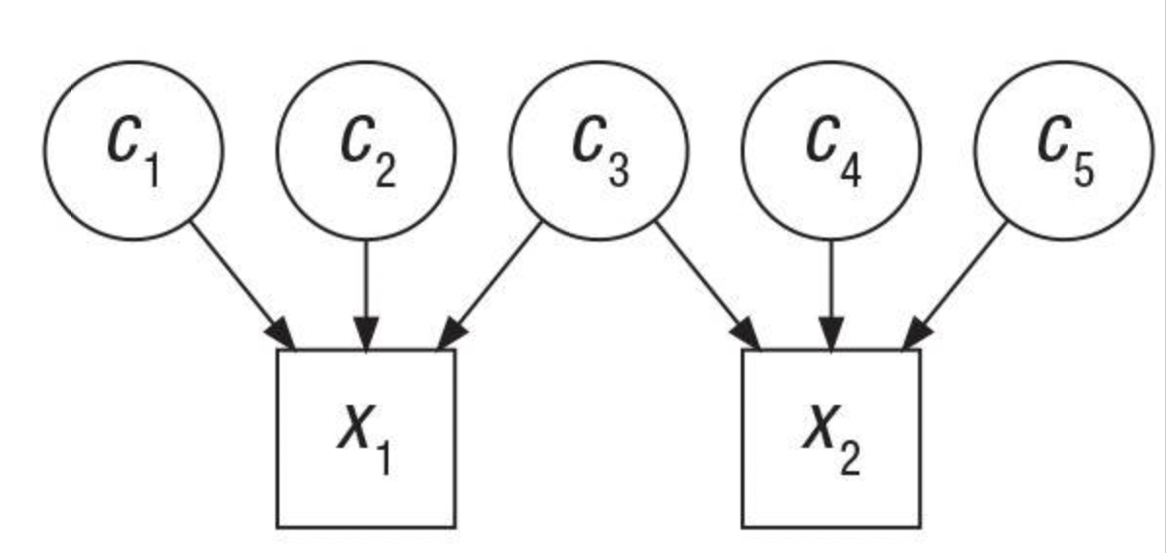
common cause
What other boats are in the marina?
"g" versus bonds
tests
tests
sampled elementary processes
“The [two-factor theory] looks upon g as being part of the test, while [sampling theory] looks upon the test as being part of g.” (Bartholomew, 575)
  Thomson's bonds/sampling model (1916) offers an alternative to Spearman's two-factor model:
  Per Thomson, the positive manifold reflects a measurement problem.
  What is a 'bond'?
  What are the implications of a top-down versus bottom-up explanation of mental capacity?
    How does our choice of boat inform our assessment of the water conditions?

Slide 9


Thomson's bonds model (sampling model)
Bonds
Bonds
Independent entities
Individual effect, , drawn from a normal distribution
  For simplicity, we used a standard normal
$$e_{i}$$
$$e_{i}$$
# Individual bond effects
E <- matrix(rnorm(N, mean = 0, sd = 1), ncol = 1)
"Intelligence"
Notes:
Aimed to assess statistical equivalency to spearman’s model
Simulated the bonds model and compared correlation matrices
Bonds are independent and contribute an individual effect

Slide 10



Thomson's bonds model (sampling model)
Bonds
Sampling procedure
Each test item, , samples which bonds are “active” (1 or 0)
Variation in sampling approach
Fixed proportion of active bonds (e.g., 3 of 10 bonds) (Thomson, 1916)
Fixed probability of bond being active (e.g., p = 0.3 for each bond) (Bartholomew , 2007)
Sampling of a subset (e.g., sample from bonds 3-10 for test item 1) (Maxwell, 1972)
$$x_{i}$$
$$e_{i}$$
$$x_{1}$$
$$x_{2}$$
# Create indicator matrix
prob <- function(x) {
rbinom(n = 1, size = 1, prob = P)}
A <- matrix(NA, nrow = X_num, ncol = N)
A <- apply(A, c(1,2), prob)
"Intelligence"
Notes:
Crux of model is each test item samples from available bonds
Sampled bonds contribute its effect to item score
Different variations of sampling
Thomson’s original method involved a fixed proportion of bonds
*CLICK*
Could be extended to a fixed probability of a bond being active
Third is where we consider a subset
Sample from the subset

Slide 11
Thomson's bonds model (sampling model)
Bonds
Scores and correlations
Test item scores are the sum of effects of active bonds
Item correlations arise from the same bond being sampled across multiple test items
$$e_{i}$$
$$x_{1}$$
$$x_{i}= a_{i1}e_{1}+a_{i2}e_{2}+ … +a_{iN}e_{N}$$
$$x_{2}$$
$$Where a_{iN} is indicator random variable of Nth bond and ith item$$
# Extract item scores
X <- matrix(data = NA, nrow = X, ncol = 1)
scores <- A %*% E
"Intelligence"
Notes:
-The active bonds for a test item contribute their effect to its score
Some bonds may be active in multiple test items
Effect of bond will contribute to x1 and x2
Thus, x1 and x2 will be correlated to some degree

Slide 12
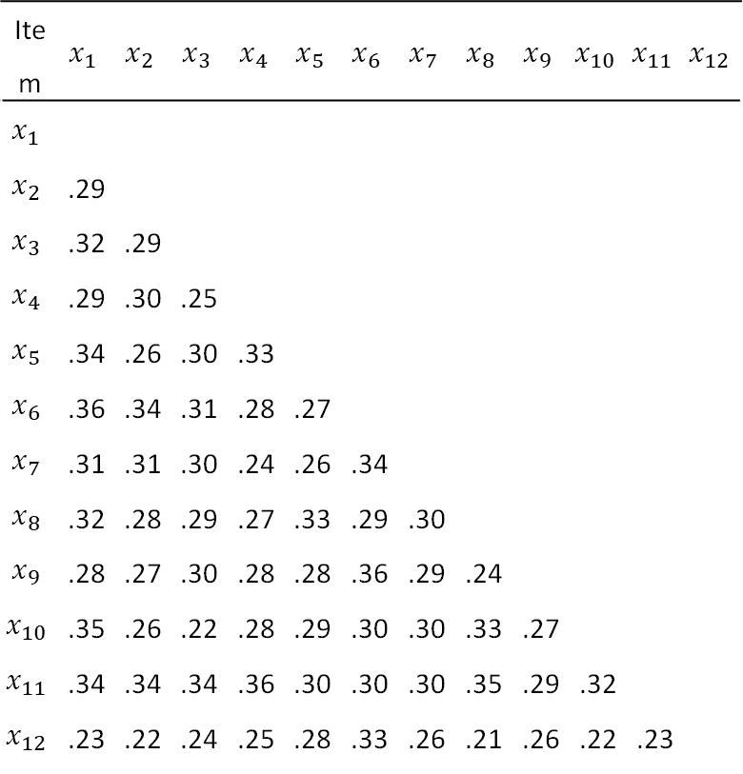
R Simulation
Correlation Matrix
N <- 1000 # N of bonds
X <- 12 # N of test items
P <- .3 # P of bond being selected for all test items
size <- 500 # N individuals tested
# SD = 1 for all bond effects
set.seed(1234)
data <- matrix(data = NA, nrow = size, ncol = X)
for (i in 1:size){
iter <- simulate_bonds(N, X, P) # Simulate bonds
data[i,] <- iter[,N+1] # Extract item scores
}
Item | $$x_{1}$$ | $$x_{2}$$ | $$x_{3}$$ | $$x_{4}$$ | $$x_{5}$$ | $$x_{6}$$ | $$x_{7}$$ | $$x_{8}$$ | $$x_{9}$$ | $$x_{10}$$ | $$x_{11}$$ | $$x_{12}$$
$$x_{1}$$
$$x_{2}$$ | .29
$$x_{3}$$ | .32 | .29
$$x_{4}$$ | .29 | .30 | .25
$$x_{5}$$ | .34 | .26 | .30 | .33
$$x_{6}$$ | .36 | .34 | .31 | .28 | .27
$$x_{7}$$ | .31 | .31 | .30 | .24 | .26 | .34
$$x_{8}$$ | .32 | .28 | .29 | .27 | .33 | .29 | .30
$$x_{9}$$ | .28 | .27 | .30 | .28 | .28 | .36 | .29 | .24
$$x_{10}$$ | .35 | .26 | .22 | .28 | .29 | .30 | .30 | .33 | .27
$$x_{11}$$ | .34 | .34 | .34 | .36 | .30 | .30 | .30 | .35 | .29 | .32
$$x_{12}$$ | .23 | .22 | .24 | .25 | .28 | .33 | .26 | .21 | .26 | .22 | .23
Positive manifold?
Notes:
Can simulate an example in R based on some initial conditions
If we have 1000 bonds, 12 test items, each bond has.3 probability of being sampled, and test 500 people
Resulting correlation matrix
Recall intention to see if we can demonstrate the equivalence of correlation matrix from bonds data to a factor model
Positive manifold? Yes!

Slide 13
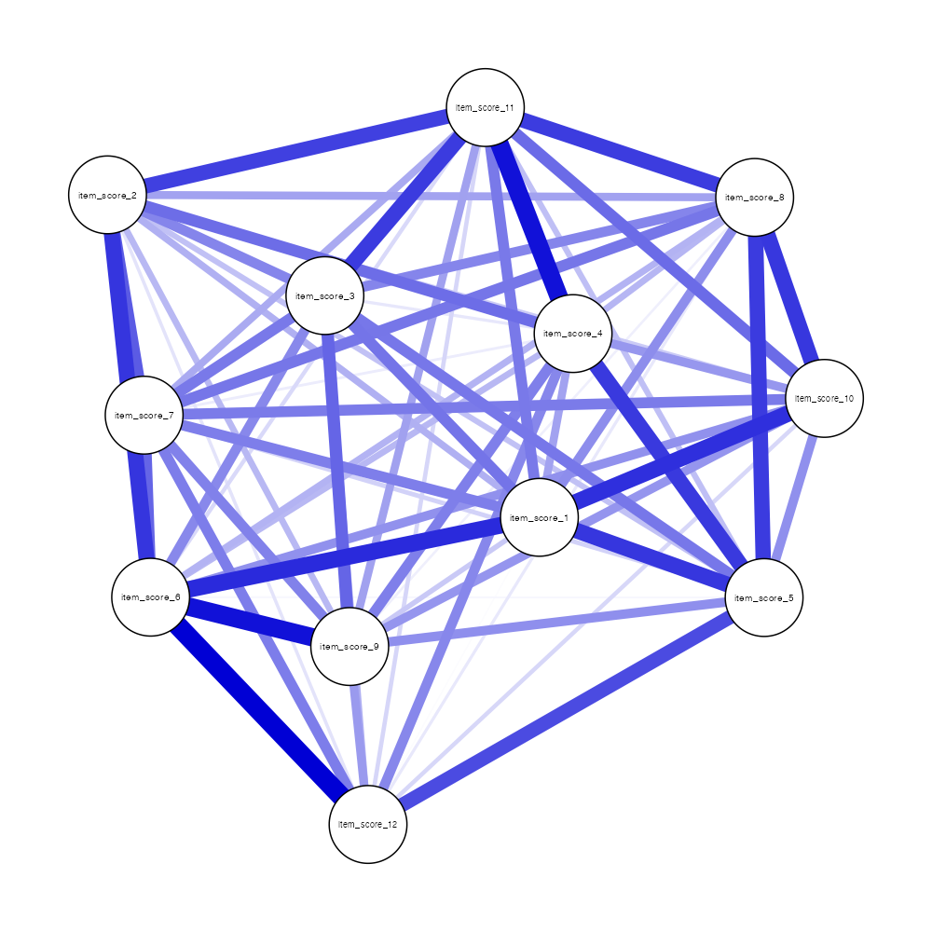
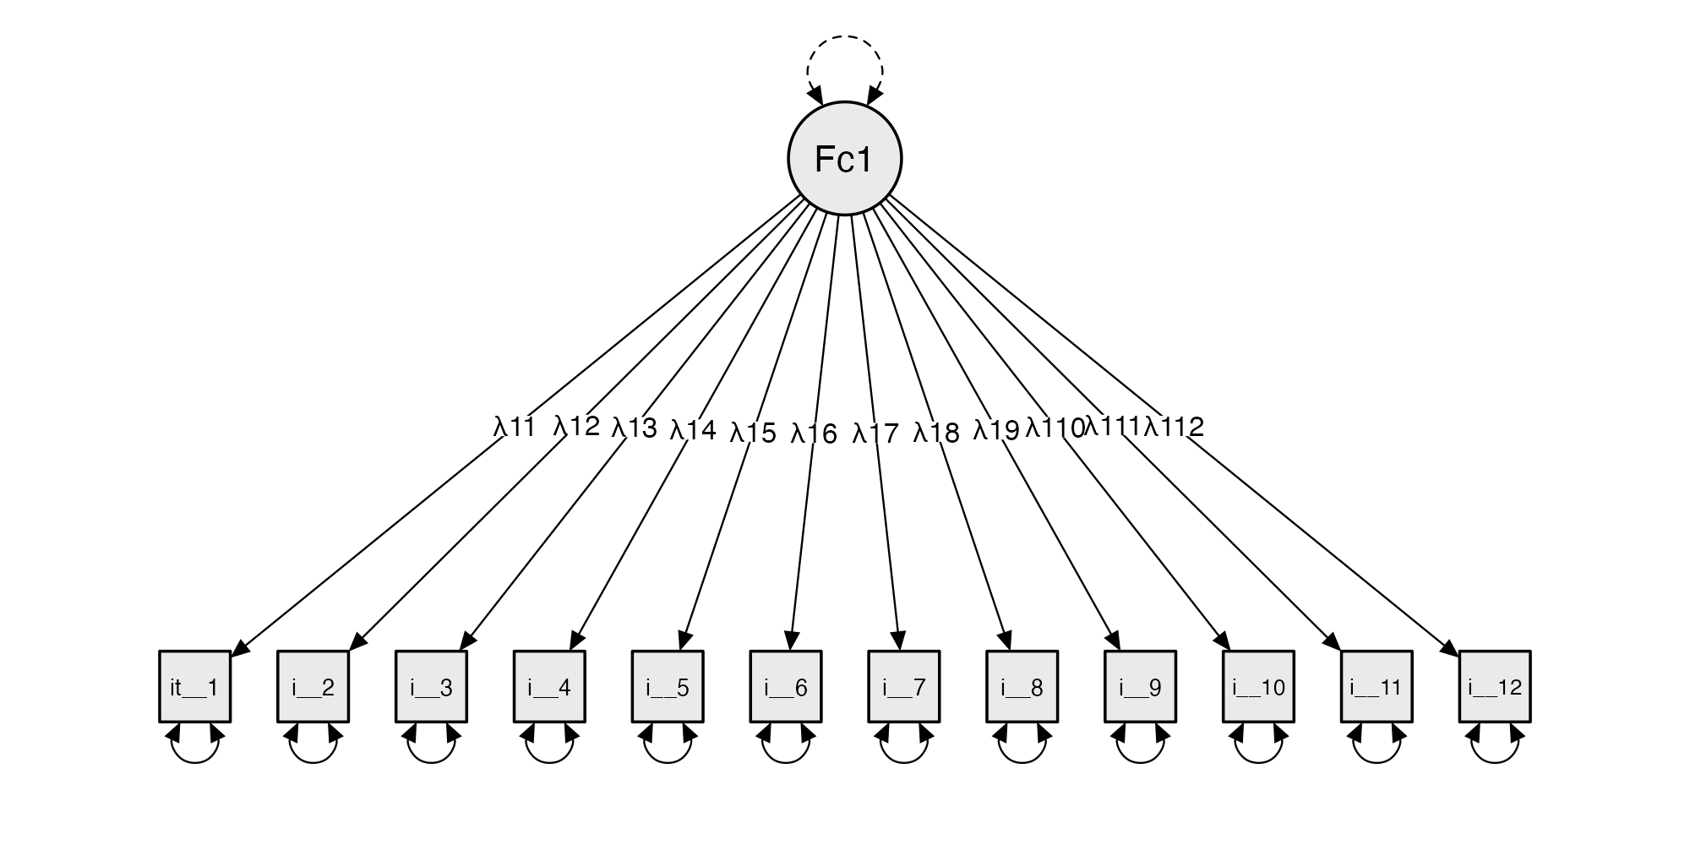
JASP Analysis
Network Analysis
Confirmatory Factor Analysis
Summary of Network
Number of nodes | Number of non-zero edges | Sparsity
12 | 56 / 66 | 0.1515
Chi-square test
Model | Χ² | df | p
Baseline model | 1240.449 | 66
Factor model | 47.841 | 54 | .710
Note. The estimator is ML. The test statistic is standard. The standard error method is standard.
Notes:
Second half is looking at if a factor model fits the simulated bonds data
See that a one factor model does fit
Suggesting that our correlation matrix is statistically equivalent to one of a factor model

Slide 14


Thomson's Bonds Model With Clustering
  Certain test items activate certain clusters of bonds more than others.
Lower sampling probability for x1
Higher sampling probability for x1
$$x_{i}$$
example item : A train travels 60 km in 1 hour. How far will it travel in 3 hours at the same speed?
$$x_{1}$$
$$e_{i}$$
Verbal reasoning
Spatial reasoning
Numerical reasoning

Slide 15
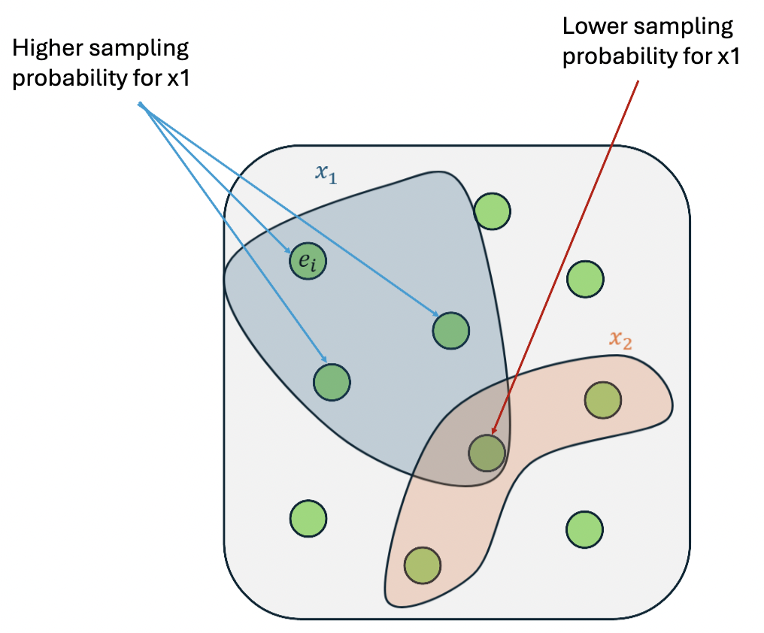
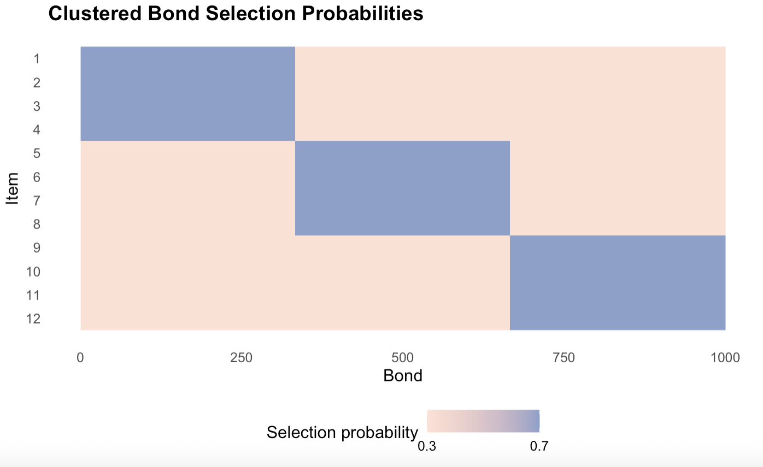
Thomson's Bonds Model With Clustering
## Bonds are assigned to 'clusters'
bond_cluster <- c(
rep(1, 333),
rep(2, 333),
rep(3, 334)
)
## Each item to its associated "higher sampling probability" cluster
item_group <- rep(1:3, each = 4)
high_p <- .7
low_p <- .3
# Initialize and populate probability and indicator matrix
cluster_prob <- matrix(NA, nrow = X_num, ncol = N)
A <- matrix(NA, nrow = X_num, ncol = N)
for (i in 1:X_num){
for(j in 1:N){
if (item_group[i] == bond_cluster[j]) {
cluster_prob[i,j] <- high_p
p <- high_p
} else {
cluster_prob[i,j] <- low_p
p <- low_p
}
A[i,j] <- rbinom(1, size = 1, prob = p)
}
}

Slide 16
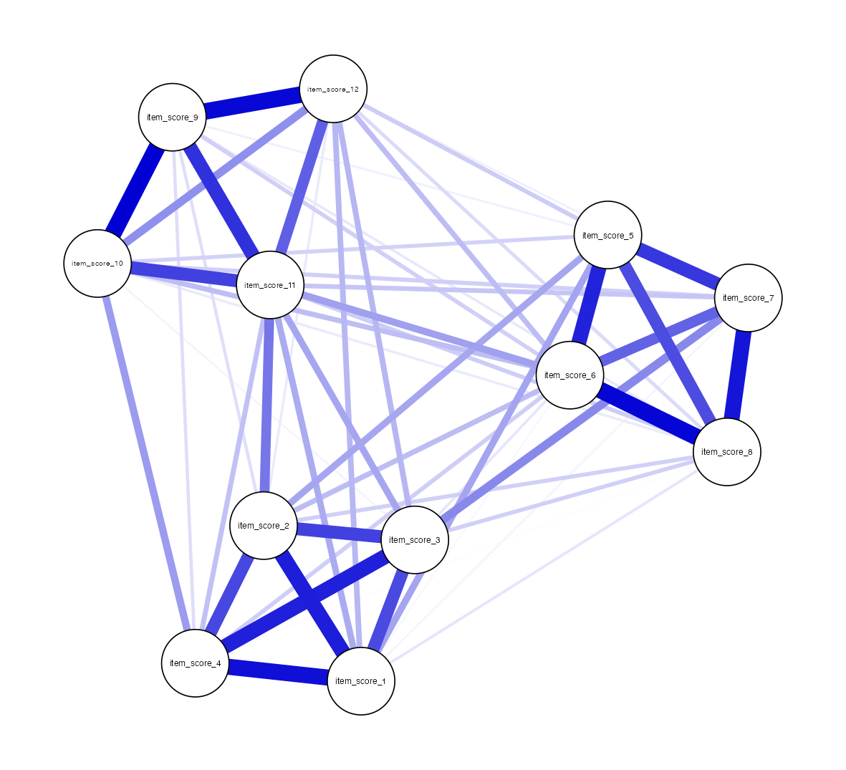
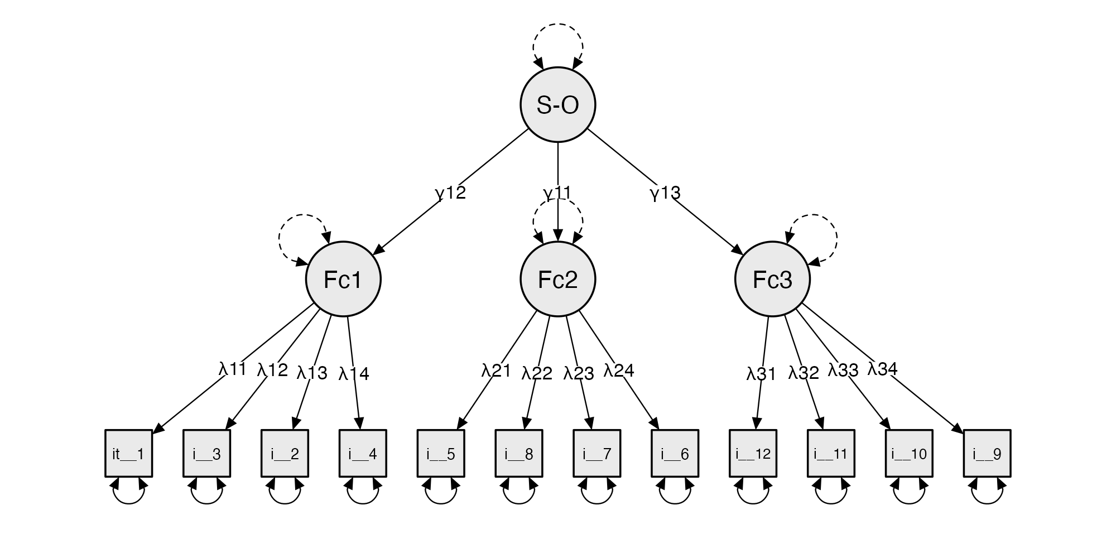
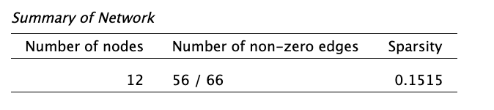
How does sampling procedure affect robustness/ statistical parity of bonds model with the two-factor model?
How does our definition of bonds inform the sampling prodcedure we implement?
Clustered Bonds JASP Analysis
Network Analysis
Confirmatory Factor Analysis
Chi-square test
Model | Χ² | df | p
Baseline model | 2435.390 | 66
Factor model | 51.610 | 51 | .450
Note. The estimator is ML. The test statistic is standard. The standard error method is standard.

Slide 17
Picking your boat: the question of model utility
Variants | Positive Manifold | Equivalent Covariance Matrix | Explanation of Manifold
Two-Factor (Spearman) | ✅ | ✅ | Underlying common source, g
Mutualism | ✅ | ✅ *for certain conditions | Reciprocally reinforcing processes
Mutualism with overlap | ✅ | ✅ *for certain conditions (maybe?) | Overlap in constructs
Thomson’s Bonds (Sampling) | ✅ | ✅ * for certain conditions | Overlap in samples of elementary cognitive processes
Bonds with clusters | ✅ | ✅ * for certain conditions | " " with clusters of frequently co-occurring processes

Slide 18
Thank you for your attention!
Bartholomew, D. J., Allerhand, M., & Deary, I. J. (2013). Measuring mental capacity: Thomson’s Bonds model and Spearman’s g-model compared. Intelligence, 41(4), 222–233. https://doi.org/10.1016/j.intell.2013.03.007
Bartholomew, D. J., Deary, I. J., & Lawn, M. (2009a). A new lease of life for Thomson’s bonds model of intelligence. Psychological Review, 116(3), 567–579. https://doi.org/10.1037/a0016262
Savi, A. O., Marsman, M., van der Maas, H. L. J., & Maris, G. K. J. (2019). The Wiring of Intelligence. Perspectives on psychological science : a journal of the Association for Psychological Science, 14(6), 1034–1061. https://doi.org/10.1177/1745691619866447
Spearman, C. (1904). “General Intelligence,” Objectively Determined and Measured. The American Journal of Psychology, 15(2), 201–292. https://doi.org/10.2307/1412107
Kovacs, K., & Conway, A. R. A. (2016). Process Overlap Theory: A Unified Account of the General Factor of Intelligence. Psychological Inquiry, 27(3), 151–177. https://doi.org/10.1080/1047840X.2016.1153946

