Slide 1
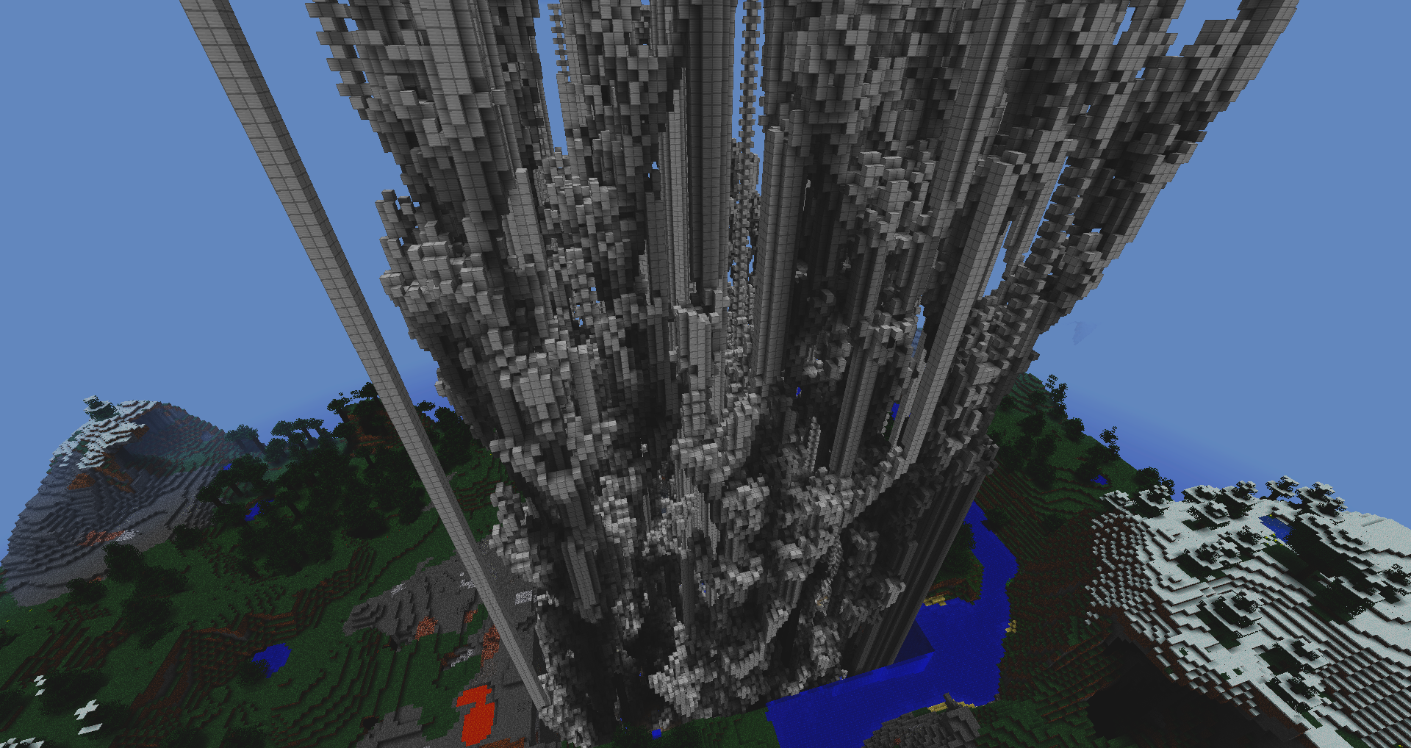
Deep Learning for Games and Simulations
ITU Copenhagen, Fall 2023
Deep Learning
for Games and Simulation

Slide 2
Deep Learning for Games and Simulations
ITU Copenhagen, Fall 2023
How to Run Labs
I. Jupyter Notebook [Google Colab] - To open directly from Github url: https://colab.research.google.com/github/{username}/{repository_name}/blob/{branch_name}/{notebook_path} e.g.:
https://colab.research.google.com/github/claireaoi/dlgs/blob/main/labs/lab1_mcts.ipynb Or go to https://colab.research.google.com/ and click on Github
- You can run the cells, modify the code, and even save a copy to your Google Drive. File -> Save a copy in Drive - Google Colab provides free access to GPUs. To use a GPU, go to Runtime -> Change runtime type and select GPU.
- Some notebooks may require specific dependencies. To install necessary libraries using !pip install library-name
git clone git@github.com:claireaoi/dlgs.git
II. Virtual env
[Locally]
clone repo
- create venv $python3.9 -m venv venv - activate venv $source venv/bin/activate
III. Jupyter Notebook
[Locally]
- clone Github repo - In terminal: $cd dlgs/labs $pip install notebook $jupyter notebook -> run from browser
IV. Jupyter Notebook [Github Codespaces]
ETC.

Slide 3
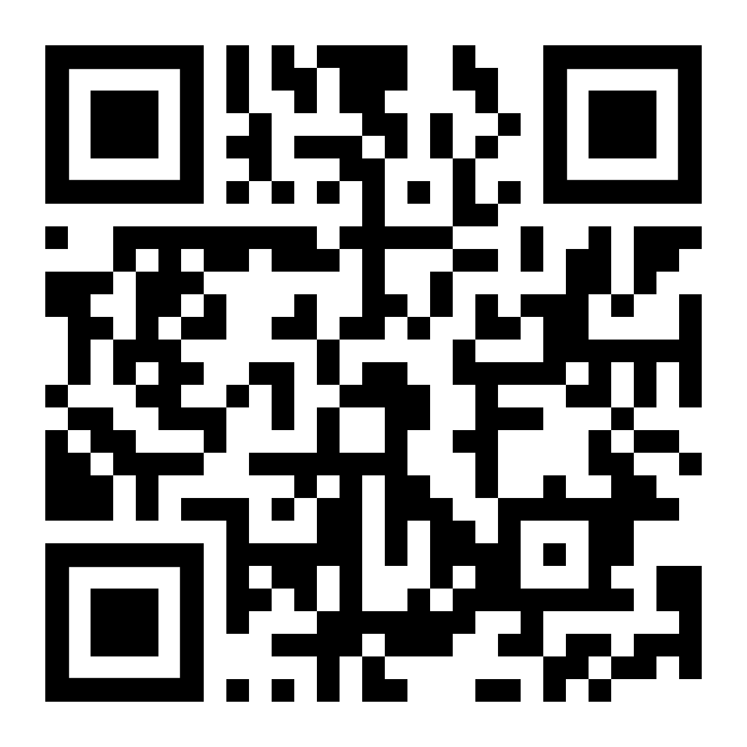
Deep Learning for Games and Simulations
ITU Copenhagen, Fall 2023
LAB 01
MONTE CARLO TREE SEARCH
https://github.com/claireaoi/dlgs

Slide 4
Deep Learning for Games and Simulations
ITU Copenhagen, Fall 2023
Apply Lecture 01 to Game Connect Four Code several Agents (several strategies) Familiarise yourself with RL concepts: Agent, State, Game (environment), Action
(1) Human Agent (2) Greedy Agent
(3)* MinMax Agent
(4) MCTS Agent
LAB 01

Slide 5
Deep Learning for Games and Simulations
ITU Copenhagen, Fall 2023
(1) Human Agent
class Human(Agent):
def __init__(self, name):
super(Human, self).__init__(name)
def get_action(self, state: State):

Slide 6
Deep Learning for Games and Simulations
ITU Copenhagen, Fall 2023
(2) Greedy Agent
def simulate_action(state: State, action: int, name: str = None) -> State:
"""
Simulate the result of an action without modifying the original state!
“""
class Gekko(Agent):
def __init__(self, name):
super(Gekko, self).__init__(name)
def get_action(self, state: State):
-> Can you beat it ?

Slide 7
Deep Learning for Games and Simulations
ITU Copenhagen, Fall 2023
(3) MinMax Agent
Can have a depth parameter to make it faster
-> Can you beat it ?
class MinMax(Agent):
def __init__(self, name: str, depth: int = 4):
super(MinMax, self).__init__(name)
self.depth = depth
def get_action(self, state: State) -> int:
maximise=bool(self.name==‘X’)
best_score, best_action = self.minmax(state, depth=self.depth, maximizing=maximise)
return best_action
def minmax(self, state: State, depth: int, maximizing: bool) -> Tuple[int, int]:
def evaluate(self, state: State)-> int:

Slide 8
Deep Learning for Games and Simulations
ITU Copenhagen, Fall 2023
(4) MCTS Agent
-> Can you beat it ?
class MCTS(Agent):
def __init__(self, name, num_simulations=1000, explore=1.4142):
super(MCTS, self).__init__(name)
def get_action(self, state: State):
def mcts(self, root: Node):
def select(self, node: Node) -> Node:
def expand(self, node: Node):
def simulate(self, node: Node) -> Node:
def backpropagate(self, node: Node):

Slide 9
Deep Learning for Games and Simulations
ITU Copenhagen, Fall 2023
(4) MCTS Agent w/ dynamic programming
-> Create a transposition table to avoid redundant computations by storing the results of previously evaluated game states. -> Make the algorithm more efficient as it avoids evaluating the same state multiple times.

Slide 10
Deep Learning for Games and Simulations
ITU Copenhagen, Fall 2023
LAB 02
MATHS - REFRESH
https://colab.research.google.com/github/claireaoi/dlgs/blob/main/labs/lab2_maths.ipynb

Slide 11
Deep Learning for Games and Simulations
ITU Copenhagen, Fall 2023
(1) Stats
Familiarise yourself with some statistical operation with Python: Min, Max, Median, standard deviation and variance
(2) Vectors
Sum, Scalar multiplication, Inner Product
(3) Matrices
Matrice Product

Slide 12
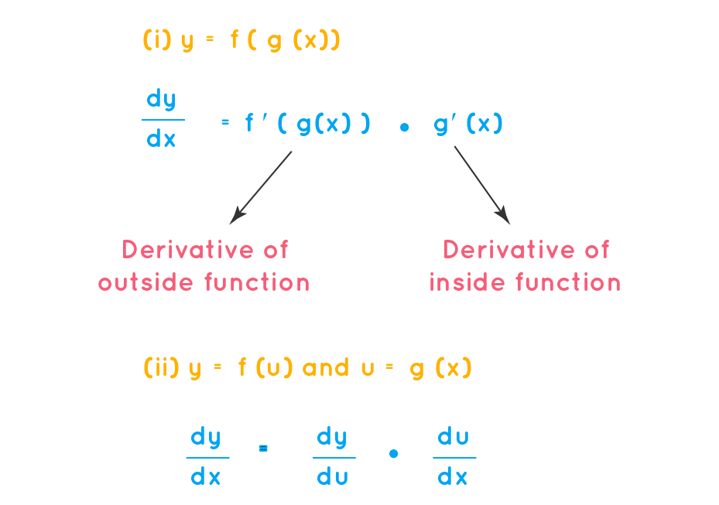
Deep Learning for Games and Simulations
ITU Copenhagen, Fall 2023
(4) Gradient
Chain Rule Formula

Slide 13
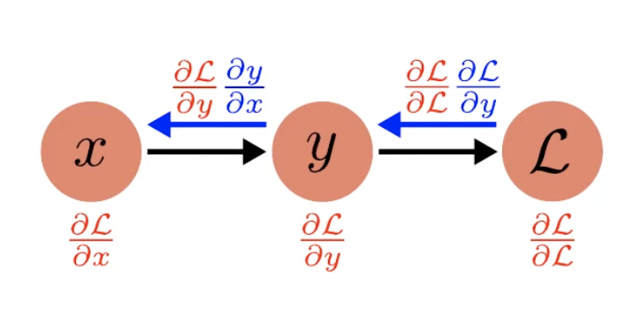
Deep Learning for Games and Simulations
ITU Copenhagen, Fall 2023
(5) Autodiff // Backpropagation
Understanding the inner working of autodiff…
- backprop method
insert in class Node
Example 1: y.backward() for y=x*y, for square function
Example 2 Chaining Call for square
Example 3: for plus
Example4: for multiply
Use python operator overloading
Blue -> Local Gradient Red -> Backpropagated Gradient

Slide 14
Deep Learning for Games and Simulations
ITU Copenhagen, Fall 2023
LAB 03
Neural Network
https://colab.research.google.com/github/claireaoi/dlgs/blob/main/labs/lab3_nn.ipynb

Slide 15
Deep Learning for Games and Simulations
ITU Copenhagen, Fall 2023
Nanograd
Automatic Differentiation
Framework
(a) explain backward (b) detail example 1 by hand (c) repeat backward (d) finite difference

Slide 16
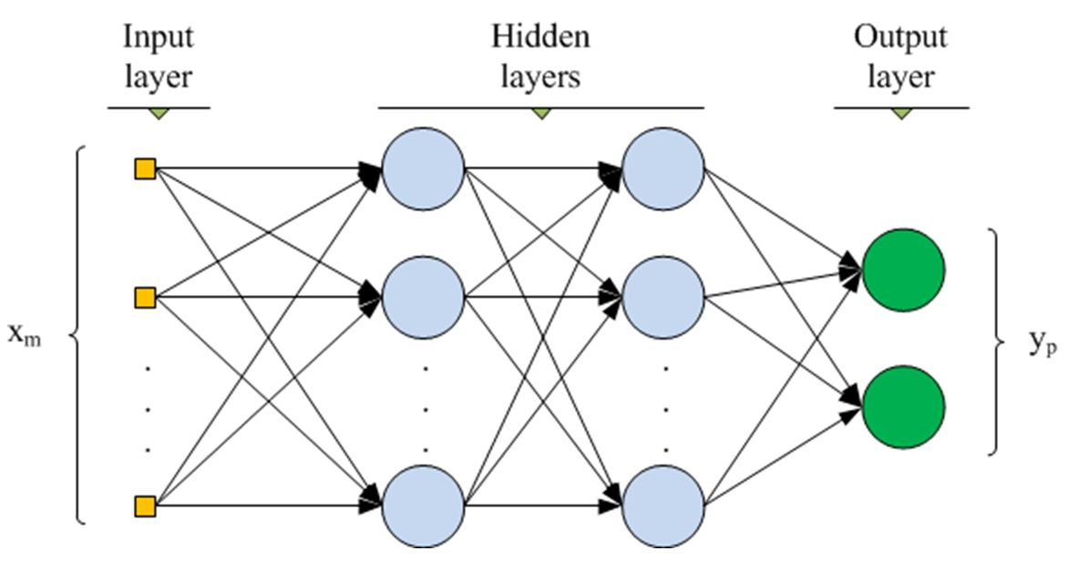
Deep Learning for Games and Simulations
ITU Copenhagen, Fall 2023
Neural
Network
>feedforward neural network consisting of a series of dense layer >for each layer, define: input size and output size, activation functions (e.g. tanh, relu), parameter initialization (e.g. Gaussian)
(e) Compute forward pass dense Layer (f) Combine multiple DenseLayers into a MLP

Slide 17
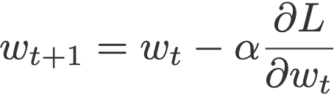
Deep Learning for Games and Simulations
ITU Copenhagen, Fall 2023
(g) Stochastic
Gradient Descent
(h) Training Neural Networks
Putting it all together !

Slide 18
Deep Learning for Games and Simulations
ITU Copenhagen, Fall 2023
LAB 04
Reinforcement Learning
https://colab.research.google.com/github/claireaoi/dlgs/blob/main/labs/lab4_rl.ipynb

Slide 19
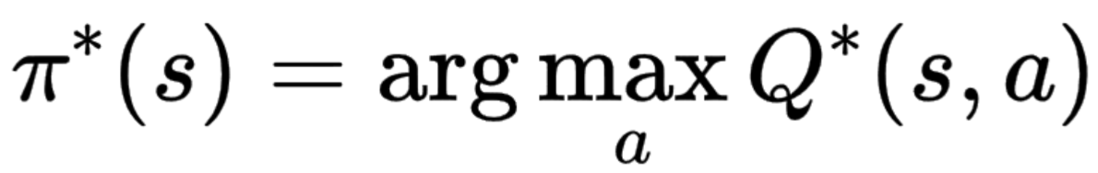
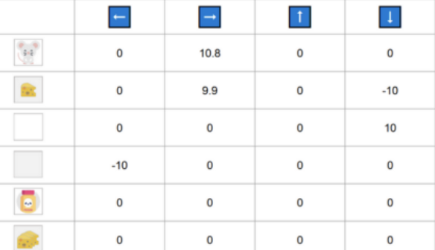
Deep Learning for Games and Simulations
ITU Copenhagen, Fall 2023
Q-Learning
Off-policy value-based method Value-based method: finds the optimal policy indirectly by learning a value function (V(s)) or action-value function (Q(a,s)) indicating the value of each state or each state-action pair. Once trained, the agent choose the action with the best value in a state.
Q-Learning: Trains a Q-Function (an action-value function) which internally is a Q-table that contains all the state-action pair values.
Off-policy: the policy used to select actions during learning differs from the target policy that is being improved upon
TD approach: updates its value function at each step instead of at the end of the episode.
Actions
States

Slide 20
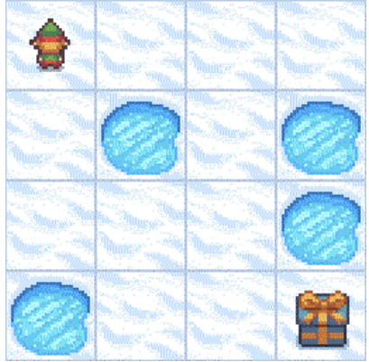
Deep Learning for Games and Simulations
ITU Copenhagen, Fall 2023
Environment:
gym.make(‘FrozenLake8x8-v1') Action Space: env.action_space
Discrete(4): 0: left, 1: Down, 2: Right, 3: Up
Observation Space: env.observation_space Discrete(64): 8*8 Grid
Agent:
def __init__(
#parameters
#qtable
def get_action(
def update_q(
(1-3) Init Env & Agent

Slide 21
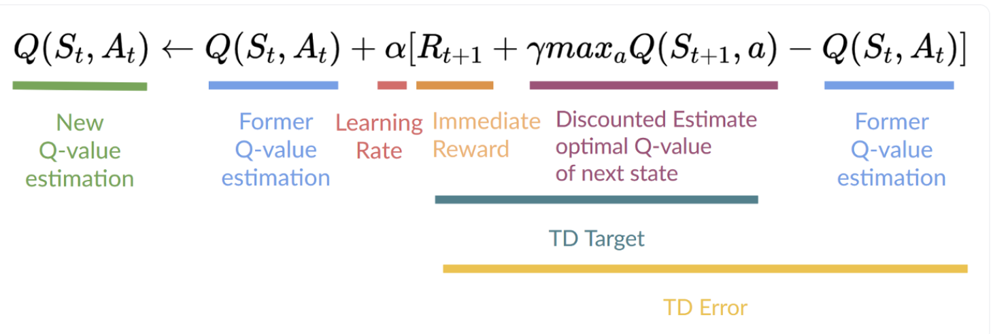
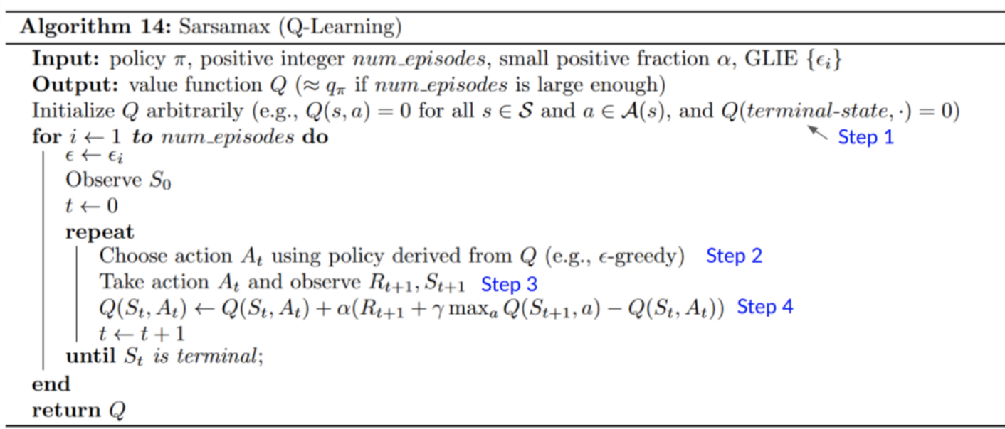
Deep Learning for Games and Simulations
ITU Copenhagen, Fall 2023
Greedy Policy
(4) Q-Learning Algorithm

Slide 22
Deep Learning for Games and Simulations
ITU Copenhagen, Fall 2023
(5) Evaluate
Render output one episode
Give average episode return
- Adapt Code to Continuous Problem - Could you imagine how to use Neural Network from previous lab?
(6) Classical Control

Slide 23
Deep Learning for Games and Simulations
ITU Copenhagen, Fall 2023
LAB 05
Deep Reinforcement Learning
https://colab.research.google.com/github/claireaoi/dlgs/blob/main/labs/lab5_drl.ipynb

Slide 24
Deep Learning for Games and Simulations
ITU Copenhagen, Fall 2023
MLP for instance, with specific activation layer. Cf Lab3
def act(self, state):
# Epsilon-greedy action selection
def replay(self, batch_size):
#apply Q-learning update rule for each experience in batch.
def train(self, batch):
for state, action, reward, next_state, done in batch:
# Q-learning update rule
target=
predicted=
# Compute the loss and update the model
loss=
#remember zero gradient before backward pass
#backward prop step
(1) Model (NN)
(2) DQN Agent

Slide 25
Deep Learning for Games and Simulations
ITU Copenhagen, Fall 2023
(3) Training Loop
(4) Train !
def train(env, agent, episodes=1000, batch_size=64):
for episode in tqdm(range(episodes)):
while not done:
# 1. Make a move in the game.
# 2. Observe new state and reward from env # 3. Have the agent remember the transition. # 4. Update current state. # 5. If we have enough experiences in our memory, learn from a batch with replay.
if len(agent.memory) >= batch_size:

Slide 26
Deep Learning for Games and Simulations
ITU Copenhagen, Fall 2023
LAB 06
MarioVAE
https://colab.research.google.com/github/claireaoi/dlgs/blob/main/labs/lab6_mario.ipynb

Slide 27
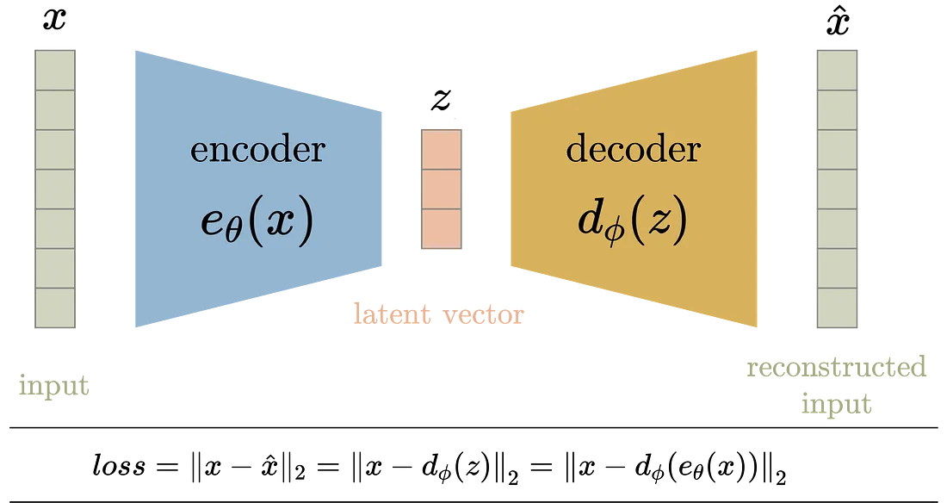
Deep Learning for Games and Simulations
ITU Copenhagen, Fall 2023
Auto Encoder (AE)
learn compact and meaningful representations of data in an unsupervised manner
Simultaneously train (1) an encoder that maps input data to a latent space (compress), and (2) a decoder that reconstructs the original data from this latent representation.
Trained with reconstruction loss: minimize the difference between the original input and its reconstruction
useful to capture the most salient features of the data in a compressed latent space.

Slide 28
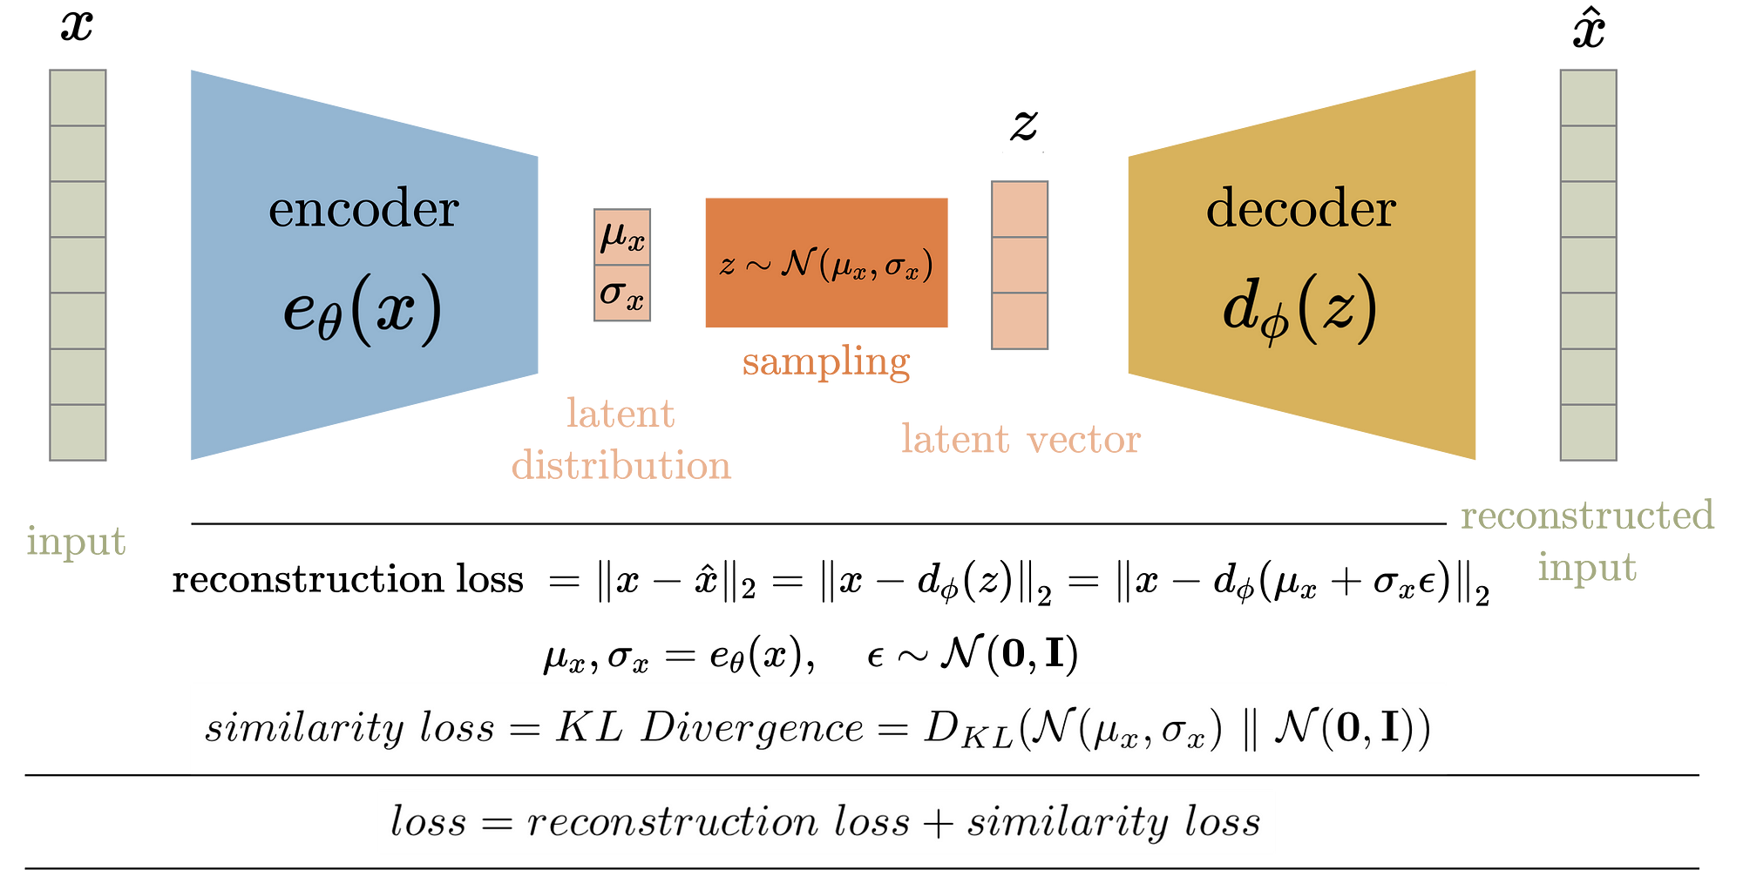
Deep Learning for Games and Simulations
ITU Copenhagen, Fall 2023
Variational Auto Encoder (VAE)
Similarly than AE, generative model that learn compact and meaningful representations of data in an unsupervised manner, with an encoder and decoder
≠ AutoEncoder: learns a probabilistic model of the data the encoder learns parameters of a probability distribution (e.g. mean, variance), from which samples are drawn to generate reconstructions
encourages the model to learn a smooth and continuous latent space, which is particularly beneficial for tasks like data generation and interpolation.
Generative model: once trained, can sample latent vector z and generate data point

Slide 29
Deep Learning for Games and Simulations
ITU Copenhagen, Fall 2023
Variational Auto Encoder (VAE)
The loss function of a VAE has 2 terms: the reconstruction loss, which measures the difference between the original input and its reconstruction, and the KL divergence, which quantifies the difference between the learned latent distribution and a prior distribution (typically a standard normal distribution).

Slide 30
Deep Learning for Games and Simulations
ITU Copenhagen, Fall 2023
(1) Play with the VAE
(2) * Interactive Evolution

Slide 31
Deep Learning for Games and Simulations
ITU Copenhagen, Fall 2023
Ressources:
about VAE:
https://towardsdatascience.com/understanding-variational-autoencoders-vaes-f70510919f73
https://towardsdatascience.com/difference-between-autoencoder-ae-and-variational-autoencoder-vae-ed7be1c038f2

Slide 32
Deep Learning for Games and Simulations
ITU Copenhagen, Fall 2023
LAB 07
GENETIC
https://colab.research.google.com/github/claireaoi/dlgs/blob/main/labs/lab7_genetic.ipynb

Slide 33
Deep Learning for Games and Simulations
ITU Copenhagen, Fall 2023
>Find the optimum for using an evolutionary strategy of a loss function of your choice.
You can simply evolve 1D parameters if the function has one argument. (I.e. every element in the population is a numpy array size 1)
#initialise population
population=
for _ in range(num_generations):
#1--- evaluation
fitness_scores=
#2–- selection best
elites =
#3– create new generation w/ crossover/mating
population=…
(1) ES Optimum

Slide 34
Deep Learning for Games and Simulations
ITU Copenhagen, Fall 2023
>Setup Game Environment such as Lunar Lander
>Define a Neural Network as your policy.
You will evolve its weights here. The input resp. output dimensions of your network should consider the game state resp. action dimension.
action = policyNN(obs)
>Code an evaluate function (fitness). It should take as input an individual, run the game, and for instance return the game score.
>Choose an Evolutionary Strategy
>Evolve the Network: run the evolution loop!
>Evaluate / Visualise
(2) Evolve a GamingNN
#For Box2D you may need install:
!pip install swig
!pip install gym[box2D]

Slide 35
Deep Learning for Games and Simulations
ITU Copenhagen, Fall 2023
Synaptic Consolidation: neurons that fire together wire together:
Δw_{ij}​=η⋅x_{i}​⋅y_{j,}
Δb_{j}​=η⋅y_{j,}
def hebbian_learning(inputs, targets, learning_rate=0.0001, epochs=10000, decay_factor=0.001):
# Initialize weights and bias - One layer enough here
for epoch in range(epochs):
for x, y in zip(inputs, targets):
# Hebbian rule to update weights and bias
# Advise: Calculate before the predicted output of the NN y_hat to use (y- y_hat) to avoid weight explosion
(3) Hebbian Learning
For boolean Gate

Slide 36
Deep Learning for Games and Simulations
ITU Copenhagen, Fall 2023
# Initialization weights
for _ in range(training_epochs):
for x, target in zip(inputs, targets): # Hebbian update rule to update weights
# can update bias with b_j= lr*b_j*y_j
# Note: use target for last layer!
(4) Hebbian Learning
for RL Agent

