Slide 1
A path to Big Data readiness
Claire Austin, PhD
IEEE International Conference on Big Data,Seattle
December 11, 2018
Twitter: @claire_austin GitHub: claireaustin

Slide 2
All opinions my own.
I am not speaking in the role
of an official spokesperson, and
I am not making explicit comments
or recommendations on,
or explicit discussions about,
federal statutory, regulatory or policy matters.

Slide 3
Work conducted as part of …
NIST Big Data Interoperability Framework (NBDIF) volume 9 (Adoption and Modernization).
IEEE Big Data Governance and Metadata Management (BDGMM).
Research Data Alliance - Assessment of data fitness for use (RDA-ADFU).
Environment and climate change Canada modernization of data management.
Acknowledgments
Wo Chang (Chair, NBD-PWG and BDGMM), Russell Reinsch (Chair, NBD-PWG Standards Roadmap Subgroup, Editor of NBDIF vol. 9), and Michael Diepenbroek, Jonathan Petters, Helena Cousijn and Marina Soares e Silva (Co-chairs, RDA-ADFU) for their leadership in this endeavor, and the many work group members for their discussions that encouraged and helped guide this work.
Jessie Gaylord at Lawrence Livermore Laboratory (LLNL) and Mark Conrad at the National Archives and Records Administration (NARA) for their comments that helped improve the data checklists.
Dr. Doris Fortin and Lindsay Copland (STSD-Science and Technology Strategies Directorate) and Cathy Cormier (DMS-Data Management Services) at Environment and Climate Change Canada (ECCC) for their support of this work and their comments that helped improve the paper, and to Dr. Monica Granados (STSD) for her gracious assistance.
This work was unfunded.

Slide 4
« Big Data readiness »
“Big Data readiness” must begin at the source where
data are first created and extend along an unbroken
path through an organization to the outside world.

Slide 5
A generic strategy
Actions directed primarily at the working level that
can be anticipated to have significantly positive
short-term impacts without overwhelming workers,
managers, or stakeholders, and to increase the
chances of success of a Big Data project and
implementation of a future data strategy.
Data checklists!

Slide 6
The Big Data problem space
Legacy systems
Organizational maturity
Lock-in
Culture change
Data standards
Degredation of data quality
Merging disparate datasets from diverse sources
Data preparation

Slide 7
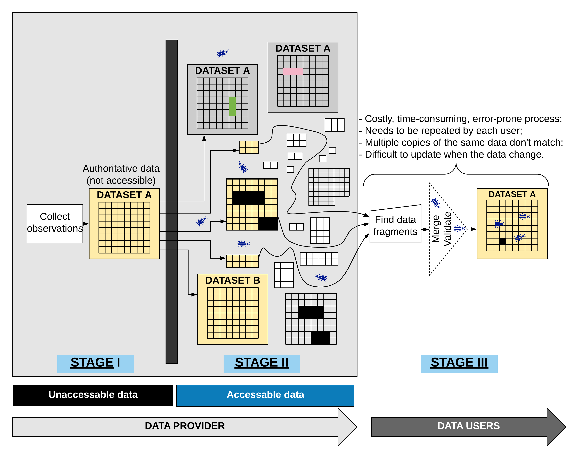

Slide 13
Data cleaning

Slide 14
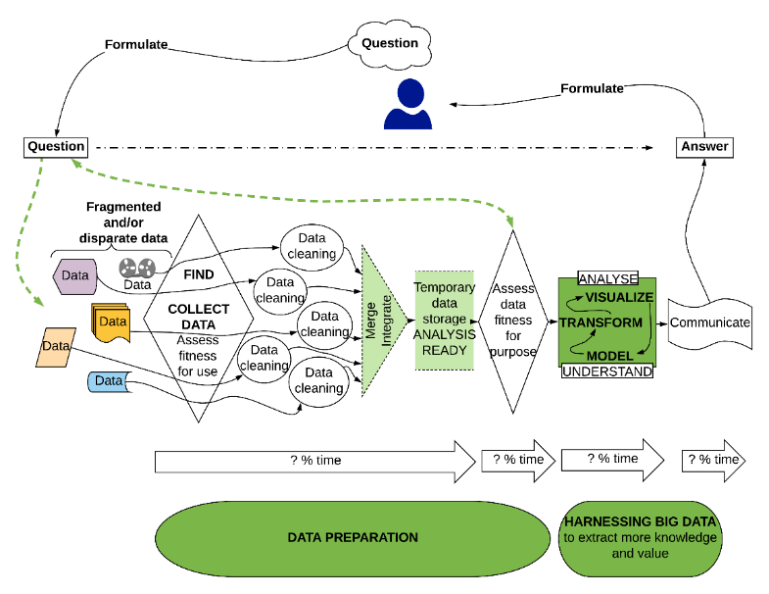

Slide 25
Big Data solution space
Big Data readiness.
Disrupting the status quo.
It’s good enough.
Data governance.
Open science practices and tools.
Implementing actions that are independent of systems currently in place.

Slide 26
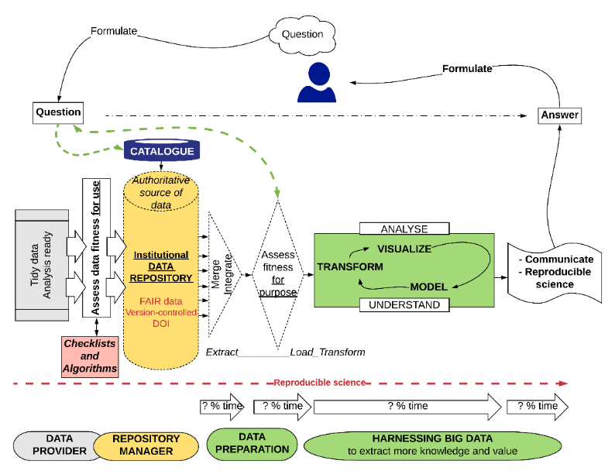

Slide 39
Data cleaning

Slide 42
Data checklists
Implemented on the input side of the data repository.
A useful data management tool for:
data providers;
data repositories;
data stewards; and,
managers who need to approve data without having been involved in their production.
Promotes consistency, awareness, understanding, and efficiency in data governance.
Critical to ensure FAIR data.
Maintains data quality, consistency, and transparency.

Slide 43
Data checklist modules
Module | Sub-modules
1. Metadata | a) Metadata management. b) Provenance. c) Multilingualism. d) Accessibility.
2. Data | a) Raw data. b) Data format/structure. c) Data collection. d) Data preparation. e) Geospatial data – additional considerations. f) Data management. g) Data fitness for use.
3. Source | a) Data repository. b) Website.
4. Visualization | a) Graphics. b) Cartography
5. Software | a) Computer code. b) Project organization. c) File organization. d) Computer code changes
6. Reproducibility
7. Manuscripts
8. Standards
9. Confidentiality

Slide 44
Show data checklist
CHECKLISTS:
https://github.com/claireaustin/BigDataReadiness/blob/master/DataChecklistModules.xlsx
PAPER: https://github.com/claireaustin/BigDataReadiness/blob/master/Austin2018POSTPRINT_PathToBigDataReadiness.pdf

Slide 45
Data checklist as a multifunctional management tool
A learning tool.
An auto-evaluation tool.
Checklist results submitted to data stewards and/or management along with or in lieu of the actual data for purpose of data approval.
Digital repository can use the checklists to identify datasets for acceptance into the repository, and to return to the provider for correction datasets that fail to meet all the criteria.
Management can easily merge checklist results received from across the organization to get a snapshot of the overall state of data quality and data management.

Slide 46
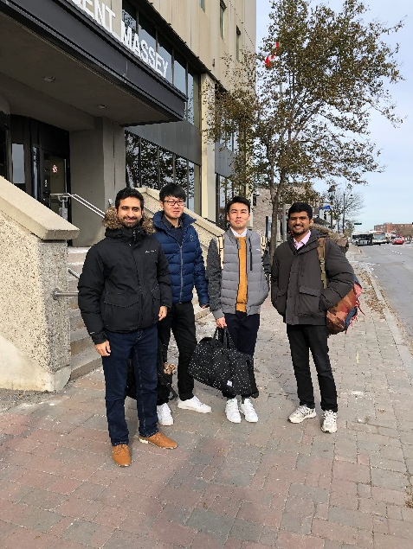
Next steps for the data checklists
Automate (or semi-automate) the data checklists.
See CanDev (October 2018) hackathon results
on GitHub.
Two teams from U Ottawa and Carleton U.
Short paper planned.
Experiment in the open (authorea.com cos-io ).
Validate checklists against real-world datasets.
Another short paper.
Get funding! Estimate 12 months work for a senior software engineer to automate ~90% of the criteria in the current data checklists.
Complement, not compete with work undertaken by other initiatives (GoFair, CoreTrustSeal, DDI, etc.).
Rajshekhar Mukherjee,
Junye Yan, Lingyun Huang,
Arslan Ahmed

Slide 47
Thank you.
Please contact me if you are interested in collaborating on this project.
Twitter: @claire_austin claire.austin@canada.ca GitHub: claireaustin

