Slide 1

China Market Analysis for one client’s products
Xinyi Samore
Feb. 17, 2019

Slide 2
What does Kung Fu Data do?
Project scope:
Analyze data collected for one of KFD’s clients to find e-commerce buyer trends and insights
New visualization format for KFD’s clients
Upgrade internal systems to analyze data
Kungfu Data provides advice for foreign brands to thrive in China’s largest e-market places(Taobao, Tmall)
Taobao, the largest consumer-to-consumer (C2C) marketplace, and TMall, the largest business-to-consumer (B2C) marketplace, both under Alibaba Group
Data includes history activities of consumers, merchants, products and brands

Slide 3
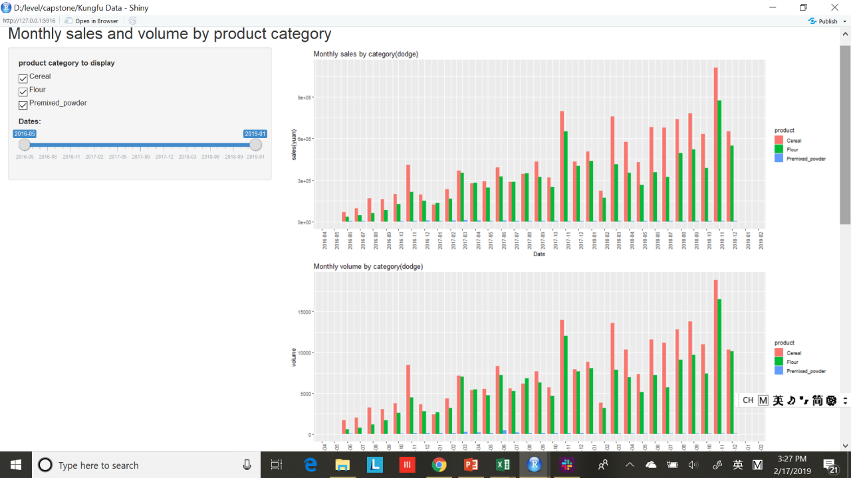
Notes:
Data was collected and analyzed using Excel. KFD asked if I can present the data in a more interactive and user-friendly way.
This is a shiny app that I have built to visualize KFD’ client’s sales data from 2016-6 to 2019-1.
The client mainly sells three categories of products, Cereal, Flour and Premixed_Powder. I included a checkboxgroup for category and sliderbar for dates.
The first graph shows monthly sales from 2016-06 to 2018-12. You can use the sliderbar to choose which date range you want to look at. Comparing sales data across different categories, you can find that Cereal sells the best, followed by flour then premixed powder.
The second graph shows the sales volume by month. The sales volume follows similar trend to sales. There is an increase of both sales and volume in November of each year because of the double 11 sales event.
The last two graphs show the same content with the first two graphs, except that the last two bar graphs are stacked instead of dodged.
The total sales and sales volume has been increasing gradually since 2016. The growth speed becomes slower in 2018 compared to 2016.

Slide 4
Competitors comparison
Products sold from the last 30 days up to Jan.14,2019
Brand Name | 30-day total sales(RMB/yuan) | 30-day units sold | Lifetime sales(RMB/yuan) | Lifetime units sold | Reviews
Client’s brand | 5.39E+05 | 9246 | 1.13E+07 | 199740 | 35487
Arnold's Farm | 6.65E+05 | 7187 | 1.19E+07 | 143983 | 39286
Jason | 1.29E+06 | 33996 | 6.70E+07 | 1467577 | 269889
Quaker | 1.38E+07 | 331810 | 2.77E+08 | 7839147 | 1507235
Notes:
KFD’s client has three main competitors, Arnold’s farm, Jason and Quaker.The table shows the sales data collected from the last days up to Jan. 14,2019. I will compare Quaker and KFD’s client in this presentation.

Slide 5
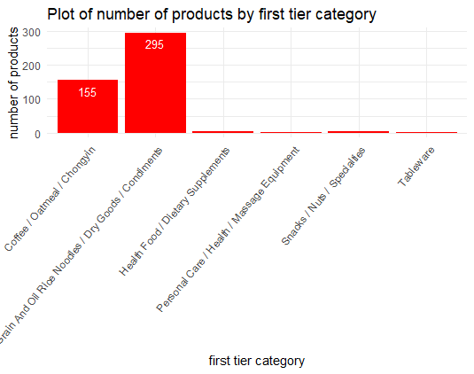
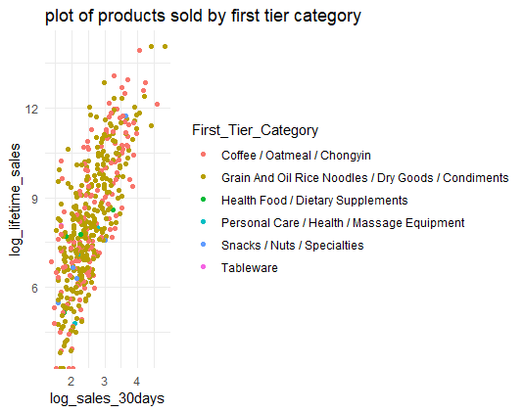
KFD’s client top product analysis
Products sold from the last 30 days up to Jan.14,2019
XXX China Market Analysis
Summary Presentation
January, 2019 Data
Notes:
Taobao and Tmall has set three tiers of categories for its products. I have selected the first tier of category. 295 products sold belong to grain and oil rice noodles dry goods and condiments category. 155 products sold belong to coffee/oatmeal category.
These are the number of distinct products that have been sold over a 30day period.
The graph on the right is a scatterplot with sales of the past 30days as x axis and lifetime sales as y axis. Each dot represents one product.

Slide 6
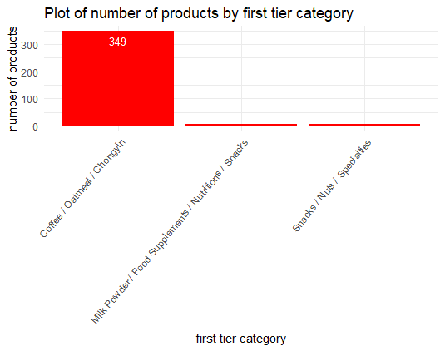
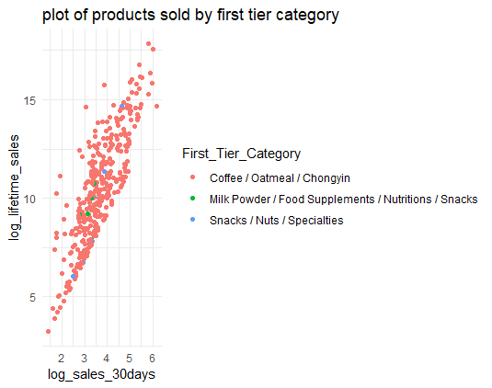
Quaker top product analysis
Products sold from the last 30 days up to Jan.14,2019
Notes:
Quaker has sold 349 products belonging to coffee/oatmeal category.

Slide 7

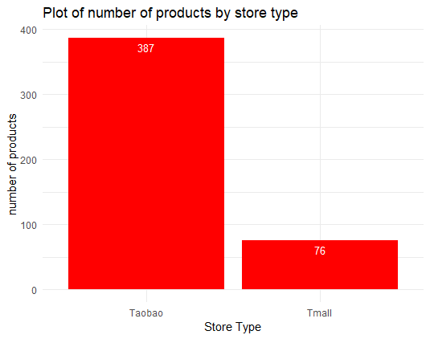
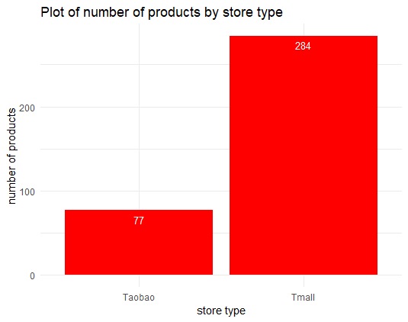
Store type comparison
Products sold from the last 30 days up to Jan.14,2019
KFD’s client
Notes:
Most of the the client’s products were sold on Taobao.

Slide 8
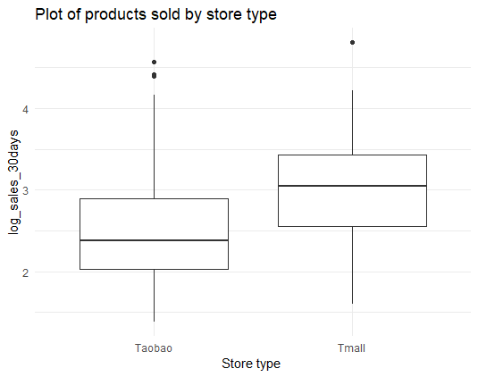
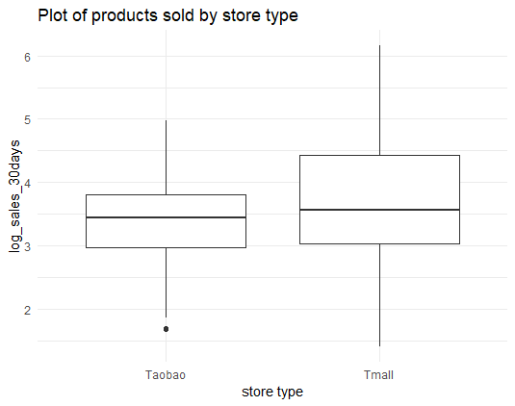
Store type comparison
Products sold from the last 30 days up to Jan.14,2019
KFD’s client
Quaker
Notes:
When we compared Quaker’s products sold on Taobao and Tmall. You can see the majority of the products are sold on Tmall. Tmall is a The key difference between Tmall and Taobao is that while Tmall is a B2C platform, Taobao is C2C (think of it like the difference between Amazon and Ebay).Tmall was set up largely because consumers felt more comfortable buying goods from a company directly rather than from an individual. This might be one of the reasons that Quaker has better sales than KFD’s client.

Slide 9
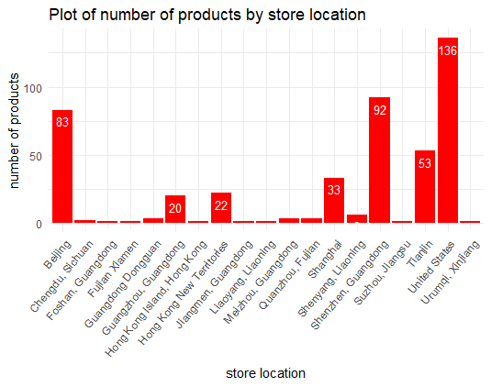
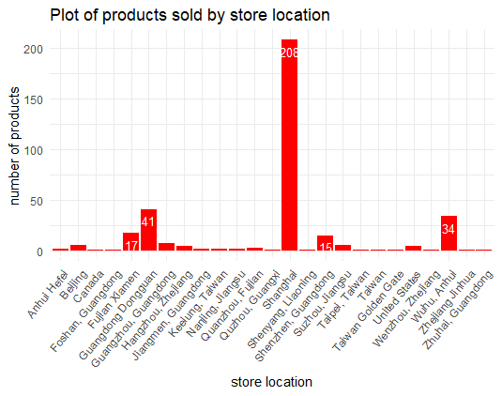
Store location comparison
Products sold from the last 30 days up to Jan.14,2019
KFD’s client
Quaker
Notes:
The most amount of products are sold stores located in the US, followed by Shenzheng then Beijing.

Slide 10
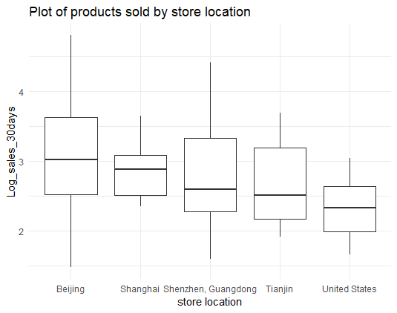
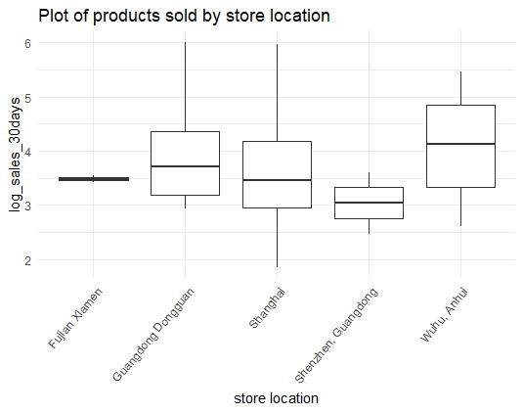
Store location comparison
Products sold from the last 30 days up to Jan.14,2019
KFD’s client
Quaker
Notes:
The majority of products were sold from stores located in Shanghai. If you look at the plot on the right, you can find that although the number of Quaker product sold was less but the sales performance for each product is about one log higher than KFD’s client.

Slide 11
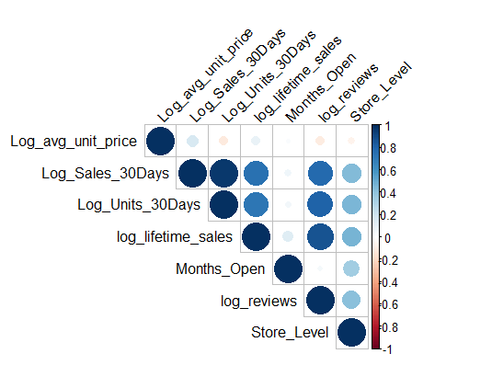

Similar correlation plots
KFD’s client
Quaker
Notes:
If we look at the correlation plots between different variables, there is not a big difference between KFD’s client and Quaker. It seems that sales in the past 30days, volumes sold in the past 30days are strongly correlated, which makes sense.
The number of reviews of the product has strong correlation with the sales performance of the product. Lifetime sales and the sales performance during the last 30days have relatively strong correlation too.

Slide 12
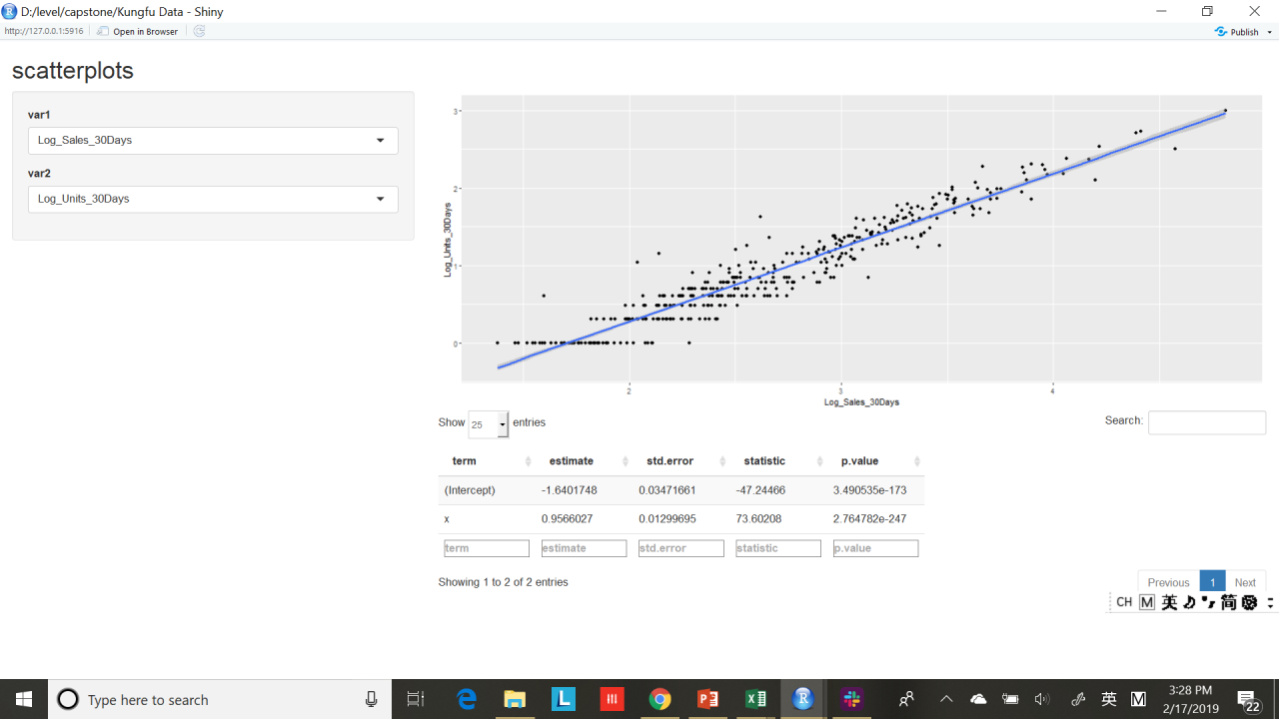
Notes:
This is another shiny app that I have built to visualize the relationship between two variables. You can select the two variables that you are interested in looking at.

Slide 13
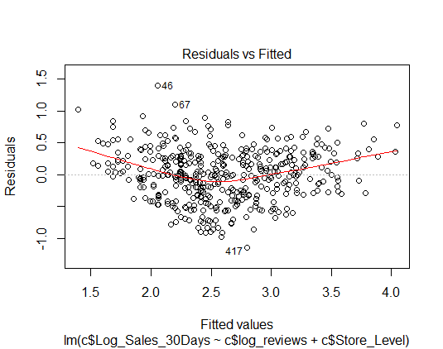
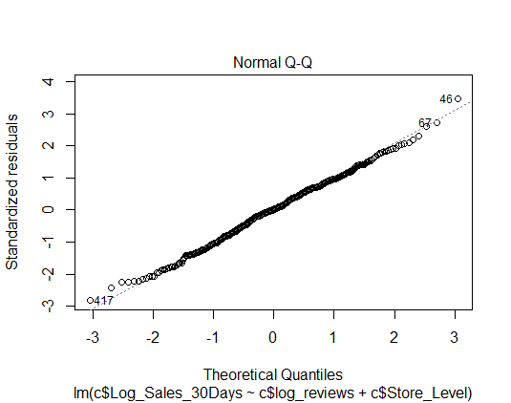
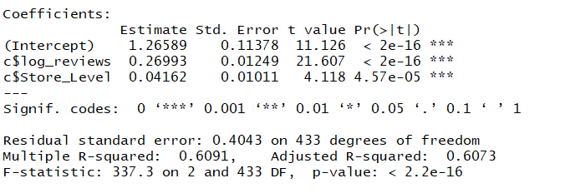
KFD’s client top product analysis
Products sold from the last 30 days up to Jan.14,2019
Linear regression Log_ Sales_30Days vs. log_reviews+Store_Level
Notes:
Based on my findings, two variables log_views and store level effect product sales. So I built a multiple linear regression.
The p -value shows that the number of reviews and store level have a statistically significant effect on the model, compared to the null hypothesis of zero slope.
The graph on top right size is the residuals plotted against the predicted values of sales. The residuals exhibit homoscedasticity along the predicted sales.
The normall qq plot also shows that the residuals are normally distributed.
Adjusted R-squared is about 0.6, the actually values are quite close to the regression line.

Slide 14

KFD’s client top product analysis
Products sold from the last 30 days up to Jan.14,2019
关键词 | Count | Key words
xxx | 406 | Our client’s brand in Chinese
美国 | 254 | United States
粉 | 202 | Powder
麸 | 156 | Wheat Bran
进口 | 140 | Imported
燕麦 | 114 | Oatmeal
xxxxxx | 113 | Our client’s brand in English
烘焙 | 113 | Baking
面粉 | 96 | Flour
燕麦片 | 95 | Oatmeal
Notes:
I tokenized the product titles for what KFD’s client has sold between Dec. 15 and Jan. 14. KFD wants me to use the Chinese product title was google translated into the English title. So the English titles are not accurate. The word cloud showed that the most popular word in the top products include, the brand’s name, United States, powder, wheat bran, imported, oatmeal, baking and flour.

Slide 15
Conclusions
The client should put more effort to help Tmall stores to grow.
The client should move the store locations to mainland China.
The number of reviews has a positive effect on sales performance. The stores should encourage buyers to give reviews of their products by offering some incentives.
The client should provide more supervision and guidance for the stores to improve store level.

Slide 16

Questions?

