Slide 1



Algorithmic fairness in cardiovascular disease risk prediction
HDR UK-Turing Wellcome PhD fairness in healthcare modelling immersion
Claire Coffey

Slide 2
This talk’s agenda
Learn/recap general algorithmic fairness background
Description of my project on producing a framework to quantify algorithmic fairness, with the use case of cardiovascular disease risk prediction models, including methods and preliminary results
Overview of my future plans
I may eventually stop talking or someone tells me to stop
Questions and discussion

Slide 3
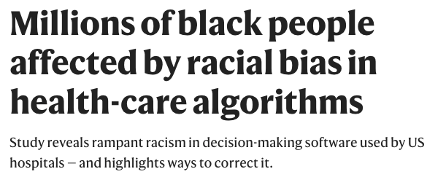
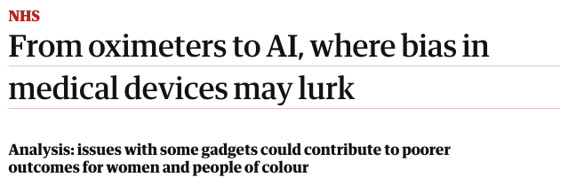

Motivation
DeepMind’s new AI predicts kidney injury two days before it happens (but it doesn’t work for women)

Slide 4
Motivation
Algorithms are biased; medical algorithms are no exception
Medical risk prediction tools must provide the best predictions for all individuals to ensure equitable treatment
Not straightforward
Some models perform worse for certain demographic groups
Little work on quantifying fairness
Being used in the clinic
Small changes in fairness -> big overall impact
Use case: cardiovascular disease (CVD)
The leading cause of death globally (32% of deaths in 2019)
Many models are used in practice to predict CVD risk, impacting millions of worldwide
But most have not been assessed for fairness!

Slide 5
Summary of my work so far
Developed a framework to quantify the algorithmic fairness of published medical predictive models, with the use case of cardiovascular disease
Selection of published prediction tools for estimating cardiovascular disease risk to make predictions of 10-year cardiovascular risk
UK Biobank dataset
Quantified the fairness according to a variety of fairness metrics for different population groups
Characteristics protected by law in the Equalities Act 2010
Recalibrated models for fairness-improvement
Re-quantified the fairness of recalibrated

Slide 6
Fairness in prediction models requires ensuring a tool does not benefit some individuals at the expense of others

Slide 7
What causes an algorithm to be unfair?

Slide 8
What causes an algorithm to be unfair?
Data used to train models:
Biased data can be caused by historical societal biases, data collection issues, imbalanced data, small sample sizes for some subgroups
Difficult to capture deviations from the training data, more likely to affect minority groups
Models perpetuating existing biases:
Models can be simplified to ignore uncommon cases, ignoring minority subgroups
Aren’t constrained to ensure predictions are equitable in different subgroups - they optimise for overall accuracy (e.g. linear regression)

Slide 9
What is algorithmic fairness?
Definitions across philosophy, law, medical, and social science
Unfairness is not a new issue: unequal society; biased humans, discriminatory decisions (automated or not)
Imperative issues are not perpetuated by algorithms
Discriminatory behaviour discovered in algorithms spawned fairness research in computer science
Ensuring a tool does not benefit some at the expense of others
Many mathematical fairness criteria have emerged
Attempt to define, quantify, and mitigate discriminatory behaviour in algorithms
But criteria are conflicting, hard to define and adapt to real-world applications, and impossible to satisfy all at once
Defining, quantifying, and enforcing fairness is not straightforward!

Slide 10
Mathematical fairnesss
Mathematical techniques cannot change unfairness entrenched in societies
Can expose and improve discriminatory algorithms
Alerting policymakers, researchers, and the public to potentially unfair prediction models
Techniques can be split into definitions, quantification metrics, and improvement methods
Fairness definitions: A statistical notion of fairness that, if satisfied, deems a model fair
Fairness quantification metrics: Adaptation of the definitions, allowing the fairness of predictions from a model to be quantified: the extent to which a fairness definition is satisfied
Fairness improvement methods: These alter the models or predictions (depending on whether they are applied during model training or post-prediction) to encourage the models to satisfy fairness definitions. The fairness of the ‘improved’ models can then be again quantified using fairness metrics

Slide 11
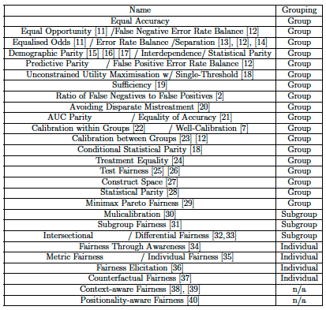
Group, subgroup, or individual fairness?
Definitions can be grouped to 3 categories: group, subgroup, or individual
Drawn from statistical measurements on the predictions for each group, subgroup, or individual
Subgroup definitions often extensions of group definitions
Each definition can be adapted to its respective fairness quantification metric and fairness improvement technique

Slide 12
Group fairness in classification
Pre-defined characteristics,, but can any grouping, there can be n groups
Group metrics compare classification predictions for each group using statistical notions to calculate a metric to quantify fairness
Calculated from true and false positives and negatives for classifications made for each group, taken from a confusion matrix (details later)
Three popular definitions
Calibration: Satisfied if there is no difference between the predicted and actual outcomes within a group
Equalised odds: Satisfied when the true positive and true negative rates are equal for all groups
Statistical/demographic parity: States that for each demographic, the proportion of individuals given a specific prediction (i.e. assigned to a certain class) will be the same, minimising the difference in predictions between groups

Slide 13
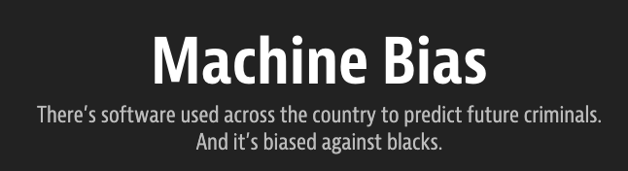
Conflicting definitions
No definition is suitable for all problems
Impossible to satisfy all, notably calibration and equalised odds
Exposed in analysis of COMPAS criminal risk prediction tool
Tool was unfair against Black individuals according to equalised odds, despite satisfying calibration and statistical parity
Encapsulates necessity of exploring multiple criteria and context
Calibration cannot acknowledge historical biases that may affect calibration of models
Equalised odds can expose these with error rates
Neither is context-aware
Group fairness definitions, combined with the one-model fits-all approach, cannot be used to optimise for all subgroups; leading to the development of subgroup and individual fairness definitions

Slide 14
Subgroup and individual fairness
Individual fairness requires similar individuals to be treated similarly, is evaluated using a distance metric
Theoretically appealing but difficult to enforce, can be very computationally expensive
Subgroup fairness allows models to be fairness-optimised for subgroups within and between groups
Overlapping subgroups within a characteristic when subgroups are not disjoint
Intersectional subgroups across multiple characteristics (e.g. Black females aged 60-70)
Extensions of group fairness definitions

Slide 15
Fairness in medical applications
How metrics etc have been used
Biases in risk prediction often mitigated through calibration on race, sex, and age
although many models are still not well-calibrated
No comprehensive comparison of fairness of CVD risk tools
Little work on medical risk prediction tools in general
One paper explores fairness in CVD risk prediction but is limited:
Develop a ‘fair’ model based on equalised odds
Do not assess multiple models already being used
Focus only on one criteria (EO)
Only looks at race, sex, and age
Learns the model using machine learning: overcomplicated?

Slide 16
Fairness in CVD prediction

Slide 17
Mitigating unfairness
Biases in risk prediction often mitigated through calibration: usually just sex and age
Although many models are still not well-calibrated
Biases in risk prediction mitigated through calibration
Many models are still not well-calibrated
Focus on sex and age: to what extent does this mitigate biases in other groups? Has not been explored

Slide 18
Quantifying algorithmic fairness in cardiovascular disease risk prediction tools

Slide 19
Project goals
To investigate and quantify the current state of fairness of multiple CVD risk prediction tools that are already used in the clinic, using a range of fairness criteria and UK Biobank data
The results could be used to guide improvements for these models as well as the development of new models
Bridging the gap between algorithmic fairness and medical risk prediction: the framework can be used for any collection of groups, any disease, and on any set of predictions

Slide 20
UK Biobank
Large longtitudinal prospective cohort study
Over 500,000 adults aged 40-69 in the UK
Baseline data includes in-depth health data on lifestyle, environment, medical records, biomedical and physical measurements, biomarkers, and genetic information
Data is linked to primary and secondary care health records, and deaths (plus causes)
Participants continue to attend follow-up appointments to track a wide range of health outcomes in the long term

Slide 21
Method details
Study selection
CVD events identified using self-reported history of disease, presence of ICD-9, ICD-10, OPCS-4 codes in linked hospital records, death certificates
Individuals with CVD at baseline excluded
464,063 individuals selected for analysis without pre-existing CVD
Predictors / features
Predictors extracted: demographic and medical risk factors
Predictors converted into required categories (eg. ethnicity) or units (eg. cholesterol in mg/dL) for each tool

Slide 22
CVD prediction models
UK-based QRISK2, 2013 and 2018 versions of US-based Pooled Cohort Equations (PCE) analysed
These are used in the clinic and influential worldwide
PCE are not defined for UK, but it is common practice to re-calibrate results from models to make predictions on another population
This re-calibration has been done as part of my ‘fairness-improvement’ analysis

Slide 23
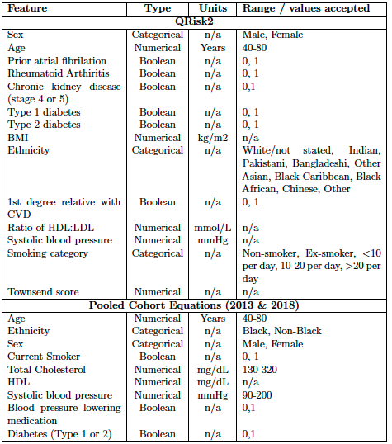
CVD prediction models

Slide 24
Scores to binary predictions
10-year risk of CVD event calculated in 464,063 participants without CVD at baseline using QRISK2, PCE 2013 and 2018
National Institute for Health and Care Excellence (NICE) guidelines used to bin predictions into into high (>=20%), medium (>=10%, recommended risk reducing therapies [e.g. statins]), and low risk categories
For fairness metrics requiring a binary classification prediction, medium risk threshold used to label individuals as predicted to have an event - this is the level at which intervention is recommended
Individuals below 10% threshold are labelled as not being predicted to have an event

Slide 25
Quantifying fairness
Each tool assessed against: Accuracy equality difference; Predictive equality difference; Equal opportunity difference; Conditional use accuracy equality difference; Treatment equality difference; Equalised odds difference; Calibration difference
Assessing using risk threshold because these are used to decide the future of patients rather than raw scores; results for different groups can identify if one-threshold-fits all approach is appropriate
Fairness quantification metrics applied to predictions from the ’fairness-improved’ re-calibrated models

Slide 26

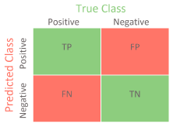
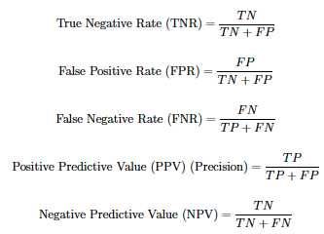
Quantifying fairness
Fairness metrics based on statistical measurements taken from a confusion matrix of true vs predicted values

Slide 27
Fairness quantification metrics
Well-calibration difference: for each group, average difference between predicted and actual outcomes across all quantiles calculated to get well-calibration measurement. Well-calibration difference is the difference between well-calibration measurements for each group
Equalised odds difference: greatest difference between the TPR or FPR of two groups. The value used for quantification is whichever difference is greater
Accuracy equality difference: greatest difference in accuracy between two groups
Predictive equality difference: greatest difference between the false positive error rates of two groups
Equal opportunity difference: greatest difference between the false negative error rates of two groups
Conditional use accuracy equality difference: greatest difference between the PPV or NPV of two groups. The value used for quantification is whichever difference is greater
Treatment equality difference: greatest difference between the ratio of false negatives and false positives of two groups

Slide 28
Protected characteristics and fairness groupings
The group fairness for age, self-reported ethnicity, and sex (characteristics protected by law) was quantified according to multiple definitions
Deprivation level was analysed using the Index of Multiple Deprivation (IMD)
Negative relationship between health outcomes and deprivation level
IMD calculated based on postcode
Distinct groups for now but also interested in intersecting groups

Slide 29
Survival function
Calculated a survival function to reduce potential bias of including only individuals who remained in the UKB study for whole 10-year follow-up period
For each algorithm and its predictions:
Divide population into deciles based on predicted risk
For each decile fit a Kaplan-Meier (K-M) survival estimator curve
Record 10-year observed risk (“survival” at 10 years) according to this K-M curve. This is 1 - the value for survival at 10 years

Slide 30
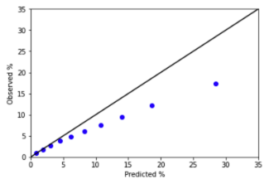
Calibration curves
10-year observed risk calculated from the K-M curve to plot a calibration curve for each algorithm
Observed risk plotted against 10-year predicted risk at each decile
Gives overall calibration curve: conventional method to assess/present difference between predicted and actual risk across deciles of a population (or subpopulation)
Stay tuned to see examples in my results section

Slide 31
Improving fairness using recalibration
[1] Lisa Pennells, Stephen Kaptoge, Angela Wood, Mike Sweeting, Xiaohui Zhao, Ian White, Stephen Burgess, Peter Willeit, Thomas Bolton, Karel GM Moons, et al.
Equalization of four cardiovascular risk algorithms after systematic recalibration: individual-participant meta-analysis of 86 prospective studies. European heart journal, 40(7):621–631, 2019.
Recalibration applied as fairness improvement technique (used standardly in medical risk prediction)
My approach based on Pennells et al.’s approach [1], adapted by Scott Ritchie, state-of-the-art
Predictions from published CVD models fed in, and individuals’ predictions are re-scaled without affecting the ability of the model to discriminate risk
Method recalibrates predictions to sex-specific incidence rates observed in UK population
Used these population rates rather than UKB, as recalibrating using UKB causes overfitting - recalibration and testing data should not be the same as this is biased and produces misleading results
Incidence rates used were for individuals without CVD history, in 5-year age group bins, obtained from primary care data in England via the Clinical Practice Research Datalink (CPRD)
Models’ predictions were plotted post fairness-improvement, along with fairness quantifications for each group (stay tuned!).

Slide 32
The moment you have all been waiting for: results!
Spoiler to reduce any potential excitement: they are all preliminary and not at all groundbreaking so far

Slide 33
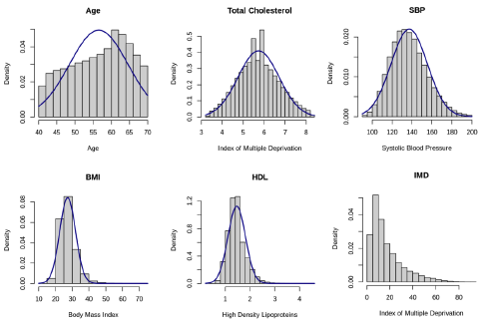
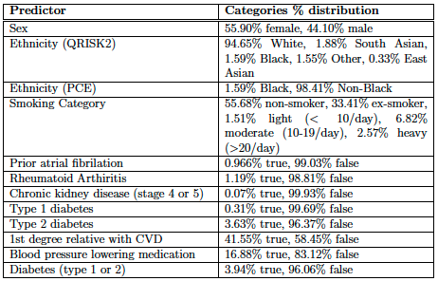
UKB data summary
To better understand data distributions in UKB
Density plots of numerical predictors approximately normally distributed
Categorical and Boolean predictors summarised

Slide 34
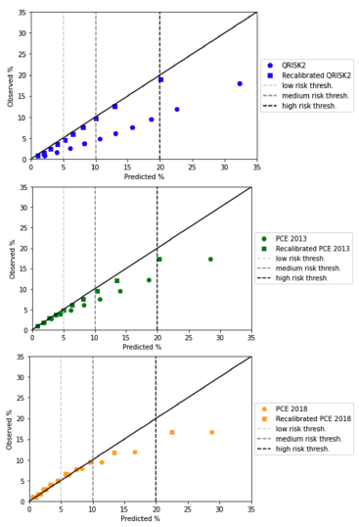
Population-wide predictions
Published models (out-of-the-box)
Predictions for published models not close to that of observed events!
Risk overestimated for nearly all deciles for all models, to a greater extent in higher risk deciles
Especially true for QRISK2: average difference between of 6.66% - yet this has been built for the UK population!
UKB population more healthy than UK – predictions are not expected to be accurate? Yet, least accurate for highest risk deciles
Algorithm is being used in clinical practice on the individuals in UKB. Overestimating risk may result in unnecessary medication being prescribed, causing over-reliance on pharmaceutical interventions and costing individuals and the health service £££
May not be the case for the whole population - deciles are defined in UKB so they may not be reflective of distribution outside UKB
Recalibrated models
Generally fit data well
Predicted and observed outcomes much more similar overall
Most difference at high-risk deciles
Calibration not perfect due to being done using CPRD incidence rates - different to those in UKB

Slide 35
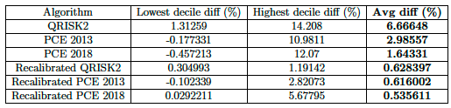
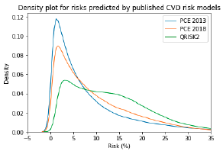
Population-wide predictions
Quantifying calibration as a measure of fairness
Differences between predicted and observed outcomes across whole population, calculated using a calibration quantification (average difference between the predicted and observed risks)
Density plot for the models’ predictions population-wide: predictions differ a lot between tools

Slide 36
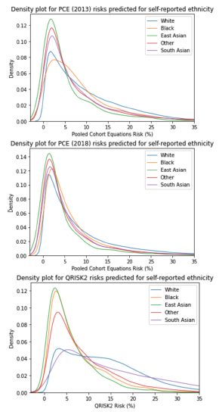
Group predictions
How do predictions differ for different subgroups?
Insight into disparities in predictions within a group, across different algorithms
Suggesting a potential difference in fairness of predictions (coming up!)
Self-reported ethnicity groups showed the greatest disparities: important characteristic in which medical risk prediction is biased
Health outcomes vary with ethnicity due to various societal factors requiring attention from policy
We can see predictions differ widely across models

Slide 37
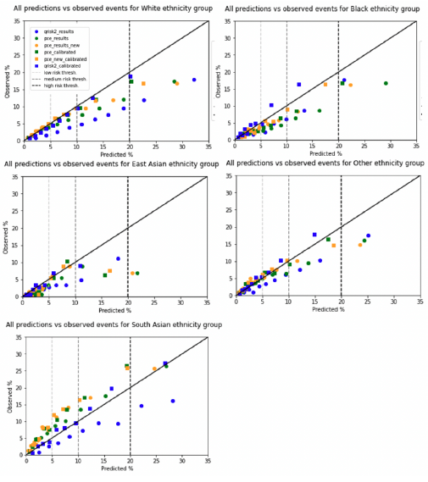
Ethnicity predictions
Calibration plots for self-reported ethnicity groups
PCE use only Black and “White”
Important ethnicity data is collected so differences can be analysed (this data is not collected in some countries such as France so cannot be used there)
Majority of models overestimate risk across most ethnicity groups other than South Asian, where the risk is underestimated, including by the recalibrated models
Suggests further analysis into South Asian group is necessary
Recalibration doesn’t work for all groups
East Asian consistently overestimated
Black underestimated in medium risk area

Slide 38
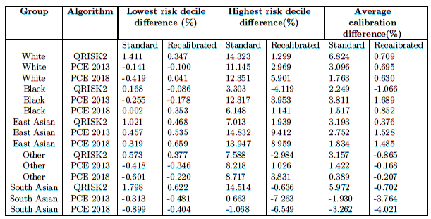
Ethnicity predictions
Calibration quantifications for self-reported ethnicity groups

Slide 39
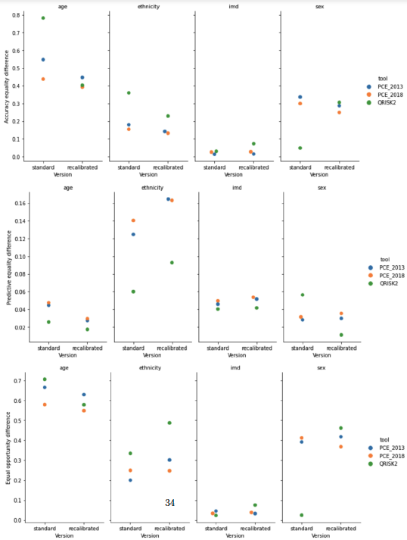
Finally… fairness quantification
Does recalibration improve fairness?
Accuracy equality difference: The recalibrated QRISK2 score is less fair for ethnicity than the standard or recalibrated PCE implementations. There is also a reduction in fairness for sex for the recalibrated QRISK2 model compared to the standard version
Predictive Equality Difference: The recalibrated versions of each of the algorithms are less fair than the standard CVD risk prediction models versions for ethnicity (but not the other attributes)
Equal opportunity difference: We see that the recalibrated versions of each of the algorithms are less fair than the standard versions for ethnicity, and for sex in QRISK2 and PCE 2013. We also see a slight decrease in fairness for IMD in recalibrated QRISK2

Slide 40
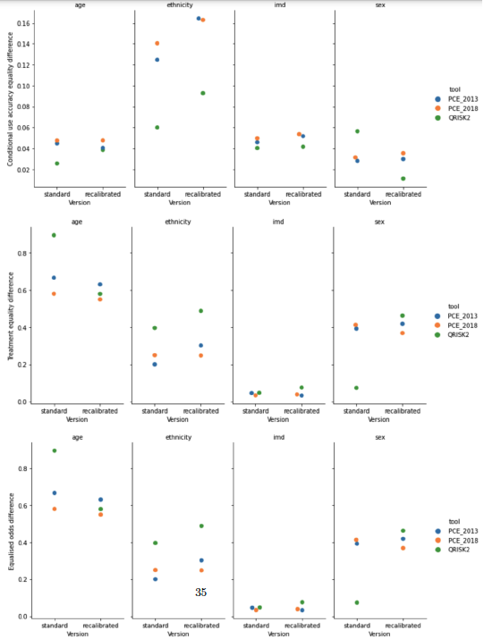
Finally… fairness quantification
Does recalibration improve fairness?
Conditional use accuracy equality difference: We see that the recalibrated versions of each of the algorithms are less fair than the standard CVD risk prediction models versions for ethnicity, and slightly less for age and IMD
Treatment equality difference: We see that the recalibrated versions of each of the algorithms are less fair than the standard versions for ethnicity, and for sex in recalibrated QRISK2
Equalised odds difference: We see that the recalibrated versions of QRISK2 and PCE 2013 are less fair than the standard CVD risk prediction models versions for ethnicity, for sex in recalibrated QRISK2

Slide 41
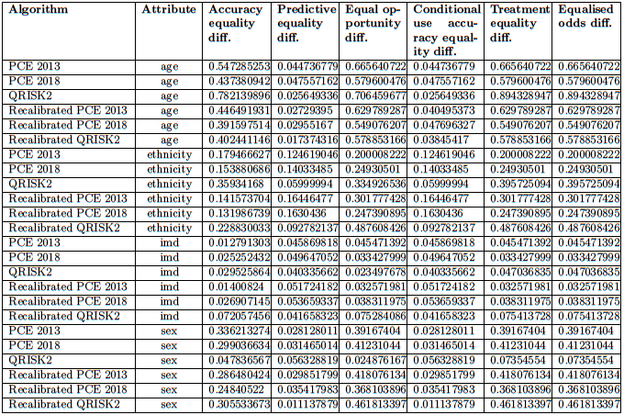
Fairness quantification

Slide 42
Discussion
Strengths | Weaknesses
Data: UK Biobank large, detailed, popular for analysis | Data: UK Biobank unrepresentative of population, unequal group sizes
Quantified algorithmic fairness using many metrics before and after recalibration for many population groups: has not been done before in medical risk prediction | Applied only one ‘fairness-improvement’ technique (recalibration). Adjusting binary threshold for different groups could be another way to do this post-prediction
Easy to adapt framework to other diseases/prediction models | Uncertainty estimates not calculated
 | Not accounting for censoring

Slide 43
Future work
This project:
Explore results in more detail to discover specific areas of unfairness
E.g. look at groups causing disparity according to equal accuracy difference for sex, age, ethnicity
Further analysis on whether 10% threshold is suitable for all groups
Assess fairness of intersectional groups: health inequalities can be worse for minority intersectional groups – has not been explored
Use existing framework but redefine groups as intersectional ones (e.g. females aged 50-60 in the 1st IMD decile across different ethnicity groups)

Slide 44
Future work
Future projects:
Clustering for unfair group discovery
How can we discover which groups may be being discriminated against, other than those defined by pre-defined characteristics?
Polygenic risk score fairness
Area of fairness concerns especially across different ancestries
Assess polygenic risk score fairness; adapt and improve polygenic scores based on these outputs
Development of fair ML model for CVD risk prediction
Incorporate multiple data types, including demographic information and polygenic scores
Generate machine learning based model that optimises for fairness across subgroups during training

Slide 45
Twitter: claireicoffey Email: cic31@cam.ac.uk
Please get in touch with any questions or if you would like to collaborate - I have many project ideas in this area but not enough time to do them all alone!

