Slide 1

Quantifying Algorithmic Fairness in disease risk prediction
Inouye Lab meeting
17th July 2023
Claire Coffey

Slide 2
Quantifying Algorithmic Fairness in disease risk prediction
Motivation
Many high-stakes algorithms have been shown to underperform for some population groups, and unfairness in medical technology exists (e.g. oximeters)
Yet most medical risk prediction algorithms have not been assessed for fairness
Essential to explore fairness of these algorithms as it is crucial for medical prediction algorithms to offer optimal predictions for all

Slide 3
Quantifying Algorithmic Fairness in disease risk prediction
Project outline
Some algorithms may underperform for specific population groups, and many have not been analysed for fairness
Developed a framework to quantify algorithmic fairness in medical prediction tools
Applied to CVD: assessing fairness across various demographic groups for different CVD risk prediction models
Using UK Biobank data to assess fairness in predictions for age, sex, ethnicity, and deprivation groups, and their intersections
Framework can be used to assess algorithmic fairness in any risk prediction model

Slide 4
Quantifying Algorithmic Fairness in disease risk prediction
Findings
Intersectional analysis reveals disparities in fairness for intersectional groups compared to individual comprising groups
Disparities in predictions for multiple ethnicity groups are seen, suggesting potential unfairness and importance of exploring less coarse ethnicity groups
Recalibrating an algorithm does not ensure group fairness
Fairness metrics are incompatible and highlight different levels of unfairness, so a range should be explored

Slide 5
algorithmic fairness
“Fair” predictions can be enforced by satisfying mathematical criteria
Has been applied in high-stakes domains, e.g. medical technology and risk prediction
Unfairness arises due to:
Data issues: historical biases, data collection inequalities, small sample sizes for minority groups
Model issues: optimization for overall accuracy, ignoring equitable predictions in different subgroups (e.g., linear regression)
Some frameworks and techniques have been developed to identify and remove potentially discriminatory behaviour
Fairness Quantification Metrics: Adaptations of fairness definitions to quantify or measure fairness in model predictions.
Fairness Definitions: Statistical notions determining model fairness.

Slide 6
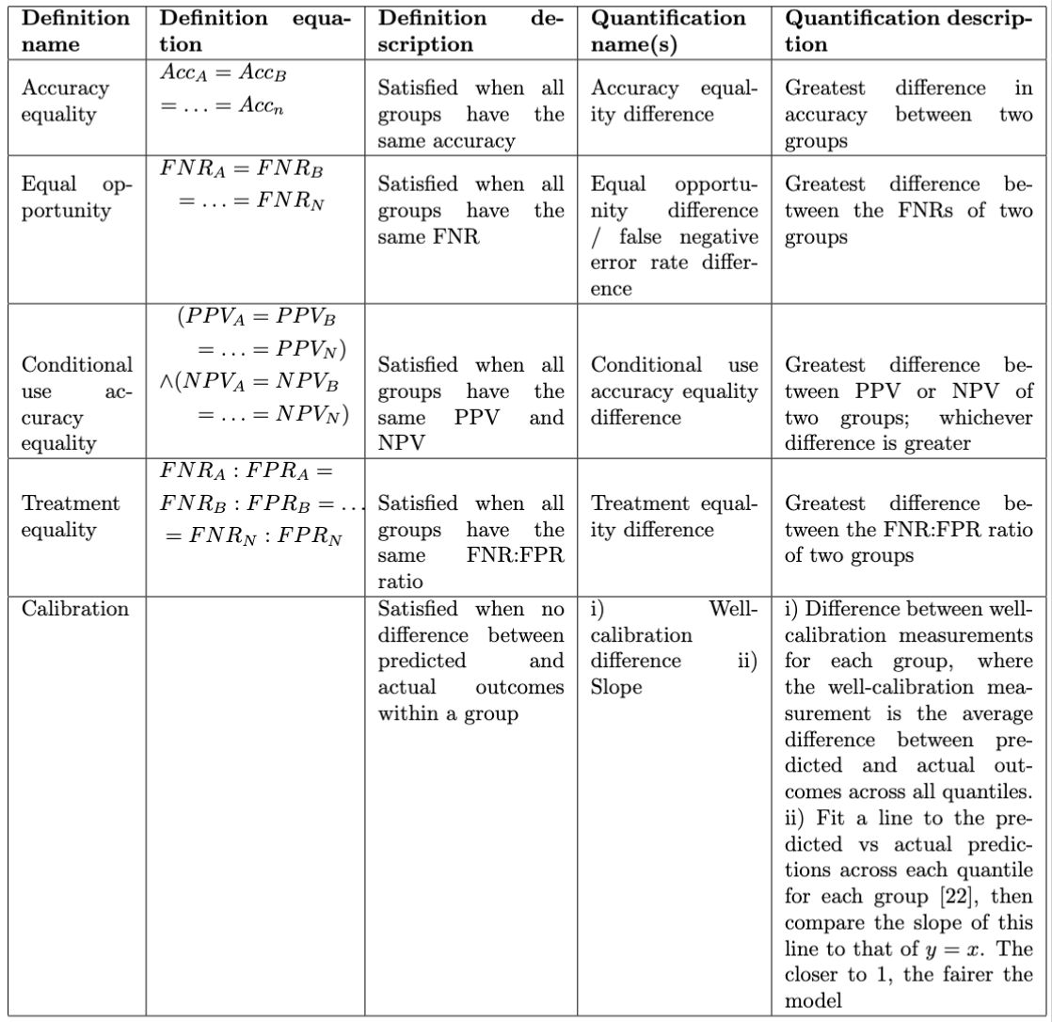
Group fairness
Algorithmic fairness can be categorized into group fairness, subgroup fairness, and individual fairness.
Group fairness is used to assess fairness of predictions across different pre-defined groups (e.g., sex or age).
Group fairness quantification metrics are calculated by comparing predictions for each group using statistical measurements for binary classification.
Metrics used include Accuracy, True Positive Rate (TPR), True Negative Rate (TNR), False Positive Rate (FPR), False Negative Rate (FNR), Positive Predictive Value (PPV), and Negative Predictive Value (NPV).
- Group fairness has various definitions, and the best choice depends on the context.
The selected definitions are popular and relevant to the problem at hand.
It's challenging to satisfy all fairness definitions simultaneously.
Exploring multiple definitions is necessary for a comprehensive fairness analysis.
Group fairness definitions, along with a one-model-fits-all approach, may not optimize for all subgroups effectively.

Slide 7
Fairness in medical risk prediction
Fairness in medical risk prediction is an underexplored area, despite the potential for perpetuating healthcare and societal inequalities.
Sex- and age-disaggregated models are commonly used to address biases and mitigate discrimination.
Wastvedt et al.'s framework for counterfactual intersectional fairness in risk prediction is being assessed with simulated data.
Risk prediction models are evaluated for predictive and discriminative ability in different data.
Generalisability is assessed through external validation and validation in trials.
The c-statistic is commonly used to measure model discrimination, but it has received some criticism.
Assessments are often done population-wide, which may miss unfairness against specific subgroups (though sex-specific assessments are relatively common).
External validation is essential but often neglected, leading to potential overestimation of model performance in clinical practice.
Siontis et al. found that only a small percentage of risk prediction models undergo external validation, with later validations showing worse predictive performance.
External validation is crucial for accurate assessment and validation of risk prediction models.

Slide 8
Fairness in CVD risk prediction
Cardiovascular disease (CVD) risk prediction models are used to assess patients' risk of CVD events (e.g., stroke, heart attack) and impact patient screening, diagnosis, and treatment.
Concerns exist over the effectiveness of these tools for different populations.
Algorithmic fairness analysis focuses on CVD risk prediction tools as an illustrative example.
Few studies have connected the CVD risk prediction and algorithmic fairness research communities.
Pfohl et al. propose a fair CVD risk prediction algorithm using machine learning, but they focus on specific fairness criteria (equalised odds) and create a new tool rather than assessing existing ones.
Foryciarz et al. assess the fairness of the Pooled Cohort Equations (PCE) used in the US, but their study is limited to one prediction model and two fairness definitions, with a focus on clinical guidelines.
Another recent publication aims to quantify the accuracy and fairness of existing CVD prediction tools but uses inappropriate fairness metrics and problematic racial categories.

Slide 9
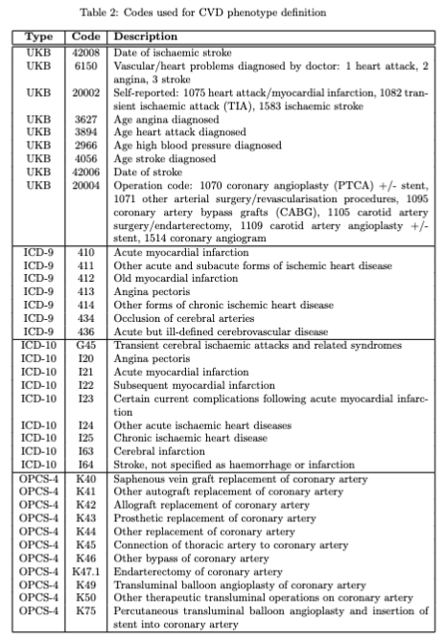
Data UK biobank
Study selection
Individuals with pre-existing CVD excluded, leaving 464,063 participants for analysis
CVD events identified using self-reported disease history and ICD-9, ICD-10, OPCS-4 codes in linked hospital records or death certificates
After excluding individuals with age >70 and those missing key predictor and analysis data, 439,049 participants remained for analysis

Slide 10
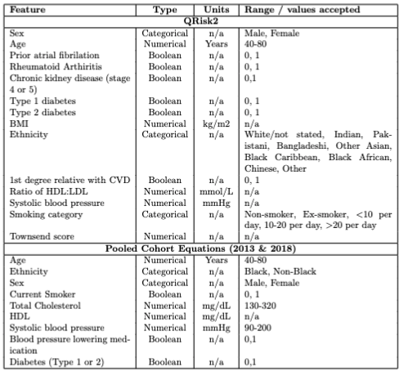
Analysis of CVD Tools
Predictors
UK-based QRISK2 and US-based Pooled Cohort Equations (PCE) from 2013 and 2018
QRISK2 and PCE are widely used in clinics and have global influence
PCE is not designed for use in the UK, but it is common practice to re-calibrate models from one population and use them for predictions in another
QRISK2 scores calculated using a re-implementation of the original open-source code in Python
PCE (both 2013 and 2018 versions) were calculated using the PCE package in R

Slide 11
calculating CVD risk scores
The 10-year risk of a CVD event calculated using QRISK2, PCE 2013, and PCE 2018 on the UKB data at baseline
Classifying into binary predictions
Using NICE guidelines thresholds:
Those with a risk ≥ 10% were labelled as predicted to have a CVD event within 10 years (1)
Individuals below threshold were labelled as not predicted to have a CVD event within 10 years (0)
10%
risk <10% labelled as not predicted to have a CVD event within 10 years
risk ≥ 10% labelled as predicted to have a CVD event within 10 years

Slide 12
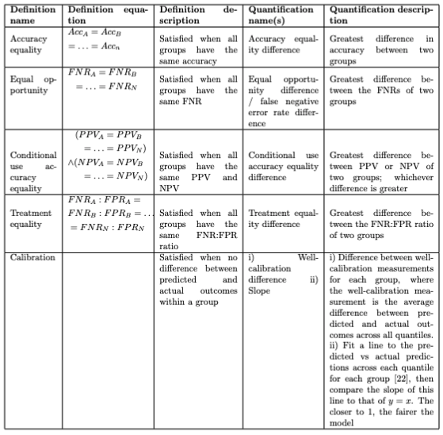
Analysing models with group fairness metrics
QRISK, PCE 2013 and PCE 2018 predictions evaluated using a variety of fairness quantification metrics
10-year observed outcomes (whether the patient experiences a CVD event within 10 years) are compared with the binary predictions for defined subgroups
Fairness quantification metrics are applied to predictions from QRISK2, PCE 2013, and PCE 2018, and the re-calibrated models

Slide 13
Group fairness analysis
Group | Subgroups
Sex | Male, Female
Age | 40-50, 50-60, 60-70
Ethnicity | White, South Asian, Black, East Asian, Other
Index of Multiple Deprivation (IMD) | D1, D2, D3, D4, D5, D6, D7, D8, D9, D10
Ethnicity groups chosen based on those used in QRISK2
IMD: complex measure of deprivation calculated using postcode, split into UKB deciles
Intersectional groups
Health outcomes differ for intersectional groups, but this has not been explored in algorithmic fairness
Also analysed fairness of predictions for intersectional ethnicity and deprivation and intersectional ethnicity and sex groups

Slide 14
Survival function
Survival function calculated to reduce potential bias caused by including only individuals who remained in the UKB study for the entire 10-year follow-up period
The process involved dividing the population into deciles based on the predicted risk from each algorithm.
For each decile, a Kaplan-Meier (K-M) survival estimator curve was fitted.
The 10-year observed risk (survival at 10 years) was recorded according to the K-M curve (1 minus the value for survival at 10 years).

Slide 15
Handling Censoring in fairness metric calculations
13,953 individuals censored before 10 years (3.18% of cohort)
Applied inverse probability censoring weighting to down-weight censored individuals by generating weighted fairness metrics:
Kaplan-Meier time-to-event estimator curves fitted on the population:
"E”: whether an individual is censored before 10 years (E=1 for all censored individuals)
"T": time to censoring (T=10 for all who remain uncensored)
Each individual then assigned a weight: the inverse of the Kaplan-Meier estimator result
Weights used to calculate a weighted confusion matrix
weighted fairness metrics calculated from this

Slide 16
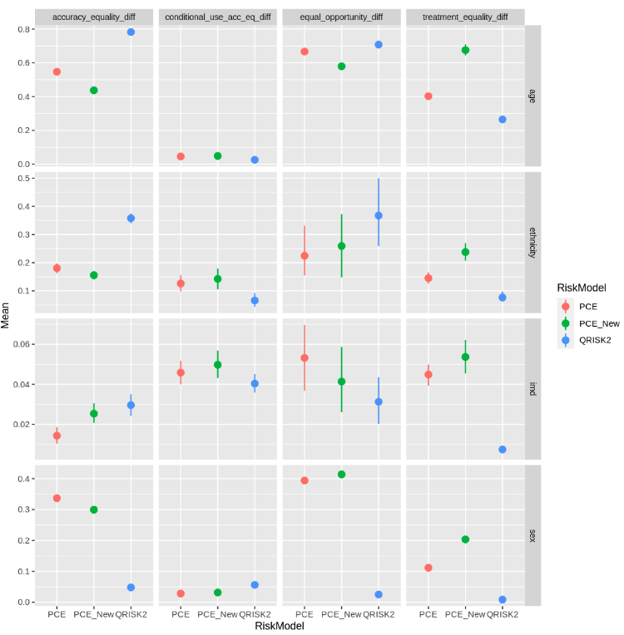
Results summary
Original prediction models
QRISK2, designed for UK population, does not necessarily show higher fairness compared to US-based PCE
QRISK2 has significantly more unfairness in accuracy equality difference for age and ethnicity, and in conditional use accuracy equality difference for sex
Treatment equality difference suggests QRISK2 is fairer across all metrics
PCE versions display more unfairness in other metrics and groups, with no consistent pattern across all metrics
Bootstrap sampling with replacement was performed 1,000 times to calculate 95% confidence intervals for the fairness metric quantifications
Accuracy equality difference:
Greatest difference in accuracy between two groups
Conditional use accuracy equality difference:
Greatest difference between positive predictive value or negative predictive value; whichever is greater
Equal opportunity difference:
Greatest difference between false negative rates of two groups
Treatment equality difference:
Greatest difference between the false negative rate to false positive rate ratio of two groups

Slide 17
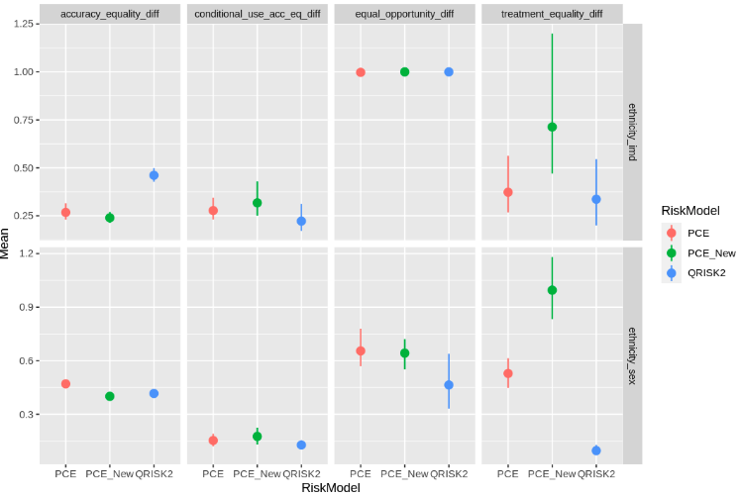
Results: intersectionality
Summary
Fewer disparities in fairness between models in intersectional groups compared to single groups, but higher levels of unfairness in most metrics
Highlights the need to consider intersectional groups, as their fairness differs from that of their comprising groups
Results discussion
Previous work on fairness in CVD rarely explores intersectional fairness, but models optimised for overall population may perform worse for smaller subgroups that deviate from the mean
Prioritizing intersectional analysis is essential to ensure minority groups are represented
Specific models may be necessary instead of a one-size-fits-all approach to capture diversity of society and represent patients appropriately
Wider exploration of intersectional groups, if data allows, would be ideal to identify potential discrimination in more nuanced groups
Further analysis
Explore which intersectional groups are most unfairly predicted
To determine if these are already disadvantaged groups in society, which would raise concerns about discrimination

Slide 18
Recalibration
Does recalibration improve model fairness?
Recalibration/rescaling was applied to the models' predictions to ensure they are applicable to the target population
Used sex-specific incidence rates observed in:
1. CPRD (UK population primary care data in England)
2. UK Biobank
Incidence rates used: no history of CVD; 5-year age group bins
Quantified fairness for new, recalibrated models to compare to out-of-the-box predictions

Slide 19
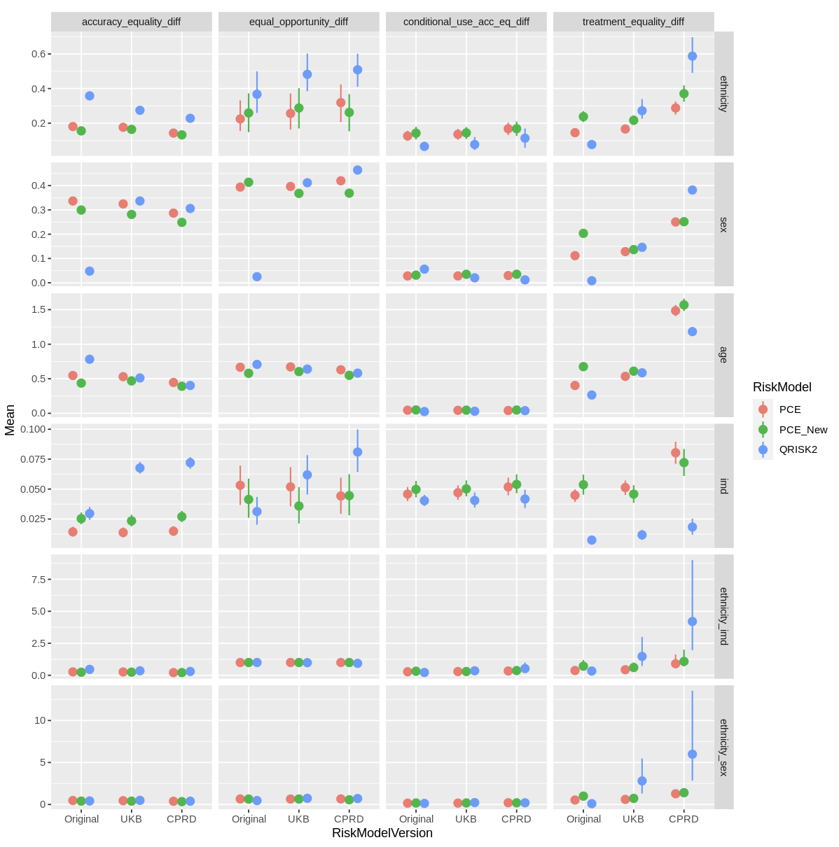
Results: recalibration
Recalibration (using sex and age incidence rates) does not improve fairness
For ethnicity, rescaling reduced fairness in most metrics, with only Accuracy equality difference showing improvements
For sex, QRISK2 showed a significant reduction in fairness in most metrics after rescaling, and both PCEs were also significantly less fair in Treatment equality difference
For age, high levels of unfairness were observed, with rescaling increasing unfairness in most cases
For IMD, rescaling slightly worsened fairness in most tools, except for PCE New rescaled with UKB
Ethnicity & IMD intersectional group showed lower values with smaller confidence intervals before rescaling
Original versions were most fair according to conditional use accuracy equality for almost all
Discussion
Calibration is mathematically incompatible with other fairness metrics; multiple definitions should be explored
Can we improve recalibration by including ethnicity (not usually done)?

Slide 20
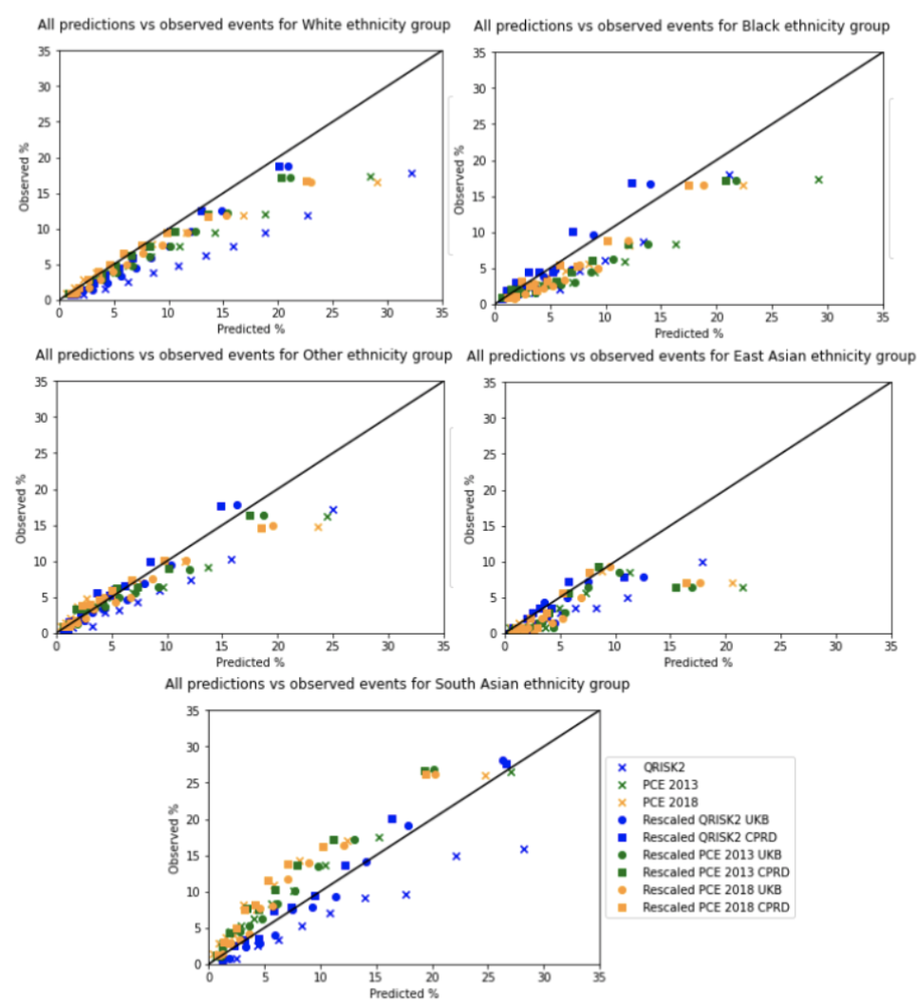
Results: ethnicity
Summary
Previous analyses often analyse for race as a binary variable and not for ethnicity
Exploring ethnicity as a quinary variable revealed significant differences in the models' predictions for each ethnicity subgroup
Calibration plots show different calibration slope and calibration difference for subgroups, leading to high unfairness in calibration difference:
East Asian: risk overestimation
South Asian: risk underestimation

Slide 21
Results: ethnicity
Discussion
Models do not appropriately consider differences in CVD risk among various ethnicity groupings, potentially leading to mistreatment of some groups
QRISK2 includes ethnicity as a predictor yet shows surprising disparities in predictions, resulting in significant unfairness in multiple metrics
Coarseness of groups is important: treating ethnicity as a binary variable or considering only race may hide prediction disparities, e.g. South Asian and East Asian grouped together

Slide 22
Next project

