Slide 1
Investigating the Causal Impact of Teacher Gender Match on Student Learning
Congli Zhang and Anwesha Guha
University of Oregon | Presented at AEFP 2023
Notes:
Introduce
Interests: methodology, policy, equity – secondary/postsecondary outcomes
Introduce paper

Slide 2
Why Study this?
Literature suggests meaningful effects, particularly for marginalized groups (Dee, 2007; Sansone, 2017)
Supported by theory (i.e. motivational theory of role modeling)
Causal estimates difficult
To truly understand teacher gender match effects, we need to break it down...
Notes:
We know this is well saturated, perpetuates gender binary, but there are also real impacts previous literature has found,even in demographic math literature more broadly, especially for groups at risk/marginalized in traditional ed systems

Slide 3
STUDENT GENDER GAP
Socially constructed and situation-dependent identities subject to stereotype threat
Negative genders norms associate being a girl with lower ability to perform in math, STEM (McIntyre et al. 2005; Spencer et al., 1999)
While impact varies (Flore & Wicherts, 2015), biases/stereotypes affect schooling experiences for girls (and boys) worldwide (UNESCO, 2022)
Ex. Girls have slowly and increasingly outperformed boys in school, particularly secondary classrooms, yet female students “remain much less likely to major in quantitative, technical, and science-related fields” (Bettinger & Long, 2005, p. 152)
Segregation by occupation and inequality of income by gender results in the long term
Notes:
So given the student gender gap in some form does exist,

Slide 4
Teacher Gender Impact
Teacher gender likely matters, particularly in the way teachers affect student interest and self-efficacy (Sansone, 2017)
Mixed effects:
Female teachers are associated with about 0.07 grade equivalents higher than male counterparts, particularly for female students (Aaronson et al., 2007) Potential Confound: High N female students
Having a female teacher lowers math scores for female students (Antecol et al., 2015) Potential Confound: Limited math background of female teachers
While teacher gender matters, behaviors and attitudes about ability and gender matter more (Sansone, 2017)
This paper follows theoretical framework of Paredes (2014)
Notes:
Second mechanism we need to understand in gender match effects is the impact of teacher gender
Paredes (2014) in that teacher gender may affect students in a variety of ways: by acting as role models, reinforcing stereotype threats, and through teacher biases that are correlated with gender (Paredes, 2014; Lavy, 2008).

Slide 5
Gender Match Effects
Mixed effects:
Some find significant positive relationship for middle school girls (Gong et al., 2018; Lim and Meet, 2017; Xu and Li, 2018)
Cho (2012), using math and science data from 15 OECD countries, found that neither boys nor girls benefit from gender match in most countries
Notes:
We pull these two frameworks and foundations to better understand gender match effects, the third and final piece of this mechanism

Slide 6
Gender Match Effects
Chinese score
Teacher gender
Student gender
English score
(gender match)
Math score
Notes:
Which brings us to our study:
We are interested in the mechanisms and impacts of gender match effects specifically in China, particularly for its student- and teacher- random assignment policy.
We examine gender match effects by examining outcomes of Chinese, English, and math score – both test score and self-reported confidence in the subject

Slide 7

Compulsory Education Law
In 2006, this law disallowed the sorting of students to teachers based on student academic performance at elementary (grades 1-6) and middle school (grades 7-9) levels
In order to comply, many local education departments create either random or stratified homerooms of students in schools, standardizing and the number of teacher groups, then randomly assigning teacher groups to student homerooms
We drew our analytic sample from China Education Panel Survey (CEPS), China’s first nationally representative, longitudinal survey of middle-school students
Notes:
We can do this bc of Compulsory Education Law
Second bullet: important to note here that unlike the US, China uses a homeroom-based school system where teachers rotate to student groups rather than the other way around (minimizing differential peer effects and allows us to methodologically isolate the teacher-student relationship from other observed and unobserved confounding factors unbiasedly)
Which started collecting data in 2013 and has been used already by researchers to overcome selection bias and ask causal questions

Slide 8
Primary Research Question
Whether and To What Extent Does same-gender match impact student academic outcomes in Chinese language arts, English, and math in Chinese Middle Schools, given gender achievement differences?

Slide 9


Data and Sample
CEPS: first nationally representative, longitudinal survey of middle school students starting in 2013-2014
Stratified, multi-stage sampling scheme:
112 schools (104 public)
Two 7th and two 9th G homeroom
All students, parents, teachers for Chinese, English, math
Successful follow-up N = 9,449, or 91.93%
Notes:
So given the student gender gap in some form does exist,

Slide 10
Panel A. Chinese sample
 | Female students, N = 2,464 | Male students, N = 2,481
Match | 80.03% | 19.59%
Female teacher | 80.03% | 80.41%
Score | 0.305 (0.814) | -0.273 (1.045)
Self-concept | 0.150 (0.921) | -0.140 (1.036)
Panel B. English sample
 | Female students, N = 2,473 | Male students, N = 2,489
Match | 89.77% | 10.85%
Female teacher | 89.77% | 89.15%
Score | 0.276 (0.858) | -0.252 (1.044)
Self-concept | 0.217 (0.935) | -0.208 (1.003)
Panel C. Math sample
 | Female students, N = 2,498 | Male students, N = 2,518
Match | 58.61% | 40.87%
Female teacher | 58.61% | 59.13%
Score | 0.100 (0.927) | -0.074 (1.042)
Self-concept | -0.106 (0.932) | 0.115 (1.036)
Notes:
True for US (STEM)

Slide 11
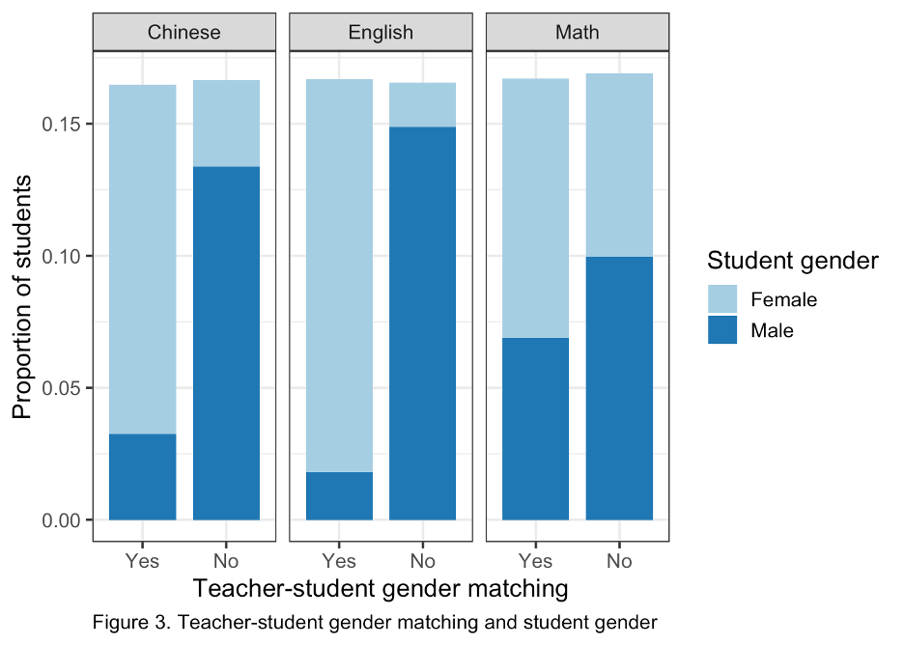

Slide 12
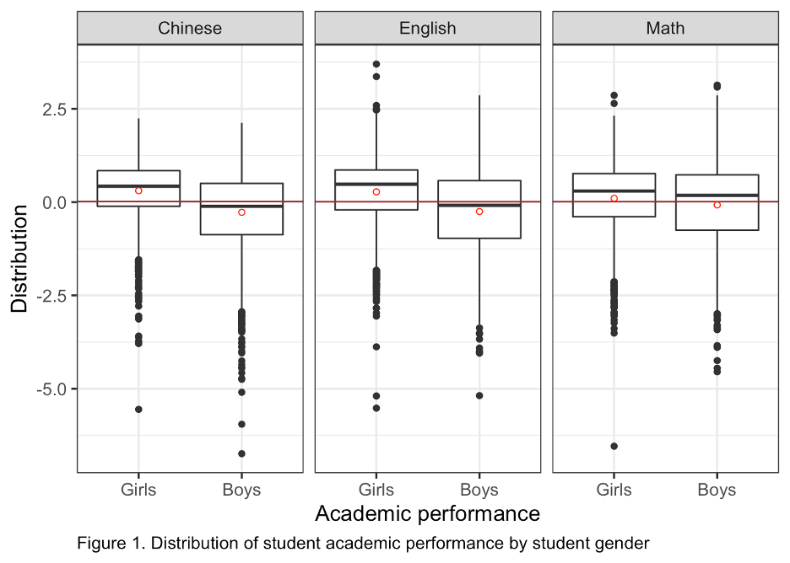
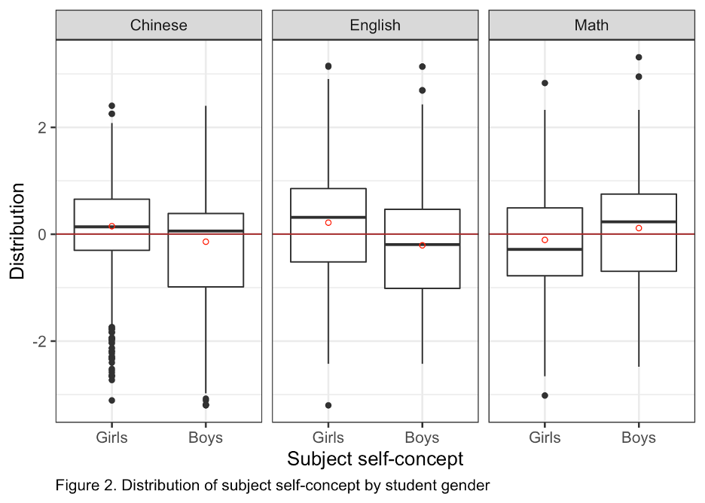

Slide 13

Estimation Framework
Primary model:
𝑂𝑈𝑇𝑖𝑗𝑠𝑡 = β0 + β1MATCH𝑗𝑡 + β2𝑋𝑖𝑡−1 + β3𝐻𝑗𝑡−1 + β4𝑇𝑗𝑡−1 + θ𝑠 + ε𝑖𝑗𝑠𝑡
Individual-level
School fixed-effects
Homeroom-level
Primary Research Question: How does same-gender match impact student academic outcomes?
Teacher-level
Estimate β1 for each Chinese, English, and math, for scores and confidence level
Notes:
X <- individual student level (e.g. own income)
H <- baseline homeroom level student chars (e.g. average income): Mean
Robustness check, accounts for peer effects within homerooms; environmental factors
T <- teacher chars (age, teaching exp, etc)

Slide 14
Results

Slide 15
MATCH For All Students – Confounded by Achievement Gap, Match Effects
Chinese
0.100*** (0.025) | 0.088*** (0.024) | 0.087*** (0.024)
Yes | Yes | Yes
No | Yes | Yes
No | No | Yes
Yes | Yes | Yes
Yes | Yes | Yes
4,945 | 4,945 | 4,945
0.603 | 0.606 | 0.607
0.596 | 0.599 | 0.599
0.623 (df = 4862) | 0.621 (df = 4853) | 0.621 (df = 4850)
English
0.093*** (0.022) | 0.085*** (0.022) | 0.085*** (0.021)
Yes | Yes | Yes
No | Yes | Yes
No | No | Yes
Yes | Yes | Yes
Yes | Yes | Yes
4,962 | 4,962 | 4,962
0.710 | 0.711 | 0.712
0.705 | 0.706 | 0.707
0.538 (df = 4879) | 0.538 (df = 4870) | 0.537 (df = 4867)
Math
0.050* (0.024) | 0.051* (0.025) | 0.051* (0.025)
Yes | Yes | Yes
No | Yes | Yes
No | No | Yes
Yes | Yes | Yes
Yes | Yes | Yes
5,016 | 5,016 | 5,016
0.615 | 0.616 | 0.619
0.608 | 0.609 | 0.611
0.619 (df = 4933) | 0.619 (df = 4924) | 0.617 (df = 4921)
Match
Student Covariates
Homeroom Covariate
Teacher Covariates
School FE
School clustered SE
Observations
R²
Adjusted R²
Residual SE

Slide 16
Wave 2 Gender Gap
 | Chinese | Chinese | Chinese | English | English | English | Math | Math | Math
Female student (Achievement) | 0.573*** | 0.172*** | 0.175*** | 0.522*** | 0.100*** | 0.108*** | 0.162*** | 0.069** | -0.078***
 | -0.032 | -0.022 | -0.022 | -0.032 | -0.022 | -0.024 | -0.036 | -0.023 | -0.02
Female student (Confidence) | 0.296*** | 0.183*** | 0.165*** | 0.422*** | 0.201*** | 0.173*** | -0.229*** | -0.286*** | -0.287***
 | -0.027 | -0.027 | -0.028 | -0.037 | -0.039 | -0.04 | -0.037 | -0.032 | -0.03
Student characteristics | Yes | Yes | Yes | Yes | Yes | Yes | Yes | Yes | Yes
Baseline same subject score | No | Yes | Yes | No | Yes | Yes | No | Yes | Yes
Baseline other subject scores | No | No | Yes | No | No | Yes | No | No | Yes
School FE | Yes | Yes | Yes | Yes | Yes | Yes | Yes | Yes | Yes
School clustered SE | Yes | Yes | Yes | Yes | Yes | Yes | Yes | Yes | Yes
Observations | 4,945 | 4,945 | 4,945 | 4,962 | 4,962 | 4,962 | 5,016 | 5,016 | 5,016
R2 Achievement | 0.106 | 0.527 | 0.605 | 0.096 | 0.681 | 0.705 | 0.027 | 0.557 | 0.612
R2 Confidence | 0.037 | 0.07 | 0.076 | 0.078 | 0.239 | 0.247 | 0.031 | 0.228 | 0.232

Slide 17
Chinese
 | Female students |  |  | Male students
Match | 0.095 (0.080) | 0.047 (0.074) | 0.067 (0.096) | -0.098 (0.083) | -0.086 (0.083) | -0.121 (0.096)
Student Covariates | Yes | Yes | Yes | Yes | Yes | Yes
Homeroom Covariates | No | Yes | Yes | No | Yes | Yes
Teacher Covariates | No | No | Yes | No | No | Yes
School FE | Yes | Yes | Yes | Yes | Yes | Yes
School clustered SE | Yes | Yes | Yes | Yes | Yes | Yes
Observations | 2,464 | 2,464 | 2,464 | 2,481 | 2,481 | 2,481
R² | 0.535 | 0.541 | 0.542 | 0.609 | 0.612 | 0.612
Adjusted R² | 0.519 | 0.524 | 0.523 | 0.596 | 0.597 | 0.597
Residual SE | 0.564 (df = 2381) | 0.562 (df = 2372) | 0.562 (df = 2369) | 0.665 (df = 2398) | 0.664 (df = 2389) | 0.664 (df = 2386)

Slide 18
English
 | Female students |  |  | Male students
Match | 0.048 (0.056) | -0.0001 (0.055) | 0.017 (0.045) | 0.076 (0.064) | 0.094 (0.059) | 0.058 (0.046)
Student Covariates | Yes | Yes | Yes | Yes | Yes | Yes
Homeroom Covariates | No | Yes | Yes | No | Yes | Yes
Teacher Covariates | No | No | Yes | No | No | Yes
School FE | Yes | Yes | Yes | Yes | Yes | Yes
School clustered SE | Yes | Yes | Yes | Yes | Yes | Yes
Observations | 2,473 | 2,473 | 2,473 | 2,489 | 2,489 | 2,489
R² | 0.688 | 0.689 | 0.691 | 0.703 | 0.704 | 0.706
Adjusted R² | 0.678 | 0.678 | 0.679 | 0.693 | 0.693 | 0.694
Residual SE | 0.487 (df = 2390) | 0.487 (df = 2381) | 0.486 (df = 2378) | 0.578 (df = 2406) | 0.578 (df = 2397) | 0.577 (df = 2394)

Slide 19
Math
 | Female students |  |  | Male students
Match | 0.165** (0.060) | 0.181** (0.067) | 0.178** (0.065) | -0.011 (0.045) | 0.003 (0.048) | -0.005 (0.051)
Student Covariates | Yes | Yes | Yes | Yes | Yes | Yes
Homeroom Covariates | No | Yes | Yes | No | Yes | Yes
Teacher Covariates | No | No | Yes | No | No | Yes
School FE | Yes | Yes | Yes | Yes | Yes | Yes
School clustered SE | Yes | Yes | Yes | Yes | Yes | Yes
Observations | 2,498 | 2,498 | 2,498 | 2,518 | 2,518 | 2,518
R² | 0.606 | 0.611 | 0.613 | 0.638 | 0.640 | 0.642
Adjusted R² | 0.593 | 0.596 | 0.598 | 0.616 | 0.626 | 0.628
Residual SE | 0.591 (df = 2415) | 0.589 (df = 2406) | 0.588 (df = 2403) | 0.637 (df = 2435) | 0.637 (df = 2426) | 0.635 (df = 2423)

Slide 20
This Paper’s Contribution
Chinese and English: Naive results find a significant effect of teacher gender on student test scores and confidence for all main subjects, Chinese (SD=0.176), English (SD=0.091) and math (SD=-0.081). However, as girls outperform boys to begin with in Chinese and English, we find that teacher-student gender match does not differentially impact boys or girls in either of these subjects, for both test score and subject confidence.
Math: We find that teacher gender match in math leads to 0.178 standard deviation increase in test scores for girls, controlling for all other covariates. (no significant difference for boys or confidence level)
Limitations –
analysis appear to be more likely located in economically developed and urban areas, serve a better educated population, and have significantly smaller class sizes compared to schools excluded
due to the self-report nature of CEPS data, there are potentially large measurement errors embedded in the key variables, like subject confidence
teacher-student gender match alone cannot address systemic inequity, especially without taking intersectionality of identity into account (Rezai-Rashti & Goli, 2010)
Notes:
Second mechanism we need to understand in gender match effects is the impact of teacher gender
Paredes (2014) in that teacher gender may affect students in a variety of ways: by acting as role models, reinforcing stereotype threats, and through teacher biases that are correlated with gender (Paredes, 2014; Lavy, 2008).

Slide 21
THANK YOU
Anwesha Guha
aguha@uoregon.edu

