Slide 1

Background (1/2)
About Stock Loan → About Exchange for Physical (EFP) → Project Intro
What is Stock Loan?
Where do the inventories come from?
Renting out our sourced inventory of stocks to clients for short-selling or hedging, earning fees while providing them synthetic short exposure
International lenders
Exclusive lenders
Internal firm inventory → EFP
Outperformance
What is EFP?
PnL
Aspect | Current Approach | This Project
Focus | Overall inventory usage (EFP, outperformance+) | Builds on foundation; predicts total utilization first, then EFP-specific usage
Horizon | t+10 | Longer: t+20
EFP Specificity | Not targeted | Forecasts EFP usage using total results
Scope | Analyzed 1,000 securities | Expands to all 8,000 securities
Features | - | Extracts statistical features from current approach
EFP inventory usage rate
Financing Cost
Breakeven Point @ EFP inventory usage rate = 40%
To predict the EFP usage rate to improve the PnL
The current way to predict inventory utilization can be further enhanced to be smarter.
Notes:
Stock loan, from our desk's perspective, is essentially renting out our sourced inventory of stocks to clients for short-selling or hedging, earning fees while providing them synthetic short exposure—in simple terms, like lending your unused bike to a neighbor for a rental fee to help them get around.
Sources of inventory in stock lending, primarily come from international lenders (e.g., global funds providing stocks for a fee), exclusive lenders (dedicated arrangements for specific securities), internal firm inventory (stocks held within BoFA's own books), and outperformance strategies (via cash or swap agreements that generate additional lendable assets)— but for the interest of the project being china specific, the majority of the inventory is internally sourced through a process called EFP, exchange for physical.
EFP, is a way of raising stock inventory in the China market by physically buying shares and immediately hedging the risk through an index swap trade—think of it as purchasing the actual goods while using a financial contract to offset any price swings. This builds our lendable stock pool, the inventory.
As we raise inventory through EFP, we incur this financing cost. The challenge is whether it'll be utilized enough to break even and generates strong short financing revenue. Below this threshold [point to breakeven line], the financing cost become losses and wasting resources.
This naturally leads us to the project introduction, the why to this project - the short answer is to have a better prediction of the EFP usage rate for the PnL. And here is the longer answer.
The current prediction method examines the overall usage rate of our entire stock inventory (including EFP, outperformance deals, and more) 10 days ahead (t+10), not targeting EFP usage specifically. The previous study also put a focus on 1/8th of the securities in the China market. T
In other words, The current way of prediction can be further enhanced.
This project extends the scope to all 8,000 available securities in China and incorporates new types of features. We'll first predict the total inventory usage rate, then leverage those results to forecast the EFP-specific usage rate over a longer horizon—20 days ahead (t+20).

Slide 2
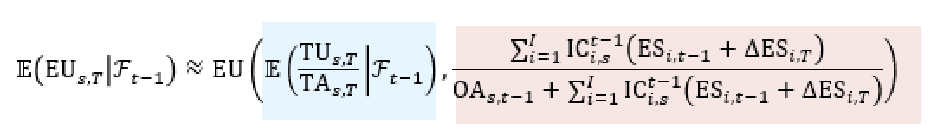
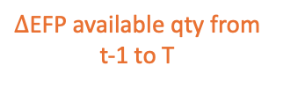
Background (2/2)
Project Breakdown – Part 1 and Part 2
Mapping Function
Predict Total Inventory Usage Rate
Predicting EFP Usage Rate
With…. T = t+20
EFP available qty @ t-1
$∆$EFP available qty from t-1 to T
Total inventory available qty @ T
Expected EFP Usage Rate at T
Expected Total Inventory Usage Rate at T
EFP usage rate
X
X
X
X
X
Change in EFP available qty @ T
0.5
1.0
1.5
2.0
2.5
Notes:
Moving on to the project Breakdown, allow me to reiterate the project flow. Part 1 of the project consists of predicting the total inventory usage rate. And
In Part 2, we use a mapping function to transform the predicted total inventory usage rate (from Part 1) into the expected EFP usage rate at time horizon, t+20.
And this mathematical equation defines our project statement that we have just gone through. With big T = small t +20,
Part 1 is represented by the blue box. Computing the Expected Total inventory Usage qty /. Total inventory Available qty , which is the total usage rate at t+20
Part 2 is represented by the pink box — The second part of the equation is a scaling factor that maps total usage rate to EFP usage rate.
This portion of the numerator shows the EFP available qty at t−1 , and this portion of the numerator captures the change in EFP available qty from t−1 to T.
The denominator includes both the other availability (OA) and the EFP availability at T. So it gives the total inventory available at T.
So this gives us a scenario tool to simulate different scale changes of EFP available qty like 0.5, 1.5, 2 , 2.5 and assess the resulting EFP usage rate.

Slide 3
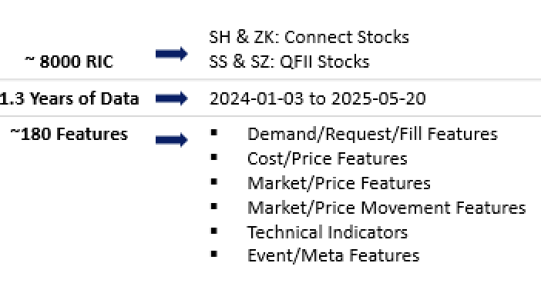


Part 1 – Predicting the Total Inventory Usage Rate (1/3)
Model Used & About the Data
About the Data
Model 1
e.g.
600138.ZK
600138.SH
XGB Regression
Squared Error loss function
e.g.
Total filled qty
Total available qty
Csi local price
Model 2
XGB Classification
Softprob loss function with continuous output
Pre – Model Data Set Up
Train/Val/Test Split : 60/20/20
Removed noise on training data + Normalization
Target :
time_horizons = [1,5,10,15,20]
Total Usage Rate @ t + {time_horizons }
Model 3
XGB Classification
Earth Mover Distance custom loss function with continuous output
Notes:
With that, allow me to dive into the details of Part 1, prediction of the total inventory usage rate.
3 models were used. XGB regression, XGB Classification 1 and 2.
XGB were choosen in general as it handles nonlinear patterns and feature interactions well, which suits the time-series structure of the data.
Model number 1, XGB Regression. This was chosen To directly predict the continuous-valued total usage rate. It was more on a natural instinct for it to be a regression problem.
Model number 2, XGB Classification with softprob objective function. The rational was To convert the regression target into 5 discrete bins (e.g., low, medium, high utilization) and predict class labels. This aims to simplify the problem, helping with interpretability and robustness under noisy or hard-to-predict conditions.
For the last Model number 3, XGB Classification 3 with custom loss function using Earth’s Mover Distance, it is similar to model 2. but the difference is it takes the distance of the predicted bin and true bin into consideration., So if the predicted bin and the true bin are far apart, the penalty is larger. This means the model doesn’t just care whether it gets the correct bin, but also how far off it is.
Now, allow me to take a step back to bring your attention on the input, The data.
As mentioned in the beginning, we have about 8000 china securities in SH ZK SS and SS stock types.
1.3 years worth of data range from jan 2024 to may 2025.
And about 180 of demand , cost , market related features.
The dataset was split into train, validation, and test sets in a 60/20/20 ratio. To ensure better learning, I also applied noise removal on the training data and normalization on the data.
The target variable for prediction was the Total Inventory Usage Rate, and while the initial aim was to forecast a full range from T+1 to T+20, running a separate model for every single horizon would have been too computationally expensive.
So instead, I focused on five key representative horizons—T+1, T+5, T+10, T+15, and T+20—to cover short-, mid-, and long-term forecasts efficiently.
To still get insights across the full timeline, I later interpolated the model outputs to estimate usage at the intermediate horizons.
Each of the three model types—regression, classification with softprob, and classification with Earth Mover’s Distance—was trained separately for these 5 horizons, giving a well-rounded view of how usage evolves over time.

Slide 4
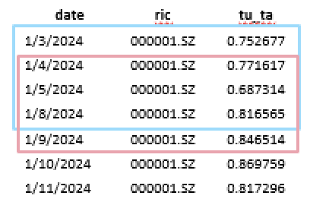
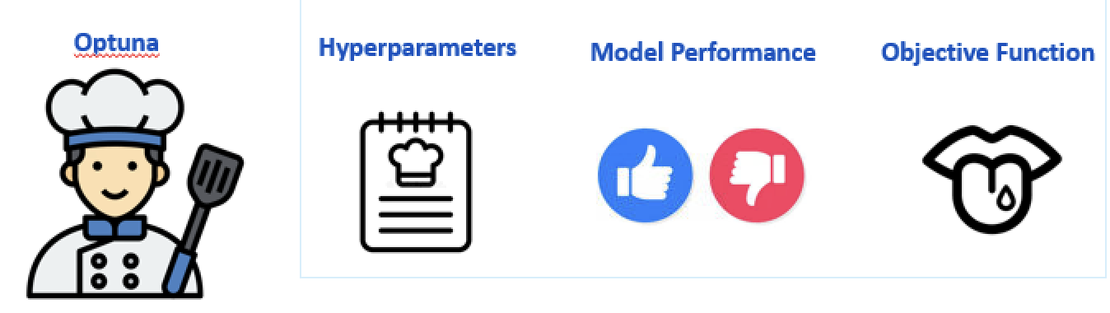
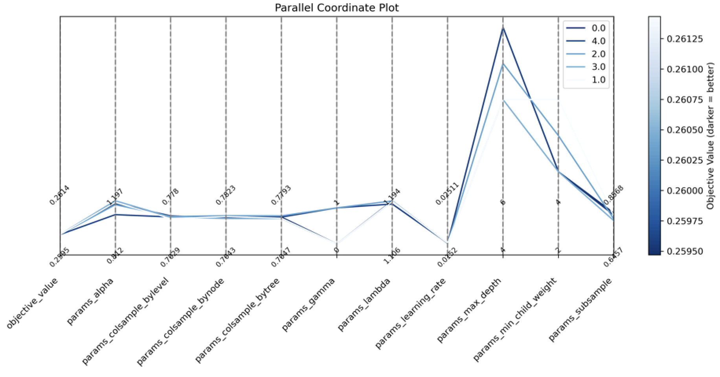
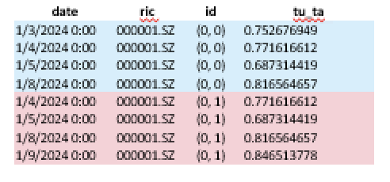
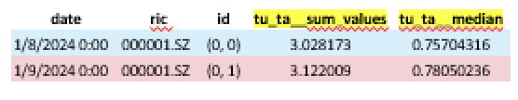
Part 1 – Predicting the Total Inventory Usage Rate (2/3)
Feature Engineering using tsfresh
What is tsfresh?
What is Optuna?
tsfresh auto-generates 750+ time-series features to capture temporal patterns for ML models.
Optuna is a powerful hyperparameter optimization framework that uses Bayesian optimization to efficiently find the best hyperparameter
Notes:
Next, after sorting and cleaning the data, we move to feature engineering. This step is crucial for time-series data like ours, which is sequential and often non-stationary—meaning patterns change over time, making it hard for models like XGBoost to learn directly from raw inputs.
To address this, I used tsfresh, Python package that automatically extracts hundreds of statistical features from time series data to help machine learning models capture temporal patterns more effectively.
Here's how it works in our case. We start by segmenting the past 60 days of data into rolling windows for each date and RIC (Reuters Instrument Code). This expands the data: for a given lookback period, each date gets its own dedicated time window.
Look at the left table—this is the raw data sorted by date and RIC, with columns like 'tu_ta' (utilization rate). We then assign a unique ID to each window, as shown in the middle table. For example, if we're looking at January 8th with a 3-day lookback, the blue-highlighted rows form one window (ID 0,0). The next window rolls forward (ID 0,1), and so on. This grouping tells tsfresh to treat each window as a separate time series for analysis.
These grouped windows are then fed into tsfresh, which extracts 21 selected statistics per original feature—like sum, median, mean, maximum, standard deviation, and others. For instance, in the right table, you see how tsfresh condenses a window's 'tu_ta' values: it calculates the sum (e.g., 3.028173) and median (e.g., 0.75704316) for that ID
Finally, tsfresh's selection stage studies the relationship between each extracted feature and the target (e.g., T+20 utilization) using significance testing. It drops any non-significant features, retaining only those statistically relevant—reducing from ~651 to around 600 in our case.
(Mention about the tsfresh selection is done on the correlation check between between each feature and the target and not between the features)
Make sure that I can explain how optuna works in laymen term.

Slide 5
Part 1 – Predicting the Total Inventory Usage Rate (3/3)
Hyperparameter Tuning using Optuna
What is Optuna?
Optuna is a powerful hyperparameter optimization framework that uses Bayesian optimization to efficiently find the best hyperparameter

Slide 6
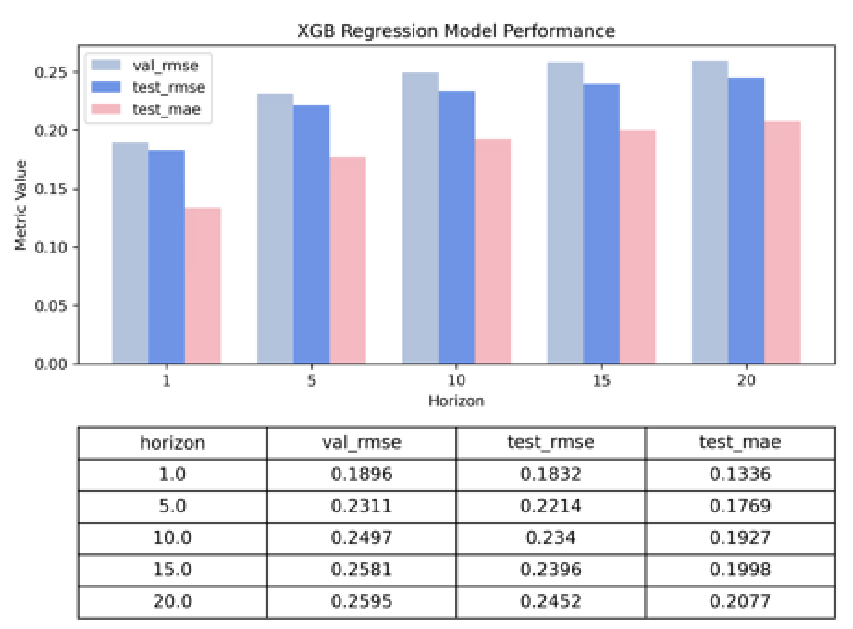
Part 1 – Predicting the Total Inventory Usage Rate (4/4)
Prediction Results for the 3 Models
Notes:
Which model has performed the best? And also add the previous study result. Xixuan’s result

Slide 7
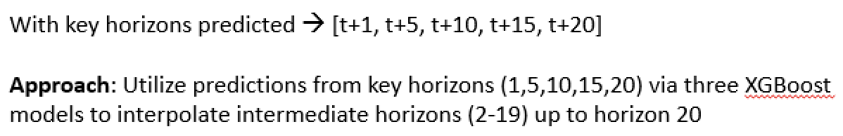
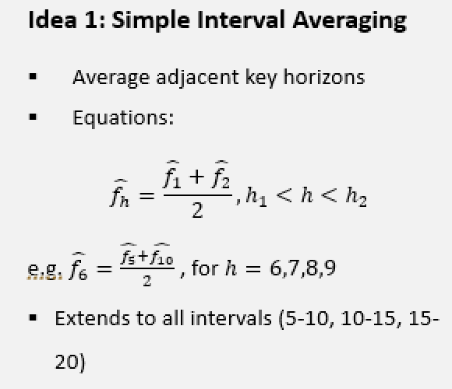
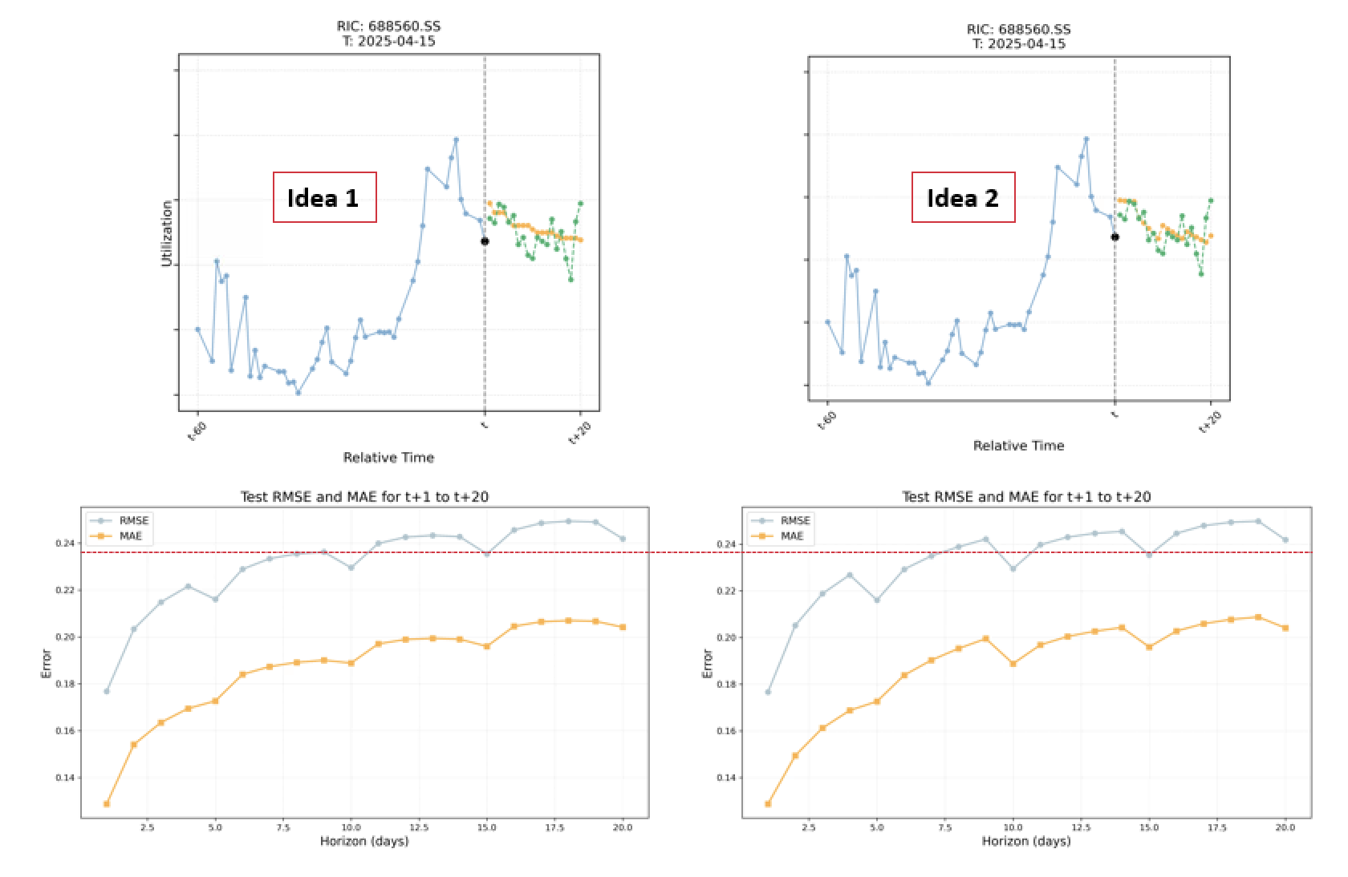
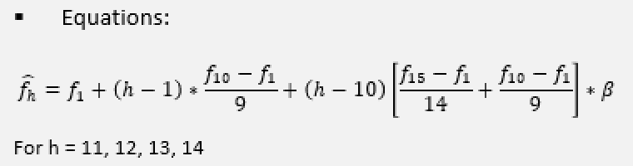
Part 1 – Predicting the Total Inventory Usage Rate (4/5)
Obtaining Predictions for Intermediate Horizons
Idea 2: Weighted Interval Interpolation
Notes:
et's move on to how we utilize the predictions from our key horizons—t+1, t+5, t+10, t+15, and t+20 days ahead—to fill in the gaps for the intermediate horizons, from day 2 up to day 19, all the way to day 20. This step is important because our XGBoost models only predict at those five key points to save computational resources, but we need a smooth curve for all 20 days to visualize trends and make practical decisions.
We explored two ideas for this interpolation.
First, Idea 1: Simple Interval Averaging. This is straightforward—we just take the average of the two adjacent key horizons for any point in between.
For idea 2: The first term is a straight-line projection based on the short-term trend from earlier predictions—it assumes things continue linearly from where we left off. The second term is a curvature correction, which we only account for any bending or acceleration in the trend, like if utilization ramps up or slows down over longer periods. Beta is a tunable parameter that controls how much weight we give to that correction—higher beta emphasizes the curve, lower beta keeps it more linear.
And with that, we plot the t-60 to t+20 points of a random date and security of selection for both idea 1 and 2.
Zoom in for a better view.

Slide 8
Part 1 – Predicting the Total Inventory Usage Rate (4/5)
Interpolated Inter Horizon for the 3 Models
Notes:
Add the t+horizon = t line

Slide 9
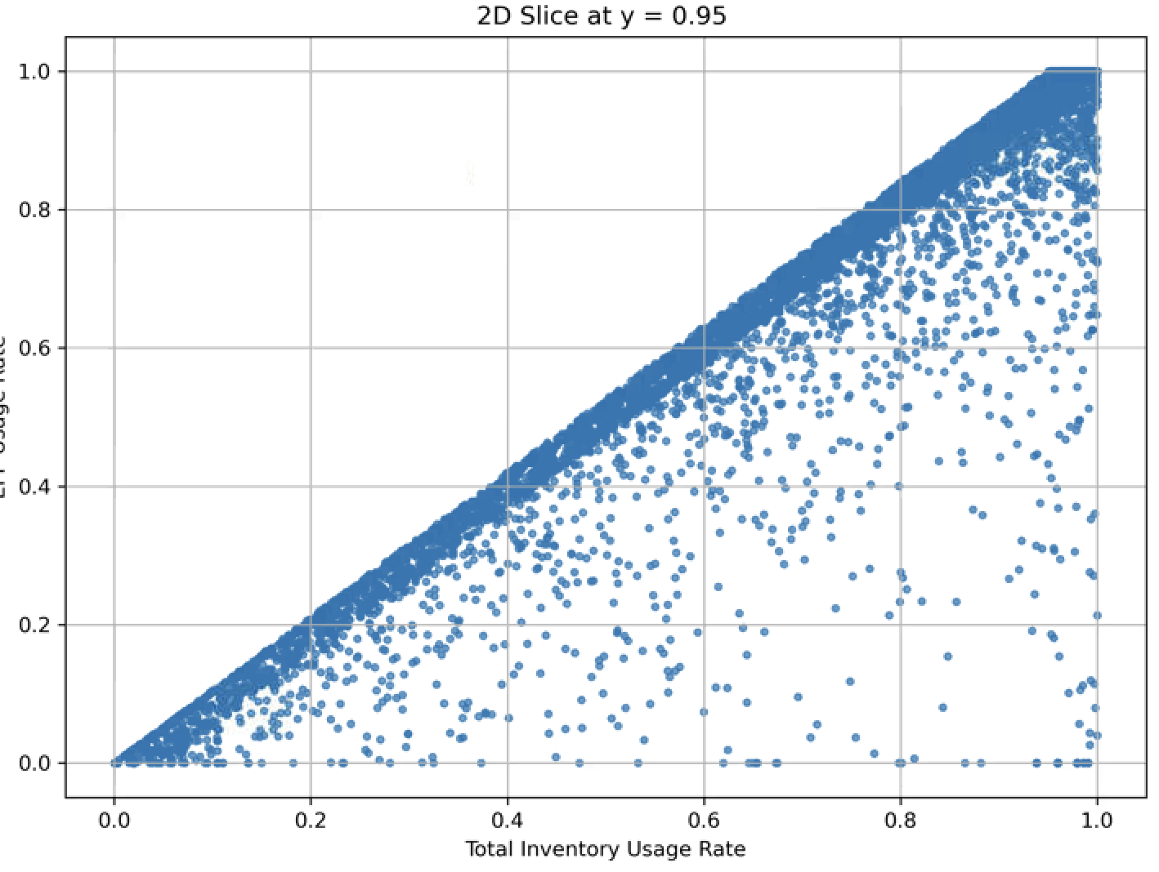
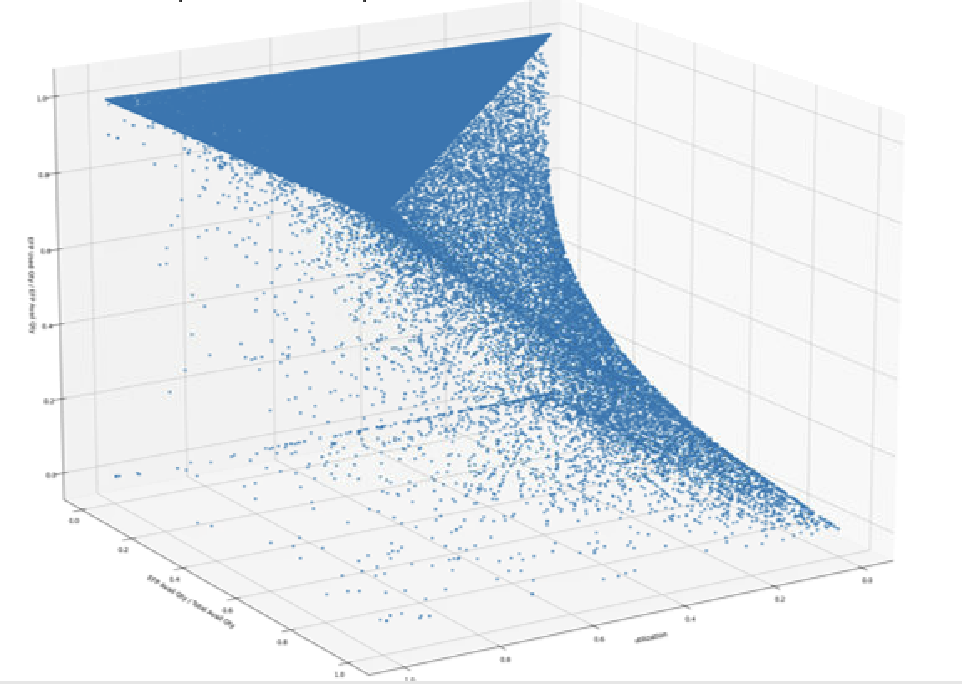
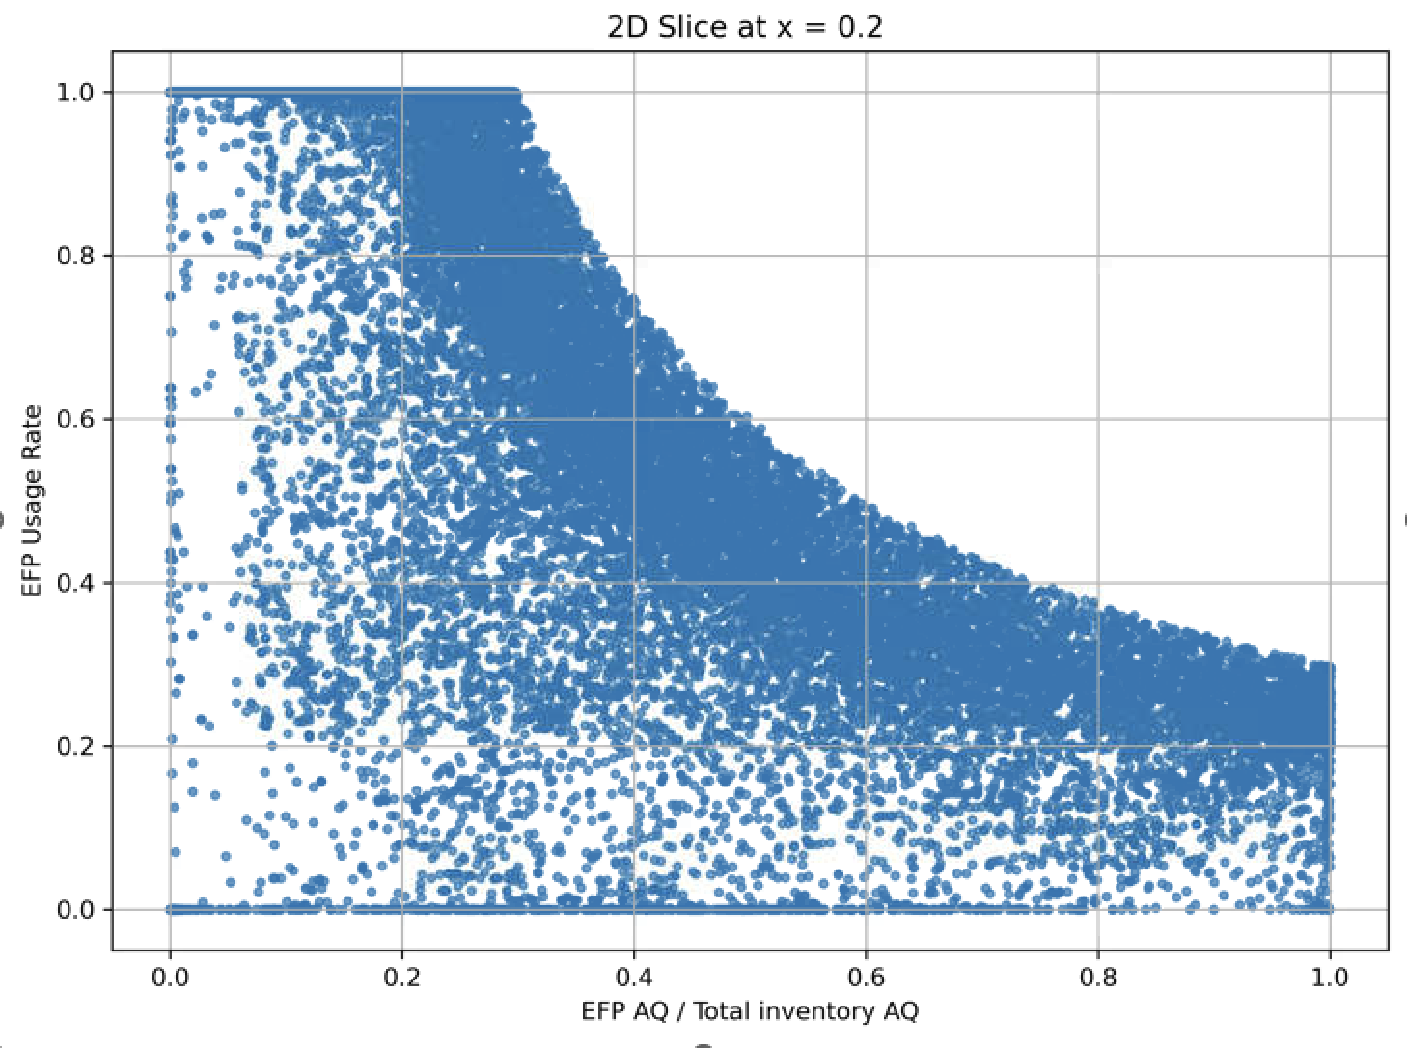
Part 2 – Predicting the EFP Usage Rate (1/3)
Data & Mapping Function Generation
EFP Usage Rate
EFP AQ / Total Inventory AQ
Total Inventory Usage Rate
Notes:
With part 1’s best result being the xgb regression approach, we bring it to the next stage of the project, the estimation of the EFP usage rate using a mapping function.
Allow me to first introduce the generation of the mapping function and its inputs. With the baseline historical data of the three inputs of Total Usage Rate as x axis, EFP AQ relative to the total avail qty as y axis and lastly EFP Usage Rate as z axis.
Then, we can observe that at a fixed EFP AQ wrt to total inventory aq, the relationship between the total inventory usage rate and EFP usage rate is always linear.
This makes sense as majority of the total inventory for china market comes from EFP and if the EFP Usage rate increase, it is only natural for the total inventory usage rate to rise.
And at a fixed total inventory usage rate, the r/s between EFP AQ wrt to total inventory aq and EFP usage rate is non linear as shown here the 2D cut. As the EFP available qty wrt the total inventory aq rises to 1, meaning more and more EFP portion in the total inventory qty, the efp usage rate drops non linearly.
This non-linear drop occurs because, with a fixed total usage rate (x), increasing the proportion of EFP in the total inventory (higher y) effectively spreads the same level of demand over a larger EFP supply base.

Slide 10
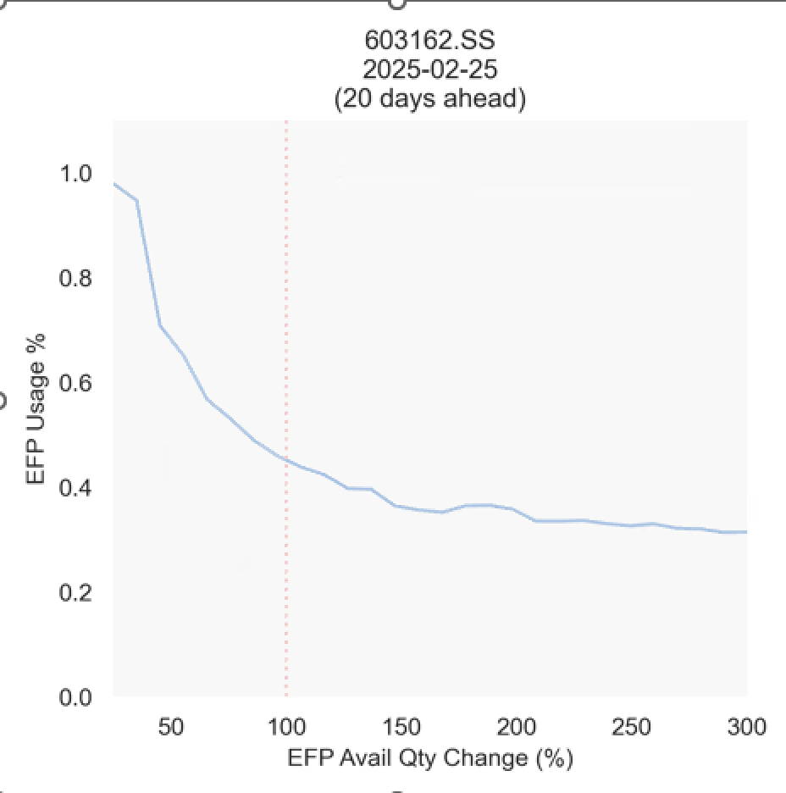
Part 2 – Predicting the EFP Usage Rate (2/3)
Prediction Results for EFP Usage Rate with the Best Performing Model

Slide 11
Conclusion (1/2) - Business Application

Slide 12
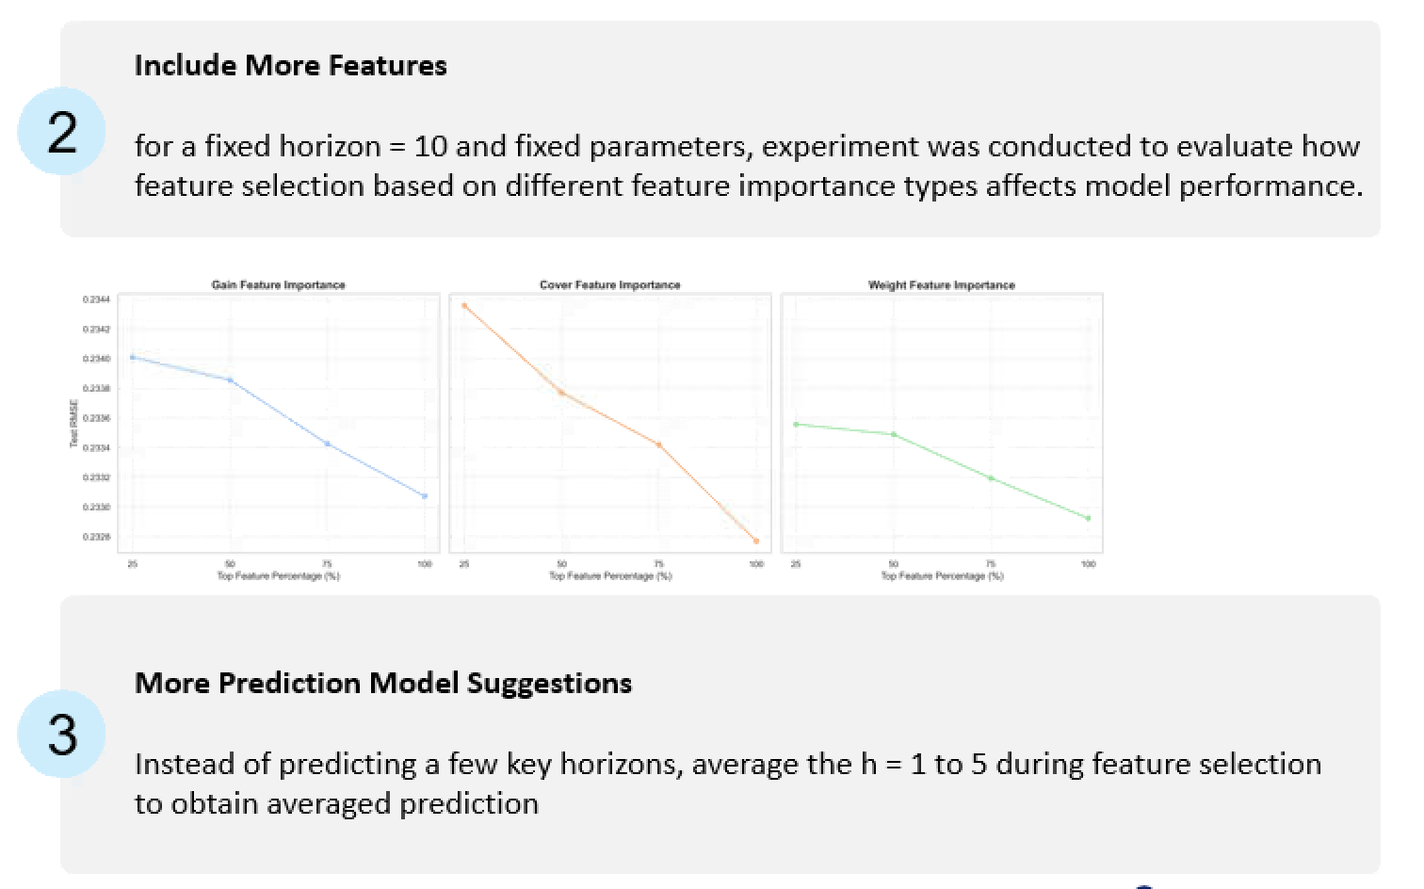
Conclusion (2/2) – Future Works

