Slide 1
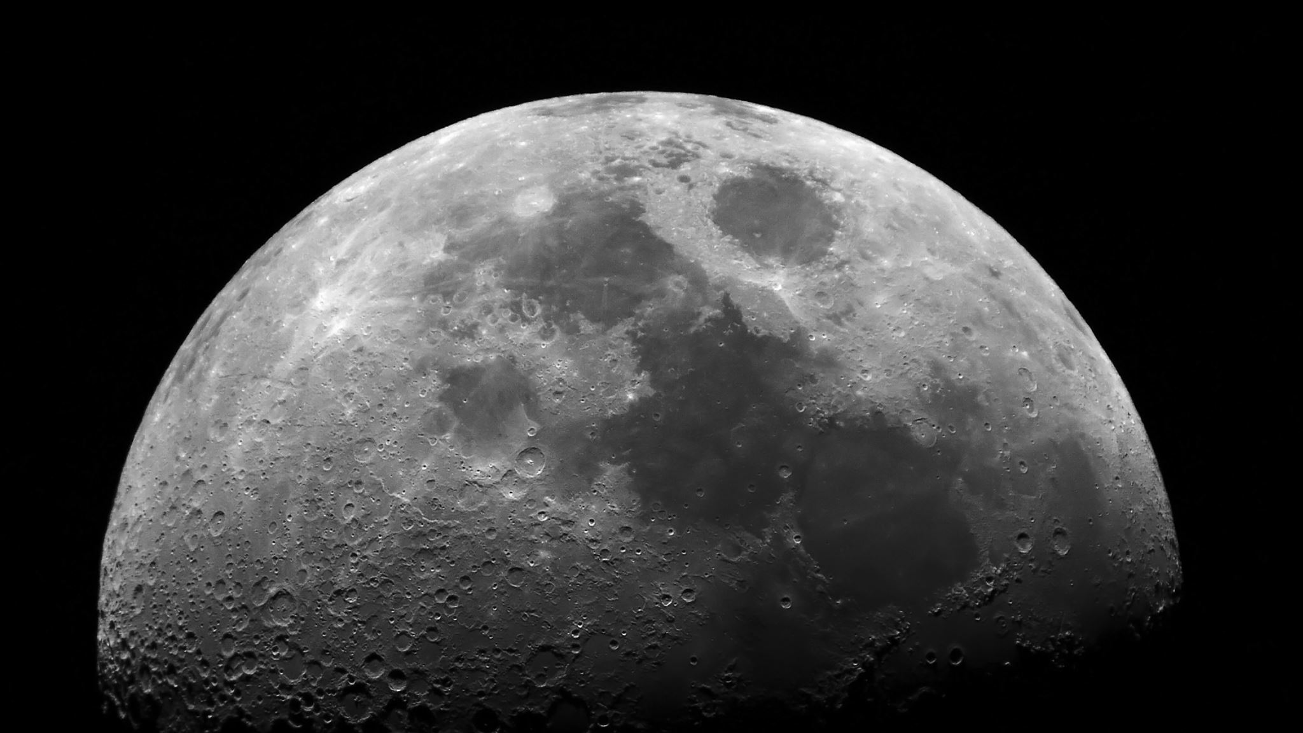
Asteroid Simulation in AMUSE
Kutay Nazli
Claire Olde Loohuis

Slide 2

The Question
Can we recreate the shape, orbit, and evolution of an asteroid based on its light curve?

Slide 3
The Plan
Part 1
Create a spherical asteroid in a Sun-Earth only system
Use the observer to determine an asteroid light curve
Add other planets into the n-body simulation and be able to produce light curves of the asteroid from various planets

Slide 4
The Plan
Part 2
Implement the YORP and Yarkovsky effects in AMUSE
Implement albedo: start simple
Will require: gravity, n-body, stellar (solar winds), radiation, bridge between forces and n-body

Slide 5
The Plan
Advanced (if we have time)
Implement observationally accurate albedo
Create non-spherical asteroids
Attempt to recreate the shape of the asteroid from the components of the light curve
Attach a spherical asteroid and have it follow the same path as the non-spherical

Slide 6
Exclusions
Math will be simplified in the name of time constraints

