Slide 1
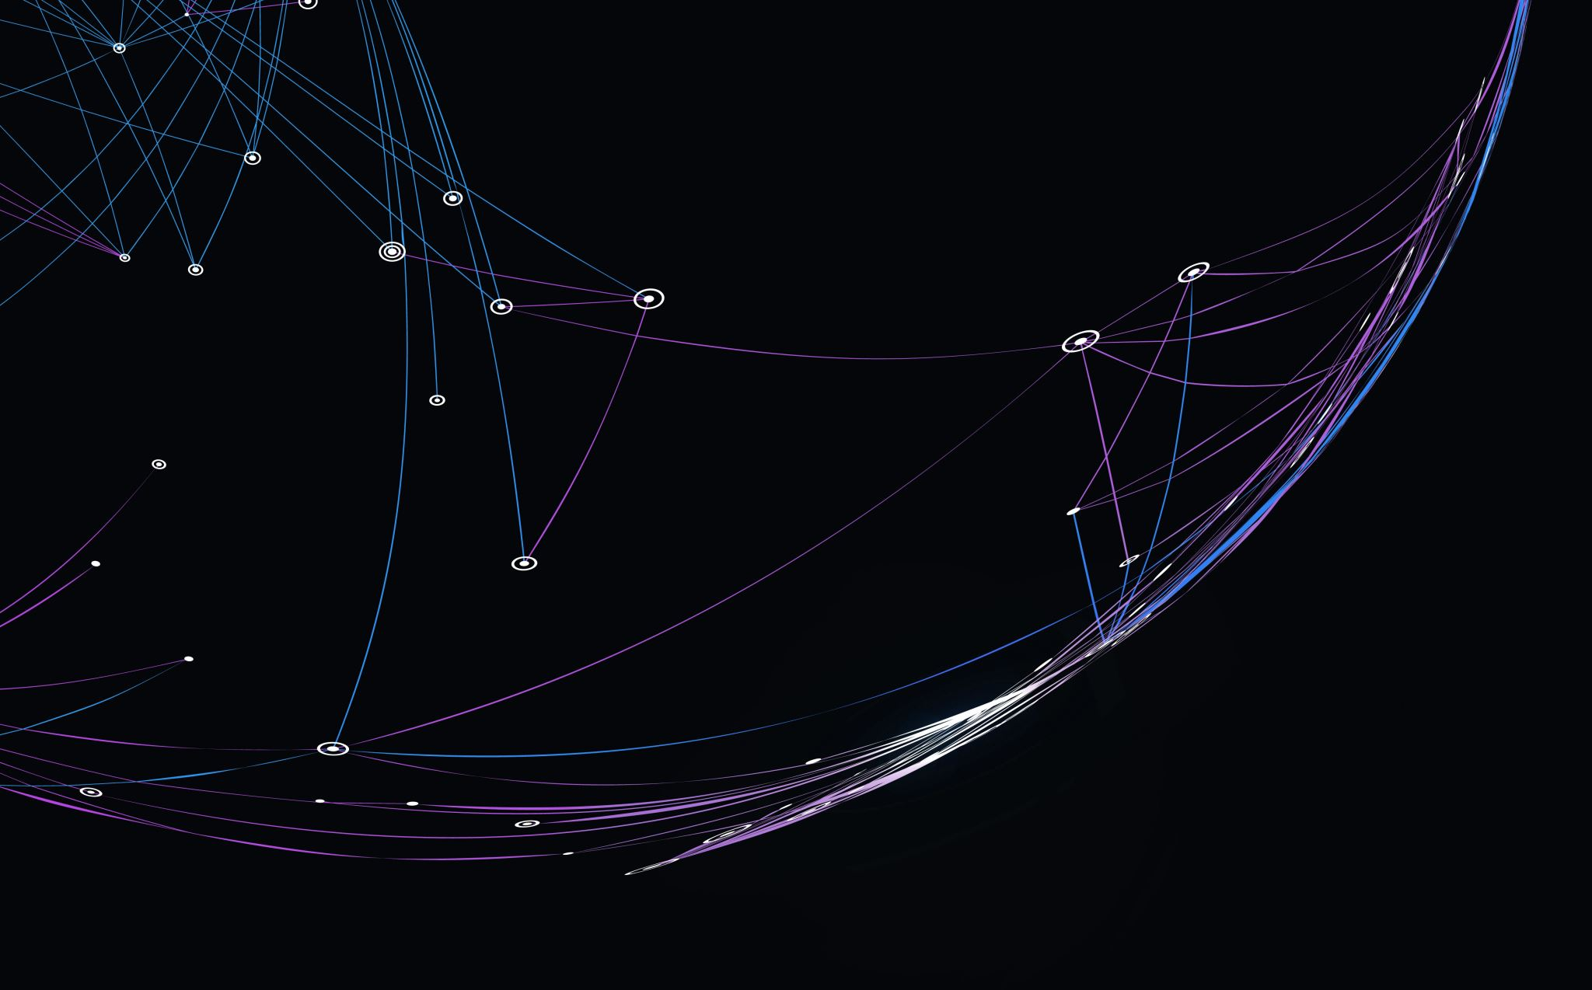
[Amuse Asteroids]
Tünde Meijer, Kutay Nazli,
Claire Olde Loohuis
Notes:
Reminder to check out the rubric to make sure this presentation is good/enough

Slide 2
Project Overview
Intention:
  Implement the YORP (Yarkovsky-O'Keefe-Radzievskii-Paddack) and Yarkovsky effects into AMUSE in order to accurately simulate asteroid orbits in our solar system
  Be able to return asteroid light curves from various points in space
Code:
  Asteroid and solar system initialization
  Functionality for different asteroid shapes
  Field code
  Gravity solver and n-body
  Bridge between n-body and radiation

Slide 3
Scientific Justification
Accurately trace asteroid orbits in the event that they need to be landed on or destroyed
Simulate light curves from any observation point
Track the evolution of asteroids, i.e. when they will experience mass loss, shedding, or be destroyed
Generalizable: multiple asteroids, non-solar systems, non-asteroid objects
  [Note: currently only generalizable for convex asteroid shapes]
Notes:
In order to accurately target an asteroid, we must be aware of all the forces affecting it: this is important for projects such as DART
Also allows us to anticipate where asteroids are going/possible collisions/implications for Earth
Simulated light curves can be compared to real observations to detect anomalies
The simulation can later be generalized to systems other than the solar system
Can also be generalized for objects other than asteroids (satellites or planetary remnants)
AMUSE does not have implementation to simulate these effects: we were doing something new and interesting, and bridging forces which are not normally combined

Slide 4
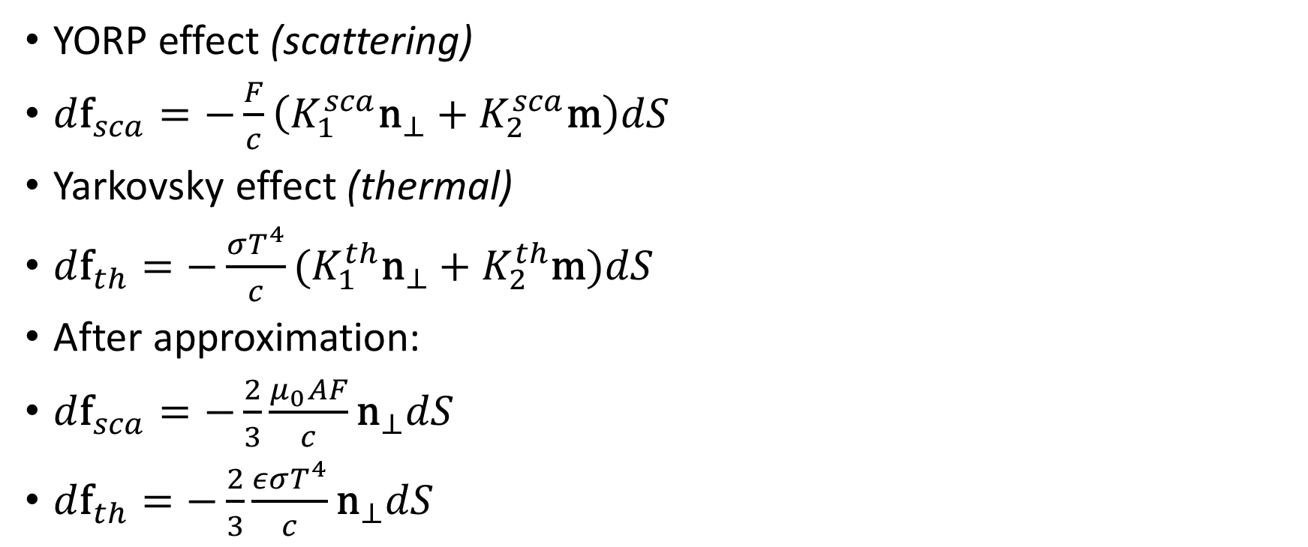
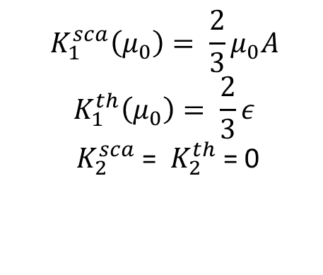
Mathematical Background
YORP effect (scattering)
$d{\text{f}}_{sca}=−\frac{F}{c}\left(K_{1}^{sca}{\text{n}}_{⊥}+K_{2}^{sca}\text{m}\right)dS$
Yarkovsky effect (thermal)
$d{\text{f}}_{th}=−\frac{σT^{4}}{c}(K_{1}^{th}{\text{n}}_{⊥}+K_{2}^{th}\text{m})dS$
After approximation:
$d{\text{f}}_{sca}=−\frac{2}{3}\frac{μ_{0}AF}{c}{\text{n}}_{⊥}dS$
$d{\text{f}}_{th}=−\frac{2}{3}\frac{εσT^{4}}{c}{\text{n}}_{⊥}dS$
$${ K}_{1}^{sca}\left(μ_{0}\right)= \frac{2}{3}μ_{0}A$$
$${ K}_{1}^{th}\left(μ_{0}\right)= \frac{2}{3}ε$$
${ K}_{2}^{sca}$ = ${ K}_{2}^{th}$ = 0
Notes:
These are two effects of the same physical phenomenon. When the asteroid is heated by the sun, some of the photons are scattered, while others are absorbed and later re-radiated. This results in two forces: a torque that affects the asteroid’s rotation rate (YORP), and a radially outward thrust that affects the asteroid’s orbit (Yarkovsky).
The forces are very small; they affect asteroids smaller than ~40km in diameter on timescales of millions to billions of years
We use the simplest solution with Lambert’s law
F = incident flux
$K_{i}^{sca}$ = surface scattering components
${\text{n}}_{⊥}$ = surface normal
${\text{n}}_{0}$ = unit vector in direction of sun
$μ_{0}$ = ${\text{n}}_{⊥}∙$ ${\text{n}}_{0}$ = surface $∙$ sun direction

Slide 5
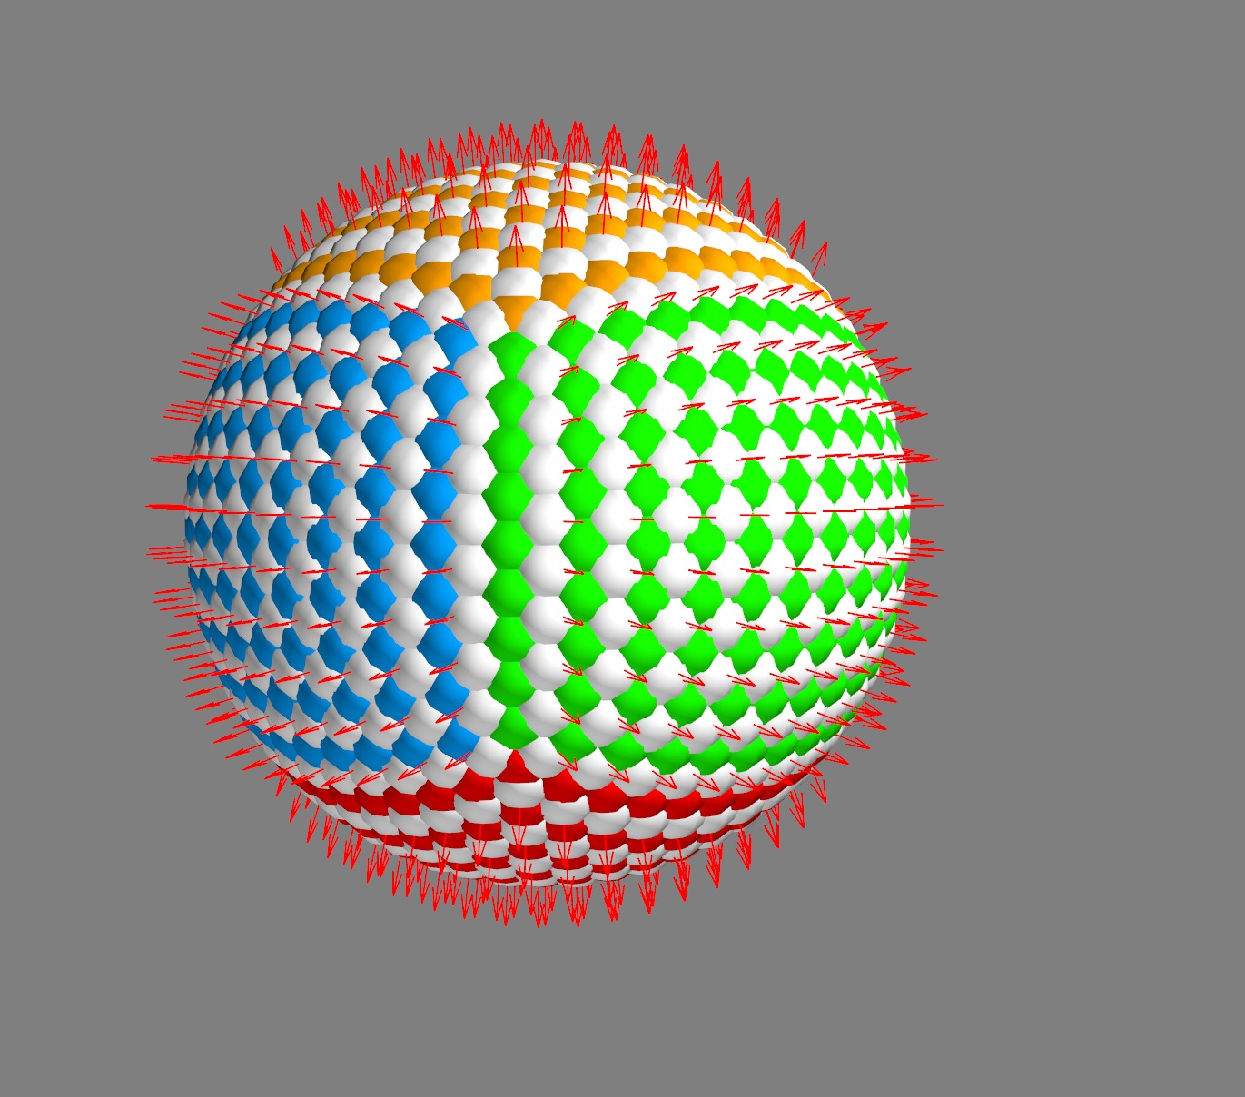
AMUSE Overview
CubeSphere: to create asteroid patches
Notes:
Used a program that would create patches of equal size on a cube, then morph that cube into a sphere with the same radius
Normal vectors found from the center of each patch by conserving the normal vectors from the cube, or failing that, by assuming patch flatness
We needed these normal vectors to calculate flux directions (we will talk more about this in the field code section)
[There is some overlap at the edges of the sphere: how is this accounted for?]
This configuration is generalizable to weirdly-shaped asteroids

Slide 6
AMUSE Overview
Asteroids: Particle class [Insert Asteroid code snippet?]
  get_albedo_emissivity
  get_acceleration (field code)
  get_flux
System: Particles class [Insert System code snippet?]
  get_directions
  calculate_flux
  get_gravity_at_point
Notes:
Asteroids is a subclass of AMUSE Particle [Explain how this is different from AMUSE Particles and why we chose Particle]
get_albedo_emissivity either takes an array input for albedo and emissivity, or initializes random values
get_acceleration is where the field code is stored. Given the directions to the star and observer, it calculates the YORPkovsky forces on the asteroid patch by patch and returns accelerations using the math from a few slides ago. The directions are calculated in the System class.
YORP/Yarkovsky code created from scratch, specifically for this project
get_flux calculates the sum of the reflected flux and re-emitted flux
Reflection_reception: checks whether the observer can see the reflected flux from the asteroid
System is a subclass of AMUSE Particles that initializes input bodies into a solar system
get_directions calculates the directions, then calculate_flux plugs them into asteroid.get_flux. System stores that flux where it can be called by plotting code to create light curves.
get_gravity_at_point is the function called by the bridge to be able to evolve the system. It calculates accelerations on all inputs using asteroid.get_acceleration.

Slide 7
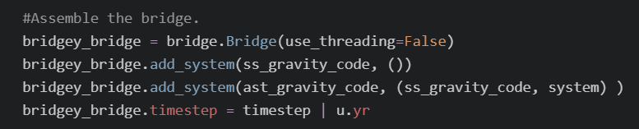
AMUSE Overview: Bridge
YORP/Yar Field Code
System (Hermite Nbody)
Asteroids (Hermite Nbody)
Evolve [Insert Bridge code snippet?]
  Solar system: Hermite n-body
  Asteroids: Hermite n-body
  Asteroids perturbed by field code
  Evolved on a timestep of ¼ year
Notes:
- Our solar system: Sun, Earth, Jupiter
- This is a hierarchical bridge because we have multiple systems talking to Asteroids
- Note that we do NOT have the asteroids talk back to the solar system; its effects on the SS bodies are negligible
- [Why did we use Hermite vs ph4? Something about tree codes]
- ast_gravity_code perturbed by both ss_gravity_code and system: system contains get_gravity_at_point, which calls the field code from the Asteroid class.

Slide 8
Interesting Results
[Simulation]
Notes:
Increase the force by a factor of a few thousand so that the effect is visible

Slide 9
Interesting Results
[Semi-major axis plot]
[Flux plot]
[Possible description of why we know the flux plot is wrong]

Slide 10
Extra Ideas
Smooth temperature function
Multiple asteroids
Observationally accurate albedo
Non-solar system (multiple stars, different planets/resonances, etc.)
Non-asteroid objects
Taking eccentricity and inclination into account
The list goes on…
Notes:
- Explain how in the flux plot we can see that the temperature function is piecewise rather than smooth (if we don’t manage to implement this before Wednesday)
- We can take eccentricity and inclination into account by making sure all binaries are created, i.e. initializing the system with make_binary_from_orbital_elements

Slide 11
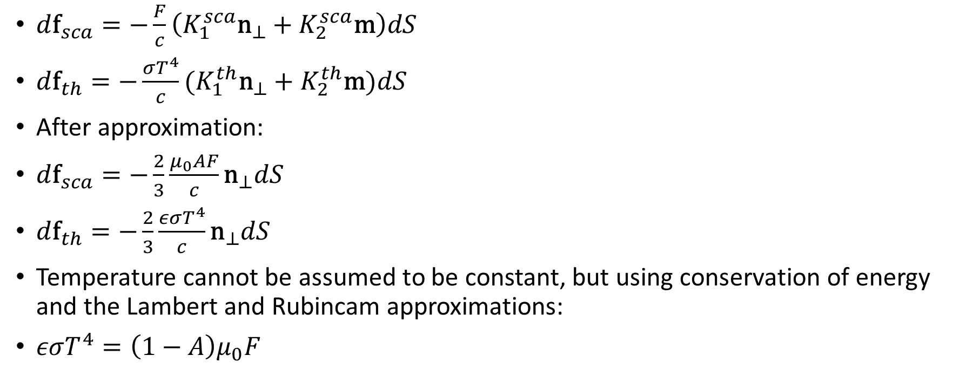
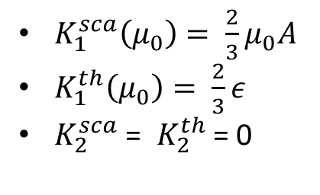
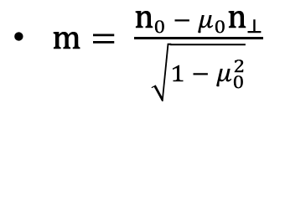
Extra Math
$d{\text{f}}_{sca}=−\frac{F}{c}\left(K_{1}^{sca}{\text{n}}_{⊥}+K_{2}^{sca}\text{m}\right)dS$
$d{\text{f}}_{th}=−\frac{σT^{4}}{c}(K_{1}^{th}{\text{n}}_{⊥}+K_{2}^{th}\text{m})dS$
After approximation:
$d{\text{f}}_{sca}=−\frac{2}{3}\frac{μ_{0}AF}{c}{\text{n}}_{⊥}dS$
$d{\text{f}}_{th}=−\frac{2}{3}\frac{εσT^{4}}{c}{\text{n}}_{⊥}dS$
Temperature cannot be assumed to be constant, but using conservation of energy and the Lambert and Rubincam approximations:
$εσT^{4}=\left(1−A\right)μ_{0}F$
$\text{m}= \frac{{\text{n}}_{0} −{{ μ}_{0}\text{n}}_{⊥}}{\sqrt{1 − μ_{0}^{2}}}$
$K_{1}^{sca}\left(μ_{0}\right)= \frac{2}{3}μ_{0}A$
$K_{1}^{th}\left(μ_{0}\right)= \frac{2}{3}ε$
$K_{2}^{sca}$ = ${ K}_{2}^{th}$ = 0
Notes:
In the last equation, temperature can be derived from surface parameters.
F = incident flux
$K_{i}^{sca}$ = surface scattering components
${\text{n}}_{⊥}$ = surface normal
${\text{n}}_{0}$ = unit vector in direction of sun
$μ_{0}$ = ${\text{n}}_{⊥}∙$ ${\text{n}}_{0}$ = surface $∙$ sun direction

