Slide 1

PlayBook
Danielle Vigent
Claire Lyles
Michael Gage
Stephen Gilmore

Slide 2

Areas of Improvement
Video/audio chat
Group chat
Streaming music
Sharing files with others (file storage)
Ask question to Users in a specified network
Professional Profile
Audio/ Video Ads
Customizable Skins
Voice-to-Text Conversion
Notes:
Profile types exsisting – fan, music, bands, business,

Slide 3
Areas of Possible Major Improvement
Notes:
Profile types exsisting – fan, music, bands, business,

Slide 4

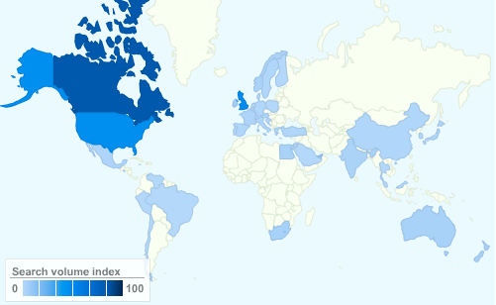
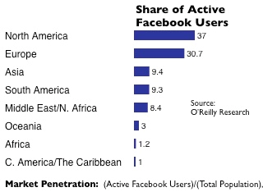
Current User Profile
Social Network Usage/day
Facebook 0.20 hours
Myspace.com 0.03 hours
Twitter.com 0.02 hours

Slide 5
Time Spent on Media

Slide 6
Extending Time Spent on Facebook
Music and Radio (usage/day)
Age <12 listens 2.7 hours
Age 12-18 listens 1.7 hours
Age 18 + listens 2.8 hours
Social Network (usage/day)
Facebook 0.20 hours
Myspace.com 0.03 hours
Twitter.com 0.02 hours

Slide 7





Music Streaming Diversity Market
Media Streaming Options Decrease
Record Labels
2007 CBS purchases Last.fm
2007 Google purchases YouTube
2009 MySpace purchases iLike and Imeem
2010 Apple purchases Lala
5/31/2010 Apple discontinues Lala
4 labels with over 70% of the market share as of 2005
Universal 25.5%
Sony 21.5%
EMI 13.4%
Warner 11.3%

Slide 8

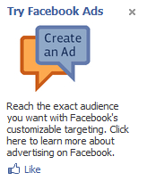
Advertisement Pricing Schemes
Audio and Visual Ads
Visual: 4 ads per artist page
Audio: 2-30 second ad/per hour
Considerations:
Cost per view, per targeted view, per 1000 views (CPM)
Cost per click
Cost per action
Measured by Click Through Rate

Slide 9
Revenue vs. Cost Comparison
Revenue from Advertisements
Expenses from Streaming
Visual Advertisements
$10/1000 advertisement views
Audio Advertisements
$10/1000 advertisement plays
Worst Case income
$1.67 billion/mo.
$0.005 - $0.01 per song streamed
3-5 minutes per song
500 billion minutes per month on Facebook
Worst Case cost
$1.67 billion/mo.

Slide 10


Slide 11
Contact Music artists/labels
Contact top four major record labels (Universal music group, Sony Music Entertainment, Warner music and EMI)
Contact smaller labels or artists directly
Explain Business model
Ads: audio and visual
Song Uploads + Tagging
Radio + Playlists

Slide 12
Upgrade Software and Hardware
Upgrade server capacity
Develop software interface
Educate employee base on digital rights management
Design and test user interface

Slide 13
Set up musician pages and consolidate song data
Be able to make connections w/ people via music
Provide musician page interface for customization
background color or image
calendar
online store
Collect Songs and Tagging Data
Song titles, albums, keyword tagging
Link to similar genres, artists, and networks

Slide 14
Unveil Music Playbook Interface to Facebook Users
Placement of graphic interface to left of chat toolbar
Notification of new changes on first login
Music links to existing info page link
Prompt for user to add more links
Have tutorial videos/forums/FAQs

Slide 15
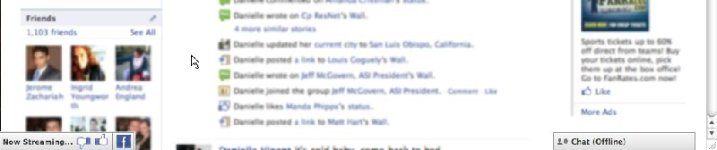
Unveil Music player interface to Facebook users

Slide 16
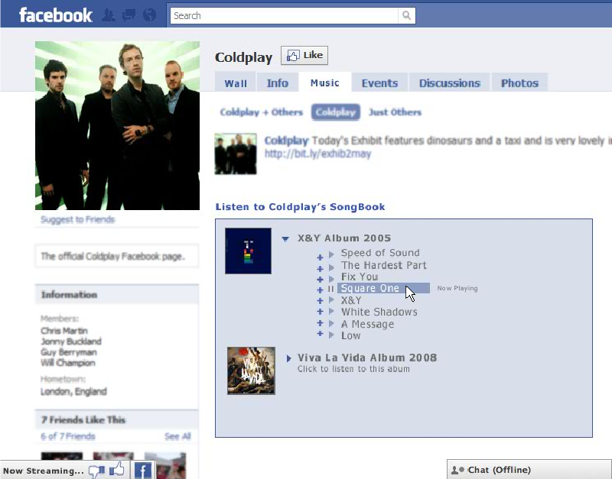

Slide 17
Risks
Low user usage
Poor reception
Usage right limitations with Record Labels
Technological difficulties
Server space, compatibility, hardware specs
Lawsuits
Digital Rights Management and RIAA

