Slide 1
EDA: Survey Data Analysis for Hospitality Industry
Claire Kelleher

Slide 2
Background
Context:
A hotel chain are looking to open a chain of hotels in the UK and are interested in the landscape of domestic tourism. They want to understand their market/category and if there is something they could leverage.
Analysis requirement:
Understand the various dynamics of the UK market when it comes to travel and hospitality.
Data:
Two waves of a consumer survey conducted in the UK between 2020 and 2021.

Slide 3
Survey Analysis
K-Means clustering to identify clusters within travel data
What features best defined the clusters?
How did these vary by wave?
Predicting if a customer has travelled on a long train journey in the past 12 months, split by waves
Encoding of non-numerical features
Decision Tree and feature importance, to filter down features initially
RFE feature selection
Selected features in Logistic Regression
How did these features differ by wave?

Slide 4
CLUSTERING METHOD
K-MEANS ALGORITHM (SCALED USING MINMAX SCALER)
ELBOW METHOD UTILISED TO IDENTIFY OPTIMAL NUMBER OF CLUSTERS (K=2-3)
CLUSTERS SPLIT BY WAVE AS WELL AS BUILT ON ALL DATA
The top 10 questions that distinguished clusters from included hiking, travelled in the last year and age, suggesting that clusters within the data could be labelled relative to life-stages or health conscious.
When split by waves, questions on smoking and gambling were slightly more prominent.

Slide 5


The top 10 questions that distinguished clusters from included hiking, travelled in the last year and age, suggesting that clusters within the data could be labelled relative to life-stages or health conscious.
Segment A: High-Flyers
465 Surveys
Segment B: Mid-Lifers
453 Surveys
Segment C: Later-Lifers
1178 Surveys
Late 20’s / early 30’s
Value Success
Slightly higher income
0-1 Children
Travelled in the last year
Hiking
Mid-30’s
1-2 Children
Watch BBC News
Betting
Age 40 +
0-1 Children
Use Desktop
Quit Smoking
Watch Sky News
Less use of IM
Use of IM
LIFE-STAGES
Use of Desktop

Slide 6
Predicting if a customer has travelled on a long train journey in the past 12 months
Model that predicts the likelihood of a user booking a long-distance train in the past 12 months.
Considerations
Number of bookings are going to be relatively low due to COVID.
Are business trips counted?
Define long distance
Brainstorm variables
Income - can they afford it?
Job type - Do they travel for work?
Number of trips booked in the past - Is this train trip a main priority?
Frequency of travel?

Slide 7
METHOD
LOGSTIC REGRESSION MODEL WITH BASIC DEMOGRAPHIC VARIABLES AS STARTING POINT
NUMERICAL ENCODING OF SOME MORE VARIABLES SUCH AS FREQUENCY OF TRAVEL
RE-RUN OF LOGISTIC MODEL
OPTED TO TRY A DECISION TREE, WITH ALL VARIABLES (SIMILAR AUC)
TOOK TOP 30 VARIABLES BASED (TO REDUCE LARGE NUMBER OF VARIABLES AT EARLY STAGE) BASED ON DT ENTROPY
RAN A RFE (RECURSIVE FEATURE SELECTION) ON THOSE VARIABLES (LINEAR KERNEL), RETURNING THE TOP 5.
RE-RUN OF LOGISTIC MODEL WITH TOP 5 VARIABLES.
RAN MULTPLIE TIMES, SPLIT BY WAVES TO INVESTIGATE IF THEY DIFFER.
RESULTS: BEST MODEL ACROSS BOTH WAVES WAS ONE OF THE EARLIER ONES:
Modelling age, income on top of frequency of travel (business and private) using a Logistic Regression resulted an AUC of 64%.

Slide 8
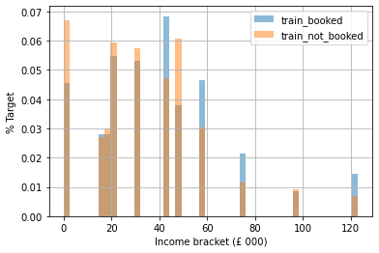
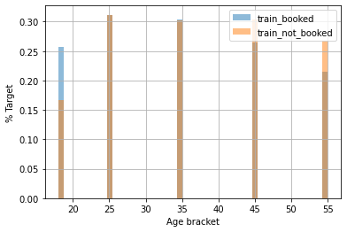
Those who booked long distance trains in the past year tend to have a higher income and be younger, in their 20’s. This could be due to younger people being less cautious travelling during COVID.

Slide 9
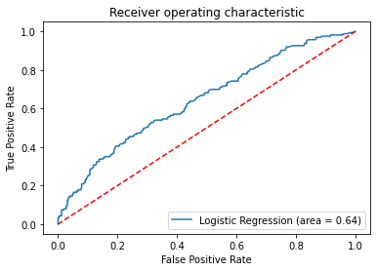
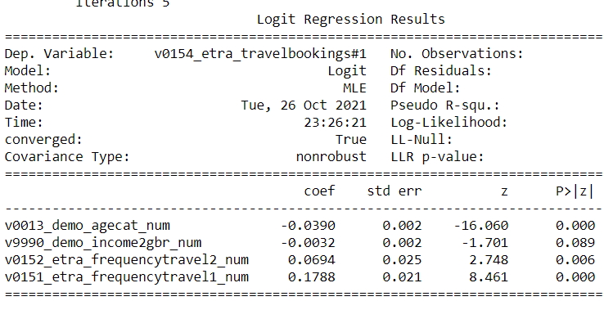
Modelling age, income on top of frequency of travel (business and private) using a Logistic Regression resulted an AUC of 64%.

Slide 10
Recommendations
Hotels that cater to different level of health consciousness:
Locations near areas where guests can hike
Gyms accessible to all ages
Cater to different types of holiday based on life-stages and interests
Early family
Early adult / Friends
Gambling
Advertise to the older group via Desktop apps and younger group via platforms access via portable devices (Facebook IM, Instagram)
Those in their 20’s, with a higher income are travelling long-distance anyway.
If company is looking to open more remote hotels, they should invest in those who are not travelling long-distance train journeys, such as discount deals (family bundles, retirement discount) and advertise them accordingly.
On-site model could be used to predict if someone falls into the deals worth bucket or if they’re going to travel long-distance anyway using their income, age and frequency of travel (business and private) in the past year.

