Slide 1
Moodscape
From Official Statistics to Sound:
Testing Each Link of a Data-to-Music System for South Korean Places
[Participant Name] · [School Name] · Republic of Korea
KSEF 2027 International · Category [Code]

Slide 2
1 · Motivation
Maps are read only with the eyes, and one number is not a place
Maps depend on vision
Sound is another channel
But atmosphere is perceived
Which regions are busy or quiet is shown only by color and labels, and does not reach people who cannot see the screen.
Sonified maps have helped users with visual impairment explore geographic data [Zhao 2008].
A soundscape is the acoustic environment as perceived (ISO 12913); perceived sources predict perception better than sound level alone [Oberman 2025].
Question: Can official statistics be turned into music, and does each link of that chain actually work?
Moodscape · KSEF 2027 International
2

Slide 3
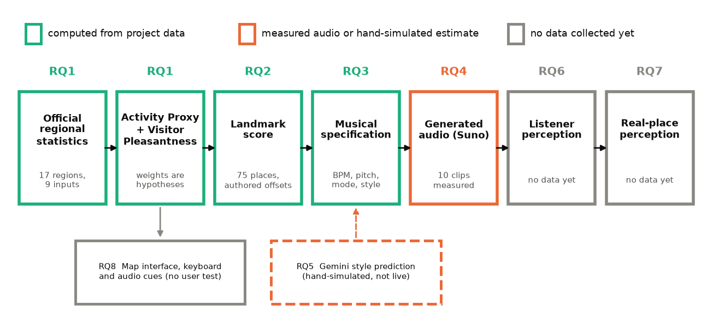
2 · Objectives and research questions
Goal: build it, then test every link on its own
Objectives
① Build a reproducible data-to-music web app
② Test each link as its own research question
③ Derive improvements from the results
Evidence classes
■ Computed: RQ1–RQ3
■ Measured / simulated: RQ4–RQ5
■ Pending: RQ6–RQ8 (listeners, field, access)
Moodscape · KSEF 2027 International
3

Slide 4
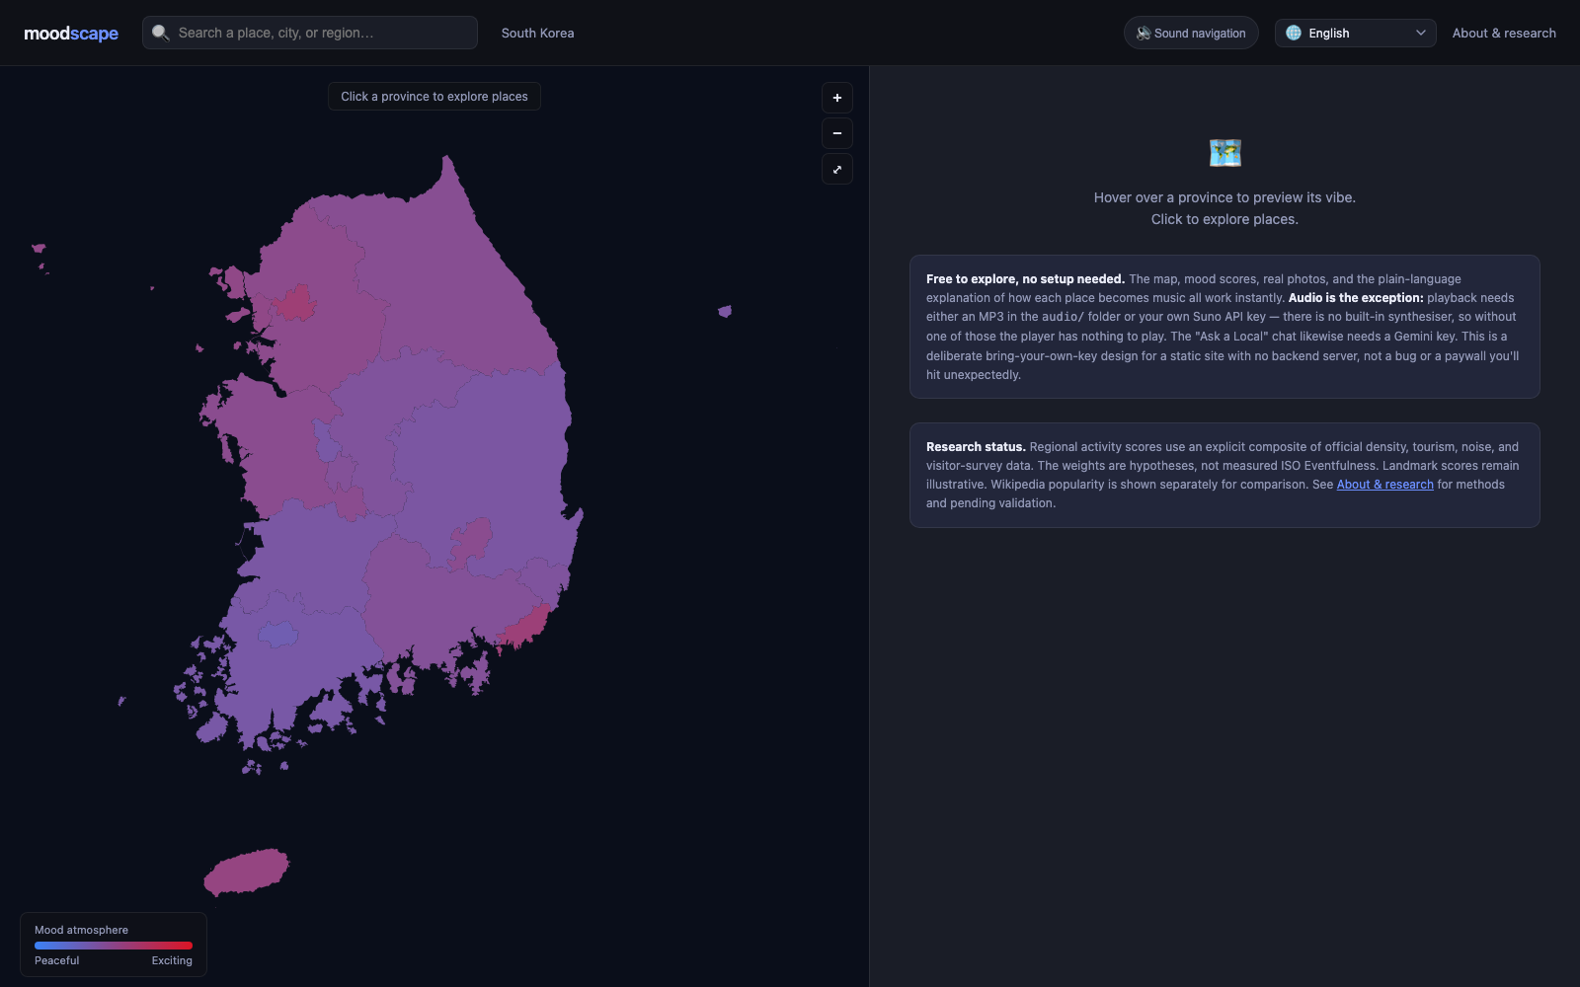
3 · System design
Idea → system: activity becomes tempo, satisfaction becomes mode
Input: 9 official indicators, 17 provinces
Density (Statistics Korea), tourism and visitor survey (2024 National Travel Survey), noise complaints and facilities (Ministry of Environment), transcribed with source links.
Activity Proxy
100 × (0.35 density + 0.30 tourism + 0.15 complaints + 0.10 facilities + 0.10 crowding)
Musical specification
Tempo = 42 + 110 × score BPM · pitch = A4 + 12 × score semitones · mode = 3 rules → generated with Suno V4_5
Accessibility
Keyboard navigation, screen-reader labels, score → pitch, east–west → stereo
Moodscape · KSEF 2027 International
4

Slide 5
4 · Verification design
Design: generate the same places twice, measure by software and by ear
Variables
Measurement
Statistics
• Independent: wording, request shape (single text / custom), genre words
• Dependent: detected mode and tempo
• Controlled: model V4_5, analysis procedure, seed 20260920
• 10 places (score quantiles) × 2 rounds
• Key: Krumhansl–Kessler profile correlation
• Tempo: single estimate + top-3 tempogram peaks, 20,000 permutations
• Weight sensitivity: 10,000 Dirichlet draws
• Clopper–Pearson intervals, Fisher exact test
• A single success is never counted as a fix (stochastic)
Human check: one listener blind-tapped one Sejong clip (engineering diagnostic, n = 1, not the listener study)
Moodscape · KSEF 2027 International
5

Slide 6
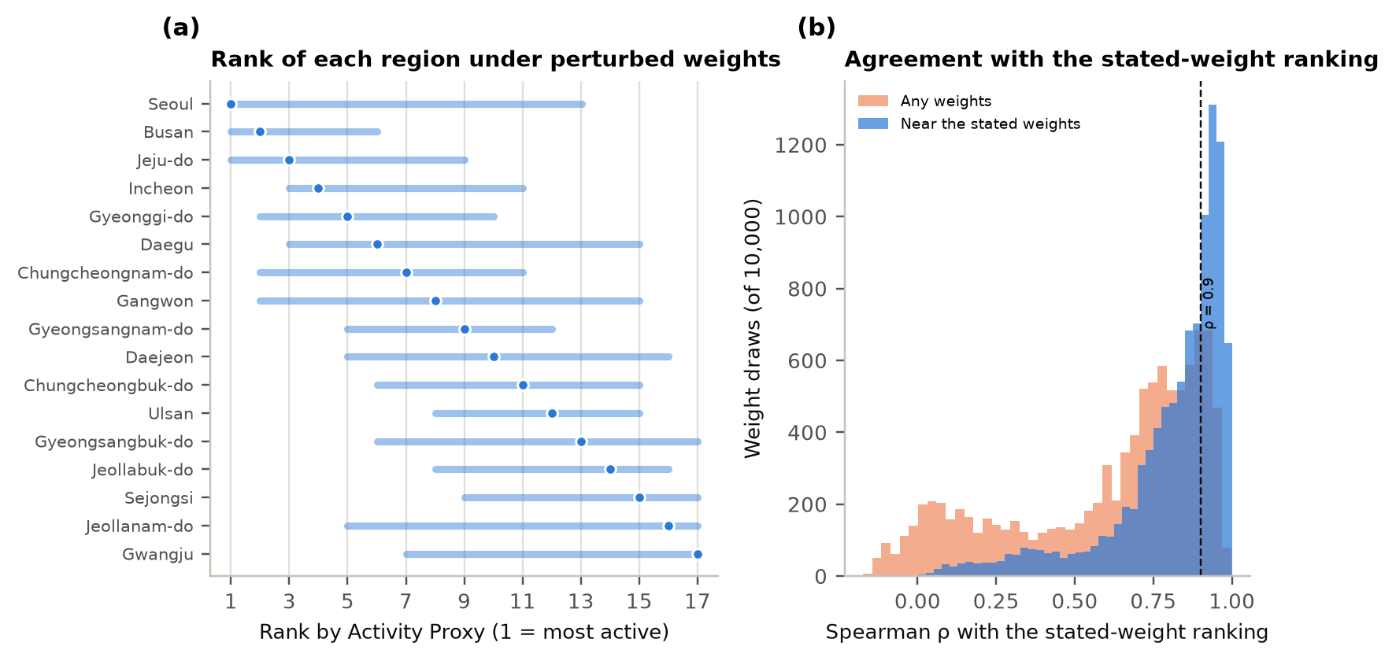
5 · Results
RQ1 · The regional order is plausible but weight-sensitive
ρ = 0.87
median rank agreement under perturbed weights
42%
of draws kept ρ ≥ 0.9
ρ = -0.07
actual influence of tourism (weight 0.30)
Moodscape · KSEF 2027 International
6

Slide 7
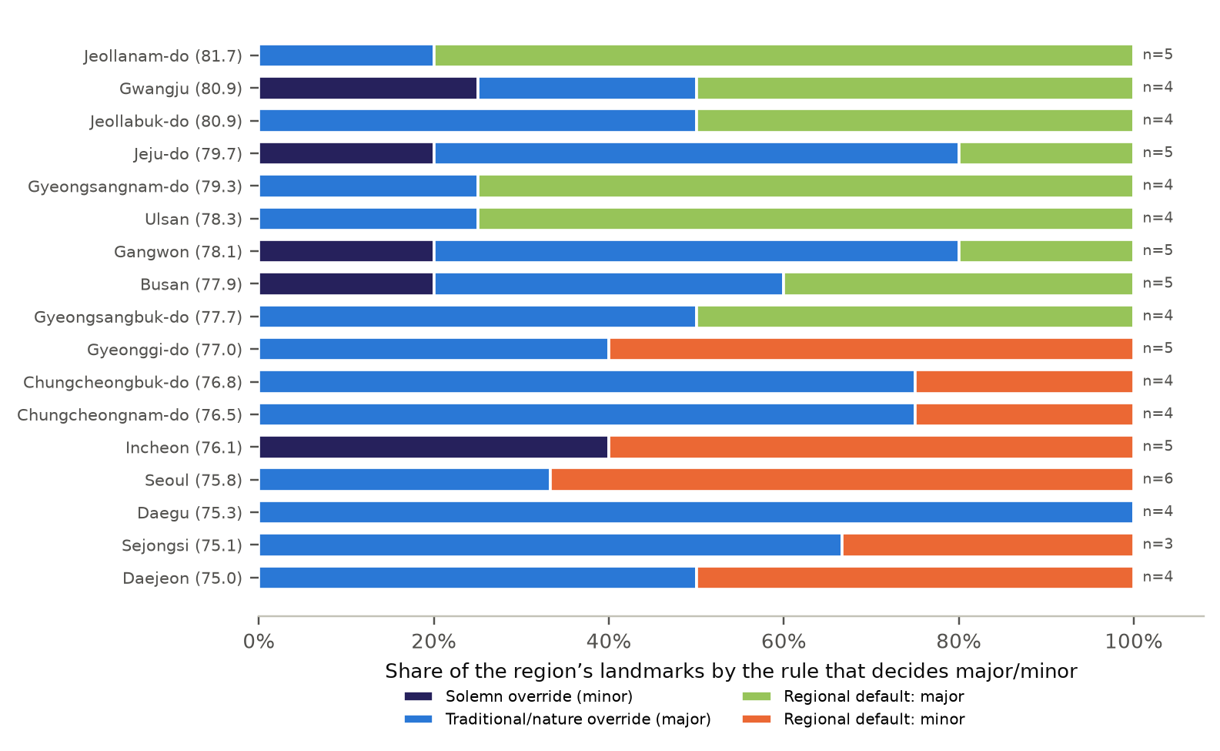
5 · Results
RQ2–RQ3 · Landmark sound is mostly authored; mode is set by region
12.2%
of landmark-score variance explained by region (η²)
35/75
places whose mode is set by Visitor Pleasantness
The 17 Pleasantness values span 6.7 points and 6 regions sit within one point of the median, so small survey differences become major vs minor.
Moodscape · KSEF 2027 International
7

Slide 8
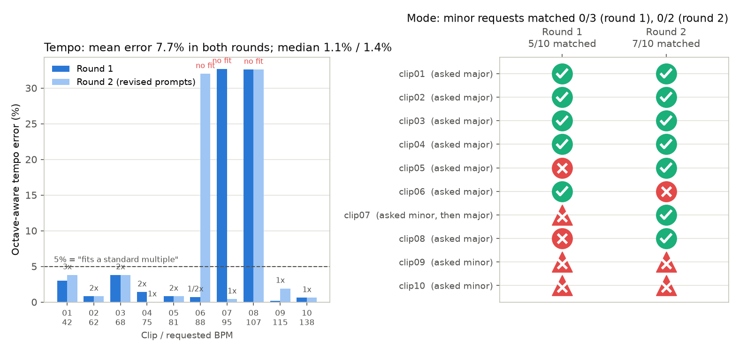
5 · Results
RQ4 · Generated audio follows the request only in part
5→7/10
mode matched (round 1→2)
0/5
minor requests honored
7·9/10
The round-2 gain mixes Sejong’s changed request (minor → major) with clips 05, 06 and 08 flipping under the same request, so it cannot be credited to rewording.
request among top-3 peaks (chance ≈1.5)
Moodscape · KSEF 2027 International
8

Slide 9
5 · Results: the Sejong case
An automatic 95 BPM match was heard at 48 BPM
Target 95 BPM | automatic → human blind tap
Round-2 Suno source
Strict 95 BPM regeneration
+ 95 BPM kick and rim
2.02× time-axis fix + hi-hat
auto 95.3
auto 95.3
auto 95.3
auto 95.3
48 BPM
48 BPM
47 BPM
96 BPM
The added pulse was absorbed as a subdivision of the slow beat. Only correcting the whole time axis from the human measurement (47) moved the heard pulse to the target (1.1% error; criterion ±5% set in advance).
Limit: one place, one listener, sequential diagnostic, not a success rate. Listen to the audio
Moodscape · KSEF 2027 International
9

Slide 10
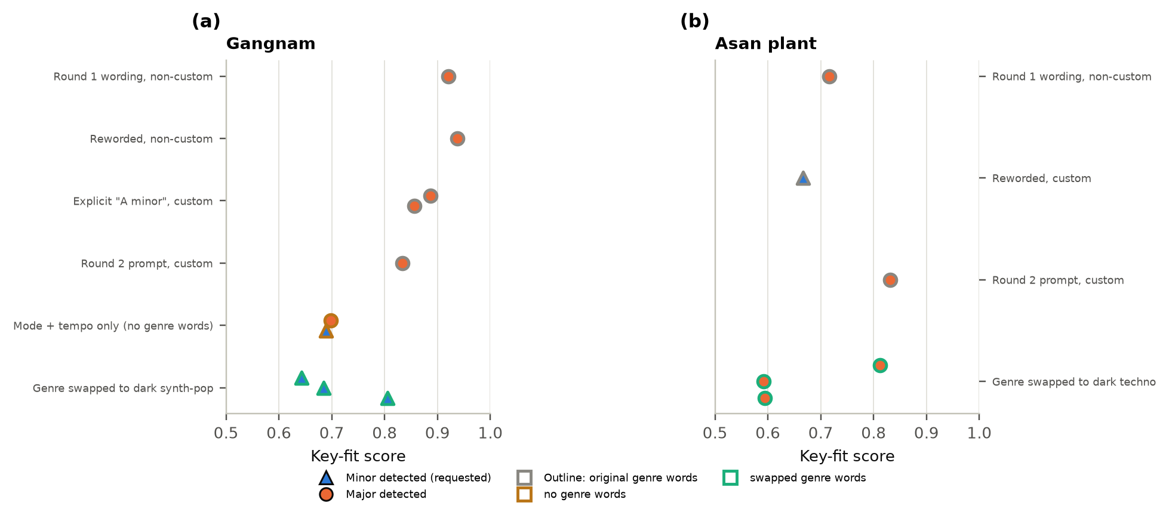
5 · Results
What changes the mode? Genre words more than mode words
0/5 → 3/3
Gangnam: original genre → “dark synth-pop”
0/3
Asan: same method, did not transfer
9/21
all minor requests (no factor beats chance)
Moodscape · KSEF 2027 International
10

Slide 11
6 · Improvements
Feedback → fixes: the biggest gains came from fixing our own rules
“complex” keyword collision → Sejong styled as a factory
→
New institutional category
later generations at 95.3 BPM
Sejong is a planned city of young families (user feedback)
→
Added to the major rule
D♯ major, key-fit 0.94
“warm, mellow” next to a minor request
→
Remove bright words when minor
necessary, not sufficient
Automatic BPM ≠ human pulse
→
Time-axis fix + hi-hat
one listener: 96 BPM
API key routed through a public relay
→
Direct calls
checked with a mocked network
Moodscape · KSEF 2027 International
11

Slide 12
7 · Discussion
Limitations and next steps
Limitations
• 20 tracks + ~20 follow-ups, one provider and model
• Follow-up comparisons were not preregistered
• Only one listener checked one clip
• Weights are hypotheses; landmark scores are not measured
• No listener, field or accessibility data yet (RQ6–8)
• No recorded Gemini output (hand-simulated)
Next steps
1. Several listeners tap every clip blind; a musician checks mode
2. Repeat each request before claiming a fix
3. Test the genre-word hypothesis at more places
4. Listener study, 15–24 adults (protocol ready)
5. Field soundwalk at 6–10 sites
6. Enforce tempo by deterministic correction
Moodscape · KSEF 2027 International
12

Slide 13
8 · Conclusion
Conclusion
• The chain from official statistics to score, specification and audio is traceable end to end, and its first four links were tested.
• The regional order is plausible but weight-sensitive, landmark scores are mostly authored, and the mode rule is coarse.
• The generator guaranteed neither minor mode (0/5) nor the perceived pulse; deterministic correction fixed tempo (one listener, one clip).
• Whether listeners hear the intended order is the next, prepared experiment.
Materials · Code & data · Web demo · Generated audio
https://github.com/clairenah19/sound-moodscape/tree/ksef2027-submission
Moodscape · KSEF 2027 International
13

