Slide 1

Health Care Cost Breakdown: Diagnosis, Doctors and Demographics

Slide 2
Contents
Page
Introduction ……………………...….……………….…….….....................................................
Data Processing Circle…………………………………….………..................​……………...
Data Cleaning………………...…...….......…....…....….....……………………..​……………..
Data Transformation………………………….…………………………............​…………….
Analysis……..………………......………….......………………....….…………..​…………….
Conclusion……………………..…………………..…….………………….…………………
1
3
4
5
8
14

Slide 3
Data Processing
Data Cleaning
Data Transformation Formatting and Formulas
Insights/ Conclusion
Analysis Pivot Table and Charts
Presentation Title

Slide 4


Data Cleaning
In cleaning our data, we did the following:
Removed duplicates using the Patient ID
Replaced blank diagnosis with “unknown” and blank doctors with “unassigned”
Remove the empty column “age range”
Standardized text values and removed extra spaces across text fields
Outcome:
5000 unique patient records
No blank/missing values
No blank columns
Standardized text values and removed extra spaces across text fields

Slide 5
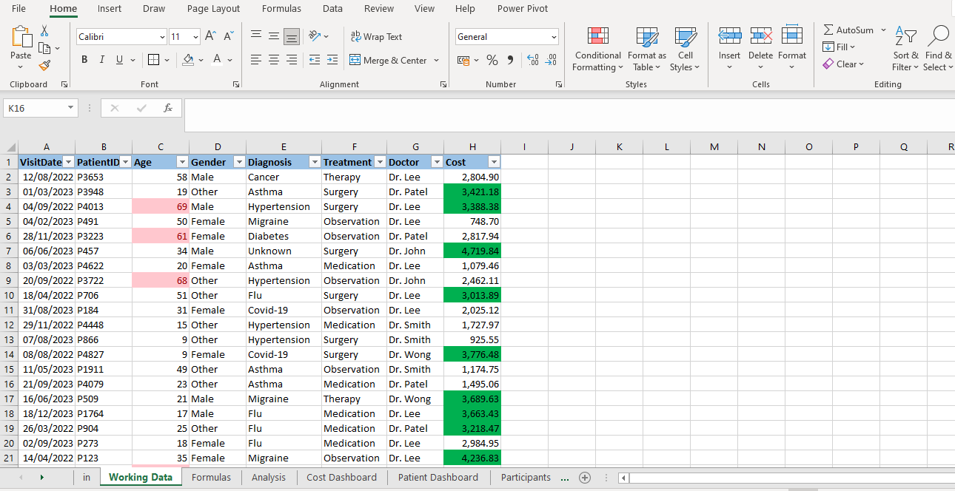
Data Transformation
Formatting
Bold column headers
Background color to column headers
Cost field – currency and decimal placements
Date field as date (dd-mm-yyyy)
Conditional formatting highlighting patients older than 60 and cost treatments higher the 3000
Outcome:
Improved readability
Easier data analysis
Consistency across entries
Enhanced/clean data presentation

Slide 6
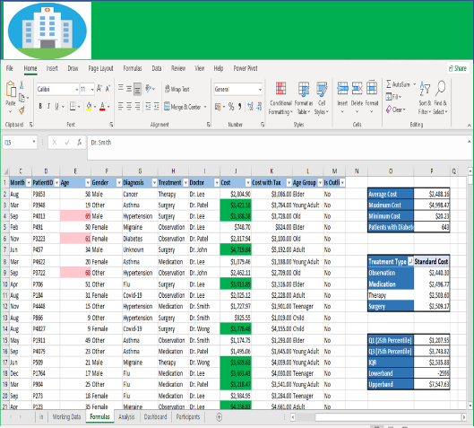
Data Transformation
Formulas
Used “IF statement”’ to classify patient ages into groups of “Toddlers”, “Child”, “Teenager”, “Young Adult”, “Adult”, “Elder” and “Old”
Used “Average”, “Maximum”, “Minimum” and “Count” functions to calculate the average, maximum, and minimum cost as well as the total number of patients.
Used Pivot Table to get the average cost across various treatment types
Calculated “cost with tax” using “cost *1.1”
Extracted the month name and years from our VisitDate column

Slide 7

Data Transformation
Outcomes:
Segmentation of ages for easier analysis
Identify highest, lowest, and average cost values
Insight to the cost variation across records – average cost across various treatment types were between $2400 and $2500
Comparison between pre-tax and post tax cost values
Better trend analysis (visits by month and performance tracking across months, quarters and years)

Slide 8
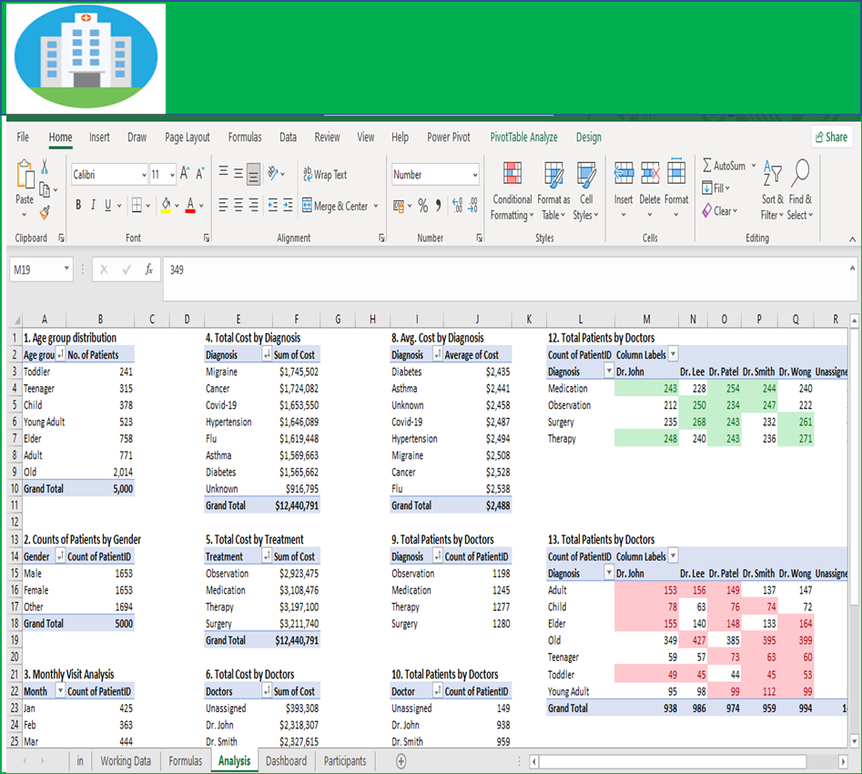
Analysis: Pivot Tables
Inserted pivot tables and charts to show:
Total cost by doctor
Counts of patients by gender
Average cost by diagnosis
Age group distribution
Gender distribution
Total cost by diagnosis
Total cost by treatment
Patient visit by month

Slide 9
Analysis: Pivot Tables
Inserted pivot tables and charts to show:
Total cost by doctor
Counts of patients by gender
Average cost by diagnosis
Age group distribution
Gender distribution
Total cost by diagnosis
Total cost by treatment
Patient visit by month

Slide 10

Analysis: Data Visualization & Reporting
Patient Demographic
5000
Male and female patients make up almost the same proportion around 33% each while the ‘other’ category also sits at about 34%. This tells us the hospital serves a fairly balanced population across genders.
The “Old” age group has the largest number of patients (2,014) This indicates that older individuals tend to visit the hospital more frequently, likely due to ongoing medical conditions or routine health checks
From the data, September had the highest number of visits (447) while February had the least (363). This indicates an increase in patients visits around September, possibly due to seasonal factors or scheduled procedures.
Patients
(2022-2023)
Patient Visit Trend

Slide 11
Analysis: Data Visualization & Reporting
Revenue Drivers:
$12,440,791
The top diagnoses driving total treatment costs are migraine, cancer, COVID-19, and hypertension. These conditions are either chronic, complex, or acute with high resource demands. Cancer and COVID, in particular, often require intensive care, specialized treatments, and prolonged recovery periods.
Surgery emerges as the most expensive, followed by therapy and medication. This aligns with expectations, as surgical and long-term treatments tend to be resource-intensive.
Total Revenue
(2022-2023)
Revenue by Treatment

Slide 12
Analysis: Data Visualization & Reporting
Provider Impact:
Looking at provider-level data, Dr. Wong, Dr. Lee, and Dr. Patel are associated with the highest total patient costs. This may indicate they handle more complex cases or see a higher volume of patients.

Slide 13
Analysis: Data Visualization & Reporting
Provider Impact:
Dr. Wong, Lee and Partel see a higher volume of patients, are among the top 3 who handle surgery and therapy cases (major cases handled in the hospital) and Dr. Wong particularly has more patients in the elder and old demography (highest across age demography)

Slide 14
Conclusion
The hospital serves a diverse and balanced gender population, with a strong emphasis on older patients. The highest costs are driven by a mix of chronic and acute conditions—particularly migraine, cancer, COVID-19, and hypertension—and by resource-heavy treatments like surgery and therapy. A few doctors, especially Dr. Wong, play a pivotal role in managing complex, high-volume cases, particularly among the elderly. These insights highlight the need for strategic resource planning, targeted care pathways, and ongoing monitoring to optimize both patient outcomes and operational efficiency.

