Slide 1
HRE Sluice Gate Culvert Modeling

Slide 2
Research questions

Slide 3
Experimental setup

Slide 4
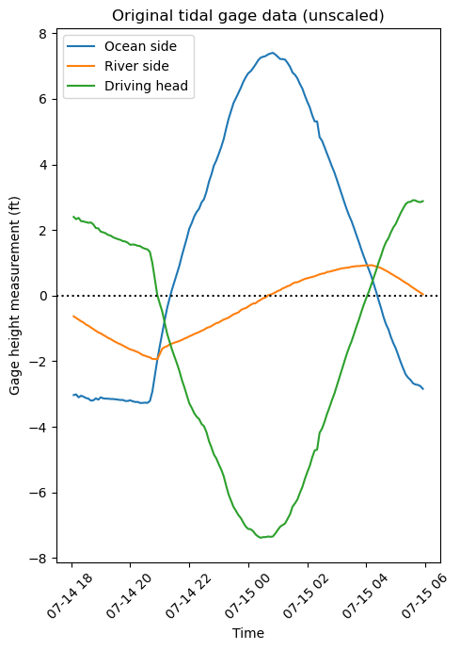
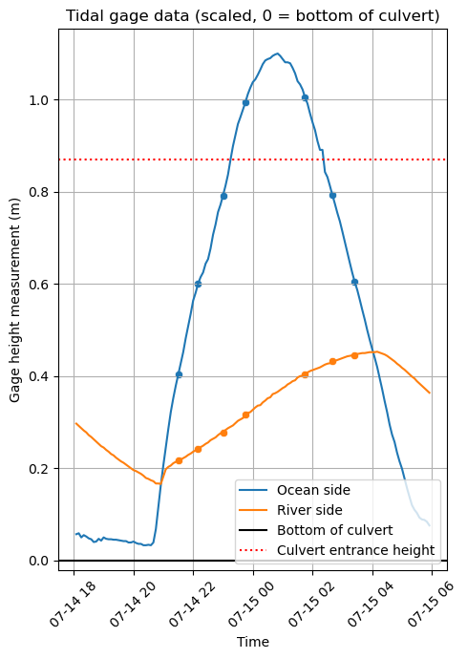
Scaled hydrograph

