Slide 1
Christopher Lall CSc 342/343 Adder Lab Professor Gertner Spring 2022
Due: March 6th 2022

Slide 2
Objective:
Design half-adder, full-adder, 4bit adder, 4bit adder/subtractor, nbit add-sub (without and with flags), lpm add-sub, and testbench adder subtractor

Slide 3
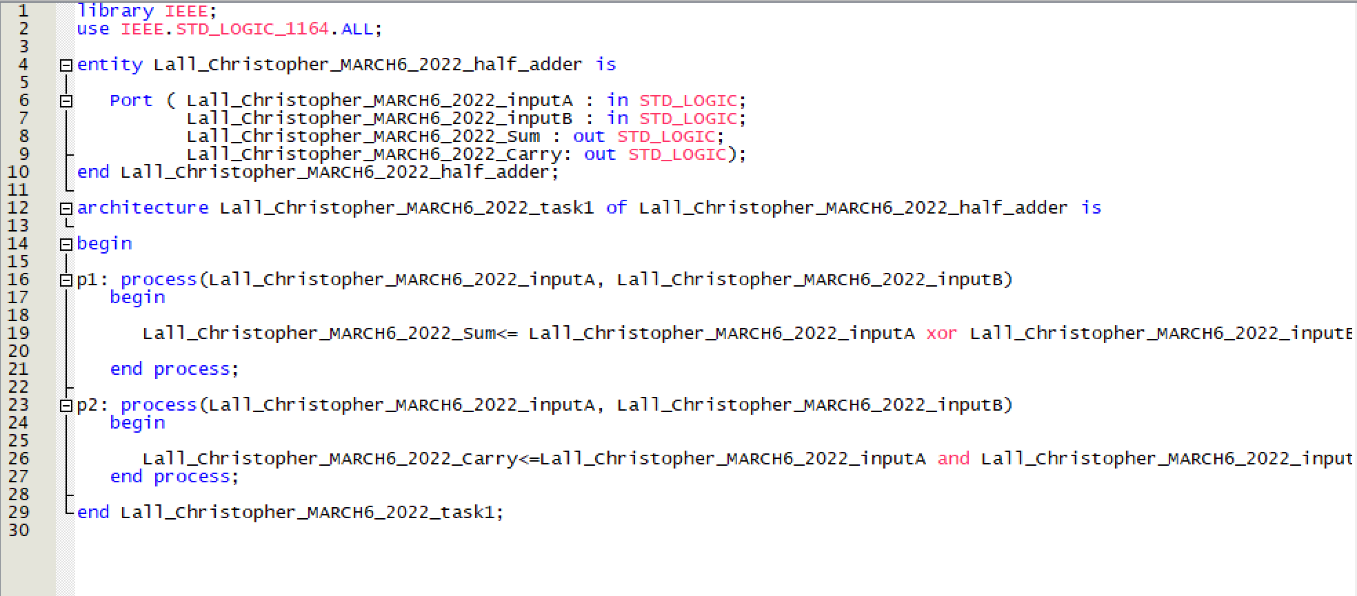
Task 1: VHDL Codes for…..half adder

Slide 4
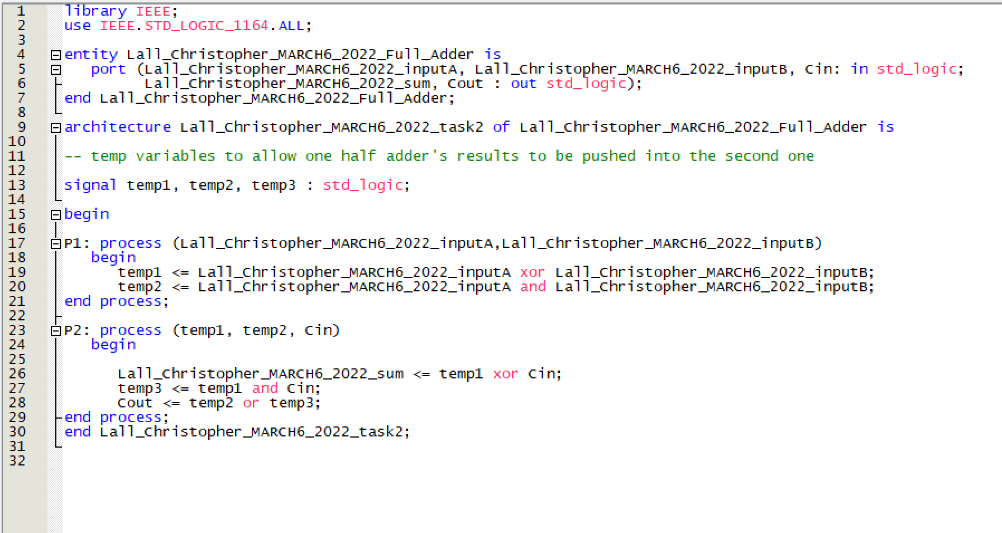
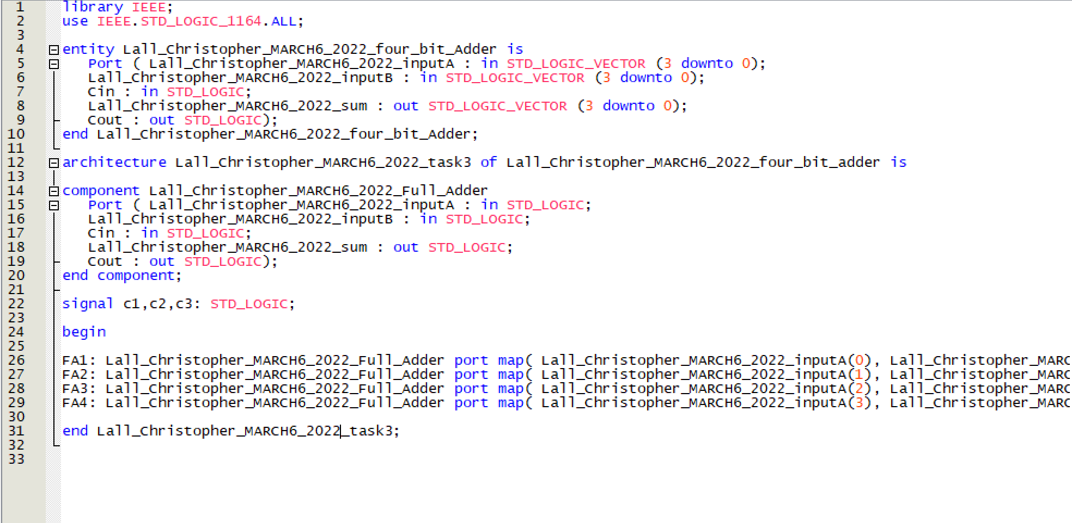
Task 1: continued, full adder(left), 4bit adder(right)

Slide 5
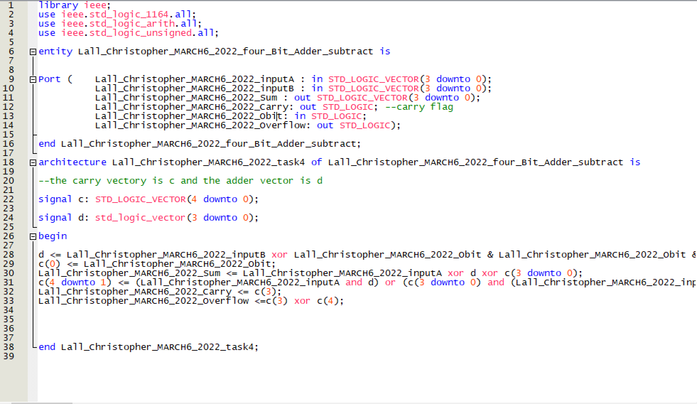
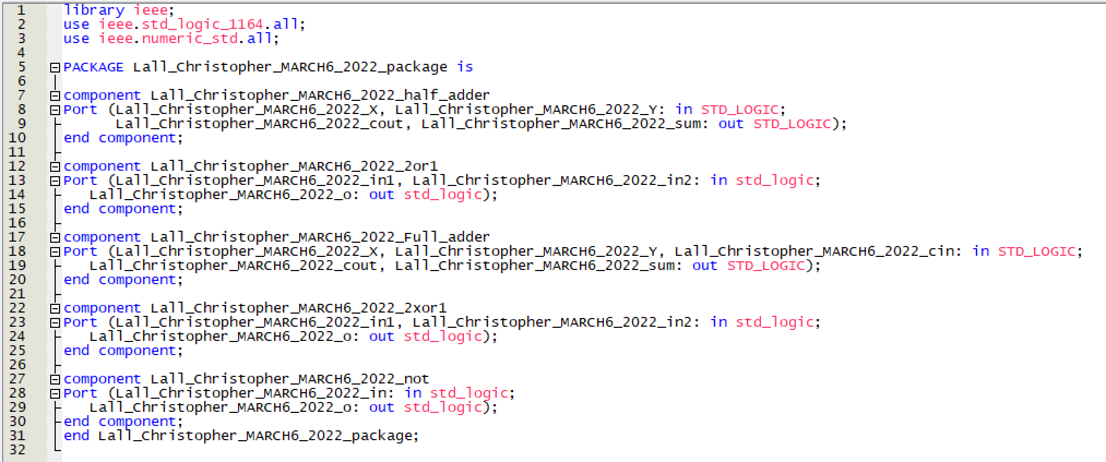
Task 1: continued, 4bit add sub, package on right

Slide 6
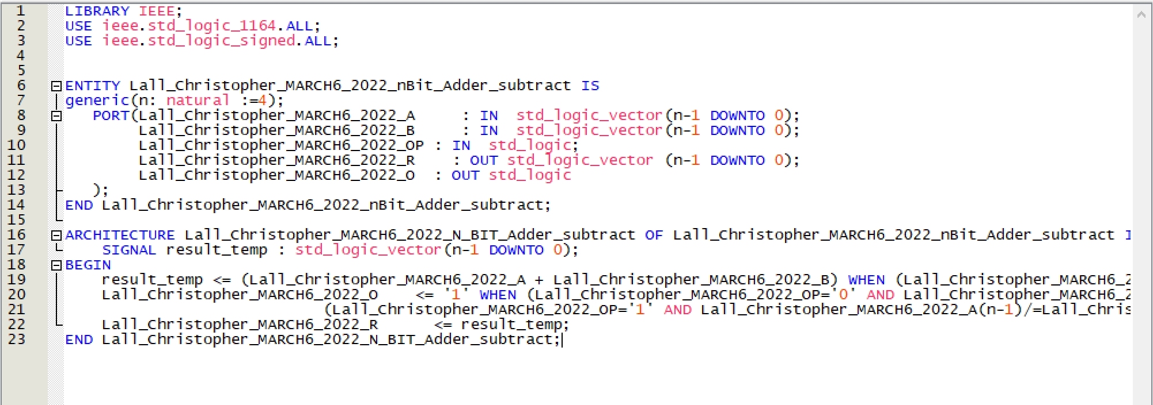
Task 2: VHDL CODES for…. N bit add-sub

Slide 7
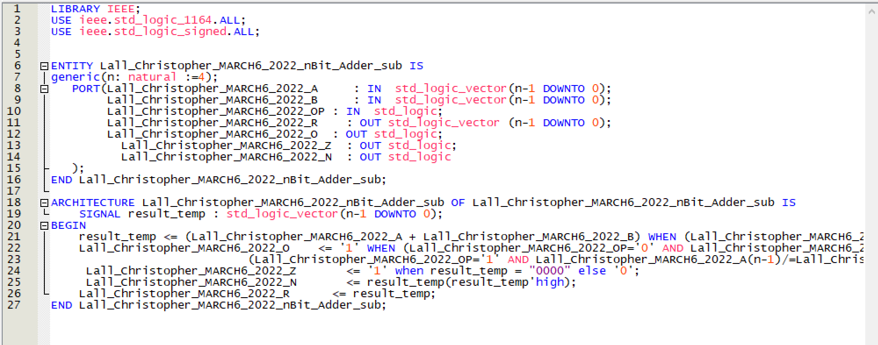
Task 2: continued, nbit add-sub with flags

Slide 8
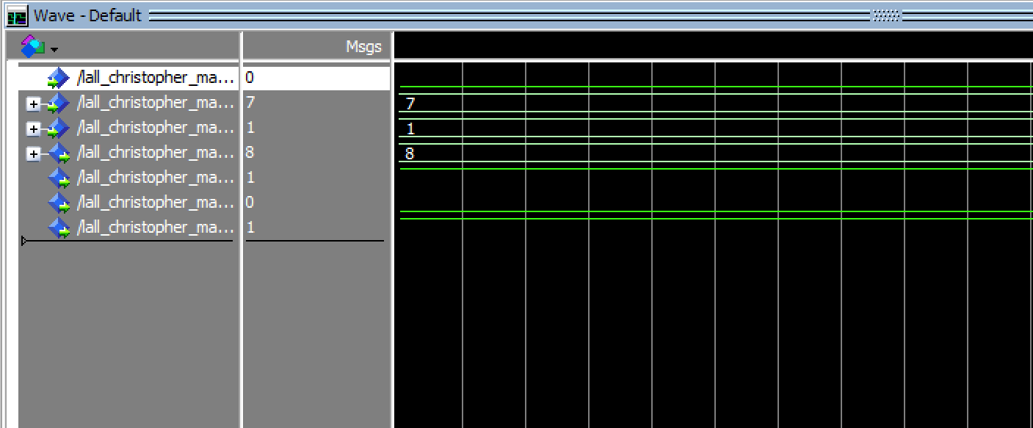
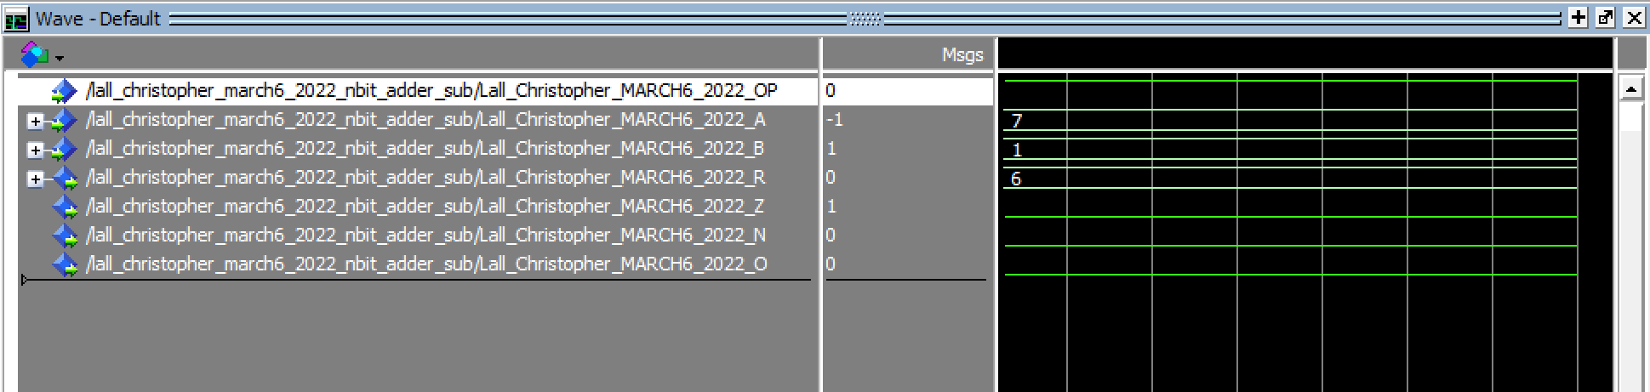
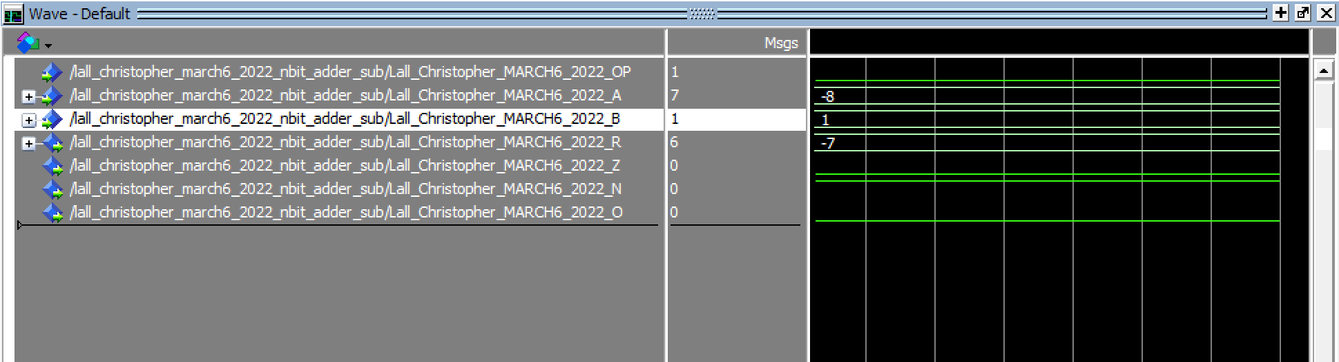
Task 3: Waveforms for nbit add-sub with flags n:4bits. 3a(left), 3b(right), 3c(bottom)

Slide 9
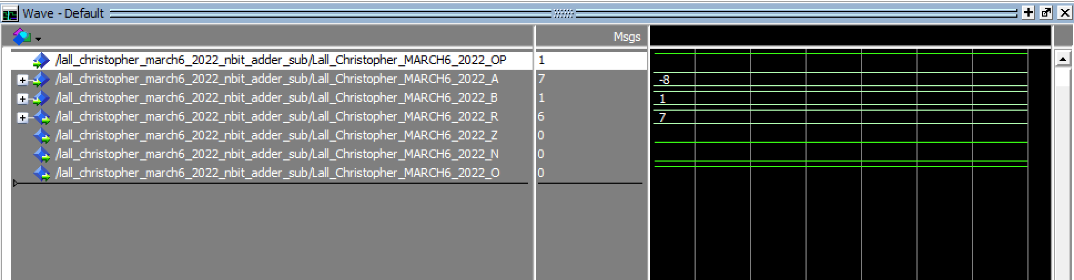
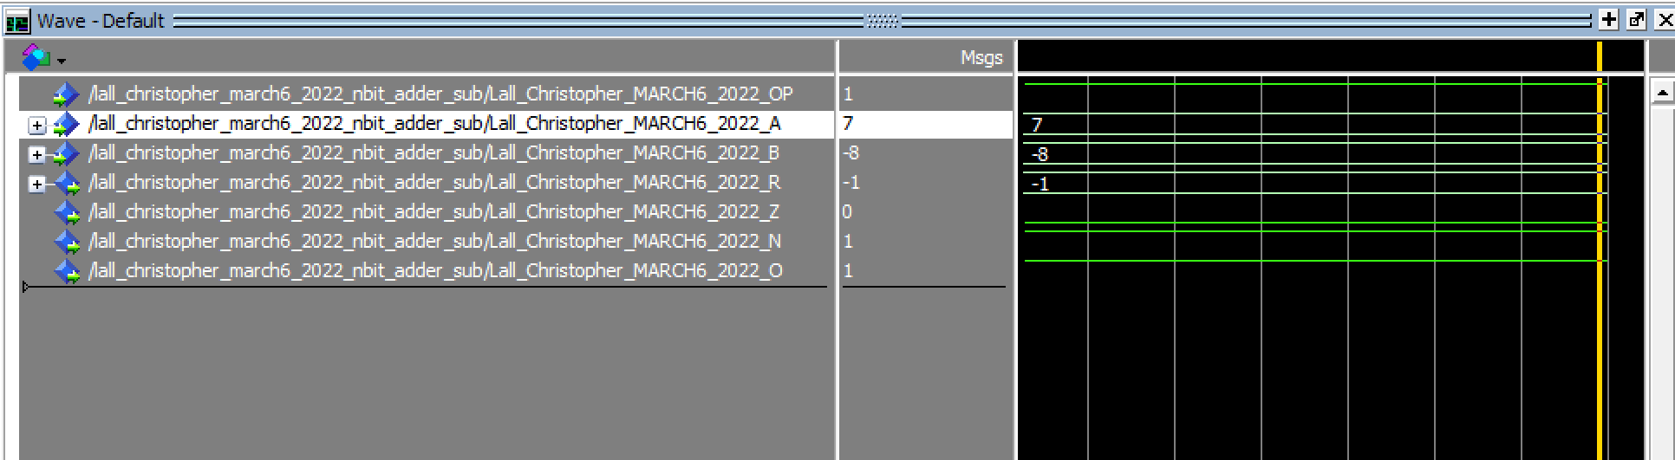
Task 3: continued, 3d(top), 3e(bottom)

Slide 10
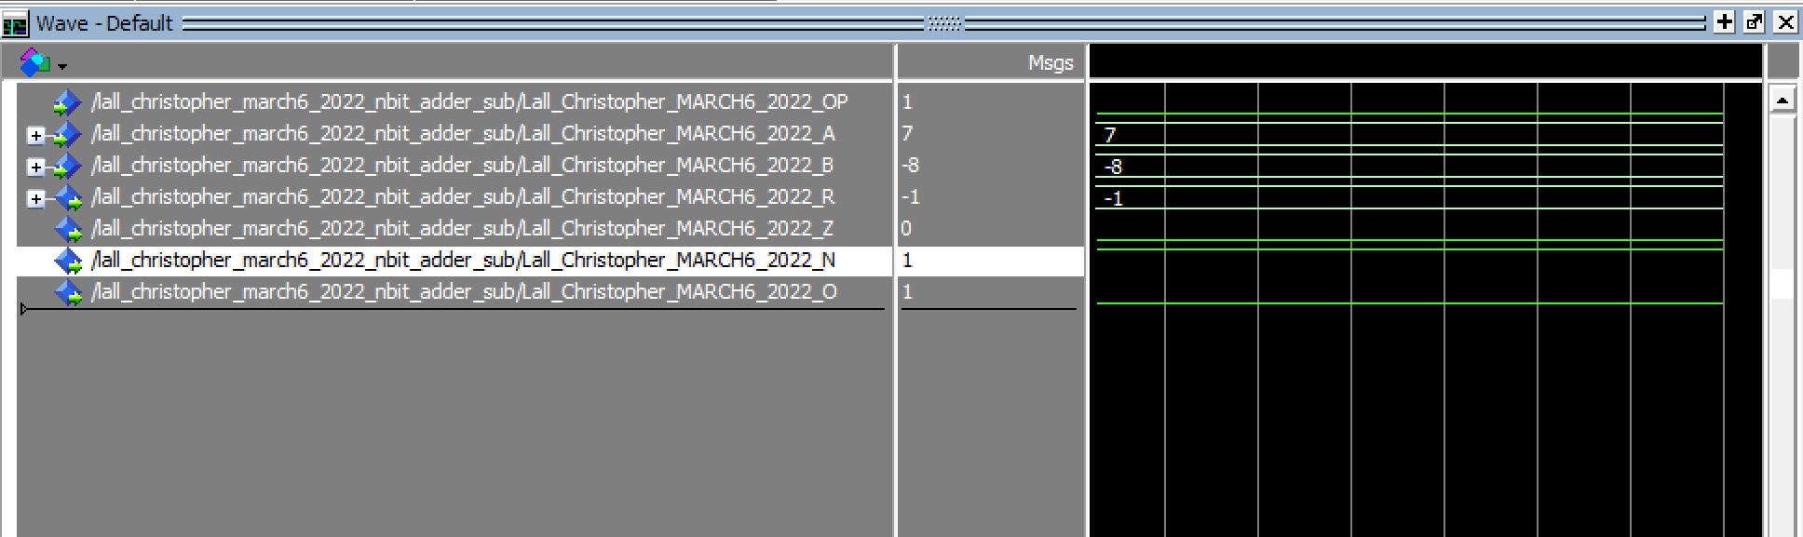

Task 3: continued, 3f(top), 3g(bottom)

Slide 11
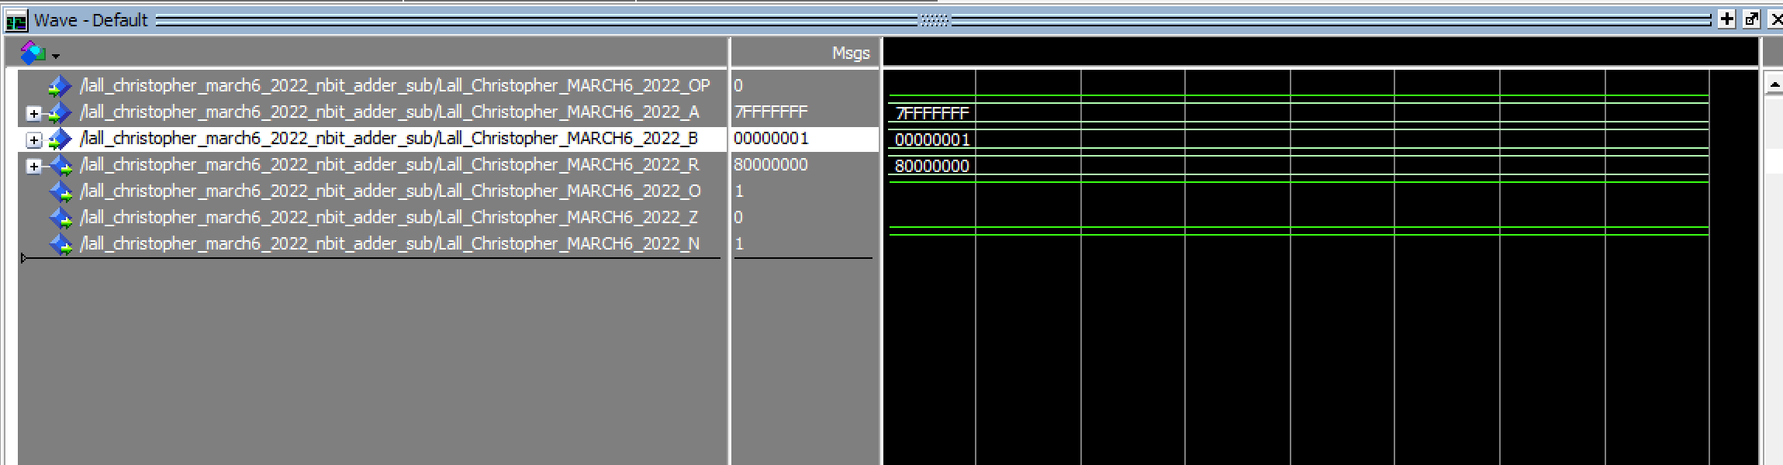
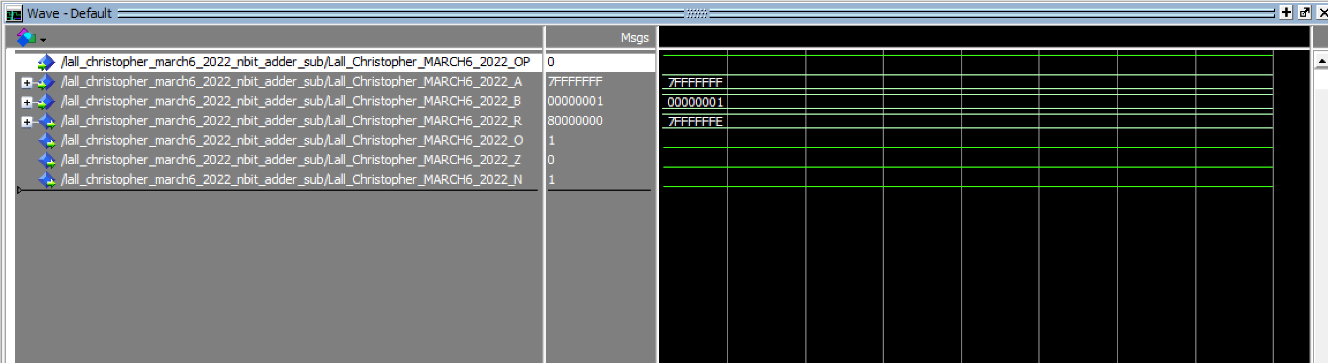
Task 3: n=32bit, 3a(top), 3b(bottom)

Slide 12
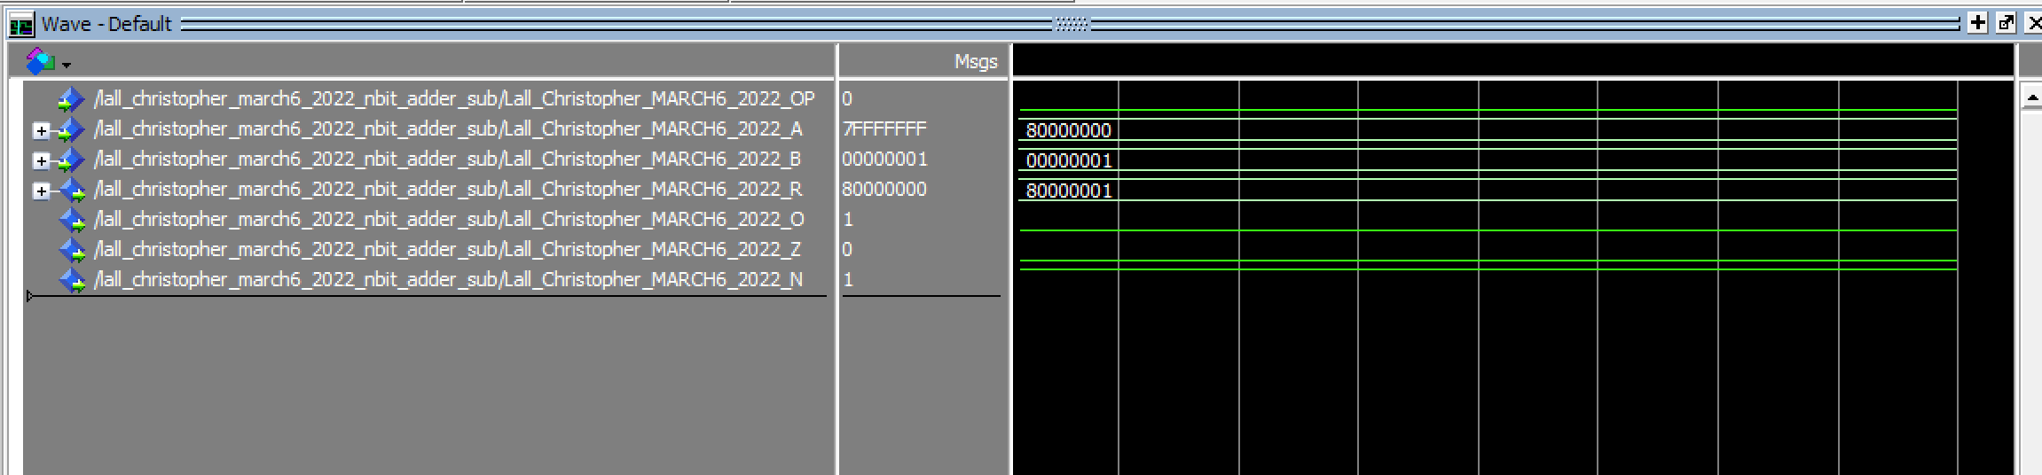

Task 3: continued, 3c(top), 3d(bottom)

Slide 13
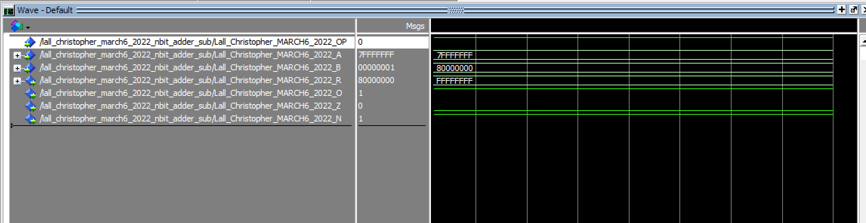
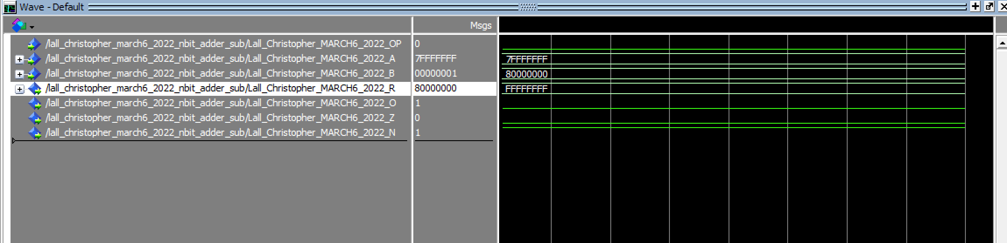
Task 3: continued, 3e(top), 3f(bottom)

Slide 14
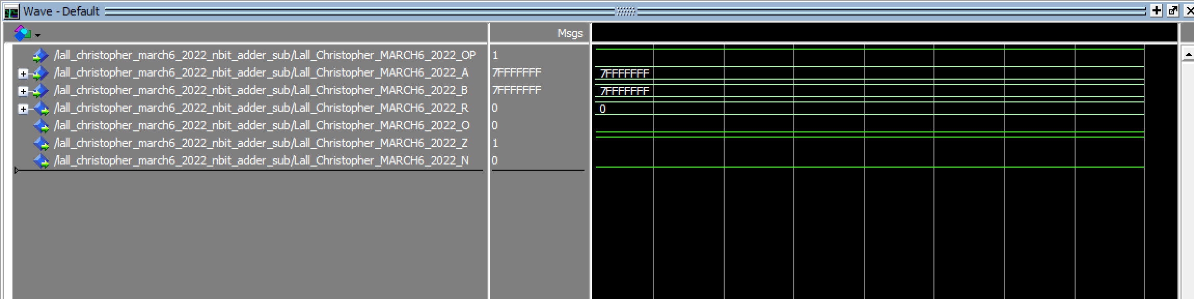
Task 3: continued, 3f

Slide 15
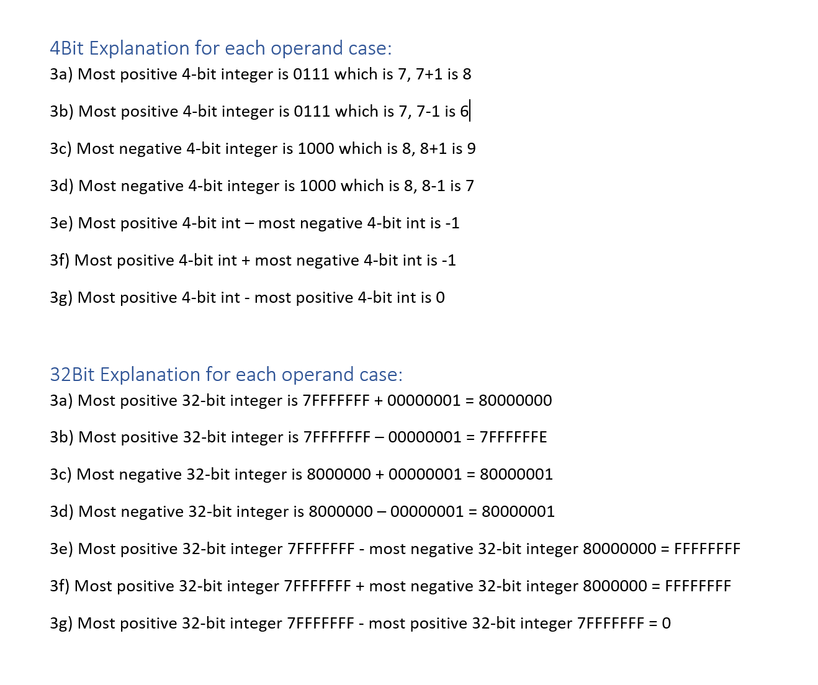
Operand Explanations

Slide 16
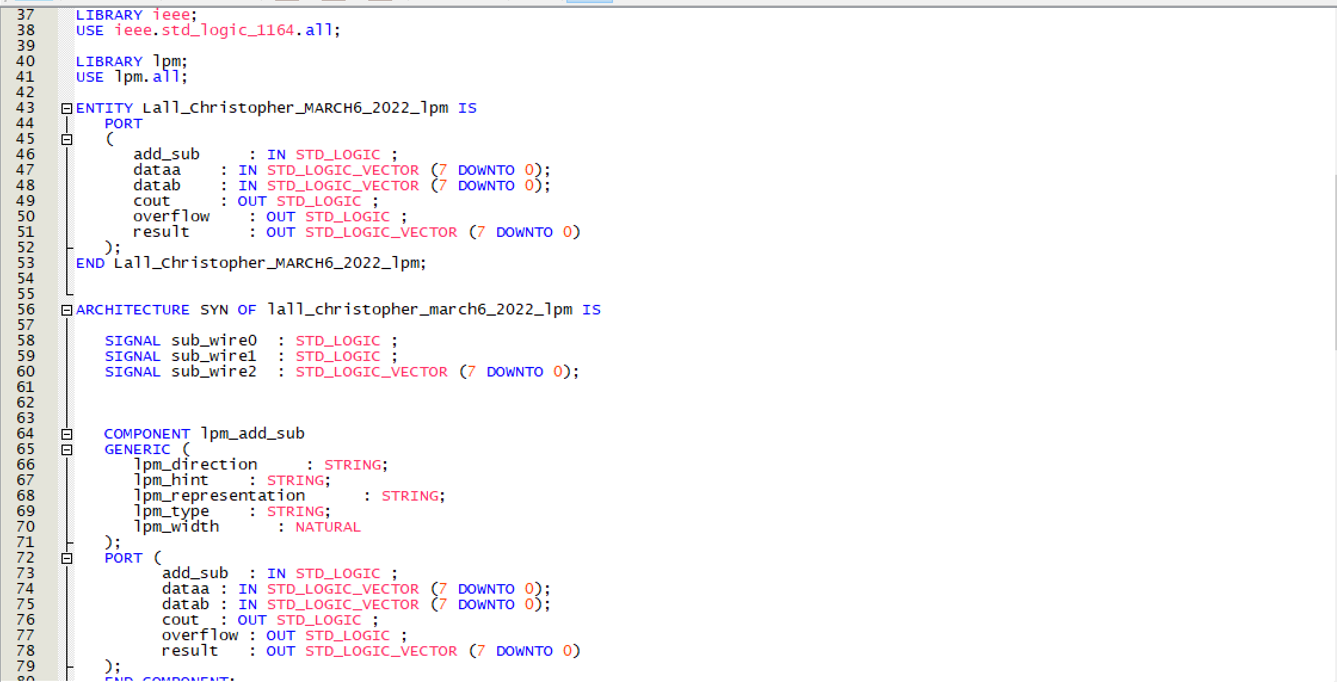
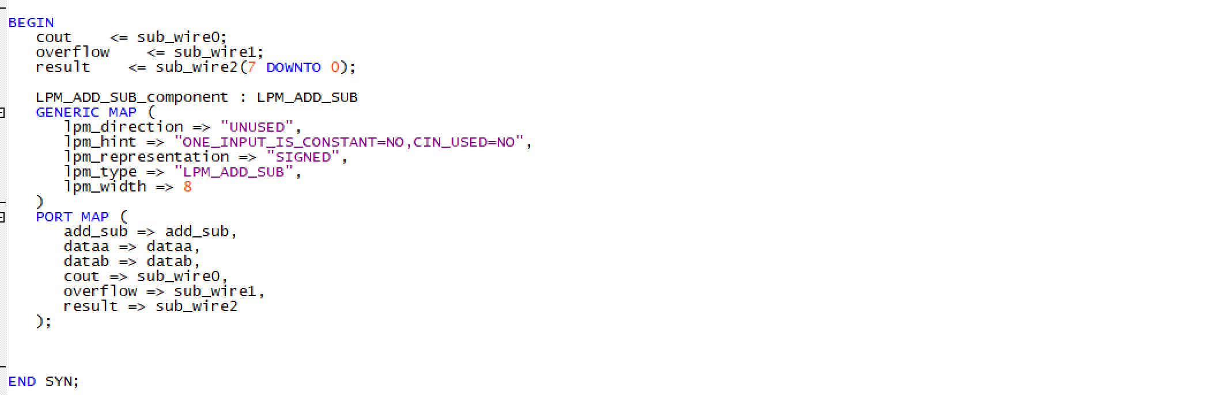
Task 4: lpm add sub VHDL code

Slide 17
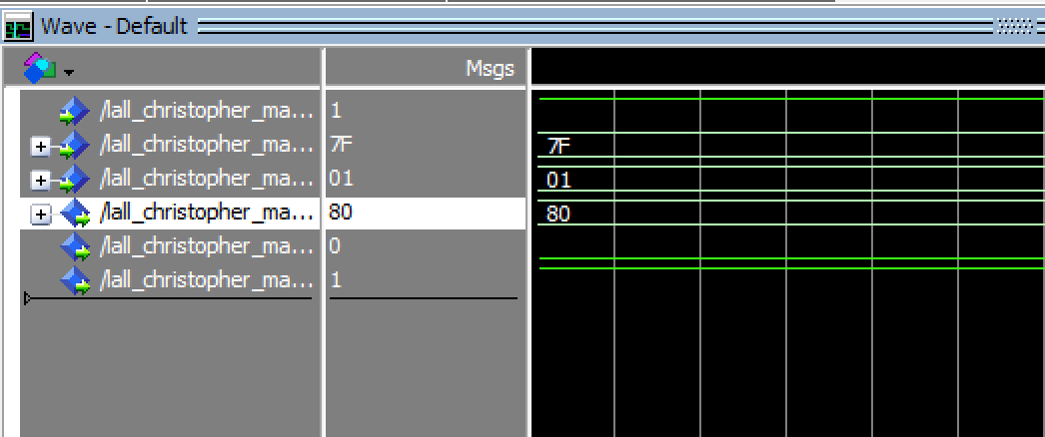
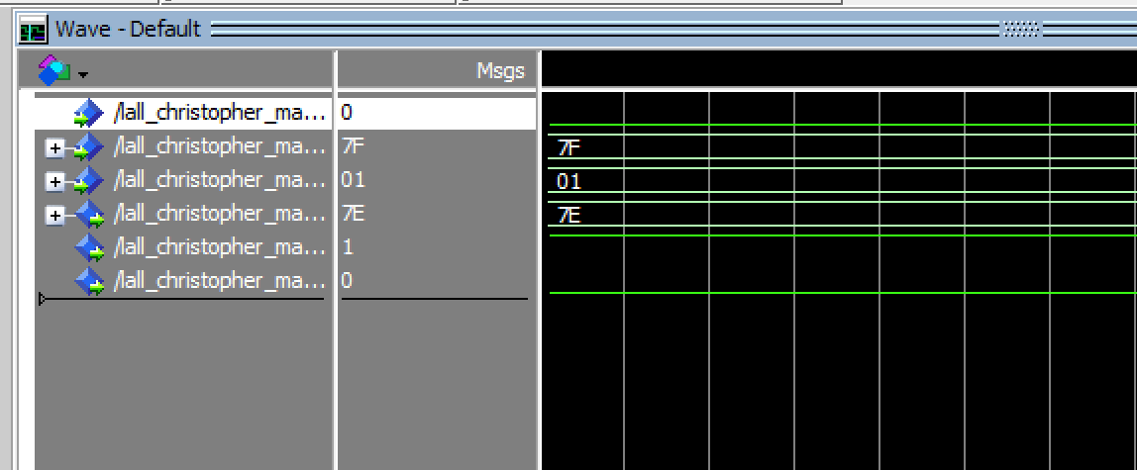
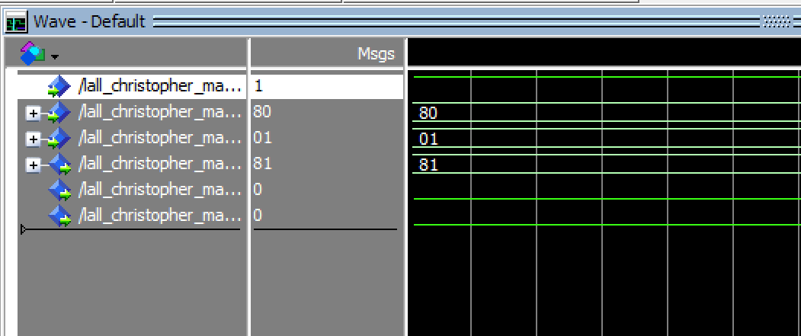
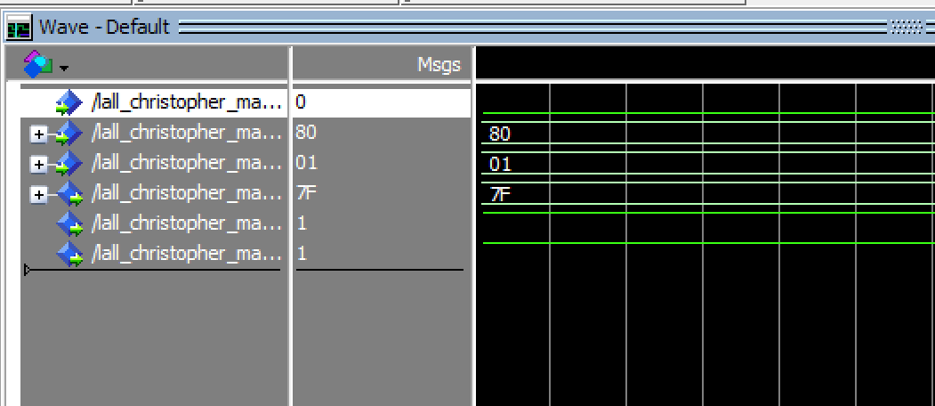
Task 4: continued, operand cases, 3a(top left), 3b(top right), 3c(bottom left), 3d(bottom right)

Slide 18

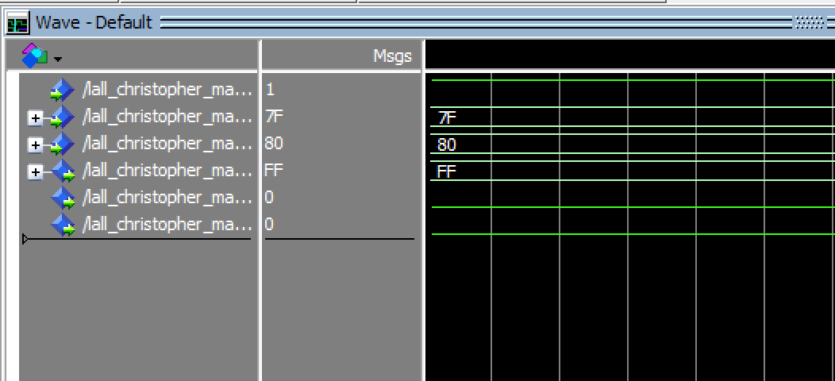
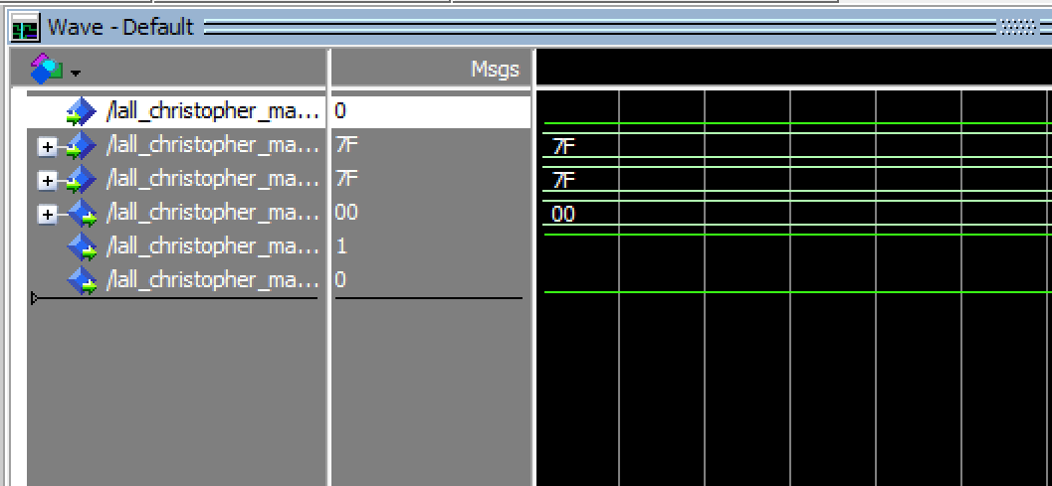
Task 4: continued, 3e(left), 3f(right), 3g(bottom)

Slide 19
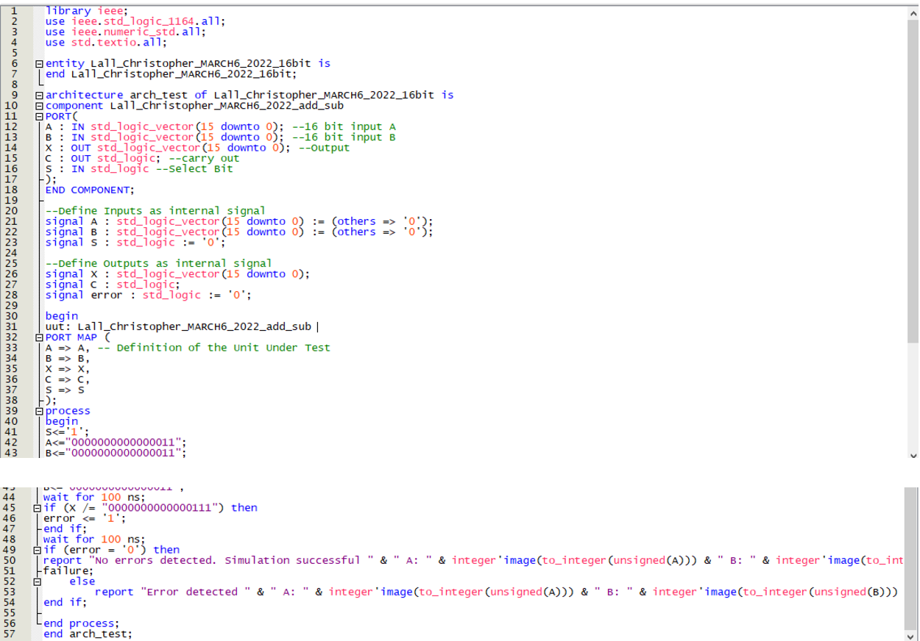
Task 5: Simulation Printouts

Slide 20
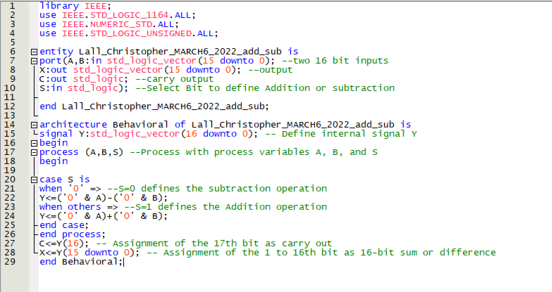
Task 5: Simulation Printouts continued.. Add sub

Slide 21
Task 5: Simulation Printouts continued… fail case(top) success case (bottom)

