Slide 1

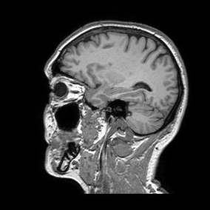
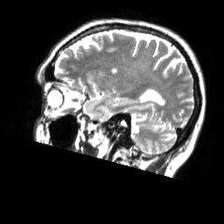
Machine Learning in Medical Imaging SS16
Project Presentation: U-Net Implementation
Claus Meschede, Leonard Rychly
Technische Universität München
Fakultät für Informatik
Chair for Computer Aided Medical Procedures & Augmented Reality
München, July 18, 2016

Slide 2
Outline
Project description
Issues
Results
Summary

Slide 3
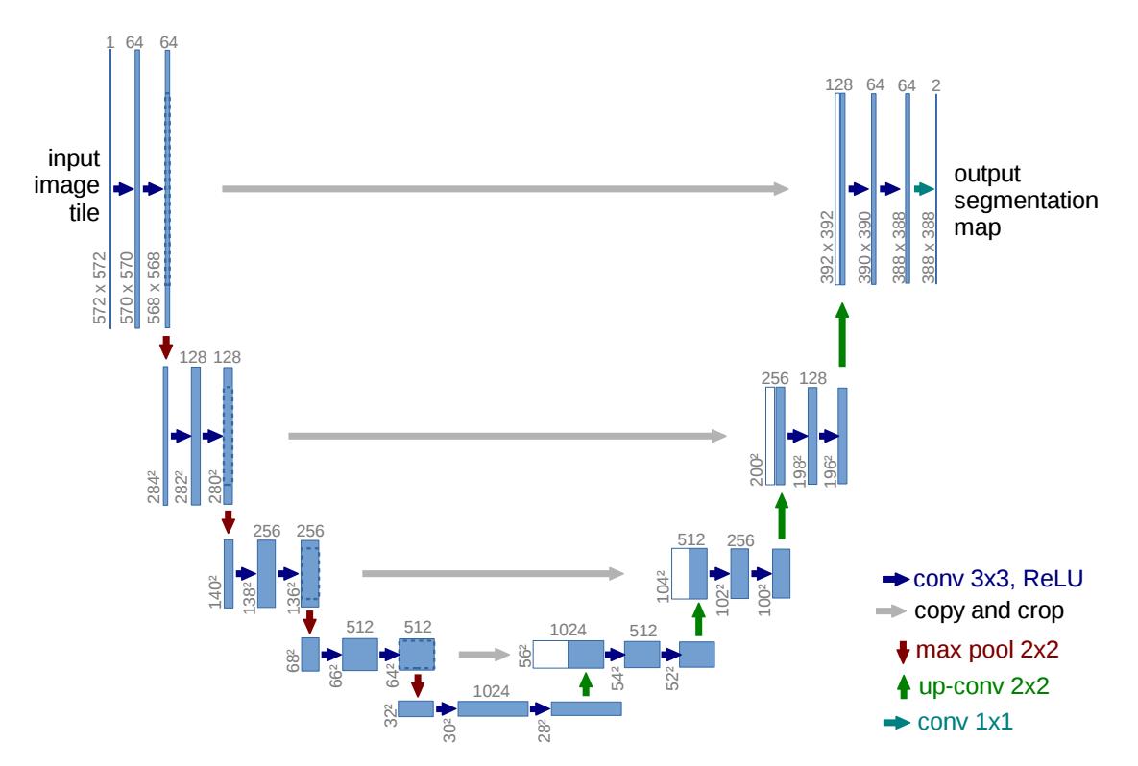
Project description – U-Net I
Main feature: skip connections for reusing finer feature maps.
Used for medical image segmentation.
Ronneberger, Olaf, Philipp Fischer, and Thomas Brox. "U-Net: Convolutional Networks for Biomedical Image Segmentation." Medical Image Computing and Computer-Assisted Intervention–MICCAI 2015. Springer International Publishing, 2015. 234-241.

Slide 4
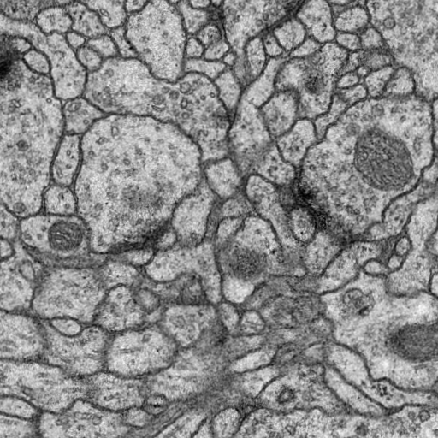
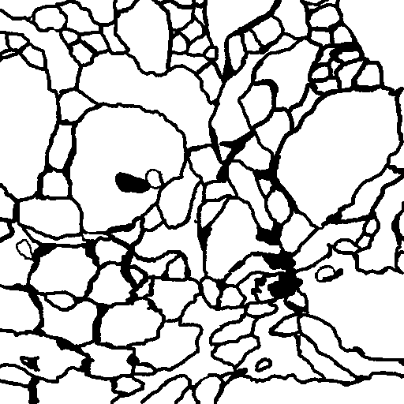
Project description – U-Net II
Main feature: skip connections for reusing finer feature maps.
Used for medical image segmentation.
Ronneberger, Olaf, Philipp Fischer, and Thomas Brox. "U-Net: Convolutional Networks for Biomedical Image Segmentation." Medical Image Computing and Computer-Assisted Intervention–MICCAI 2015. Springer International Publishing, 2015. 234-241.

Slide 5
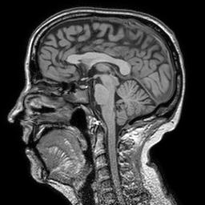
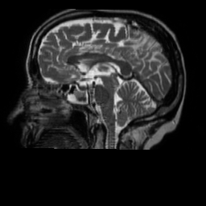
Project description – Idea
Adapt U-Net architecture to predict one modality given another.
Raw volumetric data is available (Brain MRI)

Slide 6
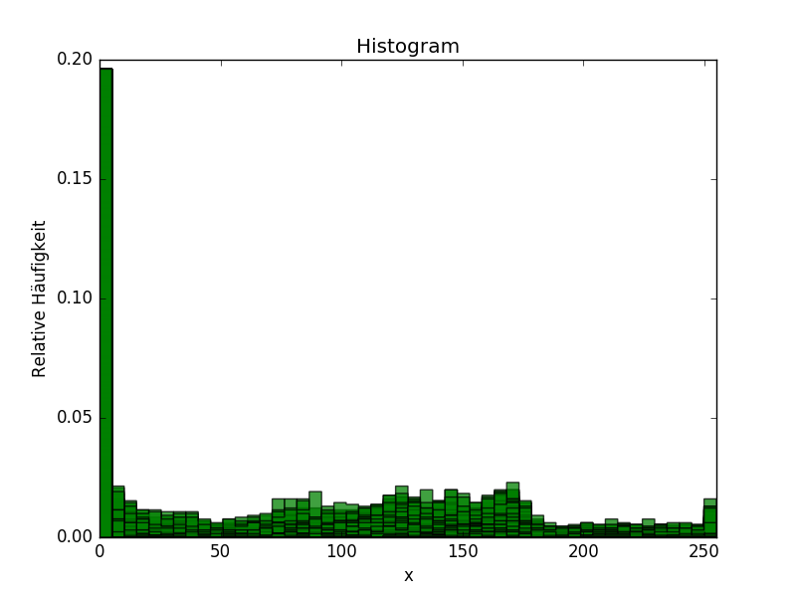
Project description – Image Generation
Generate 2D Images from raw volumetric data.
Normalize gray scale images.

Slide 7
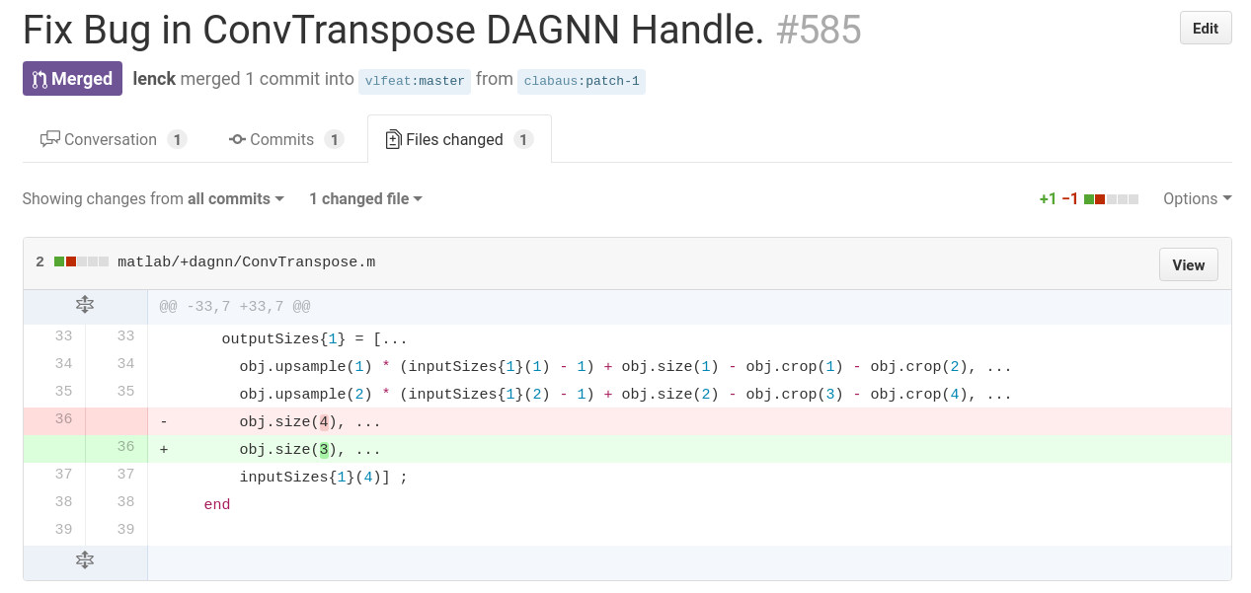
Issues – Transposed Convolution Bug

Slide 8
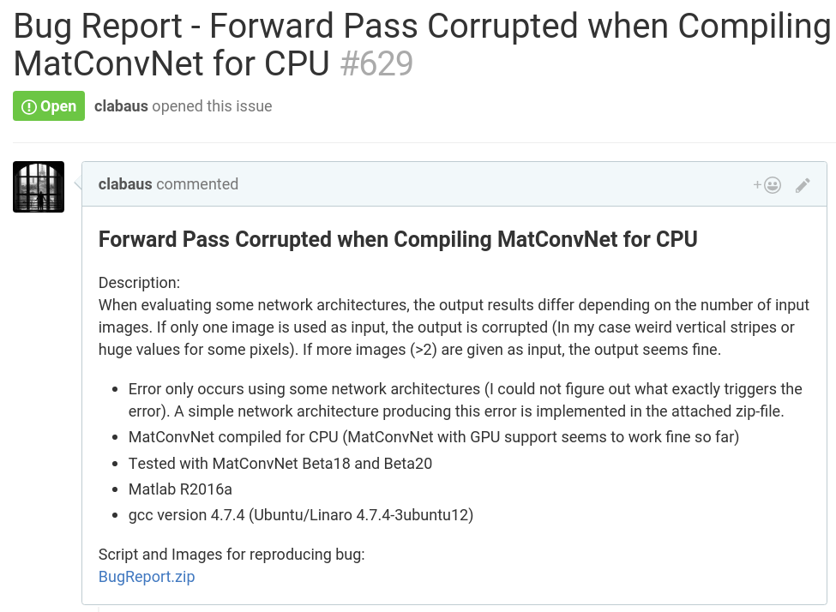
Issues – Forward Pass Bug

Slide 9
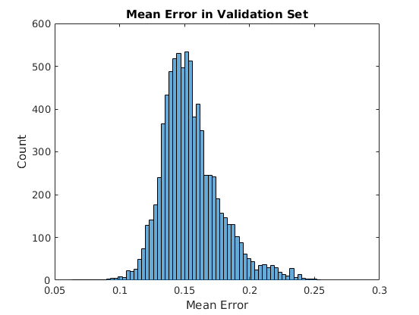
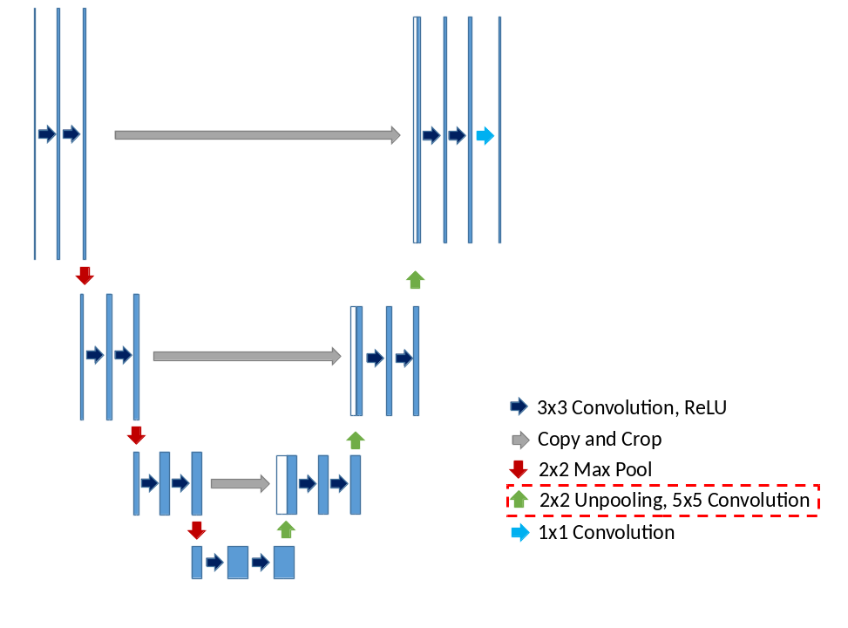
Results – U-Net with Unpooling I
Training parameters:
# of images: 8000
# of epochs: 22
Learning rate: 1e-7
Weight decay: 0.01
Momentum: 0.9

Slide 10
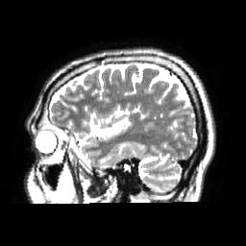
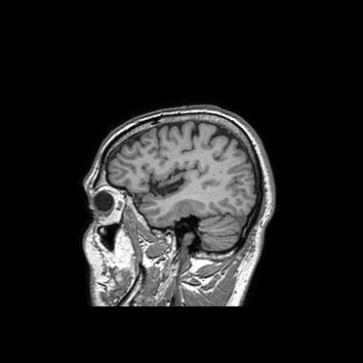
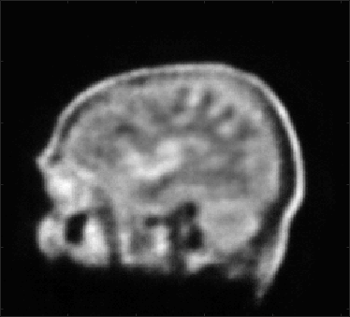
Results – U-Net with Unpooling II
Target Image
Test Image
Output Image

Slide 11
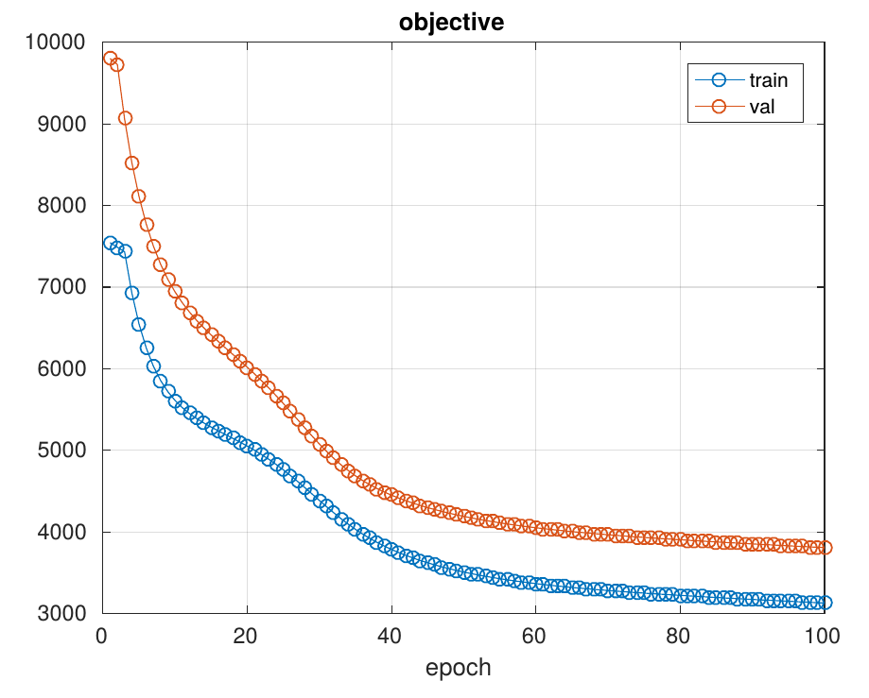
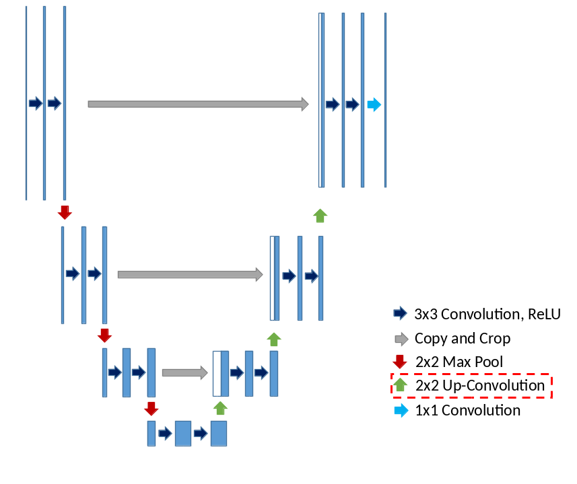
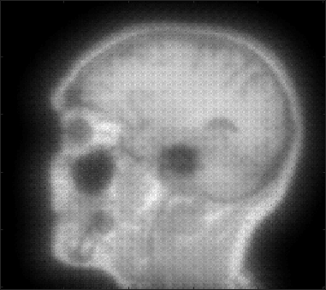
Results – U-Net with Up-Convolutions
# of images: 15
Example Output
Not trained with all available images yet!

Slide 12
Summary I
What we have learned:
  Using state-of-the-art software in development can be cumbersome:
    → Importance of systematic troubleshooting
  MatConvNet Framework
  Implementing and training CNNs
  Optimize learning parameters

Slide 13
Summary II
What we have learned:
  Using state-of-the-art software in development can be cumbersome:
    → Importance of systematic troubleshooting
  MatConvNet Framework
  Implementing and training CNNs
  Optimize learning parameters
Conclusion:
  U-Net capable of roughly predicting the target modality.
  Further testing needed for performance evaluation …
    Larger training set
    Up-Convolutions ↔ Unpooling
    Increasing depth of U-Net
    Convolutions using padding
    Adapt input images to output shape
  → Compare performance of U-Net with other CNNs

