Slide 1

Sprint 2
Sean Bassi, ali Canturk, Braden elsworth, Quinn johnson, jason mele, Lucas Polo

Slide 2
Product Backlog Item | Acceptance Criteria | Done/Partially Done/Not Done
1. Access current stock prices | Stock prices (with historical data) come from an API and are displayed in a graph | Done
2, 32. Track specific stocks and shares owned | User saves stocks to track and enters how many shares they own; dividends count as income | Partially Done
33. Create an account and log in | A user creation screen creates a new account, and a login screen logs into it | Done
14. Categorize my incomes, assets and expenses | Each income, asset and expense falls into a specific category that is displayed | Done
9. See my current net worth | Assets and income are added, expenses subtracted, and the result is prominently displayed | Done

Slide 3
Product Backlog Item | Acceptance Criteria | Done/Partially Done/Not Done
28. Run simulations based on different outcomes | User can affect the simulation with different market profiles. | Done
11. See what percentage of my net worth each item is | Pie chart with a slice per income and asset, hovering shows details | Partially Done
10. Toggle incomes, assets and expenses on and off | Toggling items changes the displayed net worth and graphs | Partially Done
7. Search my incomes, assets and expenses | User can search incomes, assets and expenses by name or data range | Partially done
21. Have a secure website | Strict password requirements and encrypted financial data | Partially Done

Slide 4
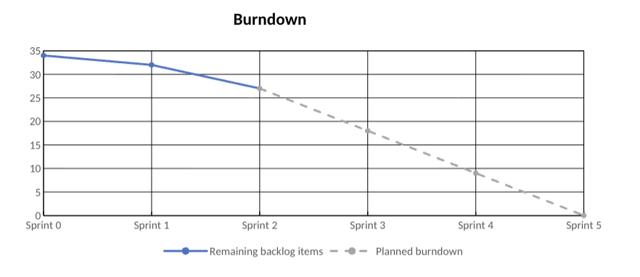
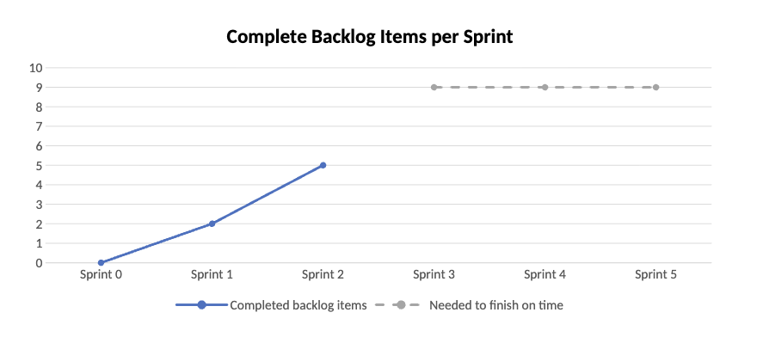
Product Backlog Items Complete: 7
Remaining PBI: 26
Average PBI/Sprint: 3.5; 9 needed for the next sprints
# of Sprints Required to Complete: 5
Duration of Sprints: 2 Weeks
Estimate to Complete: 6 Weeks
# of Sprints Remaining: 3

Slide 5

Progress & Features
Visual
Overview

Slide 6
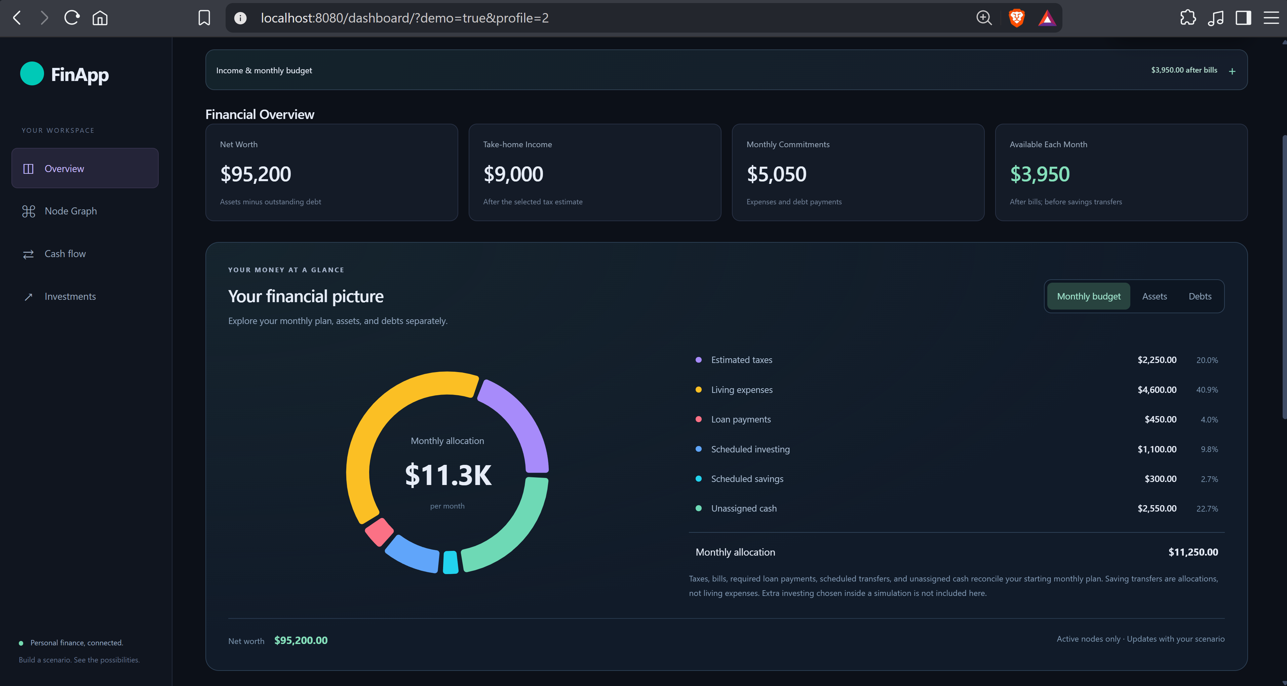

Slide 7
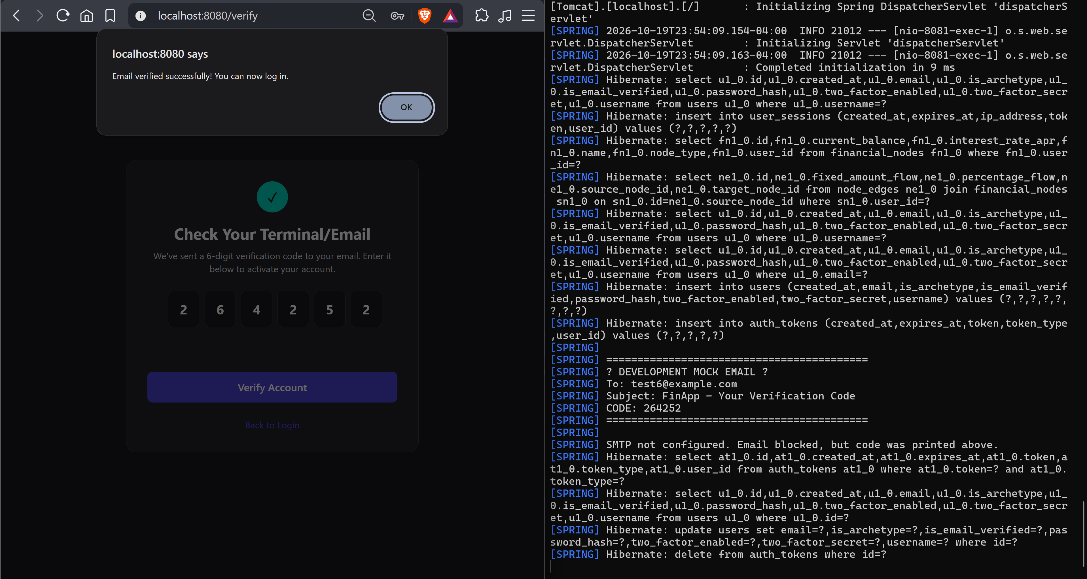

Slide 8
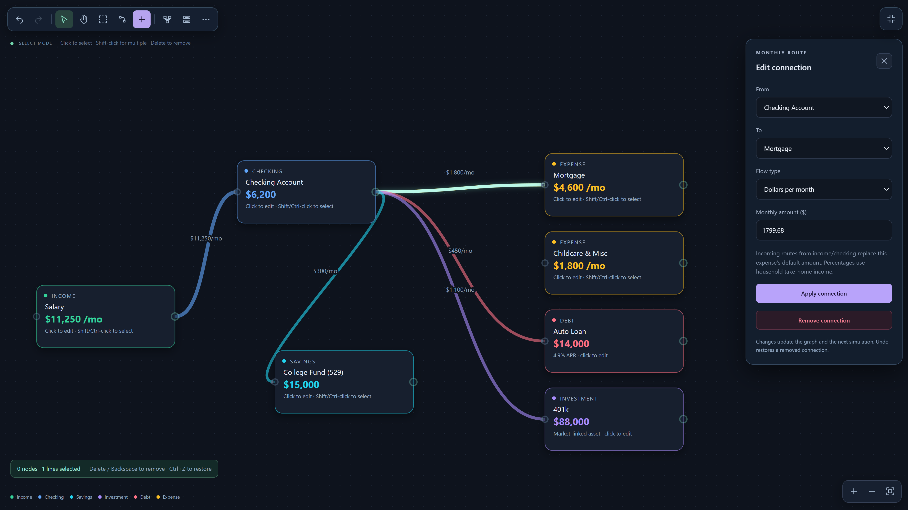

Slide 9
