Slide 1

Sprint 1
Sean Bassi, Ali Canturk, Braden Elsworth, Quinn Johnson, Jason Mele, Lucas Polo

Slide 2
Product Backlog Item | Acceptance Criteria | Done/Partially Done/Not Done
1. Access current stock prices | Stock prices (with historical data) come from an API and are displayed in a graph | Partially Done
25. Run simulations with my financial information | A Monte Carlo simulation runs over possible outcomes and returns the result | Done
3, 5, 6. Track assets, income streams and expenses | User can enter assets with estimated value, recurring income, and recurring or one-off expenses | Partially Done
33. Create an account and log in | A user creation screen creates a new account, and a login screen logs into it | Partially Done
24. AI analyzes my finances and gives suggestions | An AI chatbot reads the user’s financial information and gives relevant suggestions | Not Done

Slide 3
Product Backlog Item | Acceptance Criteria | Done/Partially Done/Not Done
14. Categorize my different incomes, assets and expenses | We generate node graphs for income, assets and expenses that fall into a specific category and display them as a node diagram | Partially Done
19. Change the theme of the website | We have multiple website themes and change them based on user input, remembering their last choice | Done
21. Have a secure website | We have strict password requirements and we encrypt any financial data | Not Done
7. Track and manage various expenses | We allow the user to search their incomes, assets and expenses by name | Partially Done
26. Track my simulation runs over time | An AI chatbot reads the user’s financial information and gives relevant suggestions | Not Done

Slide 4
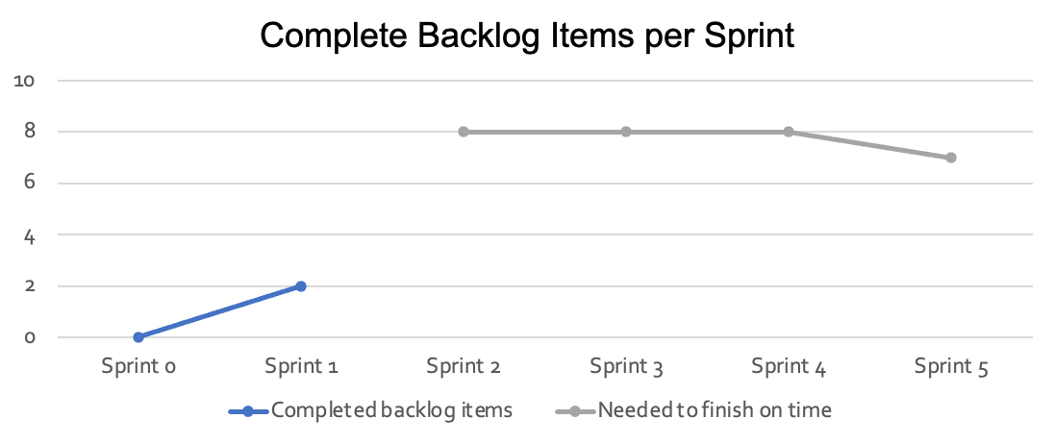
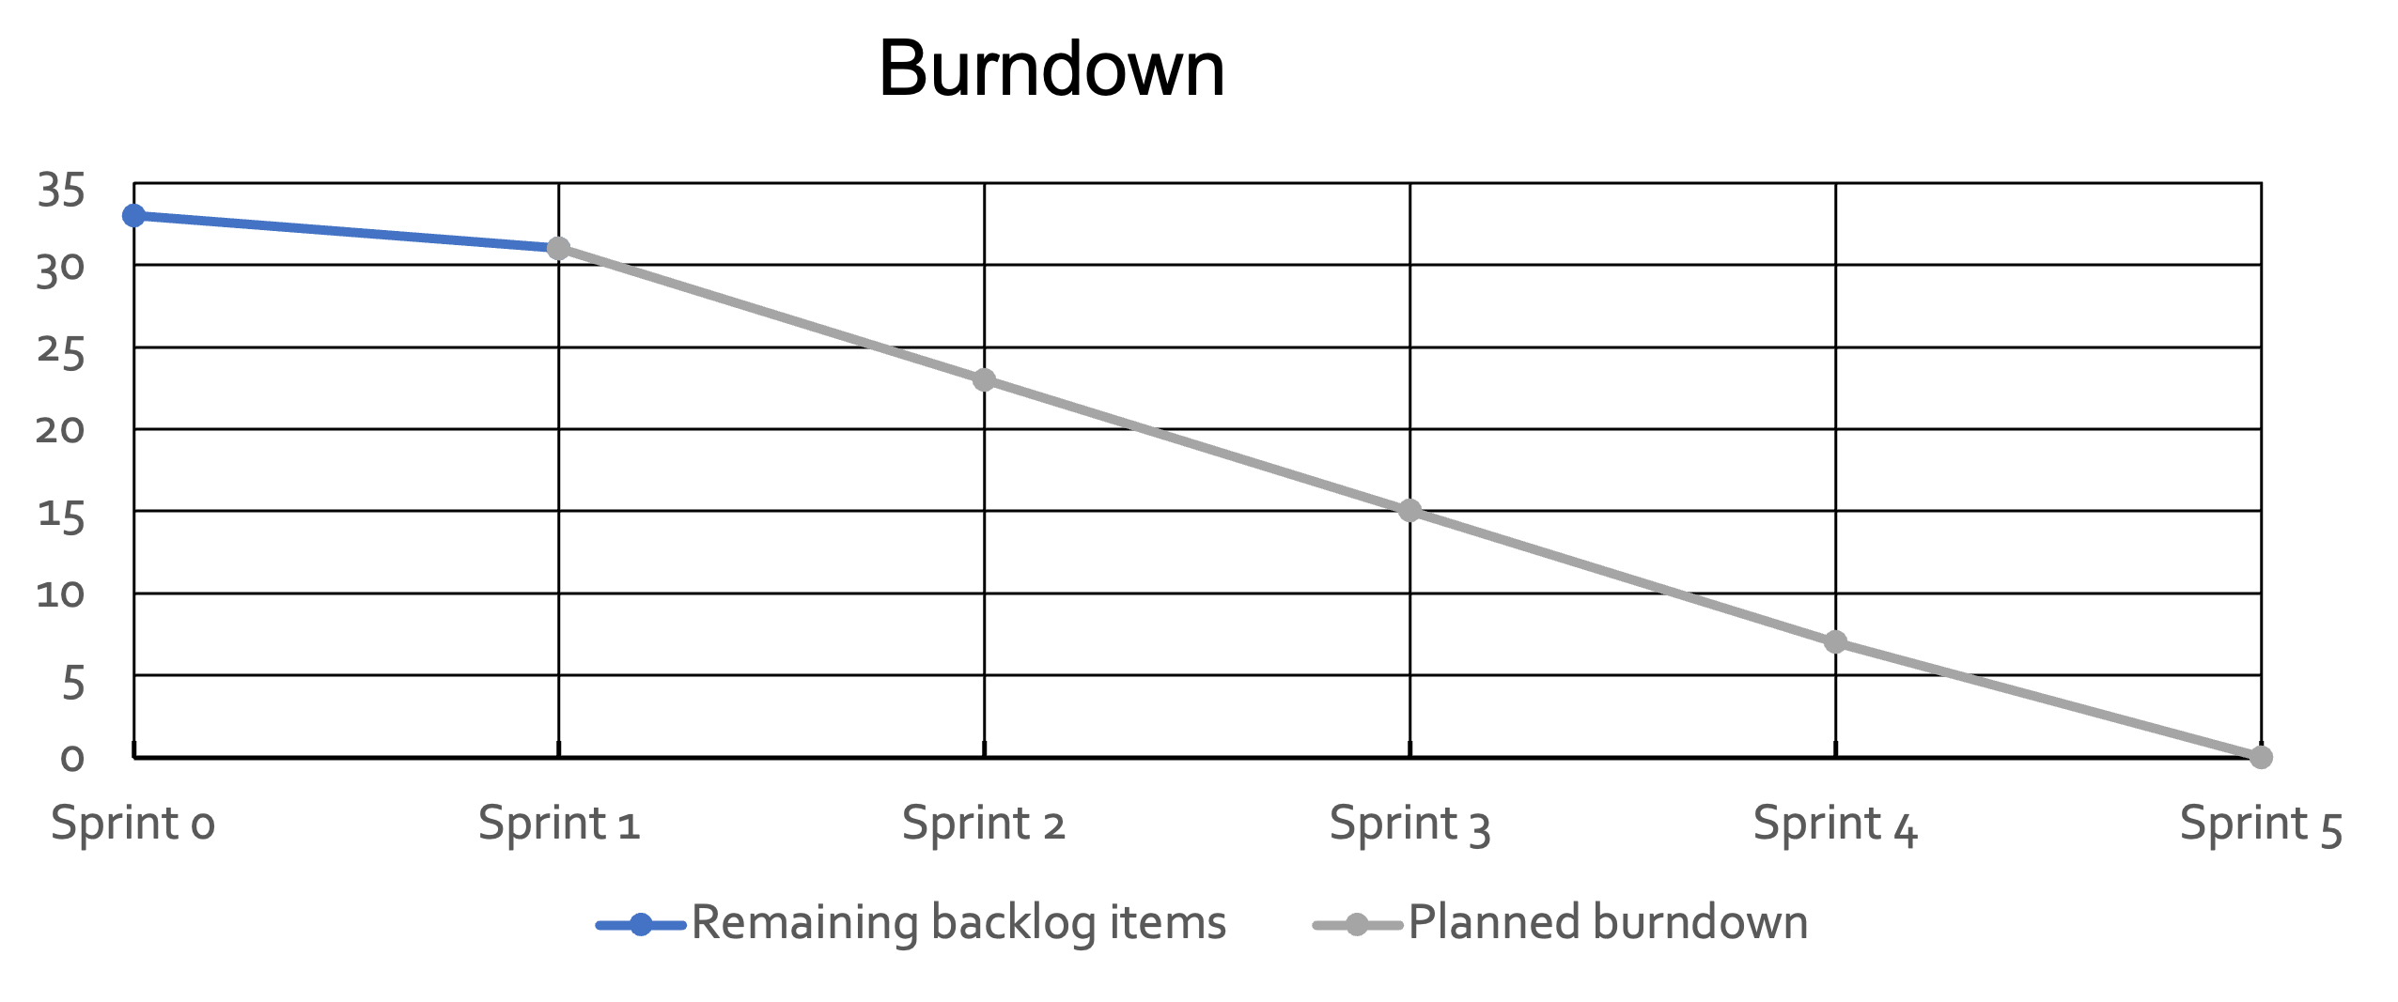
Product Backlog Items (PBI) Complete: 2
Remaining PBI : 31
Average PBI / Sprint: 8
# of Sprints Required to Complete: 6
Duration of Sprints: 2 Weeks
Estimate to Complete: 8 Weeks
# of Sprints remaining: 4

Slide 5
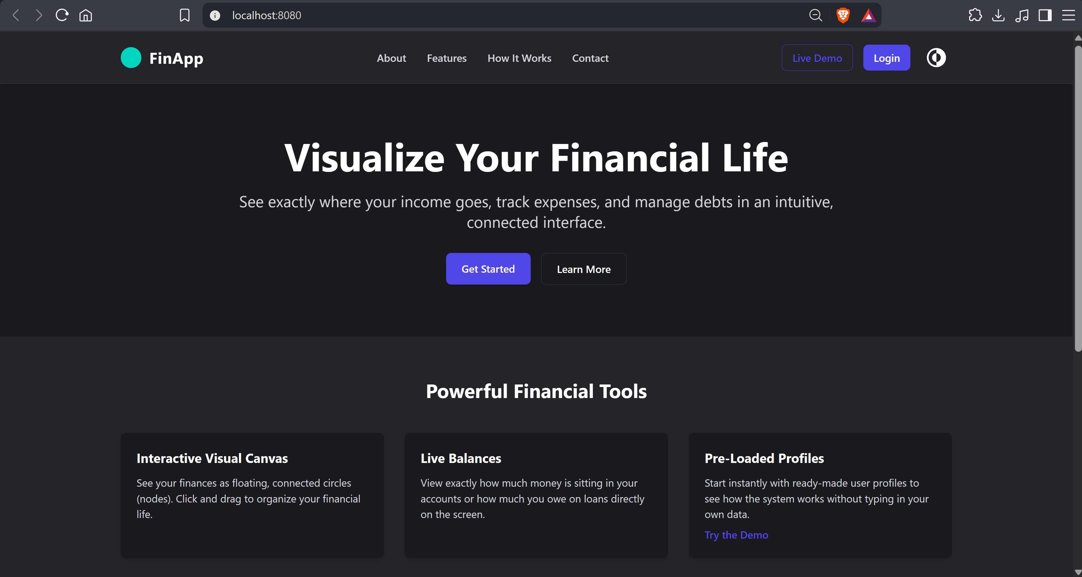
Product Overview

Slide 6
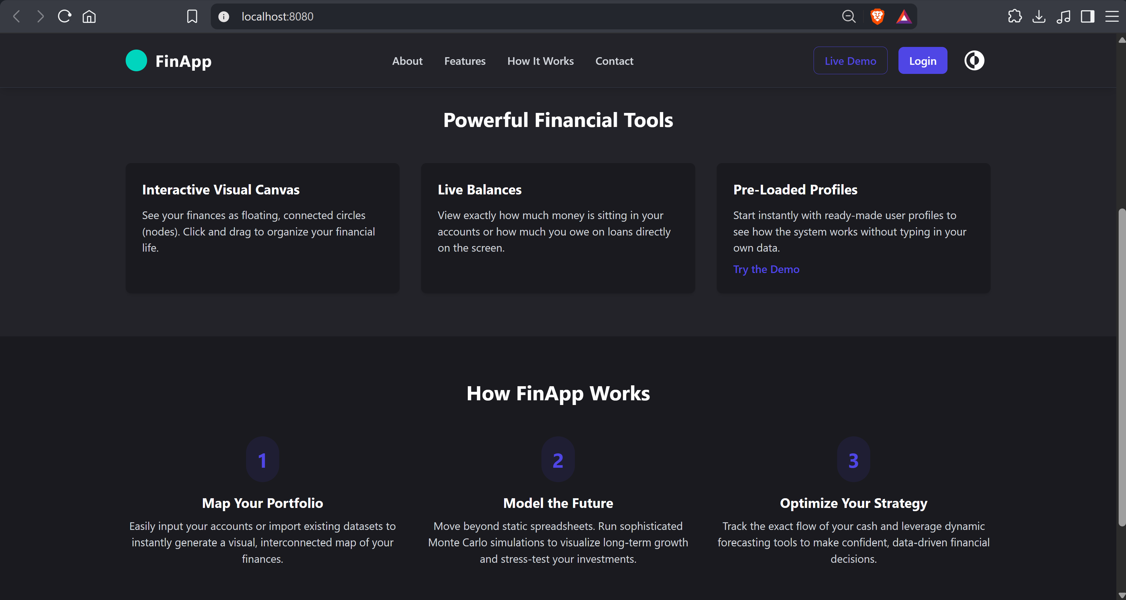

Slide 7
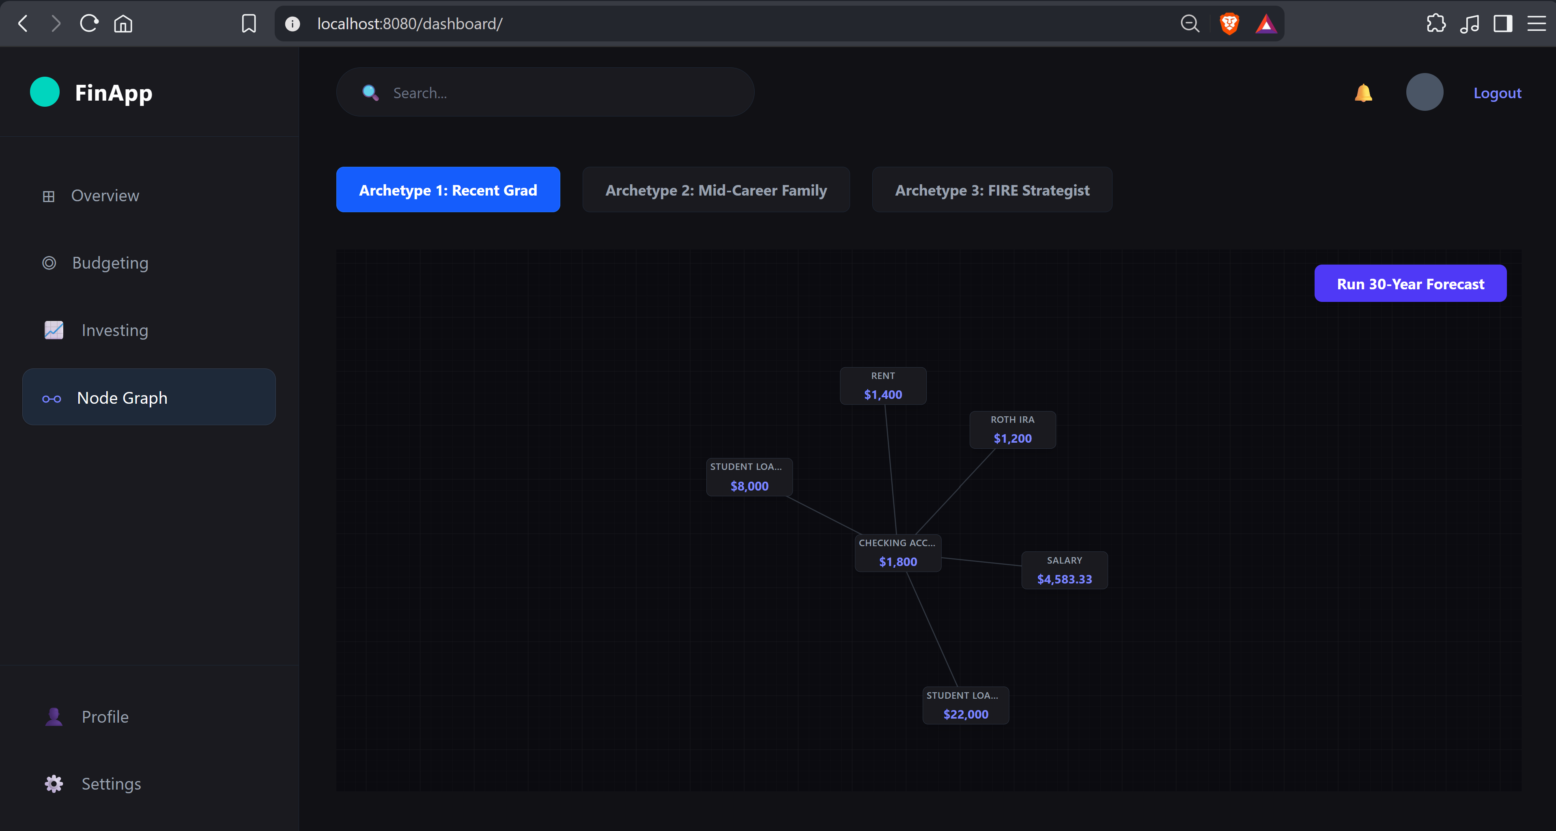

Slide 8
