Slide 1
Analyzing Glassdoor Job Postings for Top Data Science Skills
Clancey Barrington
Stat 694 project

Slide 2
Motivation
I’m graduating in Spring 2021!
What salary should I expect?
What skills do companies want?
What skills should I learn?

Slide 3
Data
Glassdoor job postings
Web scraped July 2020
Includes Business Analyst, Data Analyst, Data Engineer, and Data Scientist job postings
Includes job title, job description, salary estimate, location, etc.
12,576 job postings

Slide 4
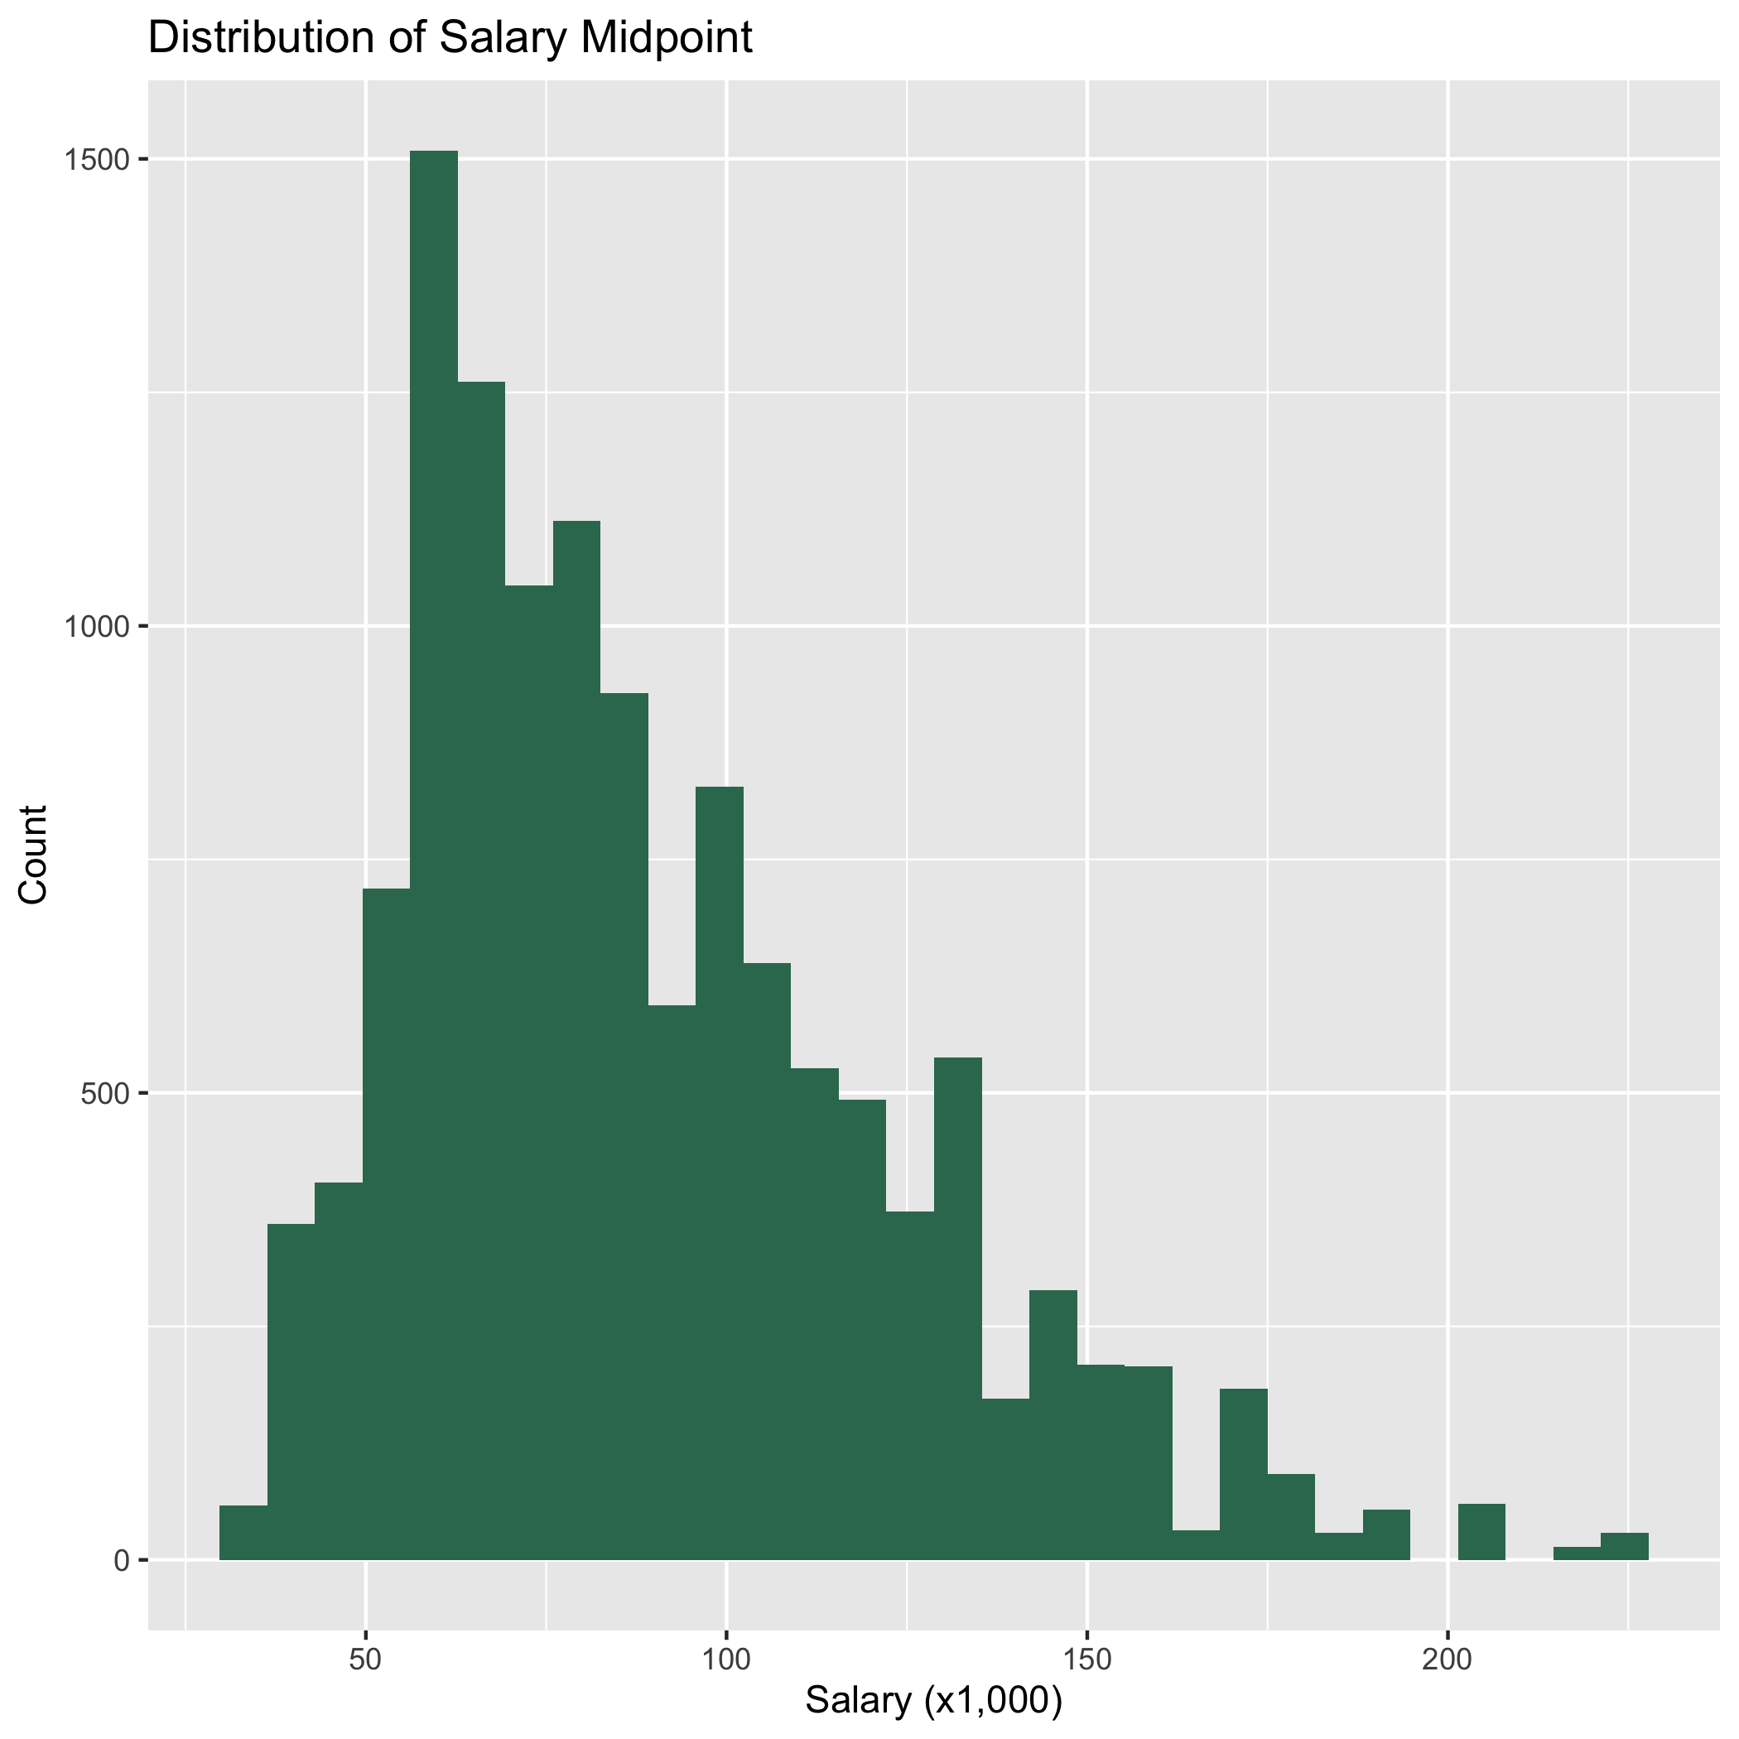
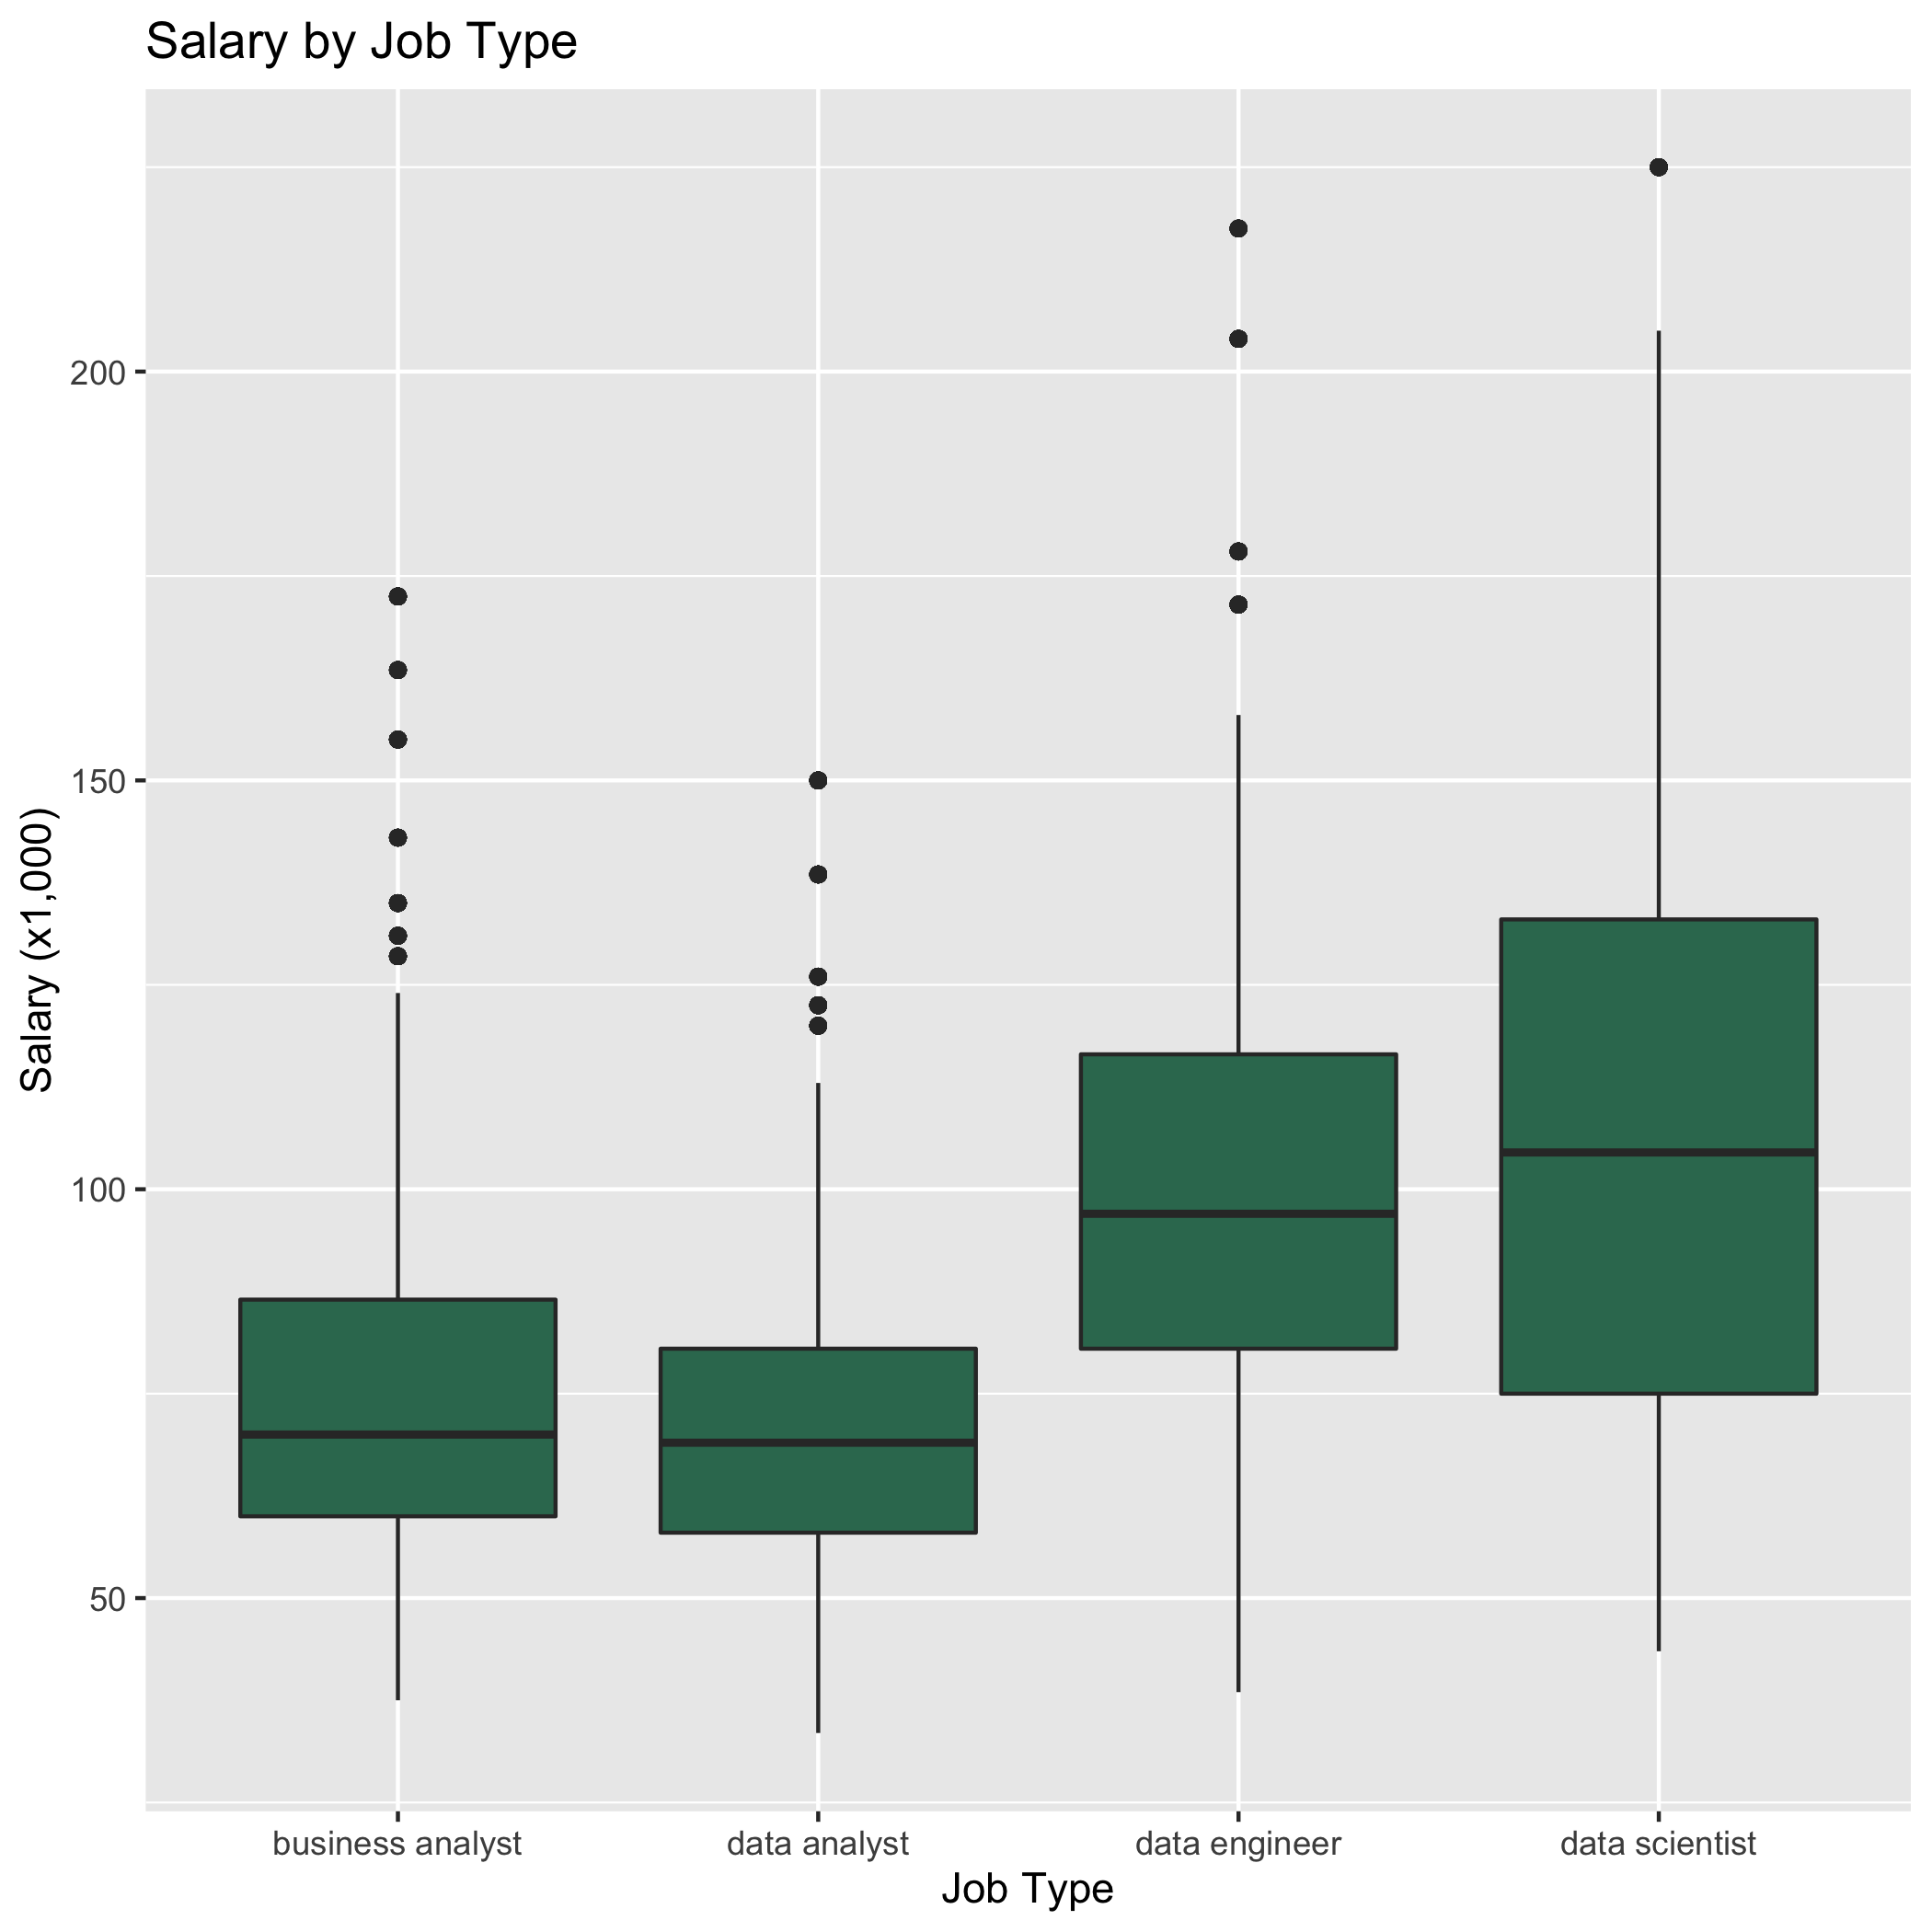
Salary Distribution and Boxplots

Slide 5
Salary in California
Job | Min Salary | Median Salary | Mean Salary | Max Salary
Business Analyst | $46,000 | $91,000 | $93,730 | $172,500
Data Analyst | $40,000 | $80,500 | $88,432 | $150,000
Data Engineer | $69,000 | $128,500 | $127,618 | $204,000
Data Scientist | $53,000 | $143,000 | $133,371 | $225,000

Slide 6
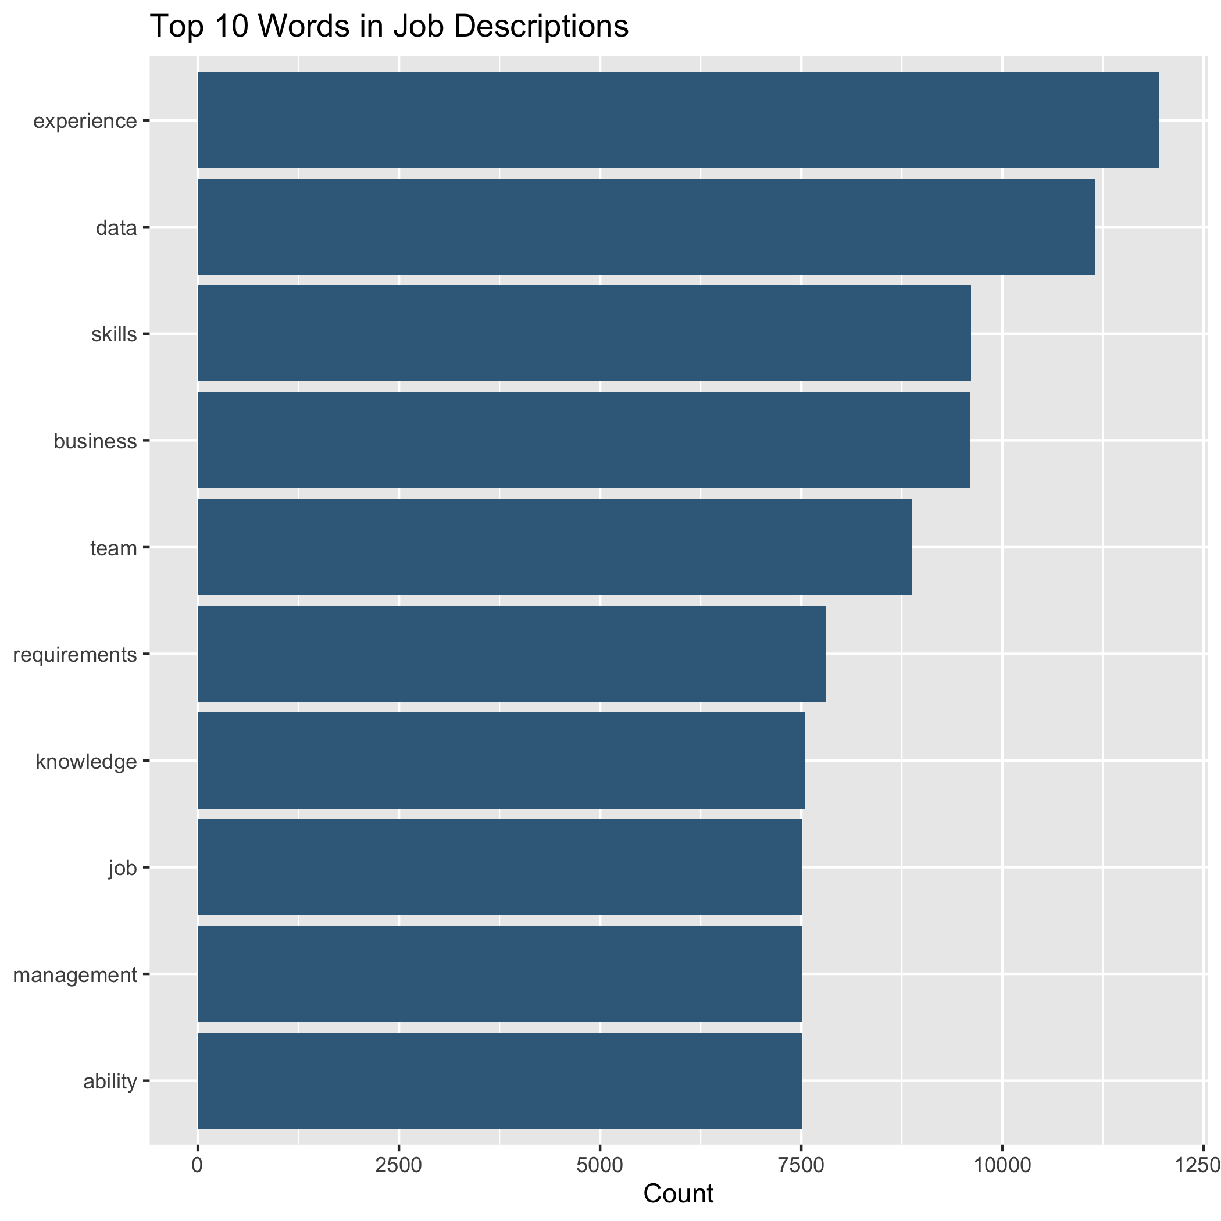
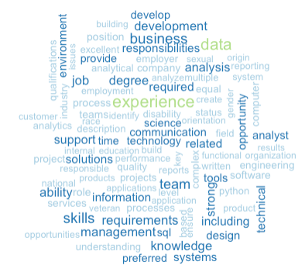
Most used words in job description

Slide 7
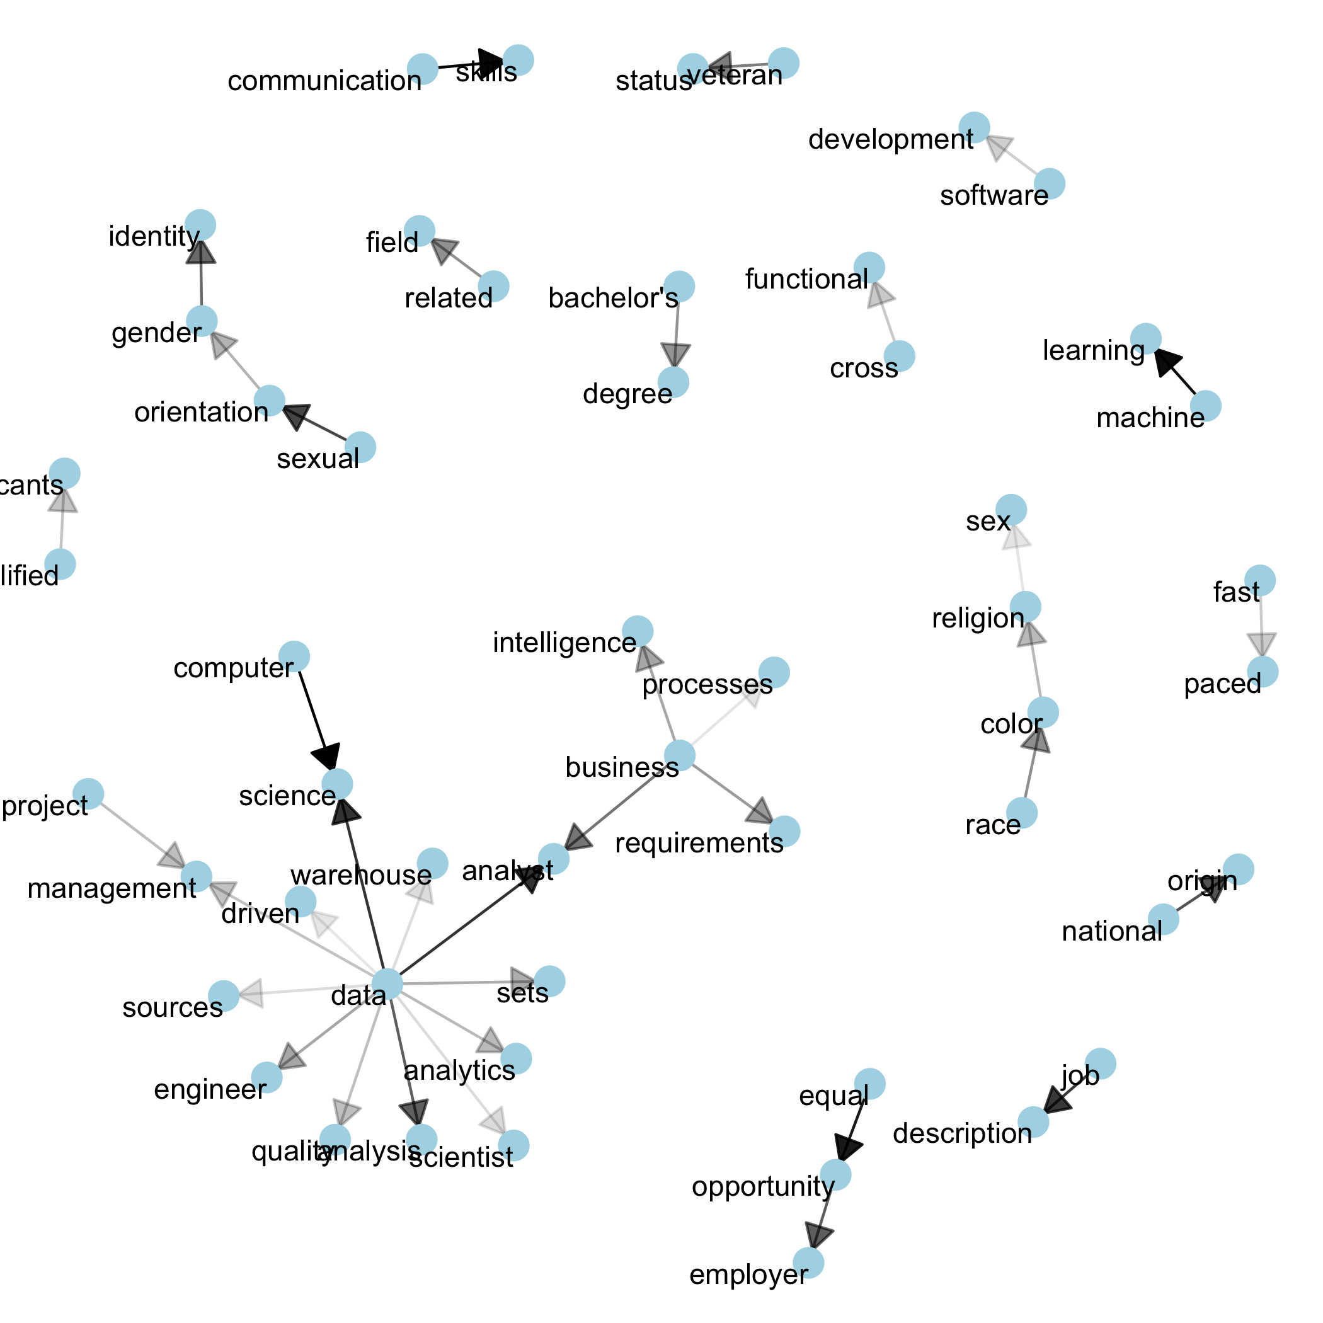
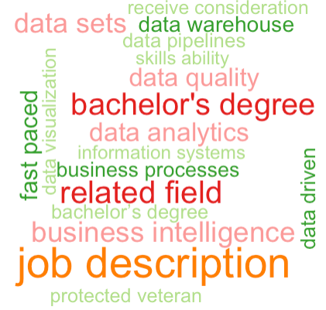
Bigrams

Slide 8
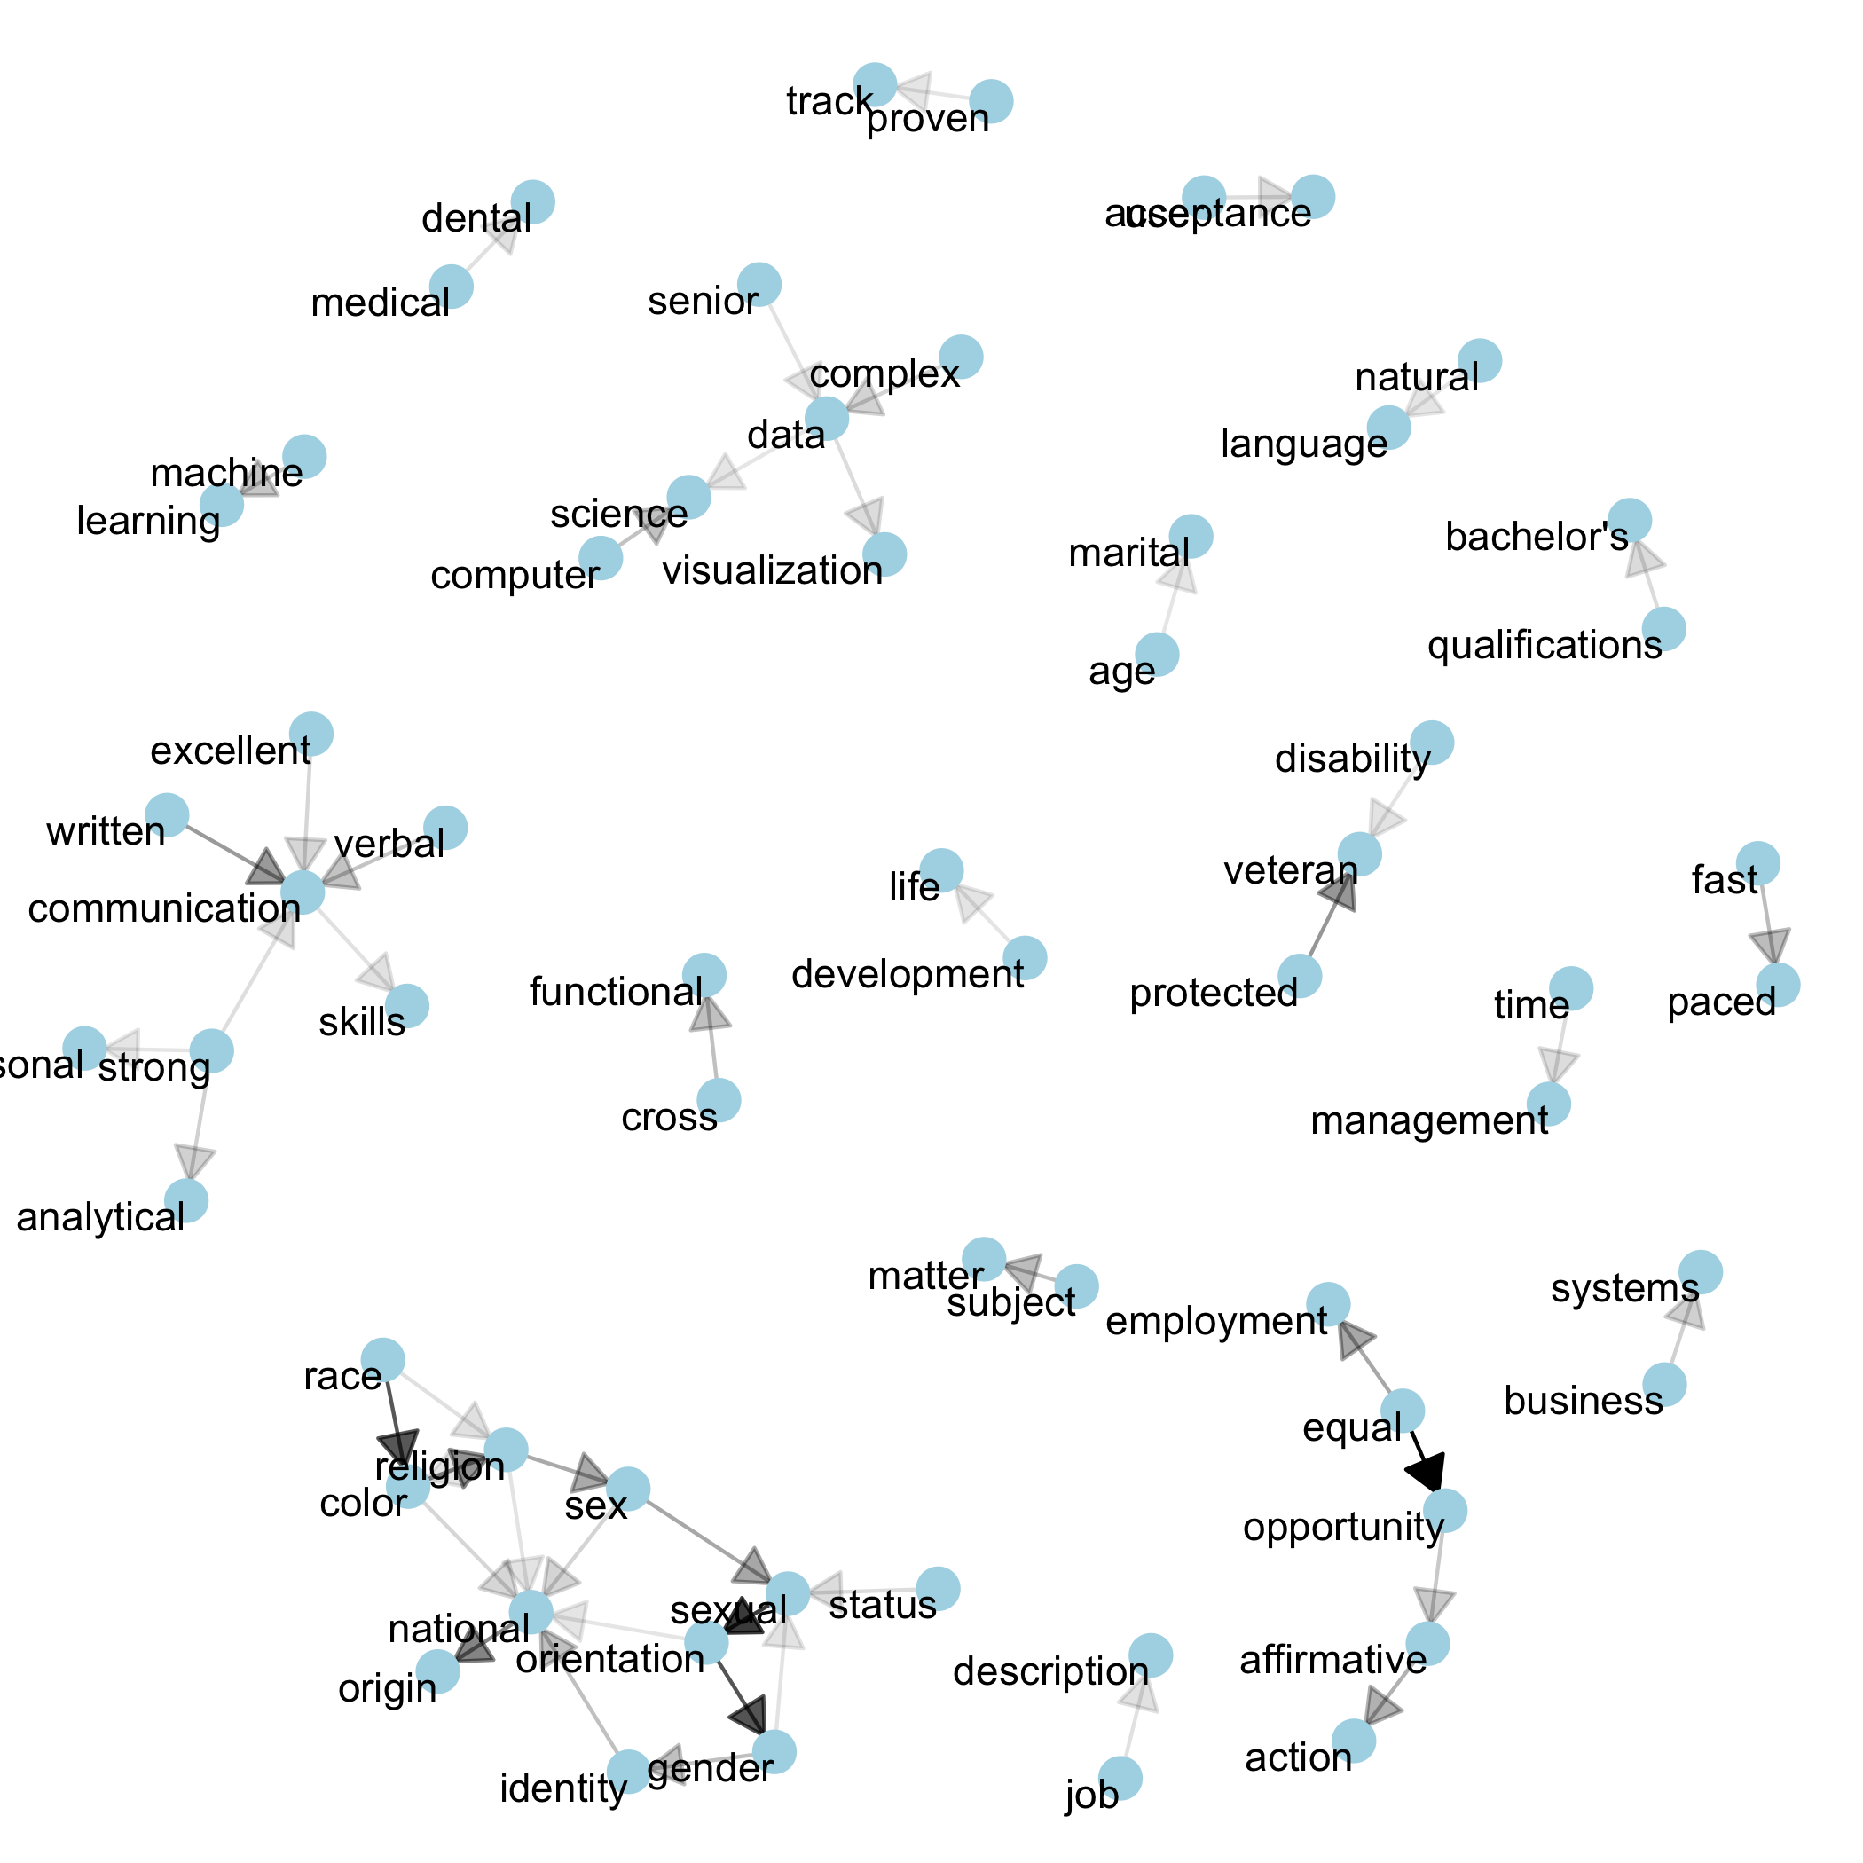
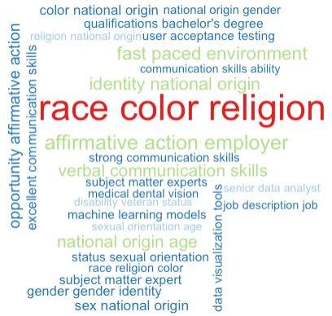
Trigrams

Slide 9
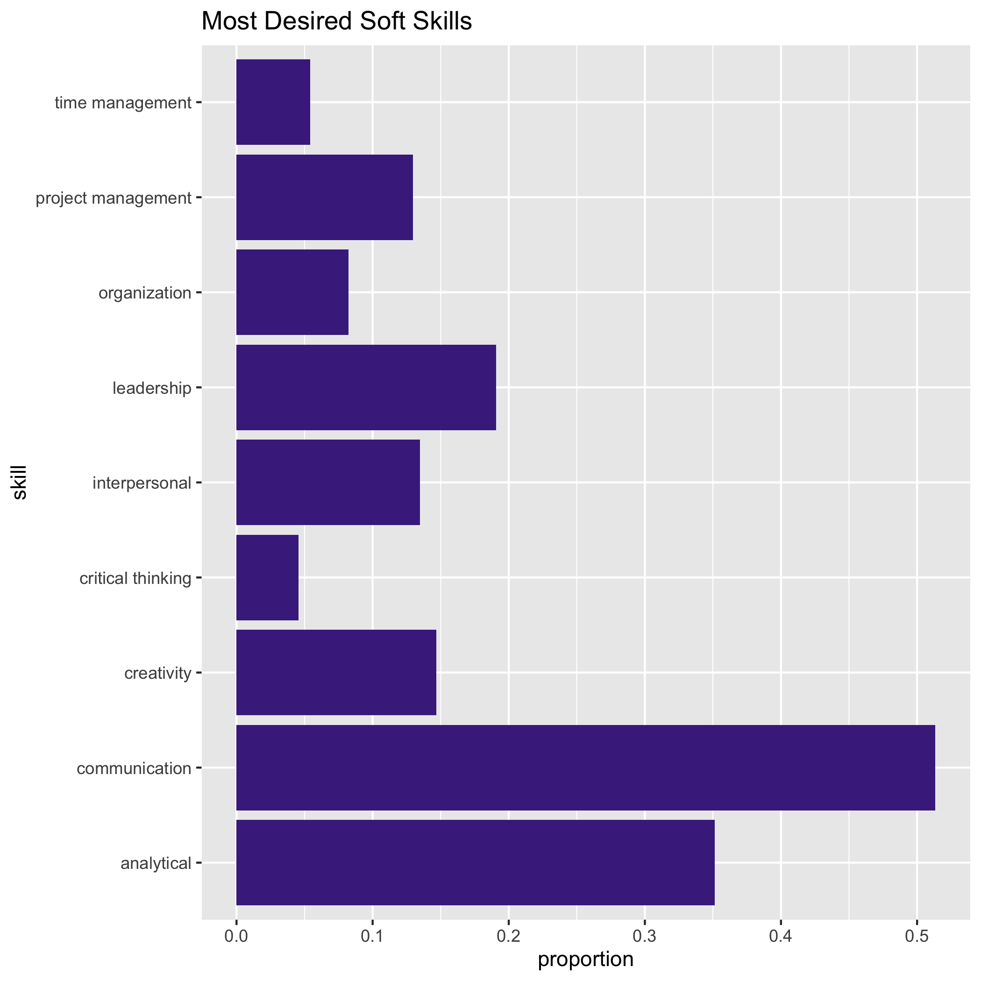
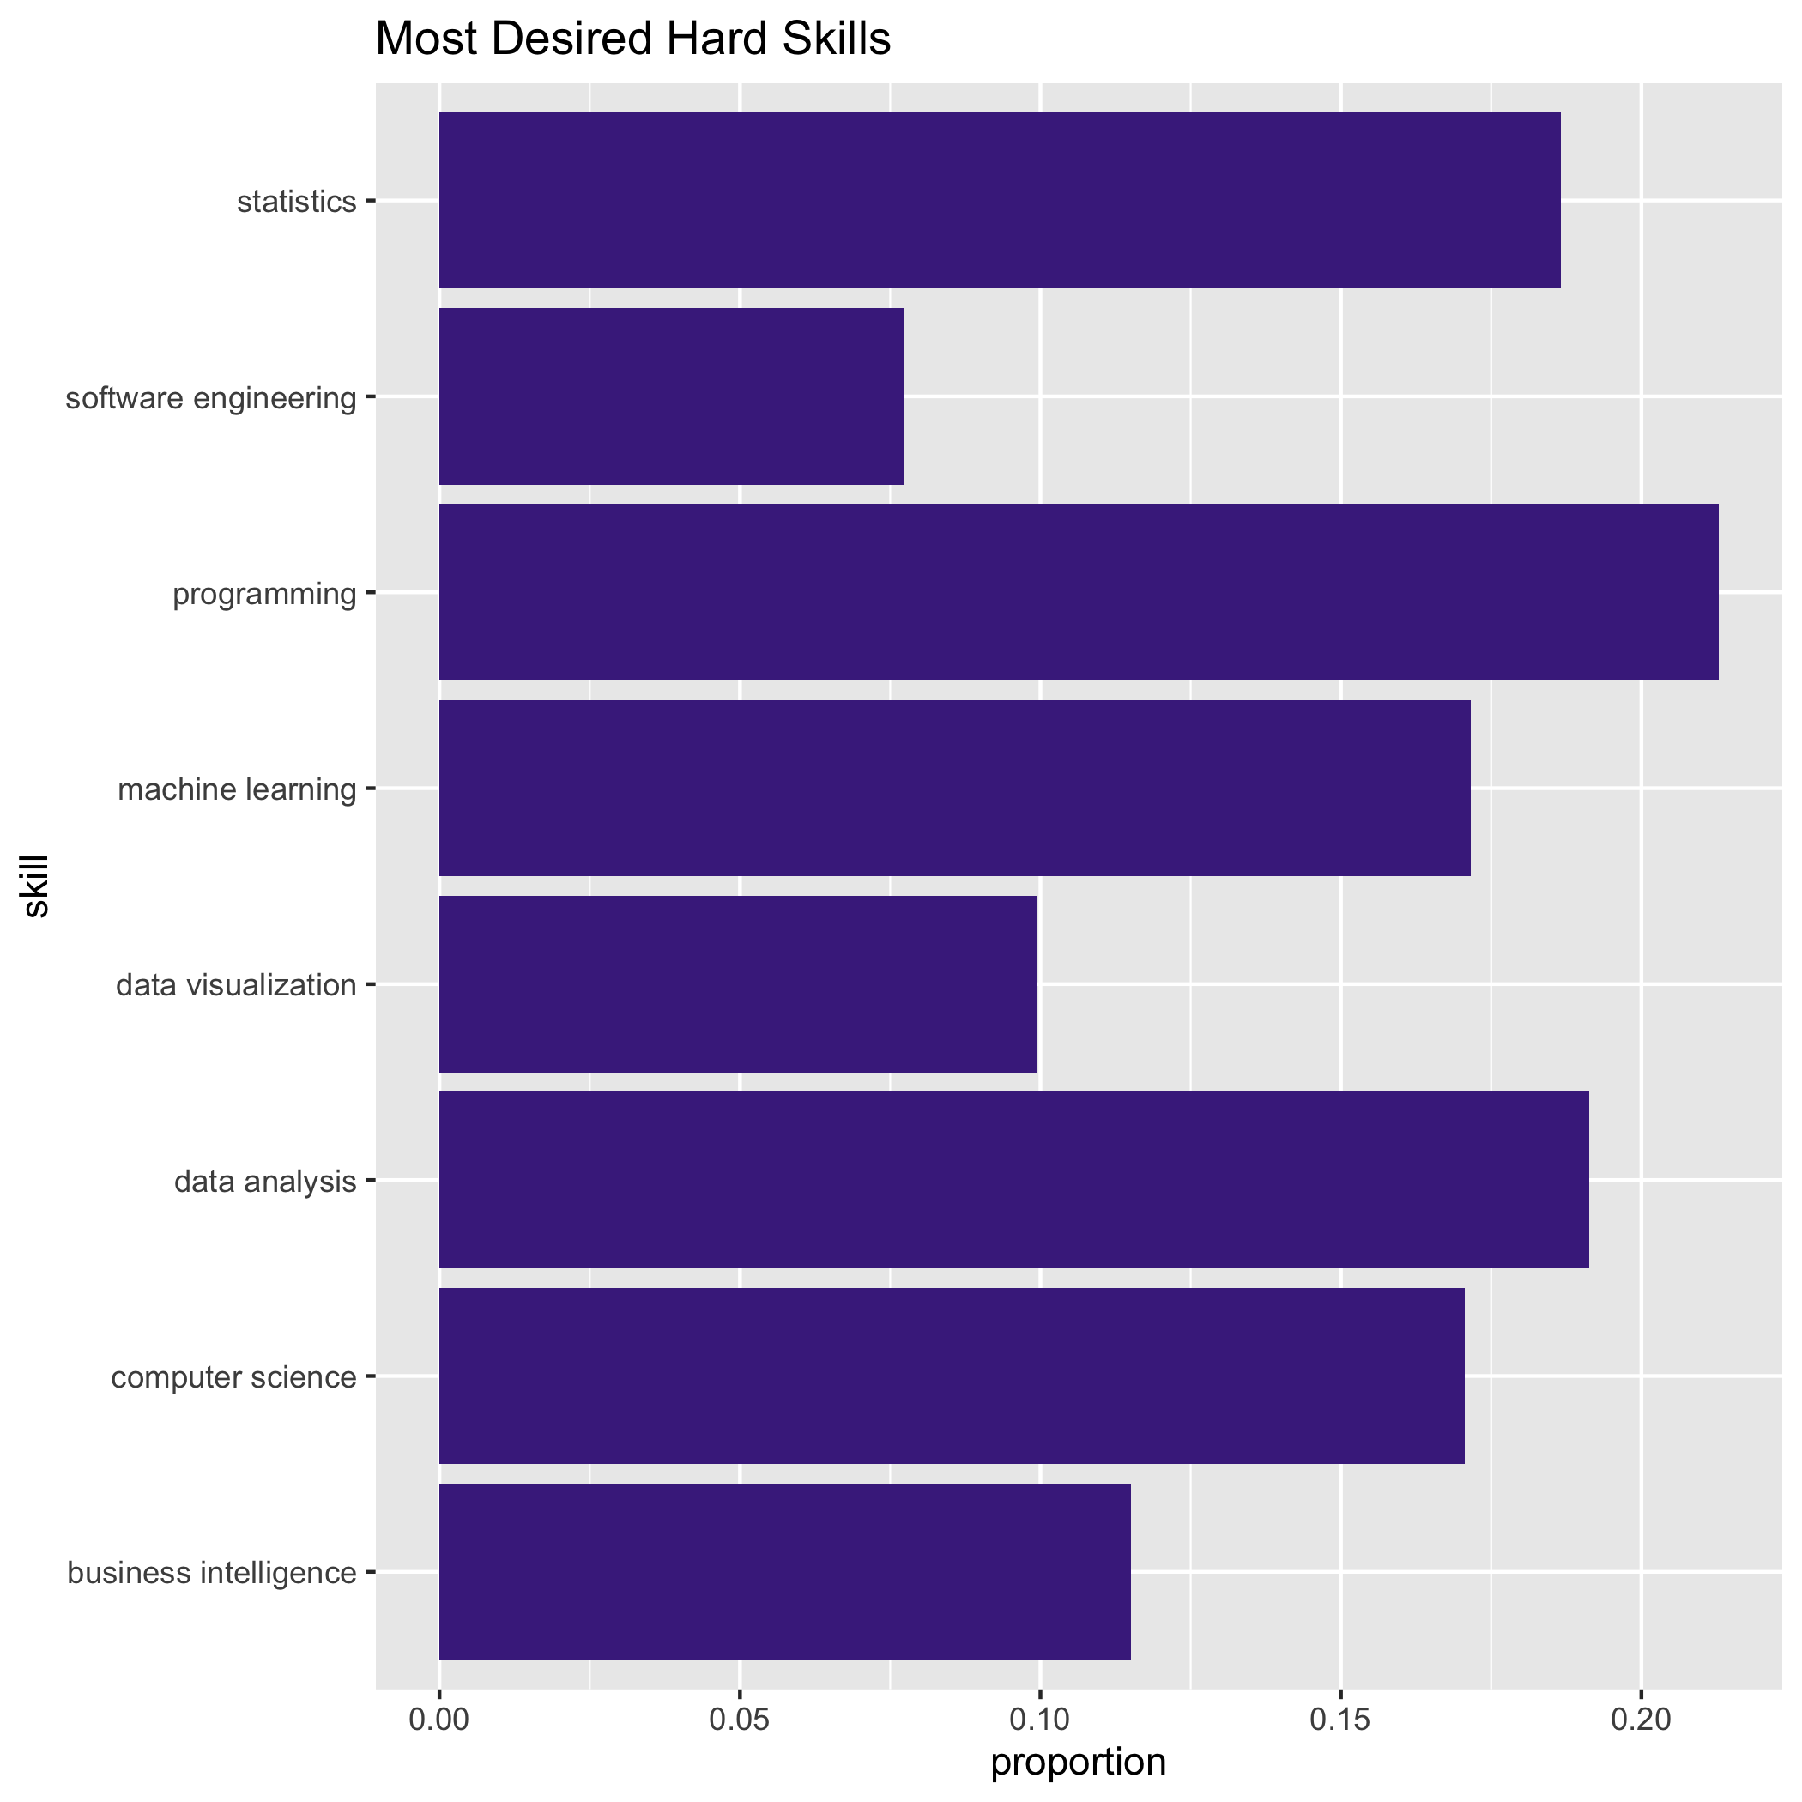
Most desired Soft/ hard skills

Slide 10
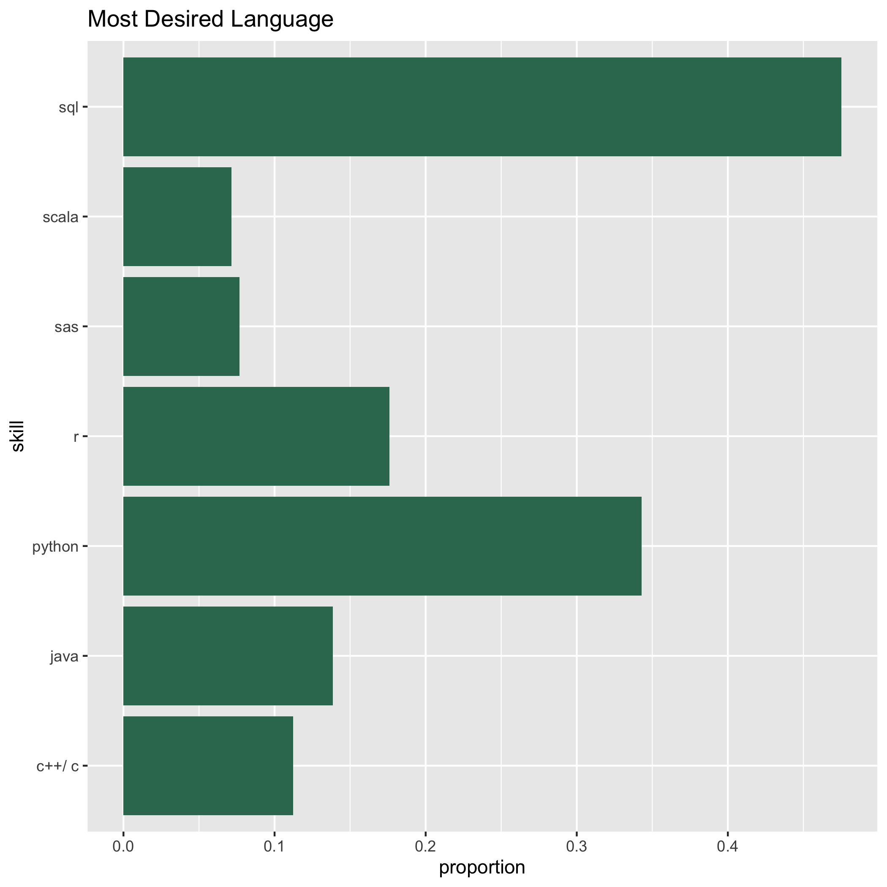
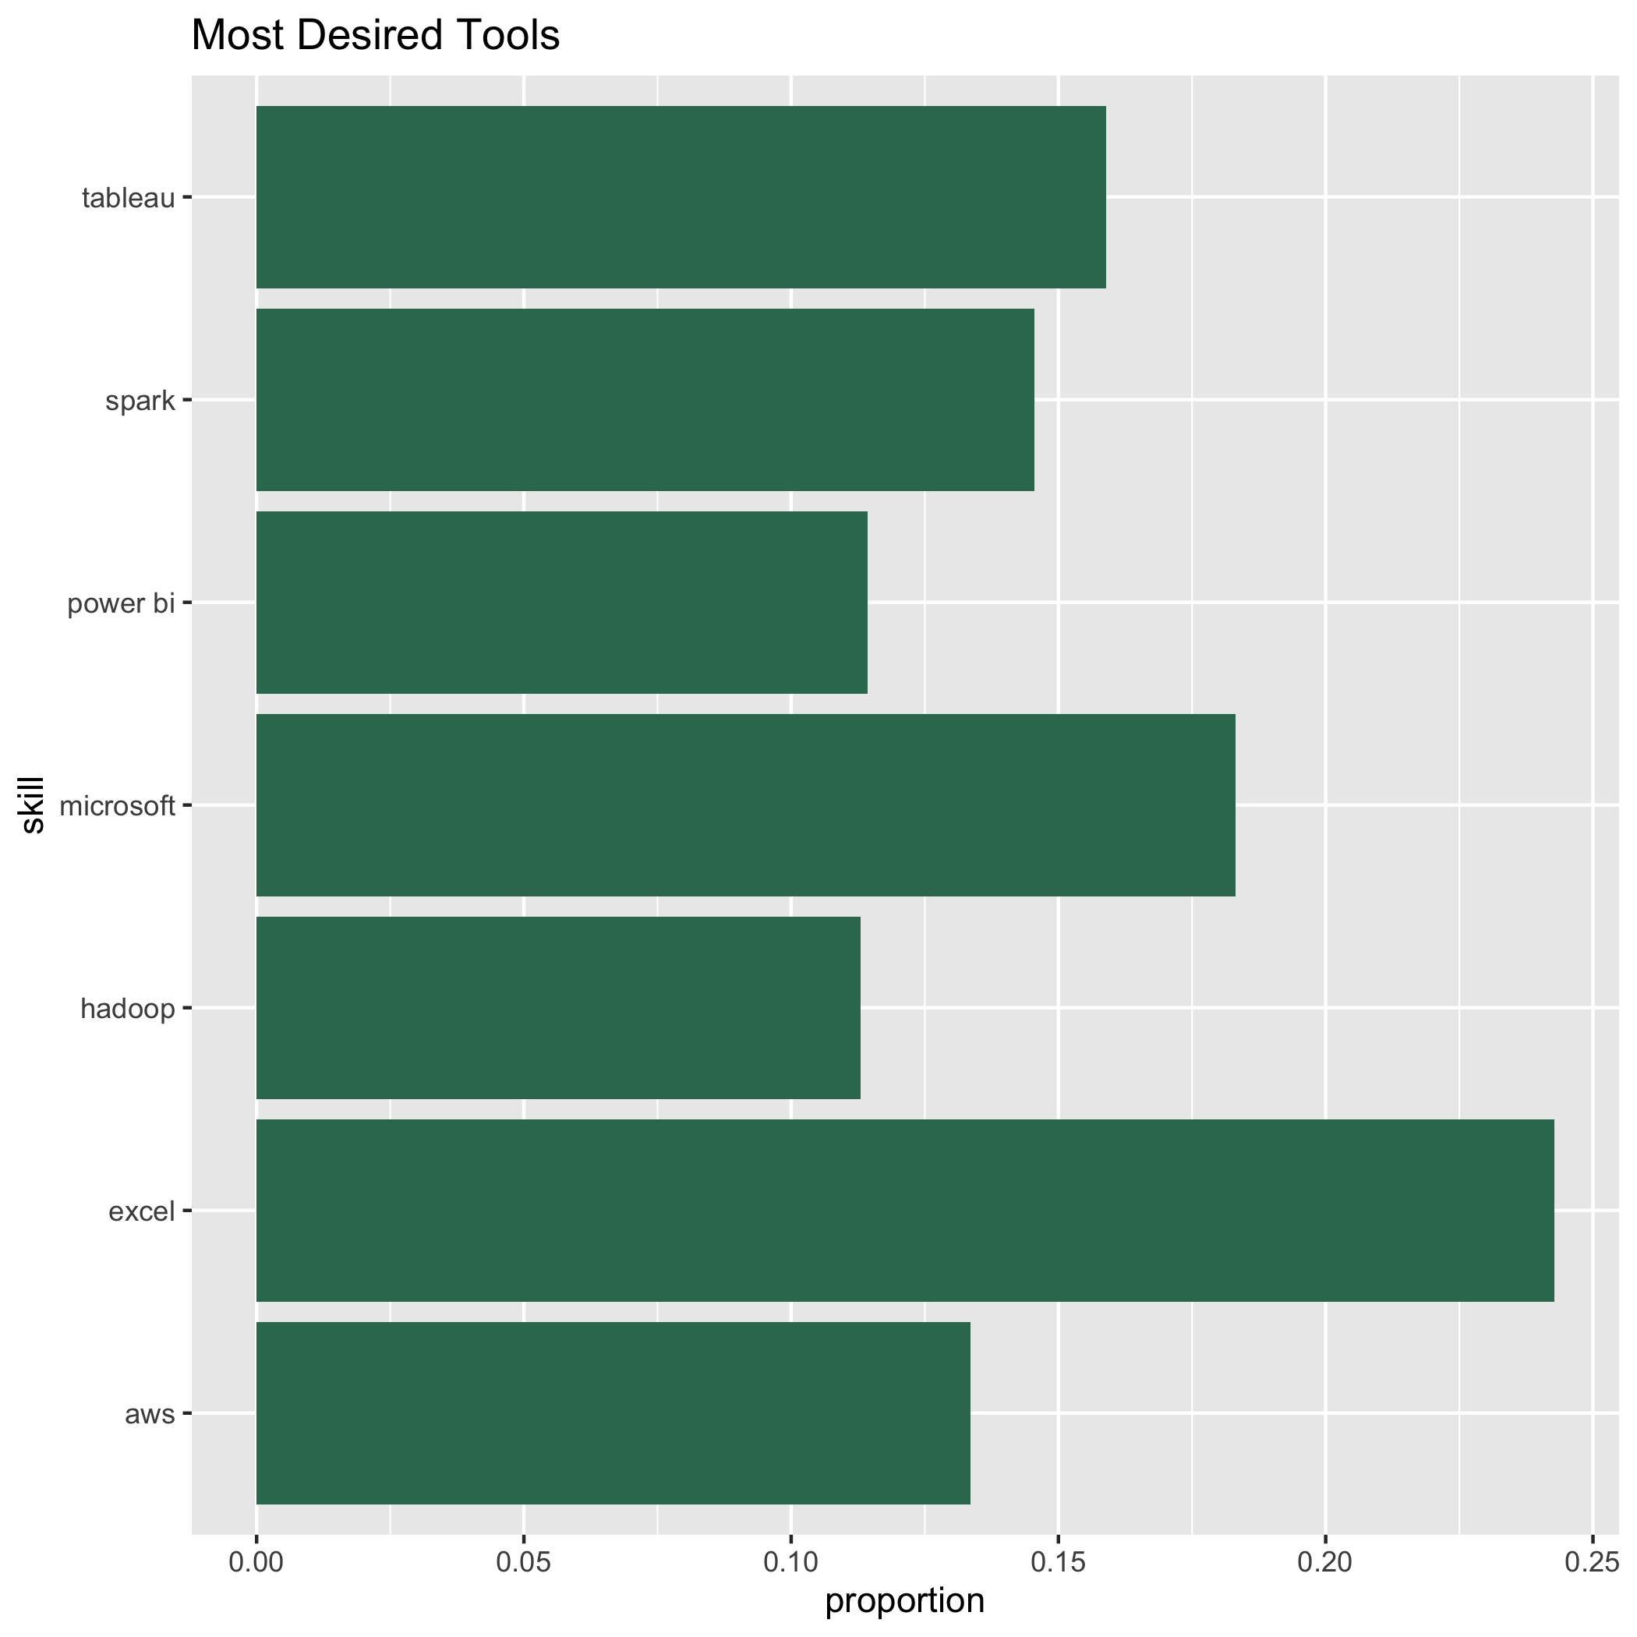
Most desired languages and tools

Slide 11
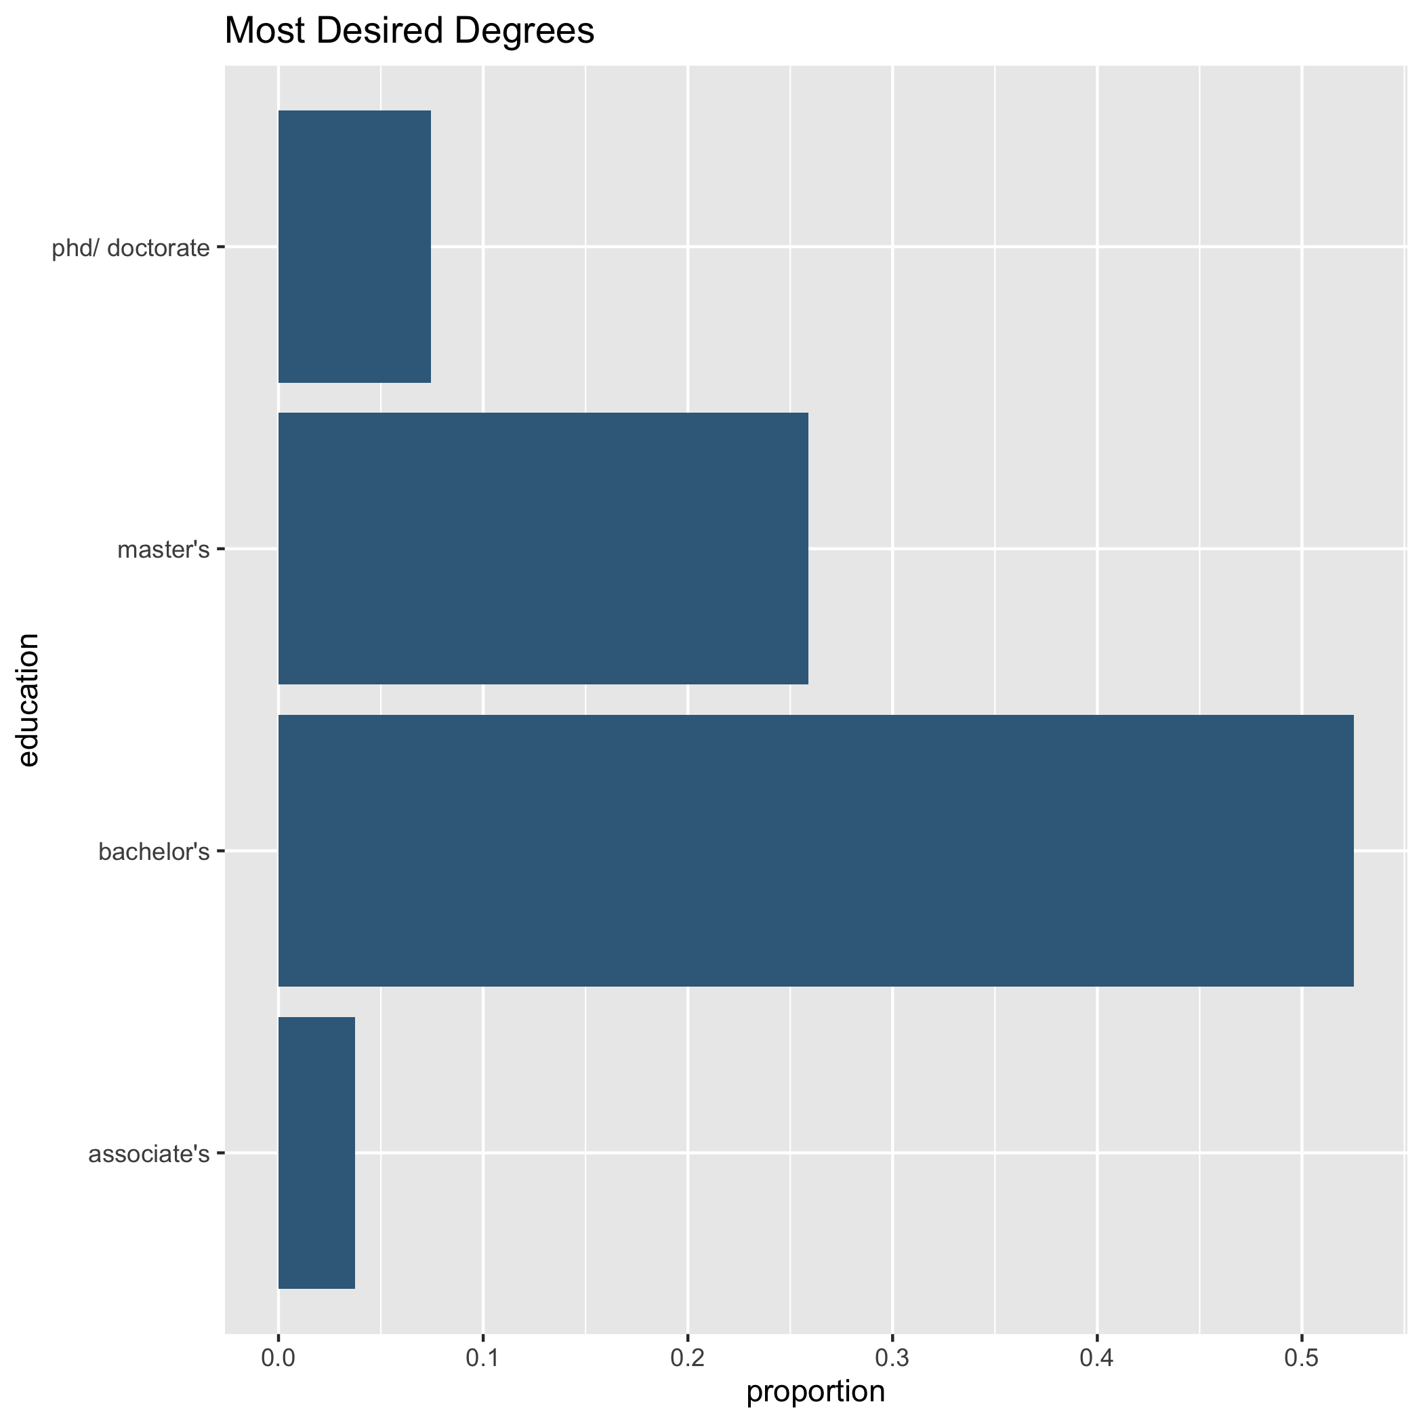
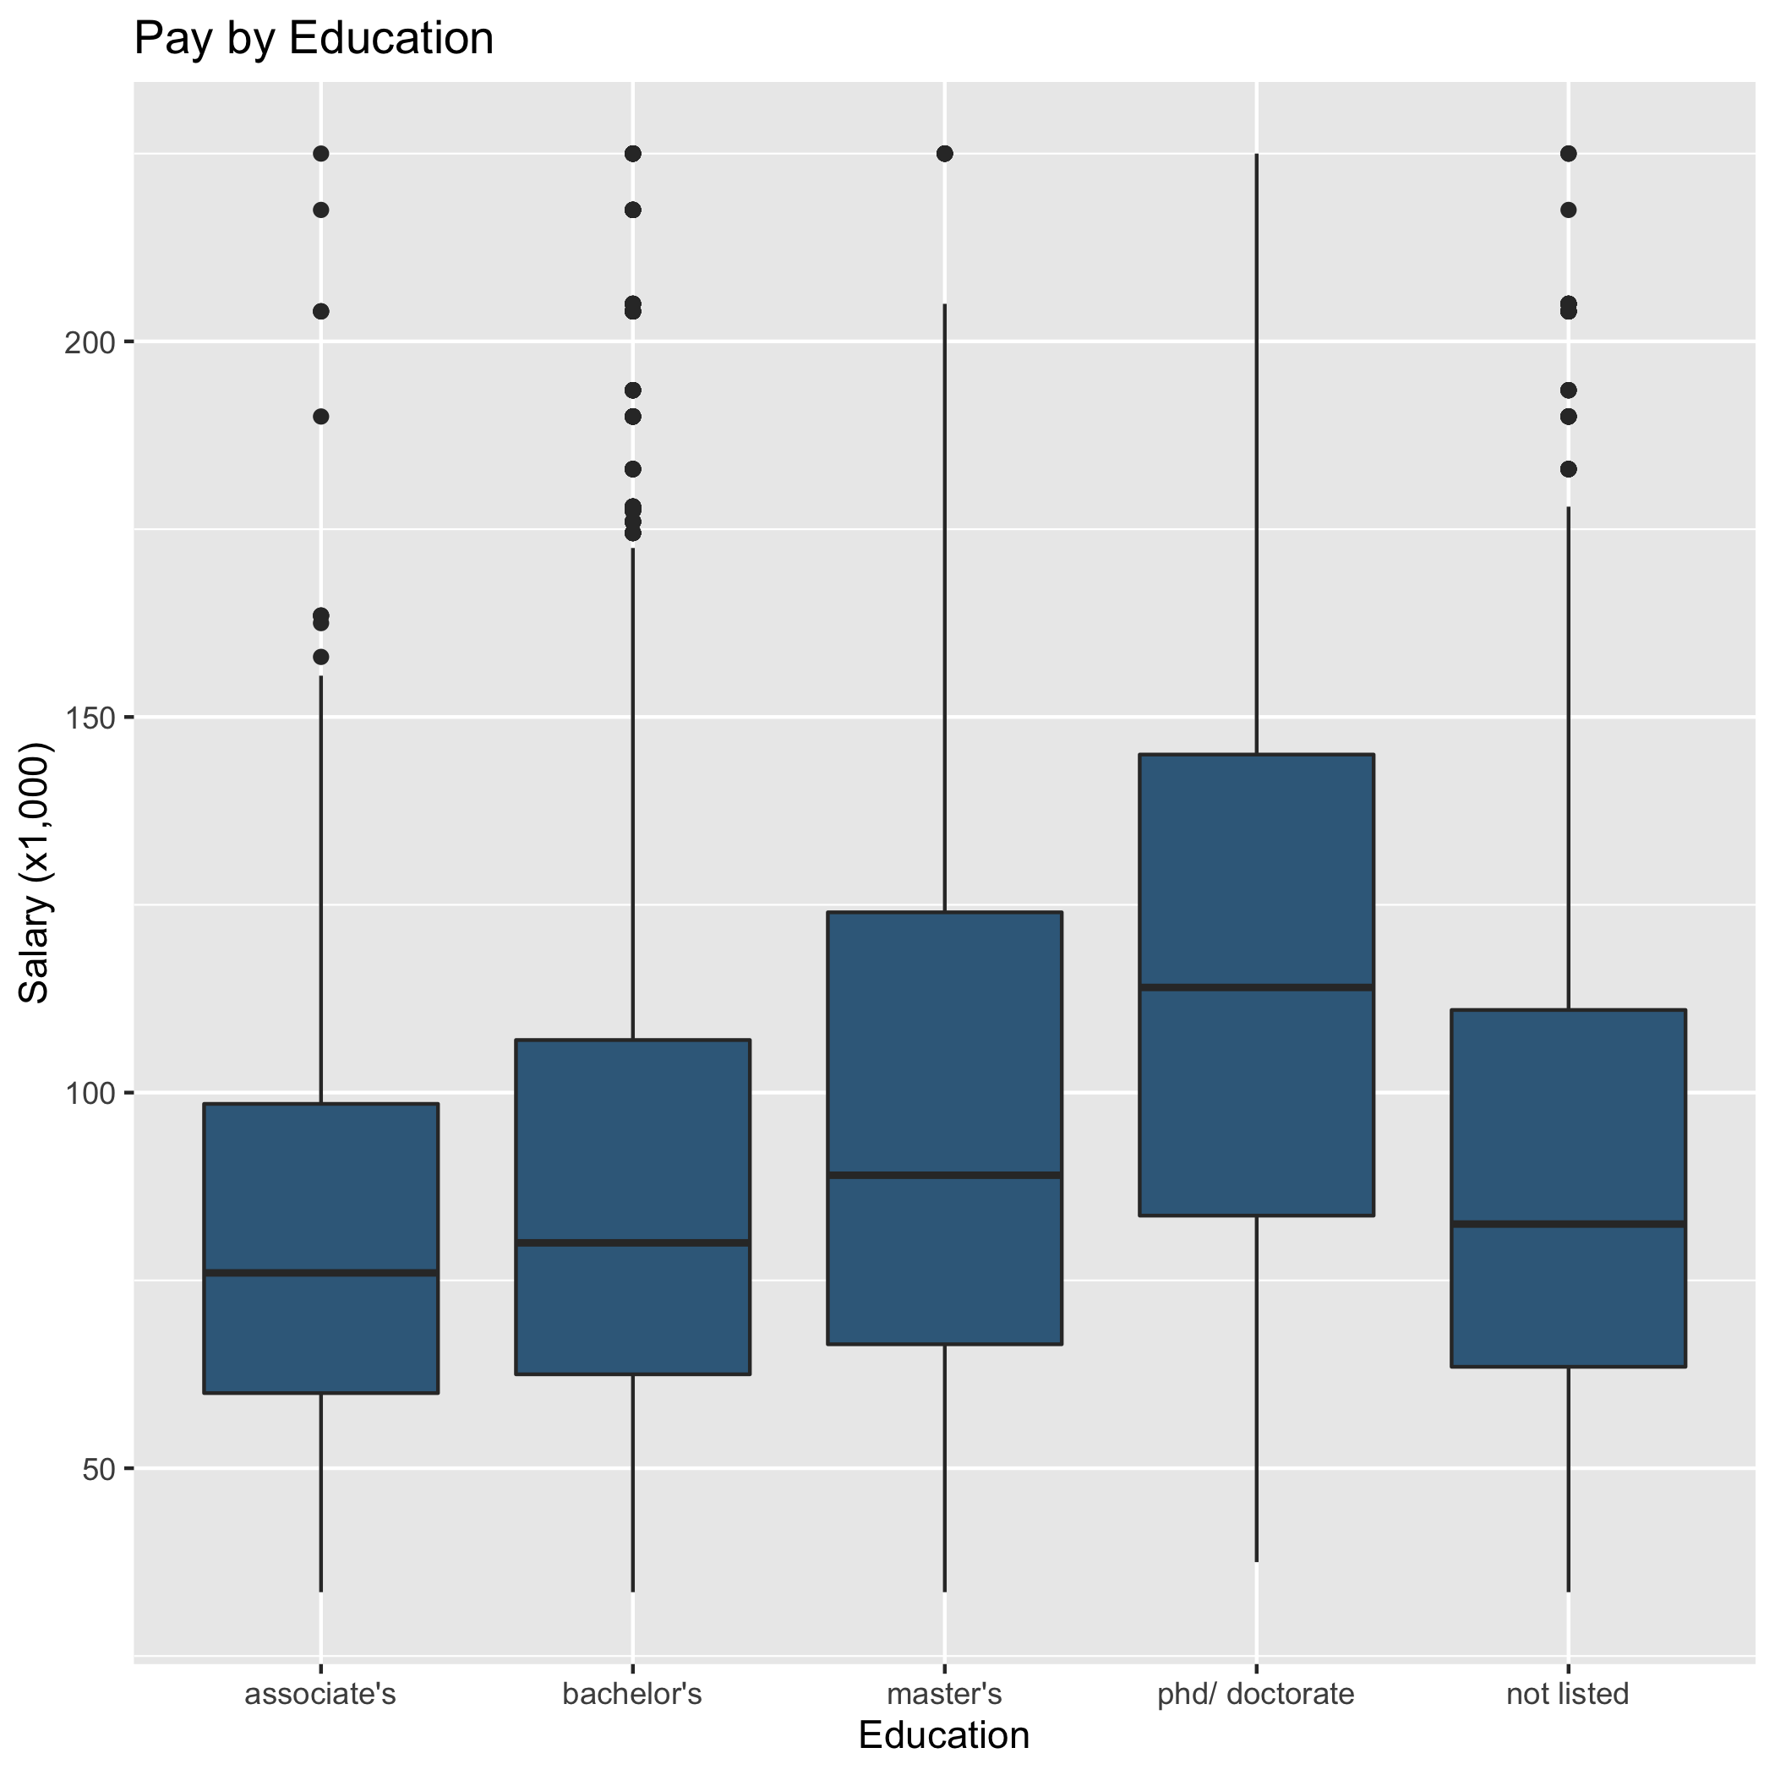
Most Desired Degree and salary by degree

Slide 12
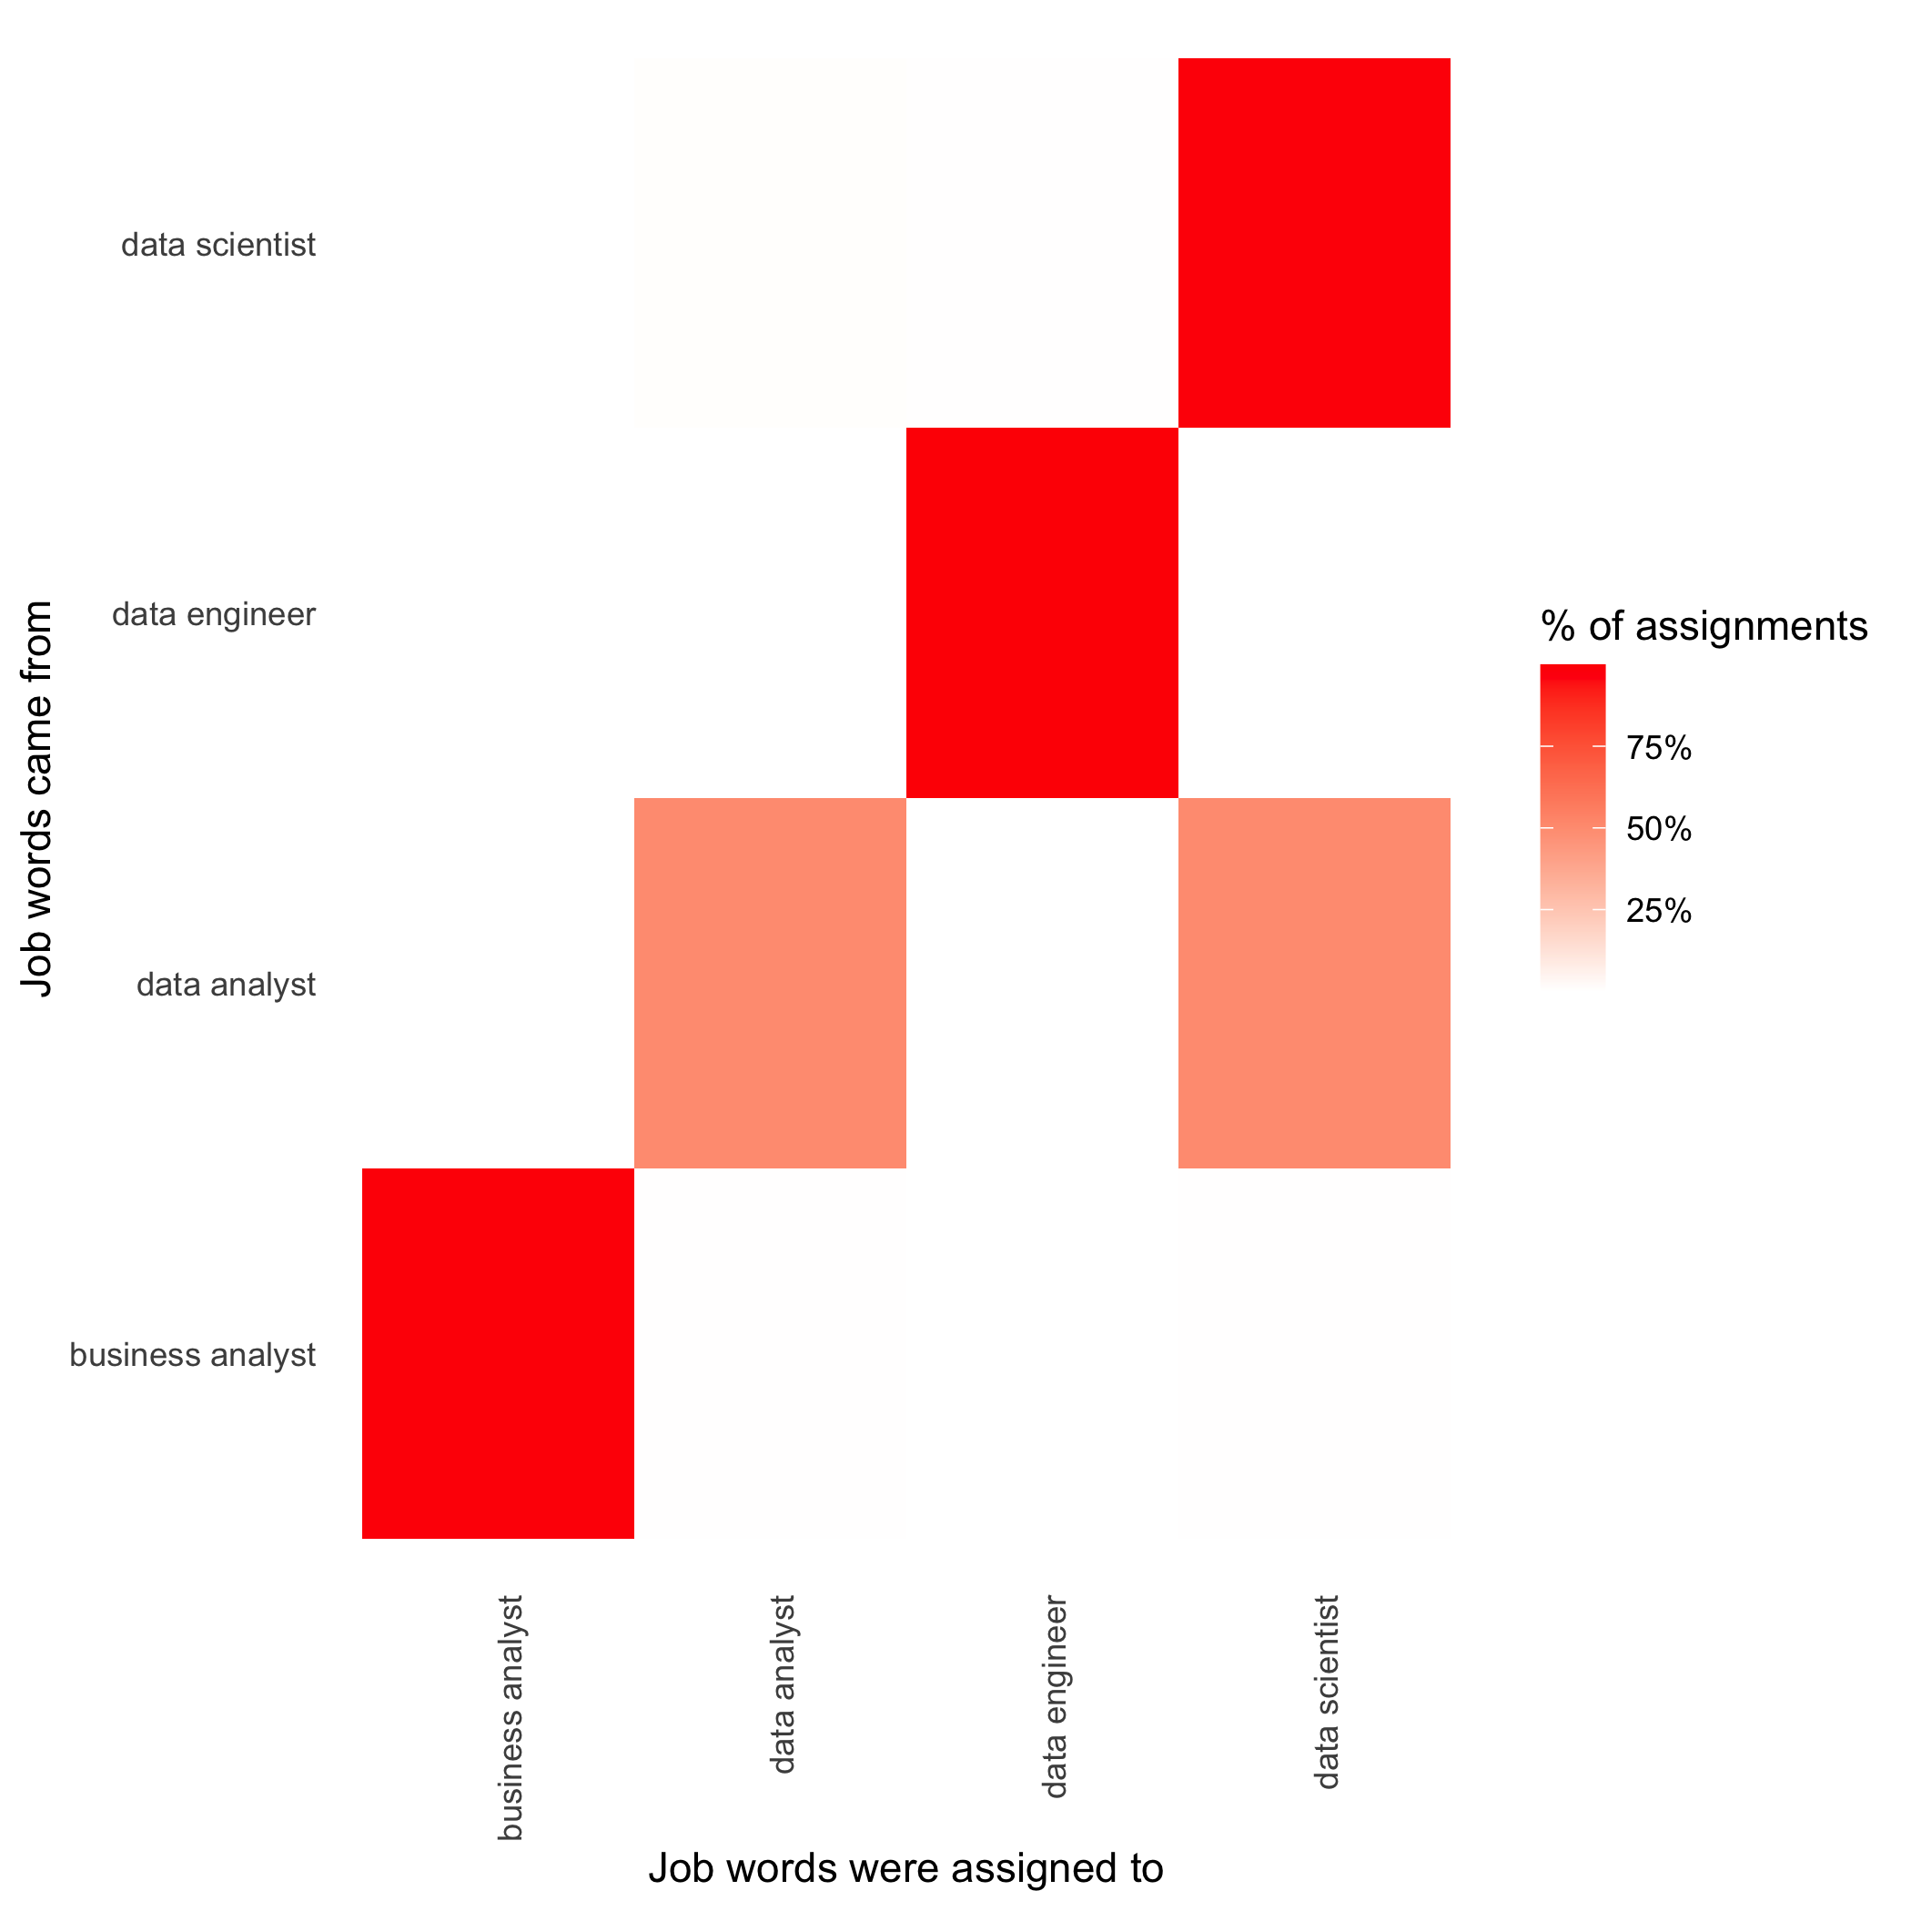
LDA
Predict job type based on job description
Basics of LDA (Latent Dirichlet allocation):
Topic model
Every document a mixture of topics
Every topic a mixture of words
Find mixture of words associated to topic and mixture of topics describes document
98.96%
99.93%
49.93%
49.95%
99.30%

Slide 13
Salary Classification
Predict salary based on job description
Split salary into binary data
Above/ below $95,000
0 – above
1 – below
Baseline
0 – 0.38
1 – 0.62
Model | Accuracy
Logistic Regression | 0.7341
Logistic Regression: Pruning & N-Grams | 0.7363
Logistic Regression: Hashing & N-Grams | 0.7234
Logistic Regression: Normalization &Tf-Idf | 0.7257
Naïve Bayes | 0.6760
Naïve Bayes: Laplace | 0.6763
Xgboost | 0.7029

Slide 14
References
https://www.tidytextmining.com/index.html
https://www.bls.gov/oes/current/oes152098.htm
http://text2vec.org/vectorization.html
https://rpubs.com/dbrown/nbclass

