Slide 1
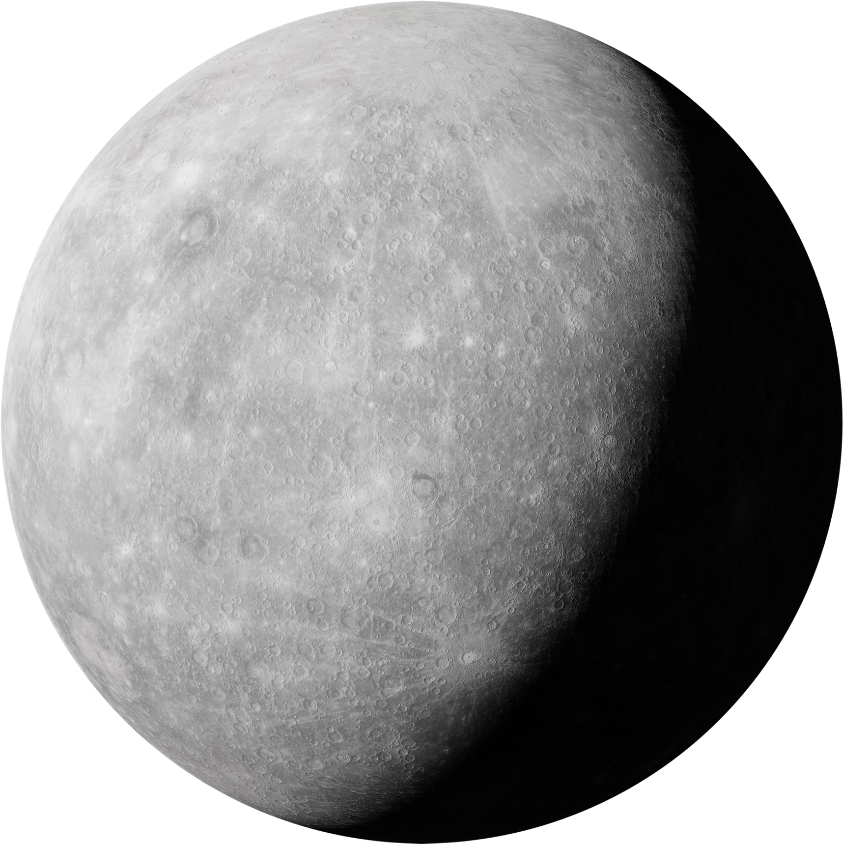

Our Mission: Lunar Lyft
Clancy Crawford

Slide 2
Contents
01> Trade Studies
02 > Work Breakdown Structure
Evaluating Stage 1 Propulsion
&
Evaluating Stage 3 Propulsion
Work Breakdown Structure
&
Requirements
03 > Vehicle Design
04 > Lunar Habitat Designs
Stage 1: Calypso
Stage 2: Intra-space Booster System
Stage 3: Big Yellow Orbital Bus
Cislunar Orbital Live Occupancy Station and Lander (COLOSAL)
Orbital Hotel: Tranquility
Lunar Base 1: Research Facility
Lunar Base 2: Regolith Mining Facility
Clancy Crawford

Slide 3
Assumptions
Structures on the surface and around the Moon’s orbit are already built.
All three vehicle stages are reusable and refueled between missions.
All parts of the mission can support safety requirements.
Unlimited water can be mined on the Moon’s poles.
Resources mined from the Moon is sufficient for our propulsion systems.
Our payload is comprised of food and supplies for…
  20 people (including the operating crew)
  Cislunar Orbital Station
  Lunar Habitats
  Emergency situations
Clancy Crawford

Slide 4
Trade Studies
01
Ewan Thompson

Slide 5
Evaluating Propulsion: Stage 3 - Earth Orbit to Lunar Orbit
Alternatives
 | Weight | Model 1 | Model 2 | Model 3 | Model 4
Safety | 10 | 6 | 1 | 9 | 9
Budget Limit | 1 | 7 | 2 | 10 | 9
Vehicle Reusability | 7 | 8 | 10 | 7 | 6
Complexity | 5 | 9 | 10 | 5 | 4
Transportation Time | 8 | 10 | 9 | 2 | 1
System Reliability | 6 | 10 | 1 | 9 | 7
System Efficiency (Power Input Vs Output) | 9 | 7 | 8 | 2 | 7
Failure Likeliness | 9 | 10 | 3 | 5 | 4
Total |  | 461 | 309 | 307 | 310
Model 1: Hydrogen + Oxygen Liquid Propulsion
Model 2: Thermal Nuclear Propulsion
Model 3: Solar Electric Propulsion
Model 4: Water Electric Propulsion
Ewan Thompson
Notes:
LOX + Hydrogen

Slide 6
Evaluating Propulsion: Stage 1 - Ground to Space
Alternative
Evaluation Criterion | Weight | Model 1 | Model 2 | Model 3 | Model 4
Safety, failure | 10 | 9 | 9 | 6 | 1
Budget Limit | 1 | 7 | 7 | 7 | 2
Vehicle Reusability/Reliability | 9 | 9 | 7 | 3 | 1
Complexity | 5 | 4 | 3 | 7 | 2
Payload Capacity “Mass” | 8 | 5 | 5 | 7 | 10
System Efficiency “Power Input Vs Output” | 9 | 7 | 8 | 6 | 10
Totals |  | 301 | 287 | 239 | 201
Model 1: Liquid Propulsion​
Model 2: Hybrid Propulsion​
Model 3: Solid Propulsion ​
Model 4: Nuclear Propulsion​
Ewan Thompson

Slide 7
Work Breakdown Structure
02
Dmytro Starysh

Slide 8
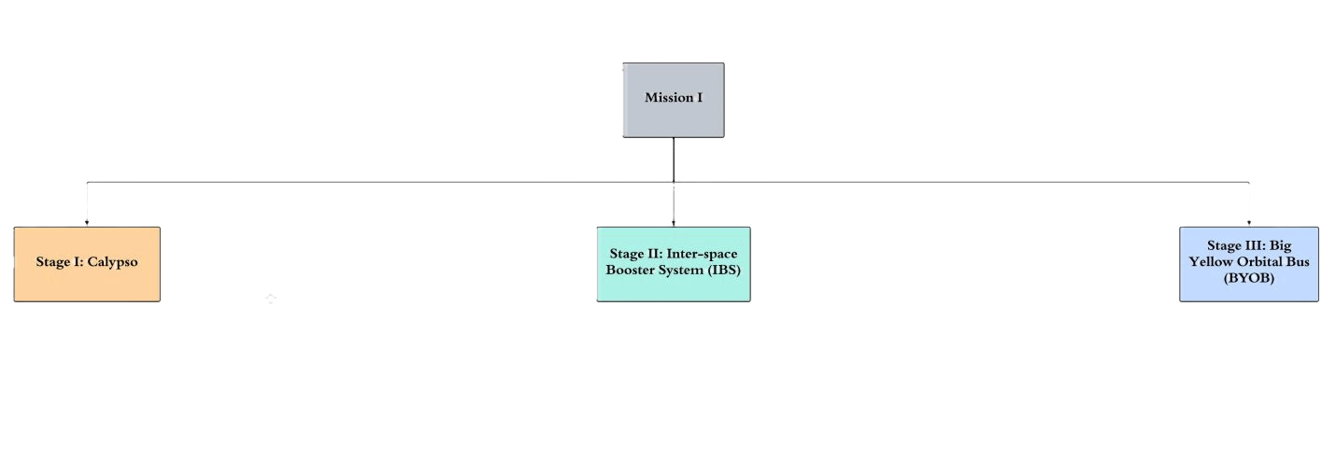
Vehicle Work Breakdown Structure
Dmytro Starysh

Slide 9
Work Breakdown Structure Requirements
WBS# | Element | L1 | L2 | Requirements
1 | Mission 1 | X |  | Mission is completed safely and in a timely manner. Minimal cost for resupplying stages Must turn a significant profit
1.1 | Stage 1 |  | X | Must land on launch pad Must be reusable and refuellable Must produce enough thrust to carry payload to mesosphere
1.2 | Stage 2 |  | X | Enough fuel to get to LEO orbit, perform TLI, and land in NRHO (docking w COLOSAL) Must reengage Earths atmosphere and return with minimal damage Must be reusable and refuellable
1.3 | Stage 3 |  | X | Must reengage Earths atmosphere and return with minimal damage Life support systems in payload area capable of safely transporting humans Storage space for tools, food, and amenities
Dmytro Starysh

Slide 10
Vehicle Design
03
Antonio Munoz

Slide 11
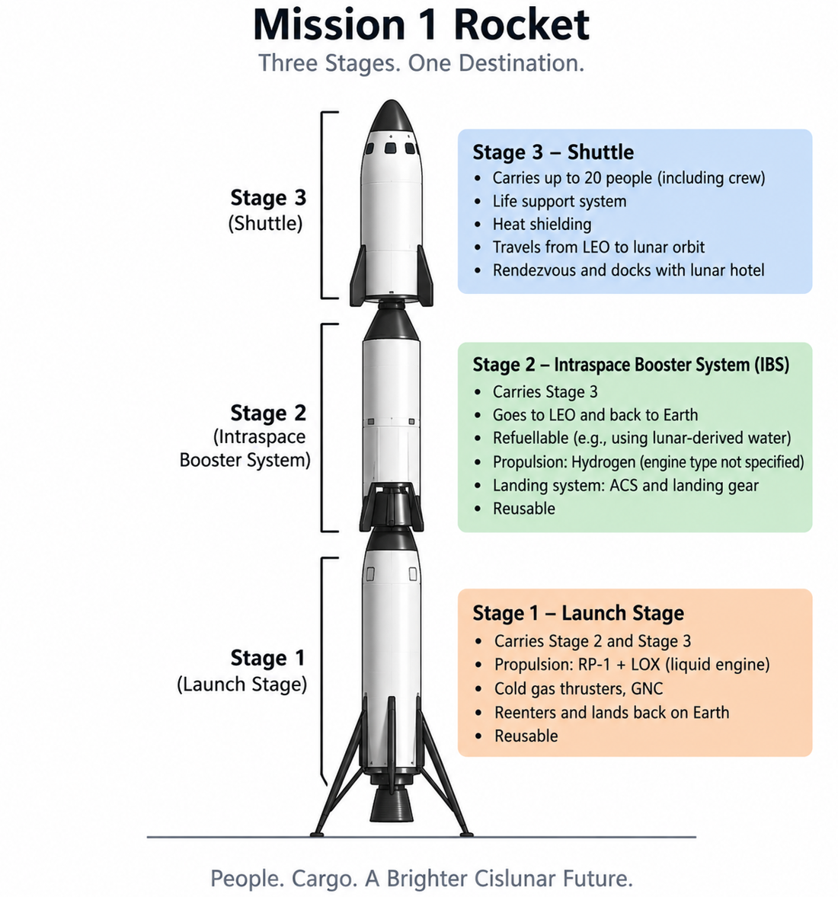
Staging
Stage 1: Ground to Mesosphere
Stage 2: Low Earth Orbit (LEO)
Stage 3: LEO to Near Rectilinear Halo Orbit (NRHO)
Antonio Munoz
Notes:
gqH8aYGAhKiqddhxrTUFJX.jpg

Slide 12
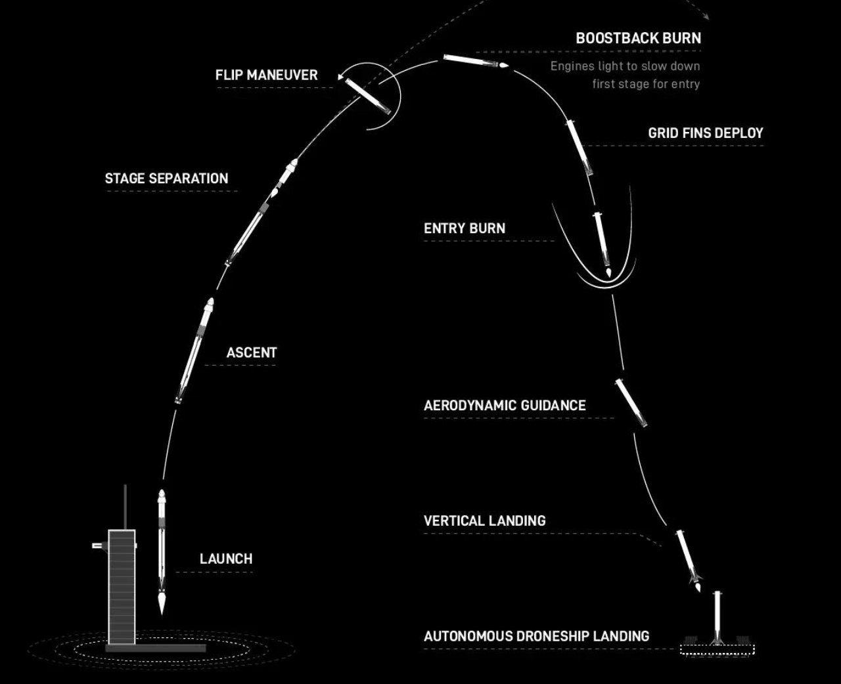
Stage 1: Calypso
RP-1 and LOX engine provides enough thrust to escape atmosphere
Stage 1 launches from sea level and takes the remaining stages into the mesosphere
Stage 1 then enters separation phase and returns to earth at about 80km altitude
Stage 1 is then recovered, refilled, and reused for future launches
Antonio Munoz
Notes:
https://www.reddit.com/r/spacex/comments/4rrh0e/thought_you_guys_might_like_this_small_falcon_9/

Slide 13
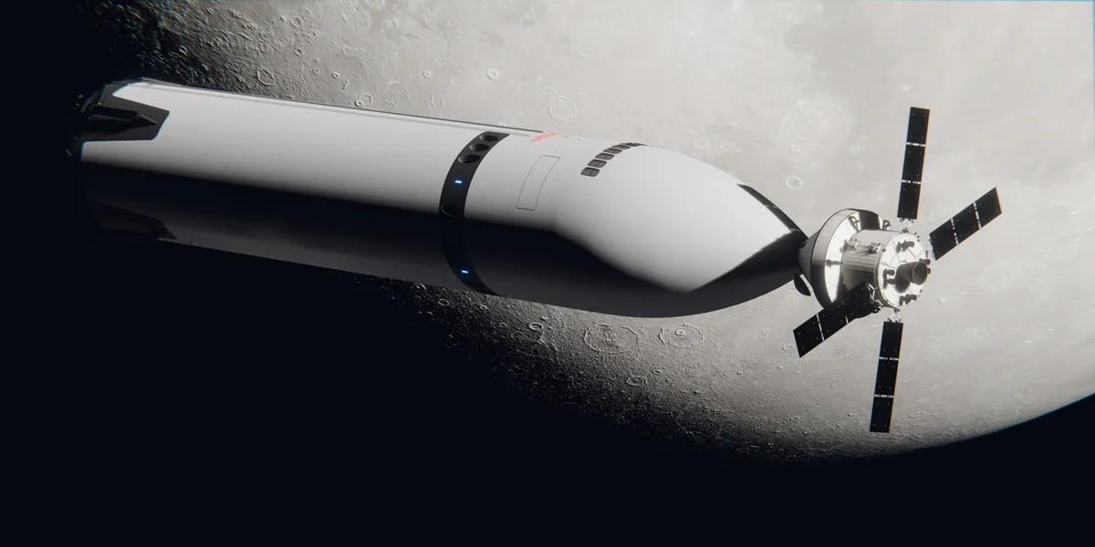
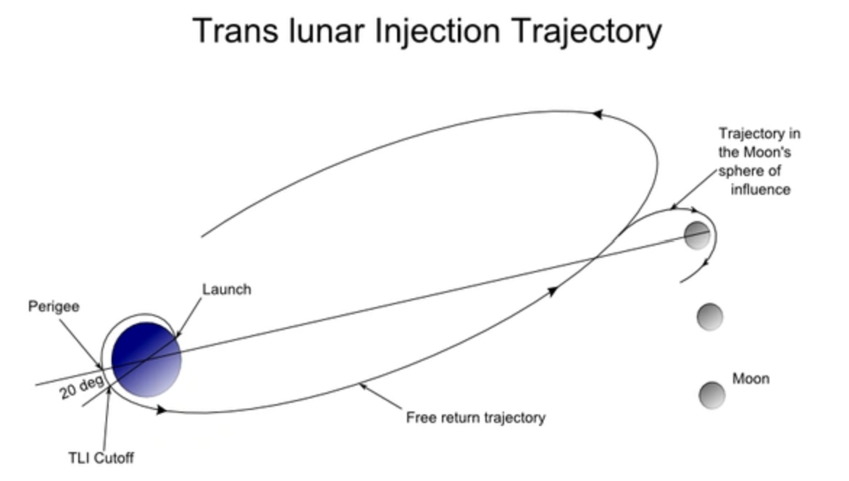
Stage 2: Intra-space Booster System (IBS)
Maneuvers to park orbit in LEO -> Trans Lunar Injection (TLI)
After necessary velocity is reached, performs braking maneuver to slow down and fall back to Earth
Refillable, Hydrogen + LOX fuel
Antonio Munoz

Slide 14
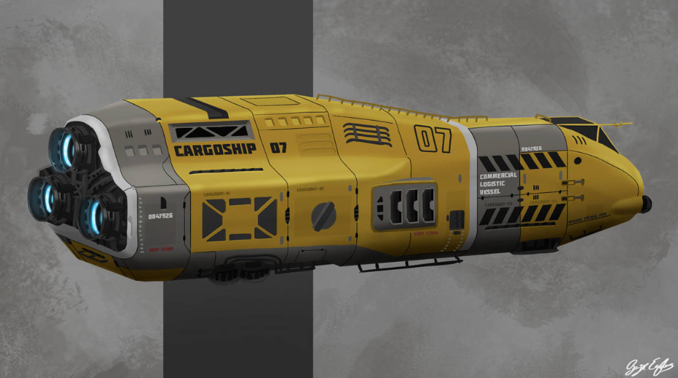
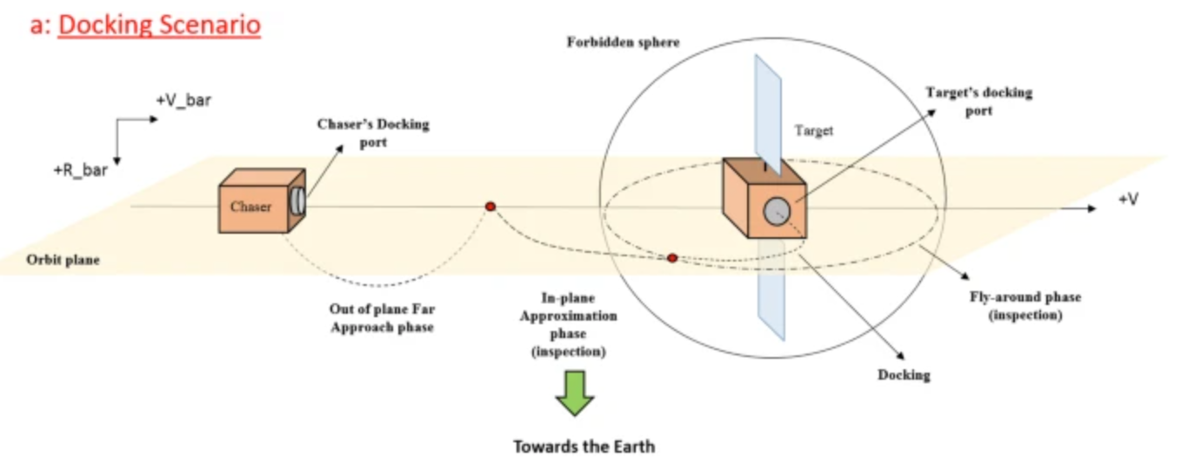
Stage 3: Big Yellow Orbital Bus (B.Y.O.B)
Shuttle on TLI trajectory after jettisoning spent second stage
Performs braking maneuver to insert into NRHO and rendezvous with Lunar Orbital Station to dock
Undocks from station and performs burn to enter a trajectory targeting Earths upper atmosphere
Skip Re-entry system
Food, water, medical supplies, and other resources necessary for operation of lunar bases
Max occupancy is 20
Azden Neufeld
Notes:
https://www.deviantart.com/basiceagles/art/Freighter-spaceship-concept-1033127474

Slide 15
Lunar Habitat Design
04
Diana Tormo

Slide 16
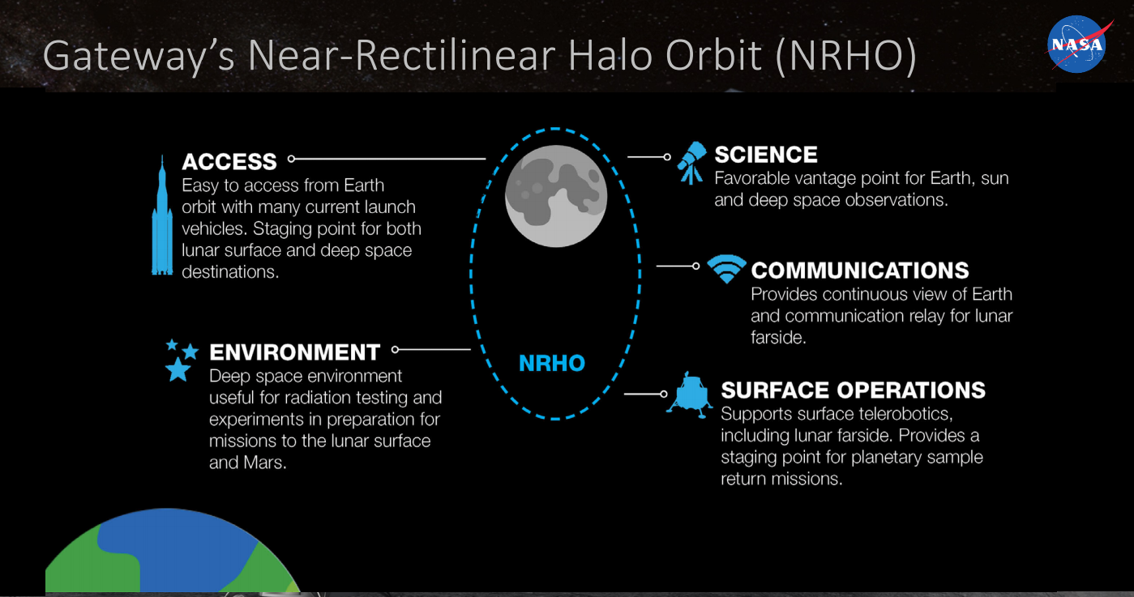
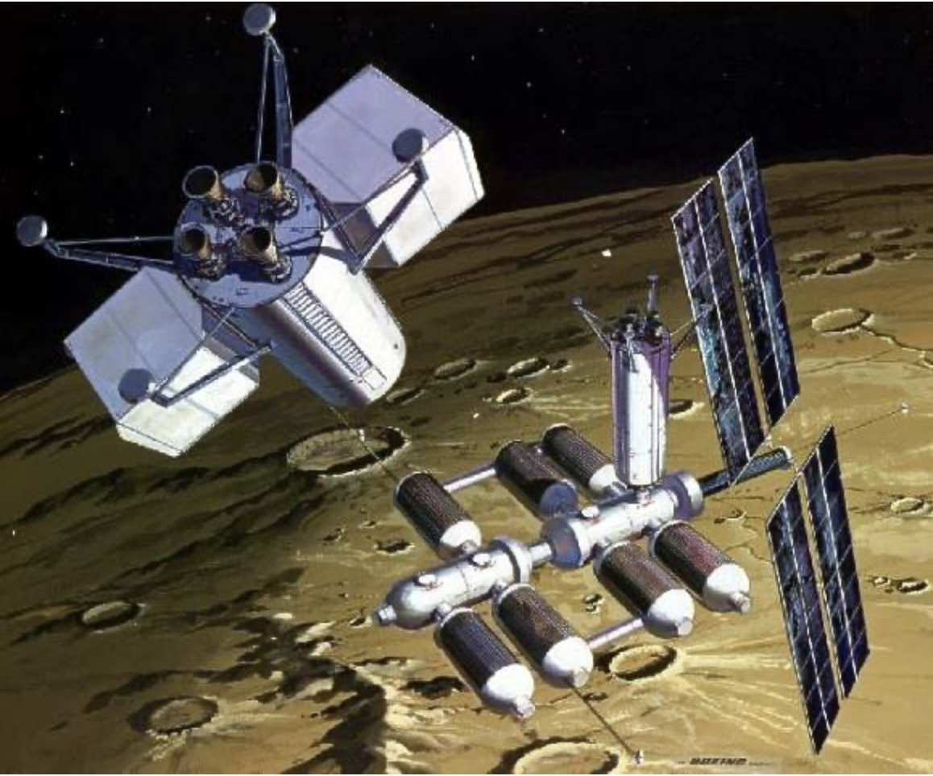
Cislunar Orbital Live Occupancy Station and Lander (COLOSAL)
The CisLunar Orbital Station is a rendezvous point for the final stage of the Launch Vehicle
NRHO
  Constant Communication with Earth
  Fuel Efficiency
  Periodic access to Moon's surface
Smaller Lunar Lander descends to Lunar Bases to carry personnel and resources to surface facilities
Lunar Lander Occupancy: 20
Diana Tormo

Slide 17
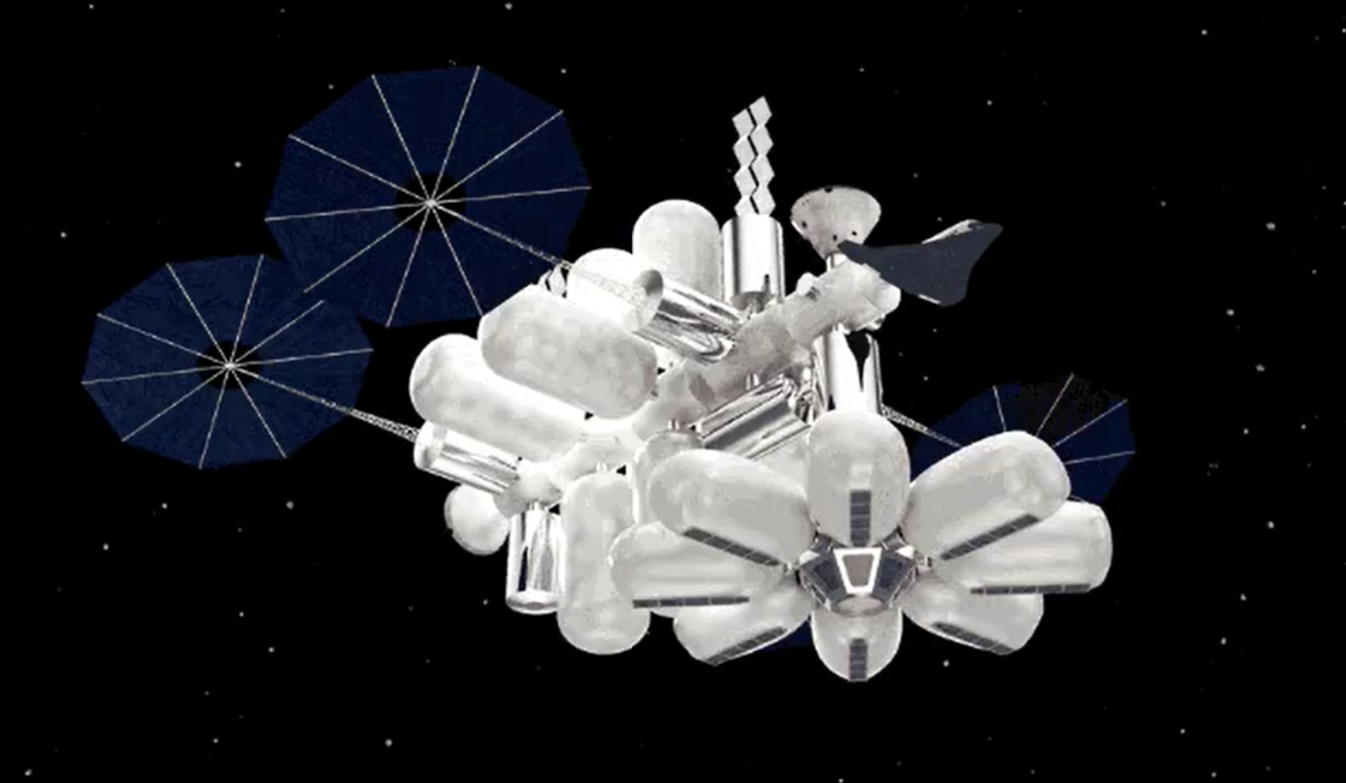
Orbital Hotel: Tranquility
Self-sustaining in NRHO providing amenities and food for 200 guests
Providing shared living and private luxury suites with constant scenic views of the Earth and the moon
Maintaining constant communication with the ground station on earth and the other lunar stations
Diana Tormo
Notes:
Image: MIT MARINA Project Team
GIF: NASA Gateway Lunar Station https://www.nasa.gov/centers-and-facilities/johnson/lunar-near-rectilinear-halo-orbit-gateway/
Self-sustaining in NRHO orbit providing amenities and food for 200 guests. Providing shared living and private luxury suites with constant scenic views of the Earth and the moon. Maintaining constant communication with the ground station on earth and the other lunar stations
- Connected to the COLOSAL

Slide 18
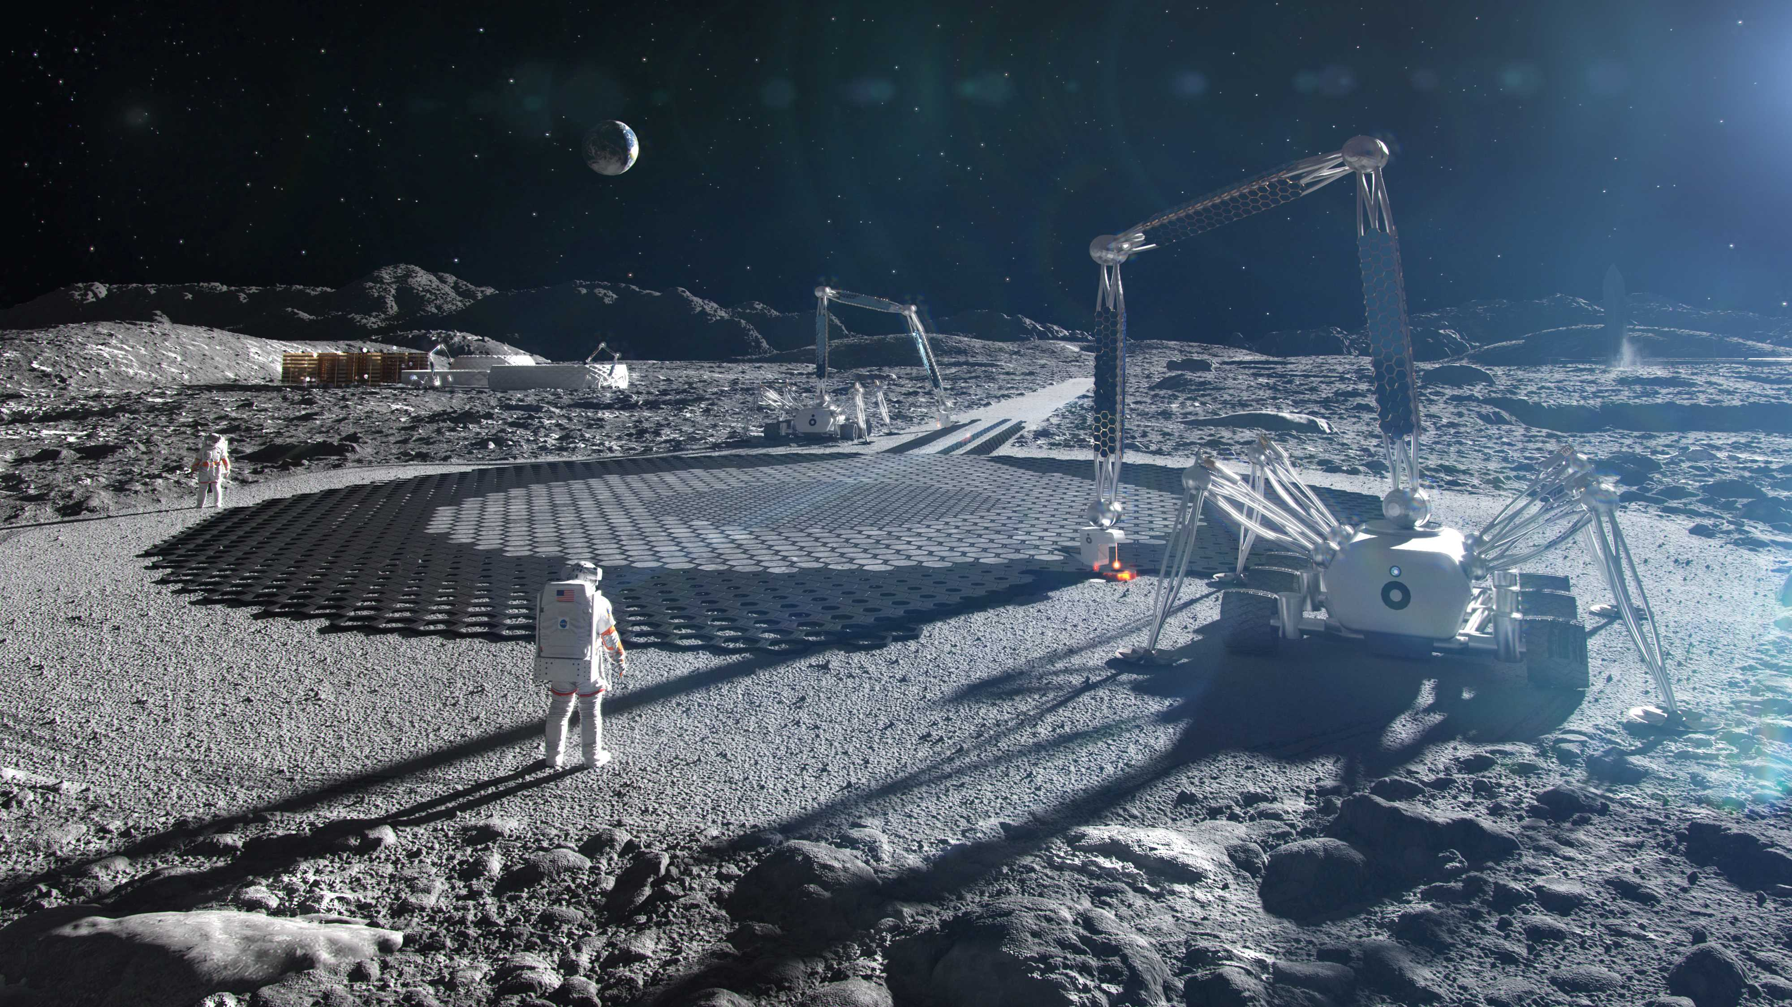
Lunar Base 1: Regolith Mining Facility
Purpose
  Provides the lunar base with local sourced materials and resources to support long-term operations.
Mining and Excavation
  Collect lunar regolith.
  Transport material to processing facility.
Resource Processing
  Extract water/ice and oxygen.
  Separate and refine useful materials.
Base Support
  Produce construction materials.
  Provide resources for life support, fuel production, and infrastructure.
Winfred Apprekuh

Slide 19
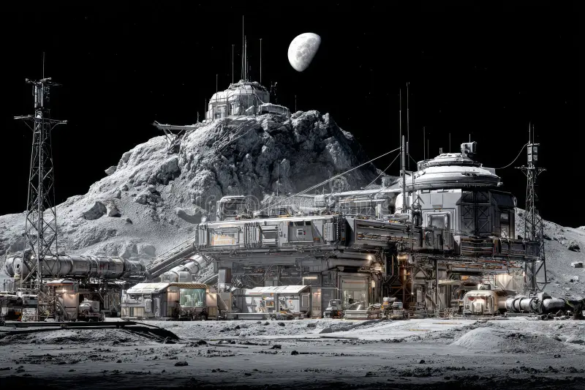
Lunar Base 2: Research Facility
Purpose
  Researches lunar resources and technologie. needed for long-term base operations.
Research and Development
  Study lunar regolith and resource extraction.
  Develop and test lunar-processing technologies.
Fuel Production
  Manufacturing machinery for fuel production.
  Convert extracted water unto hydrogen and oxygen
Technology Testing
  Test mining, processing and manufacturing equipment.
  Validate systems before full-scale deployment
Winfred Apprekuh

Slide 20
Thank you!
Any questions?

