Slide 1
A Causal Analysis of Aviation Fatalities and Their Contributing Factors
MA413-505 Final Project
Notes:
Clancy

Slide 2
Introduction of Presenters
Tayan Benson
Clancy Crawford
Brock Decker
Problem Overview and Data Source
Results Visualization
Results and Conclusion Author
Jordan Kalisher
Timothy Mascal
Seth Webster
Background Research
Causal Discovery Model Architect
Work Support (IT)
Notes:
Everyone

Slide 3
Why Statistics are Important
Why Statistics Matter
Engineering Factors
Human Factors
Vital to understand causes of lethal outcomes of aviation accidents
General aviation
1987 – 2007: 19%
2024: 16%
Crashes with fire: 13%
Fatalities from fire: 40%
Crash without fire: 15%
Crash with fire: 69%
Due to outdated/lacking fire suppression methods
Not wearing harnesses increases the percentage of lethal incidents
4x Fatality rate without harness
Jordan
Notes:
Jordan
Statistics is important to the aviation industry because we can understand many factors and causes that affect the industry, like in this case, multiple deaths due to accidents and incidents. In a twenty-year span starting in 1987, aviation had a 19% crash fatality, with it still being at 16% in 2024. These can be a variety of causes, like structural and safety failures, and human error.

Slide 4
What Drives Aviation Fatalities in Fatal Crashes?
5,000+ aviation accidents (1908–2009)
01
Real-world data + crash summaries include:
fatalities, passengers, location, cause descriptions from reports
Correlation ≠ Causation
02
Objective
03
Goal: Identify causal drivers of high-lethality crashes
Clancy
Notes:
We’re analyzing over 5,000 aviation accidents using both structured data and written crash summaries.
But instead of just looking at correlations, our goal is to understand causation—what actually drives a crash to become highly lethal.
This is important because many factors interact, and simple statistics can’t capture those relationships.
Clancy

Slide 5
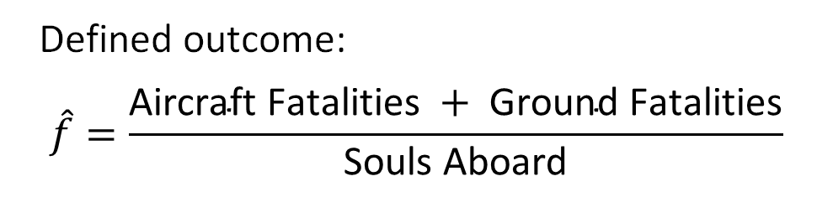
From Raw Data to a Causal Problem
Raw Crash Summaries
Binary Variables (yes/no)
Fatality Rate
Cause Categories
Weather, Mechanical, Pilot error, CFIT, etc.
Defined outcome:
$$\hat{f}=\frac{\text{Aircraft} \text{Fatalities} + \text{Ground} \text{Fatalities}}{\text{Souls} \text{Aboard}}$$
Tayan
Notes:
Tayan
The dataset includes text descriptions, so we converted those into structured variables using keyword classification—for example, identifying whether weather or mechanical failure was involved.
Each factor becomes a simple yes-or-no variable.
We also define our outcome: a crash is considered ‘high lethality’ if more than half of the passengers onboard died.
This allows us to turn a complex real-world problem into something we can model.

Slide 6
Results – Data Preparation & Classification
Dataset
Strong Accuracy Performance
Lower Accuracy Performance
5,268 aviation accidents (1908–2009)
Extracted causes from crash summaries (unstructured text)
Classified into 11 contributing factor categories
Weather (F1 ≈ 0.96)
CFIT (F1 ≈ 0.93)
Fire (F1 ≈ 0.91)
Ambiguous categories (e.g., sabotage)
Validated
Cochran's Sample Size Formula for Finite Populations (95% CI)
Manually Labeled 358 Subset
Category | TP | TN | FP | FN | Precision | Recall | F1
Sabotage | 2 | 353 | 2 | 1 | 0.5 | 0.667 | 0.571
Shot Down | 9 | 345 | 1 | 3 | 0.9 | 0.75 | 0.818
Fire | 44 | 305 | 9 | 0 | 0.83 | 1.0 | 0.907
Fuel | 8 | 350 | 0 | 0 | 1.0 | 1.0 | 1.0
Weather | 101 | 249 | 3 | 5 | 0.971 | 0.953 | 0.962
Collision | 11 | 341 | 4 | 2 | 0.733 | 0.846 | 0.786
CFIT | 133 | 204 | 14 | 7 | 0.905 | 0.95 | 0.927
Mechanical | 73 | 244 | 28 | 13 | 0.723 | 0.849 | 0.781
Pilot Error | 73 | 249 | 8 | 28 | 0.901 | 0.723 | 0.802
Undetermined | 6 | 351 | 0 | 1 | 1.0 | 0.857 | 0.923
Unknown | 50 | 288 | 19 | 1 | 0.725 | 0.98 | 0.833
Tayan
Notes:
Tayan

Slide 7
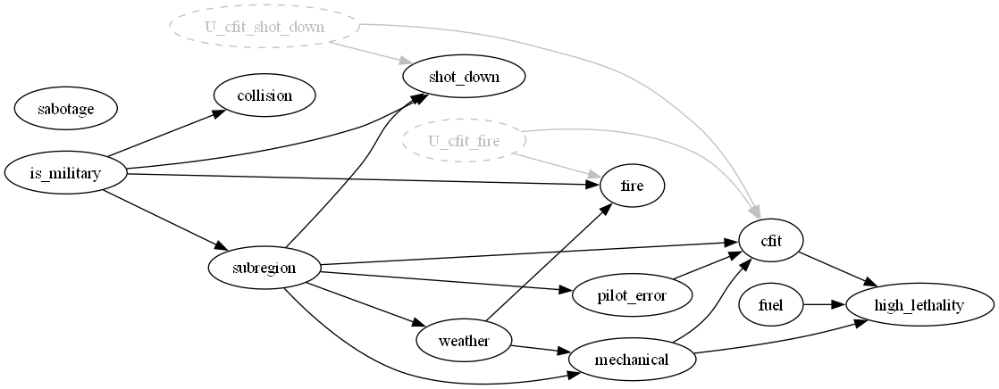
Causal Modeling Approach
Learn Structure
Apply Assumptions
FCI
Correct arrow direction
Realistic model
Interpret Graph
Accounts for hidden variables
Nodes = factors
Arrows = causal influence
Timothy
Notes:
Timothy
Our approach has three main steps.
First, we use the FCI algorithm to learn the causal structure from the data. This is important because it can handle hidden variables that we can’t directly observe.
Second, we apply real-world constraints. For example, weather can only cause events—it can’t be caused by them—and lethality must be an outcome. This ensures the model stays physically realistic.
Finally, we interpret the resulting graph. Each node represents a factor, and each arrow represents a causal influence.
For example, weather may lead to mechanical issues, which can lead to controlled flight into terrain, which significantly increases lethality.

Slide 8
Causal Discovery Algorithm
Chi-Sq
KCI
FCI + Chi-Square Test
FCI + KCI
VS
Found PAG
Works with binary variables
Efficient for large datasets
Complexity: O(n·k)
Handles hidden variable
Supports non-binary data
Much more computationally expensive
Complexity: O(n³)
Not scalable for this dataset
Timothy
Notes:
Timothy – KCI (Kernel-based Conditional Independence)

Slide 9
Assumptions
Data & Filtering
Causal
Major Crashes Only
Exogenous Variables
Subregion → root node
is_military → fully exogenous
Weather → exogenous (except subregion influence)
Exclude 1 aboard, 1 death cases
High Lethality Target
Required/Forbidden Edges
Vs
pilot_error → cfit (required)
cfit → pilot_error (forbidden)
>50% Fatality Rate
Clean Data Only
Outcome Constraint
high_lethality = sink
nodeCannot cause any other variable
Removed unknown/undetermined summaries
Bias Dataset Note
Directed by Logic
mechanical → high_lethality
Reverse direction forbidden
Dataset Only Includes Lethal Crashes
Timothy
Notes:
Timothy

Slide 10
Quantifying Causal Effects
Framework: DoWhy
Analysis
Identified unobserved confounders
Measured impact on lethality
Determined treatment sets
ATE = E[ Y | do( X = 1 )] – E[ Y | do( X = 0)]
Estimated Average Treatment Effects (ATE)
Equivalent to total causal effect for discrete binary inputs
Timothy
Notes:
Timthoy
Once we have the causal structure, we can quantify the impact of each factor.
We use the DoWhy framework to estimate Average Treatment Effects, which tells us how much a factor changes the probability of a high-lethality crash.
Importantly, this accounts for confounding variables, so we’re isolating true causal effects rather than just associations.

Slide 11
Isolation of Causal Effect
Treatment | Adjustment set | Method
cfit | {mechanical} | Backdoor
fuel | ∅ (empty) | No spurious path present
mechanical | {subregion} | Backdoor
pilot_error | {subregion} | Backdoor
weather | {subregion} | Backdoor
collision | — | NDP (effect = 0)
fire | — | NDP (effect = 0)
sabotage | — | NDP (effect = 0)
shot_down | — | NDP (effect = 0)
= No Directed Path
= Only Backdoor
= No Parents
= Control & Backdoor Via Mechanical
*NPD = No directed path
Seth
Notes:
Seth
We can check for causal effect via backdoor adjustment first. Controlling for mechanical, cfit has a backdoor to subregion via that path, and all other connections route back to subregion as well. We can rule out collisions, fire, sabotage, and getting shot down as there’s no direct path, and fuel can not be adjusted as there is no spurious path.

Slide 12
Results – Causal Structure Modeling
Approach
Challenge
FCI Algorithm
Learned causal relationships
Generated DAG
Initial model produced unrealistic relationships
Weather modeled as an effect
Title 01
Title 02
Solution
Key Insight
Added domain constraints:
Weather → cause only (except for subregion)
is_military → root node
High lethality → outcome (sink)
Domain knowledge is critical for valid causal modeling.
Title 03
Title 04
Brock
Notes:
Brock (says Jordan in teams, so I’m going with that for now)
PC Algorithm was used to learn causal relations. Generated CPDAG from observational data. Domain knowledge is critical for Valid Causal Modeling. Without knowledge of the physical constraints, a bad model would not be recognized or adjusted for. Initial model produced unrealistic relationships. Weather was modeled as an effect of other factors instead of a cause.
To fix this, weather and Military were constrained to be causes only, with High Lethality being constrained to outcome only

Slide 13
Results – Key Causal Findings
Relationships Identified
Insights
Pilot Error → Collision/CFIT
Mechanical, Fuel, CFIT → High Lethality
What we learned…
mission determines geographic location → Military aircraft
Evidence of hidden confounders
Title 01
Title 02
Risk Drivers
Limitations/Notes
Drivers of High Lethality
CFIT
Mechanical failure
Fuel-related issues
Model Caveats
Based on Sample Biased Dataset
Title 03
Title 04
Jordan
Notes:
Jordan
The Results indicate a causal relation between Adverse weather conditions and Pilot Error, with Pilot Error relating to controlled flight into terrain.
Mechanical, Fuel, and flight into terrain all related to High Lethality
Military Aircraft were heavily associated with High-Risk Scenarios
Indication of hidden confounders in play, as seen with stronger than expected links (Weather – Sabotage) or weaker than expected (Collision – Lethality)

Slide 14
Results – Causal Impact on Lethality
01 - Method
01
Linear regression used to estimate causal effects
Controlled for variables identified in DAG
02 – Relationships Tested
Weather → Lethality
Pilot Error → Lethality
Mechanical → Lethality
Fuel, CFIT, etc.
02
03 – Key Takeaways
Multiple factors significantly impact lethality
Effects depend on interactions between variables
Observational data limits full causal certainty
03
Jordan
Notes:
Jordan
Linear regression used to estimate causal effects.
Controlled identified variables within the CPDAG to remove impossible causations
Stuff that lead to high lethality
Key takeaways

Slide 15
Average Treatment Effect Results
Treatment | ATE | Interpretation
Ran out of fuel | -20.19% | Strongly protective
Mechanical Failure | -9.62% | Protective
Control Flight into Terrain (CFIT) | 6.68% | Harmful
Pilot error | -3.57% | Weakly protective
Bad Weather | 1.99% | Weakly harmful (direct only)
Collision | 0.00% | No directed path
Fire | 0.00% | No directed path
Sabotage | 0.00% | No directed path
Shot Down | 0.00% | No directed path
Seth
Notes:
Negative = Inversely Correlated

Slide 16
Conclusion
Limitations
Key Takeaways
Observational data limits full causal certainty
Presence of hidden confounders (e.g., risk tolerance, mission type)
Causal modeling provides deeper insights than correlation-based analysis
Weather and CFIT are primary drivers of crash severity
Future Works
Impact
Improve labeling using advanced NLP techniques
Incorporate additional variables (aircraft type)
Apply alternative causal discovery methods (e.g., KCI)
Enables data-driven aviation risk assessment
Supports improved safety policies and operational decisions
Brock
Notes:
Brock

Slide 17
References
[1] J. Xu, L. Chen, H. Xing, and W. Tian, “Causation Correlation Analysis of Aviation Accidents: A Knowledge Graph-Based Approach,” Applied Sciences 2024, Vol. 14, Page 6887, vol. 14, no. 16, p. 6887, Aug. 2024, doi: 10.3390/APP14166887.
[2] G. Li and S. P. Baker, “Crash risk in general aviation,” JAMA, vol. 297, no. 14, pp. 1596–1598, Apr. 2007, doi: 10.1001/JAMA.297.14.1596.
[3] G. D. Israel, “Determining Sample Size 1”, Accessed: Apr. 05, 2026. [Online]. Available: http://edis.ifas.ufl.edu.
[4] A. Sharma, E. Kiciman. "DoWhy: An End-to-End Library for Causal Inference," in arXiv preprint arXiv:2011.04216, 2020.
[5] P. Spirtes, C. Glymour, and R. Scheines, “Causation, Prediction, and Search”.
Clancy
Notes:
Clancy

