Slide 1
A Causal Analysis of Aviation Fatalities and Their Contributing Factors
MA413-505 Final Project
Notes:
CLancy

Slide 2
Introduction of Presenters
Tayan Benson
Clancy Crawford
Brock Decker
Problem Overview and Data Source
Results Visualization
Results and Conclusion Author
Jordan Kalisher
Timothy Mascal
Seth Webster
Background Research
Causal Discovery Model Architect
Work Support (IT)
Notes:
Everyone

Slide 3
Why Statistics are Important
Vital to understand causes of lethal outcomes of aviation accidents
General aviation had a 19% crash fatality rate between 1987 and 2007, still at 16% in 2024
Engineering shortcomings
Fire occurs 13% of the time with 40% of crash related deaths
Crash without fire has 15% chance of fatality
Crash with fire has 69% chance of fatality
Due to outdated/lacking fire suppression methods
Human Factors shortcomings
Not wearing harnesses increases the percentage of lethal incidents
Notes:
Seth
Statistics is important to the aviation industry because we can understand many factors and causes that affect the industry, like in this case, deaths due to accidents and incidents. In a twenty-year span starting in 1987, aviation had a 19% crash fatality, with it still being at 16% in 2024. These can be a variety of causes, like structural and safety failures, and human error.

Slide 4
What Drives Aviation Fatalities in Fatal Crashes?
5,000+ aviation accidents (1908–2009)
Real-world data + crash summaries
Includes:
fatalities, passengers, location
cause descriptions from reports
Correlation ≠ causation
Goal: identify causal drivers of high-lethality crashes
Notes:
We’re analyzing over 5,000 aviation accidents using both structured data and written crash summaries.
But instead of just looking at correlations, our goal is to understand causation—what actually drives a crash to become highly lethal.
This is important because many factors interact, and simple statistics can’t capture those relationships.
Clancy

Slide 5

From Raw Data to a Causal Problem
Extracted causes from summaries using keyword classification
weather, mechanical, pilot error, CFIT, etc.
Converted into binary variables (yes/no)
Defined outcome:
$$\hat{f}=\frac{\text{Aircraft} \text{Fatalities} + \text{Ground} \text{Fatalities}}{\text{Souls} \text{Aboard}}$$
Notes:
Timothy/Tayan
The dataset includes text descriptions, so we converted those into structured variables using keyword classification—for example, identifying whether weather or mechanical failure was involved.
Each factor becomes a simple yes-or-no variable.
We also define our outcome: a crash is considered ‘high lethality’ if more than half of the passengers onboard died.
This allows us to turn a complex real-world problem into something we can model.

Slide 6
Results – Data Preparation & Classification
Dataset & Processing
5,268 aviation accidents (1908–2009)
Extracted causes from crash summaries (unstructured text)
Classified into 11 contributing factor categories
Model Performance
Strong classification accuracy for major categories:
Weather (F1 ≈ 0.96)
CFIT (F1 ≈ 0.93)
Fire (F1 ≈ 0.91)
Lower accuracy in ambiguous categories (e.g., sabotage)
Validated using 358 Manually Labeled Subset
95% confidence interval sample size using Cochran's Sample Size Formula for Finite Populations
Category | TP | TN | FP | FN | Precision | Recall | F1
sabotage | 2 | 353 | 2 | 1 | 0.5 | 0.667 | 0.571
shot down | 9 | 345 | 1 | 3 | 0.9 | 0.75 | 0.818
fire | 44 | 305 | 9 | 0 | 0.83 | 1.0 | 0.907
fuel | 8 | 350 | 0 | 0 | 1.0 | 1.0 | 1.0
weather | 101 | 249 | 3 | 5 | 0.971 | 0.953 | 0.962
collision | 11 | 341 | 4 | 2 | 0.733 | 0.846 | 0.786
CFIT | 133 | 204 | 14 | 7 | 0.905 | 0.95 | 0.927
mechanical | 73 | 244 | 28 | 13 | 0.723 | 0.849 | 0.781
pilot error | 73 | 249 | 8 | 28 | 0.901 | 0.723 | 0.802
undetermined | 6 | 351 | 0 | 1 | 1.0 | 0.857 | 0.923
unknown | 50 | 288 | 19 | 1 | 0.725 | 0.98 | 0.833
Notes:
Timothy/Tayan

Slide 7
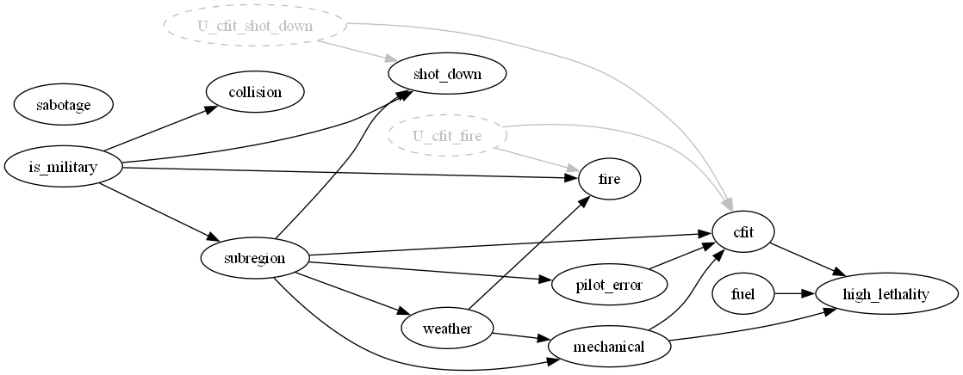
Causal Modeling Approach
Update Assumptions in Model
Learn Structure
FCI (Fast Causal Inference) algorithm
Interpret Graph
Nodes = factors
Accounts for hidden variables
Arrows = causal influence
Apply Assumptions
Notes:
Timothy
Our approach has three main steps.
First, we use the FCI algorithm to learn the causal structure from the data. This is important because it can handle hidden variables that we can’t directly observe.
Second, we apply real-world constraints. For example, weather can only cause events—it can’t be caused by them—and lethality must be an outcome. This ensures the model stays physically realistic.
Finally, we interpret the resulting graph. Each node represents a factor, and each arrow represents a causal influence.
For example, weather may lead to mechanical issues, which can lead to controlled flight into terrain, which significantly increases lethality.

Slide 8
Why FCI vs PC Algorithm for Causal Discovery
FCI vs KCI
Used FCI with Chi-Square Algorithm to find PAG
Chi-Square algorithm, works with binary system used to process data.
KCI would allow for non-binary values but is prohibitively expensive to compute.
O(n*k) vs O(n)^3
Notes:
Timothy

Slide 9
Assumptions
Only using data on Major fatal crashes, which is defined as >1 Death
Is tracing onto "High Lethality" which is defined as >50% death rate.
Excluded all events with an unknown/undetermined event summary.
Excluding all 1 aboard, 1 death events
Notes:
Timothy
Our approach has three main steps.
First, we use the FCI algorithm to learn the causal structure from the data. This is important because it can handle hidden variables that we can’t directly observe.
Second, we apply real-world constraints. For example, weather can only cause events—it can’t be caused by them—and lethality must be an outcome. This ensures the model stays physically realistic.
Finally, we interpret the resulting graph. Each node represents a factor, and each arrow represents a causal influence.
For example, weather may lead to mechanical issues, which can lead to controlled flight into terrain, which significantly increases lethality.

Slide 10
Quantifying Causal Effects
Used DoWhy framework
Estimated Average Treatment Effects (ATE)
Equivalent to Total Causal Effect for Discrete Binary Inputs
Identifies Unobserved Unknown Confounders in the DAG
Measures impact of each factor on lethality
Then used DoWhy to Identify Treatment Sets and Causal Impact of each Contributing Factor
Notes:
Timthoy
Once we have the causal structure, we can quantify the impact of each factor.
We use the DoWhy framework to estimate Average Treatment Effects, which tells us how much a factor changes the probability of a high-lethality crash.
Importantly, this accounts for confounding variables, so we’re isolating true causal effects rather than just associations.

Slide 11
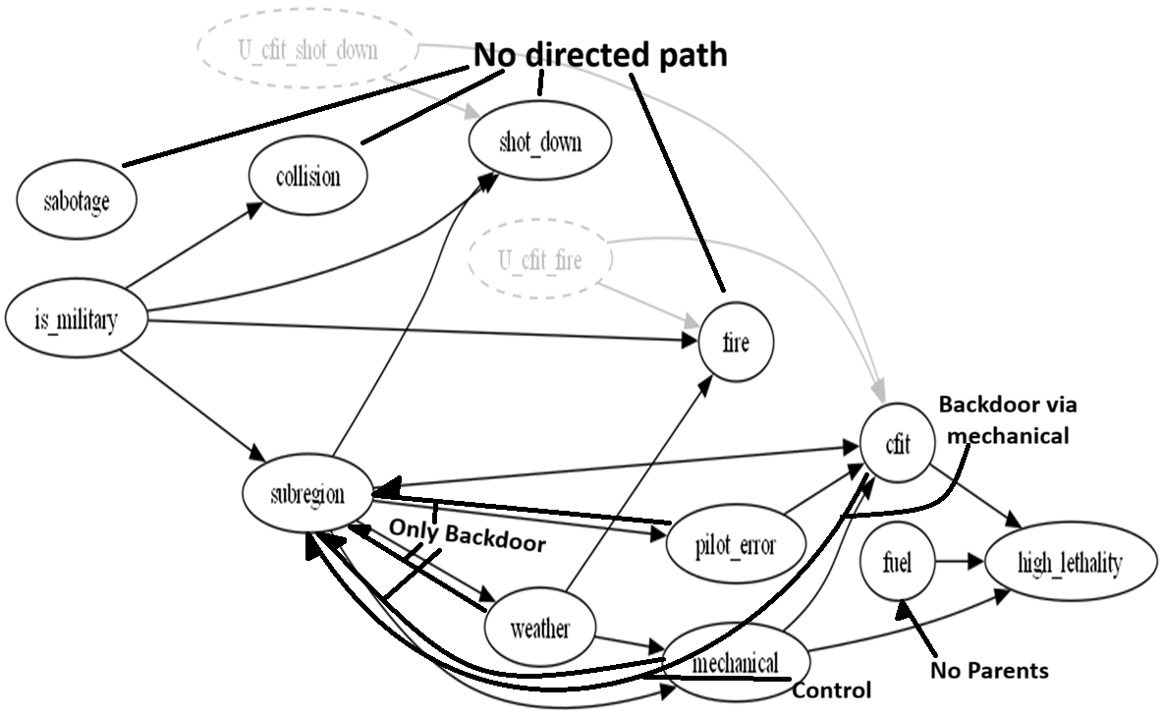
Isolation of Causal Effect
Treatment | Adjustment set | Method
cfit | {mechanical} | Backdoor Adjustment
fuel | ∅ (empty) | No spurious paths present
mechanical | {subregion} | Backdoor Adjustment
pilot_error | {subregion} | Backdoor Adjustment
weather | {subregion} | Backdoor Adjustment
collision | — | No directed path → effect set to 0
fire | — | No directed path → effect set to 0
sabotage | — | No directed path → effect set to 0
shot_down | — | No directed path → effect set to 0
Notes:
Seth
We can check for causal effect via backdoor adjustment first. Controlling for mechanical, cfit has a backdoor to subregion via that path, and all other connections route back to subregion as well. We can rule out collisions, fire, sabotage, and getting shot down as there’s no direct path, and fuel can not be adjusted as there is no spurious path.

Slide 12
Results – Causal Structure Modeling
Approach
Applied PC Algorithm to learn causal relationships
Generated CPDAG from observational data
Challenge
Initial model produced unrealistic relationships
Example: Weather modeled as an effect
Solution
Added domain constraints:
Weather → cause only (except for subregion)
is_military → root node
High lethality → outcome (sink)
Key Insight
Domain knowledge is critical for valid causal modeling
Notes:
Brock

Slide 13
Results – Key Causal Findings
Relationships Identified
Weather → Pilot Error
Pilot Error → Collision / CFIT
Mechanical, Fuel, CFIT → High Lethality
Additional Findings
Military aircraft linked to higher-risk scenarios
Some relationships suggest hidden confounders
Notes
Example artifact: Sabotage ↔ Weather
Some expected links were weak or absent (e.g., collision → lethality)
Notes:
Jordan

Slide 14
Results – Causal Impact on Lethality
01 - Method
01
Linear regression used to estimate causal effects
Controlled for variables identified in CPDAG
02 – Relationships Tested
Weather → Lethality
Pilot Error → Lethality
Mechanical → Lethality
Fuel, CFIT, etc.
02
03 – Key Takeaways
Multiple factors significantly impact lethality
Effects depend on interactions between variables
Observational data limits full causal certainty
03
Notes:
Jordan

Slide 15
Conclusion
Limitations
Key Takeaways
Observational data limits full causal certainty
Presence of hidden confounders (e.g., risk tolerance, mission type)
Causal modeling provides deeper insights than correlation-based analysis
Weather, pilot error, and mechanical issues are primary drivers of crash severity
Future Works
Impact
Improve labeling using advanced NLP techniques
Incorporate additional variables (aircraft type, region)
Apply alternative causal discovery methods (e.g., FCI)
Enables data-driven aviation risk assessment
Supports improved safety policies and operational decisions
Notes:
Brock

Slide 16
References
[1] J. Xu, L. Chen, H. Xing, and W. Tian, “Causation Correlation Analysis of Aviation Accidents: A Knowledge Graph-Based Approach,” Applied Sciences 2024, Vol. 14, Page 6887, vol. 14, no. 16, p. 6887, Aug. 2024, doi: 10.3390/APP14166887.
[2] G. Li and S. P. Baker, “Crash risk in general aviation,” JAMA, vol. 297, no. 14, pp. 1596–1598, Apr. 2007, doi: 10.1001/JAMA.297.14.1596.
[3] G. D. Israel, “Determining Sample Size 1”, Accessed: Apr. 05, 2026. [Online]. Available: http://edis.ifas.ufl.edu.
[4] Y. Zheng et al., “Causal-learn: Causal Discovery in Python Mingming Gong 4,” Journal of Machine Learning Research, vol. 25, pp. 1–7, 2024, Accessed: Apr. 05, 2026. [Online]. Available: https://github.com/py-why/
[5] P. Spirtes, C. Glymour, and R. Scheines, “Causation, Prediction, and Search”.
Notes:
Clancy

