Slide 1
Numerical Methods for Ordinary Differential Equations
Wylie Roberts, Hillary Spang, Clancy Crawford

Slide 2
Table of Contents
Problem Statement
Methods/Analysis
Solutions/Results
Discussion
Conclusion

Slide 3
Introduction
What is an ODE?
Ordinary Differential Equations model dynamic systems
Set of equations all dependent on a single variable (Generally time)
Why use numerical methods?
Save computational power over producing exact solutions
Simplify complex definite integrals

Slide 4
Problem Statement
Numerical Methods for Integration and ODE
Part 1: Implement numerical methods to approximate definite integral
Part 2: Use Simpson’s rule to approximate bags of mulch needed to fill an irregularly shaped plot
Part 3: Use Euler’s method to Estimate population growth

Slide 5


Methods and Analysis: Part 1
Numerical Methods:
Midpoint Rule:
$$\int_{a}^{b}{f\left(x\right)dx}≈h\sum_{i=1}^{N}{f\left(x_{i}\right),h=\frac{b−a}{N},x_{i}=a+\frac{2i−1}{2}h}$$
Simpson’s Rule
$$\int_{a}^{b}{f\left(x\right)dx}≈\frac{h}{3}[f\left(x_{0}\right)+4\sum_{i=1,3,5}^{N−1}{f\left(x_{i}\right)}+2\sum_{i=2,4,6}^{N−2}{f\left(x_{i}\right)}+f\left(x_{N}\right), h=\frac{b−a}{N},x_{i}=a+ih$$
Trapezoid Rule
$\int_{a}^{b}{f\left(x\right)dx≈}h\left[\frac{1}{2}f\left(x_{0}\right)+\sum_{i=1}^{N−1}{f\left(x_{i}\right)}+\frac{1}{2}f\left(x_{n}\right)\right],, h=\frac{b−a}{N},x_{i}=a+ih$
2-point Gauss-Quadrature Rule
$$\int_{a}^{b}{f\left(x\right)dx}≈\frac{h}{2}\sum_{i=1}^{N}{[f\left(x_{i})+f(x_{r})]\right)x_{l}=\frac{1}{2}\left(x_{i}+x_{i−1}−\frac{h}{\sqrt{3}}\right)x_{r}=\frac{1}{2}\left(x_{i}+x_{i−1}+\frac{h}{\sqrt{3}}\right),h=\frac{b−a}{N},x_{i}=a+\frac{2i−1}{2}h}$$
Solve Definite integral
$\int_{0}^{1}{e^{{−x}^{2}}dx}$

Slide 6
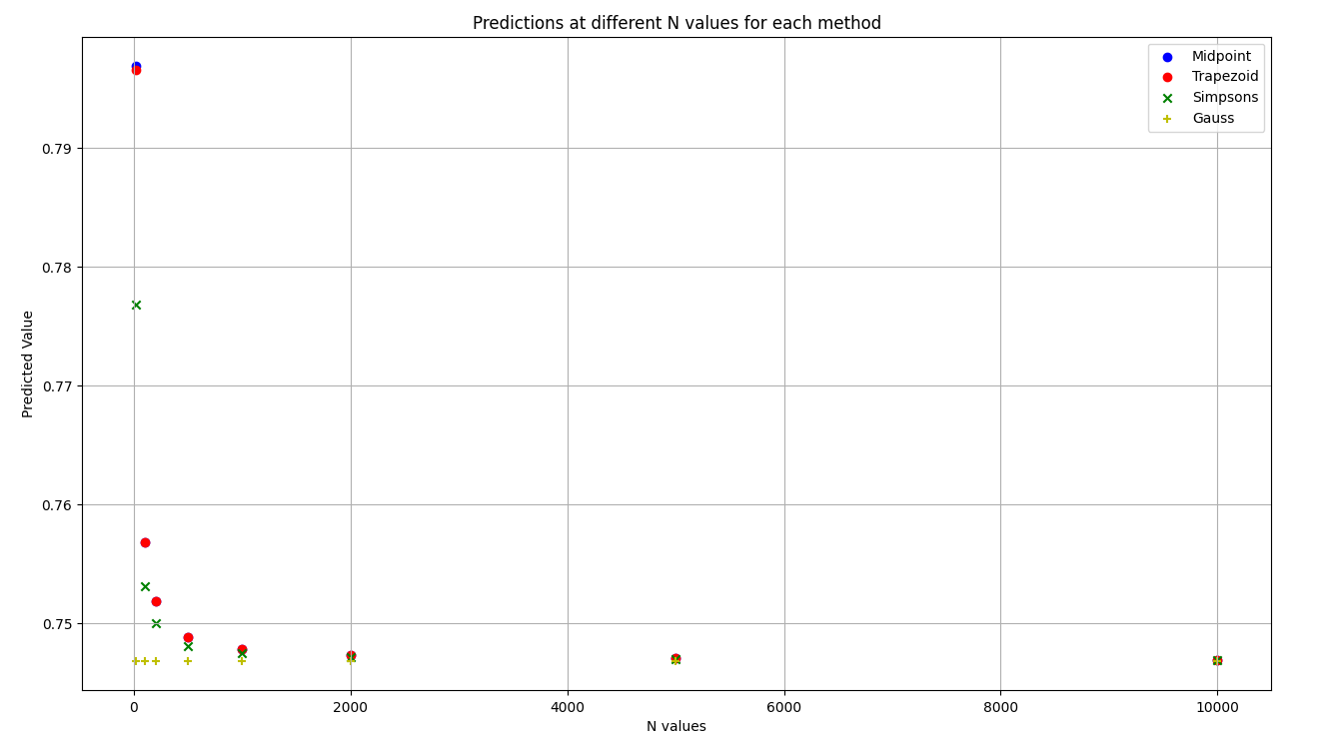
Results: Part 1
Iterations (N) | Midpoint | Simpson’s | Trapezoid | Gauss
100 | 0.756827 | 0.753083 | 0.756818 | 0.746824
500 | 0.751825 | 0.748086 | 0.748824 | 0.746824
1000 | 0.747824 | 0.747456 | 0.747824 | 0.746824
2000 | 0.747324 | 0.747140 | 0.747324 | 0.746824
5000 | 0.747024 | 0.746951 | 0.747024 | 0.746824
10000 | 0.746924 | 0.746887 | 0.746924 | 0.746824
Figure 1: table showing values of x for each numerical method at different values of N
Considering exact answers:
x = 0.74682413
Figure 2: plot of predicted values of x with increasing N values

Slide 7
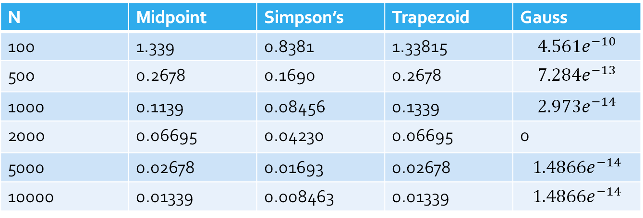
Discussion: Part 1
Considering exact answer x = 0.74682413
2-Point Gauss Quadrature Rule is the most accurate
Midpoint and Trapezoid rules are nearly identical – also least accurate
N | Midpoint | Simpson’s | Trapezoid | Gauss
100 | 1.339 | 0.8381 | 1.33815 | $$4.561e^{−10}$$
500 | 0.2678 | 0.1690 | 0.2678 | $$7.284e^{−13}$$
1000 | 0.1139 | 0.08456 | 0.1339 | $$2.973e^{−14}$$
2000 | 0.06695 | 0.04230 | 0.06695 | 0
5000 | 0.02678 | 0.01693 | 0.02678 | $$1.4866e^{−14}$$
10000 | 0.01339 | 0.008463 | 0.01339 | $$1.4866e^{−14}$$
Figure 4: table showing percent difference of each numerical method at different values of N

Slide 8
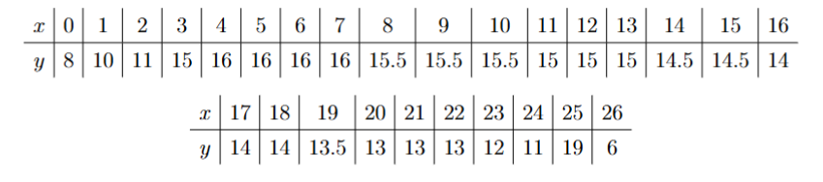
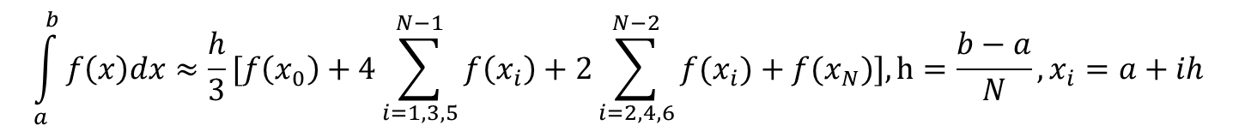
Methods and Analysis: Part 2
Use Simpson’s rule to approximate bags of mulch needed to fill an irregularly shaped plot
3 inch covering of mulch over entire plot
3 cubic feet of Bark mulch per bag
Dimensions
Simpson's Rule
$$\int_{a}^{b}{f\left(x\right)dx≈\frac{h}{3}[f\left(x_{0}\right)+4\sum_{i=1,3,5}^{N−1}{f\left(x_{i}\right)+2\sum_{i=2,4,6}^{N−2}{f(x_{i}}}})+f(x_{N})], h=\frac{b−a}{N},x_{i}=a+ih$$

Slide 9

Results
Part 2
Area of land: 359.827${ft}^{2}$
Volume of Mulch: 89.9567 ${ft}^{3}$
Bags needed: 30
Considering Exact Answers:

Slide 10
Discussion: Part 2
Simpson’s rule approximates the definite integral to find the area of an irregularly shaped plot of land
Simpson’s rule is ideal for the shape because it better follows curvatures of functions
After that It was used to find the volume of mulch need to complete the task with a 3-inch covering
With 3 cubic feet per bag, we can determine how many bags needed

Slide 11

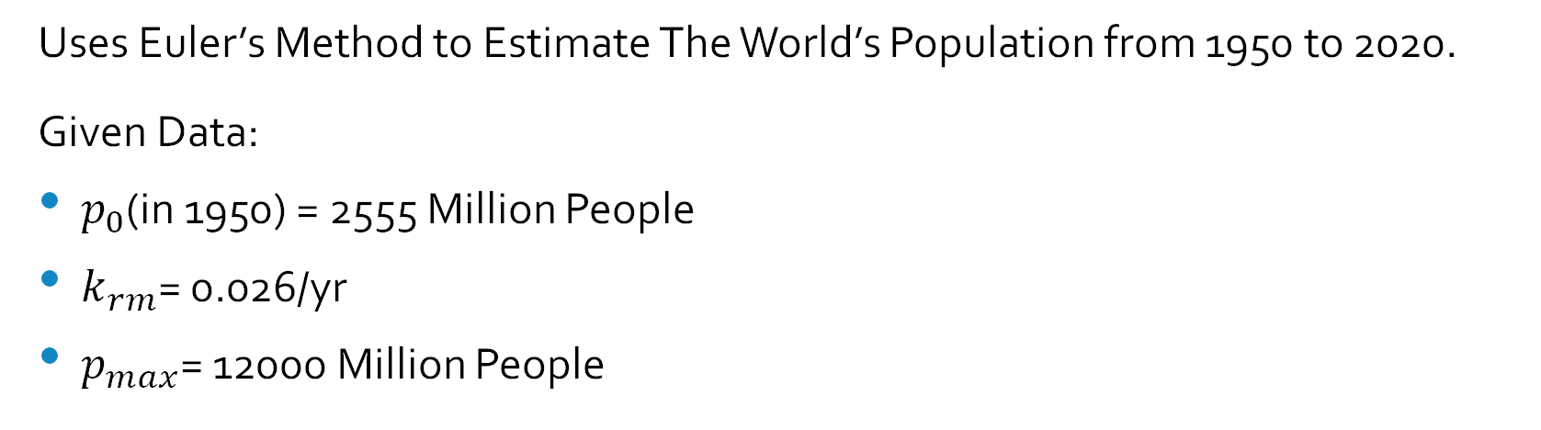
Methods and Analysis: Part 3
Uses Euler’s Method to Estimate The World’s Population from 1950 to 2020.
Given Data:
$p_{0}$(in 1950) = 2555 Million People
$k_{rm}$= 0.026/yr
$p_{max}$= 12000 Million People
Differential Equation:
$$\frac{dp}{dt}=k_{rm}\left(1−\frac{p}{p_{max}}\right)p$$
Euler’s Method:
$$p_{n+1}=p_{n}+h f(p_{n})$$
Year | 1950 | 1960 | 1970 | 1980 | 1990 | 2000 | 2010 | 2020
Population (Millions) | 2555 | 3040 | 3708 | 4454 | 5276 | 6079 | 6922 | 7753
Table above: Given world population data from 1950-2020.

Slide 12
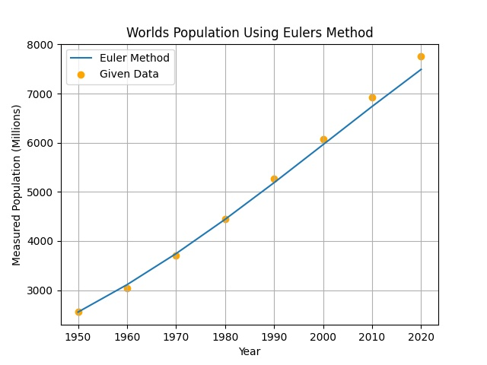
Results
Part 3:
Year | Population (Millions) | Euler Method
1950 | 2555 | 2555
1960 | 3040 | 3112.52
1970 | 3708 | 3744.33
1980 | 4454 | 4441.35
1990 | 5276 | 5187.79
2000 | 6079 | 5962.03
2010 | 6922 | 6738.84
2020 | 7753 | 7492.50
Considering exact answers:
Figure 3: Plot of exact population data vs. Euler method approximation / Table of relevant data

Slide 13
Discussion: Part 3
For Part 3, Euler’s Method shows that the population trend provides growth from 1950 to 2020. However, the first-order nature of Euler’s Method gives inaccuracy the longer the time period. As far as the scope of this class, Euler’s Method is adequate.
Year | Population (Millions) | Euler Method
1950 | 2555 | 2555
1960 | 3040 | 3112.52
1970 | 3708 | 3744.33
1980 | 4454 | 4441.35
1990 | 5276 | 5187.79
2000 | 6079 | 5962.03
2010 | 6922 | 6738.84
2020 | 7753 | 7492.50
Figure 5: table comparing exact values to Euler approximations

Slide 14
Conclusion
2-Point Gauss Quadrature Rule is the most accurate numerical method for evaluating ODEs
Simpson’s Rule is useful for approximating area and volumetric sums while maintaining simple algorithms and low computing power
Euler’s method, while more complicated, is adequate at reproducing results of an exponential growth function

