Slide 1
How vulnerabilities are abused
Using offensive security tools safely
Navigating the Darknet & Offensive Security – Responsibly
Understanding the Darknet and Tor

Slide 2
Objectives & Scope
By the end of this workshop, you will:
Understand what the darknet is (and what it is not)
Know how Tor and the Tor Browser work
Use Metasploit safely in a controlled lab
Understand what Torify does and its limitations
Recognize legal and ethical boundaries
Out of scope:
No attacks against real-world systems
No illegal activity
Notes:
One Pager noch erstellen. Tor/Torify

Slide 3
Deep Web vs. Darknet
Surface Web
Indexed by search engines
Publicly accessible websites
Deep Web
Login-protected content
Cloud services, internal portals
Darknet
Intentionally hidden networks
Requires special software (e.g. Tor)
The darknet is not automatically illegal

Slide 4
What is Tor?
Tor (The Onion Router)
Routes traffic through multiple relays
Encrypts data in multiple layers
Hides the origin of your connection
Goal:
Increase privacy and anonymity online

Slide 5
Getting Started: Tor Browser
Tor Browser
Firefox-based browser
Routes all web-traffic through Tor
Reduces tracking and fingerprinting
Best practices:
Do not log into personal accounts
Do not install browser extensions
Avoid changing window size or settings

Slide 6
Limits of Anonymity
Important to understand:
Tor does not make you invisible
Exit nodes can see unencrypted traffic
Browser fingerprinting is still possible
User behavior is often the weakest point
Anonymity = Technology + Operational Security

Slide 7
Limits of Anonymity
Please start your (Browser-)Engines
-verifying the circuits
-search for BBC, The Guardian, DeutscheWelle or Reddit – make sure search results are „onionised“
Example Guardian DropBox: http://theguardian.securedrop.tor.onion/

Slide 8
What Are Vulnerabilities?
Vulnerabilities are weaknesses in:
Software
System configuration
Network design
Human processes
Examples:
Outdated services
Open ports
Weak or default credentials

Slide 9
How Attackers Use Vulnerabilities
Typical attack phases:
Reconnaissance
Scanning
Exploitation
Post-exploitation
Purpose of this workshop:
Understand the process
Learn how to test systems defensively

Slide 10
What is Metasploit?
Metasploit Framework
Penetration testing framework
Used by security professionals
Also used by attackers
Components:
Exploits
Payloads
Auxiliary modules
Use only with explicit permission

Slide 11
Lab Environment
Why a lab setup?
Safe and legal testing
No harm to real systems
Example setup:
Attacker: Linux system with Metasploit
Target: Vulnerable VM
Network: Host-only or NAT

Slide 12
Torify & Proxychains
Torify
Routes application traffic through Tor
Example: torify msfconsole
Proxychains
Chains multiple proxies together
More control over routing
Limitations:
Not all tools work well over Tor
Increased latency and instability

Slide 13
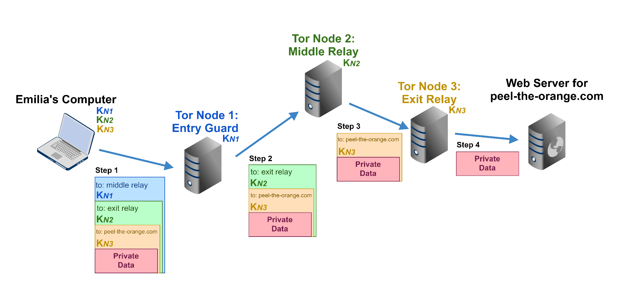
Torify & Proxychains

Slide 14
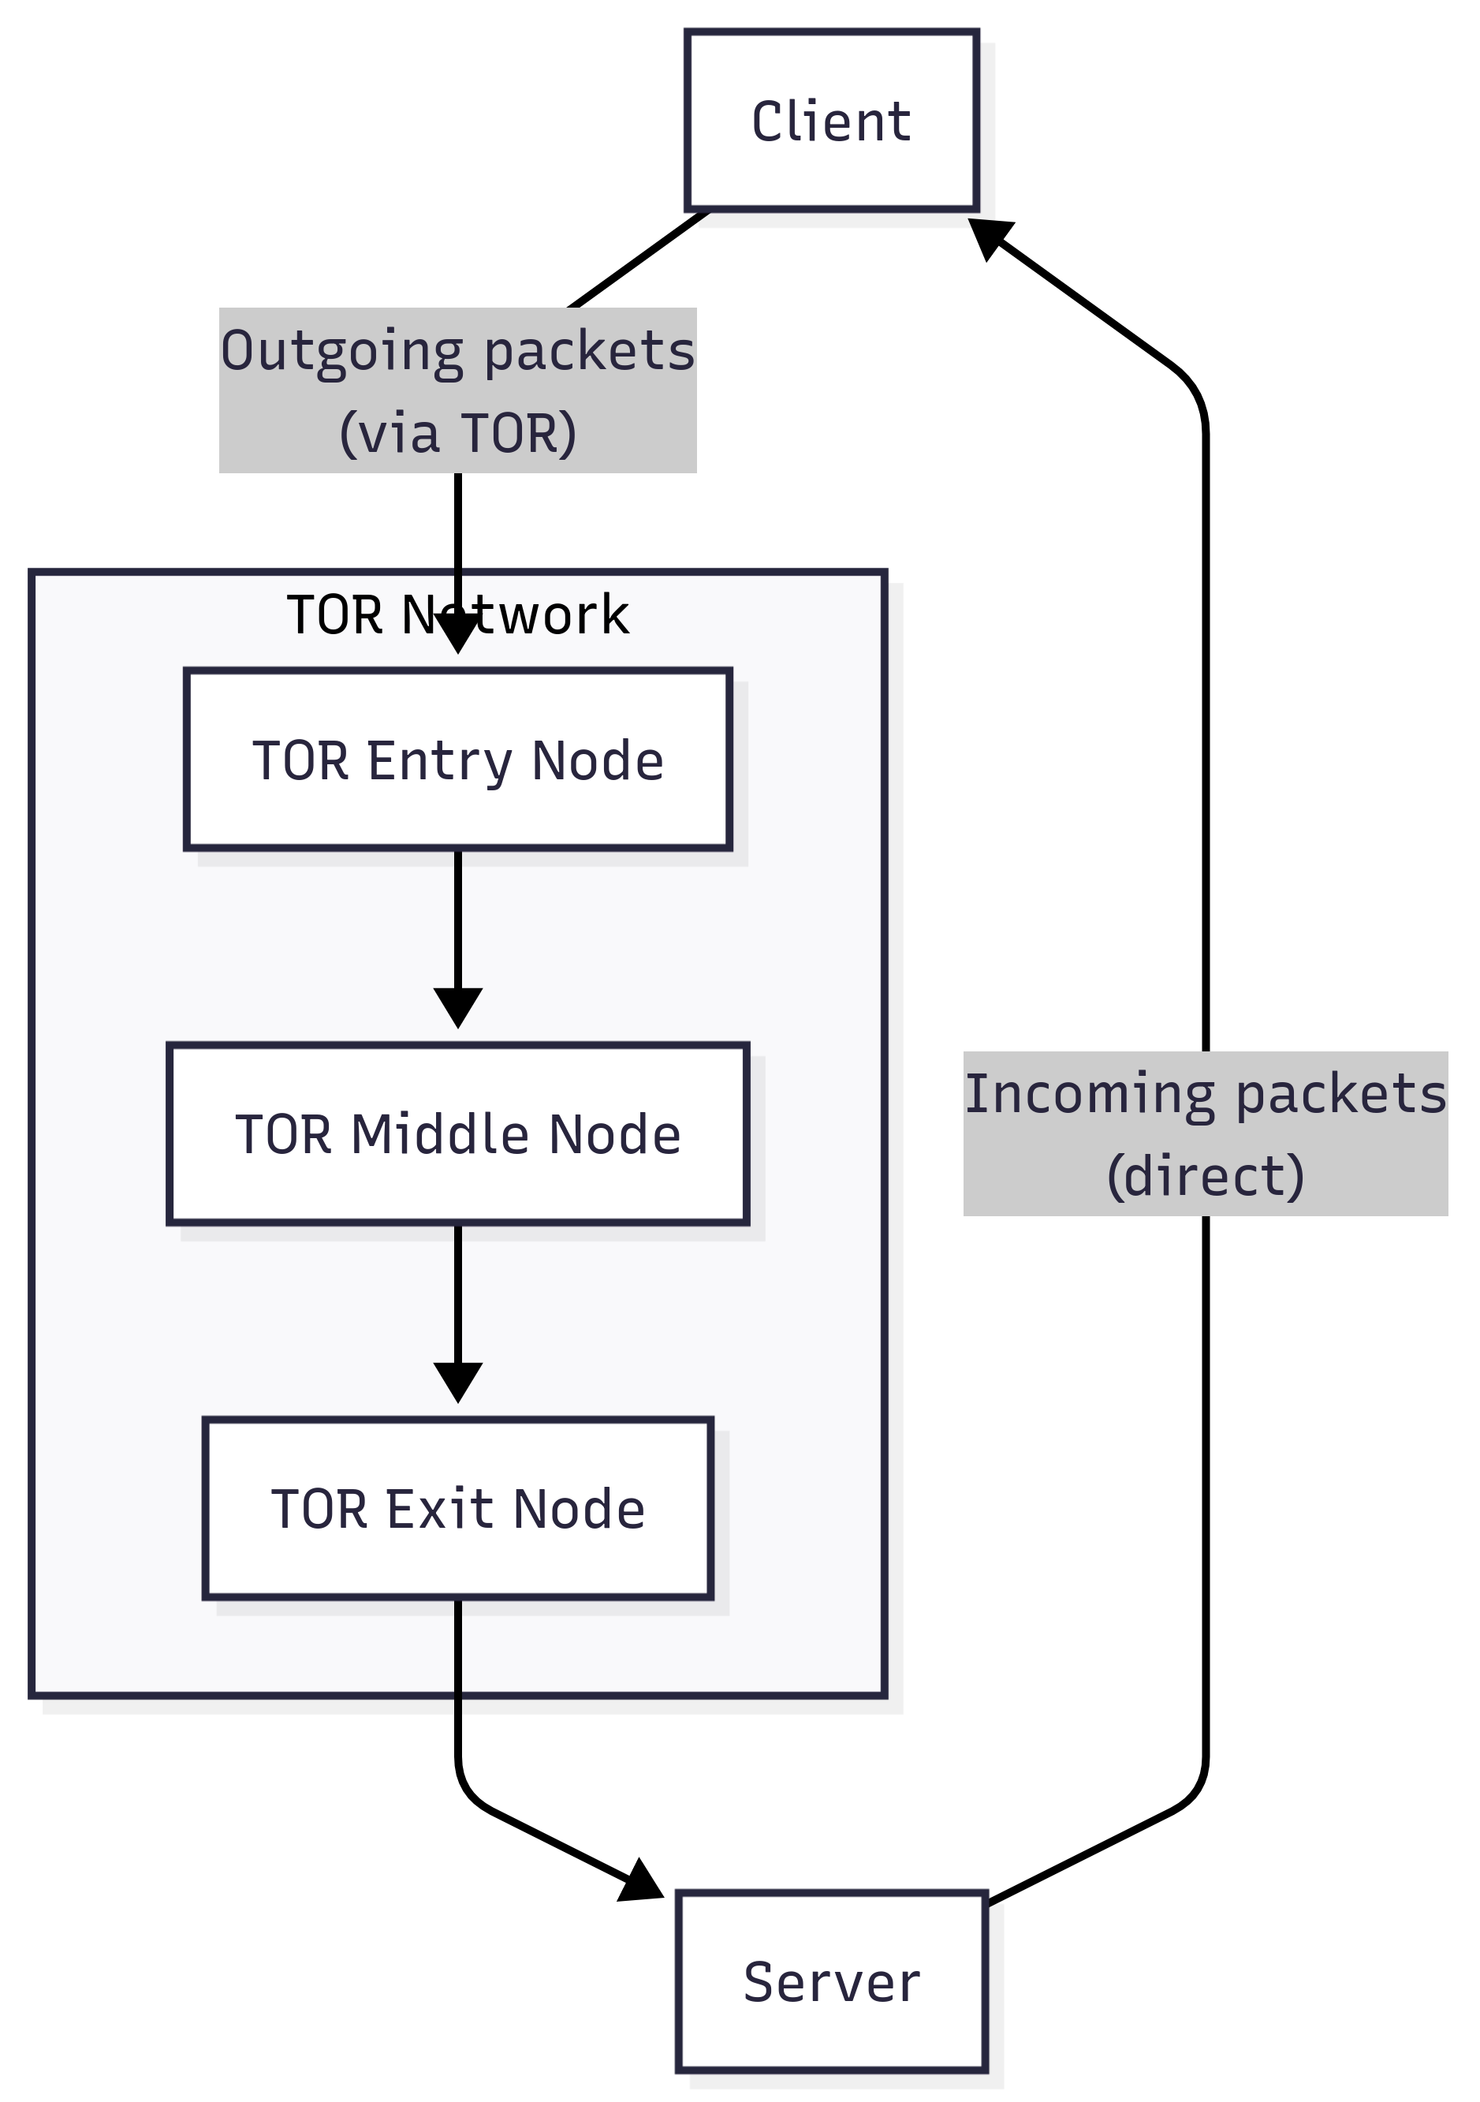
Torify & Proxychains

Slide 15
Risks & Common Mistakes
Metasploit creates very noticeable traffic
Tor does not protect against all logging
Misconfiguration leaks identity
Overconfidence is dangerous
Assume traces always exist

Slide 16
Legal & Ethical Considerations
Legal aspects:
Unauthorized testing is illegal
Permission must be explicit and documented
Ethical aspects:
Security work is about protection
No glorification of cybercrime
Responsibility comes with knowledge

Slide 17
Resources & Further Learning
OWASP WebGoat
Metasploit Unleashed
Tor Project Documentation
TryHackMe / Hack The Box Academy

Slide 18
Demo / Walkthrough (Conceptual)
What we will look at:
Starting Metasploit
Selecting a target in the lab
Understanding exploit modules
(Observing traffic behavior – if Wireshark is installed)
No real-world exploitation

Slide 19
LAB
Remember the different Hacking-Stages?
Reconnaissance
Connect to LAN (allow DHCP)
CLI-Command arp -a
Spot the server
Scanning
Look for software installed
Google for vulns/exploits
Notes:
Reconnaissance
Scanning
Exploitation
Post-exploitation

Slide 20
LAB
Exploitation
CLI: msfconsole
Search for the vuln
Use #
Set RHOSTS correctly
Exploit
Be patient!
Done.
Post-exploitation?

Slide 21
Discussion
Where do you personally draw ethical boundaries?
What risks/techniques surprised you the most?

Slide 22
Thank you for attending!
Contact: @Kresteena@mastodon.social

