Slide 1

CSCI-E89
Deep Learning
CSCIE89 Section – Harvard Extension School
https://zoom.us/j/689481777
Deep Learning - Lab 6 – Claudio Bustamante

Slide 2

CSCI-E89, Lab 6, 3-04-2018
Learning
Objectives
…
1
Keras Notes
2
Review Assignment 5
3
Week 6 – Lecture material
4
TBD - Assignment 6

Slide 3
Homework and Piazza
Document your solution in detail, please see some showcase solutions every week
Do NOT fall behind on the homework, do not wait till Thursday to read the assignment. Please start on it right away.
Read the LECTURE NOTES – lots of great content in the notes.
Help each other out in Piazza
Each homework should be an individual effort.
Submit some code even if it is incomplete for partial credit

Slide 4

Keras - Required Dependencies
Some of the most crucial dependencies are NumPy and SciPy. These are general-purpose numeric computing modules that give Python fast and efficient computations. Depending
For model configuration and saving and loading, we also need PyYAML. Further, if you want to look at the visualizations produced in this course, you'll need to install Matplotlib.
Data for this course is provided either as compressed NumPy arrays or in another common format, called High Density Format 5, used by many machine learning datasets.
Therefore I have installed the following: pip /pip3
pip install numpy pip install scipy pip install pyyaml pip install matplotlib pip install h5py pip install keras
There's just one more thing we should do before installing Keras. We need a powerful back end library to compile to. Keras supports both Theano and TensorFlow back ends. Because Keras is a flexible high-level wrapper, it doesn't really matter which back end you choose
Keras.json
{
"floatx": "float32",
"epsilon": 1e-07,
"backend": "tensorflow",
"image_data_format": “th"
}

Slide 5
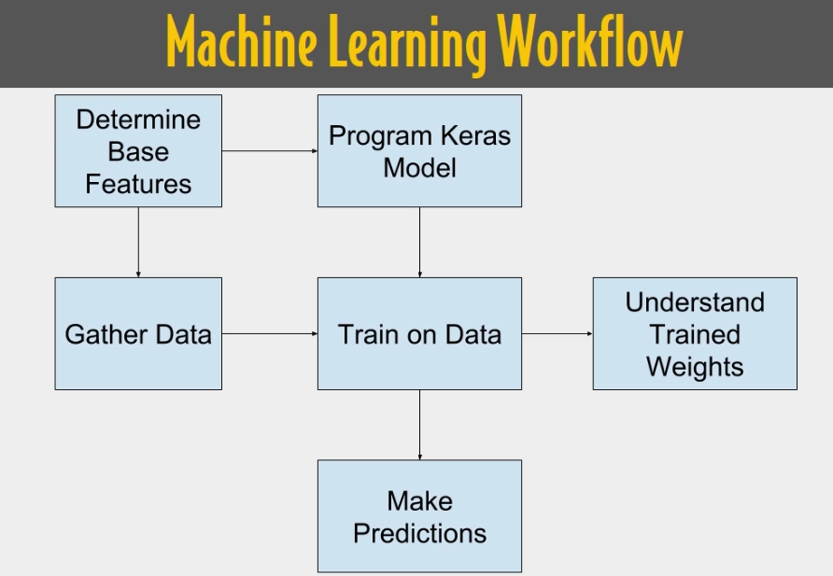
Keras Introduction
Anatomy of a neural network
As you saw in the previous lecture, training a neural network revolves around the following objects:
Layers, which are combined into a network (or model) – some more appropriate for diff tensor formats
Input data and corresponding targets
Loss function, which defines the feedback signal used for learning - measure of success
Optimizer, which determines how learning proceeds: how the network will be updated based on the loss function.
The network, composed of layers that are chained together, maps the input data to predictions. The loss function then compares these predictions to the targets, producing a loss value: a measure of how well the network’s predictions match what was expected. The optimizer uses this loss value to update the network’s weights
•

Slide 6
Review Assignment 5
Problem 1. Consider Jupyter Notebook 3.6-classifying-newswires.ipynb analyzing classification of Reuters newswires into 46 classes. Consider the model used in the notebook
model = models.Sequential()
model.add(layers.Dense(64, activation='relu',
input_shape=(10000,)))
model.add(layers.Dense(64, activation='relu'))
model.add(layers.Dense(46, activation='softmax'))
model.compile(optimizer='rmsprop',
loss='categorical_crossentropy',
metrics=['accuracy'])
model.fit(partial_x_train,
partial_y_train,
epochs=20,
batch_size=512,
validation_data=(x_val, y_val))
results = model.evaluate(x_test, one_hot_test_labels)
Determine the optimal number of epochs by training the model with one training set of
7982 samples and one validation set of 1000 samples.
Determine the accuracy of the model when trained with such optimal number of epochs.

Slide 7
Review Assignment 5
Problem 2. Run the above model with the optimal number of epochs. Determine the accuracy of the model using 4 fold validation. Model accuracy should be considered the average accuracy of all 4 training runs with one of 4 validation sets. Compare this
accuracy the accuracy obtain in Problem 1.
Please study the following post: https://machinelearningmastery.com/evaluate-performance-deep-learning-models-keras/
The gold standard for machine learning model evaluation is k-fold cross validation.
It provides a robust estimate of the performance of a model on unseen data. It does this by splitting the training dataset into k subsets and takes turns training models on all subsets except one which is held out, and evaluating model performance on the held out validation dataset. The process is repeated until all subsets are given an opportunity to be the held out validation set. The performance measure is then averaged across all models that are created.
Cross validation is often not used for evaluating deep learning models because of the greater computational expense. For example k-fold cross validation is often used with 5 or 10 folds. As such, 5 or 10 models must be constructed and evaluated, greatly adding to the evaluation time of a model.
Nevertheless, it when the problem is small enough or if you have sufficient compute resources, k-fold cross validation can give you a less biased estimate of the performance of your model.
Note: The performance is printed for each model and it is stored. The average and standard deviation of the model performance is then printed at the end of the run to provide a robust estimate of model accuracy.
There are three ways that you can estimate the performance of your deep learning models in Python using the Keras library:
Use Automatic Verification Datasets.
Use Manual Verification Datasets.
Use Manual k-Fold Cross Validation.

Slide 8
Review Assignment 5
Problem 3. Consider the model in Problem 1. Examine the effect of L2 regularization on the optimal number of epochs. Perform experiments with the Lambda value of 0.001, 0,005 and 0.0005. Present the dependence of the optimal number of epochs on the varying regularization parameter.
history_orig = history
history_reg = []
test_loss_and_accuracy = []
lambdas = [0.001, 0.005, 0.0005]
for llambda in lambdas:
model = models.Sequential()
model.add(layers.Dense(64, kernel_regularizer=regularizers.l2(llambda), activation='relu', input_shape=(10000,)))
model.add(layers.Dense(64, kernel_regularizer=regularizers.l2(llambda), activation='relu'))
model.add(layers.Dense(46, kernel_regularizer=regularizers.l2(llambda), activation='softmax'))
model.compile(optimizer='rmsprop', loss='categorical_crossentropy', metrics=['accuracy'])
history = model.fit(partial_x_train,
partial_y_train,
epochs=20,
batch_size=512,
validation_data=(x_val, y_val))
history_reg.append(history)
test_loss_and_accuracy.append(model.evaluate(x_test, one_hot_test_labels))

Slide 9
Keras – CNN-1
Understanding convolutional neural networks (convnets)
Using data augmentation to mitigate overfitting
Using a pretrained convnet to do feature extraction
Fine-tuning a pretrained convnet
Visualizing what convnets learn and how they make classification decisions
https://keras.io/layers/convolutional/
The following lines of code show you what a basic convnet looks like. It’s a stack of Conv2D and MaxPooling2D layers
Importantly, a convnet takes as input tensors of shape (image_height, image_width, image_channels) (not including the batch dimension). In this case, we’ll configure the convnet to process inputs of size (28, 28, 1), which is the format of MNIST images.
The number of channels is controlled by the first argument passed to the Conv2D layers (e.g. 32 or 64).
The next step is to feed the last output tensor (of shape (3, 3, 64)) into a densely connected classifier network like those you’re already familiar with: a stack of Dense layers.
model.summary(): prints a summary representation of your model. Shortcut for utils.print_summary
https://keras.io/optimizers/#parameters-common-to-all-keras-optimizers
The (3, 3, 64) outputs are flattened into vectors of shape (576,) before going through two Dense layers.
But why does this simple convnet work so well, compared to a densely connected model? let’s dive into what the Conv2D and MaxPooling2D layers do.

Slide 10
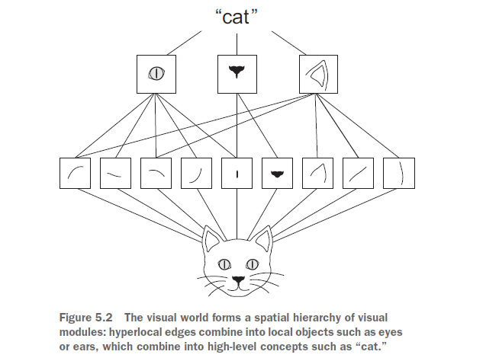
Keras – CNN-2
The fundamental difference between a densely connected layer and a convolution layer is this: Dense layers learn global patterns in their input feature space (for example, for a MNIST digit, patterns involving all pixels), whereas convolution layers learn local patterns (see figure 5.1), in the case of images, patterns found in small 2D windows
of the inputs.
Images can be broken into local patterns such as edges, textures, and so on.
This key characteristic gives convnets two interesting properties:
(1) The patterns they learn are translation invariant. After learning a certain pattern in the lower-right corner of a picture, a convnet can recognize it anywhere
(2) They can learn spatial hierarchies of patterns (see figure 5.2). A first convolution layer will learn small local patterns such as edges, a second convolution layer will learn larger patterns made of the features of the first layers, and so on.
Convolutions operate over 3D tensors, called feature maps, with two spatial axes (height and width) as well as a depth axis (also called the channels axis). For an RGB image, the dimension of the depth axis is 3, because the image has three color channels: red, green, and blue.

Slide 11
Keras – CNN-3
Convolutions are defined by two key parameters:
Size of the patches extracted from the inputs—These are typically 3 × 3 or 5 × 5.
Depth of the output feature map—The number of filters computed by the convolution
In the MNIST example, the first convolution layer takes a feature map of size (28,28, 1) and outputs a feature map of size (26, 26, 32): it computes 32 filters over its input.
That is what the term feature map means: every dimension in the depth axis is a feature (or filter), and the 2D tensor output[:, :, n] is the 2D spatial map of the response of this filter over the input.
A convolution works by sliding these windows of size 3 × 3 or 5 × 5 over the 3D input feature map, stopping at every possible location, and extracting the 3D patch of surrounding features (shape (window_height, window_width, input_depth)).
Training a convnet from scratch on a small dataset
As a practical example, we’ll focus on classifying images as dogs or cats, in a dataset containing 4,000 pictures of (2,000 cats, 2,000 dogs). We’ll use 2,000 pictures for training—1,000 for validation, and 1,000 for testing
This will get you to a classification base line accuracy of 71%. At that point, the main issue will be overfitting. Then we’ll introduce data augmentation, a powerful technique for mitigating overfitting in computer vision. By using data augmentation, you’ll improve the network to reach an accuracy of 82%.
Data files: https://www.kaggle.com/c/dogs-vs-cats/data, The Dogs vs. Cats dataset that you’ll use isn’t packaged with Keras.
So we have indeed 2000 training images, and then 1000 validation images and 1000 test images. In each split, there is the same number of samples from each class: this is a balanced binary classification problem, which means that classification accuracy will be an appropriate measure of success.
https://github.com/Kulbear/deep-learning-nano-foundation/wiki/ReLU-and-Softmax-Activation-Functions

Slide 12
Keras – CNN-4
Data preprocessing
As you know by now, data should be formatted into appropriately preprocessed floating point tensors before being fed into the network. The data sits on a drive as JPEG files, so the steps for getting it into the network are roughly as follows:
Read the picture files.
Decode the JPEG content to RGB grids of pixels.
Convert these into floating-point tensors.
Rescale the pixel values (between 0 and 255) to the [0, 1] interval (as you know, neural networks prefer to deal with small input values).
It may seem a bit daunting, but fortunately Keras has utilities to take care of these steps automatically. Keras has a module with image-processing helper tools, located at keras.preprocessing.image. In particular, it contains the class ImageDataGenerator, which lets you quickly set up Python generators that can automatically turn image files on disk into batches of preprocessed tensors.
These plots are characteristic of overfitting. Our training accuracy increases linearly over time, until it reaches nearly 100%, while our validation accuracy stalls at 70-72%. Our validation loss reaches its minimum after only five epochs then stalls, while the training loss keeps decreasing linearly until it reaches nearly 0.
Because we only have relatively few training samples (2000), overfitting is going to be our number one concern. You already know about a number of techniques that can help mitigate overfitting, such as dropout and weight decay (L2 regularization).
Introduce a new technique, specific to computer vision, and used almost universally when processing images with deep learning models: data augmentation.

Slide 13
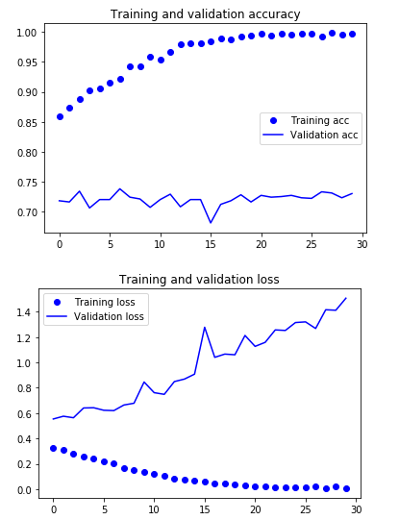
Keras – CNN-5
These plots are characteristic of overfitting. The training accuracy increases linearly over time, until it reaches nearly 100%, whereas the validation accuracy stalls at 70–72%.
The validation loss reaches its minimum after only five epochs and then stalls, whereas the training loss keeps decreasing linearly until it reaches nearly 0.
Because you have relatively few training samples (2,000), overfitting will be your number-one concern. You already know about a number of techniques that can help
mitigate overfitting, such as dropout and weight decay (L2 regularization).

Slide 14
Keras – CNN-6
Using data augmentation
Data augmentation takes the approach of generating more training data from existing training samples, by augmenting the samples via a number of random transformations that yield believable-looking images. The goal is that at training time, your model will never see the exact same picture twice. This helps expose the model
to more aspects of the data and generalize better. In Keras, this can be done by configuring a number of random transformations to be performed on the images read by the ImageDataGenerator instance. Let’s get started with an example.
These are just a few of the options available (for more, see the Keras documentation).
Let’s quickly go over this code:
rotation_range is a value in degrees (0–180), a range within which to randomly rotate pictures.
width_shift and height_shift are ranges (as a fraction of total width or height) within which to randomly translate pictures vertically or horizontally.
shear_range is for randomly applying shearing transformations.
zoom_range is for randomly zooming inside pictures.
horizontal_flip is for randomly flipping half the images horizontally—relevant when there are no assumptions of horizontal asymmetry (for example, real-world pictures).
fill_mode is the strategy used for filling in newly created pixels, which can appear after a rotation or a width/height shift.
To further fight overfitting, you’ll also add a Dropout layer to your model, right before the densely connected classifier

Slide 15
Keras – CNN-7
Using a pretrained convnet
A common and highly effective approach to deep learning on small image datasets is
to use a pretrained network. A pretrained network is a saved network that was previously trained on a large dataset, typically on a large-scale image-classification task
A common and highly effective approach to deep learning on small image datasets is to use a pretrained network. A pretrained network is a saved network that was previously trained on a large dataset, typically on a large-scale image-classification task
In this case, let’s consider a large convnet trained on the ImageNet dataset (1.4 million labeled images and 1,000 different classes). ImageNet contains many animal classes, including different species of cats and dogs, and you can thus expect to perform well on the dogs-versus-cats classification problem. You’ll use the VGG16 architecture, developed by Karen…
Feature extraction
Feature extraction consists of using the representations learned by a previous network to extract interesting features from new samples. These features are then run through a new classifier, which is trained from scratch.
Feature extraction consists of taking the convolutional base of a previously trained network, running the new data through it, and training a new classifier on top of the output

Slide 16
Keras – CNN-8
The VGG16 model, among others, comes prepackaged with Keras. You can import it from the keras.applications module. Here’s the list of image-classification models (all pretrained on the ImageNet dataset)
You pass three arguments to the constructor:
Weights: specifies the weight checkpoint from which to initialize the model
Include_top: refers to including (or not) the densely connected classifier on top of the network. By default, this densely connected classifier corresponds to the 1,000 classes from ImageNet. Because you intend to use your own densely connected classifier (with only two classes: cat and dog), you don’t need to include it.
Input_shape: is the shape of the image tensors that you’ll feed to the network.
This argument is purely optional: if you don’t pass it, the network will be able to process inputs of any size.

