Slide 1
ROLLOUT PROPOSAL
Accreditation Survey Prep
From a specialist's spreadsheet to a department-wide system
The Survey Prep App runs an accreditation readiness visit end to end — nine binder and field checklists, the OP 541 / 541T self-audit reconciliation, JC 427 personnel records, every export the visit produces, and a company-wide trend dashboard built from all of it.
BUILT
COST
ASK
In production use
No licence fee
Approve the rollout
Prepared by the Accreditation Department · July 2026
Rotech Accreditation · Survey Prep App
1
Notes:
Framing: this is not a request to build something. It already exists and is being used. The ask is to make it the department standard and fund the small amount of work left.

Slide 2
EXECUTIVE SUMMARY
What we are asking for
Three decisions, none of which require new headcount or a software purchase.
1
Approve the rollout
Make the Survey Prep App the standard tool for every accreditation readiness visit, replacing the current mix of paper forms, Word write-ups and personal spreadsheets.
2
Approve the weighting model
Add severity weighting to every checklist item so the trend data ranks sites by risk, not by how many boxes happened to be ticked.
3
Confirm ownership
Name the department owner and the support path, so the tool is a departmental asset rather than one specialist's side project.
Rotech Accreditation · Survey Prep App
2
Notes:
Keep this slide up while taking questions at the end — everything else in the deck supports one of these three.

Slide 3
THE CASE
The same visit, before and after
Nothing about the standards changes. What changes is how many times a specialist retypes the same finding.
TODAY
WITH THE APP
Paper or Word checklists carried into the location
Findings retyped into an email, then again into a tracker
OP 541 self-audit compared to on-site answers by eye
JC 427 expiry dates worked out by hand, per employee
Follow-up chased by phone and email, status in one head
No company-wide view — every visit ends in its own file
One tool on a laptop or iPad, offline-capable
Findings entered once; every output is generated from them
Self-audit uploaded — the app flags every disagreement
Expiry status colour-coded automatically, 3-year rule built in
A shared checklist link the manager ticks off in real time
Every finalized visit feeds one live trend dashboard
Rotech Accreditation · Survey Prep App
3
Notes:
The point is not that specialists are slow. It is that the current process makes them enter the same finding four or five times, and none of those copies talk to each other.

Slide 4
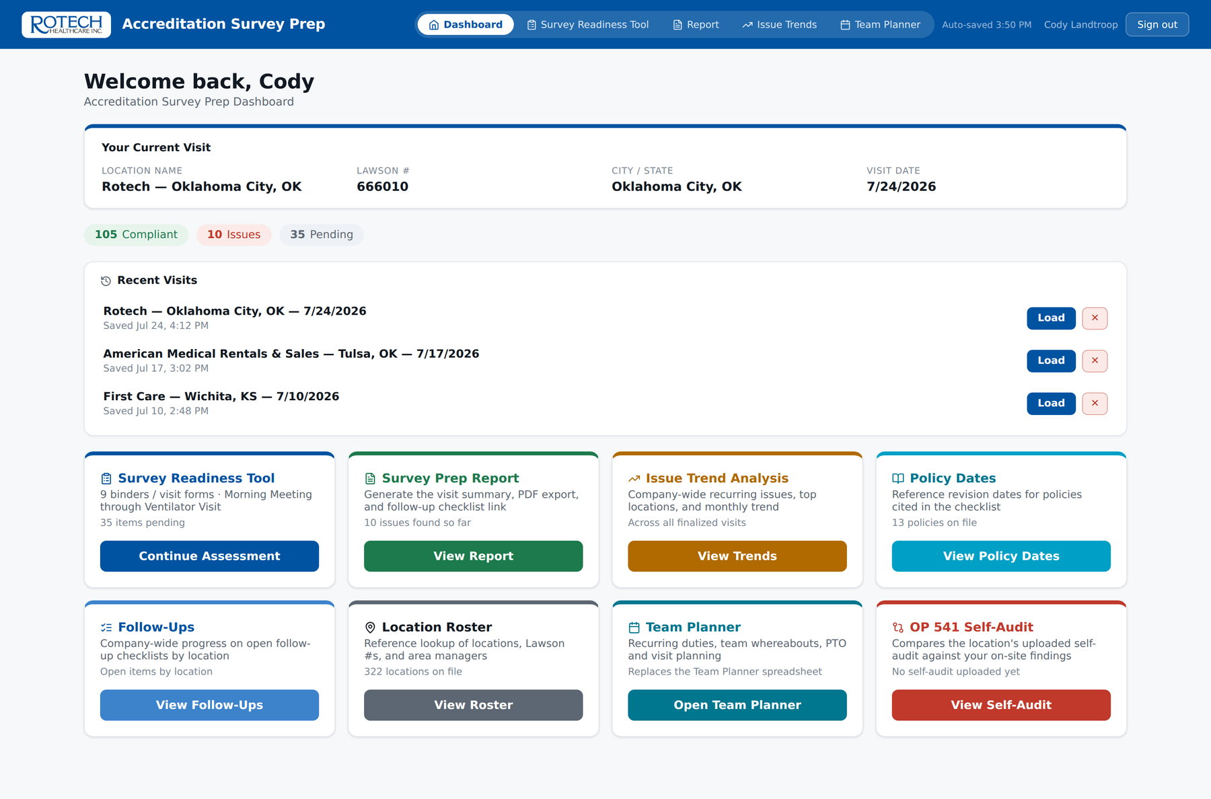
THE APP
One place to start, everything one click away
The dashboard opens on the visit in progress, with every module reachable from a single card.
Visit in progress
Location, Lawson #, city and date carried into every output
Live counters
Compliant / issues / pending across all 174 checklist items
Resume anywhere
Saved visits sync, so an iPad start finishes at a desk
Eight modules
Checklists, report, trends, policy dates, roster, follow-ups, planner
Specialist dashboard — visit in progress, recent visits, and the eight modules
Rotech Accreditation · Survey Prep App
4
Notes:
Everything in the rest of the deck is reachable from this screen. Note the counters at the top — they are live across every tab, so a specialist always knows what is still unanswered.

Slide 5
01
9 checklists
Binders 1–5 plus four field-visit forms
A visit, end to end
174 items
Every item tied to its policy and form reference
Follow one accreditation readiness visit from the moment it is created to the moment the follow-up closes.
2 uploads
OP 541 and OP 541T self-audits reconciled
1 entry
Answered once, reused by every output
Rotech Accreditation · Survey Prep App
5

Slide 6
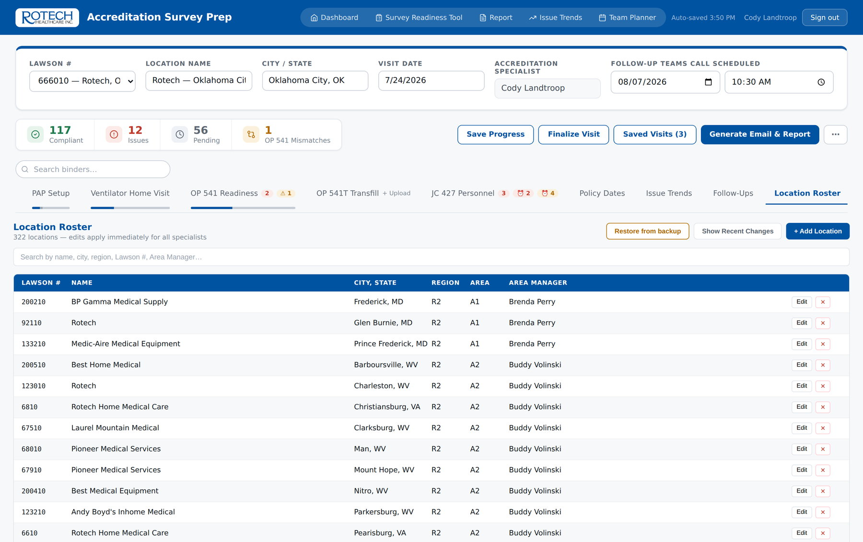
STEP 1 · SET UP
The visit starts from the roster, not a blank page
Picking the Lawson number fills in the location, city, region, area code and area manager.
322 locations on file, maintained in the app by admins — no code change, no redeploy
Region and area manager travel with every finding, so trend data rolls up the org chart automatically
Every roster edit writes an immutable audit entry with a full before/after snapshot
A standing backup can be restored from the roster tab in one click
Location Roster — the company-wide reference every visit draws from
Rotech Accreditation · Survey Prep App
6
Notes:
This is why the trend data can be sliced by region and area manager without anyone typing a region name.

Slide 7
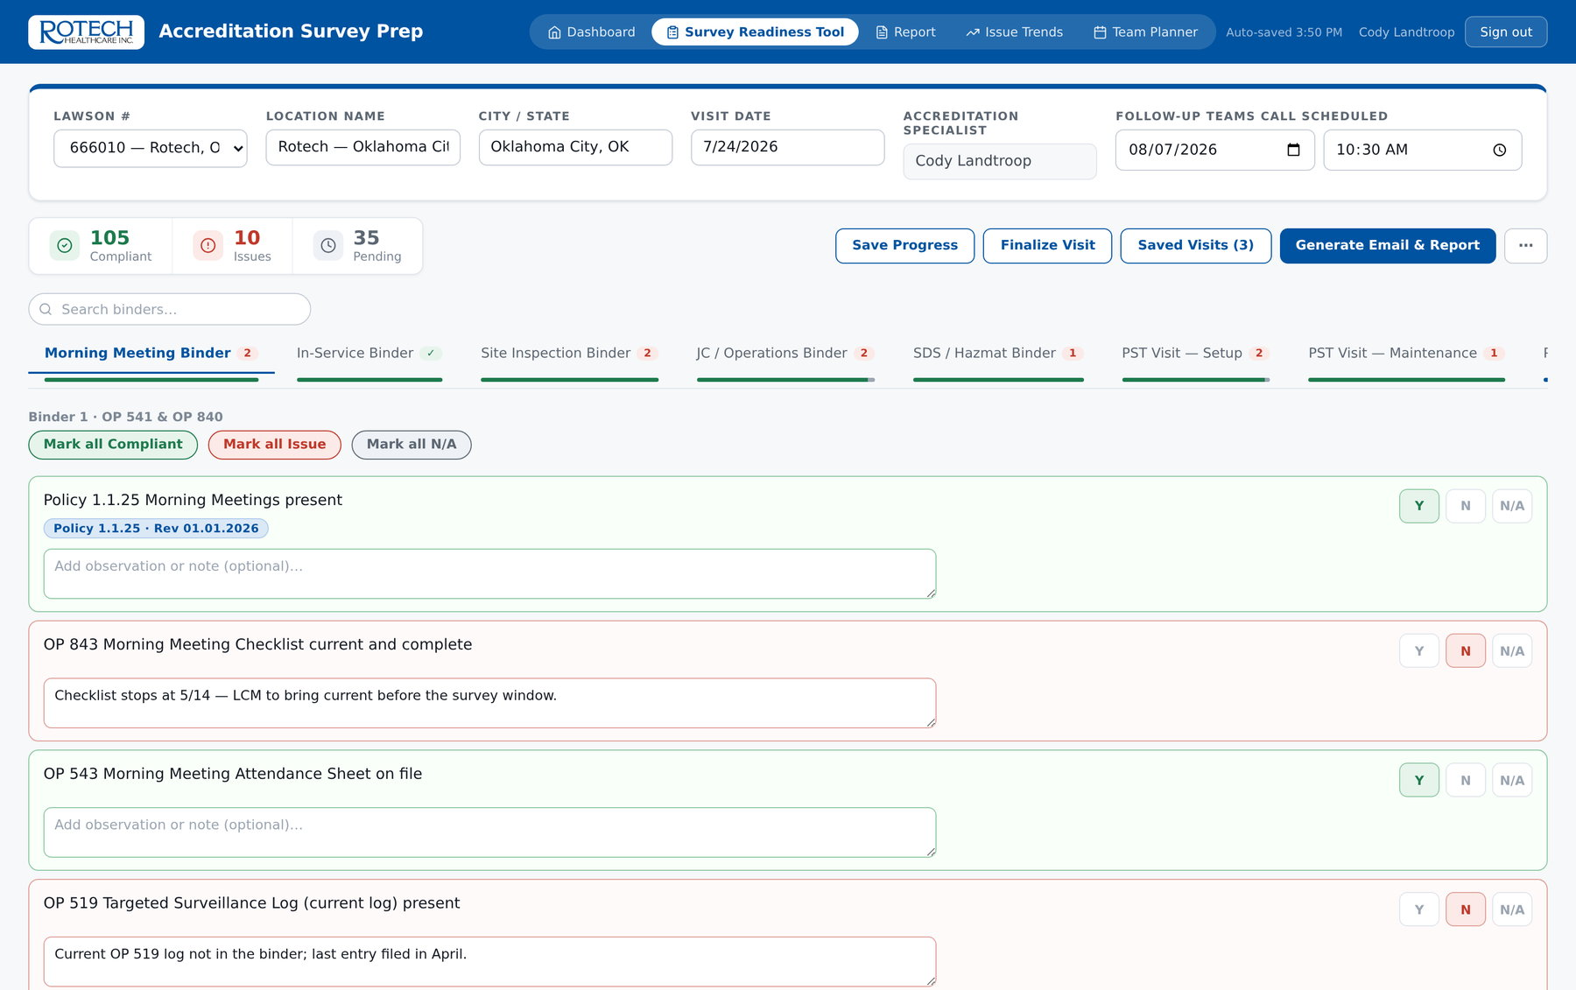
STEP 2 · BINDERS
Nine checklists, each tied to its form and policy
Y / N / N-A on every item, with a note field that becomes the corrective action wording later.
Binders 1–5: Morning Meeting, In-Service, Site Inspection, JC / Operations, SDS / Hazmat
Policy numbers cited in an item show the current revision date as a badge — no separate lookup
Guidance notes from the real forms sit under the items that need them
The tab rail shows issue counts and a progress bar per binder, so nothing is left half-done
Morning Meeting Binder — answers, notes and policy revision badges
Rotech Accreditation · Survey Prep App
7

Slide 8
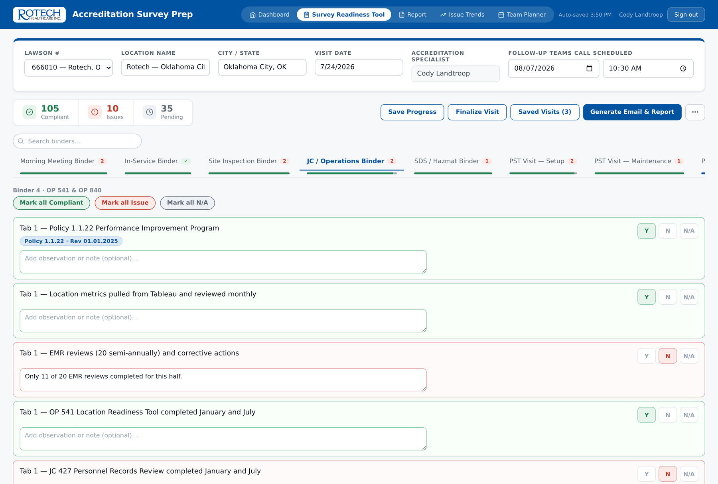
STEP 2 · BINDERS
The long ones stay manageable
The JC / Operations binder alone runs 24 items across five tabs of the real binder.
Answer once
The note typed here becomes the email wording, the report line, the tracker row and the follow-up item
Nothing lost
Every keystroke is auto-saved locally; an app update mid-visit cannot wipe the answers
Progress visible
Per-binder counts mean a specialist can stop and resume without re-reading the whole form
JC / Operations Binder — 24 items, tab-by-tab, with the note field open on every finding
Rotech Accreditation · Survey Prep App
8

Slide 9
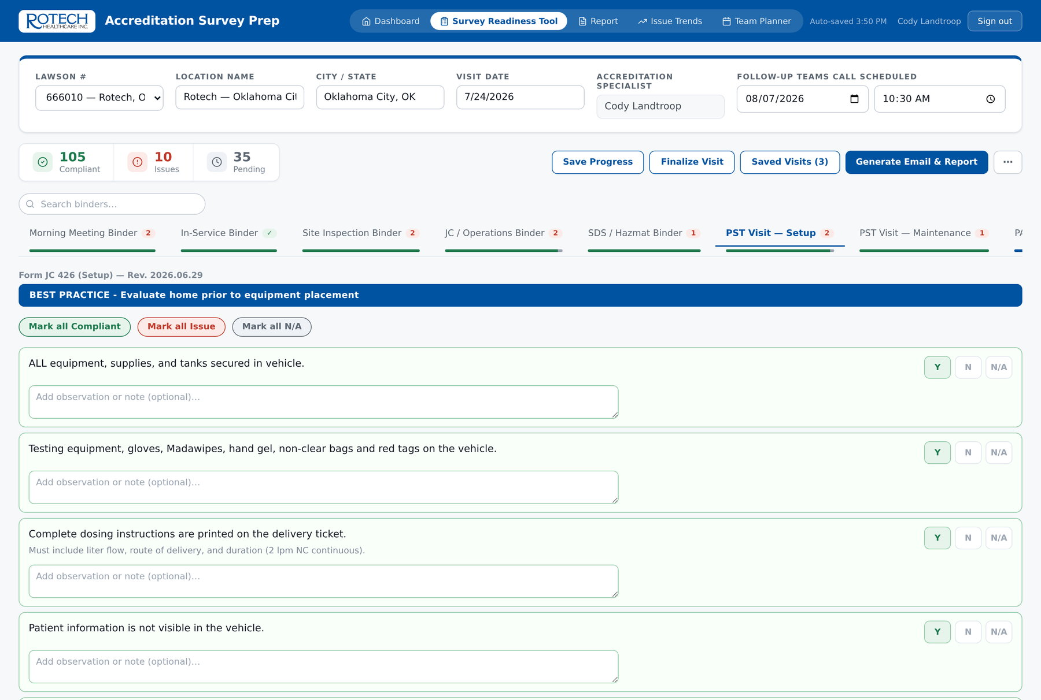
STEP 3 · FIELD VISITS
PST, PAP and ventilator home visits
Four field forms — JC 426 Setup, JC 426 Maintenance, JC 424 PAP and JC 423 Ventilator — with the guidance in place.
27 items on a PST setup, each with the same coaching text the paper form carries
Patient Global ID and current Rx recorded per visit type
A free-text visit note per form, which lands in the report and the trend record
Items reference the real forms and revision dates, so the app tracks the form, not a copy of it
PST Visit — Setup (JC 426), with patient info and per-item guidance
Rotech Accreditation · Survey Prep App
9

Slide 10
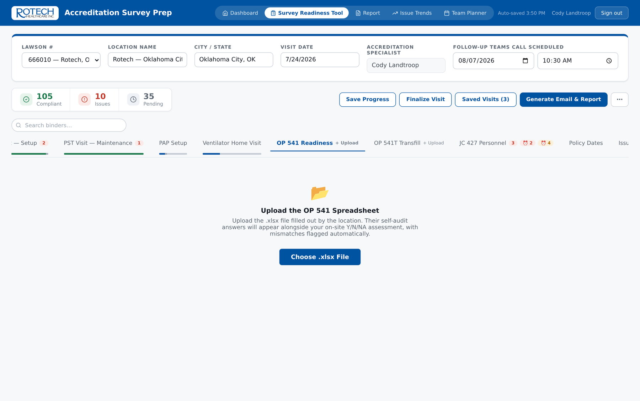
STEP 4 · OP 541
The location's self-audit, uploaded and read
The location completes OP 541 before the visit. The app parses that workbook — every sheet, every row.
Sheet layout is discovered, not hardcoded: the parser finds the LOCATION column and works from there
Vehicle sheets are recognised by their unit number and grouped separately
Re-uploading the same file never wipes answers already entered — items are matched by parse order
The uploaded file itself is never stored anywhere; only the answers are
OP 541 tab before upload — the self-audit is dropped straight in
Rotech Accreditation · Survey Prep App
10

Slide 11
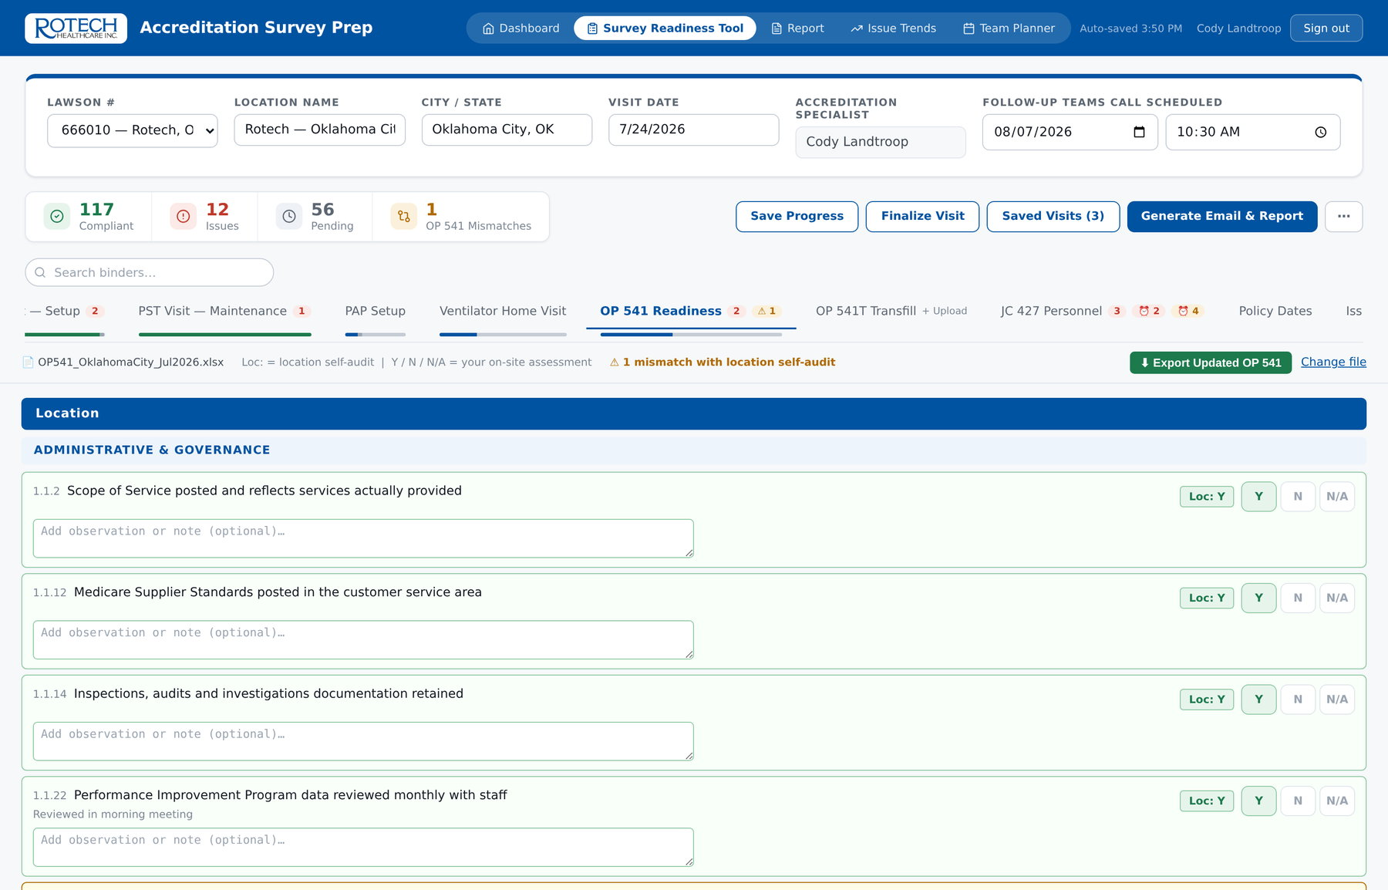
STEP 4 · OP 541
Every disagreement with the self-audit is flagged
The location said Y. The specialist found N. That gap is the single most useful thing a readiness visit produces — and it used to be found by eye.
Loc: Y / N
The location's self-audit answer is shown on every row, in place
Mismatch flag
A disagreement is counted in the header, badged on the tab and marked on the row
Carried through
Mismatches are annotated in the follow-up tracker export, not just on screen
OP 541 on-site review — the location's own answer sits beside the specialist's, mismatches called out
Rotech Accreditation · Survey Prep App
11
Notes:
This is the slide to slow down on. A location that self-audits Y on something that is actually N is the exact pattern a surveyor finds, and before this tool it was caught only if the specialist happened to remember what the spreadsheet said.

Slide 12
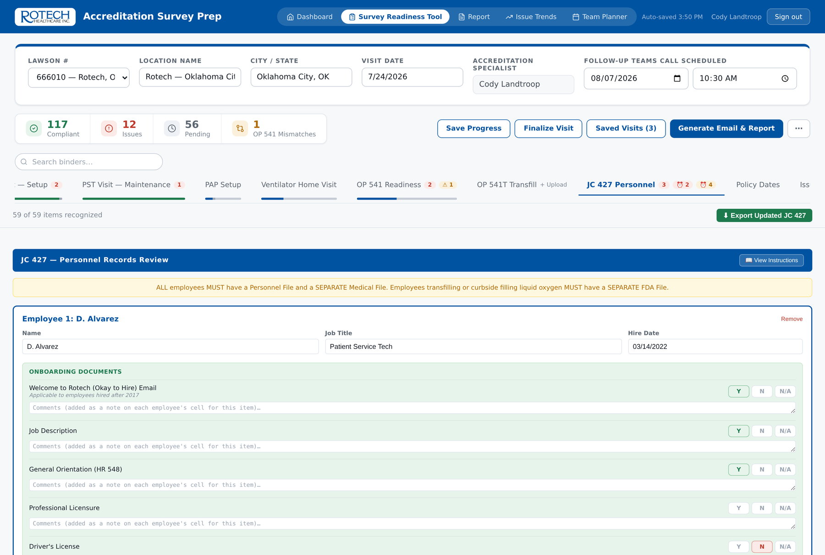
STEP 5 · JC 427
Personnel records, one column per employee
The JC 427 Personnel Records Review ships inside the app — no file to hunt down, no blank template to find.
Onboarding, training, performance review and medical-record items per employee
44 non-clinical and clinical competency assessments, each date-tracked
Employees can be added on the spot; the app assigns the next free column, including overflow sheets
The full JC 427 instruction set is one click away, ported verbatim
JC 427 Personnel Records Review — employees as columns, exactly as the real sheet is laid out
Rotech Accreditation · Survey Prep App
12

Slide 13
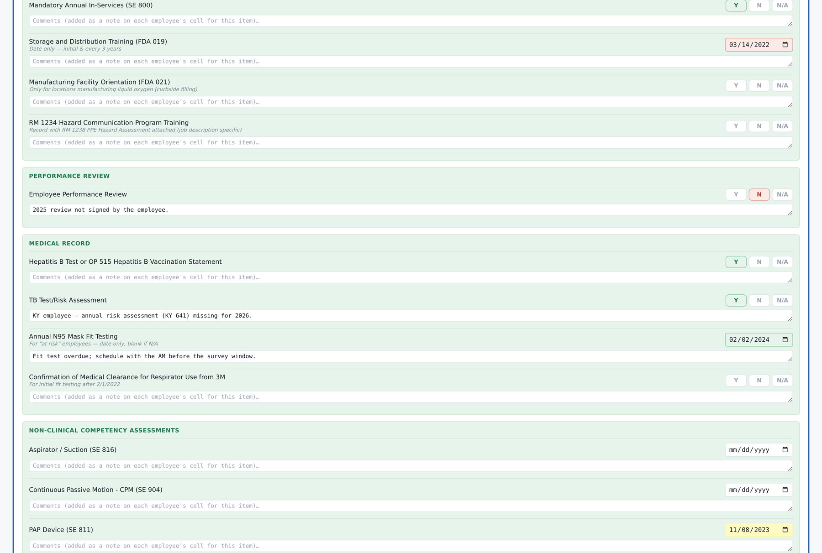
STEP 5 · JC 427
Competency expiry, worked out for you
Three-year validity with a six-month warning window — applied to every competency date, for every employee, instantly.
Red · expired
Past three years from the recorded date — becomes a finding automatically
Amber · expiring
Inside six months of expiry — surfaced before it lapses, not after
Into the trend data
Expired and expiring competencies are recorded as findings when the visit is finalized
Personnel and competency dates — red expired, amber expiring within six months, green current
Rotech Accreditation · Survey Prep App
13
Notes:
Doing this by hand is roughly 50 competencies times the number of employees, per location, twice a year. That arithmetic is where errors live.

Slide 14
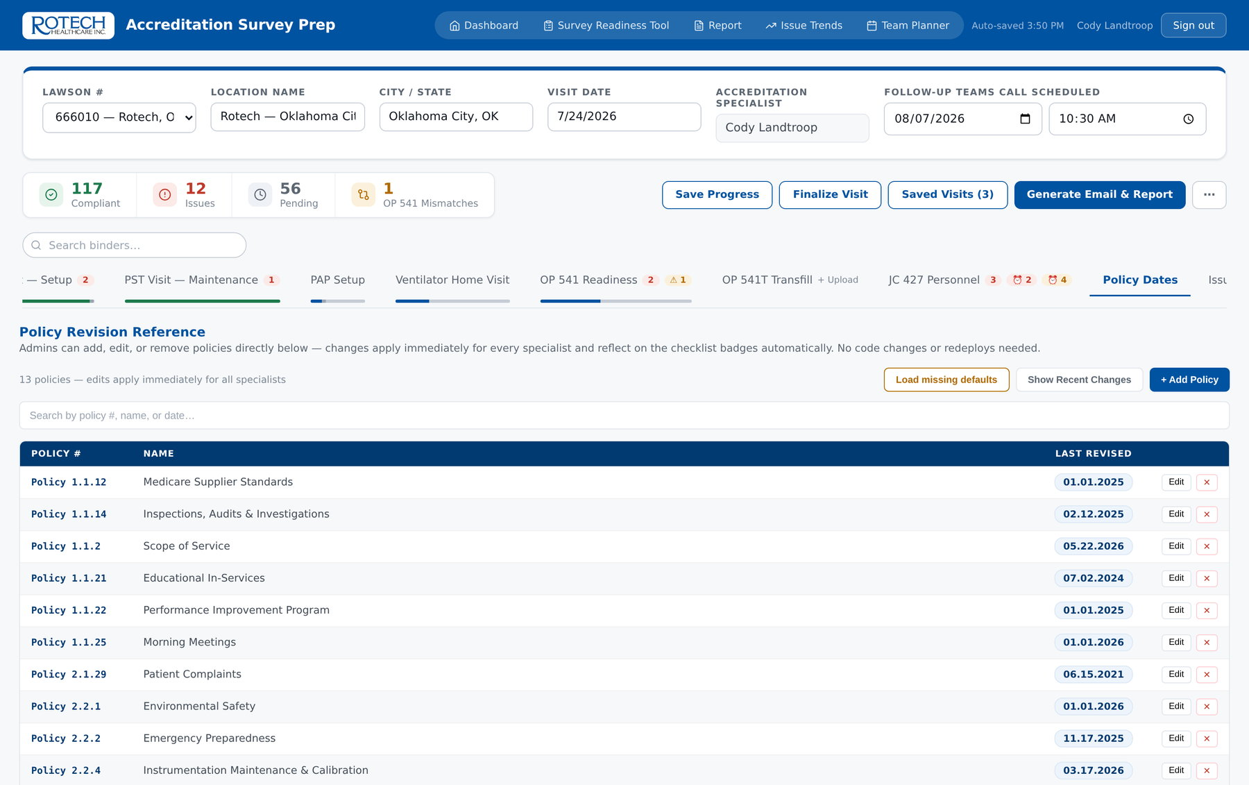
STEP 6 · REFERENCE
Policy revision dates, current for everyone
Admins update a policy date once and every specialist's app shows it — no redeploy, no version drift.
Revision dates appear as badges on the checklist items that cite the policy
Edited in the app by named admins, enforced server-side by the database rules
The reference tab is read-only for everyone else, so nobody works from a stale printout
The same allowlist governs the roster, so administration is one concept, not two
Policy Dates — the shared reference behind the checklist badges
Rotech Accreditation · Survey Prep App
14

Slide 15
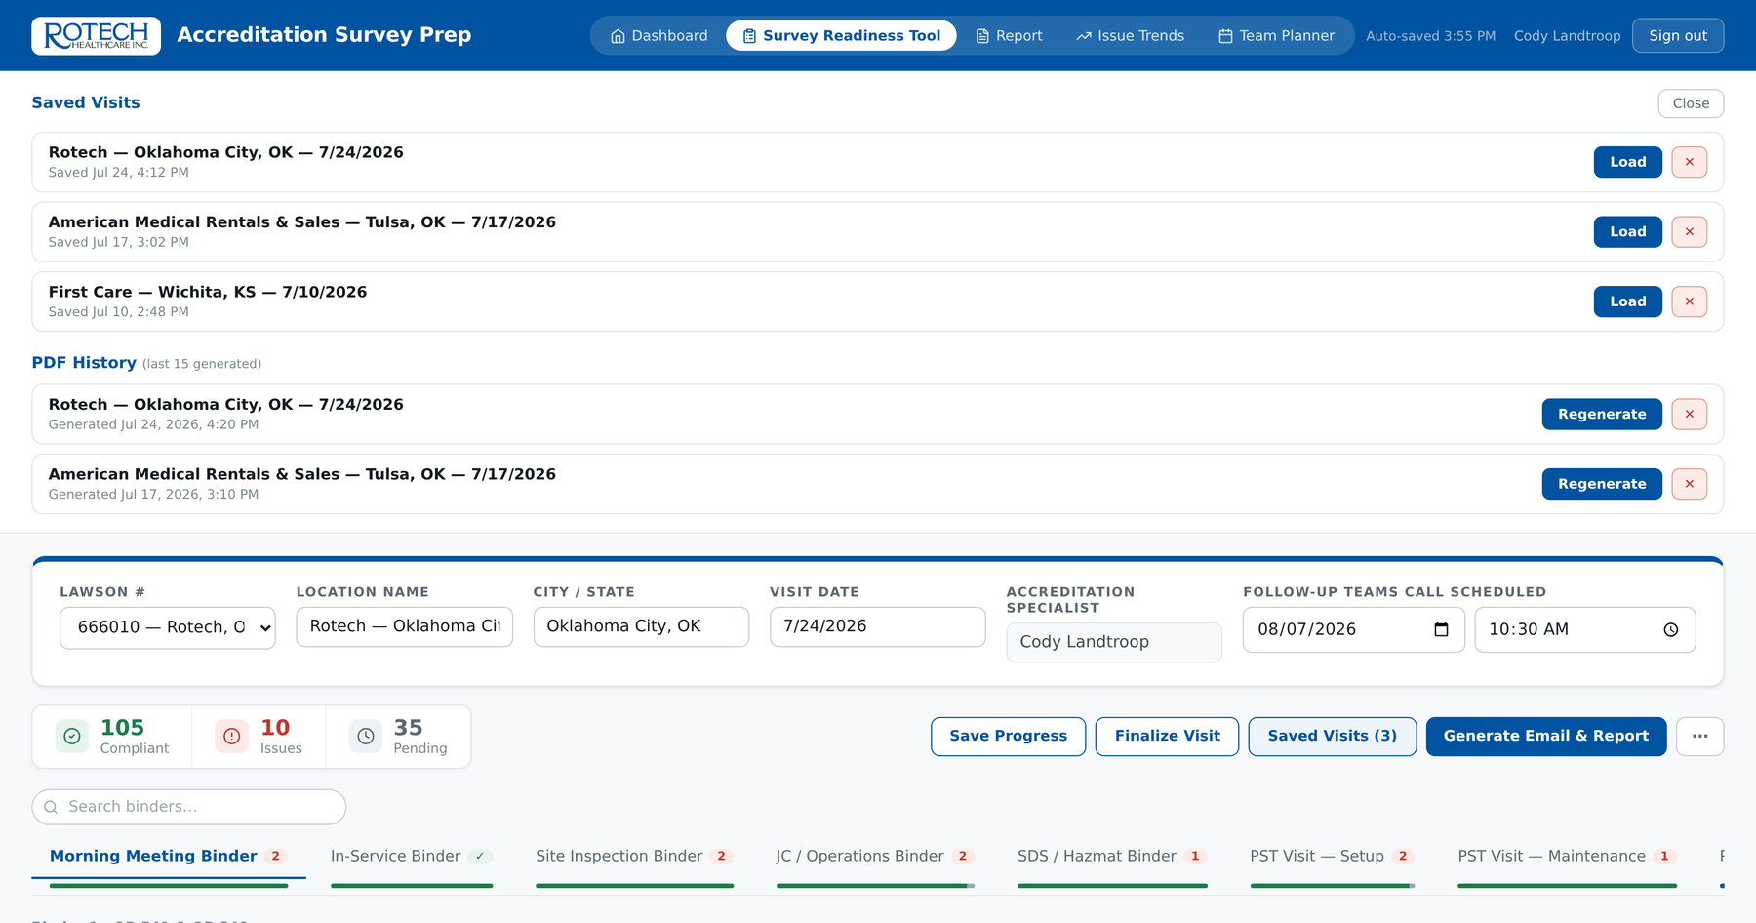
STEP 7 · CONTINUITY
Start on an iPad, finish at a desk
Progress is saved continuously on the device and synced to the specialist's account on demand.
Auto-save covers every tab — including OP 541 answers — on every keystroke
"Save Progress" syncs the visit so it can be picked up on another device
A reminder fires after 30 minutes without an explicit save
Installs as an app on a phone or tablet and works with no signal in the building
Saved visits — any visit resumable from any signed-in device
Rotech Accreditation · Survey Prep App
15

Slide 16
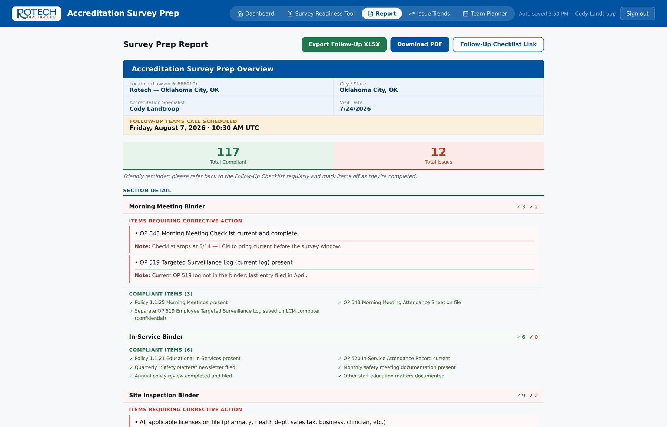
STEP 8 · REPORT
The write-up writes itself
One click turns the answers into a complete visit overview — compliant items, findings, notes, and the scheduled follow-up call.
Totals up front
Total compliant and total issues, before any detail
Findings first
Each section leads with items requiring corrective action and the note recorded on site
Compliant listed too
The evidence that an area was actually reviewed, not skipped
Survey Prep Report — generated from the visit, not retyped from it
Rotech Accreditation · Survey Prep App
16

Slide 17
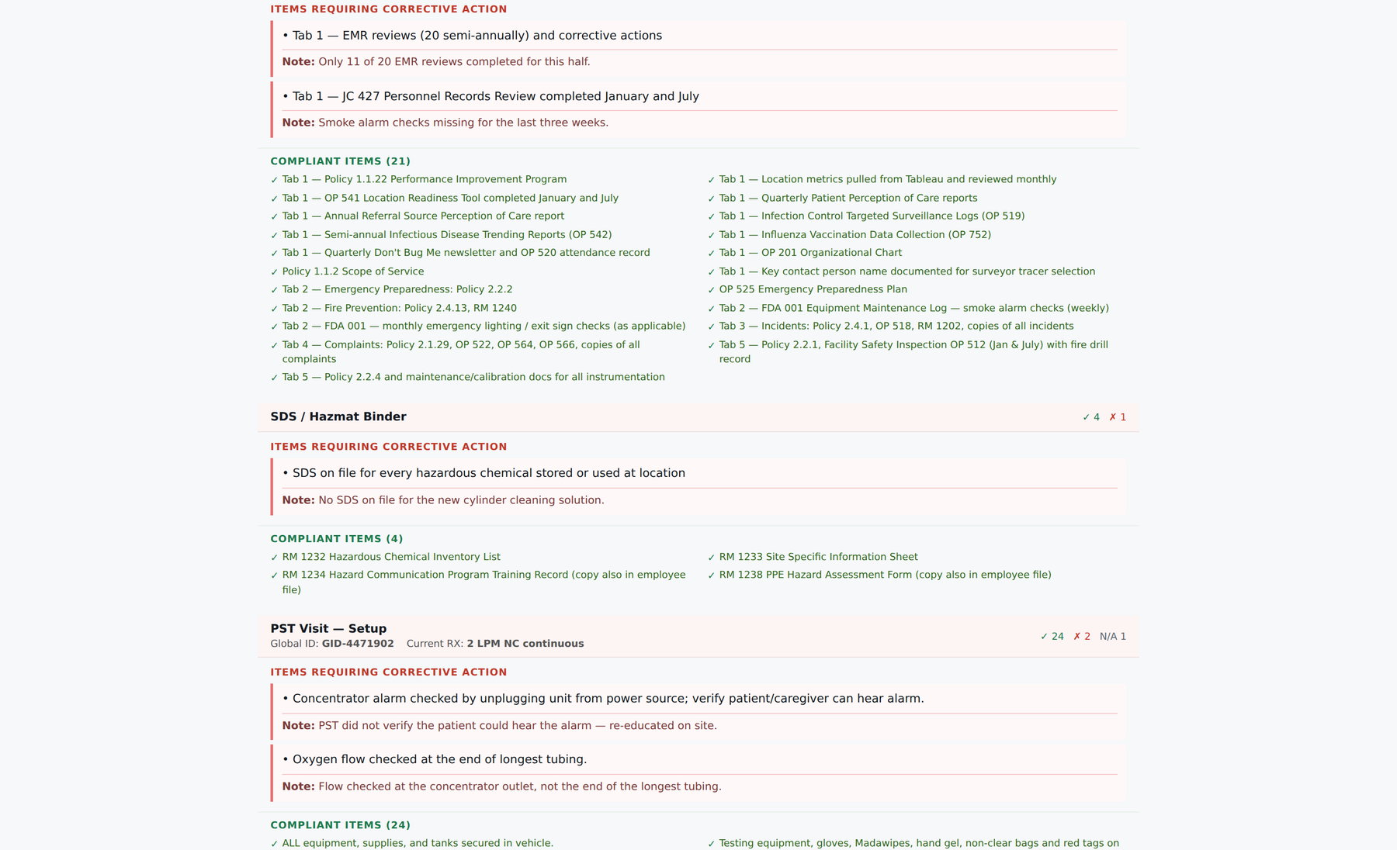
STEP 8 · REPORT
Section by section, in the order the binders sit
The same report continues through every checklist, the OP 541 sheets and each vehicle unit.
Report detail — findings, notes, compliant items and mismatch callouts per section
Rotech Accreditation · Survey Prep App
17

Slide 18
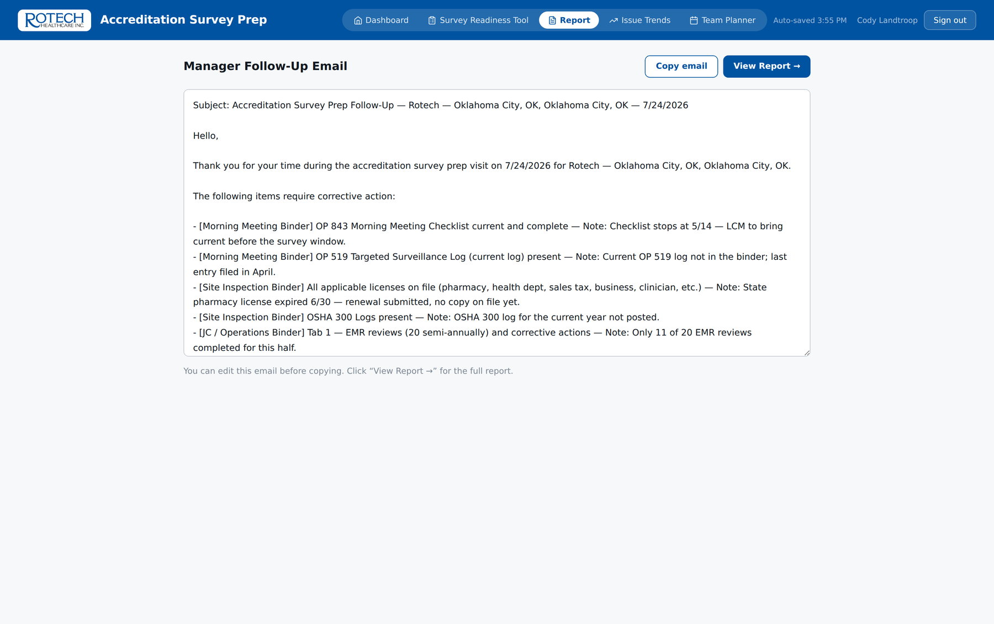
STEP 9 · FOLLOW-UP
The follow-up email, already written
Addressed, dated, and populated with every finding and its note — ready to copy into Outlook.
Subject line carries the location, city and visit date
Findings listed with their section and the note recorded on site
Clean visits get the compliant wording automatically instead of an empty list
The Teams follow-up call date and time are captured on the visit and printed on the report
Generated follow-up email — copy, paste, send
Rotech Accreditation · Survey Prep App
18

Slide 19
02
OP 541
Written back into the original workbook
What comes out of a visit
Tracker
Follow-up workbook, one sheet per area
Five outputs, all generated from the same answers — nothing is retyped, and nothing can disagree with anything else.
PDF
Full visit overview plus a data backup
Checklist
A live link for the location manager
Rotech Accreditation · Survey Prep App
19

Slide 20
EXPORTS
Every output the app produces
All five come from one set of answers, so the tracker, the report and the trend record can never drift apart.
Output | Format | Who it goes to | What makes it different
Updated OP 541 / 541T | .xlsx | Location, area manager | Written into the location's own file — formatting, formulas and layout untouched
Follow-Up Tracker | .xlsx | LCM and area manager | One sheet per binder or form, with a Yes / No / Pending dropdown and colour rules
Visit Overview | PDF | Region, file | Printed from the report, with an automatic data backup file alongside it
Follow-Up Checklist | Web link | Location manager | Live — the specialist sees items ticked off as they are completed
Issue Trend workbook | .xlsx | Leadership | Eight sheets, scoped to whatever filters are on screen
Every filename carries the location, city and visit date, so a folder of exports sorts and searches without being renamed.
Rotech Accreditation · Survey Prep App
20

Slide 21
EXPORT 1
The OP 541 goes back as the location's own file
The app writes the on-site answers into the uploaded workbook's actual cells. It does not rebuild the file.
Cell-level patching
Only the answer and comment cells are rewritten; styles, formulas and conditional formatting survive intact
Comments preserved
Specialist notes are written into the Comments column and as native Excel cell notes
Confirmed on export
The app reports how many values it wrote and across how many sheets
"Export Updated OP 541" — the same workbook, now carrying the on-site column
Rotech Accreditation · Survey Prep App
21
Notes:
Verified on a real export during preparation of this deck: the on-site answers appear in the ON-SITE VISIT column of the original workbook, and every other part of the file is byte-for-byte unchanged.

Slide 22
EXPORT 2
The follow-up tracker, ready to work from
One workbook, one sheet per binder or form that actually has findings. Nothing empty is exported.
Item / Finding
Corrected?
Notes / Comments
The finding, in the words of the form
Yes / No / Pending dropdown, validated on entry
The specialist's note, plus any self-audit mismatch warning
What the file does that a pasted list cannot
Turns green on Yes, red on No and amber on Pending — status is readable at a glance across a long list
Rejects anything that is not Yes, No or Pending, so the column stays countable
Freezes the title, visit details and column headers, so a 200-row sheet stays navigable
Flags any finding where the location's own self-audit had claimed compliance
Sheet names mirror the binder names, so the workbook maps onto the physical binders on the shelf
Rotech Accreditation · Survey Prep App
22
Notes:
This file is what the LCM and area manager actually work from between the visit and the follow-up call.

Slide 23
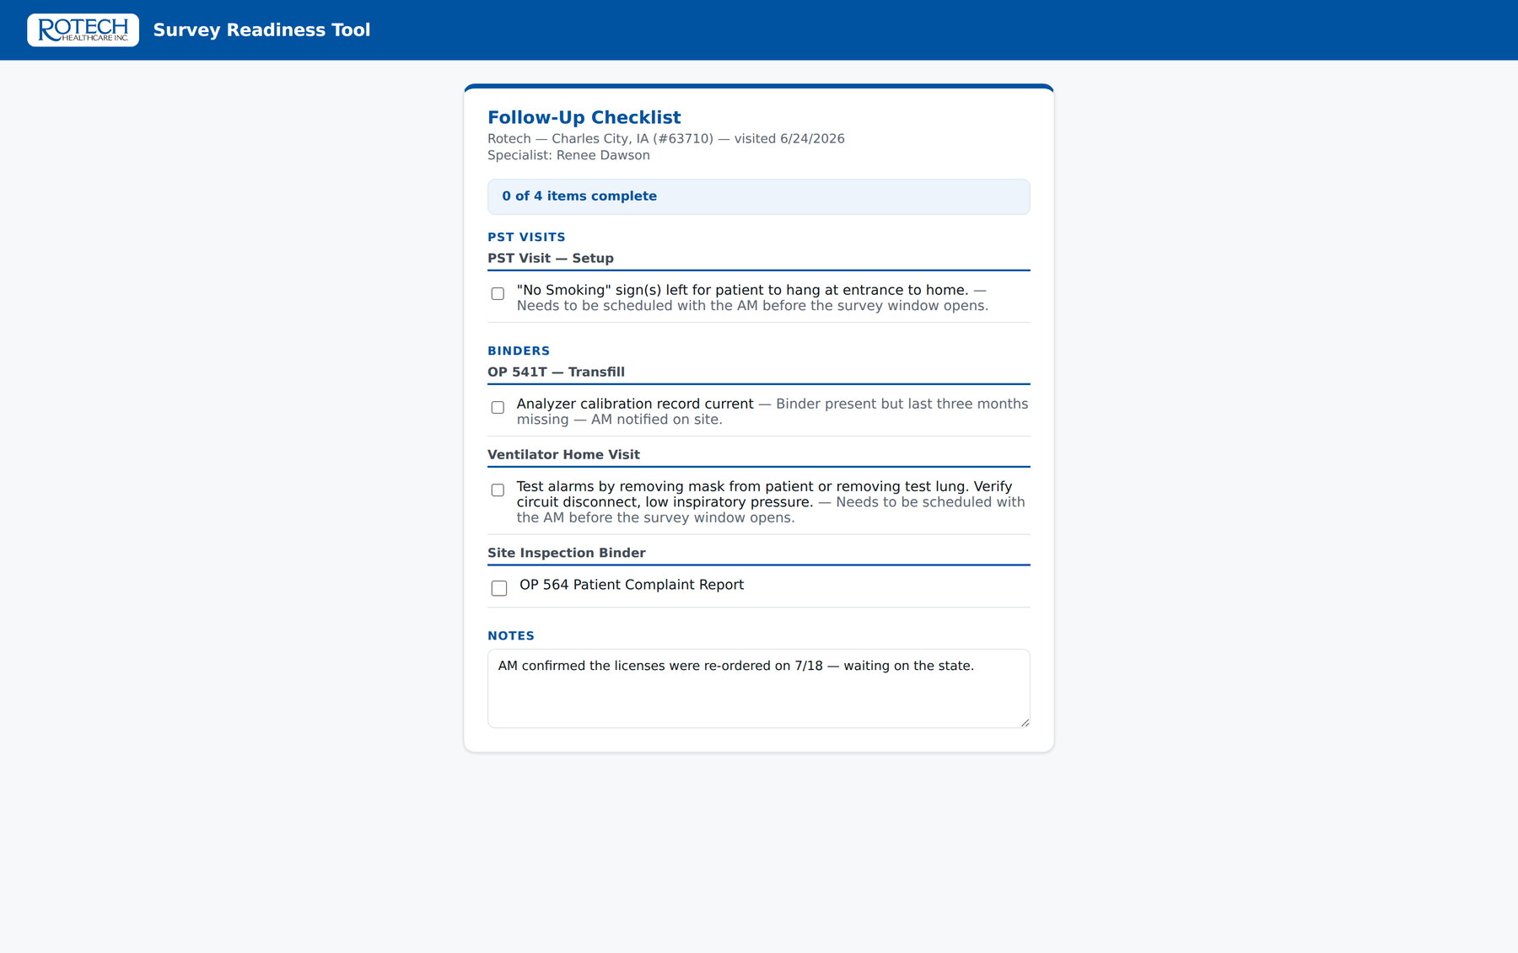
EXPORT 4
A follow-up checklist the manager ticks off
A link, not an attachment. The location works through it, and the specialist watches progress without asking.
Grouped the way the work is done — Binders, Warehouse, PST Visits, Vehicles, Personnel
Each item carries the note the specialist made on site
A notes box for the location to reply in
Regenerating after an update keeps everything already ticked
The shared follow-up checklist, as the location manager sees it (sample data)
Rotech Accreditation · Survey Prep App
23

Slide 24
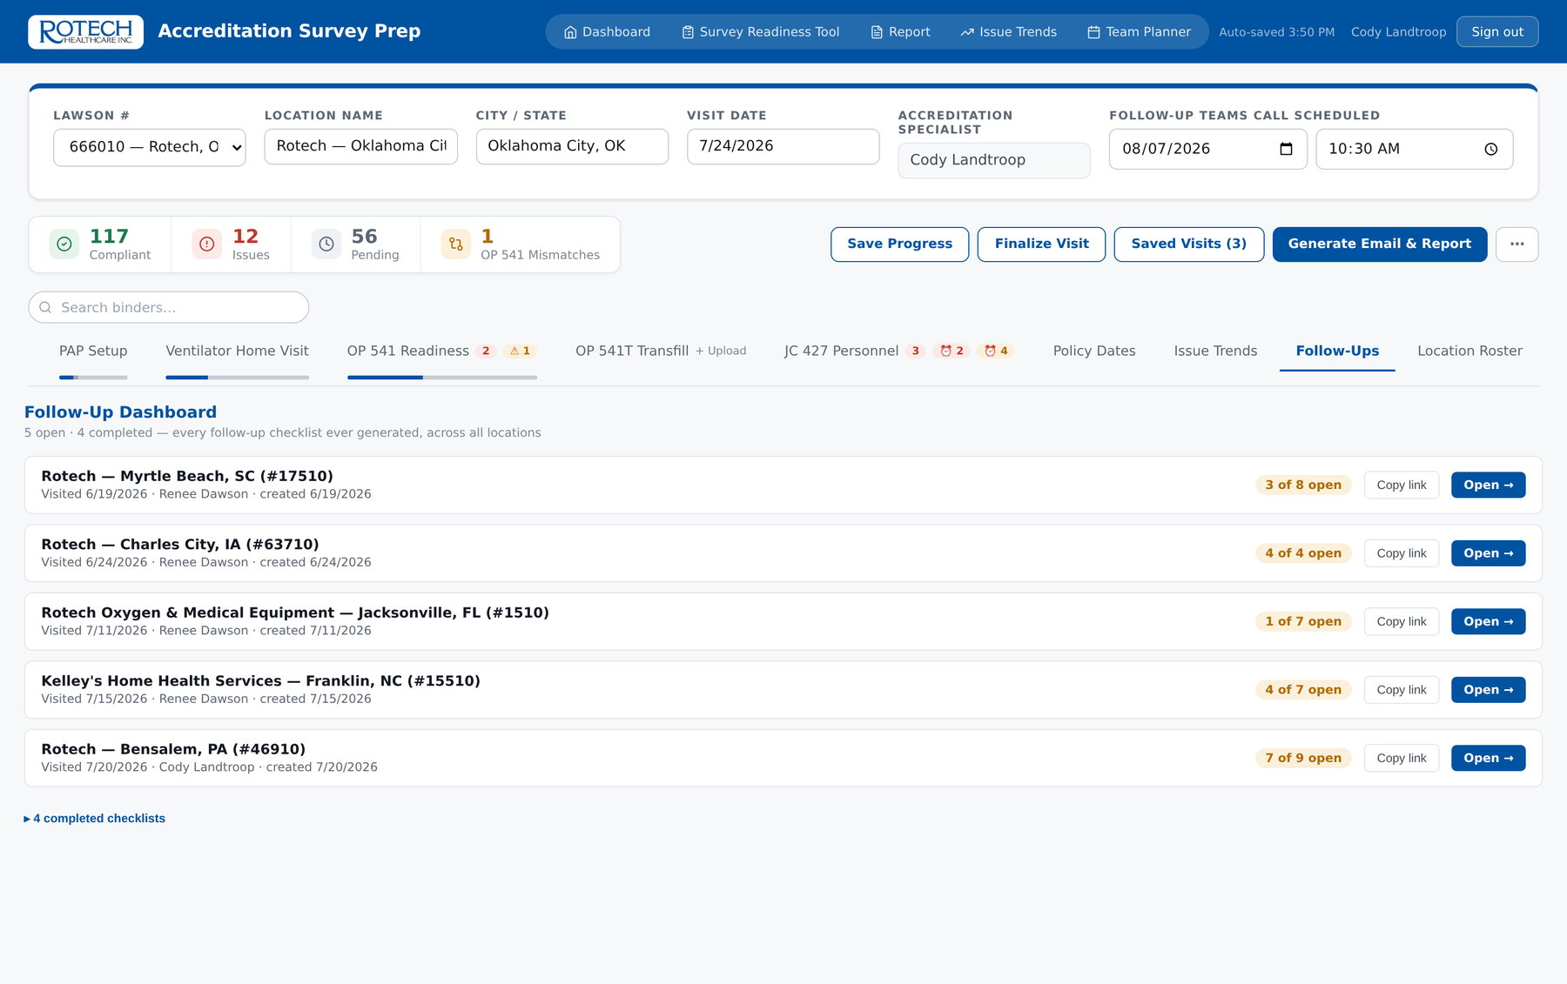
EXPORT 4
And a dashboard of every follow-up open right now
Across all locations and all specialists — what is outstanding, and how much of it.
Open and completed checklists, oldest first
Progress shown as items remaining out of total, per location
Link copying built in, for chasing by email
Answers the question "where do we actually stand" without a status meeting
Follow-Up Dashboard — company-wide progress on open corrective actions (sample data)
Rotech Accreditation · Survey Prep App
24

Slide 25
03
Every finding
Location, region, manager, specialist, date
Trend data
Seven views
Overview, recurring, sites, items, sections, managers, log
Finalizing a visit writes every finding into one company-wide dataset. This is the part that did not exist before at all.
Every figure on the trend and weighting screens that follow comes from a sample dataset built for this deck — the layout is live, the numbers are not ours.
Live
Updates as each specialist finalizes
Exportable
Eight-sheet workbook or PDF, filtered
Rotech Accreditation · Survey Prep App
25

Slide 26
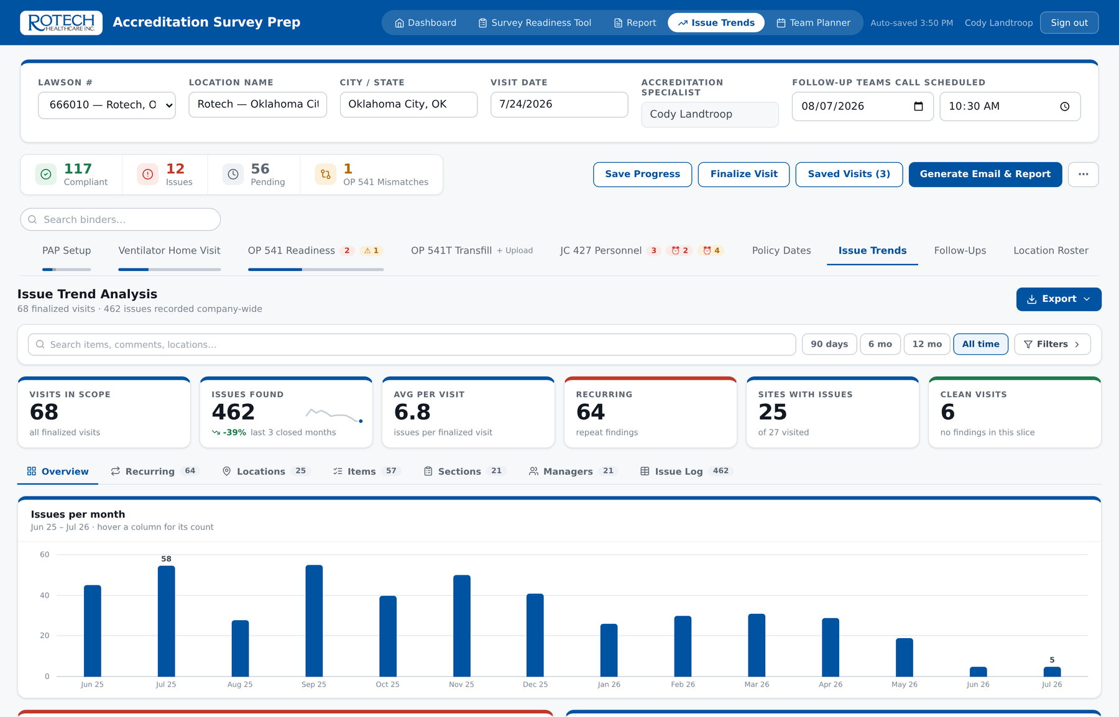
TRENDS
How are we actually doing?
The landing view answers that in one screen, before any drilling down.
Direction of travel
Change measured on closed months only, so a part-month never reads as an improvement
Recurring count
Findings that came back — the ones a corrective action did not fix
Clean visits
Visits with no findings at all, tracked deliberately
Everything filtered
Location, section, specialist, region, manager, date range — every view and export obeys them
Issue Trend Analysis — KPI row and the monthly trend, scoped by the filters above (sample data)
Rotech Accreditation · Survey Prep App
26
Notes:
Demo dataset shown. The shape is real: 68 finalized visits, 462 findings, trending down over 14 months.

Slide 27
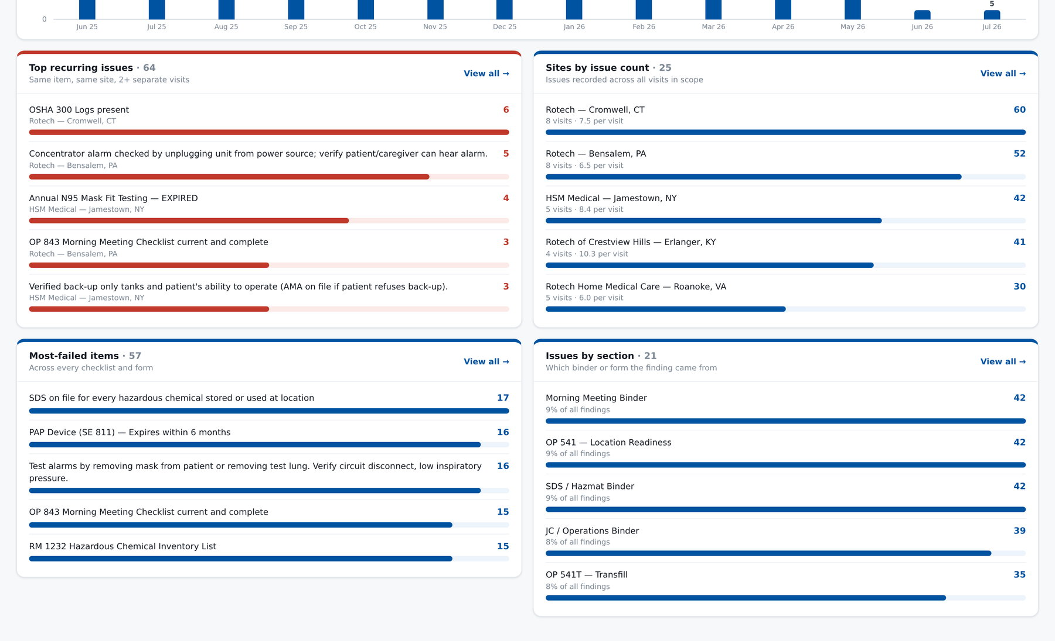
TRENDS
What is going wrong, and where
Four rankings on the overview, each one clickable straight through to the underlying findings.
Recurring issues, sites by issue count, most-failed items and issues by section (sample data)
Rotech Accreditation · Survey Prep App
27

Slide 28
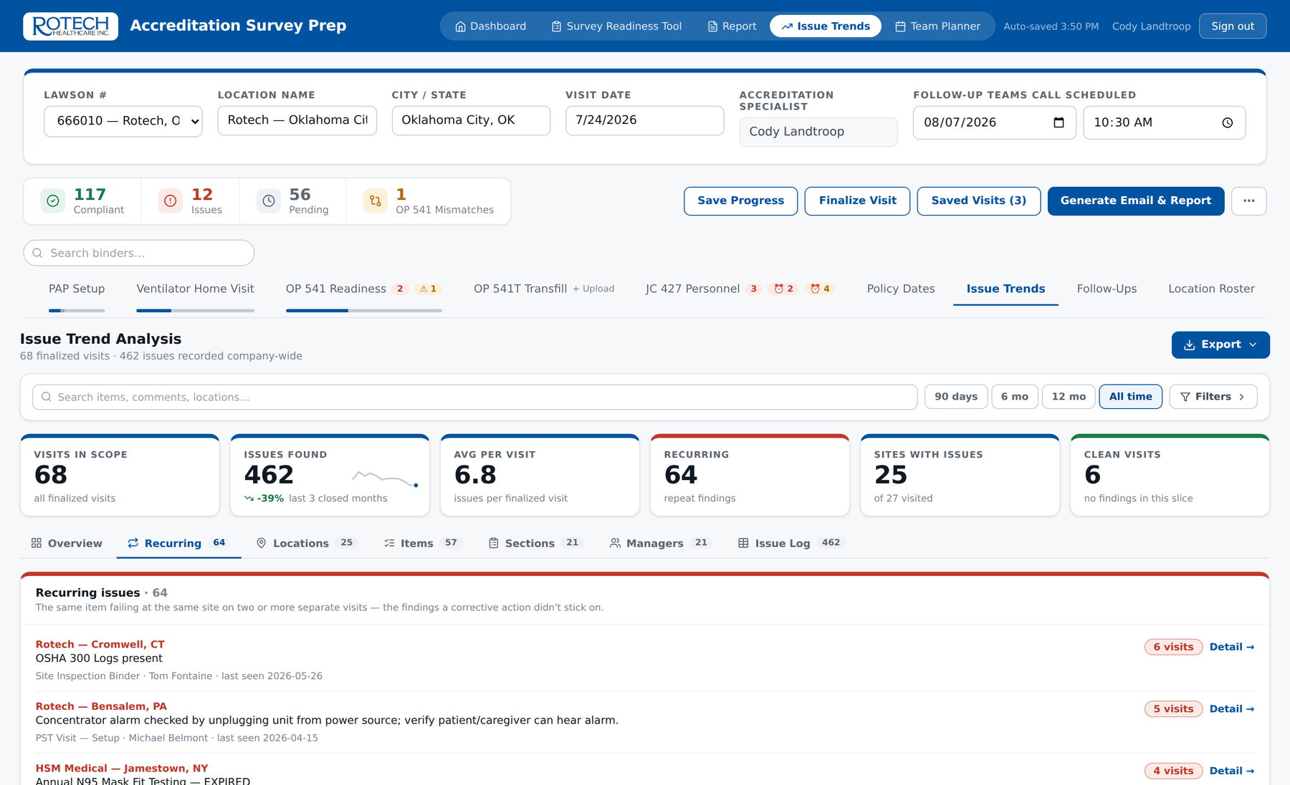
TRENDS
The findings that keep coming back
The same item failing at the same site on two or more separate visits — the corrective actions that did not stick.
Counted by visits failed, not by records, so one visit with three affected employees is one finding
Shows the section, the area manager and when it was last seen
Clicking through opens the issue log already filtered to that site and item
This is the list that should drive the agenda of a regional call
Recurring issues — same item, same site, two or more visits (sample data)
Rotech Accreditation · Survey Prep App
28

Slide 29
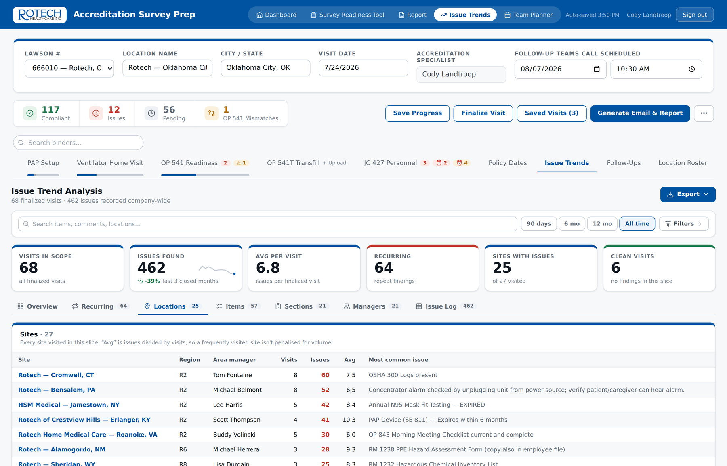
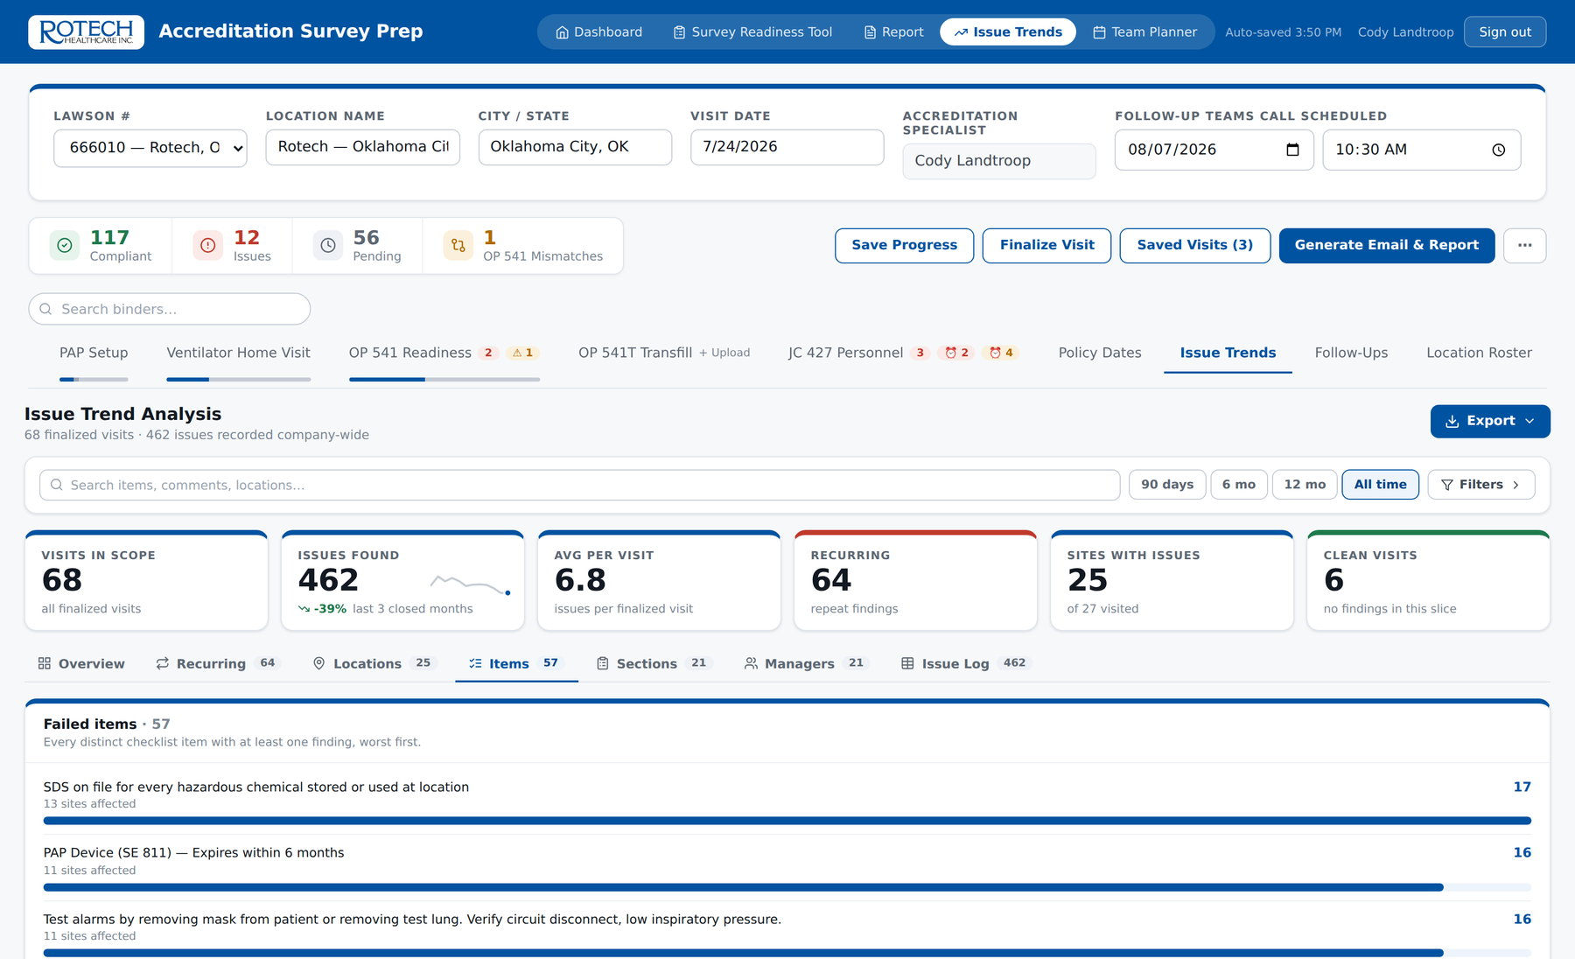
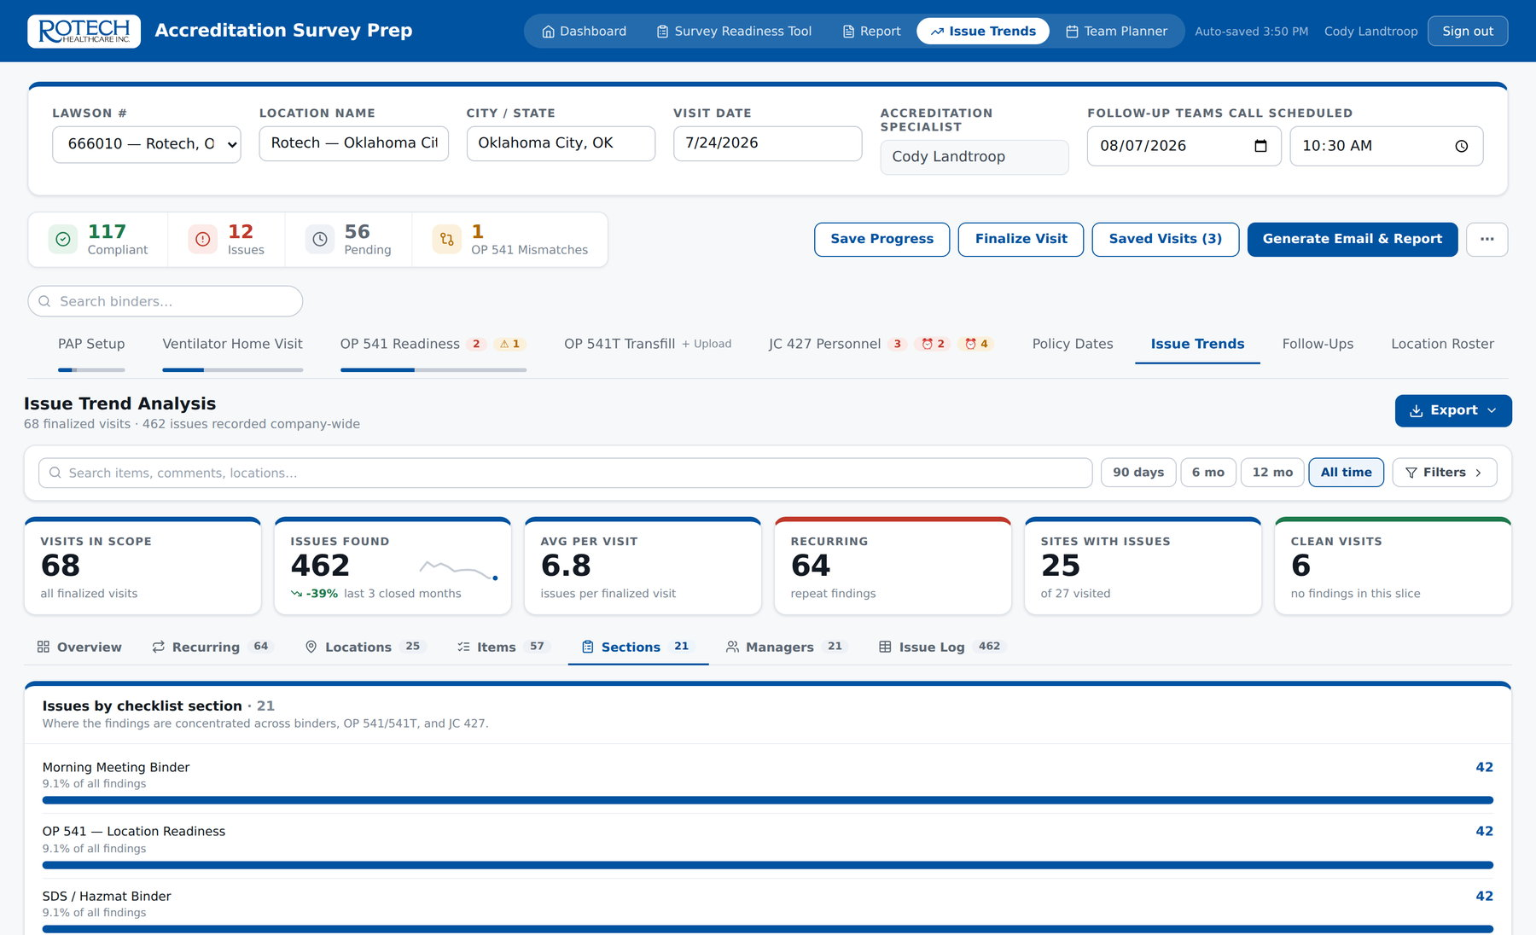
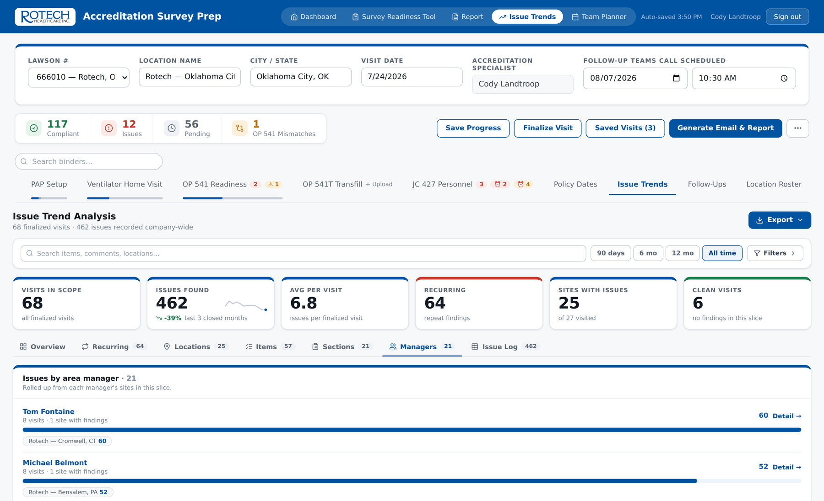
TRENDS
Four more ways to slice the same data
Sites, items, sections and area managers — the same filtered set, ranked differently.
By site
By item
By section
By area manager
Rotech Accreditation · Survey Prep App
29

Slide 30
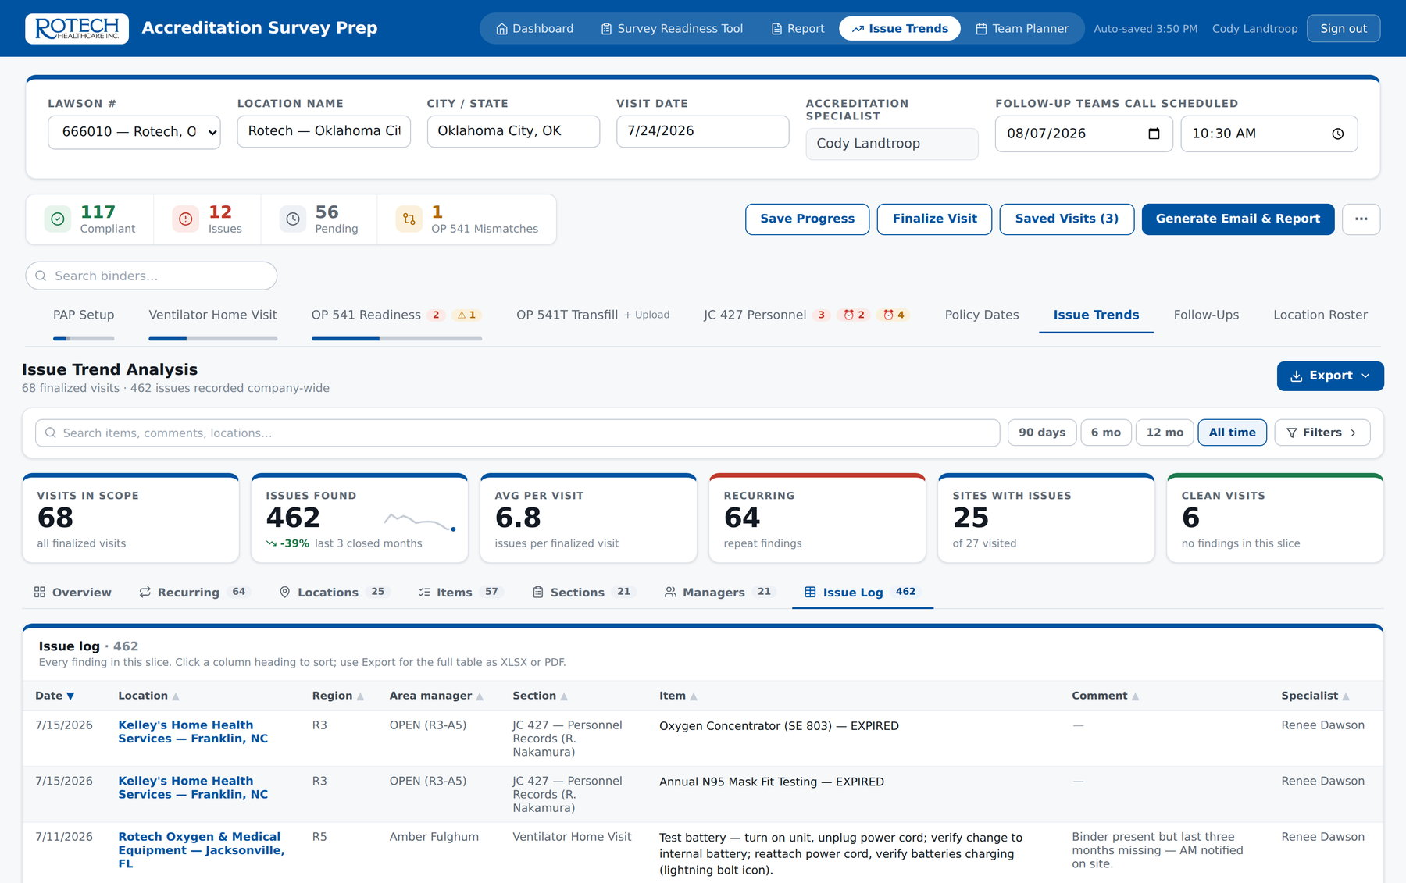
TRENDS
And the complete log underneath all of it
Every finding ever recorded, sortable, searchable, and exportable exactly as filtered.
Nothing hidden
Every ranking on every other view resolves to rows in this table
Filters are the scope
What is on screen is what exports — the workbook cannot disagree with the dashboard
Eight sheets out
Summary, monthly, recurring, by site, by item, by section, by manager, full log
Issue log — date, site, region, manager, specialist, section, form reference, item and note (sample data)
Rotech Accreditation · Survey Prep App
30

Slide 31
04
The problem
Eight minor items outrank two critical ones
Metrics weighting
The model
Critical ×5, Major ×3, Minor ×1
The proposal: stop counting findings and start scoring them, so the data ranks by risk rather than by volume.
The multipliers
Recurrence and age push items up the queue
The output
One score, comparable across sites and time
Rotech Accreditation · Survey Prep App
31

Slide 32
WEIGHTING
Why counting findings is not enough
Two sites, the same number on today's dashboard. Only one of them is a survey risk.
Site A — 8 findings
Site B — 2 findings
Quarterly newsletter not filed
Org chart out of date
Phone listing missing
Driver's licence copy expired
Performance review unsigned
Patient booklet not flagged
Complaint form missing
Attendance sheet incomplete
Concentrator alarm never verified with the patient
N95 fit test expired for two at-risk staff
8 minor items · weighted 8
2 critical items · weighted 10
On today's dashboard Site A ranks worse. Weighted, Site B ranks worse — and Site B is the one a surveyor would fail.
Rotech Accreditation · Survey Prep App
32
Notes:
This is the whole argument for weighting in one slide. Do not rush it.

Slide 33
WEIGHTING
The model
Three severity tiers, two multipliers, one score. Simple enough to explain to a location manager.
Critical ×5
Patient-safety and licensure items: alarm and flow verification, grounding, cylinder storage, ventilator alarm and battery tests, expired competencies, TB and N95, licences, insurance
Two multipliers
Recurrence — ×1.5 when a finding returns on a second visit, ×2 on a third or later
Age — ×1.25 once open past 30 days, ×1.5 past 60 days
Major ×3
Accreditation documentation: binder records, EMR reviews, safety inspections, in-service records, SDS files, competencies expiring within six months
Score = 100 − ( weighted findings ÷ weighted items assessed ) × 100
Minor ×1
Administrative and housekeeping: newsletters, filing order, org charts, phone listings, signage placement, booklet flagging
Why this and not a percentage of items passed:
A flat percentage is dominated by the 100+ routine items every location passes, so it barely moves and hides the findings that matter. Weighting the denominator the same way as the numerator keeps the score sensitive to severity while staying comparable between a five-employee site and a thirty-employee one.
Rotech Accreditation · Survey Prep App
33

Slide 34
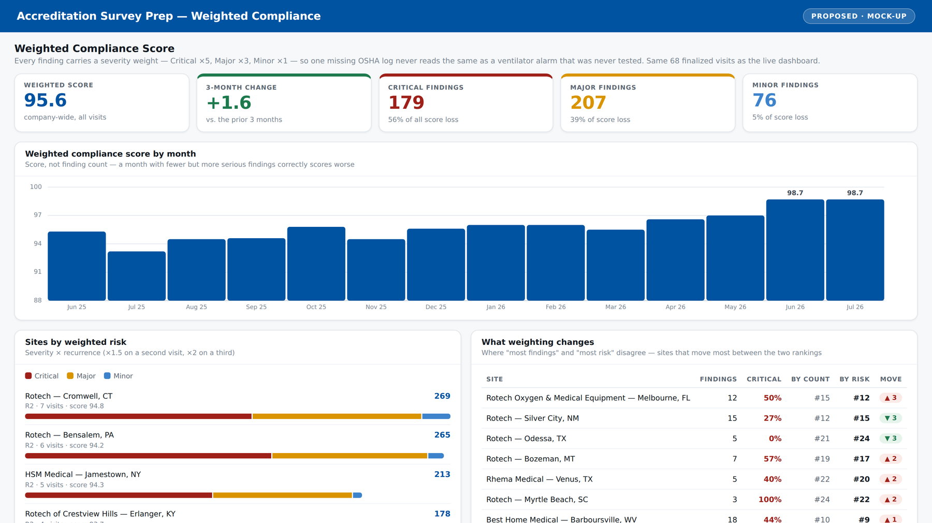
WEIGHTING · PROPOSED
What the weighted dashboard would look like
Built on the same visits the live dashboard already holds — this is a redisplay of existing data, not new data collection.
One headline number
A weighted score that can be tracked, targeted and compared across regions
Severity split
Where score loss actually comes from, not how many boxes were ticked
Trend that means something
A month with fewer but more serious findings correctly scores worse
Proposed Weighted Compliance view — mock-up, computed from the same demo dataset shown earlier
Rotech Accreditation · Survey Prep App
34

Slide 35
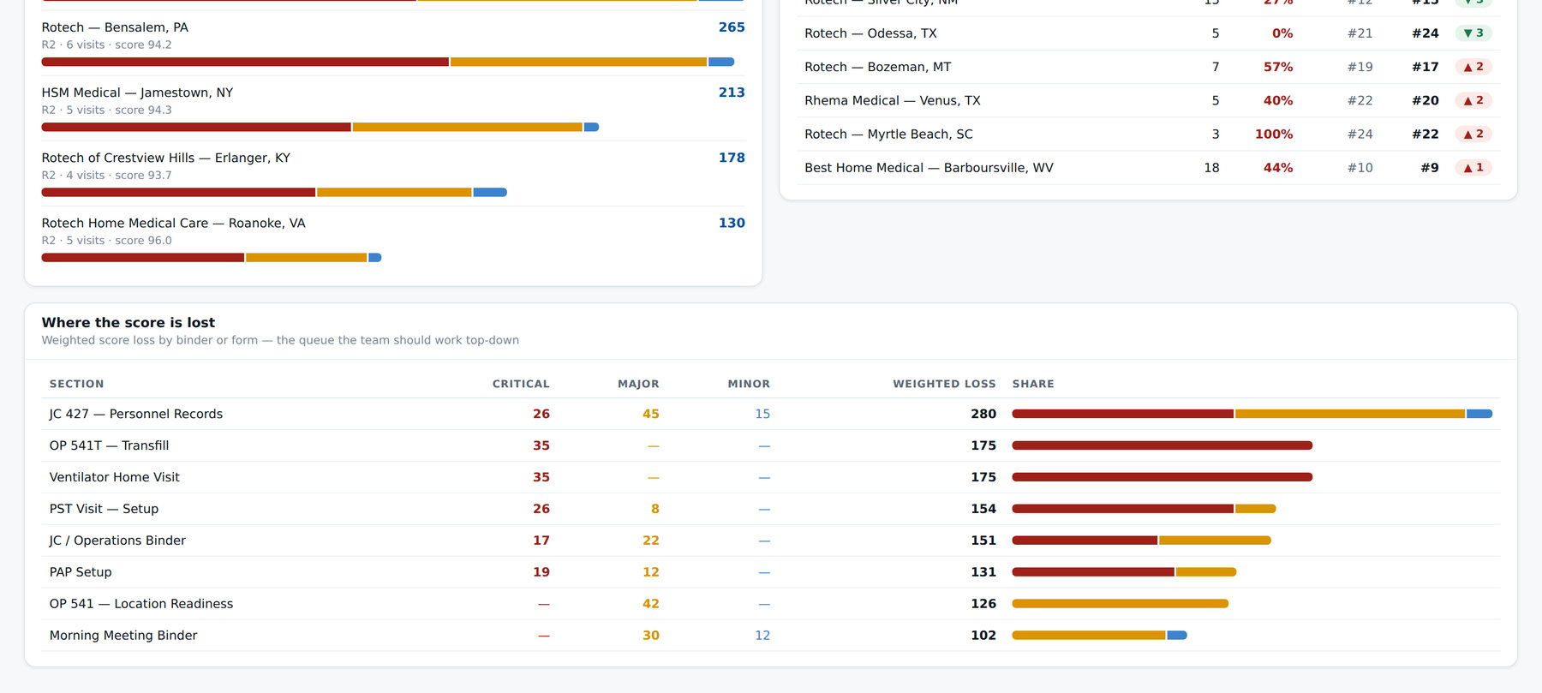
WEIGHTING · PROPOSED
Where 'most findings' and 'most risk' disagree
The ranking change is the payoff. Sites move when severity is taken into account — and the movers are the interesting ones.
Risk ranking
Severity × recurrence, so a repeat critical finding outranks a pile of one-off minor ones
Rank shift
Sites that move between the two rankings are where the current view is misleading us
Work queue
Weighted score loss by binder tells the team what to fix first, company-wide
Proposed risk ranking and rank-shift table — mock-up on demo data
Rotech Accreditation · Survey Prep App
35

Slide 36
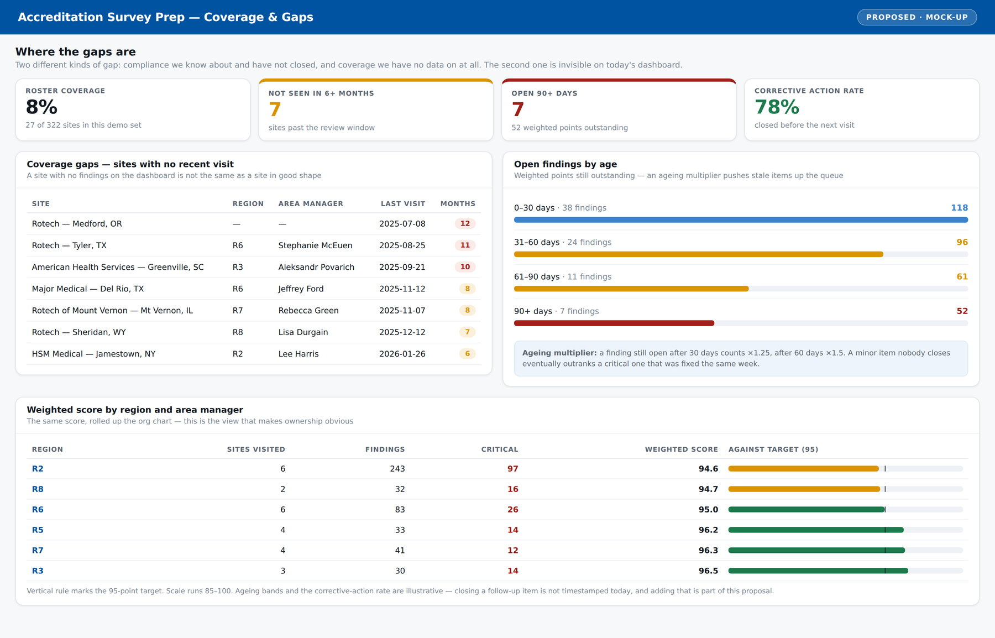
WEIGHTING · PROPOSED
The gap we cannot currently see
A site with no findings on the dashboard is not the same as a site in good shape — it may simply not have been visited.
Coverage gaps
Sites with no visit inside the review window — invisible on today's dashboard because they generate no findings
Ageing findings
Weighted points still outstanding by age band, so stale items rise up the queue instead of sitting quietly
Rolled up the org chart
The same weighted score by region and area manager, measured against a target
Proposed Coverage & Gaps view — mock-up; coverage figures reflect the demo dataset, not the real roster
Rotech Accreditation · Survey Prep App
36
Notes:
Two kinds of gap. Compliance gaps we know about and have not closed. Coverage gaps where we have no data at all. Only the first is visible today.

Slide 37
WEIGHTING
What it takes to build
The scoring is arithmetic on data the app already stores. The work is in the tiering decisions, not the code.
Work | Who | Effort | Note
Assign a tier to every checklist item | Accreditation team | 1–2 days | The real decision. 174 items plus the JC 427 and OP 541 rows
Store the tier with each item | Development | Half a day | One field per item; no change to how a visit is entered
Weighted score and risk index | Development | 1–2 days | Computed from findings already recorded on every finalized visit
Weighted views in the dashboard | Development | 2–3 days | New tab alongside the existing seven; nothing removed
Timestamp follow-up closure | Development | 1 day | Needed for the ageing multiplier — not captured today
Backfill existing visits | Automatic | — | Historic findings re-score as soon as tiers exist; no re-entry
Tiering is a clinical and regulatory judgement, not a technical one — it should be signed off by the department, and revisited annually with the standards.
Rotech Accreditation · Survey Prep App
37

Slide 38
05
Per visit
Hours of retyping removed
The value
Per month
Trend consolidation gone entirely
Time returned to specialists, risk found earlier, and a dataset the department has never had.
Per survey
Mismatches and repeats found first
Ongoing
One dataset, not many files
Rotech Accreditation · Survey Prep App
38

Slide 39
VALUE
Where the time goes today
Estimates to be validated against the team's own numbers — the arithmetic is shown so they can be replaced.
Task | Today (min) | With the app (min) | Saved (min)
Writing up the visit report and follow-up email | 90 | 5 | 85
Transcribing OP 541 / 541T and comparing to the self-audit | 60 | 10 | 50
JC 427 personnel review — transcription and expiry dates | 75 | 15 | 60
Building and distributing the follow-up list | 45 | 2 | 43
Chasing follow-up status to closure | 60 | 10 | 50
Per visit | 330 | 42 | 288 · 4.8 hrs
Plus the monthly trend consolidation — previously a manual gather across every specialist's files, now continuous and free.
4.8 hrs
≈ 0.5 FTE
Zero
Same day
Saved per visit
At 240 visits a year
Licence cost
Report turnaround
on the estimates above
1,150 hours returned to the team
no per-seat or per-site fee
written before leaving the location
Rotech Accreditation · Survey Prep App
39
Notes:
Be explicit that these are estimates. Ask the team leads to replace the two middle columns with their own figures before this goes any further — the point is the method, not the numbers.

Slide 40
VALUE
What the time is spent on instead
Removing transcription does not shrink the job. It moves the hours to the part only a specialist can do.
1
More locations reached
2
Deeper on-site work
The binding constraint on coverage is specialist hours. Four hours back per visit is roughly one additional site visited per specialist per week.
Time in the building goes to observation, coaching and tracer practice rather than to writing the visit up afterwards.
3
Corrective actions actually closed
4
Preparation ahead of a real survey
The follow-up dashboard makes chasing cheap, so items close before the next visit instead of reappearing on it.
Recurring findings and self-audit mismatches identify the sites that need attention before a surveyor arrives, not after.
Rotech Accreditation · Survey Prep App
40

Slide 41
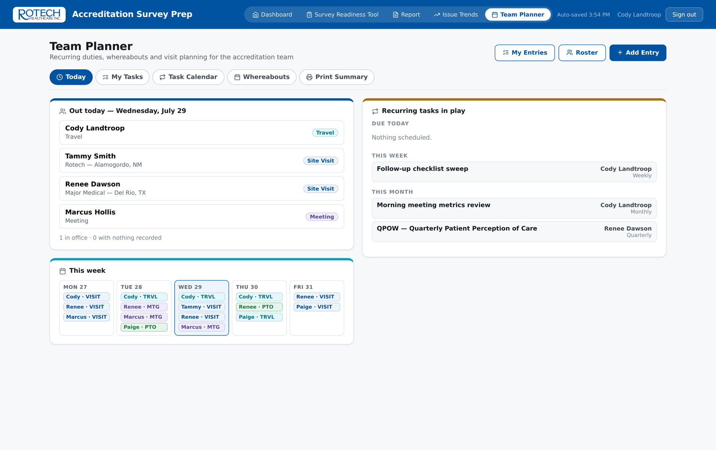
ALSO INCLUDED
Team Planner — the department's other spreadsheet, retired
Whereabouts, PTO, recurring duties and visit planning, migrated off the shared workbook.
Who is out today, who is on site, and where — for the whole team
Recurring duties by cadence: weekly, monthly, quarterly, semi-annual and annual
A month grid that prints, replacing the tab-per-person spreadsheet
Same sign-in, same admin allowlist, same audit trail as the rest of the app
Team Planner — today's whereabouts and the recurring duties in play
Rotech Accreditation · Survey Prep App
41
Notes:
Worth mentioning but not dwelling on — it is a second module that came out of the same work.

Slide 42
PRACTICALITIES
Access, data and continuity
The questions that get asked when a tool moves from one person to the department.
Who can get in
What is stored
If something fails
Named accounts only — no shared logins, no anonymous access
The specialist's own name is stamped on every report and every trend record
Roster and policy-date editing limited to named admins, enforced server-side
Findings, notes and visit metadata — no patient records
Patient Global ID and Rx are entered per visit for the specialist's own reference
Uploaded OP 541 files are read in the browser and never stored
Works with no connection; syncs when signal returns
Every PDF export writes an automatic data backup file alongside it
The location roster keeps a standing restorable backup
The one real risk
The app is currently maintained by one person. That is the strongest argument for approving it formally: naming a departmental owner and a documented support path turns a personal project into an asset the department can rely on.
Rotech Accreditation · Survey Prep App
42
Notes:
Say this one out loud rather than glossing it. Raising the key-person risk yourself is what makes the rest of the deck credible.

Slide 43
ROLLOUT
How we would roll it out
Phased, with the tool already proven on real visits before anything is switched off.
Phase | When | What happens | Done when
1 · Confirm | Weeks 1–2 | Department signs off the item tiering; owner and support path named | Tiering approved
2 · Train | Weeks 3–4 | Every specialist runs one live visit in the app alongside their normal process | All specialists have finalized one visit
3 · Switch | Month 2 | The app becomes the standard for all readiness visits; paper write-ups retired | No parallel process left
4 · Weight | Month 3 | Weighted scoring and the coverage view go live; historic visits re-score automatically | Weighted score reported to leadership
5 · Review | Month 6 | First half-year review: score trend, coverage, and time actually saved | Estimates replaced with measured figures
No phase requires taking a specialist off the road, and no phase depends on the one after it being funded.
Rotech Accreditation · Survey Prep App
43

Slide 44
THE ASK
What we need from you
1
2
3
Approve the rollout
Approve the weighting
Name the owner
Make the app the standard for every readiness visit from month 2.
Sign off the severity tiers so the trend data ranks by risk.
Turn a working tool into a supported departmental asset.
The tool exists, it is in use, and it costs nothing to license. What it needs now is a decision.
Questions welcome — and a live walkthrough of any screen in this deck can be run on request.
Rotech Accreditation · Survey Prep App
44

Slide 45
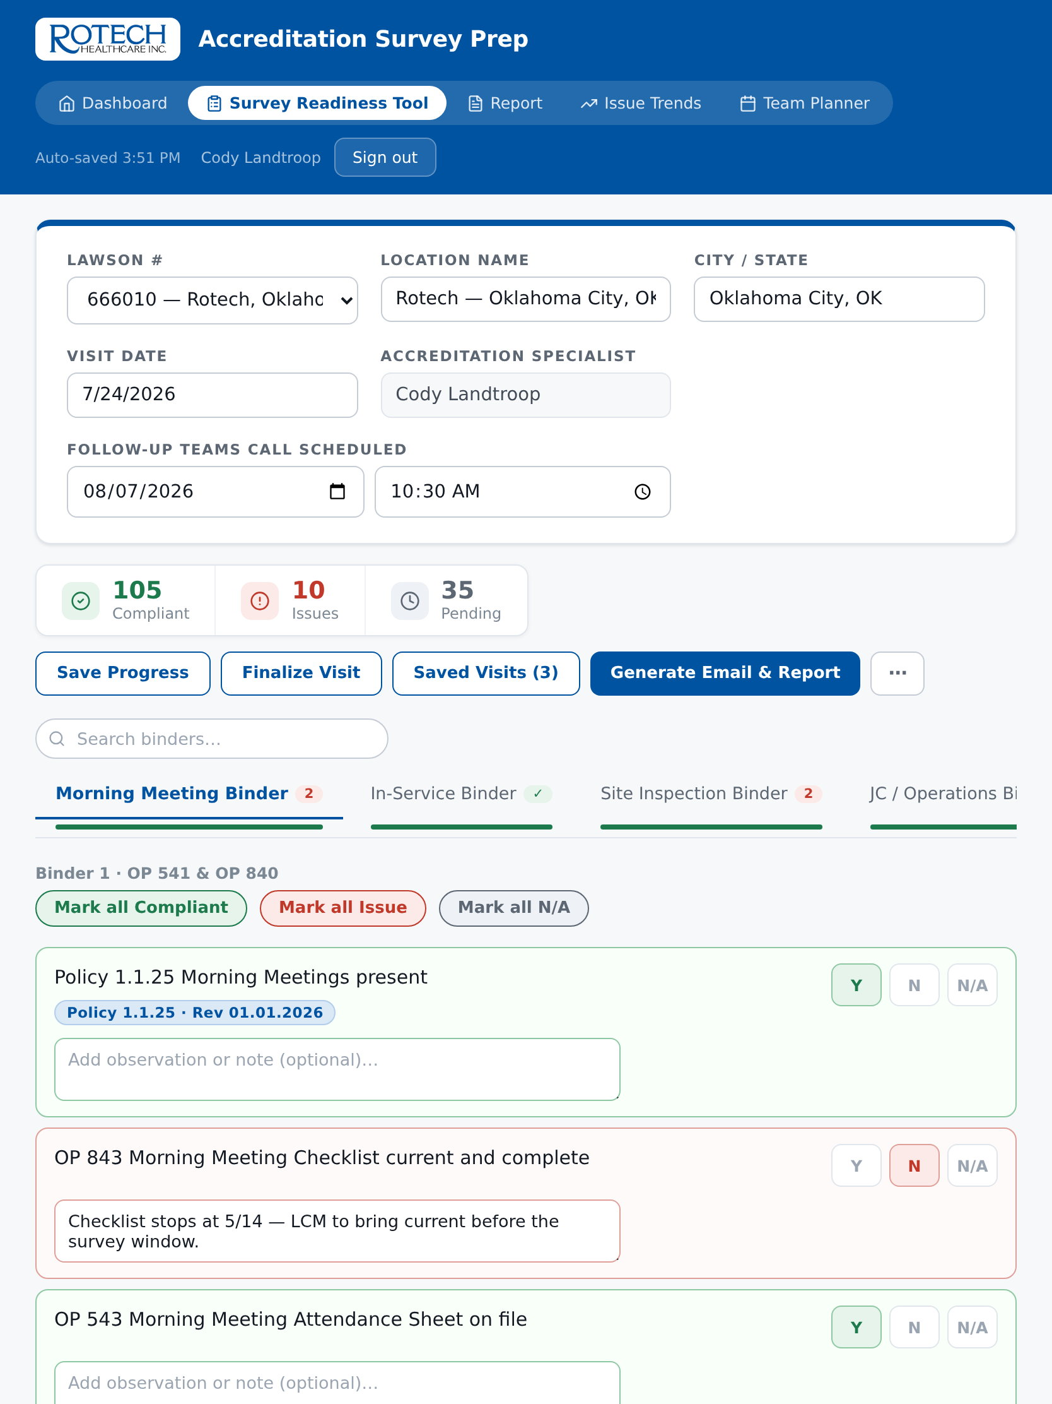
APPENDIX
In the field
The app installs to the home screen and runs full-screen on a tablet, with or without a signal.
Installable as a standalone app on iPad, Android and desktop
The full checklist, OP 541 review and JC 427 tabs work offline
Answers sync the moment a connection is available
Updates are offered, never forced — an update cannot interrupt a visit in progress
The app on an iPad, mid-visit
Rotech Accreditation · Survey Prep App
45

